Slide 1
Positron Physics
at the
Electron-Ion Collider
E. Voutier
and the JLab Positron Working Group
Université Paris Saclay, CNRS/IN2P3
Laboratoire de Physique des 2 Infinis Irène Joliot-Curie (IJCLab)
Orsay, France
Physics motivations
Generalized parton distributions
Charm production
Right-handed W-bosons
Polarized positron beams
Questions
Weekly Meeting of the Exclusive Processes Working Group
March 27th, 2020

Slide 2


Physics motivations
Eric Voutier
JPos17
Proc. of the International Workshop on Physics with Positrons at Jefferson Lab, J. Grames and E. Voutier Edts. AIP Conf. Proc. 1970 (2018)
https://aip.scitation.org/toc/apc/1970/1?size=all&expanded=1970
March 27th, 2020
2/14

Slide 3
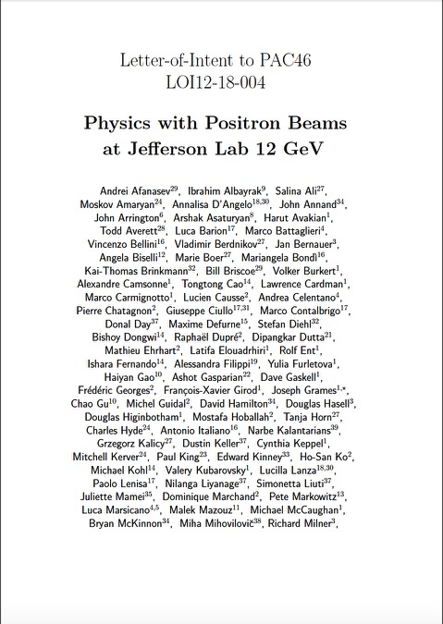
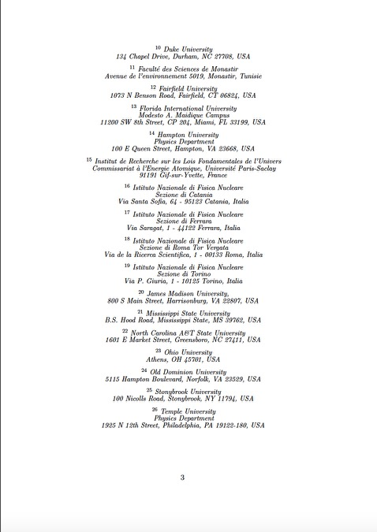
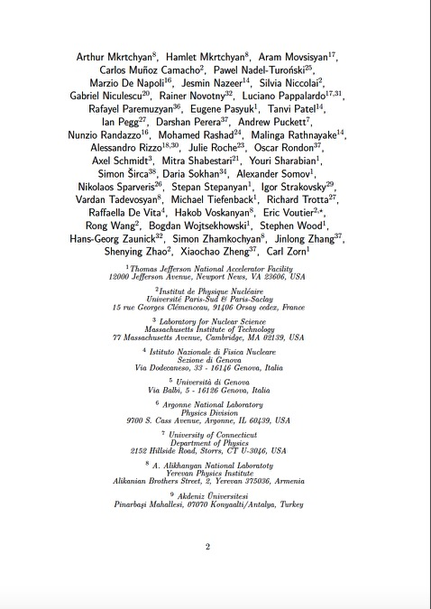
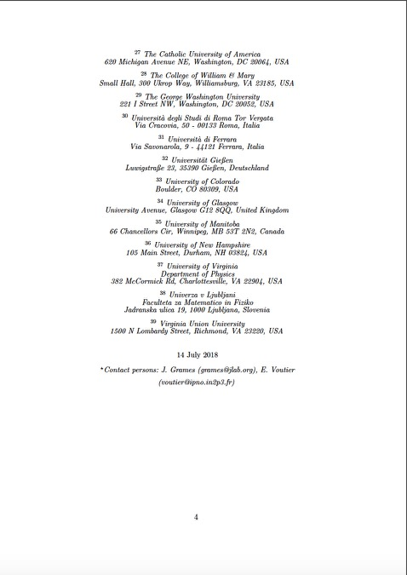
Physics motivations
Eric Voutier
LOI12-18-004
J. Grames, E. Voutier et al. Jefferson Lab LOI12-18-004 (2018), arXiv:1906.09419
Letter of Intent submitted to JLab PAC46 (July 2018)
Highlighting 7 mini-LOI’s
  Supported by 127 members 39 institutions
J. Arrington⁷, M. Battaglieri^{1,5}, J. Bernauer³, V. Burkert¹,
A. Celentano⁵, L. Elouadrhiri¹, Y. Furletova¹, F.-X. Girod¹,
J. Grames¹, J. Guo¹, F. Lin¹, S. Mantry⁹, L. Marsicano^{5,6},
C. Muñoz Camacho², V. Morozov¹, S. Niccolai², A. Puckett⁸,
A. Schmidt⁴, E. Voutier² , Y. Zhang¹ …
¹Thomas Jefferson National Accelerator Facility, Newport News, VA, USA
²Université Paris Saclay, IJCLab, Orsay, France
³Stony Brook University, Stony Brook, NY, USA
⁴The George Washington University, Washington, DC, USA
⁵Istituto Nazionale di Fisica Nucleare, Genova, Italia
⁶Università di Genova, Genova, Italia
⁷Argonne National Laboratory, Argonne, IL, USA
⁸University of Connecticut, CT, USA
⁹University of North Georgia, Dahlonega, GA, USA
…
March 27th, 2020
3/14

Slide 4
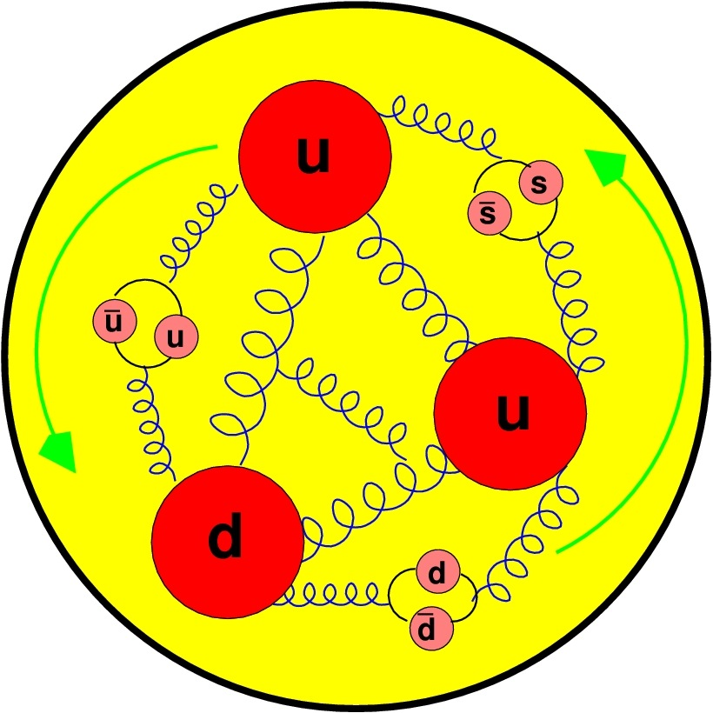
Physics motivations
Eric Voutier
Positron Physics
Two-photon physics
Generalized parton distributions
Radiative corrections
Neutral and charged currents DIS
Charm production
Pion and kaon structure
Charge conjugation violation
Right-handed W-bosons
Dark photon search
Leptoquarks, leptogluons
Interference
Physics
Structure
Functions
Tests of the
Standard Model
March 27th, 2020
4/14

Slide 5
Physics motivations
Eric Voutier
Positron Physics
Two-photon physics
Generalized parton distributions
Radiative corrections
Neutral and charged currents DIS
Charm production
Pion and kaon structure
Charge conjugation violation
Right-handed W-bosons
Dark photon search
Leptoquarks, leptogluons
Interference
Physics
Structure
Functions
Tests of the
Standard Model
March 27th, 2020
4/14

Slide 6

Generalized parton distributions
Eric Voutier
Parton Imaging
D. Müller, D. Robaschik, B. Geyer, F.M. Dittes, J. Horejsi, FP 42 (1994) 101 X. Ji, PRD 55 (1997) 7114 A. Radyushkin, PRD 56 (1997) 5524
GPDs parameterize the partonic structure of hadrons and offer the unprecedented possibility to access the spatial distribution of partons.
GPDs encode the correlations between partons and contain information about the dynamics of the system like the angular momentum or the distribution of the strong forces experienced by quarks and gluons inside hadrons.
X. Ji, PRL 78 (1997) 610 M. Polyakov, PL B555 (2003) 57
A new light
on hadron
structure
M. Burkardt, PRD 62 (2000) 071503 M.Diehl, EPJC 25 (2002) 223
GPDs can be interpreted as a distribution in the transverse plane of partons carrying some fraction of the longitudinal momentum of the nucleon.
March 27th, 2020
5/14

Slide 7
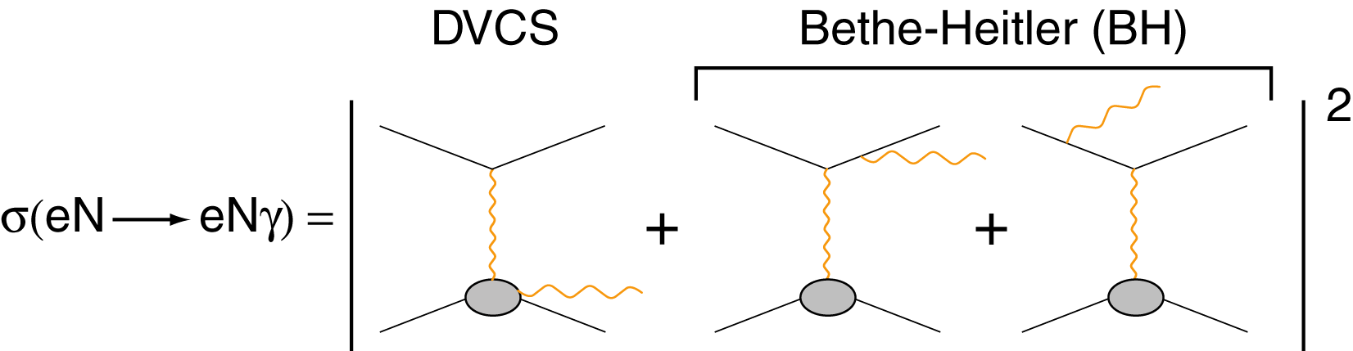
Generalized parton distributions
Eric Voutier
N(e,e′γN) Differential Cross Section
M. Diehl at the CLAS12 European Workshop, Genova, February 25-28, 2009
Electron
observables
Electron & positron
observables
March 27th, 2020
6/14

Slide 8
Generalized parton distributions
Eric Voutier
N(e,e′γN) Differential Cross Section
M. Diehl at the CLAS12 European Workshop, Genova, February 25-28, 2009
Additional observables
Electron
observables
Electron & positron
observables
March 27th, 2020
6/14

Slide 9
Generalized parton distributions
Eric Voutier
N(e,e′γN) Differential Cross Section
M. Diehl at the CLAS12 European Workshop, Genova, February 25-28, 2009
Additional observables
Electron
observables
Electron & positron
observables
Polarized electrons and positrons allow to separate the
unknown amplitudes of the cross section for electro-production of photons.
March 27th, 2020
6/14

Slide 10
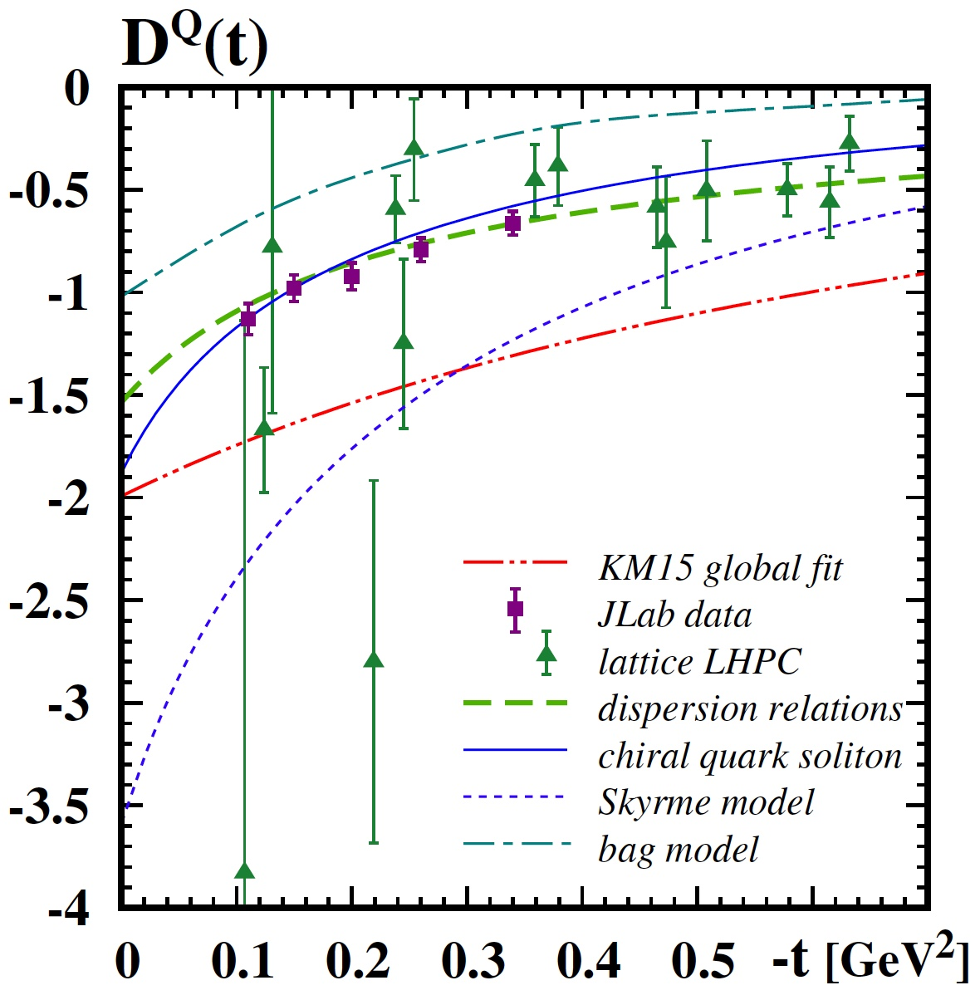
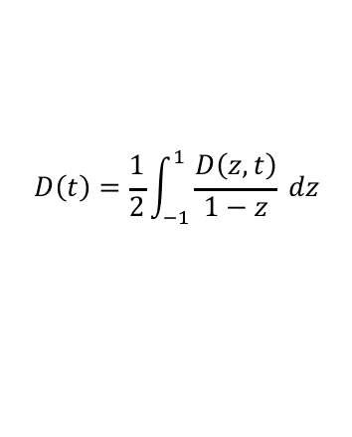
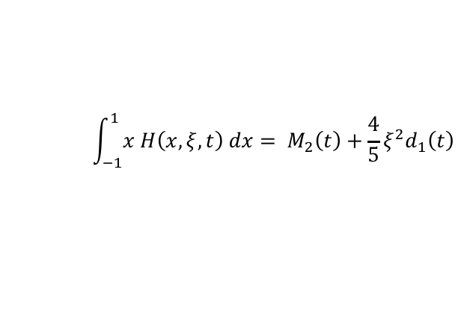
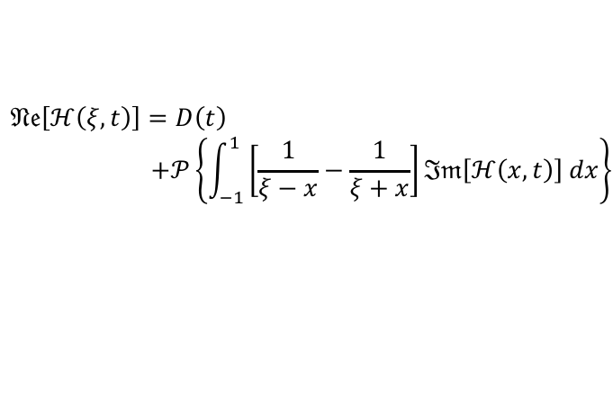
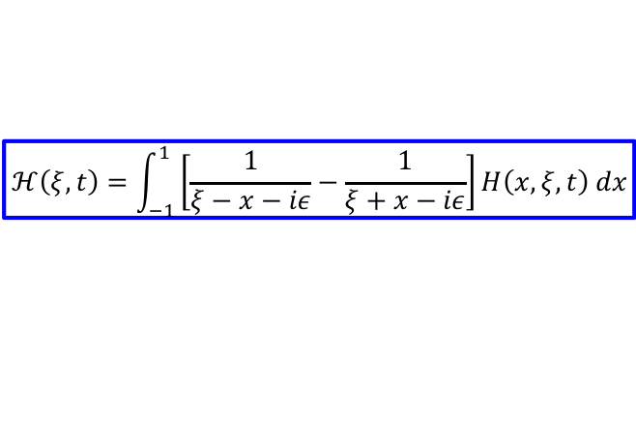

Generalized parton distributions
Eric Voutier
Nucleon Internal Pressure
V. Burkert, L. Elouadrhiri, F.-X. Girod, Nature 557 (2018) 396 M.V. Polyakov, P. Schweitzer, Int. J. Mod. Phys. A33 (2018) 1830025
K. Kumerički, Nature 570 (2019) E1
The 2nd order Mellin moment of GPDs allow to access the pressure distribution inside hadrons through the skewness dependency of GPDs… (DDVCS).
$$\int_{−1}^{1}{x H\left(x,ξ,t\right) dx}= M_{2}\left(t\right)+\frac{4}{5}ξ^{2}d_{1}\left(t\right)$$
CFF
$$ℋ\left(ξ,t\right)=\int_{−1}^{1}{\left[\frac{1}{ξ−x−iε}−\frac{1}{ξ+x−iε}\right]H\left(x,ξ,t\right) dx}$$
D(t)
LO
$$𝔑𝔢\left[ℋ\left(ξ,t\right)\right]=D\left(t\right)$$
$$+𝒫\left\{\int_{−1}^{1}{\left[\frac{1}{ξ−x}−\frac{1}{ξ+x}\right]ℑ𝔪\left[ℋ\left(x,t\right)\right] dx}\right\}$$
$$D\left(t\right)=\frac{1}{2}\int_{−1}^{1}{\frac{D\left(z,t\right)}{1−z}} dz$$
$$D\left(z,t\right)=\left(1−z^{2}\right)\left[d_{1}\left(t\right) C_{1}^{3/2}\left(z\right)+ …\right]$$
Real part of Compton form factors
(σ_{INT})
March 27th, 2020
7/14

Slide 11
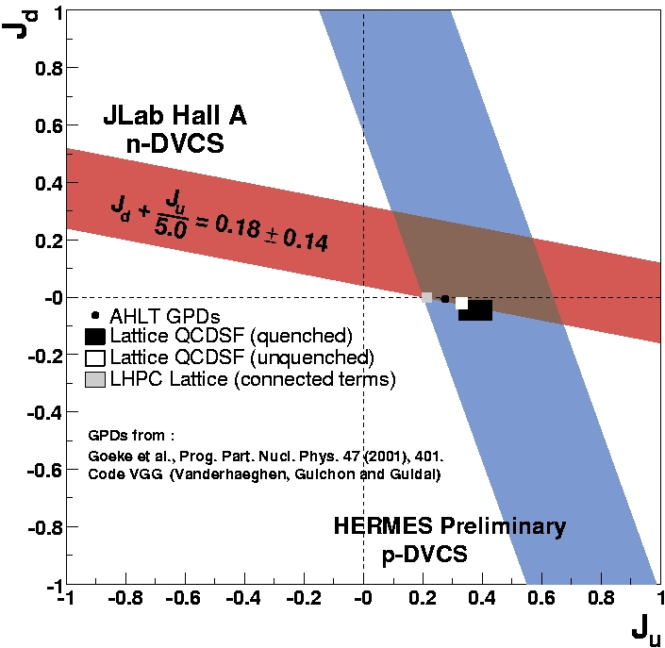
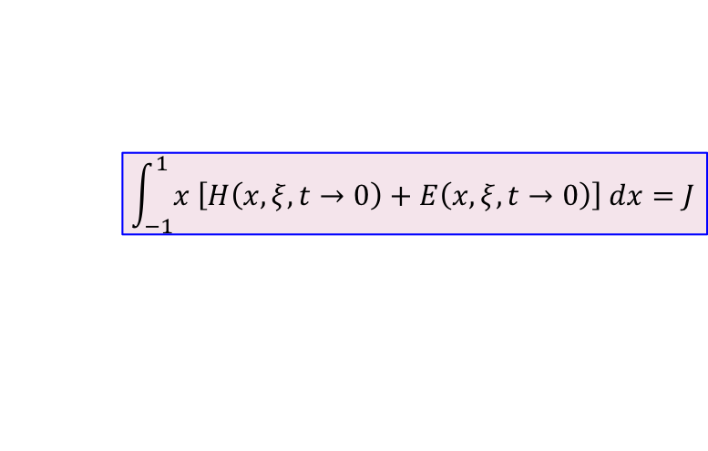
Generalized parton distributions
Eric Voutier
LOI12-18-004
S. Niccolai, E. Voutier et al.
Contrary to H, the GPD E flips the spin of the nucleon and is consequently not constrained by Deep Inelastic Scattering data.
X. Ji, PRL 78 (1997) 610
M. Mazouz et al., PRL 99 (2007) 242501
$$\int_{−1}^{1}{x \left[H\left(x,ξ,t→0\right)+E\left(x,ξ,t→0\right)\right] dx}=J$$
d
A. Airapetian et al. arXiv:0802.2499
A.W. Thomas, arXiv/hep-ph:0803.2775
u
March 27th, 2020
8/14

Slide 12






Generalized parton distributions
Eric Voutier
LOI12-18-004
S. Niccolai, E. Voutier et al.
The BCA on the neutron accesses the real part of the CFF E, and is sensitive to H at some kinematics.
$$A_{C}∝\frac{1}{F_{2}}ℜ𝔢\left[ξ{\tilde{H}}_{n}−\frac{t}{4M^{2}}E_{n}\right]$$
~
$$Δ_{LU}^{C}=\frac{\left({d^{4}σ}_{+0}^{+}−{d^{4}σ}_{−0}^{+}\right)−\left({d^{4}σ}_{+0}^{−}−{d^{4}σ}_{−0}^{−}\right)}{{d^{4}σ}_{+0}^{+}+{d^{4}σ}_{−0}^{+}+{d^{4}σ}_{+0}^{−}+d^{4}σ_{−0}^{−}}$$
e⁺ and e⁻ beams
$$∝{\tilde{σ}}_{INT}$$
e⁻ beam only
$$Σ_{LU}^{C}=\frac{\left({d^{4}σ}_{+0}^{+}−{d^{4}σ}_{−0}^{+}\right)+\left({d^{4}σ}_{+0}^{−}−{d^{4}σ}_{−0}^{−}\right)}{{d^{4}σ}_{+0}^{+}+{d^{4}σ}_{−0}^{+}+{d^{4}σ}_{+0}^{−}+d^{4}σ_{−0}^{−}}$$
$$∝{\tilde{σ}}_{DVCS}$$
$$A_{LU}=\frac{Σ_{LU}^{C}}{1−A_{C}}−\frac{Δ_{LU}^{C}}{1−A_{C}}$$
Polarized positron beams provide a different access to the imaginary part, and probe the importance of higher twists.
March 27th, 2020
9/14

Slide 13
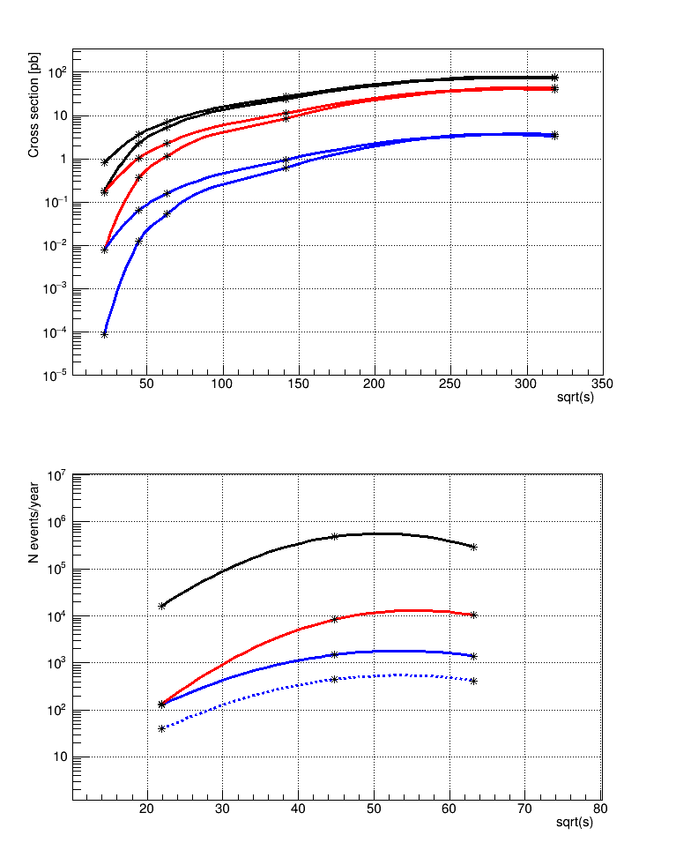
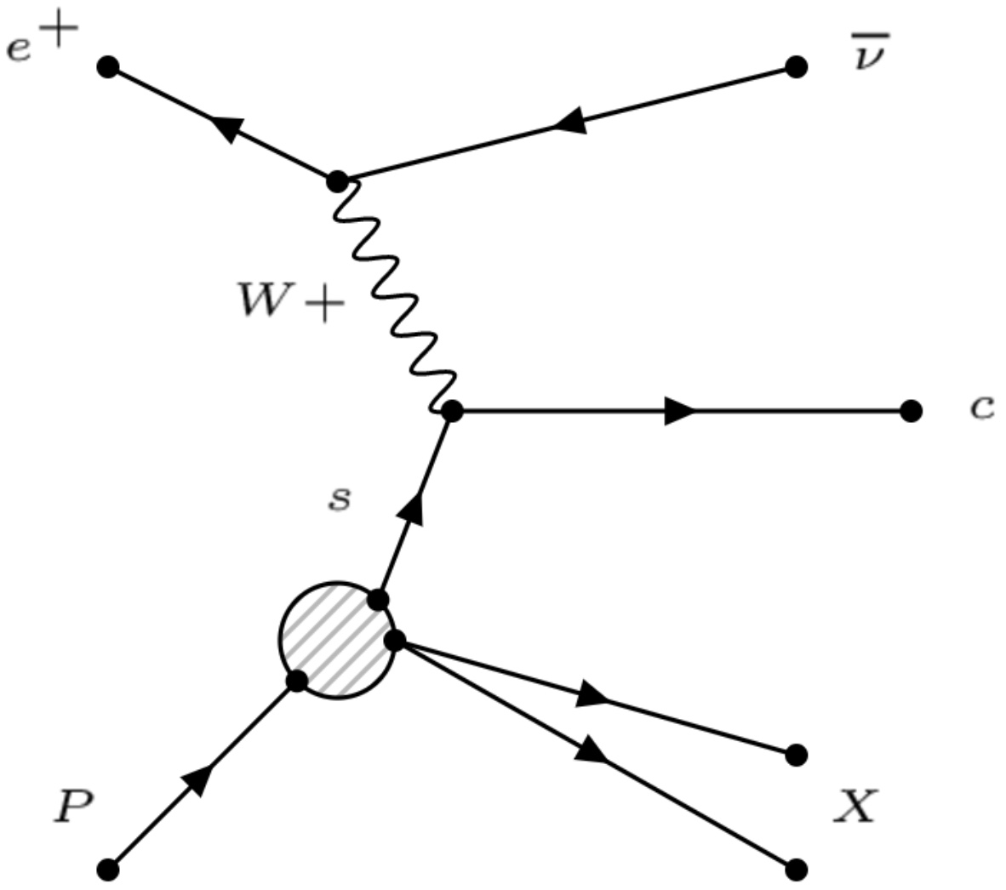
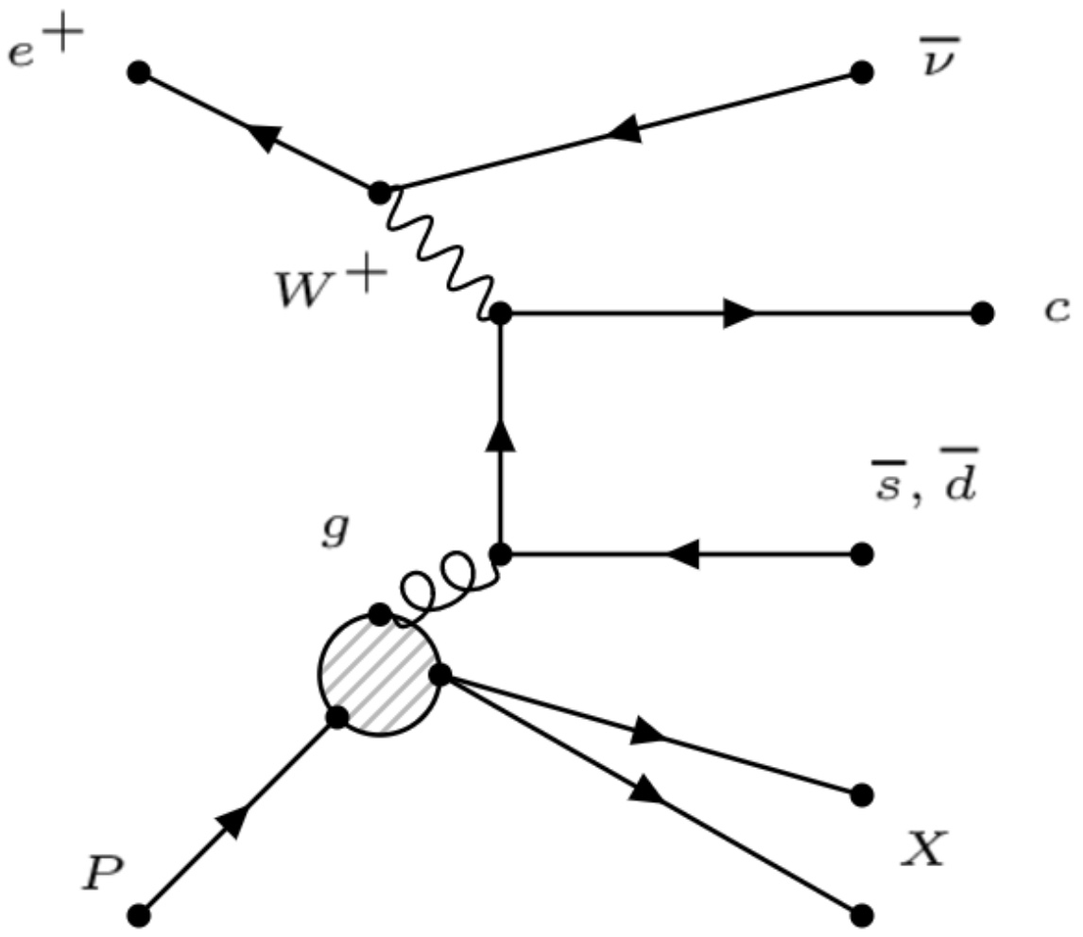

Charm production
Eric Voutier
Strangeness Tagging
The modest center-of-mass energy at the EIC can be compensated by the high luminosity and polarization degree of the lepton beam, to help for precise measurements of the small charge current cross section.
10
Q² > GeV²
100
CC e⁻p
CC e⁺p
Charm production via charge current exchange preferentially couples to the strange content of the nucleon.
The boson-gluon-fusion mechanism is a source of background, manageable with good PID and vertex reconstruction.
CC e⁺p (s->c)
EIC
$$e^{+}+p →\overline{υ_{e}}+c+X$$
$$e^{−}+p →υ_{e}+\overline{c}+X$$
An integrated luminosity of 10 fb⁻¹/year would provide ~1500 events/year.
March 27th, 2020
10/14

Slide 14
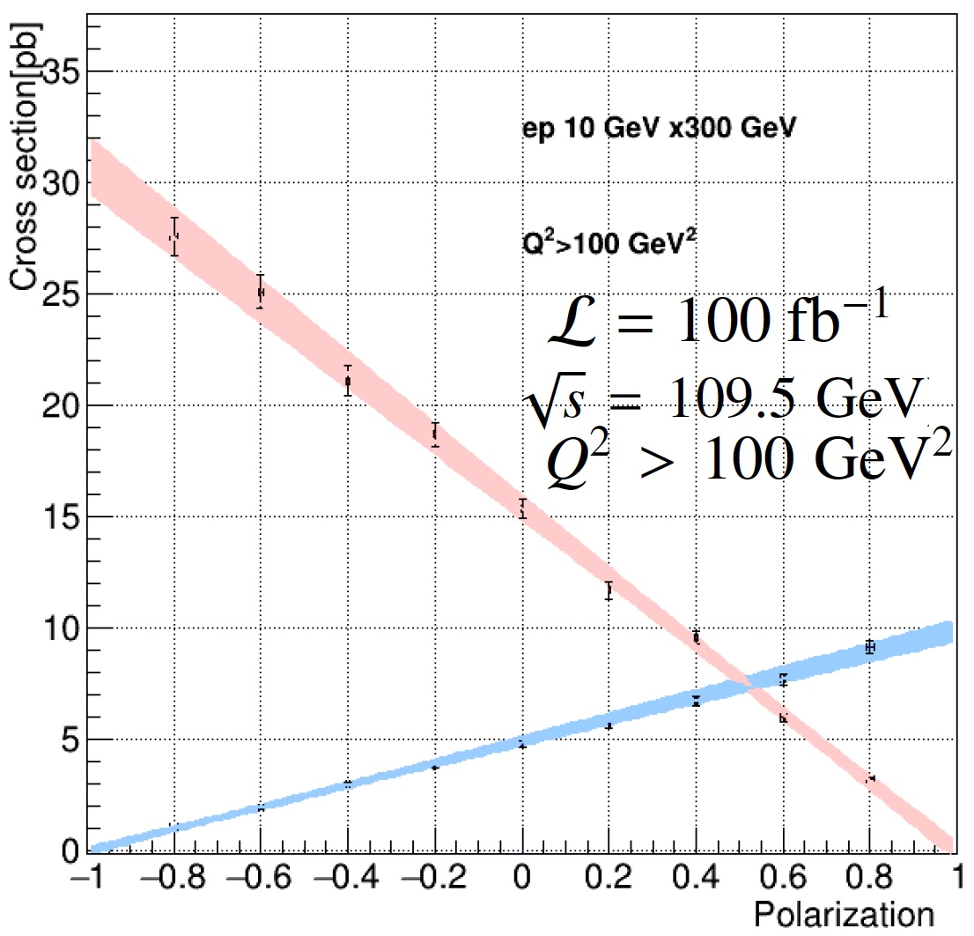


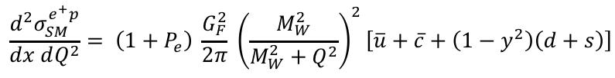
Right-handed W-bosons
Eric Voutier
Polarized Charged Current Cross Section
Y. Furletova, S. Mantry, (JPos17) AIP CP 1970 (2018) 030005
The polarization dependence of the charge current cross section can be measured to potentially reveal deviations from the Standard Model prediction.
EIC projections
$$\frac{d^{2}σ_{SM}^{e^{+}p}}{dx dQ^{2}}= \left(1+P_{e}\right) \frac{G_{F}^{2}}{2π} {\left(\frac{M_{W}^{2}}{M_{W}^{2}+Q^{2}}\right)}^{2}\left[\overline{u}+\overline{c}+\left(1−y^{2}\right)\left(d+s\right)\right]$$
ΔP_{e}/P_{e}=1%
ep 10 GeV x 100 GeV
$$\frac{d^{2}σ_{SM}^{e^{−}p}}{dx dQ^{2}}= \left(1−P_{e}\right)\frac{G_{F}^{2}}{2π}{ \left(\frac{M_{W}^{2}}{M_{W}^{2}+Q^{2}}\right)}^{2}\left[u+c+\left(1−y^{2}\right)\left(\overline{d}+\overline{s}\right)\right]$$
$σ^{e^{±}p} \left(P_{e}=∓1\right)≠0 →$
Limit on the mass of
right-handed W-boson
95% confidence level upper bound
$σ^{e^{±}p} \left(P_{e}=∓1\right)<0.0776 pb → M_{R}≥270 GeV$
(HERA limit in e⁺p is 208 GeV)
11/14
March 27th, 2020

Slide 15


Polarized positron beams
Eric Voutier
Polarized Electrons for Polarized Positrons
(PEPPo Collaboration) D. Abbott et al. , PRL 116 (2016) 214801
PEPPo demonstrated efficient polarization transfer from 8.2 MeV/c electrons to positrons, expanding polarized positron capabilities from GeV to MeV accelerators.
e⁻ beam polarization
85.2 ± 0.6 ± 0.7 %
The PEPPo technique can achieve up to 100% transfer of the electron.
March 27th, 2020
12/14

Slide 16
Polarized positron beams
Eric Voutier
Positron Production Scheme
F. Lin, J. Grames, J. Guo, V. Morozov, Y. Zhang, (JPos17) AIP CP 1970 (2018) 050005
PEPPo positron source = conventional positron source
with a polarized electron beam and the selection of high energy positrons.
Accumulator Ring (36m)
500-turn
phase-space painting
Positron Conversion/Collection Efficiency ~ 10⁻⁵ - 10⁻³
>40% in polarization
Bunch
Management
Polarized Electron
50 MeV Injector
Harmonic kicker
Extraction
to CEBAF
200 keV polarized e⁻
8 pC @ 748.5 MHz
50 MeV polarized e⁻
4 nC @ 748.5 MHz
50 MeV polarized e⁻
4 nC @ 17 MHz
~25 MeV Polarized e⁺
2 pC @ 17 MHz
Electron gun
demanding
Positron collection
Power on target
3.4 MW peak
0.6 kW average
CM energy | GeV | 21.9 |  | 44.7 |  | 63.3
 |  | p | e⁺ | p | e⁺ | p | e⁺
Beam energy | GeV | 40 | 3 | 100 | 5 | 100 | 10
Collision frequency | MHz | 119 |  | 119 |  | 119
Polarization | % | 80 | >40 | 80 | >40 | 80 | >40
Luminosity/IP, w/HG, 10³³ | cm⁻²s⁻¹ | 0.18 |  | 2.9 |  | 1.7
Accumulator
has to be demonstrated
March 27th, 2020
13/14

Slide 17
Questions
Eric Voutier
e⁺ @ eRHIC
Unpolarized and polarized positron beams provide a unique opportunity
to enhance the physics reach at a future EIC.
Interferences, neutral and charged currents, test of the Standard Model…
Unpolarized positron beams are determinant for the GPD program.
Positron beams would be a small addition to eRHIC.
Unpolarized beams are straightforward, polarized beams are challenging but achievable within the PEPPo scheme.
i) Is the machine design compatible with positron beam operation (magnets, interaction region…) ?
ii) Are the detection capabilities compatible with high energy positron detection ?
iii) Is the detector symmetric with respect to electron and positron detection (systematics…) ?
iv) …
March 27th, 2020
14/14

