Slide 1
PID Working Group T. Hemmick & P. Rossi
In order to move forward on in a coherent and effective way we plan to establish a regular bi-weekly meeting schedule to accomplish our tasks prior to the Pavia Meeting:
  Consider fully the Pro/Con matrix in each region (FWD, BKW, CENTRAL)
  Define, as best possible, PID-driven requirements on external parameters (tracking, machine, etc...)
  Continue to refine external input requests for our task (physics, tracking)
Doodle poll: https://www.doodle.com/poll/mtcwd3t86yxmyzas
  Preference for Wednesday @12pm

Slide 2

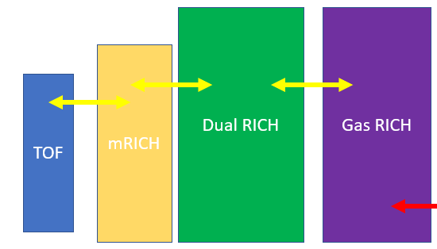
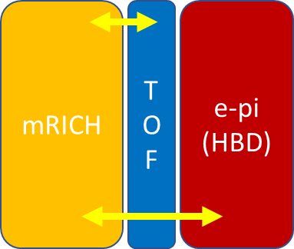
Comparison Matrices (in progress)
 | Pro | Con | Comment
DIRC
B-tolerant
Both
 | Pro | Con | Comment
dRICH
dRICH & TOF
mRICH & gas
TOF & gas
More…
 | Pro | Con | Comment
DIRC
B-tolerant
Both

