Slide 1
AGS with four partial helices to overcome spin resonances for polarized p and ³He⁺²
N. Tsoupas, H. Huang, F. Méot, V. Ptitsyn

Slide 2
What this presentation is about?
Acceleration of polarized protons in AGS does not maintain the polarization of the beam injection which is ~80%
Although the imperfection and vertical intrinsic resonances in AGS are eliminated by the use of two partial helices.
The horizontal spin resonances due to the partial helices are reduced in strength by the method of spin-tune jumps…But not completely eliminated.
In this presentation we use a set of four partial helices to eliminate both horizontal and vertical intrinsic resonances.

Slide 3
Background:
1. Thomas Roser introduced The idea of using partial helices in the AGS ring
to overcome imperfection and vertical intrinsic resonances.
T. Roser, et al., Proc. EPAC04, (2004), p. 1577
H. Huang, et al., PRL 99, 154801(2007)
2. Nick Tsoupas worked on the beam optics of the AGS with two partial helices.
He introduced compensation Quadrupoles and local beam bumps to design the AGS optics
and AGS has adopted this beam optics to accelerates polarized protons
3. The beam optics of the AGS with two partial helices falls a bit short to eliminate all
the vertical intrinsic resonances and could not eliminate the horizontal intrinsic ones
4. Studies of the AGS with four partial helices shows that the beam optics can eliminate
the imperfection and all the horizontal and vertical resonances.
Actually four identical partial helices are not better than two.
But the paper in the next slide describes how four helices can do the job.

Slide 4
PHYSICAL REVIEW SPECIAL TOPICS - ACCELERATORS AND BEAMS 16, 043501 (2013) BNL alternating gradient synchrotron with four helical magnets to minimize the losses of the polarized proton beam N. Tsoupas, H. Huang, W.W. MacKay, F. Meot, T. Roser, and D. Trbojevic Brookhaven National Laboratory, Upton, New York 11973, USA (Received 20 September 2012; published 11 April 2013)
Background:
One of the referees did not want this paper to be published
because he thought it was an extension of the 2-partial helices
I had to write a separate section to show her/him the basic idea was different
A single very strong partial helix can do the Job
but the beam optics does not work because of the strong high order multipoles of the snake
The task was to find an arrangement of few low field partial helices
with “spin motion” equivalent to that of the single strong snake

Slide 5
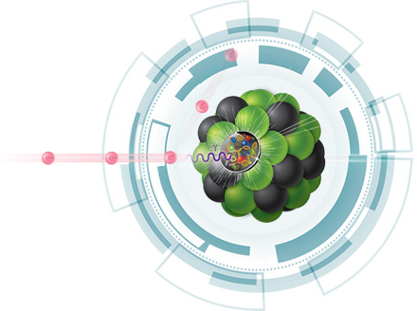
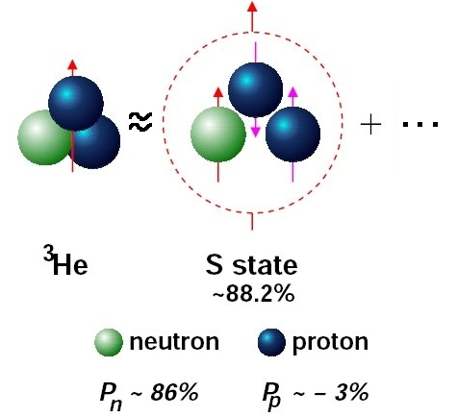
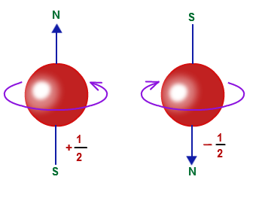
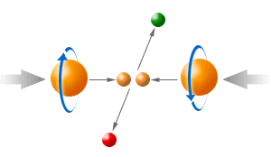
eIC Collider
110 GeV/u Heavy Ions
18 GeV e⁻
Aspect with polarized beams
Electrons
at 18 GeV
(HadronSynchrotron)
Exists and operates RHIC
electrons
(Rapid Cycling Synchrotron)
electrons
v
Hadrons at
~110 GeV/u
electrons 18 GeV
p 275 GeV
AGS-Booster
Spin
Spin
In spin physics
³He⁺² 184 GeV/u
physics.bu.edu/~kolarkar/dissert/Kolarkar_dissertation.pdf
https://www.researchgate.net/publication/13322287_Neutron_polarization_in_polarized_He_3_targets

Slide 6


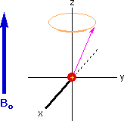
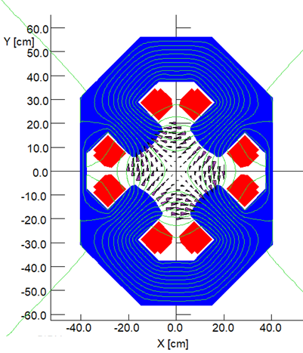
Why should we pay attention in the acceleration of polarized ions?
G=(g-2)/2
γ Relativistic factor
When Gγ=n or Gγ=n+Q_{y} & B_{hor}
The magnetic moment will presses also about the direction of B_{hor} “NMR-effect”
B_{hor}
Q_{y}=vertical betatron tune
Synchrotron
Horizontal fields B_{hor} are caused by magnet imperfections or magnet design.
(Imperfection spin resonances) Gγ=n
Horizontal fields B_{hor} are also caused by Quadrupoles, Sext. Etc.
(Intrinsic spin resonances) Gγ=n+Q_{y}
Q_{y}=vertical betatron tune
https://www.google.com/search?biw=1483&bih=704&tbm=isch&sa=1&ei=8NgjW4XTLs7uzgL_gInIAQ&q=animation+of+NMR&oq=animation+of+NMR&gs_l=img.12...0.0.0.28563.0.0.0.0.0.0.0.0..0.0....0...1c..64.img..0.0.0....0.gitB9seXuAg#imgrc=r0ZpRdDK3ezKJM:

Slide 7
Why should we pay attention in the acceleration of polarized ions?
G=(g-2)/2
γ Relativistic factor
When Gγ=n or Gγ=n+Q_{y} & B_{hor}
The magnetic moment will presses also about the direction of B_{hor} “NMR-effect”
B_{hor}
Q_{y}=vertical betatron tune
Synchrotron
Horizontal fields B_{hor} are caused by magnet imperfections or magnet design.
(Imperfection spin resonances) Gγ=n
Horizontal fields B_{hor} are also caused by Quadrupoles, Sext. Etc.
(Intrinsic spin resonances) Gγ=n+Q_{y}
Q_{y}=vertical betatron tune
https://www.google.com/search?biw=1483&bih=704&tbm=isch&sa=1&ei=8NgjW4XTLs7uzgL_gInIAQ&q=animation+of+NMR&oq=animation+of+NMR&gs_l=img.12...0.0.0.28563.0.0.0.0.0.0.0.0..0.0....0...1c..64.img..0.0.0....0.gitB9seXuAg#imgrc=r0ZpRdDK3ezKJM:

Slide 8
The preservation of polarization of a polarized beam during its acceleration is one of the subjects of spin physics in the acceleration technology.
A simple Example of a polarized beam loosing some of its polarization when it crosses a resonance?
y
τ
y
τ+δτ
Synchrotron
x
x
θ_{cone}
B_{Hor}
z
V
z
θ_{cone}>θ_{cone}
after resonance crossing
θ_{cone}
At Imperfection spin resonances Gγ=n & B_{hor}
Each time the particle passes by the location of the B_{Hor}
The μ will precess about the x-axis by a different amount depending on the particle’s speed (γ).
The μ of every particle does not experience the same torque from the B_{Hor} field.
At Intrinsic spin resonances Gγ=n±Q_{y} & B_{Hor}(Quad)
The B_{Hor} is the horizontal field of the quadrupoles
The different Q_{y} and γ of the particles in the bunch contributes to the loss of the polarization.

Slide 9
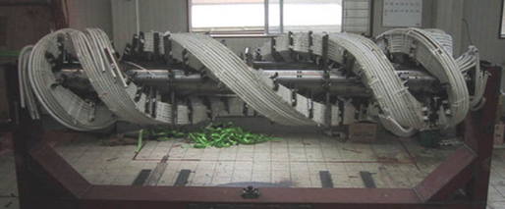
How can the imperfection and intrinsic resonances be eliminated?
Condition to suppress the spin resonances Gγ≠n, Gγ≠n±Q_{y}
One method is the Use of partial helices
T. Roser, et al., Proc. EPAC04, (2004), p. 1577
H. Huang, et al., PRL 99, 154801(2007)
Inserting partial-helical magnetic fields to rotate the by angle<180⁰ about z-axis
Partial snakes in AGS at BNL:
(Eliminates Imperfection and under certain conditions eliminates Intrinsic spin resonances)

Slide 10
The “key” physical quantity is the spin tune Gγ=Number of spin precessions about the stable spin direction in one revolution
For a synchrotron with vertical guiding field “B” the spin tune is ν_{s}=Gγ
AGS

Slide 11
Spin tune of a synchrotron with dipoles having B_{y} vertical guiding field
ν_{s}=Gγ
Gγ=n, Gγ=n±Q_{y}, Gγ=m±Q_{x}
All these conditions are satisfied during acceleration
Therefore we can not accelerate polarized ions in AGS
2
1
1
Gγ

Slide 12
How can I change the spin tune ν_{s}=Gγ in a way that the
conditions: Gγ=n, Gγ=n±Q_{y}, Gγ=m±Q_{x} are not satisfied.
Partial helix
AGS

Slide 13
How to compute the spin tune ν_{s} of a synchrotron having a partial helix?
What is the ν_{s} if we introduce a
partial helical magnet?
Partial
helix
Fringe fields in AGS affect the ν_{s} insignificantly
Transformation of Spinors in Accelerators and Beam Transfer Lines
N. Tsoupas, F. Méot, H. Huang
Technical Note submitted This week
Synchrotron

Slide 14
Mathematical derivation of Spin Tune ν_{s}
z
Beam
y
x
Transformation of Spinors in Accelerators and Beam Transfer Lines
N. Tsoupas, F. Méot, H. Huang
Technical Note submitted This week
Initial Spinor
Final Spinor
Magnet Rotates the spinor state by angle θ

Slide 15
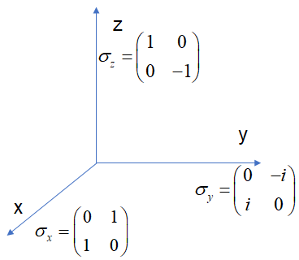
Spin tune of a synchrotron with dipoles having B_{y} vertical guiding field
Beam

Slide 16
How to compute the spin tune ν_{s} of AGS with two partial helices
The stable spin direction of an AGS magnet is along the vertical.
Warm Partial
Helix δ=10.6º
The stable spin direction of a partial
helix is along the beam axis.
Cold Partial
Helix δ=19º
θ₂=120º
Synchrotron
θ₁=30º
z
θ₃=210º
Beam
y
x

Slide 17
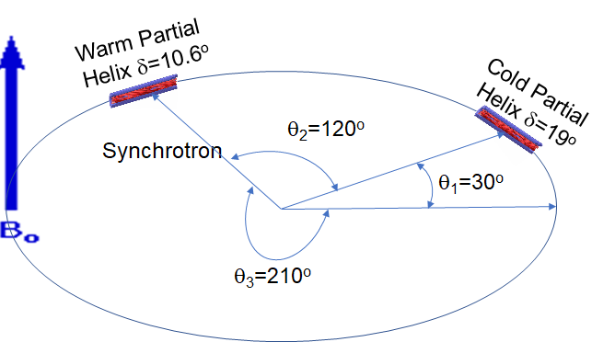
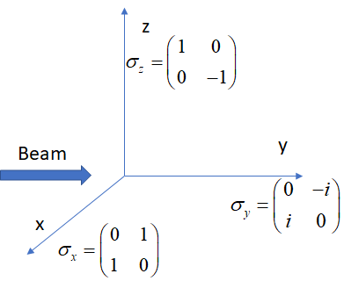
Spin tune of a synchrotron with dipoles having B_{y} vertical guiding field and a single partial snake
Transformation of Spinors in Accelerators and Beam Transfer Lines
N. Tsoupas, F. Méot, H. Huang
Technical Note submitted This week
A computer code is written to carry these calculations

Slide 18
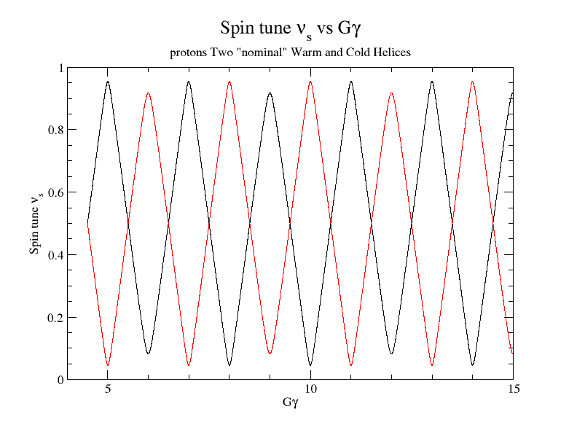
We do use two partial helices in AGS So? What is the problem?
Tune placement
In this gap

Slide 19
Here are pros and cons with the warm and cold AGS helices
Pros:
The condition Gγ≠n, is satisfied (eliminate all imperfection resonances)
The condition Gγ≠n±Q_{y}, is almost satisfied for Gγ>5.5
Based on N.Tsoupas beam optics work
Cons:
The condition Gγ≠n±Q_{y}, is not satisfied for Gγ<5.5
Based on N.Tsoupas beam optics work.
He could not place the Q_{y} within the gap for Gγ<5.5
The condition Gγ≠n±Q_{x}, is not satisfied
Based on N.Tsoupas beam optics work.
He could not place the Q_{x} within the gap for any range of Gγ
Based on this AGS beam optics Haixin proved experimentally
That the statements above are true.

Slide 20
“Reason” to use multipole partial Helices.
One would think that Increasing the number of Helices having reasonable strength will increase the spin tune gap.
The above statement is not TOTALLY true
However Using a Single Strong Partial Helix the spin tune gap can be increased.
Is there a way to obtain the same spin tune gap as the one the Single Strong Partial Helix generates by using more but less strong Helices?

Slide 21
Spin tune ν_{s} with a single partial helix
The stable spin direction of an AGS magnet is along the vertical.
Partial
helix
The stable spin direction of a partial
helix is along the beam axis.
z
Beam
y
Synchrotron
x

Slide 22
Spin tune of a synchrotron with dipoles having B_{y} vertical guiding field and a single partial snake
M_{AGS}
M_{ps}
z
Beam
y
x
A computer code is written to carry these calculations

Slide 23
Spin tune ν_{s} of AGS with a single partial helix as a function of Gγ
The stable spin axis of the partial helix is around the longitudinal axis and the spin rotation angle δ=2x19º
z
z
Spin rotates
about y-axis
in helix
y
y
Beam
x
x

Slide 24
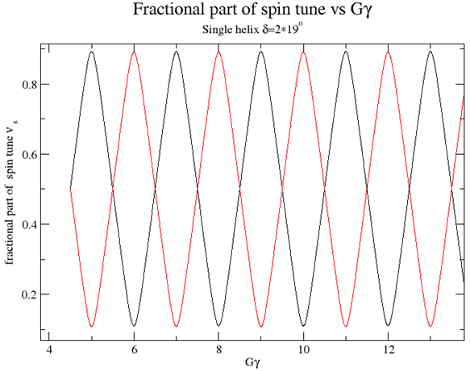
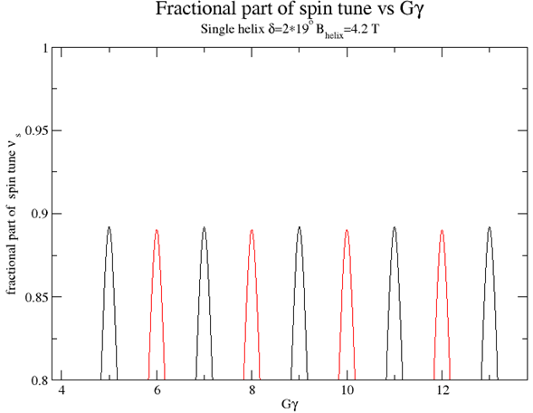
Spin tune ν_{s} of AGS with a single partial helix as a function of Gγ. Rotation angle δ=2x19º
Spin-tune-gap
3.0
Spin-tune-gap
If the fractional part of the tunes Q_{x,y}
are in the spin tune gap
Gγ≠n±Q_{y}, Gγ≠m±Q_{x} are satisfied

Slide 25
Spin tune ν_{s} of AGS with a single partial helix as a function of Gγ. Rotation angle δ=2x19º
3.0
If the fractional part of the tunes Q_{x,y}
are in the spin tune gap
Gγ=n±Q_{y}, Gγ=m±Q_{x} are not satisfied
Can a single partial Helix with B_{helix}= 3 T do the job?

Slide 26
Can a single partial Helix with B_{helix}= 3.0 T do the job?
Partial helix
The non-linear nature of the partial helix introduces multipoles which will not allow the low rigidity beam survive even for few turn after injection.
If there is a solution to this problem it requires detailed study of the helix’s multipoles and a way to compensate them.
The above difficulties is the reason of splitting the single strong partial helix into four partial helices with lower strength.

Slide 27
Each of these partial helices arrangements provides the same spin tune ν_{s} as a function of Gγ

Slide 28
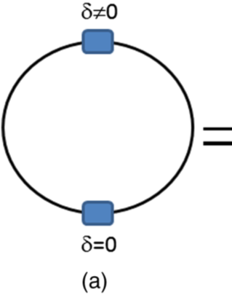
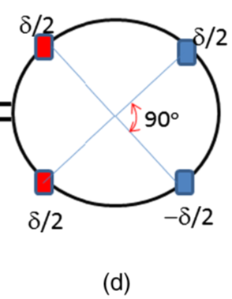
The spin tune gap generated by a single 3.0 Tesla (δ=38º) partial helix is identical to that generated by four 2.1 Tesla (δ=19º) partial helices
2.1 Tesla each
3.0 Tesla

Slide 29
Advantages of using four partial helices
Each partial helix has 2.1 T field instead of 3.0 T
Placing the helices in a symmetric way around the ring of the AGS a four fold symmetry can be generated.

Slide 30
Spin tune ν_{s} of AGS with four partial helices (B=2.1 T) as a function of Gγ. Rotation angle of spin in each helix δ=19º
2.1
If the fractional part of the tunes Q_{x,y}
are in the spin tune gap the conditions
Gγ=n±Q_{y}, Gγ=m±Q_{x} are not satisfied

Slide 31
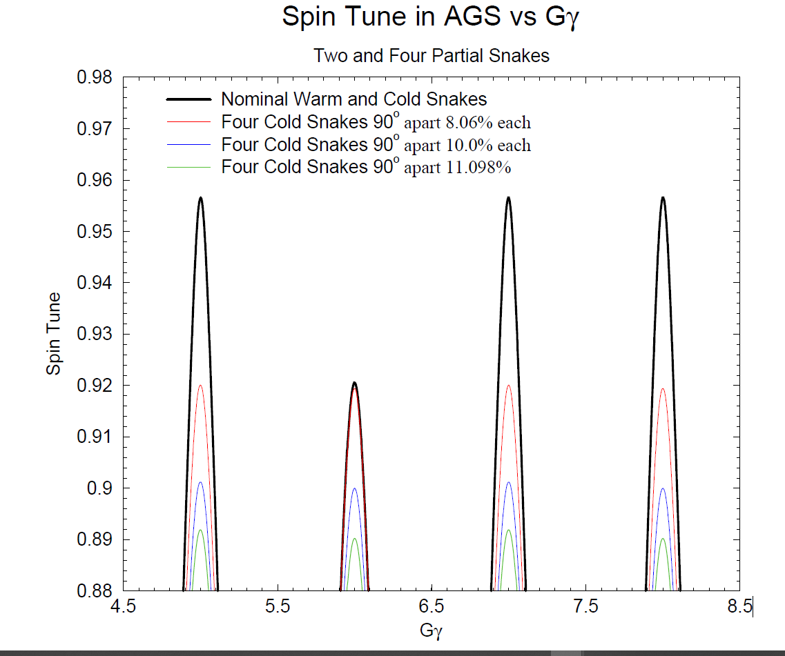
Comparison of spin tunes with different Partial Helices

Slide 32
Beam optics of AGS with four helical magnets
Preparation of the AGS lattice:
Use of three super-periods (out of 12) with the AGS with the Partial helix at the center.
One quarter of the AGS
Generate a Local Beam bump on each of the helices
Use Compensation quads along the three AGS superperiods (1/4 of AGS).
Use Magnetic-Elements to represent the R-Matrices derived from raytracing in the Helix. Explanation to follow in a slide below.

Slide 33
Use Magnetic-Elements to represent the R-Matrices derived from raytracing in the Helix.
The following five slides is not only theory
It is also Reality applied in AGS to setup the cold snake beam optics with the polarized beam
Why the Use of Magnetic-Elements to represent the R-Matrices derived from raytracing in the Helix?

Slide 34
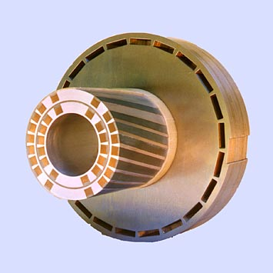
Trajectories in a 2.1 T helical magnet
Projection of trajectory on the (x,y) plane
y
Center of Partial helix is at “center of the beam pipe”
Beam at Injection Energy Enters the Partial Helix
~2 cm
x
Bean into the page
Beam at Injection Energy Exits the Partial Helix
Beam needs to be bumped at
the location of the partial Helix

Slide 35
Top view of the beam trajectory in the partial helix
Beam needs to be bumped at
the location of the partial Helix

Slide 36
Top view of the beam trajectory in the partial helix
The beam is “bumped” therefore Matrices as calculated by the
Raytrace code cannot be used because
there is no provision in MAD to displace an R-matrix
Beam needs to be bumped at
the location of the partial Helix

Slide 37
To solve the problem of MAD of not allowing to displace an R-matrix the following procedure was adapted
A set of magnetic elements were placed along the span of the partial helix:
∙ Normal-Quads,
∙ Skew-Quads,
∙ Solenoids,
∙ and small dipoles
These elements generated the same R-matrix
6x6 R-Matrix⇔R-Matrix{of Magnetic-Elements}

Slide 38
Top view of the beam trajectory in the partial helix
The beam is “bumped” therefore Matrices as calculated by the
Raytrace code cannot be used because
there is no provision in MAD to displace an R-matrix
Beam needs to be bumped at
the location of the partial Helix
6x6 R-Matrix⇔R-Matrix{of Magnetic-Elements}
Assuming this project will continue.
After the initial MAD model, I hope we will use the zgoubi model
which will use the 3D field mass therefore we do not have
To employ this process Rmatrix=>Elements=>DisplaceElements

Slide 39
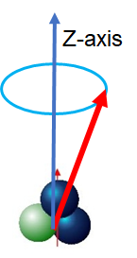
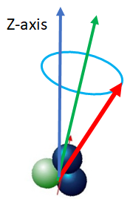
Stable spin Direction at Injection “L20” and Extraction “H10”
Four partial Helices
Extraction H10
Extraction H10
φ_{spin}=δ=19º
φ_{spin}=δ
θ=90º
Warm Snake SS⇒E20 φ_{spin}=10.6º
φ_{spin}=-δ
Cold Snake at SS⇒ A20 φ_{spin}=19º
φ_{spin}=δ
Injection L20
Injection L20

Slide 40
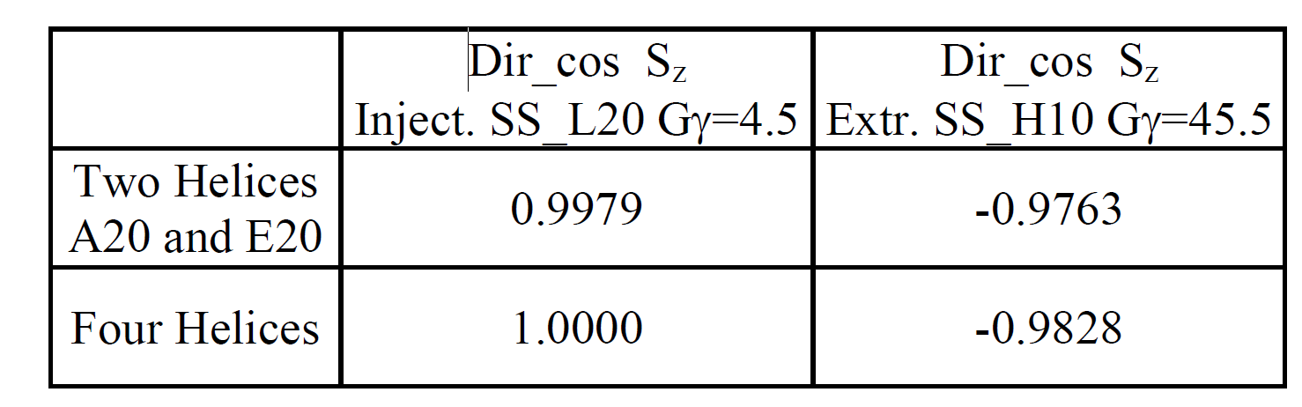
Stable spin Direction at Injection “L20” and Extraction “H10”

Slide 41
The beam optics of the AGS with four Helices
AGS three super period
Each super-period 3 cold
Partial Helix at the middle
Extraction
φ_{spin}=δ
Extraction
φ_{spin}=δ
θ=90º
φ_{spin}=-δ
Matcing
β_{x,y} η_{x,y}
φ_{spin}=δ
Injection
Injection

Slide 42
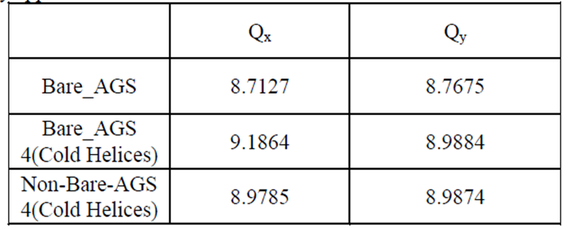
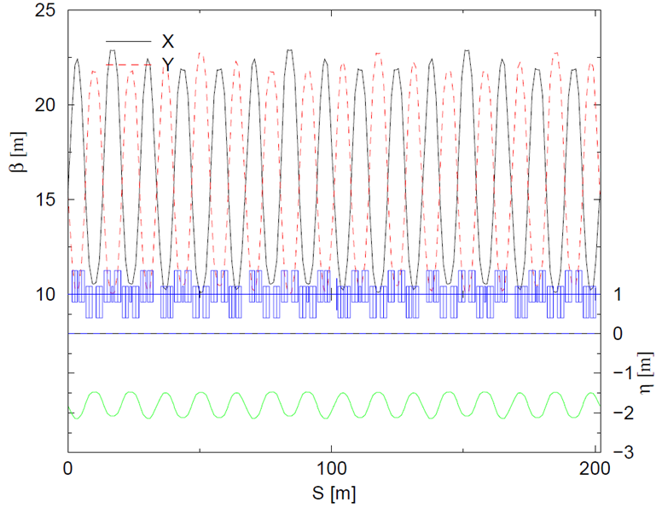
The beam optics of Bare AGS: Three SuperPeriods
Partial Helix to be placed

Slide 43
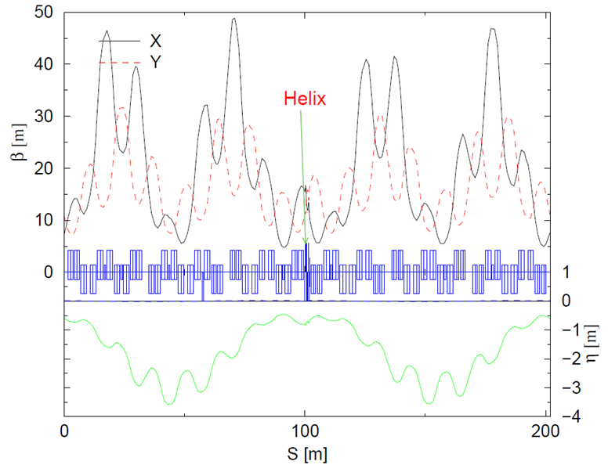
The beam optics of Bare AGS: Three Super Periods
Partial Helix
We can run with Q_{x}=9.1864
But for Q_{x} to be within tune qap
It should be 9.0<Q_{x}<9.1
Partial Helix is placed
in the middle

Slide 44
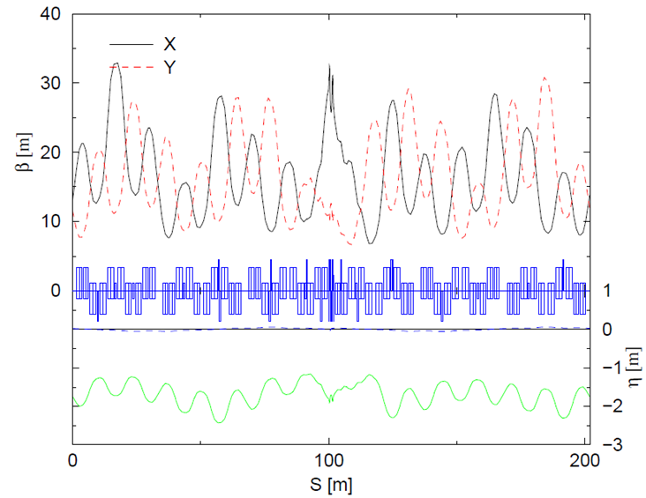
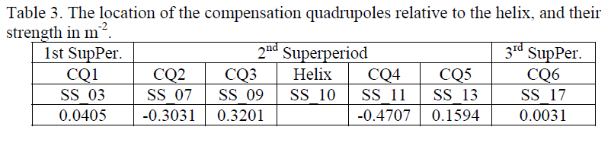
The beam optics of AGS: Three Super Periods
Partial Helix, Tune Quads on, and Compensation Quads on
Partial Helix is placed
in the middle

Slide 45
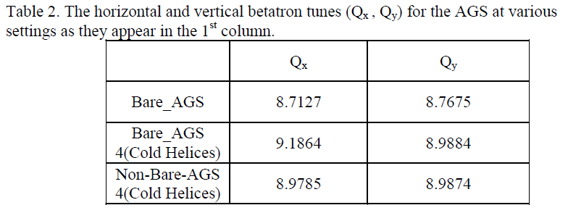
Tunes of AGS:

Slide 46
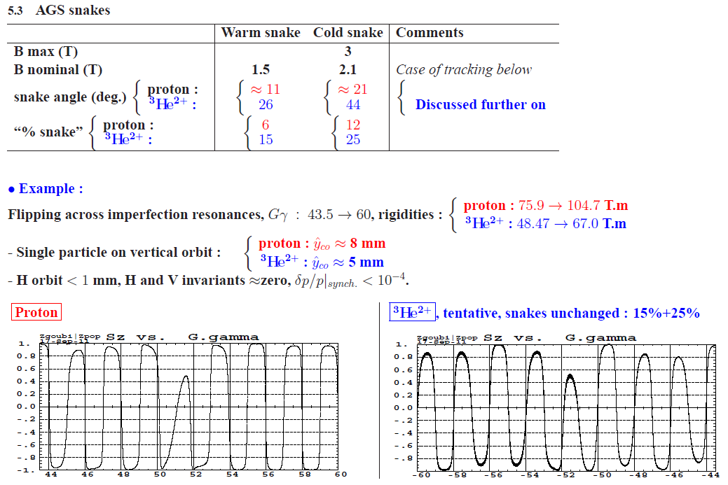
Spin tune ν_{s} of AGS with two Helices accelerating ³He⁺²
Spin Rotation angle in partial helix
This slide from
Francois Méot

Slide 47
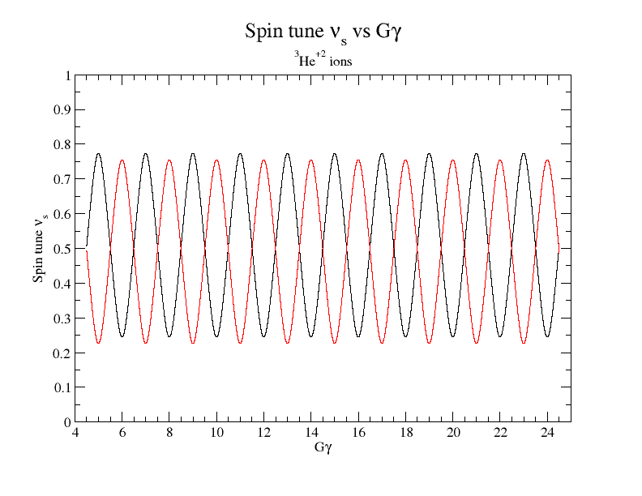
Spin tune ν_{s} of AGS with four Helices accelerating ³He⁺²
Spin-tune-gap

Slide 48
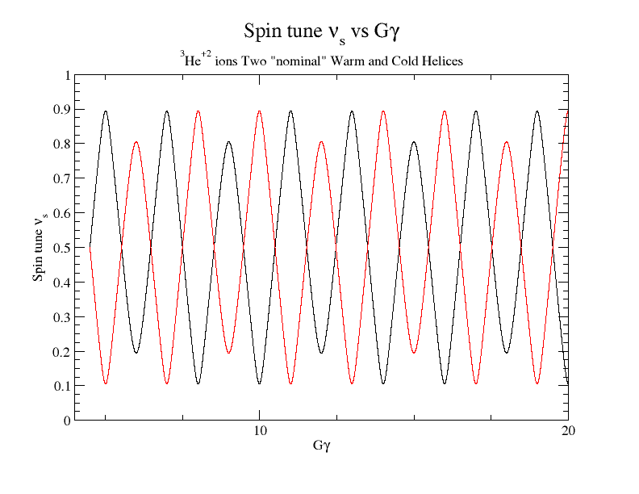
Spin tune ν_{s} of AGS Nominal Warm&Cold Helices accelerating polarized ³He⁺²
Spin-tune-gap

Slide 49
Conclusions:
This study is very important and requires an additional detailed study.
Based on previous experience; We do have confidence in the beam optics calculations made by MAD
The R-matrices we use for the partial helices are similar to the one we use in AGS
To investigate whether the MADX code allows displacement of 6x6 R-matrices
It is also beneficial to use MADX code instead of MAD because it allows optimization with linear coupled elements
The modeling of the partial helix with strength -δ has to be performed and the R-matrix to be calculated
The acceleration of polarized ³He⁺² ions in the AGS with four partial helices poses no problem and the beam optics appears to be easier than polarized protons.

Slide 50
Thank you for the invitation

