Slide 1
Contents

Slide 2
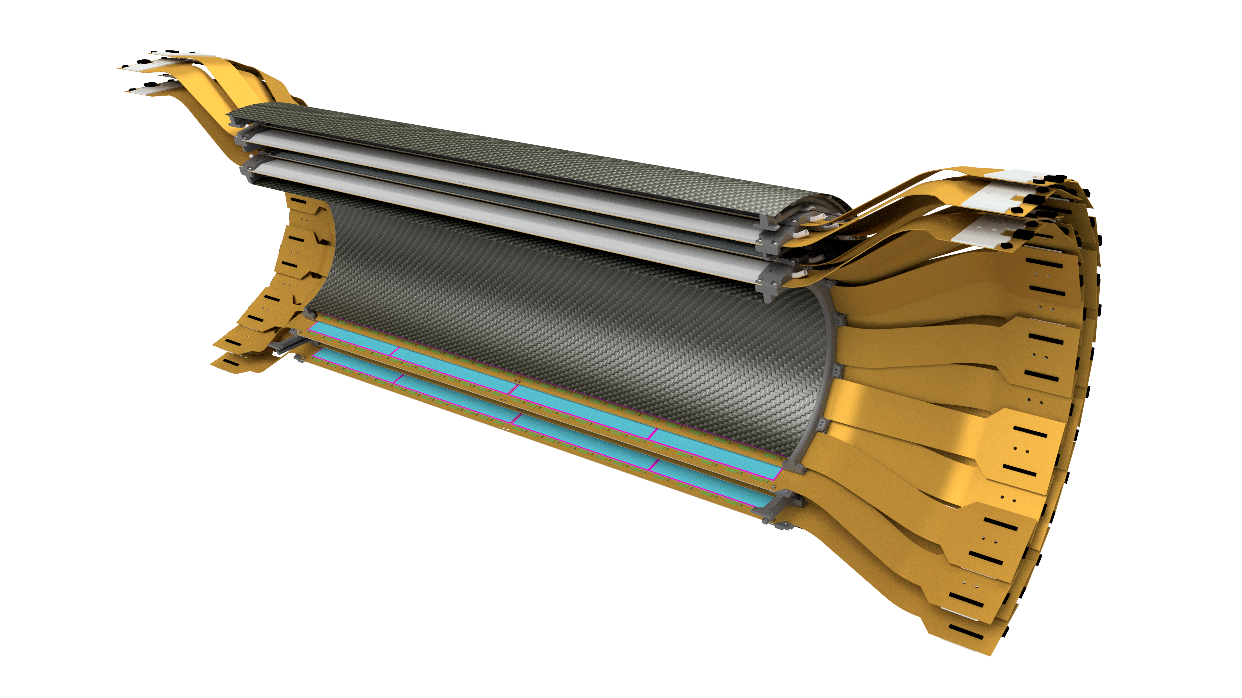
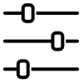
Intermediate Silicon Tracker (INTT) Specifications Daniel Cacace, Connor Miraval, Rachid Nouicer, and Itaru Nakagawa Brookhaven National Laboratory
Ladder
HDI Design
Stave Design
Stave FEA Analysis
Barrel Configuration
Ladder Support Structure
End Ring Design
End Ring FEA Analysis
Barrel Support Structure
Service Barrel Design
Service Barrel FEA Analysis
Detector Support Structure
Supports Design
Supports FEA Analysis

Slide 3
Status
Parts | Material | Concept | Design | FEA Analysis | Drawings | Prototype | Production
Stave | CFC | Done | Done | Done | Done | Done | WIP
Ladder base | Aluminum | Done | Done | N/A | Done | Done | N/A
Chip tools | Acrylic | Done | Done | N/A | Done | Done | N/A
Sensor tools | Acrylic | Done | WIP | N/A | Done | Done | N/A
End rings | PEEK | Done | Done | WIP | WIP | Done
Barrel asm fixture | Aluminum | WIP
Ring attachment | Aluminum | Done | WIP
Service barrel outer | CFC | Done | WIP
Service barrel inner | CFC | Done | WIP
Ribs | Aluminum | Done | WIP
Cooling attachment | PEEK | WIP
Cable attachment | PEEK | WIP
ROC attachment | Aluminum | WIP
ROC cooling | Aluminum | WIP
Support tube | CFC | Done | WIP
Support beams | Aluminum | Done | WIP
Installation tooling | TBD | WIP

Slide 4
Requirements
Physics
Mechanics
|η| ≥ 1.0 @ |Z_{vertex}|= 10 cm
100% φ coverage
X/X˳ ≤ 1.25%
T ≤ 20°C
δ ≤ 50μ
ω ≥ 80Hz

Slide 5
1.1 HDI Design

Slide 6
Sensor Design
BUS Extender
HDI
Silicon Module
Silicon Module
HDI
BUS Extender
Thickness: 320 um
Pitch: 9.984 mm/128 = 78 um
Φ-length (single sensor) = 22.5 mm F-length (active area) = 20.0 mm
Z-length type-A (single sensor) = 130.0 mm Z-length type-A (active area) = 128.0 mm
Z-length type-B (single sensor) = 102.0 mm Z-length type-B (active area) = 100.0 mm

Slide 7
HDI Design
HDI Thickness: 473 um
Width: 38.0 mm
z-length total: 400 mm (radiation length = 0.49%)
Sensor thickness: 320 um
FPHX chip thickness: 320 um

Slide 8
Layer Structure of HDI

Slide 9
Radiation Length of INTT Ladder
Material | Thickness [μm] | $X/{X_{0}}$
Silicon | 320 | 0.34%
HDI | 473 | 0.39%
Stave | 3620 | 0.40%
Total | 4413 | 1.13%
HDI Material | Thickness [μm] | $X/{X_{0}}$
Copper* | 52 | 0.26%
Polyimide | 380 | 0.13%
Total** | 432 | 0.49%
*Copper thickness is not physical thickness, but effective thickness. **Total thickness is not 473μm, because of copper effective thickness.
The HDI is composed of 7 copper layers. 4 layers are solid ground or power layers.
The remaining 3 layers are signal line layers containing a few percent of solid copper per layer.

Slide 10
1.2 Stave Design

Slide 11
Prototype Stave Design
Thickness: 0.76 mm
Height: 3.76 mm
Width: 38.00 mm
Length: 497 mm
Material: Carbon Fiber, Polymethacrylimide (PMI),
Stainless Steel and Epoxy
(radiation length = 0.40% )

Slide 12
Prototype Stave Design
Endcap
(Carbon PEEK)
CFC Formed
(K13C2U +
20301A 34 GSM)
Epoxy
(EP75-1)
Rohacell 110 RIST Foam
(polymethacrylimide)
Tube Sleeve
(316 Stainless)
Tube Bend
(316 Stainless)
CFC Tube (OD: 3mm,
ID: 2mm) (T700)
Pin Receptacle
(Copper)
CFC Flat
(K13C2U +
20301A 34 GSM)

Slide 13
Stave Average Radiation Length
Stave | Equivalent Thickness (mm) | Radiation Length (mm) | X/X0 *100
CFC Flat | 0.3300 | 256.4122 | 0.1287
CFC Formed | 0.3411 | 256.4122 | 0.1330
CFC Tube | 0.1033 | 282.2909 | 0.0366
Foam | 1.4740 | 3771.3741 | 0.0391
Epoxy | 0.1016 | 298.7463 | 0.0340
Water | 0.0826 | 356.7854 | 0.0231
 |  | Total | 0.3946
 | Radiation Length (mm) | Fraction
CFC | 194.0909 | 0.6
Epoxy | 349.8941 | 0.4
Total | 256.4122
Water | 360.8000 | 0.7
Glycol | 349.2849 | 0.3
Total | 356.7854
Notes:
13
Le plan de l’expose se presente de la manière suivante :

Slide 14
Ladder – Stave with Two HDIs
|η| α | Z_{Si} - Z_{vertex}| / Radius
|η| = 1.1 @ |Z_{vertex}|= 10 cm
Ladder
BUS Extender
HDI
Silicon Module
Silicon Module
HDI
BUS Extender
465.5 mm
Signal
Signal

Slide 15
1.3 Stave FEA Analysis

Slide 16
Structural – Under its Own Weight
Deflection – MAX: 0.0001 in (2.5 um)
Stress – MAX: 105 psi (0.7 MPa)

Slide 17
Vibration – Natural Frequencies
First Mode – 469 Hz
Second Mode – 784 Hz

Slide 18
Thermal – Temperatures
Stave ΔT – 3.8 °C (6.8 °F)
Sensors ΔT – 1.2 °C (2.2 °F)

Slide 19
Thermal – Midplane Cross Section
Temperature
Heat Flux

Slide 20
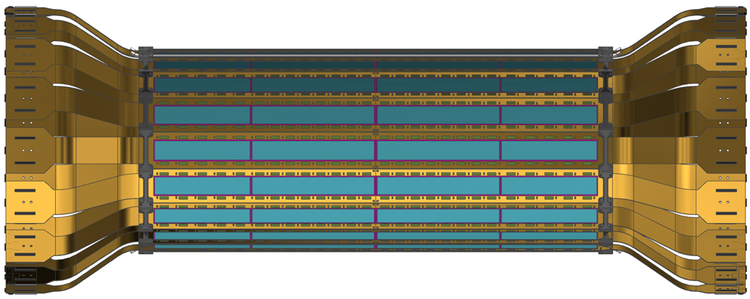
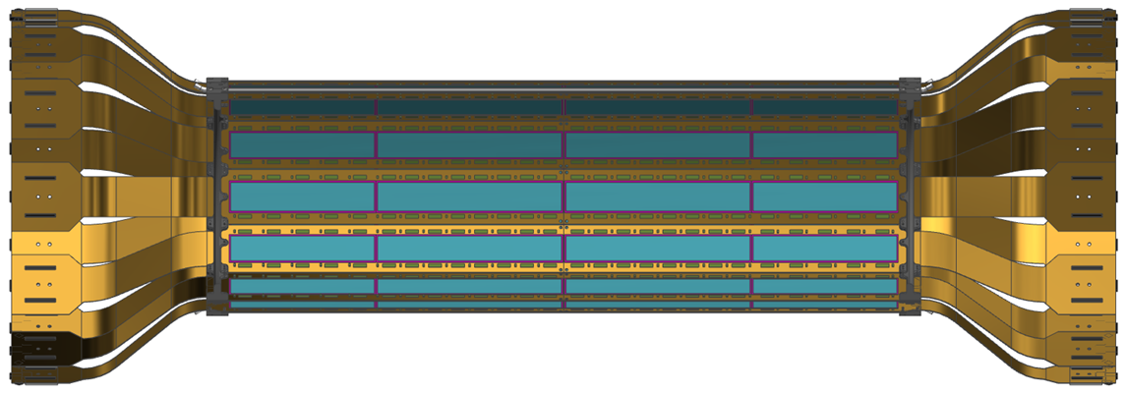
1.4 Barrel Configuration

Slide 21
INTT Components
Cooling Barb
(316 Stainless Steel)
CFC Outer Shell
(Inner Shell not shown)
CFC Stave
(K13C2U)
HDI
(High Density Interconnect)
Stave Endcap
(Carbon PEEK)
Endcap Ring
(Carbon PEEK)
Sensor
(Silicon)
Chip
(FVTX)

Slide 22
INTT Two Barrels
Full Detector
Half Barrel
Outer Layer
Inner Layer

Slide 23
Two Barrel Layout
1a (Inner)
1b (Outer)
2a (Inner)
Water Cooling
2b (Outer)

Slide 24
Two Barrel Layout Active Area
1a (Inner)
1b (Outer)
2a (Inner)
2b (Outer)
The width of the active area is 52.6% of the total width of the ladder. In order to have overlap for full PHI coverage and have a reasonable stave thickness, the ladders were stager radially with no tilt.

Slide 25
Two Barrel Configuration
|η| α | Z_{Si} - Z_{vertex}| / Radius
|η| ≥ 1.0 @ |Z_{vertex}|= 10 cm
Ladder Concept
BUS Extender
HDI
Silicon Module
Silicon Module
HDI
BUS Extender
465.5 mm
Signal
Signal
Barrel | Center of Sensor Tangent Radius (mm) | Pseudo rapidity | QTY of Ladders | Angle (deg) | Coverage (PHI) (%) | Overlap (%) | Clearance (mm) | Chip Power Dissipation (W) | Stave Rad Length (%) | Barrel Rad Length (%)
1 | - | - | 24 | - | 100 | 1.8 | 2.0 | 62.30 | 0.80 | 2.26
1a (Inner) | 71.88 | 1.37 | 12 | 0 | 52.7 | 0 | 0.6 | 31.15 | 0.40 | 1.13
1b (Outer) | 77.32 | 1.31 | 12 | 0 | 49.4 | 0 | 3.6 | 31.15 | 0.40 | 1.13
2 | - | - | 32 | - | 100 | 1.8 | 2.0 | 83.07 | 0.80 | 2.26
2a (Inner) | 96.80 | 1.12 | 16 | 0 | 52.4 | 0 | 0.6 | 41.53 | 0.40 | 1.13
2b (Outer) | 102.62 | 1.07 | 16 | 0 | 49.4 | 0 | 3.0 | 41.53 | 0.40 | 1.13
Total | - | - | 56 | - | - | 100 | 11.22 | 145.37 | 1.60 | 4.52
Notes:
25
Le plan de l’expose se presente de la manière suivante :

Slide 26
Two Barrel Configuration

Slide 27
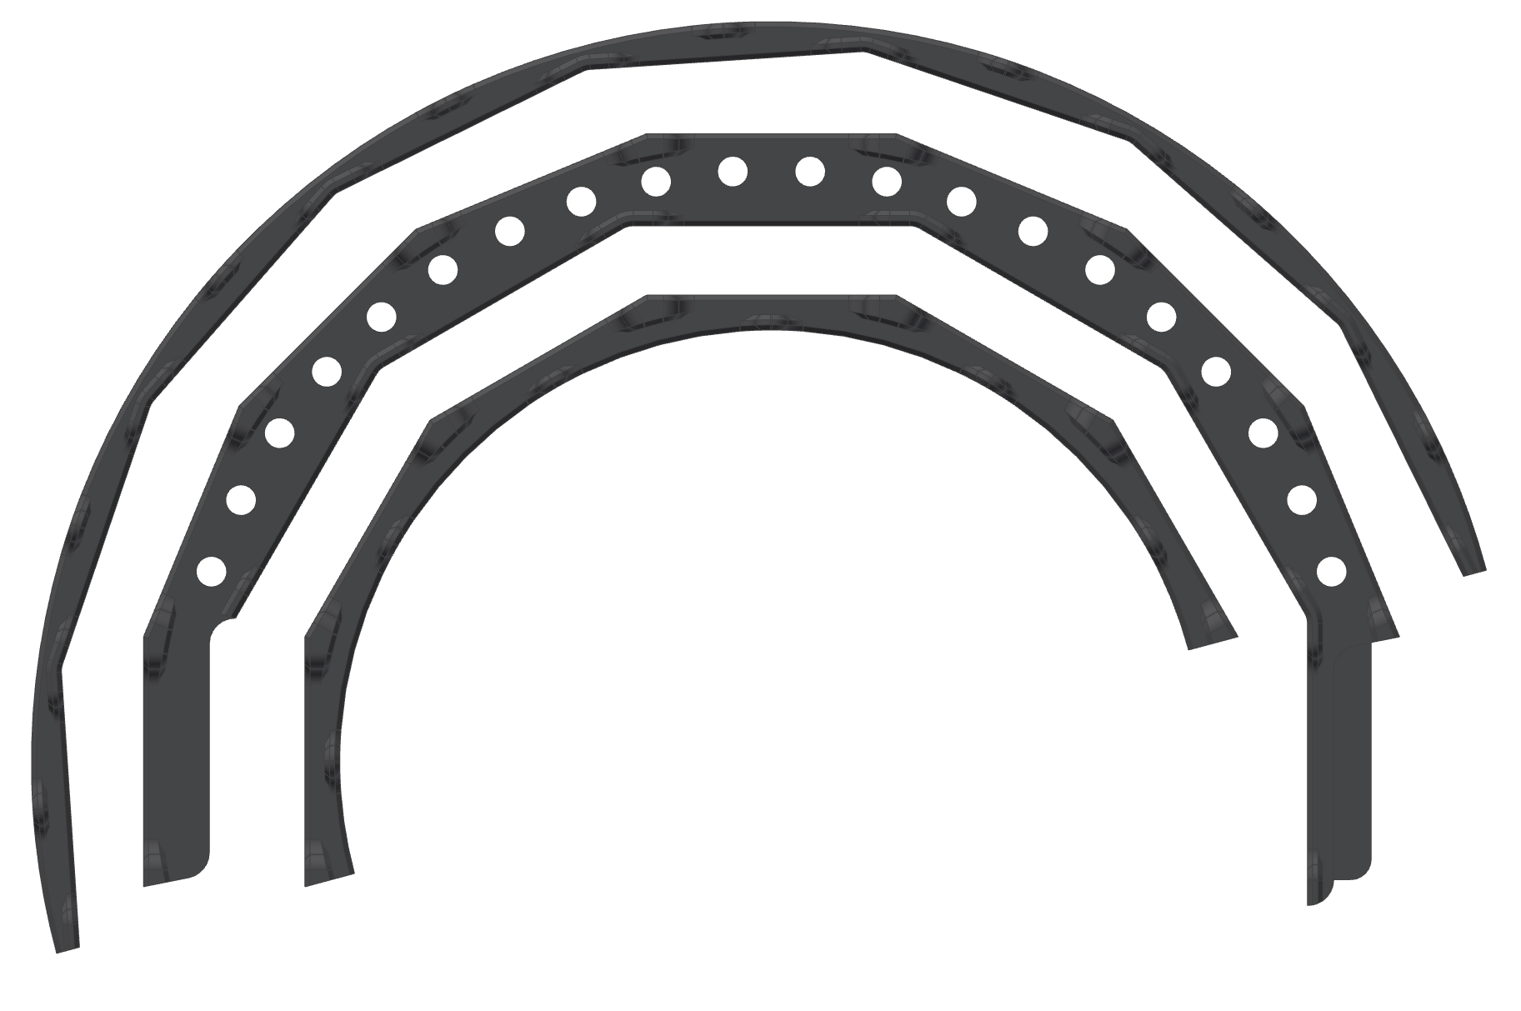
2.1 End Ring Design

Slide 28
Cooling Connection

Slide 29
Endcap Rings - Half Barrel, One Side
Endcap Rings With Staves and HDIs
Endcap Rings With Staves

Slide 30
Endcap Rings - Half Barrel, One Side
Gap for layers 2a and 2b
Gap for layers 1a and 1b
End Ring 3
End Ring 1
End Ring 2

Slide 31
Assembly

Slide 32
2.2 End Ring FEA Analysis

Slide 33
Structural – Under its Own Weight
Deflection – MAX: 0.0025 in (63.5 um)
Stress – MAX: 170 psi (1.17 MPa)

Slide 34
Vibration – Natural Frequencies
First Mode – 83 Hz
Second Mode – 85 Hz

Slide 35
3.1 Service Barrel Design

Slide 36
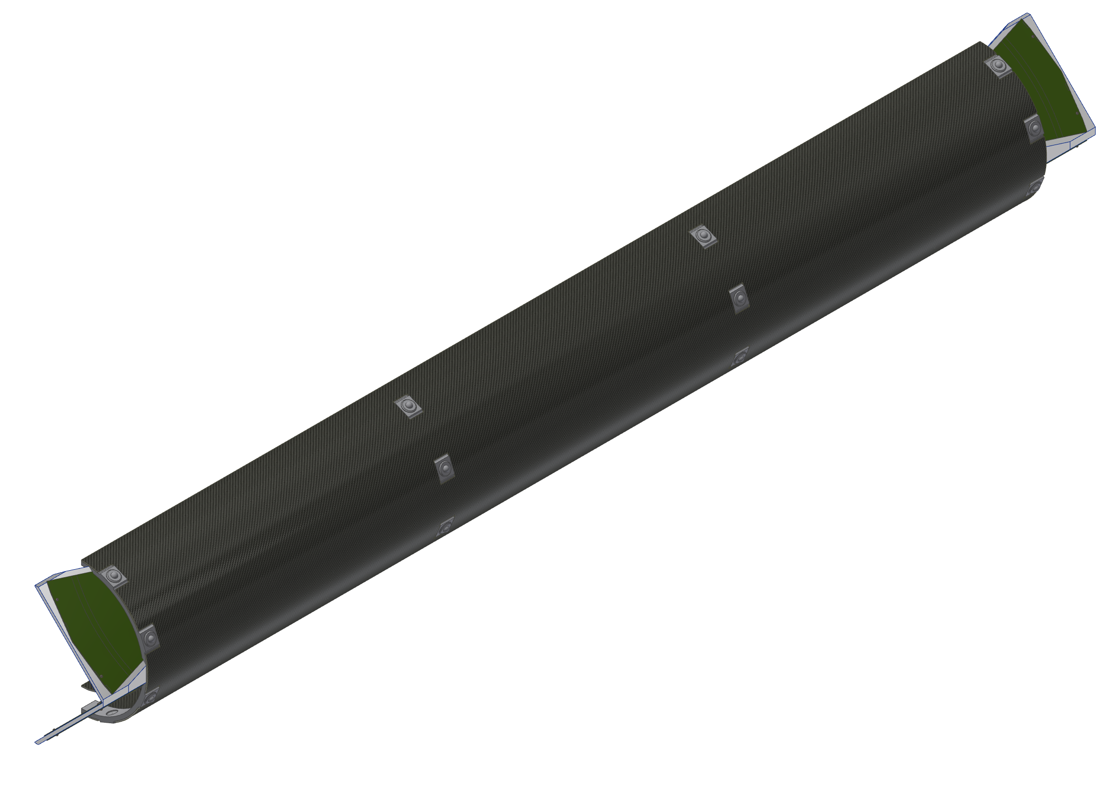
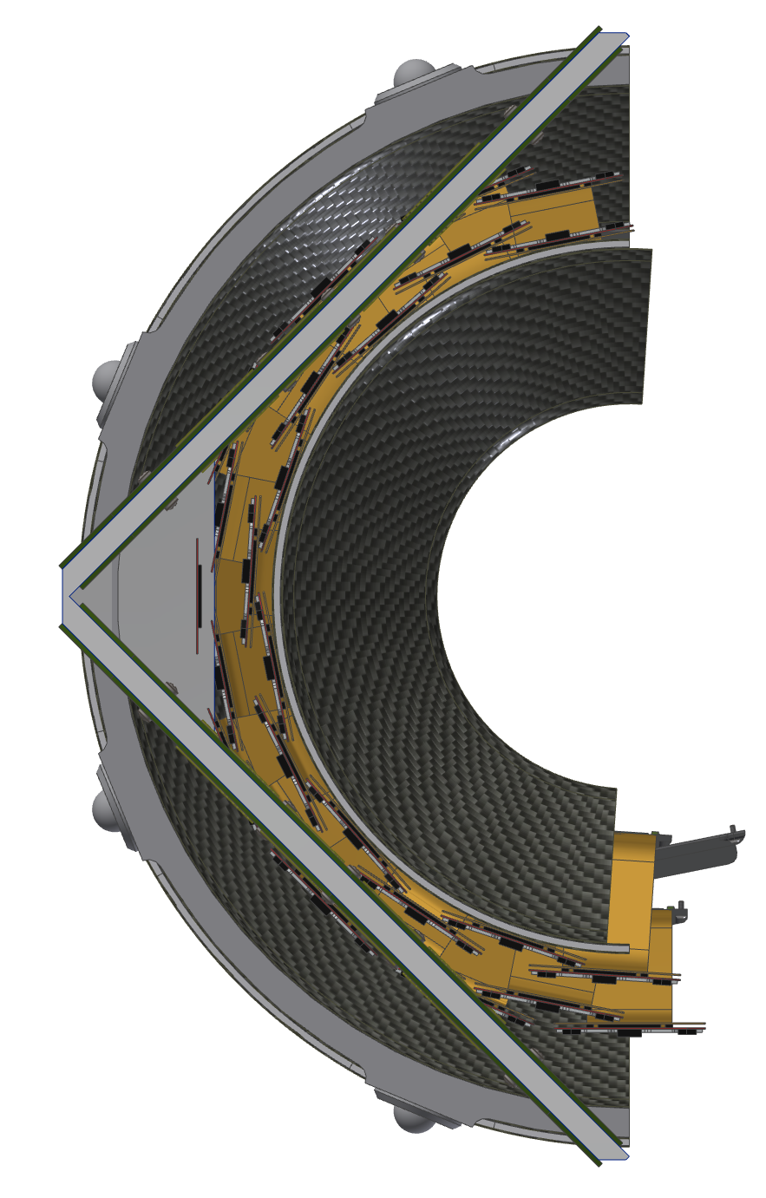
INTT Service Barrel
Back View
Ball Transfers
Cylinder Panel
Carbon Fiber
Ladder Layers
Extension Cables
End View
ROCs

Slide 37
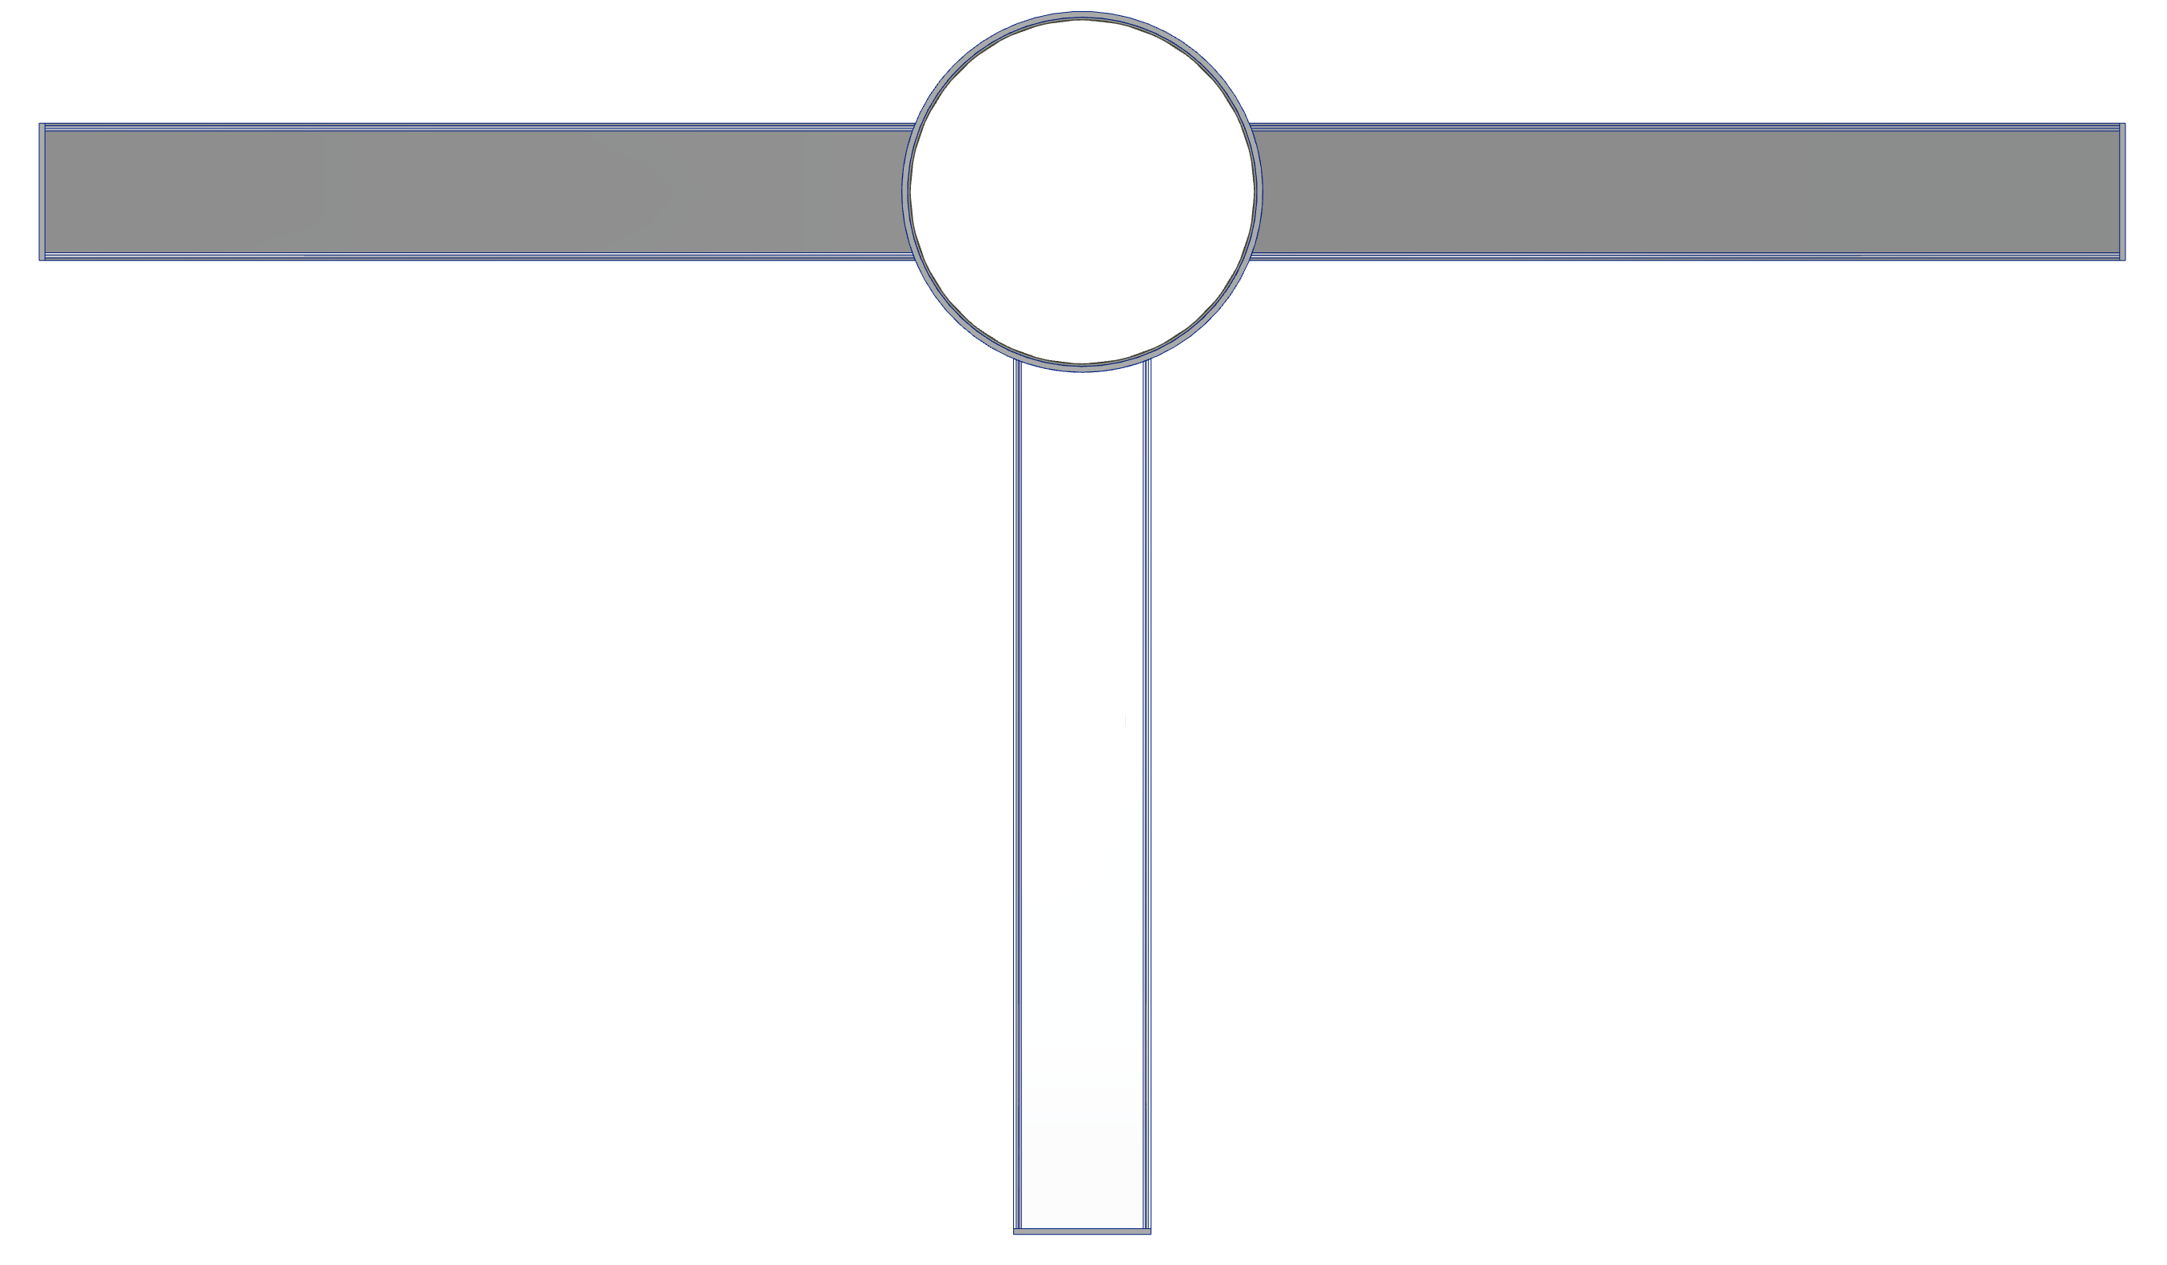
Support Structure
End View
Cylinder Panel
Carbon Fiber
Aluminum I Beams
(6061)

Slide 38
INTT Installation
Installing
Installed
Roll in on Ball Transfers

Slide 39
iHCal, EMCal, TPC, INTT & MVTX

Slide 40
3.2 Service Barrel FEA Analysis

Slide 41
4.1 Supports Design

Slide 42
4.2 Supports FEA Analysis

Slide 43
End

