Slide 1
EIC PID Meeting
TK Hemmick, P Rossi April 1, 2020

Slide 2
Brief Agenda
Priority for today
Basic strategy:
Define specific tasks more concretely.
External requirements.
Pro/con matrix.
Assemble groups addressing tasks:
Significant work happens between our meeting lead by groups.
Our expectation is that each group will, of course, include the relevant experts.
Set timeline/agenda for defense of findings in upcoming meetings.
Klaus Dehmelt has volunteered to collect the PID code that everyone has (should have) written and distribute via git. Klaus.Dehmelt@stonybrook.edu

Slide 3
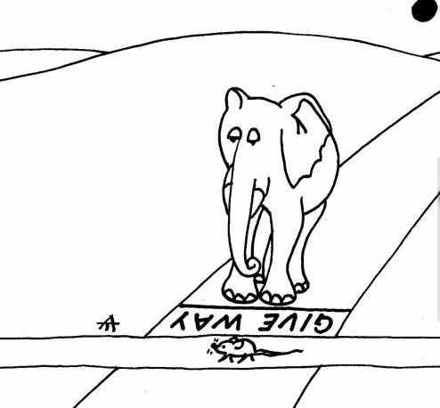
External Requirements.
Many items represent coupled problems.
No “final” PID assessment can be made without tracking performance.
No “final” tracking design can be made without considering PID.
Someone must make the first move…let it be us.
In the absence of explicit design of both systems we must use experience to define optimistic and pessimistic needs.
Two couplings:
Combined System must meet the physics.
Tracker should not “ruin” the PID device beyond the physics.
Strategy:
Define requirements to tracking.
Present to tracking group and begin to iterate.
Someone must cross first

Slide 4
“Don’t ruin my result, Dude”
Basic Internal Characteristics:
Cherenkov Detectors: (dispersion, N_{photons}, Pixelation, Mirror, Multiple Scattering, background hits{intrinsic, electronics, physics, …})
TOF Detectors: (σ_{t} , …)
Basic External Input (others…help me out here):
Cherenkov Detectors: $\left|\vec{p}\right|$ and $\hat{p}|_{volume}$ (magnitude and direction of momentum, bending in the field, external “machine” background)
TOF Detectors: L, t₀ (internal), $\left(x_{intercept}, y_{intercept}\right)$
Effectively we need the combined system to meet a goal.
Example Formulation:
Cherenkov (θ_{C}).
At any $\left|\vec{p}\right|$, there exists a “1-sigma” resolution in $δθ_{C}$ which we’ll call $δθ_{C1}$
Physics will demand that our full uncertainty follows: $\frac{δθ_{C1}}{N}$.
If we take the detector performance with a perfect tracker to be $δθ_{C0}$.
Then our external requirement on the tracker system is: ${\left(\frac{δθ_{C1}}{N}\right)}^{2}≤ {\left(δθ_{C0}\right)}^{2}+{\left(δθ_{tr}\right)}^{2}$
Useful to understand the different between errors that “do/don’t” depend upon N_{pe}

Slide 5
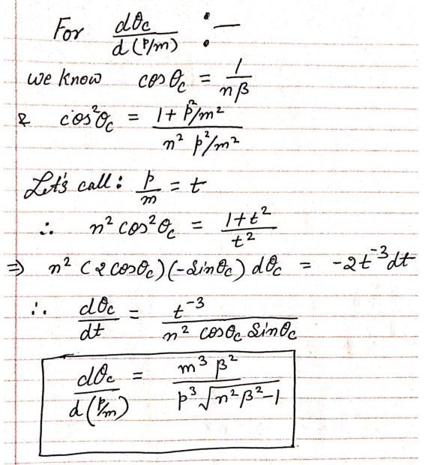
Example Contribution: Track Momentum
Some factors are simple analytical formulas.
Here “momentum” means magnitude, $p≡\left|\vec{p}\right|$
These can be expressed easily and will provide what is not likely the strictest limit.
An expression like this can be used to drive the momentum magnitude requirement.
Simple to calculate, but often not the limiting at the highest momentum.
H. Klest, P. Garg

Slide 6
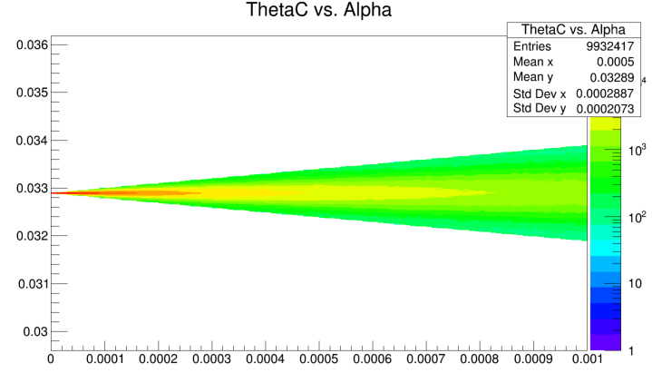
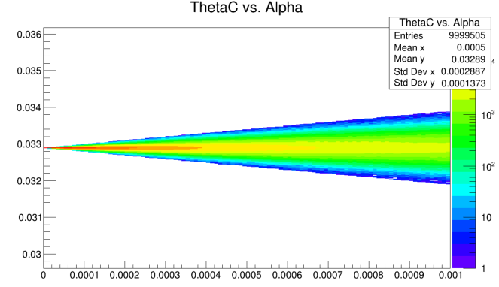
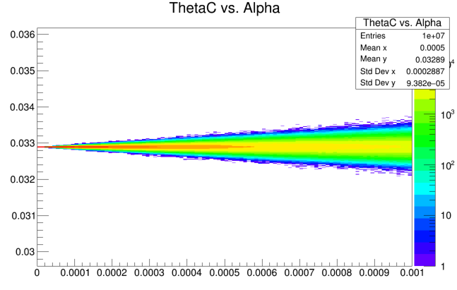
Example Contribution: Track Direction
truth
θ_{C}
α
N_{photon}=5
tracker
Trivial (not real) Calculation:
Each photon measured perfectly.
Tracker wrong by α.
<θ_{C}> measured depends on <N_{ph}>
Tighter requirement on tracker
N_{photon}=10
N_{photon}=20
NOTE:
Ignores internal ability to find “ring center”
Maximum reliance on tracker.
Looser requirement on tracker
Lesson: What we require depends upon what we deliver.

Slide 7
Outline request:
${\left(\frac{δθ_{C1}}{N}\right)}^{2}≤ {\left(δθ_{C0}\right)}^{2}+{\left(δθ_{tr}\right)}^{2}$
Assume π-K as the figure of merit → $δθ_{C1}$ as a function of momentum.
Assume that N=3 (not valid forever, but it is a place to start).
Foreach technology calculate “pessimistic” and “optimistic” boundaries for $δθ_{C0}$
Technology dependent.
Performance dependent.
…
Same workflow for TOF, DIRC, etc…
Invert the equation to determine the tracking requirements.
Produce PLOTS to be shared with the trackers…
Today:
Refine the model of what to do.
Assemble the groups to make presentations (1 week…2 weeks)?
NOTE: This is intended to outline what MIGHT be the process
Experts must refine this to match the task to the question

Slide 8
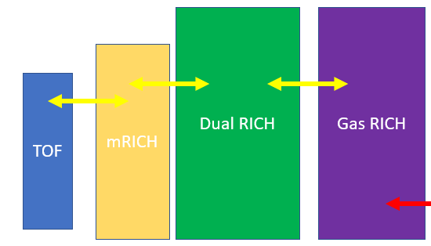
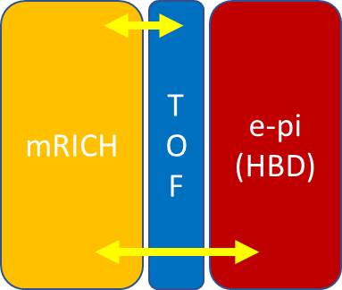
Temple Comparison Matrices
Same Groups as for the Tracking Feedback?
p-Focus RICH
 | Pro | Con | Group
DIRC |  |  | GSI, CUA
Babar-bar DIRC |  |  | GSI, CUA
B-tolerant |  |  | BNL, ANL, RU
p-RICH |  |  | SBU
 | Pro | Con | Group
dRICH |  |  | INFN, SBU, ANL
dRICH & TOF |  |  | BNL, RU
mRICH & gas |  |  | GSU, SBU
TOF & gas |  |  | BNL, RU, SBU
Performance summary (PID class)
Pro/Con/Space consideration matrix
External requirements (min tracking)
 | Pro | Con | Group
mRICH |  |  | GSU,
TOF |  |  | BNL, RU
HBD

Slide 9
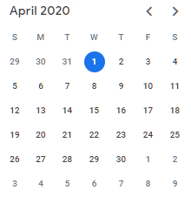
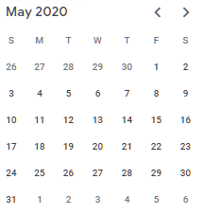
Looking forward at the Calendar.
Posting Slides: (minimum draft form) in 24 hours in advance.
Decide agenda one week in advance. (based upon Email status report)
Option:
April 15: Results for feedback to tracking requirements.
April 29: Results for pro/con matrix.
May 6: Refinement of the above with additional physics input.
May 20: Recap and finalize results for Pavia
Does it make sense to advance all this by one week?
Does it make sense to switch to weekly?

