Slide 1


Tungsten Scintillator Calorimeter Technologies for EIC
Craig Woody
Brookhaven National Lab
EIC Users Group Yellow Report
Working Group on Calorimetry
March 31, 2020

Slide 2
eRD1 Collaborators
sPHENIX W/SciFi
W/Shashlik

Slide 3
Calorimetry for an EIC Detector (Conceptual)
B
EMCAL resolution ~ (5-7)%/√E ⊕ 1%
EMCAL resolution
~ (10-12)%/√E ⊕ (2-3)%
Energy resolution ~ (1.0-2.0)%/√E ⊕ 0.5%
Requires high resolution crystal calorimetry
Candidates for W-Scintillator Calorimeters

Slide 4
Kinematics of Scattered and Produced Particles

Slide 5
Calorimeter Requirements
(from the EIC Handbook)
Minimal resolution from tracking because of solenoid field
Requires good spatial resolution (i.e., segmentation)
Needs to be radiation tolerant since is close to beamline
Resolution provided by a tradeoff between calorimeter and tracking
(resolution and segmentation depends on η)
Needs to be compact and cost effective
Readout must work in fringe field of magnet
Better resolution is provided by tracking
Provide e/h separation to > 1:100
Needs to be compact to fit inside the magnet and minimize cost
Readout must work inside magnetic field

Slide 6
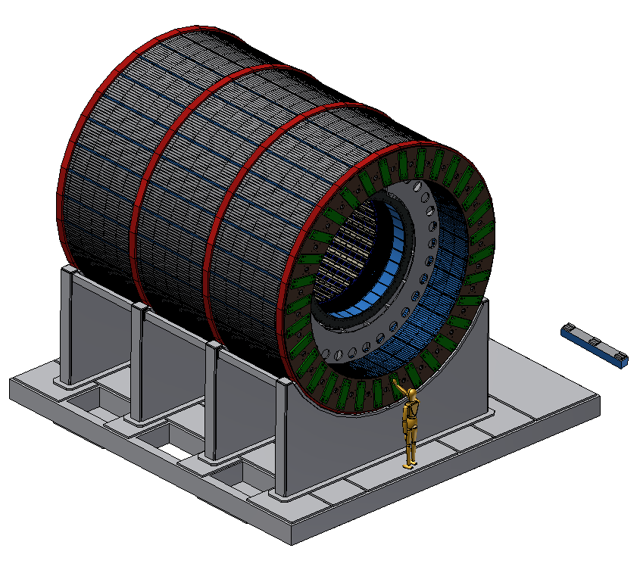
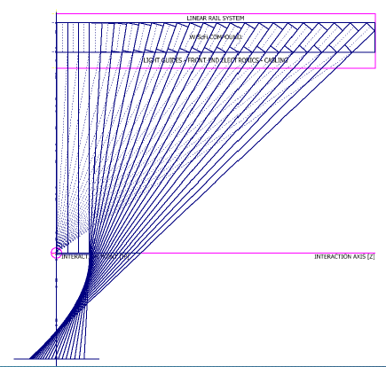
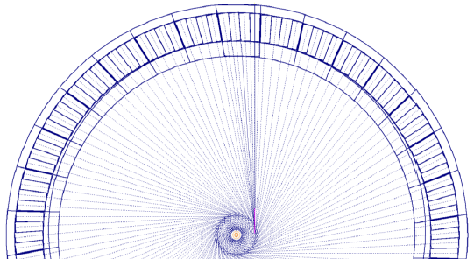
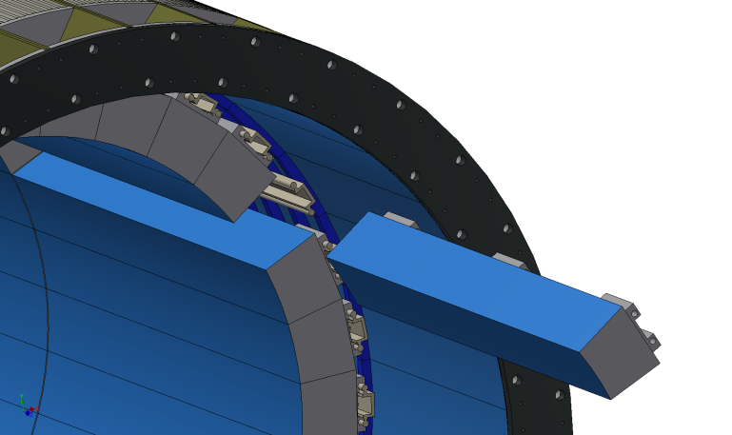
sPHENIX/ePHENIX
Barrel EMCAL
EMCAL Sector
DIS event simulated in a converted sPHENIX detector for EIC
Sectors and blocks are approximately projective and tilted in η and φ

Slide 7
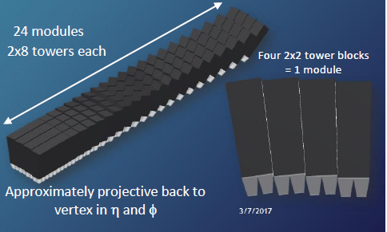
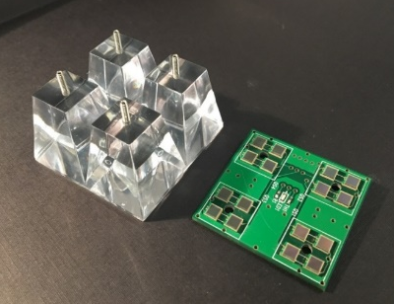
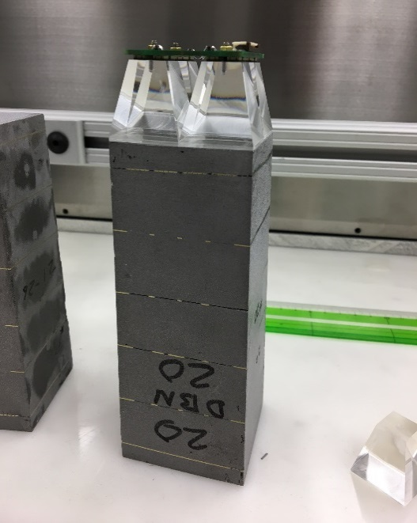
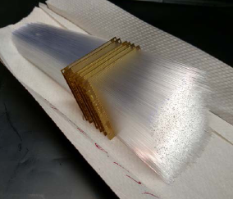
sPHENIX W/SciFi EMCAL
Barrel electromagnetic calorimeter covering ± 1.1 in η and 2π in φ
2(±η) x 32 (φ) = 64 Sectors
  6144 Blocks (24,576 towers)
Matrix of tungsten powder and epoxy with embedded scintillating fibers
(0.47 mm, spacing 1 mm, SF ~ 2%)
Density ~ 9 g/cm3
X₀ ~ 7 mm (18 X₀ total), R_{M} ~ 2.3 cm
2D Projective
Blocks
Readout with light guides and SiPMs
W Powder ~ 50 μm
Fiber Assembly
Mold with W powder, fibers + epoxy

Slide 8
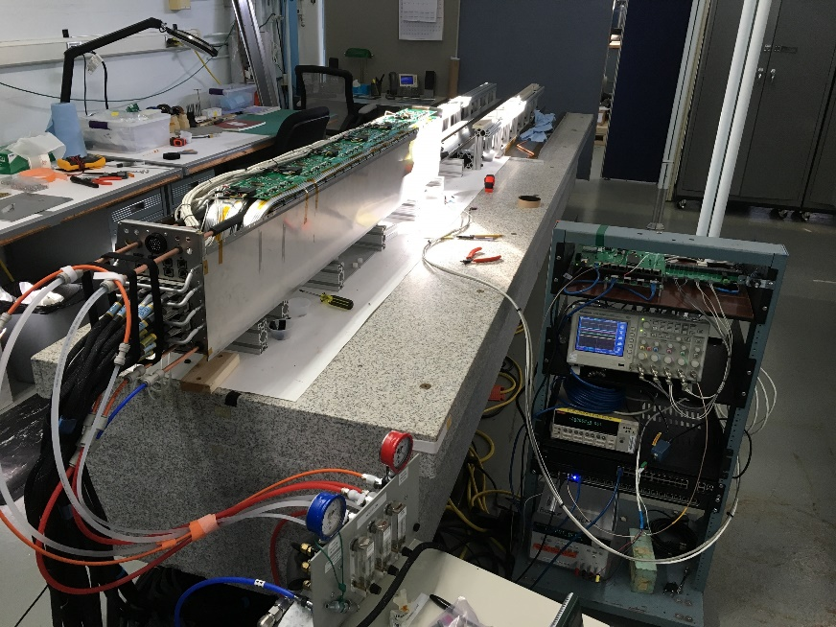
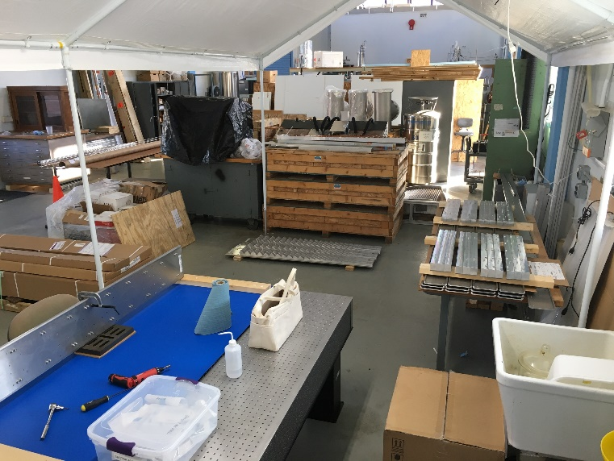
sPHENIX EMCAL under construction
Sector 0 undergoing testing at BNL
Sector storage and testing area in the Physics High Bay
11 Tons of W powder now at UIUC
Blocks for Sector 2 at UIUC

Slide 9
W/SciFi Performance
Non-uniformities are inherent in the design and contribute to the energy resolution
X axis projection
Uniformity of response over 8x8 towers with 8 GeV electrons (test beam data)
Block Boundary
Light Guide Boundaries
Y axis projection
Uniformity after position dependent correction
Block Boundaries
Light Guide Boundaries

Slide 10
Energy Resolution
Energy resolution after position dependent correction
Beam covering a 2.5 x 2.5 cm² area centered on a tower
Beam covering a 1.0 x 0.5 cm² area centered on a tower
Resolution ~ (13-15)%/√E ⊕ 3%
Resolution ~ (12-13)%/√E ⊕ 2.5%

Slide 11
Improvements to the Energy Resolution
  The inherent energy resolution can be tuned by adjusting the sampling fraction (at some expense in reducing the density and hence the radiation length and Moliere radius).
  However, the main limitation in the energy resolution is the position dependence of the shower due to the fact that the shower is so compact
  One can improve the non-uniformities by minimizing the mechanical and optical boundaries.
  One can try and measure the shower position within a tower or increase the segmentation.

Slide 12
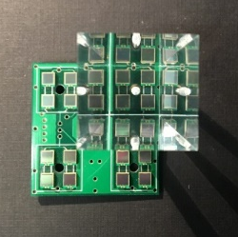
Increasing Photocathode Coverage of W/SciFi Blocks
  The sPHENIX W/SciFi blocks consist of 4 towers, each read out with its own light 1” long guide with four 3x3 mm² SiPMs. The uniformity of the light exiting the fibers is very good but the light guide provides poor mixing and the SiPMs cover only 23% of the readout area of the light guide (6.4% of the total readout area of the block).
  The light collection efficiency and uniformity can be greatly improved by increasing the photocathode area coverage on the readout end of the block
Increased coverage using existing sPHENIX light guides
Maximum photocathode coverage using the sPHENIX blocks
PCB Readout
3 SiPMs in series then 3 summed in parallel
(C/3 x 3 = C)
Short (1.5 mm) light guide covering entire block
Hamamatsu S13360
6x6 mm² SiPM with TSVs
(50 μm pixels)
2x2 array of 6x6 mm² SiPMs

Slide 13
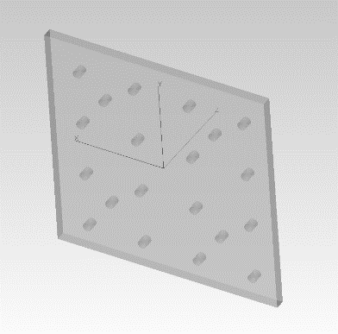
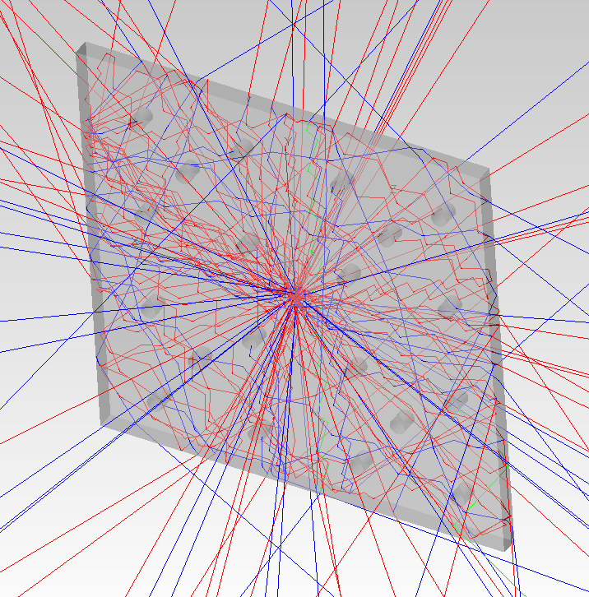
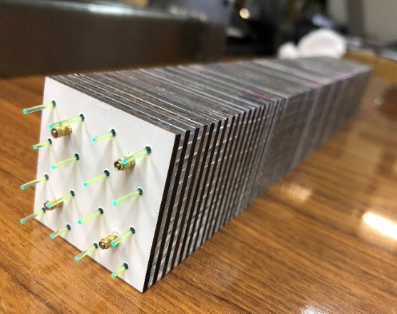
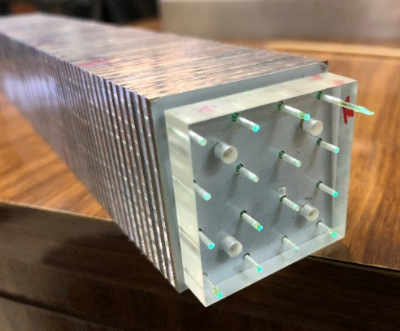
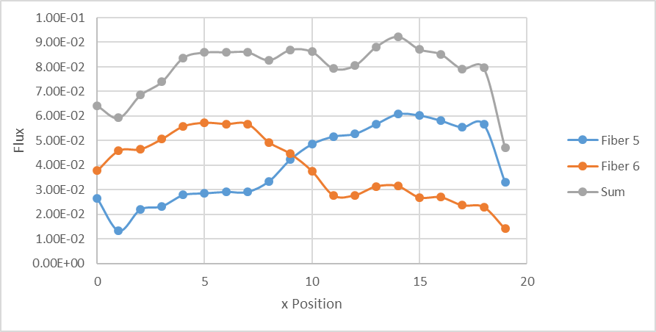
W/Shashlik Calorimetry
  A compact shashlik offers the possibility of improving the light collection uniformity due to the short light path to the WLS fibers.
  Availability of low cost SiPMs allows reading out each fiber individually. This allows determining the position of a shower even within a tower.
Ray tracing withing a scintillation tile
80% W/20 % Cu absorber plates
1.5 mm scintillating tiles read out with WLS fibers
Each fiber read out by its own SiPM
Light collection efficiency for 2 adjacent WLS fibers vis position

Slide 14
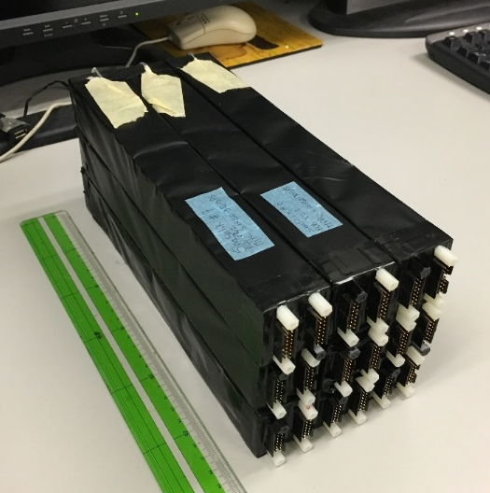
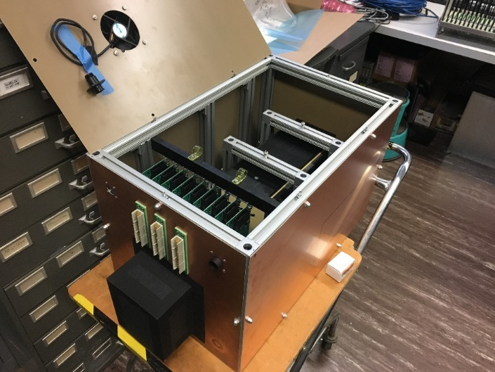
Progress on W/Shashlik Calorimetry
Nine W/Shashlik modules were produced and tested at UTFSM and have now been delivered to BNL.
3x3 array of W/Shashlik modules
Test enclosure for W/Shashlik modules and front-end readout electronics
Cosmic Ray Spectra
The modules will be assembled into a 3x3 array and tested using the sPHENIX calorimeter readout electronics.

Slide 15
Summary
  W/Scintillator calorimetry provides a cost effective option for instrumenting the barrel region of an EIC detector and could possibly be used in the electron or hadronic endcap regions.
  Due to its compactness the position dependence of the shower can lead to non-uniformities that contribute to the energy resolution (particularly in the constant term).
  Minimizing the mechanical and optical boundaries of the readout will help to minimize the position dependencies and lead to better energy resolution.
  A large central EMCAL barrel calorimeter is currently under construction for sPHENIX and will be available for use at EIC.

