Slide 1
EIC Project Overview Jim Yeck, EIC Project Director
April 23, 2020

Slide 2
EIC Design Satisfies NSAC and NAS Requirements
Center of Mass Energies 20 GeV – 141 GeV
Maximum Luminosity 10³⁴ cm⁻²s⁻¹
Hadron Beam Polarization 80%
Electron Beam Polarization 80%
Ion Species Range p to Uranium
Number of interaction regions up to two

Slide 3
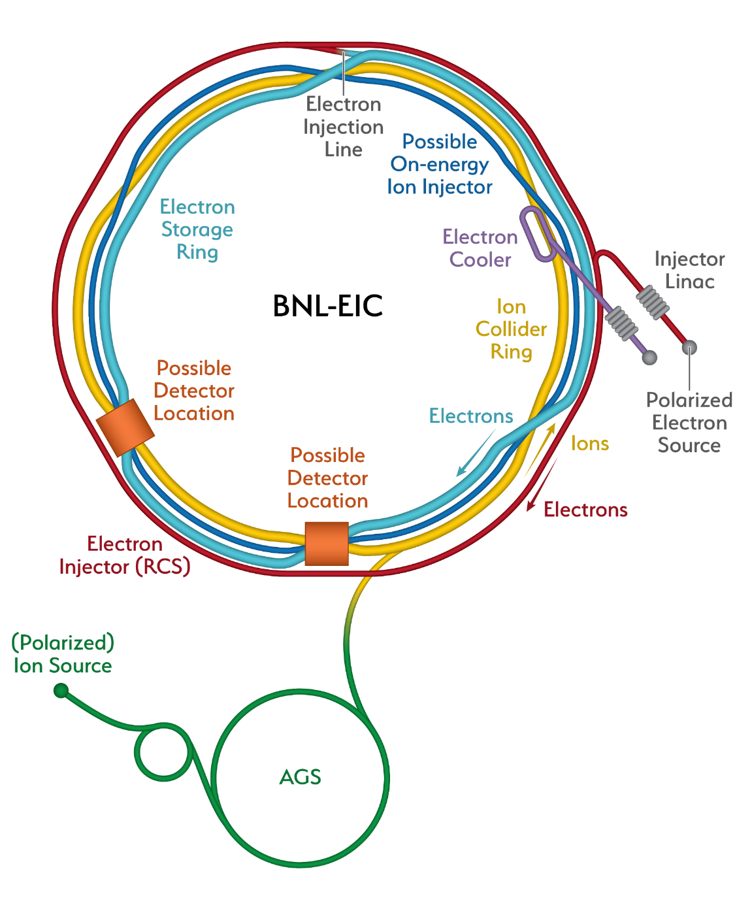
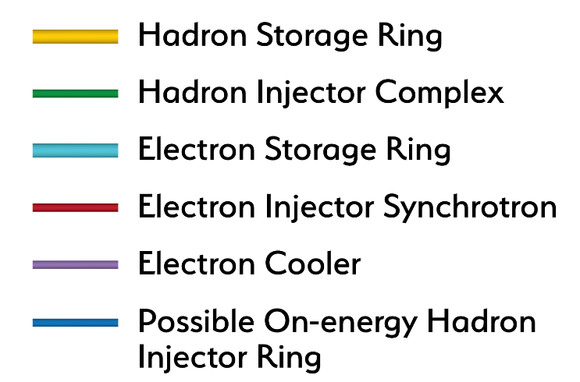
Electron Ion Collider

Slide 4
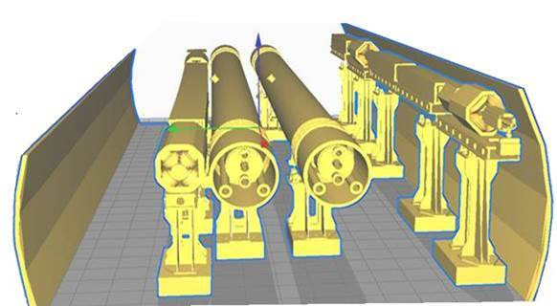
EIC Machine in the RHIC Tunnel
Rapid Cycling Synchrotron (RCS) for electrons and Electron Storage Ring (SR) fit easily into the existing RHIC tunnel
Two existing detector halls available for interaction regions and detectors
SR
RCS

Slide 5
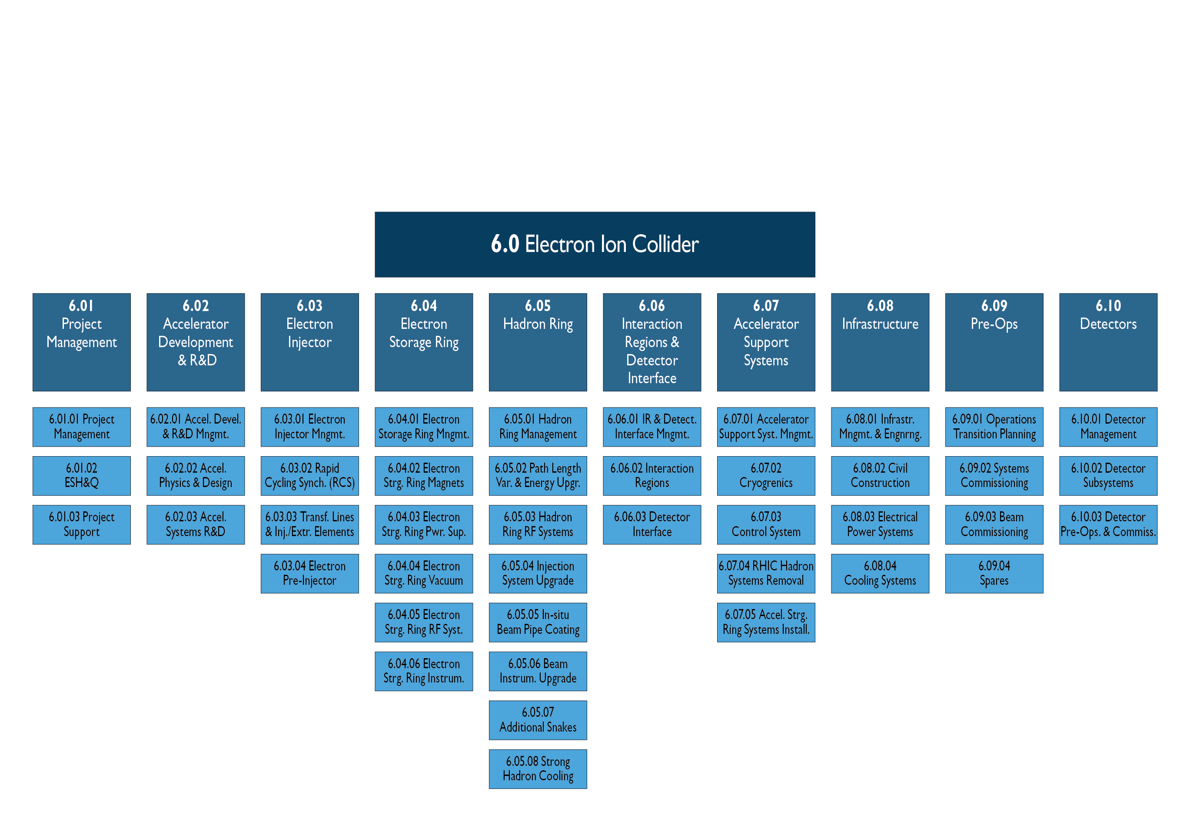
EIC Project Scope

Slide 6
Reference Funding Profile
CD-1: March 2021
CD-2: September 2022
CD-3: September 2023
CD-4a: September 2029
CD-4b: September 2031
Staged Luminosity
Operations Start CD-4a
Full RF Power Installed by CD-4b
$100M from New York State toward infrastructure

Slide 7
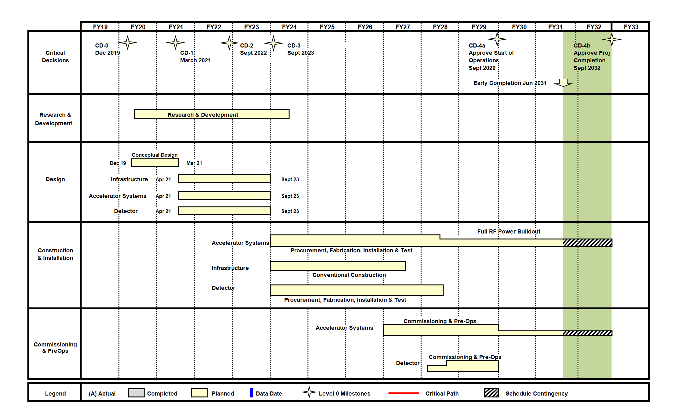
Reference Schedule

Slide 8
BNL-JLAB Joint Efforts
TJNAF Visit to BNL – Feb 10, 2020
BNL Visit to TJNAF – Feb 28, 2020
Partnering Agreement Approved
EIC Project Executive Management Team Established: E. Aschenauer, Rolf Ent, Diane Hatton, Allison Lung, Andrei, Seryi, Ferdinand Willeke, and Jim Yeck (Abhay Deshpande, ex officio)
Working on organization and management approach

Slide 9
Organization
EIC management approach
Organization structure is being assessed to benefit from TJNAF commitment and prospects for significant international and domestic partners
EIC Council will be established based on project experience from other projects including LCLS-II, Exascale, and other recent large projects, both DOE and international projects
Project leadership team to be strengthened and membership and mandates of advisory committees clarified:
Project Advisory Committee
Machine Advisory Committee
Detector Advisory Committee

Slide 10
EIC Accomplishments
Accelerator
Design Task Forces established BNL/TJNAF/Others
Discussing potential future partnerships for design and construction
Experimental Program
Development Timeline and Process Defined
EIC User Group “Yellow Report” Workshops
Strong domestic and international interest in two detectors/interaction regions recognized
Conceptual Design Report (Draft) – Sept 1, 2020

Slide 11
Timeline to CD-1
May 7, 2020: EIC Program Steering Group Meeting
May 7, 2020: Partnership Agreement Signed
Late May: EIC All Hands Meeting
May 29, 2020: Call for EoI for Contributions to Detectors
June 15, 2020: A/E Services Contract awarded
Mid-June: EIC Director’s Council Meeting
June 30, 2020: Preliminary drafts/full outline of CDR due
June 30, 2020: DRAFT CD-1 documents complete
July 15, 2020: Analysis of Alternatives Team report due
July XX, 2020: Risk Workshop
July 31, 2020: Deadline for drafts of new CDR Material
July 31, 2020: Freeze Design updates for Draft CDR

Slide 12
Timeline to CD-1
August 1, 2020: Freeze data for DOE Mini Review
Week of August 10, 2020: Independent Review of AoA
August 15, 2020: CD-1 Documents complete
August 25, 2020: AoA Final Report Complete
August 26, 2020: Post Material for DOE Mini Review
August 27, 2020: Project Advisory Committee Meeting
September 1, 2020: DRAFT CDR Complete
September 9-10, 2020: DOE Mini Review
Early October: First Detector Advisory Committee (DAC) Meeting
October 6, 7 or 8, 2020: First Machine Advisory Committee (MAC) Meeting

Slide 13
Timeline to CD-1
November 1, 2020: Deadline for Detector EoI
November 19, 2020: PAC Meeting
November 23, 2020: Post Material for Director’s Review
November 30, 2020: NEPA Process Complete
Dec 8-10, 2020: CD-1 Director’s/CDR Review
December 15, 2020: Freeze data for DOE CD-1 Review
January 7, 2020: ½ Day Briefing with NP and OPA
January 12, 2021: Final CDR complete
January 12, 2021: Post Material for CD-1 Review
January 26-28, 2021: DOE CD-1 Review
February 2021: Evaluate EoI & Draft Call for Det. Prop.
March 2021 – Initial Plan for Call for Detector Proposals
March 31, 2021 – Goal for CD-1 Approval

Slide 14
Using the Path to CD-1 to Status
DRAFT

Slide 15
Post CD-1
April 1, 2021 – Start Preliminary Design
Focused Technical Reviews
March 2022 – Establish preliminary performance management baseline and start using cost and schedule tracking tools, including EVMS
September 2022 – Goal for CD-2 Approval
July 2023 – Goal for CD-3 Approval [pending schedule update to determine when procurements will need to begin]

Slide 16
EIC Challenges
Affordability – very large project for DOE Office of Nuclear Physics (NP) and Office of Science (SC)
Reprioritization of funding to EIC
Critical to ramp up of funding in FY2021 to maintain timeline for DOE Critical Decisions
COVID-19
Current EIC work is primarily planning and design work which can be done remotely, some R&D stalled
Indirect impacts are likely to be more significant, including aligning with RHIC operations plans, uncertain fiscal context, design efficiency

Slide 17
Conclusion
Project Delivery Plans Maturing
Strong Foundation: pre-conceptual design, cost estimate, schedule
BNL/TJNAF Collaboration
Plans aligned with reasonable annual funding projections
DOE review and approval process is important: CD-1 approval in 2nd Quarter of FY2021
Strong Effort to Develop Experimental Program
Community engagement essential including “host” role of BNL/TJNAF in the process
Timeline important for the Yellow Book, Call for Expressions of Interest, Call for Proposals, etc.
Working to align and integrate within the overall integrated project

