Slide 1


EIC Luminosity Limitations &
IR Design
Ferdinand Willeke
EIC User Group Remote Meeting
“Pavia Meeting”
May 20-22, 2020
Electron Ion Collider

Slide 2
Colliding Beam Detectors in the EIC Project
All stakeholders agree that an EIC wit two detectors is more than desirable
    Two detectors with similar functionality mutually confirm important results
    Two detectors with different specialization for stronger support in certain areas
The EIC project, as presented during the 2019 site decision process by BNL includes
One colliding beam detector^{*)}
One fully built-out interaction Region
Sufficient space and flexibility to include a 2nd detector and IR including existing large halls to accommodated 2 colliding beam detectors
Concepts to operate two IR’s simultaneously including
  concept of luminosity sharing and
  IR-to-IR intrinsic compensation of detrimental
At this time, funding for a second detector and IR is not included in the project cost profile. Funding is envisioned to come from “other”, non-DOE sources
*) Funding for the first detector includes a “day-1” detector which can cover the EIC physics program, but there are many opportunities for further optimization n support of an optimum exploitation of the luminosity and the center of mass energy range.

Slide 3
Circular high luminosity colliders colliders
Early e+e- colliders in the 60-ties, (E_{cm} 100MeV), Vepp1, ADdA, ACO ….
-establishment of a “beam-beam” limit, maximum strength of the focusing of one beam by the other, depends on radiation damping Δν ~0.01-0.03 ….
Discovery of coherent beam-beam instabilities (DCA) (4-beam e+e- vs e+e-)
Double Ring collider DORIS, 70-ties
Hadron colliders, ISR, SpS p-pbar, TEVATRON, LHC … hadron beams stable in collisions at tune-shift limit Δν ~0.006 limited by distance between high order resonances (70-80-90)
Lepton Hadron Collider: HERA, stable collisions with tune shifts similar to what is achieved in single species colliders
e+e- colliders with many bunches (Pretzel scheme) CESR….
High current double ring asymmetric colliders PEP-II, KEK-B (B-factories), luminosity boosted by exploiting resonance enhanced pinch effect (core of the beam focused by opposite beam)
Super B-factories, DAFNE: nano beam and crab waist beams
EIC IR designs based on experience of ~60 years collider

Slide 4
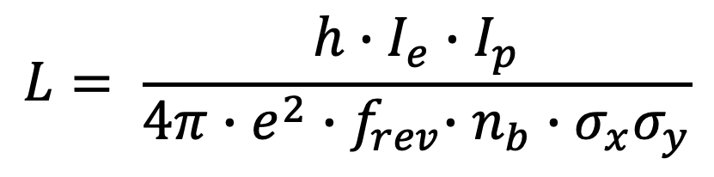


EIC Luminosity Limitations
$$L= \frac{{h∙f}_{rev}∙n_{b}∙N_{e}∙N_{p}}{4π∙σ_{x}σ_{y}}$$
Assumptions:
Gaussian beams (horizontal ok, vertical probably not)
No pinch effect (cannot exploit pinch in ep collisions)
σ_{xe}= σ_{xh}; σ_{ye}= σ_{yp} strongly suggested by SpS p-pbar, HERA, TEVATRON experience
$$L= \frac{h∙I_{e}∙I_{p}}{4π∙e^{2}{∙f}_{rev}∙n_{b}∙σ_{x}σ_{y}}$$
Electron beam current limited by synchrotron radiation for large energies
Proton beam current limited by collective effects, electron cloud, …
Hour glas factor h reduces luminosity quickly for β_{e,p,x,y} < σ_{p}
$$I_{e}∝ \frac{P_{rf}∙ρ}{E^{4}}$$

Slide 5
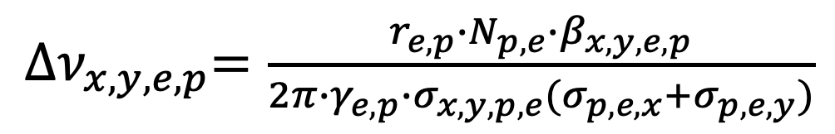
EIC Luminosity Limitations
Beam-beam tune shift:
${∆ν}_{x,y,e,p}=\frac{r_{e,p}∙N_{p,e}∙β_{x,y,e,p}}{2π∙γ_{e,p}∙σ_{x,y,p,e}{(σ}_{p,e,x}+σ_{p,e,y})}$
Δν_{p,x,y} < 0.015 (RHIC, LHC, TEVATRON)
Δν_{e,x,y} < 0.10 (HERA, e+e- factories )
Note: there is
total beam-beam tune shift (adding up collision points)
which is the limit for hadron beams
beam-beam tune shift/IP which could be additional limit for e-beams (there is no well established simple law)

Slide 6
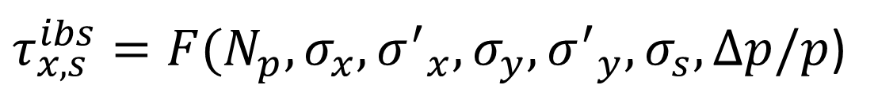
EIC Luminosity Limitations in making beam sizes at collision point small- hadron beam emittance
Intra beam Scattering: Lorentz boosted Coulomb scattering of protons in the bunch leads to transverse and longitudinal emittance growth ➔ very short high luminosity lifetime
$τ_{x,s}^{ibs}=F(N_{p},σ_{x},{σ^{′}}_{x},σ_{y},{σ^{′}}_{y},σ_{s},Δp/p$)
Limits the densities N_{p}/s in all six phase space dimensions
Can be overcome by hadron cooling, but …
- However cooling is extremely difficult for GeV energies
- Fermilab achieved cooling of 8 GeV pbars by a DC Pelletron, a 4 MV DC accelerator with energy recovery
BNL achieved cooling of 5.2 GeV ions with RF accelerated electrons
- Acceleration of multi 10 to 100 GeV beams requires new technologies ➔ major technology challenge for EIC

Slide 7
EIC Luminosity Limitations in making beam sizes at collision point small- electron beam emittance
Electron beam emittance can be obtained by lattice design in the arc
E_{e}~D_{x}²/β_{x}
Strong focusing in the arc gives small dispersion and thus small emittance
Strong focusing has a soft limit somewhere above 100 degree betatron
phase advance/FODO cell (for affordable FODO lattice)
Fortunately, with the large circumference and large bending radius of the EIC (250m), all required electron emittances can be achieved with a comfortable focusing range of 60-90 degree per FODO cell)

Slide 8
EIC Luminosity Limitations in making beam sizes at collision point small- electron beam emittance
Electron beam emittance can be obtained by lattice design n the arc
E_{e}~D_{x}²/β_{x}
Strong focusing in the arc gives small dispersion and thus small emittance
Strong focusing has a soft limit somewhere above 100 degree betatron phase advance (for affordable FODO lattice)
Fortunately, with the large circumference and large bending radius of the EIC (250m), all required electron emittances can be achieved with a comfortable focusing range of 60-90 degree per FODO cell)

Slide 9
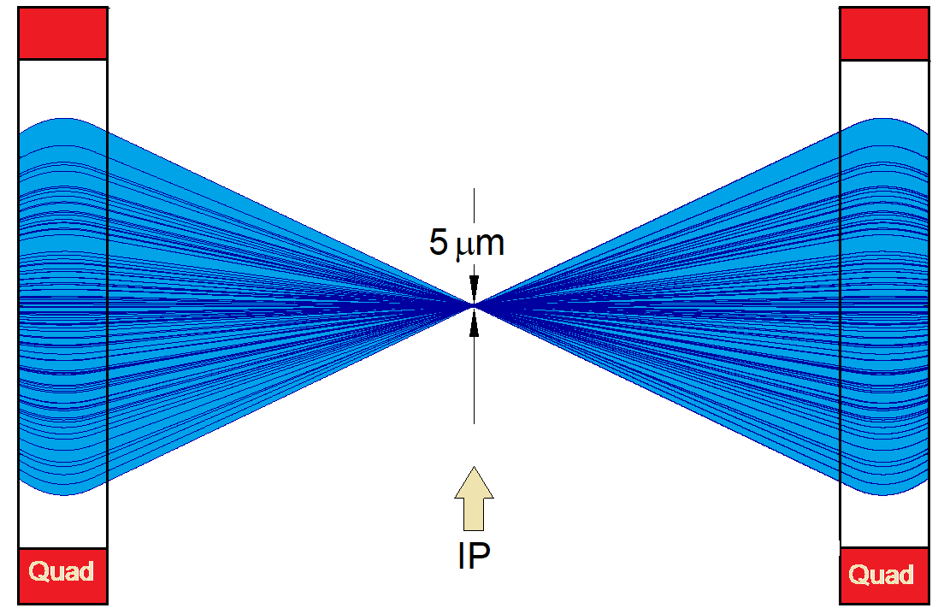
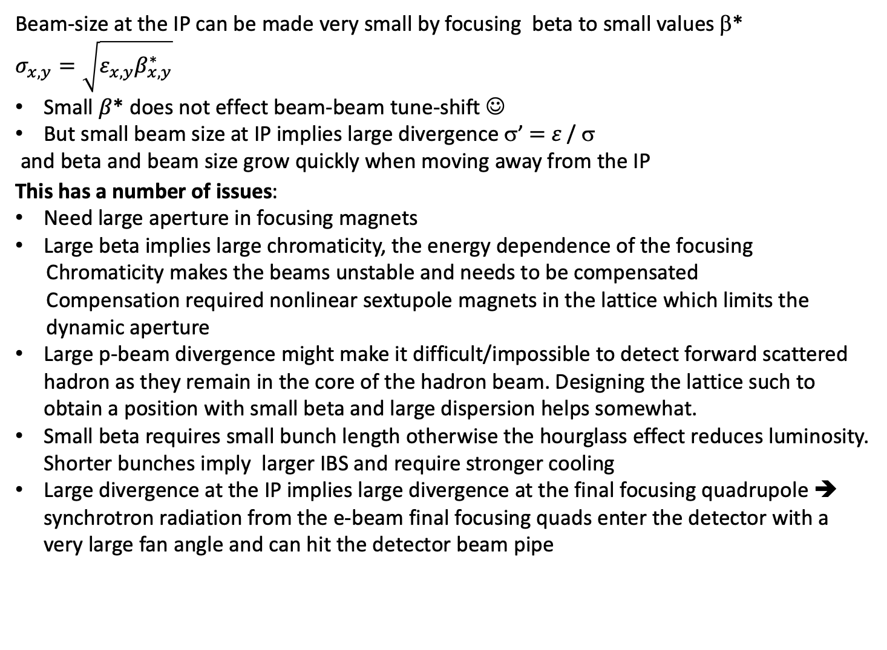
EIC Luminosity Limitations for small beta β*
Beam-size at the IP can be made very small by focusing beta to small values β*
$$σ_{x,y}=\sqrt{ε_{x,y}β_{x,y}^{∗}}$$
Small $β$* does not effect beam-beam tune-shift ☺
But small beam size at IP implies large divergence σ’ $=$ $ε$/ σ
and beta and beam size grow quickly when moving away from the IP
This has a number of issues:
Need large aperture in focusing magnets
Large beta implies large chromaticity, the energy dependence of the focusing
Chromaticity makes the beams unstable and needs to be compensated
Compensation required nonlinear sextupole magnets in the lattice which limits the
dynamic aperture
Large p-beam divergence might make it difficult/impossible to detect forward scattered hadron as they remain in the core of the hadron beam. Designing the lattice such to obtain a position with small beta and large dispersion helps somewhat.
Small beta requires small bunch length otherwise the hourglass effect reduces luminosity. Shorter bunches imply larger IBS and require stronger cooling
Large divergence at the IP implies large divergence at the final focusing quadrupole ➔ synchrotron radiation from the e-beam final focusing quads enter the detector with a very large fan angle and can hit the detector beam pipe

Slide 10
Design strategy for 1st IR
For each center of mass energy, 20 GeV – 140 GeV:
Find the maximum single bunch collision parameters N_{e,p}, σ_{x,y}
Iterate making sure it
  …has tolerable beam-beam tune shift,
  …keeps the hourglass effect low,
  …keeps manageable IBS rates and hadron cooling time (2h for 275 GeV beam),
  …has betas allow designing an IR with realistic magnets at realistic distances
  …requires only a moderate crossing angle
  …has beta with manageable IR chromaticity and sufficient dynamic aperture
  …provides sufficient acceptance
  …does not lead to depositing synchrotron radiation on the detector pipe.
Increase the number of bunches until the maximum e-beam current and RF power limit is reached

Slide 11
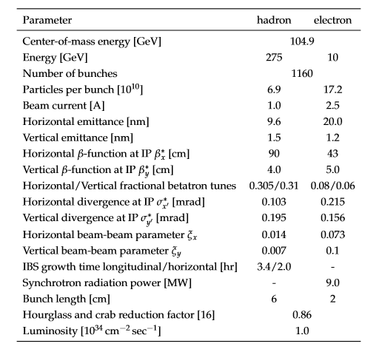
pCDR Parameters list for E_{cm}= 105 GeV

Slide 12
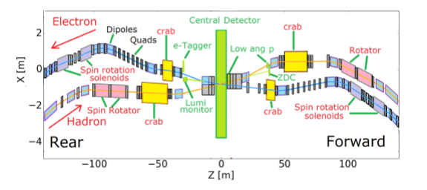
pCDR Solution of the IR

Slide 13
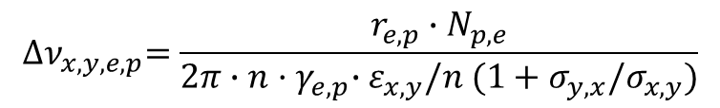
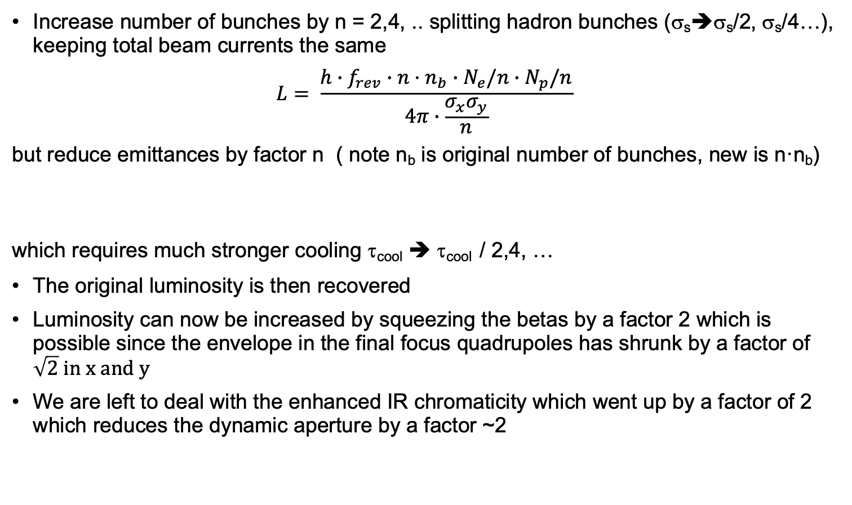
Strategy for higher luminosity at low E_{cm}
Increase number of bunches by n = 2,4, .. splitting hadron bunches (σ_{s}➔σ_{s}/2, σ_{s}/4…), keeping total beam currents the same
$$L= \frac{{h∙f}_{rev}∙{n·n}_{b}∙N_{e}/n∙N_{p}/n}{4π∙\frac{σ_{x}σ_{y}}{n}}$$
but reduce emittances by factor n ( note n_{b} is original number of bunches, new is n·n_{b})
which requires much stronger cooling τ_{cool} ➔ τ_{cool} / 2,4, …
The original luminosity is then recovered
Luminosity can now be increased by squeezing the betas by a factor 2 which is possible since the envelope in the final focus quadrupoles has shrunk by a factor of $\sqrt{2} in x and y$
We are left to deal with the enhanced IR chromaticity which went up by a factor of 2 which reduces the dynamic aperture by a factor ~2
$${∆ν}_{x,y,e,p}=\frac{r_{e,p}∙N_{p,e}}{2π∙n{·γ}_{e,p}∙ε_{x,y}/n (1+σ_{y,x}/σ_{x,y})}$$

Slide 14
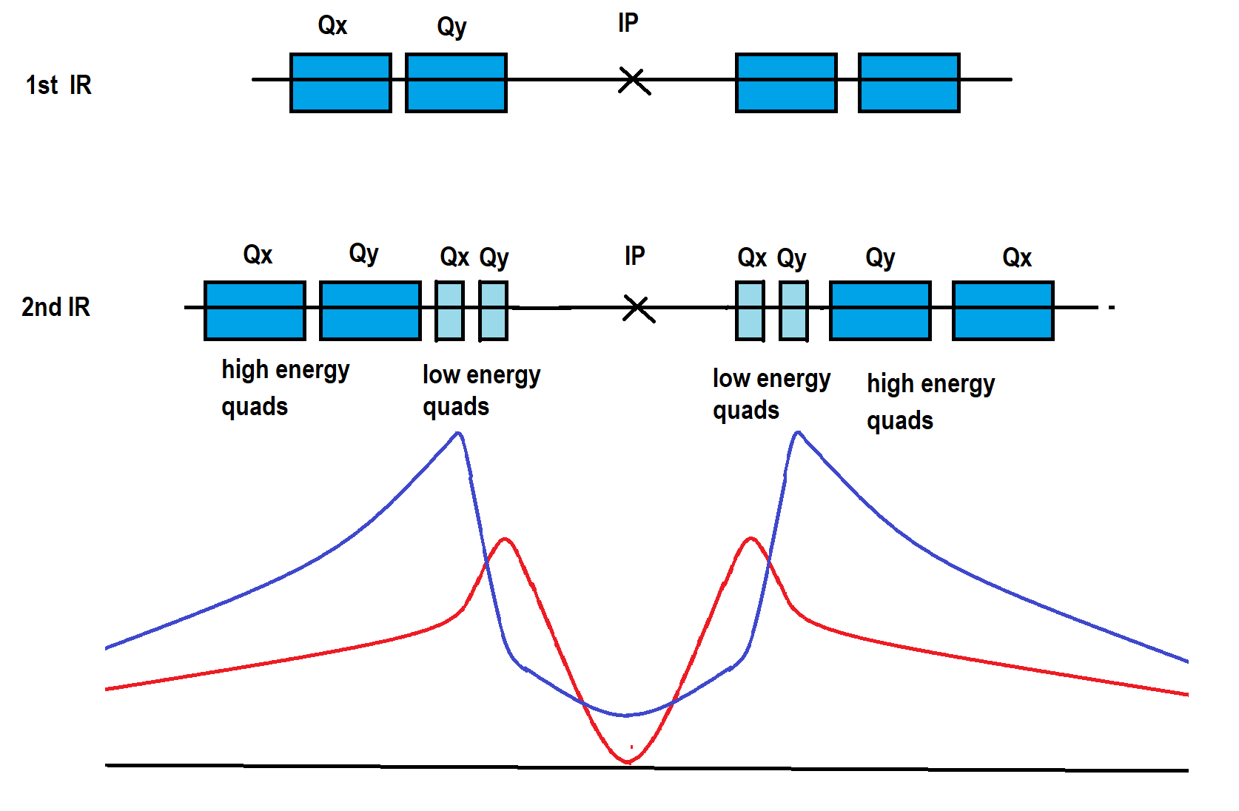
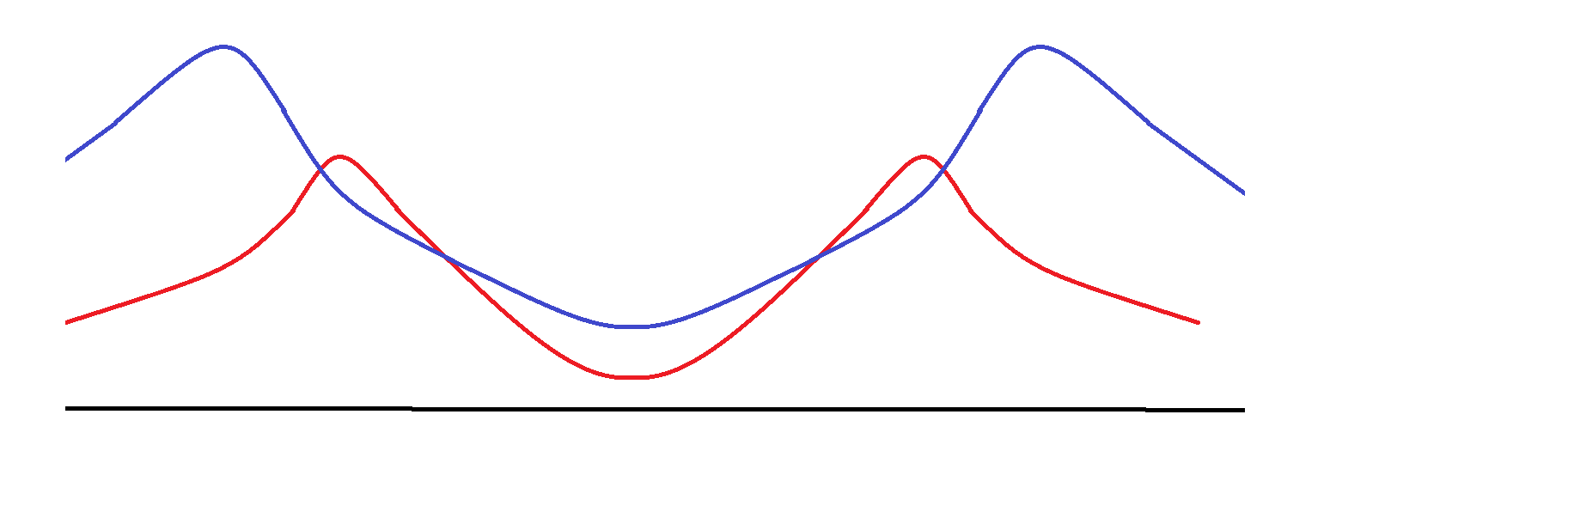
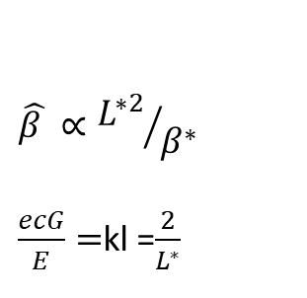
How to reduce IR chromaticity?
Increase crossing angle to get final focus quadrupoles closer to IP
θ_{cross} ➔θ_{cross} x 2
Electrons: final focuss qudrupoles in the detector
Hadrons
$$\hat{β }∝{L^{∗2}}/{β^{∗}}$$
$\frac{ecG}{E}=$kl =$\frac{2}{L^{∗}}$
L*
Low energy optics
High Energy optics

Slide 15
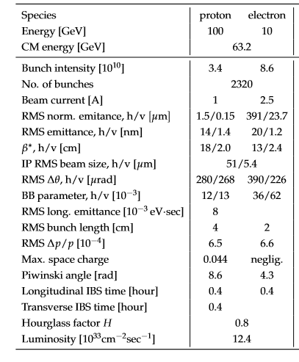
pCDR Parameters for optics optimized for low energy *)
*) Note:
For this exercise we made similar assumptions as those has been made for JLEIC which may be considered quite optimistic. Dynamic apertures, acceptance, synchrotron radiation and other things as outlined before was not checked

Slide 16
Wrap up
Luminosity at low E_{cm} can be increased w.r.t. present “nominal” solution by
Increasing the number of bunches, reduce bunch length (factor 2 ?)
Decreasing β* by same factor ➔ Luminosity increases by the same factor 2
Increasing hadron cooling rates significantly, significantly more than increase in luminosity (ok at low hadron energy?) to get smaller transverse emittance
Introducing an inner quadrupole doublet pair which will run out of strength at E_{p} = 60 GeV
Need more longitudinal space in the IR for additional crab cavities (difficult, L_{ss} < 200m)
Crab cavities need at certain phase advance to the IR, unclear whether that is possible, ++>run low energy optics without || polarization in 2nd IR?
Bunches are shorter now, which reduces residual crab effects
At high cm energies (E_{p}> 60 GeV Ecm>50 GeV) the luminosity will be lower than nominal

Slide 17
EIC Luminosity versus E_{CM} center of mass energy
as presented in previously
EIC
Optimization for low E_{cm}
EIC
Optimization for high E_{cm}
Annual Integrated Luminosity [fb⁻¹]
Peak Luminosity [cm⁻²s⁻¹]
10³⁴
10³³
10³²
100
10
1
Tomography (p/A)
Spin and Flavor Structure of
the Nucleon and Nuclei
Internal
Landscape of the Nucleus
QCD at Extreme Parton Densities-
Saturation
150
Center of Mass Energy E_{cm} [GeV]

Slide 18
At this point, you can go back to my presentation on 2 IRs I presented at the last yellow report meeting …

