Slide 1
Physics Working Group:
overview and progress report
Dumitru, O. Evdokimov, A. Metz, C. Muñoz Camacho
(input from all physics working groups)

Slide 3
Charge for Pavia Workshop
Straw-man plan of attack:
a. Review previous existing work related to your subgroup.
b.Converge on a set of important and representative measurements for your subgroup.
c. Break-down physics deliverables into “physics objects” (PO) [electron, hadron (ID/noID), muon, jet]; map out kinematics for each PO.
d.Cross-check PO maps across physics subgroups to determine the most challenging constraints in terms of detector design; resolve overlaps [decide who runs what].
e.Focus on fast simulations for the most demanding measurements first; determine the optimal/acceptable detector performance; confirm/check resulting impact on the rest of the measurements
Presented at the Temple meeting

Slide 4
Simulation baseline parameters
Based on the current BNL design, we suggest, as a starting point for our physics simulations,
to study one or several of the following beam energy combinations:
p-e | 275 on 18 GeV | 100 on 10 GeV | 100 on 5 GeV | 41 on 5 GeV
d/³He/⁴He-e | 110 on 18 GeV | 110 on 10 GeV |  | 41 on 5 GeV
C/⁴⁰Ca/Cu-e | 110 on 18 GeV | 110 on 10 GeV |  | 41 on 5 GeV
Au-e | 110 on 18 GeV | 110 on 10 GeV |  | 41 on 5 GeV
(For nuclei the energy refers to the energy per nucleon)
Please assume integrated luminosities of 10 fb⁻¹ and 100 fb⁻¹
A polarization of 70% may be assumed for electrons and light ions

Slide 5
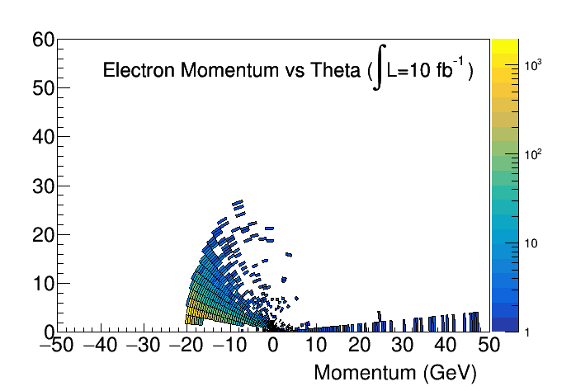
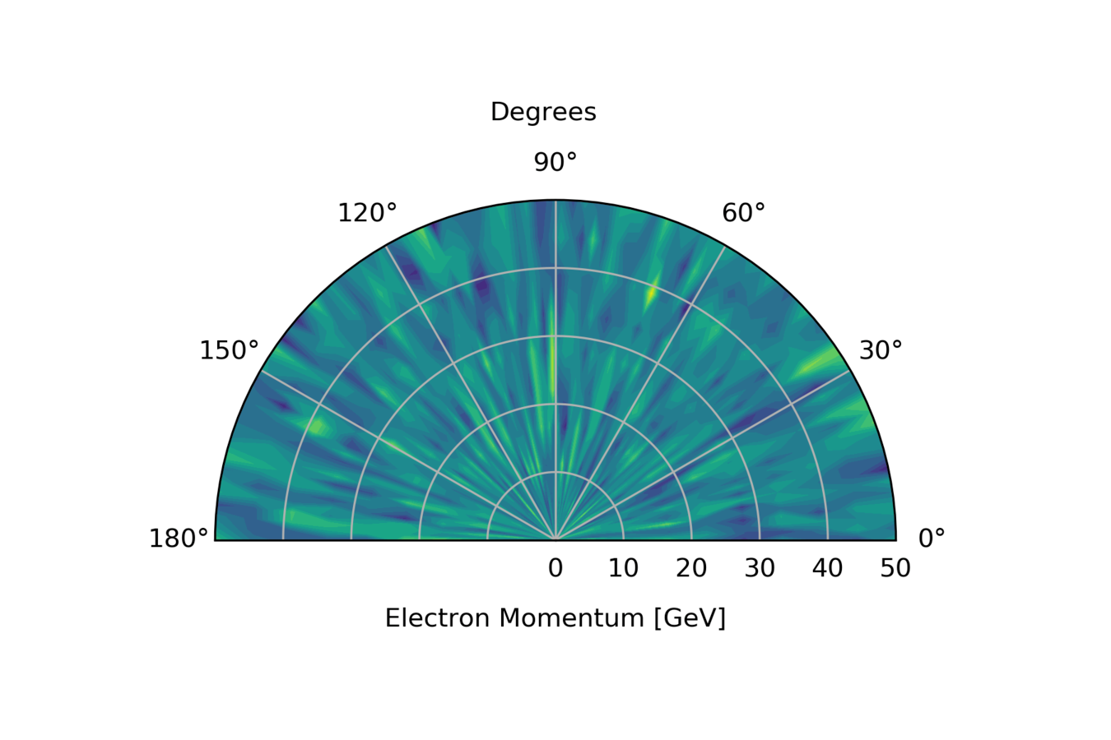
Simulation Tools and Information Flow
To ensure reproducibility of YR studies and consistency across simulations for different processes/working group, the prefered solution is to converge on a single simulation tool (for each detector region): EIC-smear, EICRoot
Coordination with Software team to establish versioning/ coherent implementation of Detector response parametrizations
Have a common data-exchange format for kinematic maps
https://wiki.bnl.gov/eicug/index.php/Yellow_Report_Physics_Common#Standard_histogram_to_display_kinematic_coverage

Slide 6
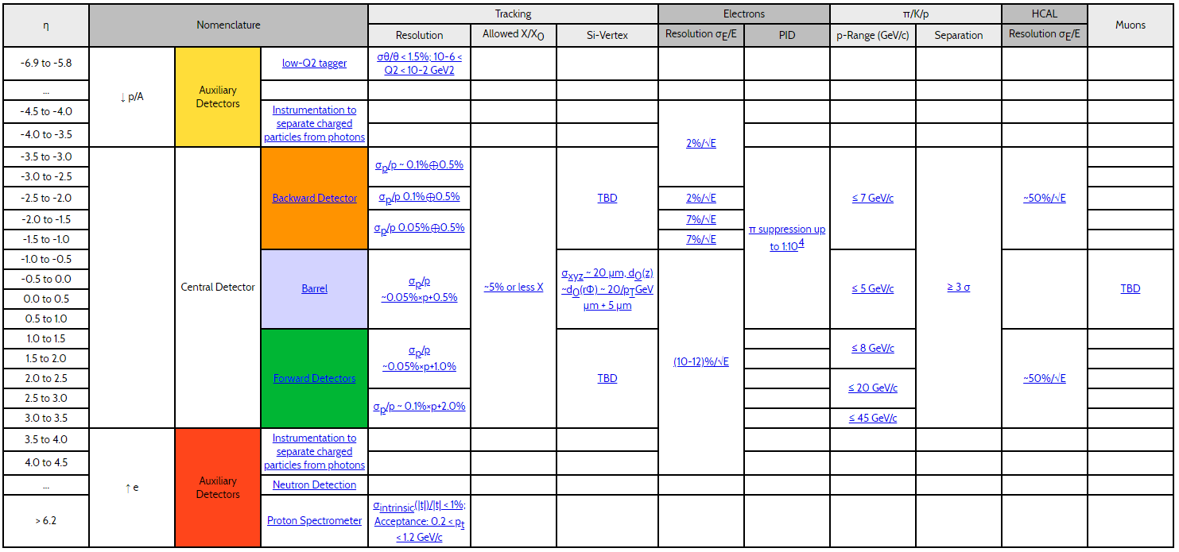
Exchanges with DWG
Document studies/results in the wiki: https://wiki.bnl.gov/eicug/index.php
Send information to the detector group in order to update the interactive detector matrix
https://physdiv.jlab.org/DetectorMatrix/

Slide 7
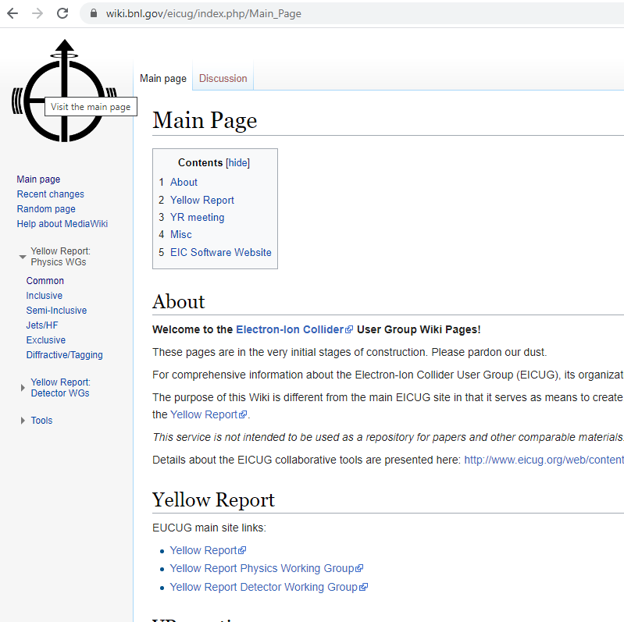
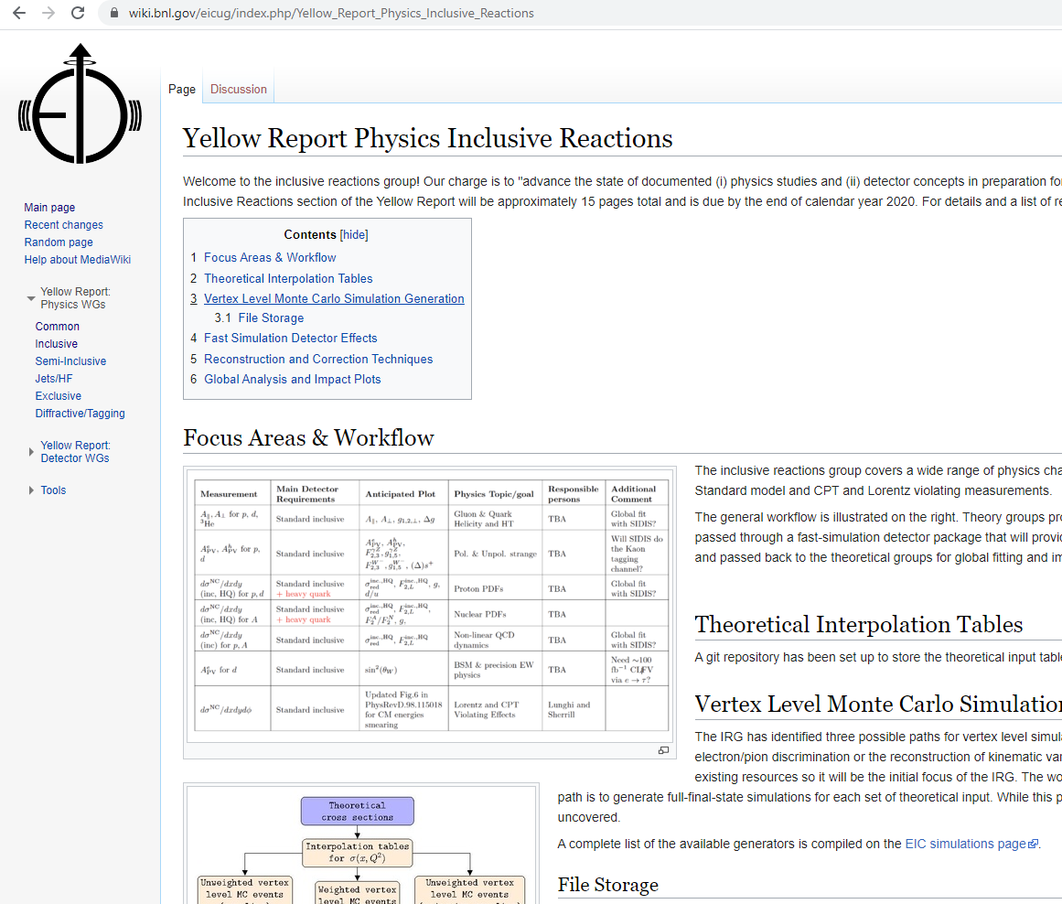
YR Wikipages

Slide 8
Inclusive physics working subgroup
Pavia YR Meeting
Barak Schmookler, Nobuo Sato, Renee Fatemi

Slide 9
Summary of studied channels: kinematics
Note : Each kinematic map represents several physics channels
Measurement/process | Main detector requirement | Expected YR plot | Physics goal/topic | Contact person | Comments
Neutral current e-p cross-sections and asymmetries | EMcal for e- energy, Tracker to reconstruct e- momentum and scattering angle, provide e/h discrimination (via E/p) and e+/e- separation | A||, A⟘, A^{e}_{PV} g_{1,2}, g^{ɣZ}_{1,5} F₂, F_{L}, F^{ɣZ}_{2,3} ∆g, g, ∆s⁺, s⁺ 𝛔^{NC}_{red}, sin²𝛉_{w} | Gluon and quark proton momentum & helicity PDFs. Non-linear QCD dynamics. | Barak Schmookler | e-p 10-100 e-p 5-41 e-p 5-100 e-p 18-275 e+/pion maps? e-A?
Charged current e-p cross-sections and asymmetries | EMcal, HCal and tracker for E and p of hadronic recoil. Need low thresholds and as forward as possible. | A^{h}_{PV}, 𝛔^{Cc}_{red,} ∆u/u, ∆d/d, high x sbar | Polarized and unpolarized sea quark asymmetries | Xiaoxuan Chu | e-p 18-275

Slide 10
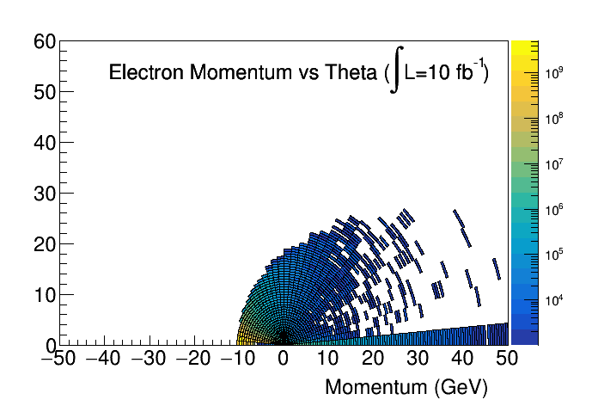
Neutral Current: kinematics 10x100
PYTHIA6, no radiative effects. All electrons, scattered + decay
Largest yield is for electrons scattered backwards (toward the electron beam-pipe)
Highest momentum electrons scatter at mid to mid-forward rapidity.
High momentum electrons at large angle original from meson decay.

Slide 11
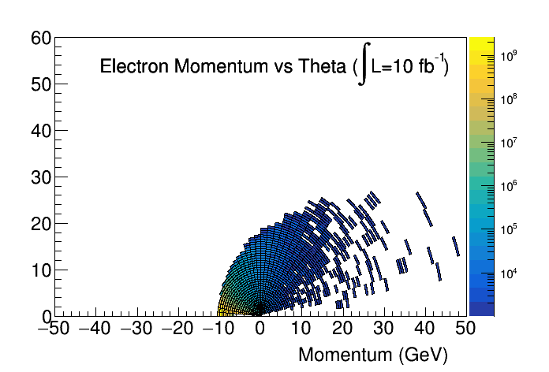
Neutral Current: kinematics 10x100
PHYTHIA 6, no radiative effects. All electrons, scattered + decay
Largest yield is for electrons scattered backwards (toward the electron beampipe)
Highest momentum electrons scatter at mid to mid-forward rapidity.
High momentum electrons at large angle original from meson decay. These are removed when looking at only the scattered beam electrons.

Slide 12
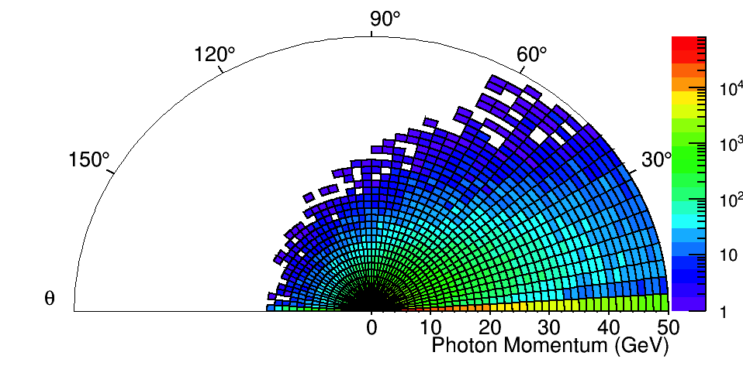
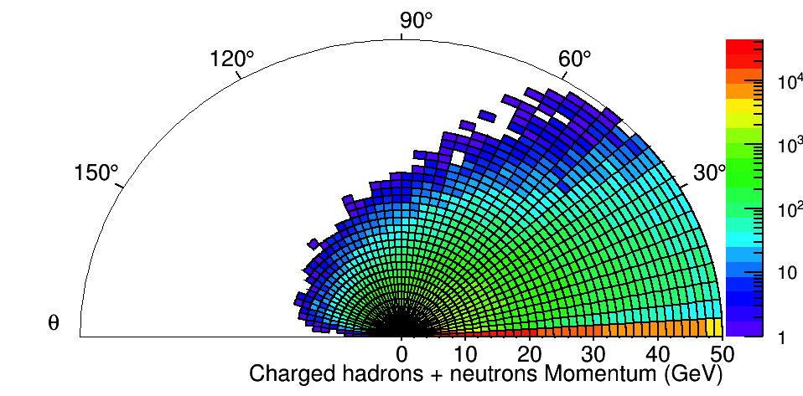
Charged Current: kinematics
Highest momentum gamma go down the proton (+z) beamline
Mid-range momentum photons from pion decay contribute in the forward (mid-forward eta) region.
Peaked backward (-z) direction gamma come from e- radiation
High momentum hadrons from the beam remnant go down the beampipe (+z)
Fragmentation hadrons from scattered quark are produced at mid-range (mid-forward eta) region.
Need detector to be pushed as far forward as possible.

Slide 13
Summary of studied channels: fast simulations
Measurement/process | Main detector requirement | Expected YR Plot | Physics goal/topic | Contact person | Comments
Charged current e-p cross-section | EMcal, HCal and tracker for E_{h} and p_{h} of hadronic recoil. Need thresholds to be as low as possible and detectors extending as far forward as possible. | 𝛔^{Cc}_{red}, sbar | Sea quark distributions in the proton | Xiaoxuan Chu | Radiation, detector acceptance and PID effects studied. EIC smearing studies ongoing.
Neutral current e-p cross-section | EMcal for E_{e-} and tracker for p_{e-}, scattering angle, e/h discrimination (via E/p) and e+/e- separation | 𝛔^{Nc}_{red} , g, d/u | Proton PDFs | Xiaoxuan Chu Barak Schmookler | Generator level cross-section and EIC-smear studies ongoing.
g₂ | Same at NC e-p cross-section | g₂(x) vs Q² | Quark and gluon helicity and higher Twist | Matt Posik | Generator level cross-section comparison to theory.
A^{e}_{PV} | Same as NC e-p cross-section | A^{e}_{PV} | Polarized and unpolarized strange PDFs | Hanjie Liu | Generator level PID studies.

Slide 14
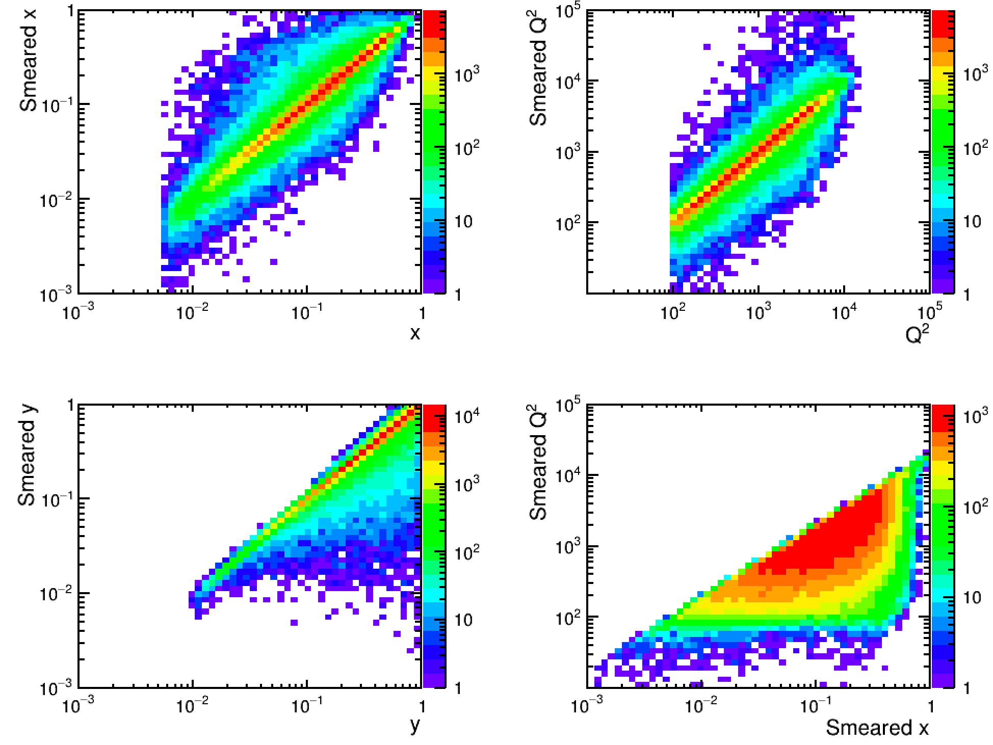
Charged Current Cross-section: smeared kinematics
Work of Xiaoxuan Chu - https://indico.bnl.gov/event/8389/
Django e+p = 18 + 275 GeV, √s = 141 GeV
Radiative effects turned on.
L = 10 fb⁻¹, 0.01 < y < 0.95, 100 < Q² < 10⁵ GeV².
EIC Smear input:
Device SmearThetaHadronic(Smear::kTheta, "0.001");
HCAL -3.5 < η < -1.0 : sigma_E/E ~ 0.45/sqrt(E)+0.06
HCAL -1.0 < η < 1.0 : sigma_E/E ~ 0.85/sqrt(E)+0.07
HCAL 1.0 < η < 3.5 : sigma_E/E ~ 0.45/sqrt(E)+0.06
TRACKER -3.5 < η < -2.5 : sigma_p/p ~ 0.1% p+2.0%
TRACKER -2.5 < η < -1.0 : sigma_p/p ~ 0.05% p+1.0%
TRACKER -1.0 < η < 1.0 : sigma_p/p ~ 0.05% p+0.5%
TRACKER 1.0 < η < 2.5 : sigma_p/p ~ 0.05% p+1.0%
TRACKER 2.5 < η < 3.5 : sigma_p/p ~ 0.1% p+2.0%
Reduced cross-section extracted using Jacquet-Blondel (JB) kinematic reconstruction

Slide 15
Semi-inclusive
physics working subgroup
Pavia YR Meeting
Ralf Seidl (RIKEN), Justin Stevens (William & Mary), Alexey Vladimirov (Regensburg), Anselm Vossen (Duke), Bowen Xiao (Central Normal University)

Slide 16
Summary of studied channels: simulations
Measurement/process | Main detector requirement | Expected plot for the YR | Physics goal/topic | Contact person
Single hadron SIDIS | 𝜂 acceptance for hadrons • angular resolution • granularity of the detector ( -1 <𝜂< 4), • π/K/p identification • PID, Tracking, Δp/p, min p | pseudo-3D Sivers function vs (x,kt) • Value of Tensor charge uncertainties, h1 vs x • Q2 dependence of Sivers function or Collins at fixed x | 3D (𝑥, 𝑘T) Sivers Function, TMD Evolution, test of Sivers at inter. 𝑥, Tensor charge via Collins | Alexey Vladimirov
Comments: Use of existing simulations at Elke’s group + smearing + weights originating from theorists, weights for Sivers asymmetries prepared, Work on common database ongoing, integrate in SW environment, Theory work on fits/parameterizations. First impact studies for unpol.TMD and TMD evolution.
Di-hadron correlations in eA | backward hadron acceptance, sufficiently high resolution for the momentum (mainly high pT) and azimuthal angle (need 2\pi coverage). | decorrelation plot as in white paper | low x, Probe onset of saturation phenomena | Bowen Xiao
Comments: Continuation of work based on arXiv:1403.2413 with extension to jets with different algorithms using the new collisional energies at eRHIC.

Slide 17
Summary of studied channels: simulations
Measurement/process | Main detector requirement | Expected plot for the YR | Physics goal/topic | Contact person
Dijets and di-hadrons for Gluon Sivers | resolution for the momentum (mainly high pT) and azimuthal angle (2\pi coverage) | Size of the asymmetry as a function of 𝑥 | Probing the size of the gluon Sivers function | Bowen Xiao
Comments: Continuation of study based on arXiv:1805.05290 together with current EIC detector design • consideration of different jet algorithms (Elke, Zheng, Lee and Yin) • Possible different parameterizations of gluon Sivers function inputs from Pavia
Spectroscopy | • leptons from J/ψ • displaced vertex and π/K separation for open charm | Kinematic map of decay particles; mass resolution and sensitivity for J/ψπ, DD* final states | Representative spectroscopy channels : X, Y, J/ψππ, DD* | Justin Stevens
Comments: Custom generators with theory input, eic-smear for mass resolution etc., Pythia background estimation

Slide 18
Summary of studied channels: simulations
Measurement/process | Main detector requirement | Expected plot for the YR | Physics goal/topic | Contact person
Sea quark helicity measurements | hadron momentum and energy resolution in forward direction (2 < 𝜂 < 4) for CC events | Update of previous sea quark helicity PDF uncertainty plots | flavor separated (anti)quark helicity distributions over wide range of x | Ralf Seidl
Comments: Work will follow ongoing sensitivity studies by Elke’s group + Argentinian global fitters. • Implementation of detector smearing, etc needs to be added to existing studies. • Concentration on CC and 𝐷/3𝐻𝑒.

Slide 19
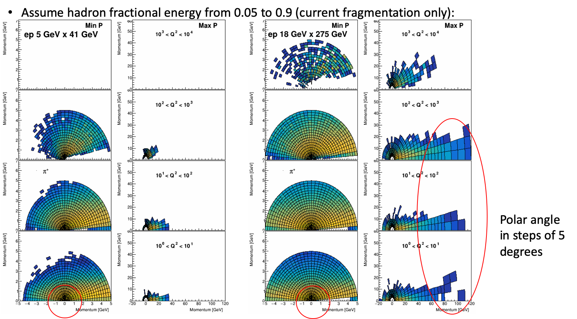
Results for Single hadron SIDIS: kinematics
pi/K separation
low mom.
hadrons

Slide 20
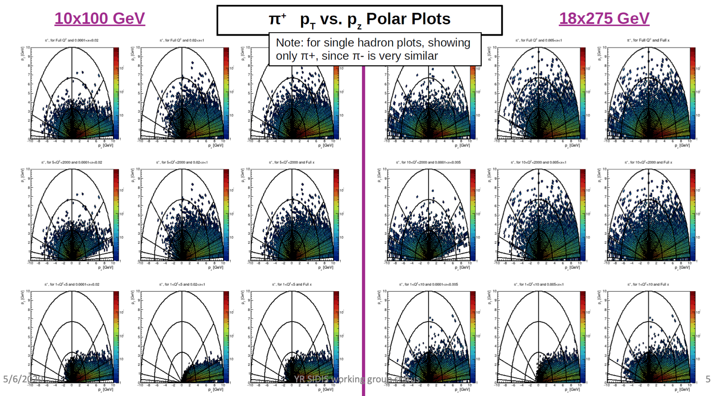
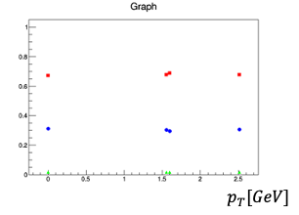
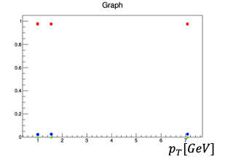
Results for Di-hadron Correlations: kinematics
PID Study of K𝞹 Purities
2 𝝈 K𝞹 separation
3 𝝈 K𝞹 separation

Slide 21
Results for Gluon Sivers: kinematics

Slide 22
Results for Gluon Saturation: kinematics

Slide 23
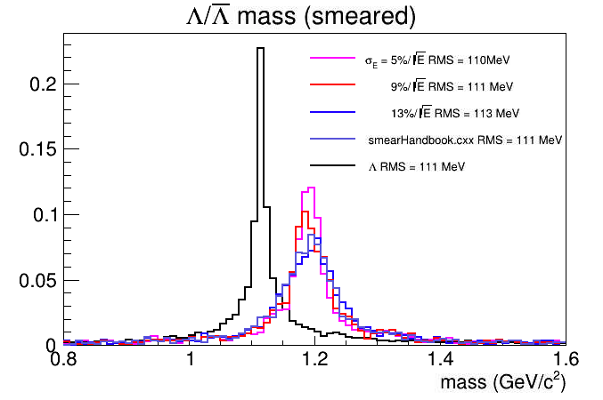
Results for Hyperons: kinematics + smearing
Λ mass resolution and Σ → Λɣ feeddown

Slide 24
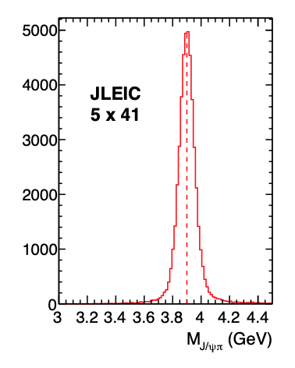
Results for Spectroscopy: kinematics + smearing
Smeared mass resolution

Slide 25
Jets and Heavy Flavor
physics working subgroup
Pavia YR Meeting
Leticia Cunqueiro, Brian Page, Frank Petriello, Ernst Sichtermann, Ivan Vitev

Slide 26
Summary of studied channels: simulations
Measurement/process | Main detector requirement (if known/anticipated) | Expected plot for the YR | Physics goal/topic | Contact person | Comments
Open heavy flavor Mesons Λ_{c} Leptons Displaced tracks | Momentum resolutions dp/p over 2-3% or better for invariant mass reconstruction; challenging B.dl in very forward region; Currently ideal PID assumed, to be investigated further; Several displaced vertex resolution studies ongoing (implications for pixel size) | Heavy meson modification vs fragmentation fraction z, Structure functions, e.g. F2-charm | Heavy flavor production, energy loss, hadronization Gluon content of the nucleon and nuclei | Prior JLab and BNL work, X. Li, X. Dong, | Nearing completion
Quarkonia / Exotics | Tracking performance consistent or better than the EIC handbook requirement. Good electron ID, muon ID | Quarkonium suppression vs p_{T}, rapidity | Quarkonium interactions in matter Threshold production | M. Durham | Nearing completion
Jet Angularity (Photoproduction) | High efficiency and resolution tracking. Calorimeter spatial resolution requirements need to be investigated | Shift in angularity spectrum for different detector configs | Cold nuclear matter effects; access to NP shape function; detailed Monte Carlo tuning | B. Page | Nearing completion

Slide 27
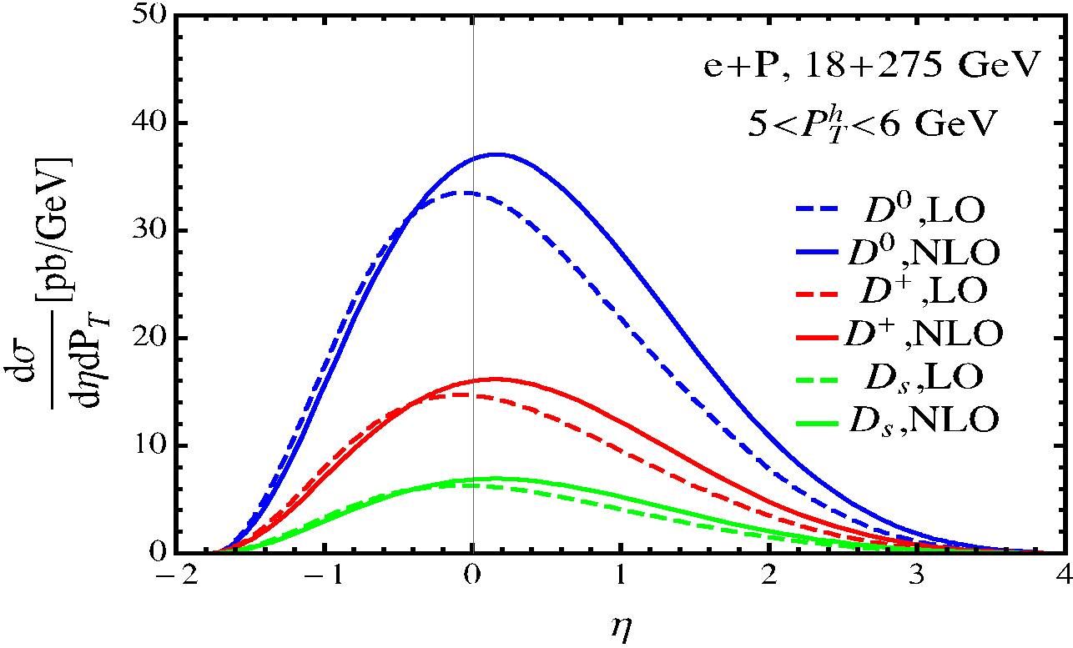
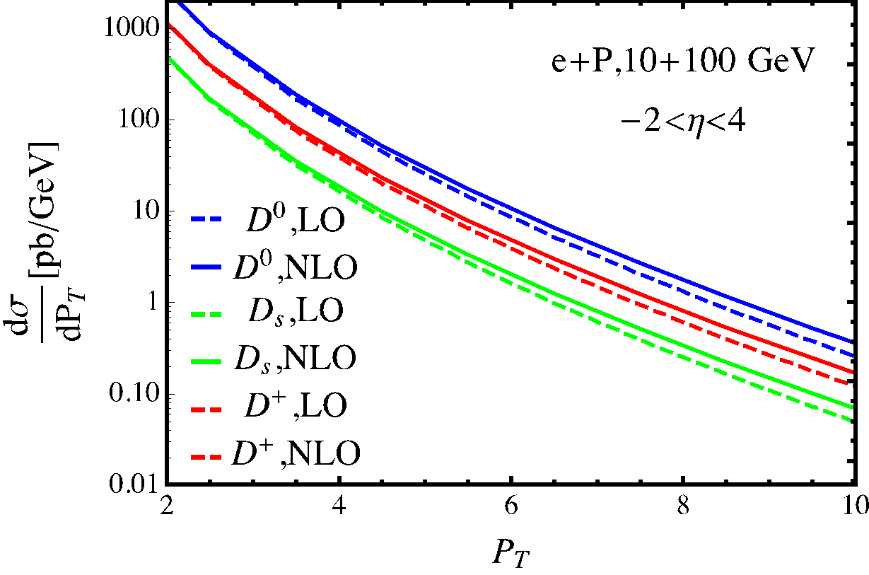
Results for open heavy flavor: kinematics
Kinematic distributions up to NLO where possible
Mid rapidity to forward coverage. For this measurement - moderate to high momenta
eta | theta [deg] | pT for p=10 [GeV]
0 | 90 | 10
1 | 40.4 | 6.5
2 | 15.4 | 2.7
3 | 5.7 | 1
4 | 2.1 | 0.4

Slide 28
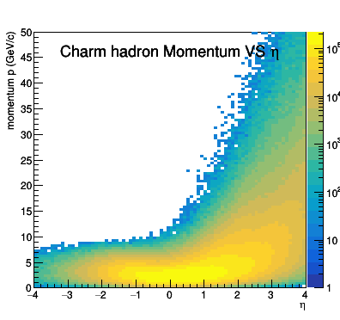
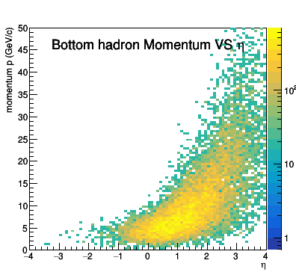
Results for open heavy flavor: kinematics
Example: Charm mesons through various decay channels (K, pi, semileptonic): 10 GeV electron + 100 GeV proton with integrated luminosity at 10 fb⁻¹. Minimum Q² = 10 (GeV/c)²
Charm hadrons
Decay products: pi, K, e
Have maps for various energy combinations. , also B mesons
Mid rapidity to forward coverage. Moderate momenta going to high at forward angles
Bottom hadrons

Slide 29
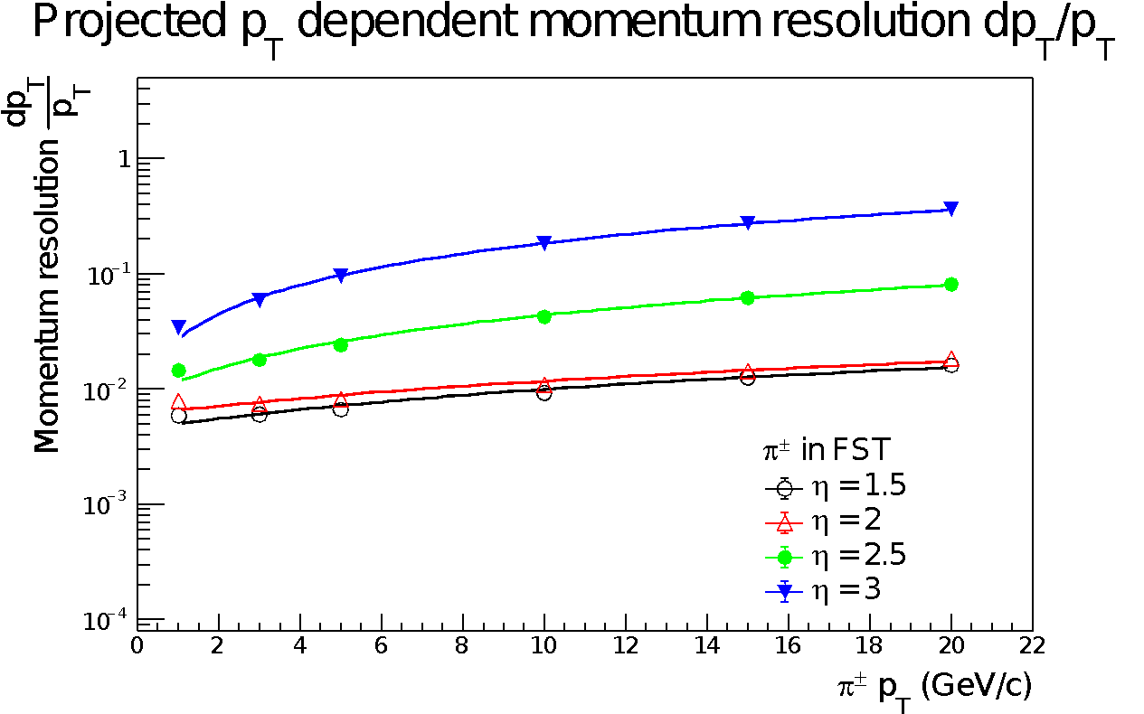
Results for D, B mesons: fast simulation
Example: in fast simulation 18 GeV electron + 100 GeV proton int. luminosity at 10 fb⁻¹. Track pseudorapdity cut: 1 to 3.
Assumption a hybrid design of MAPS (0.4%X₀) and HV-MAPs (0.8%X₀) – forward tracker
Vertex spatial resolution smeared.
Pseudorapidity dependent tracking momentum and spatial resolution smeared.
95% tracking efficiency.
100% PID identification.

Slide 30
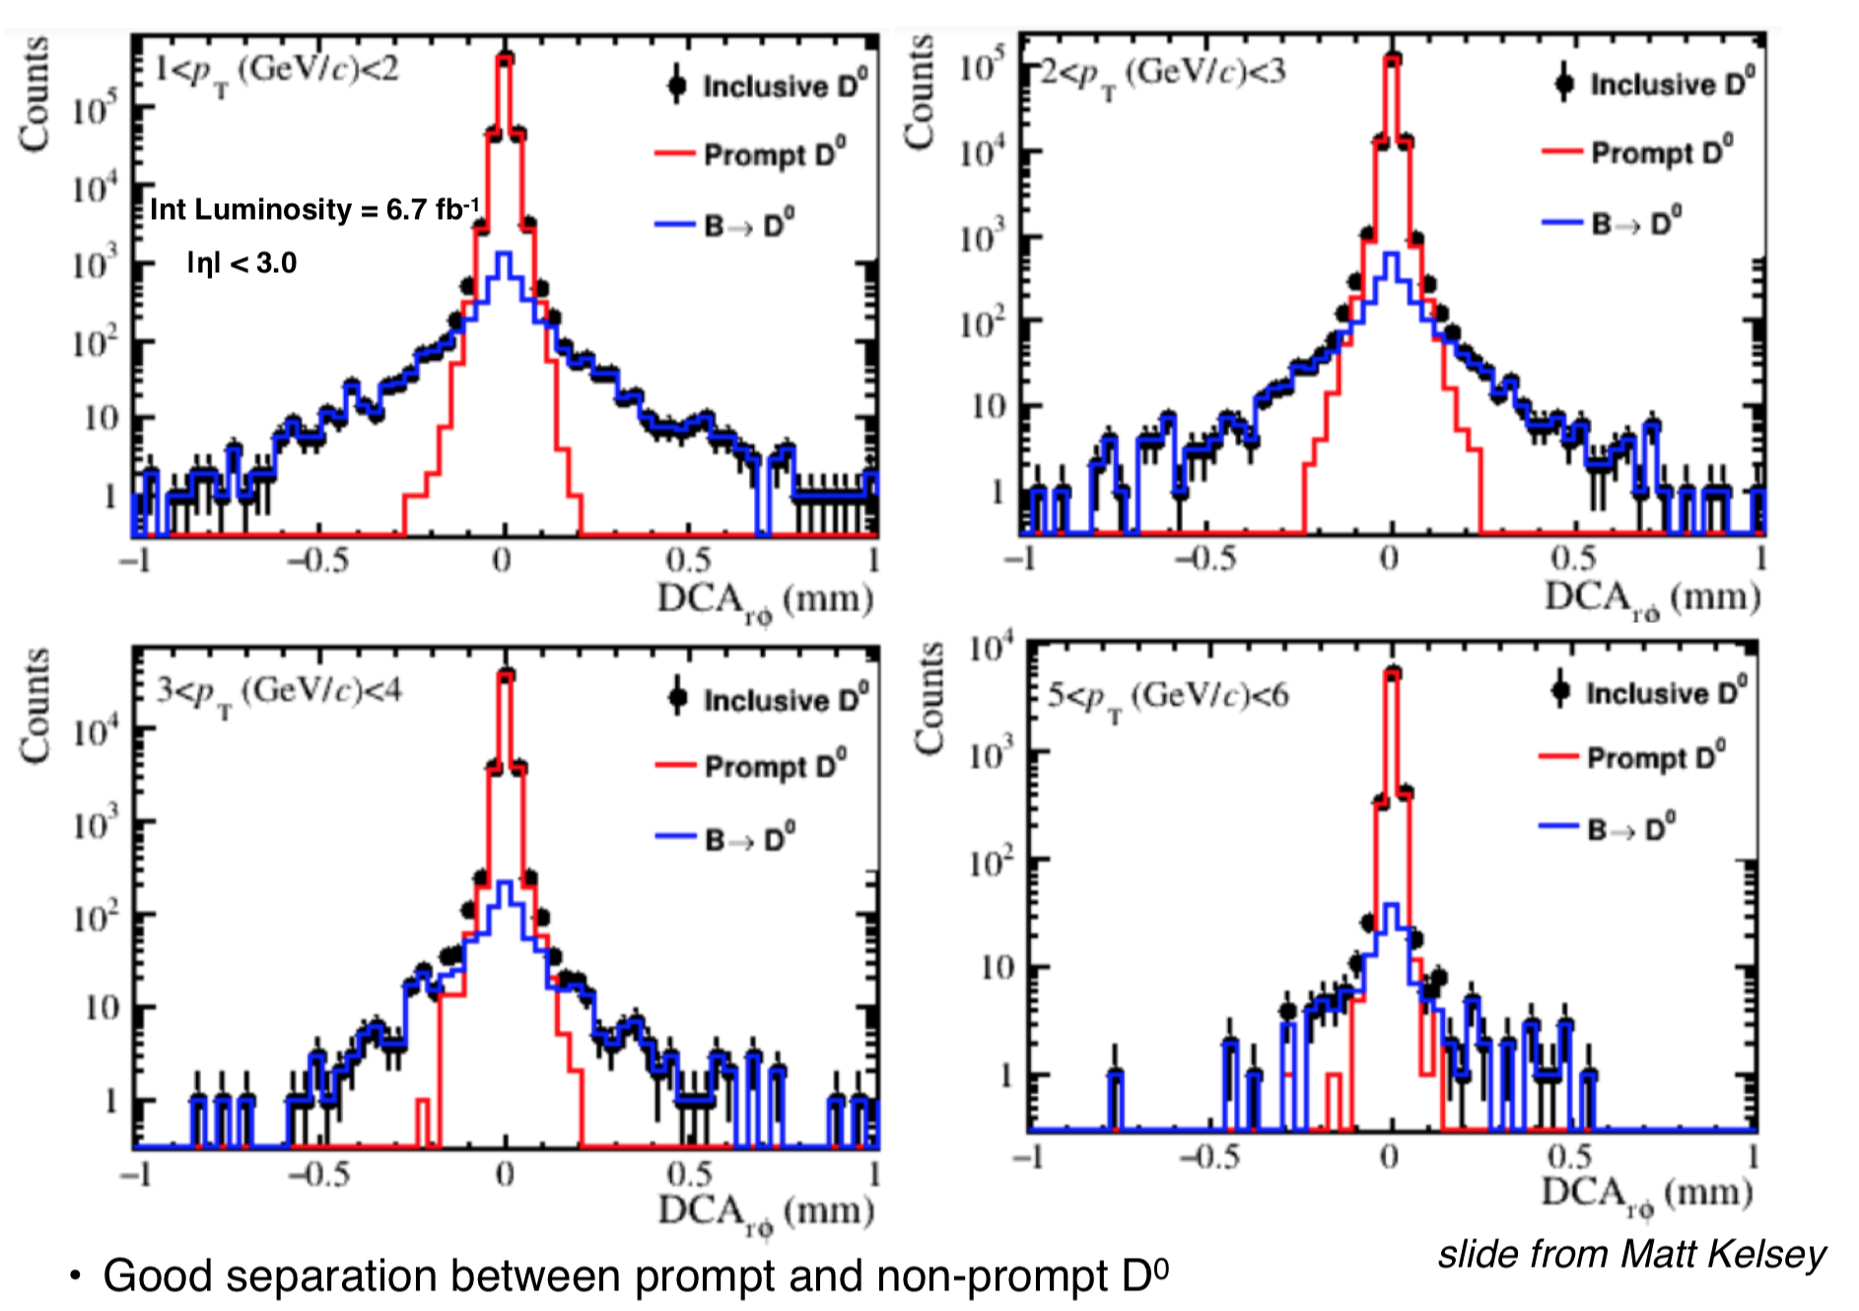
Results for B reconstruction with vertexing
Example: D0 → k,pi:
20 GeV electron + 100 GeV proton with integrated luminosity 10 fb⁻¹. Minimum Q² = 1 (GeV/c)²
Momentum resolutions taken from Detector Matrix

Slide 31
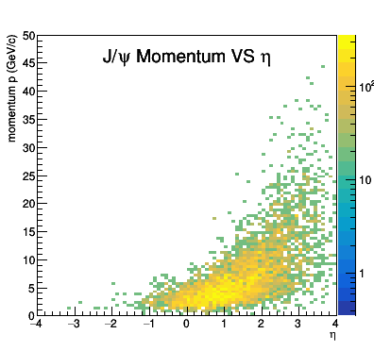
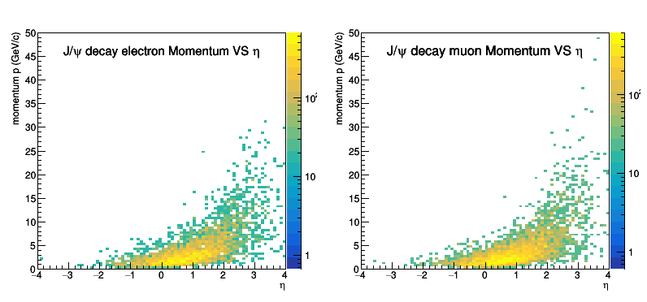
Results for quarkonia: kinematics
Example Charm through various decay channels (k,pi,semileptonic): 18 GeV electron + 275 GeV proton with integrated luminosity at 10 fb⁻¹. Minimum Q² = 10 (GeV/c)²
J/psi
Decay products: electrons, muons
Similar mid to forward rapidity distribution. Upsilon counts are much fewer
For this measurement - somewhat smaller energies/pT coverage than charm

Slide 32
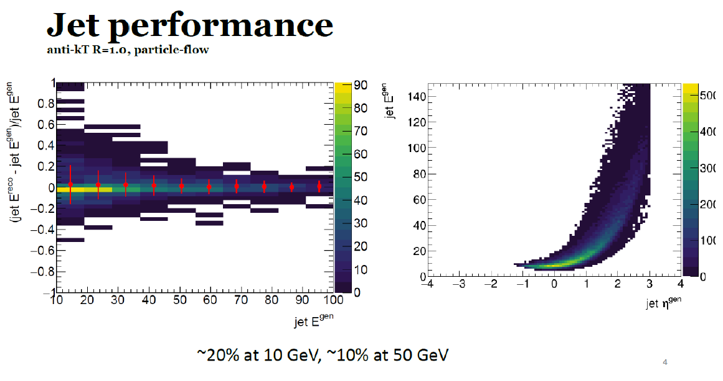
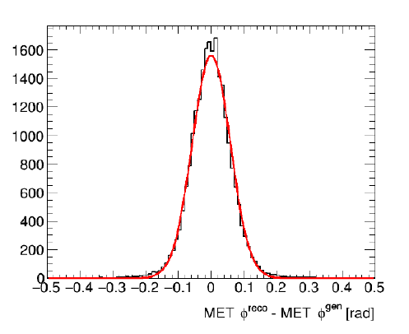
Jets for 3D imaging
Neutrino 𝜑-angle

Slide 33
Results for Jet Angularity: Cuts
Photoproduction Region: 10⁻⁵ < Q² < 1 (0.01 < y < 0.95)
Cluster all stable particles with |eta| < 3.5 (excluding scattered electron)
Find jets using Anti-k_{T} with R=0.8 and R=0.4; Only consider jets with p_{T} > 10 GeV and |eta| < 3.5 – R
Note:
Low Q² only, higher Q² -> higher momentum particles
No cuts on minimum particle p_{T} or energy
Lowering jet p_{T} cut will enhance numbers of low momentum particles and extend range in negative eta
Plot momentum (energy) vs theta for all charged hadrons, photons, and neutral hadrons in jets

Slide 34
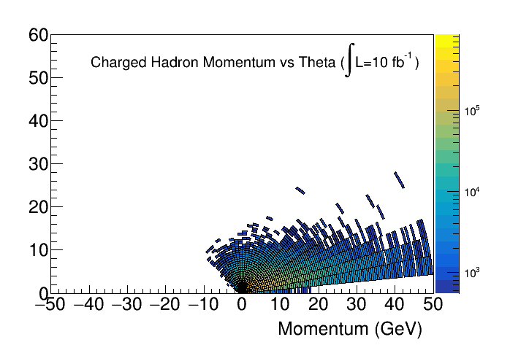
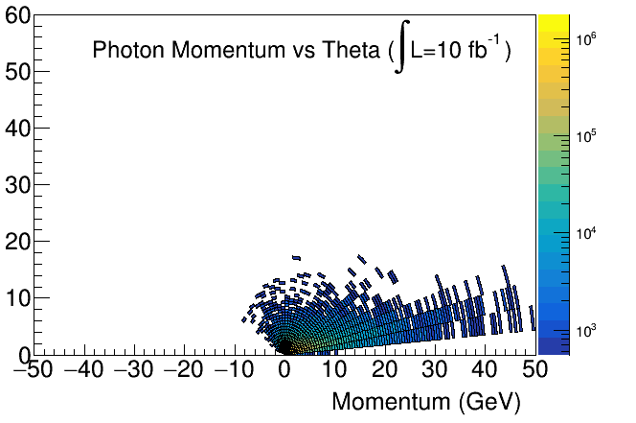
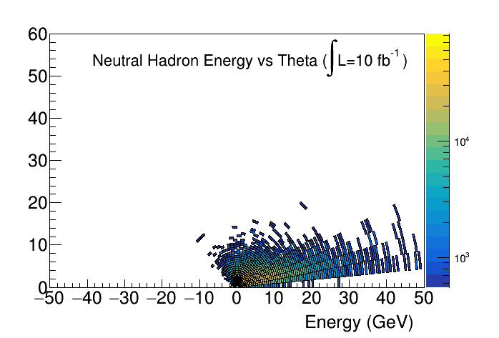
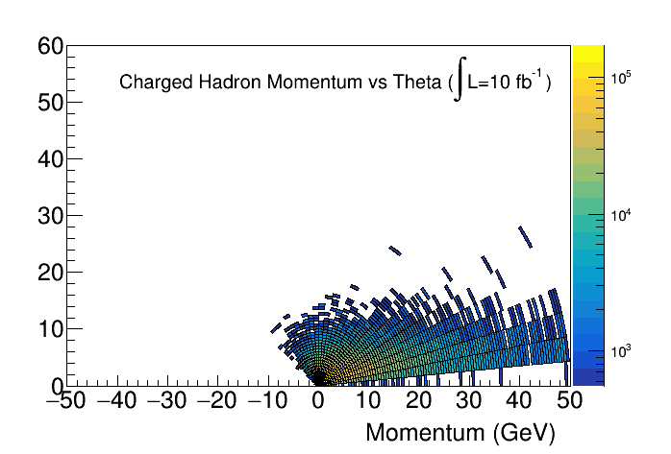
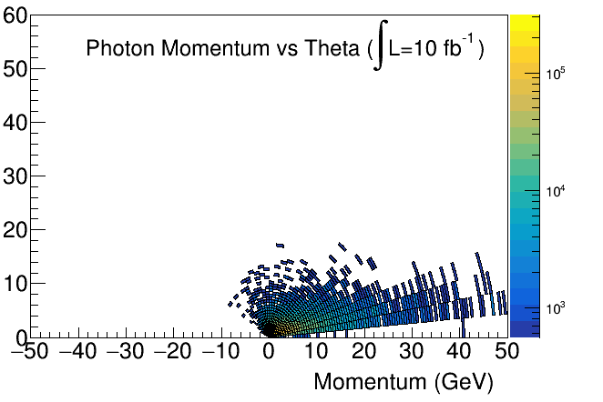
Results for Jet Angularity: Kinematic Plots
R = 0.8
R = 0.4

Slide 35
Other channels
Measurement/process | Main detector requirement (if known/anticipated) | Expected plot for the YR | Physics goal/topic | Contact person | Comments
Heavy flavor jets |  | Heavy flavor jet cross sections /substructure | Heavy vs light flavor | P. Wong | Initial cross section simulations

Slide 36
Exclusive physics working subgroup
Pavia YR Meeting
Raphael Dupré, Salvatore Fazio, Tuomas Lappi, Barbara Pasquini, Daria Sokhan

Slide 37
Summary of studied channels: kinematics
Kinematic distributions have been studied and required coverages are available
Measurement/process | Main detector requirement (if known/anticipated) | Expected plot for the YR | Physics goal/topic | Contact person | Comments
DVCS | Low t reach, forward h detection, full ϕ hermeticity, EM Calorimeter cluster resolution for π⁰ subtraction | A_{UT} | 3D imaging, Ji’s sum rule, GPDs | M. Defurne, F.-X. Girod, S. Fazio | Study in progress
J/Ψ and other VMs in eA | p_{T} resolution for e±, μ±, hermiticity (rapidity gap), incoherent background suppression via forward instrumentation | dσ/dt | Saturation and shadowing, nGPDs | T. Ullrich | Study close to completion
Diffractive dijets | Jet p_{T} resolution | dσ/dϕ for different t, jet p_{T} | Elliptic gluon Wigner distribution | Z. Zhang | Study close to completion

Slide 38
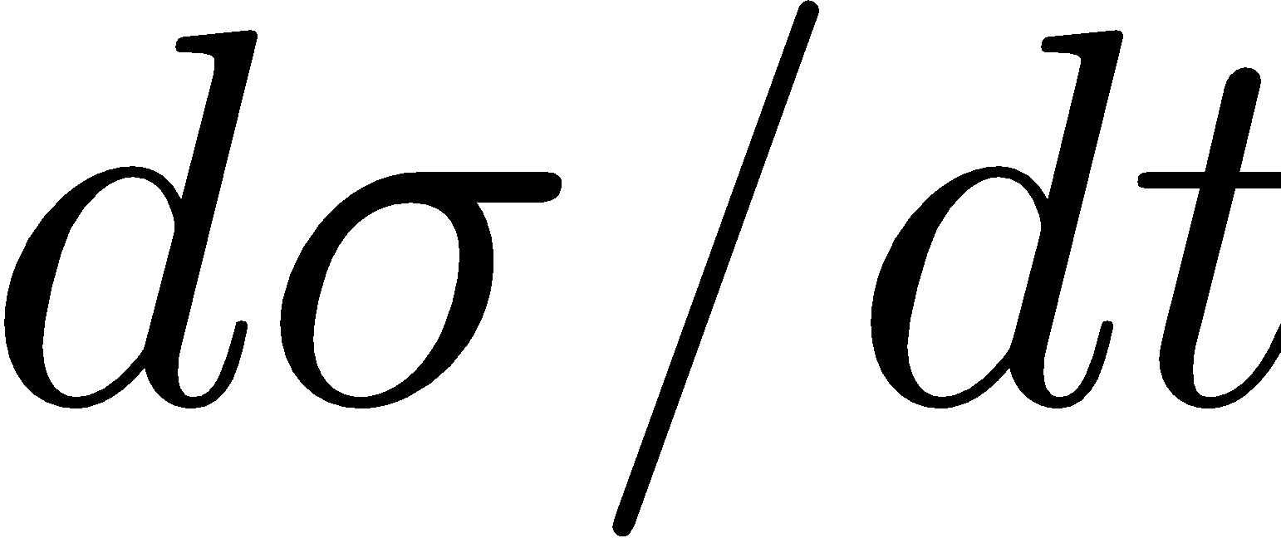
Summary of studied channels: kinematics
Kinematic distributions have been studied and required coverages are available
Measurement/process | Main detector requirement (if known/anticipated) | Expected plot for the YR | Physics goal/topic | Contact person | Comments
Coherent DVCS on D, ³He, ⁴He | t acceptance in forward spectrometers |  | Nuclear GPDs | R. Dupré, S. Fucini, S. Scopetta | Study ongoing
DVCS on neutron: double-tagging on d | ZDC acceptance, t resolution, spectator detection |  | Neutron GPDs, flavour separation | Jentsch, Z. (Kong) Tu | Study close to completion
TCS and J/Ψ in ep | Lepton pair momentum resolution and acceptance in forward detectors |  | GPDs, proton mass / trace anomaly | Y. Furletova, S. Joosten, J. Wagner (PARTONS) | Study close to completion

Slide 39
Summary of studied channels: kinematics
Kinematic distributions have been studied and required coverages are available
Measurement/process | Main detector requirement (if known/anticipated) | Expected plot for the YR | Physics goal/topic | Contact person | Comments
Exclusive π⁰ and π⁺ | PID, EM Calorimeter resolution, cluster separation for photons |  | GPDs (chiral-odd and chiral-even), TDAs. | M. Defurne, F.-X. Girod, K. Tezgin (PARTONS), L. (Bill) Wenliang | Study ongoing
Charged current pion production | Actually a semi-inclusive process |  | GPDs | M. Siddikov, I. Schmidt | Study near completion

Slide 40
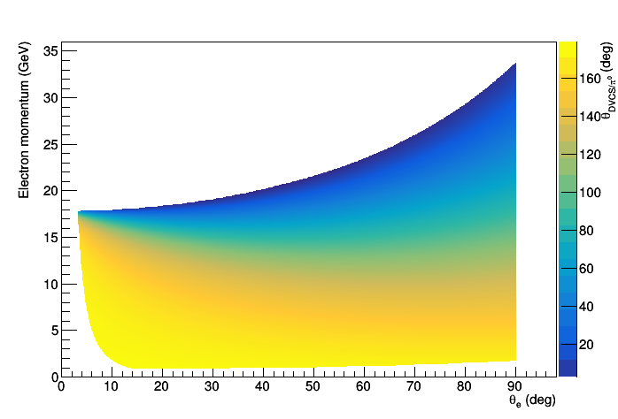
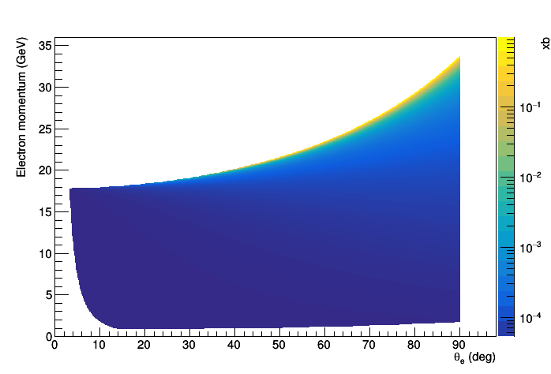
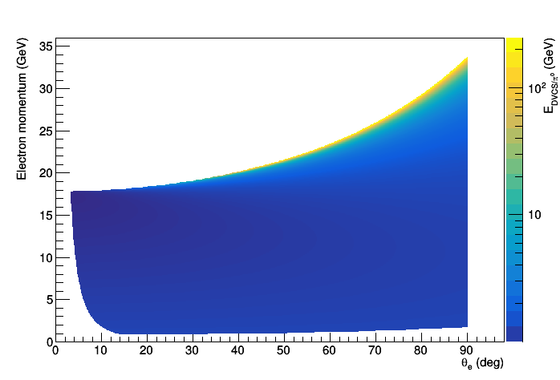
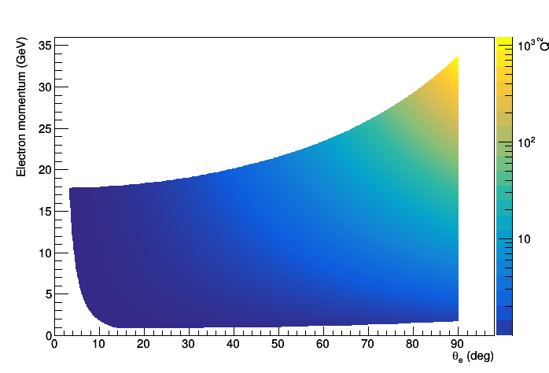
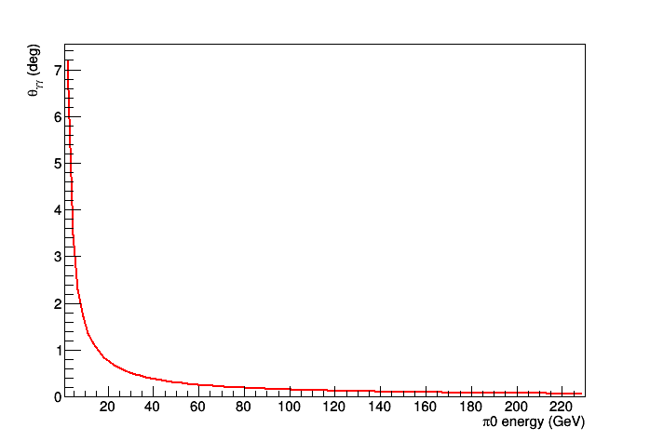
DVSC/𝛑0 production: electron kinematics
Maxime Defurne (CEA Saclay)
z: DVCS photon/π⁰ angle (deg)
z: x_{B}
Each 2D plot shows electron momentum vs scattering angle.
Cross-section falls as Q² rises.
Detection of both decay photons constrained by energy threshold (assume ~ 300 MeV min) in calorimeter and angular resolution between clusters.
z: E of DVCS photon/ π⁰
z: Q²
Photon opening angle vs π⁰ E

Slide 41
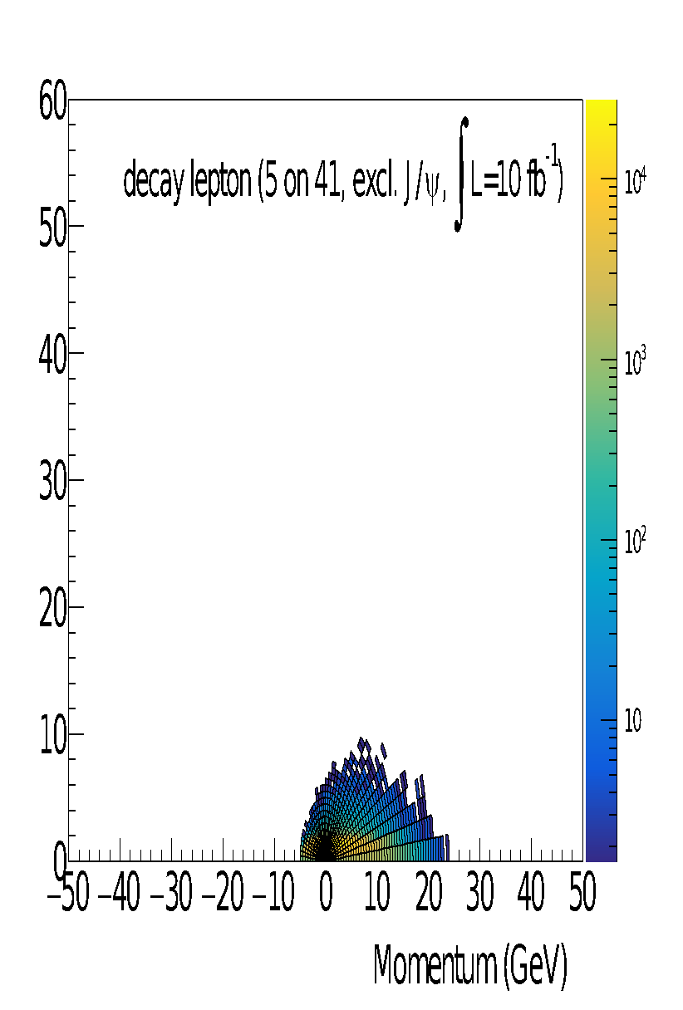
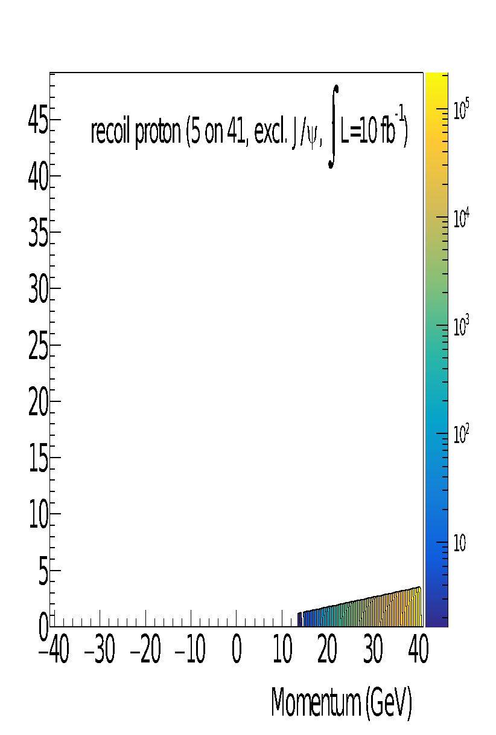
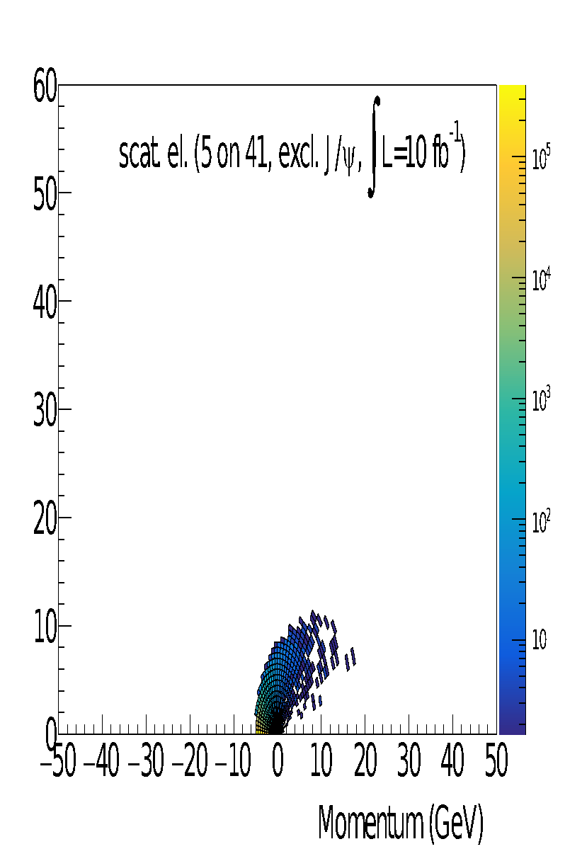
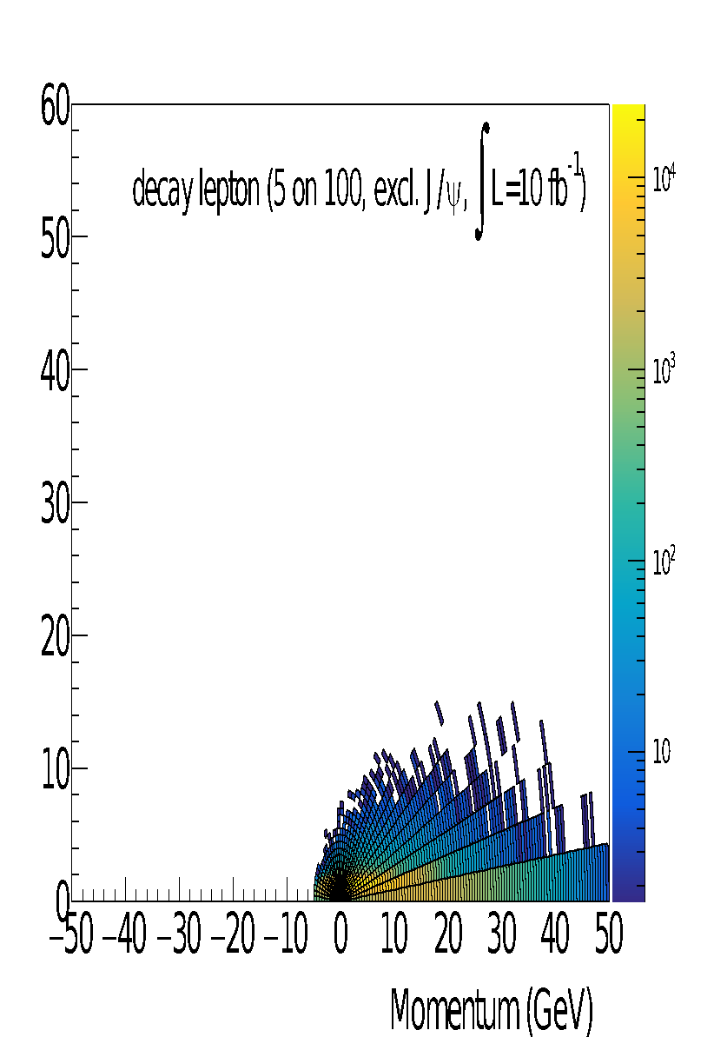
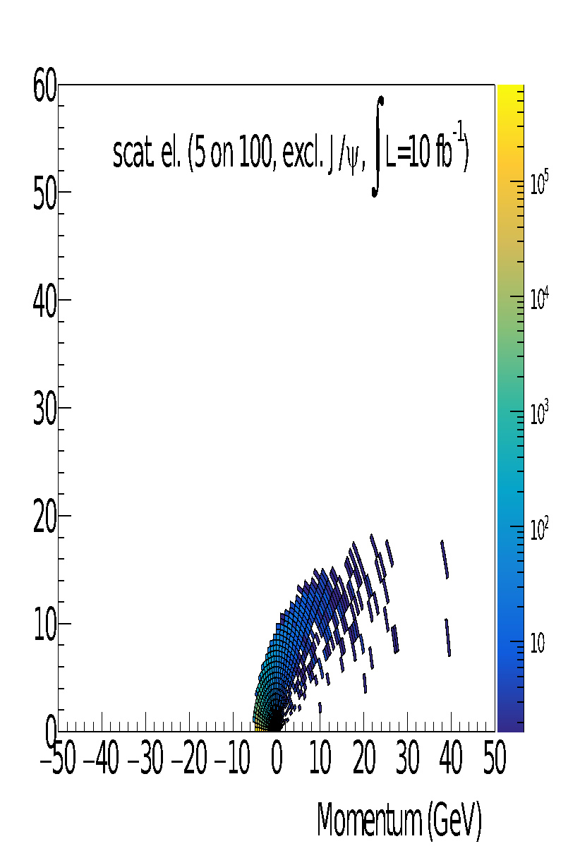
J/𝛙 production in e+p
Sylvester Joosten (ANL)
5 x 41 GeV
5 x 100 GeV

Slide 42
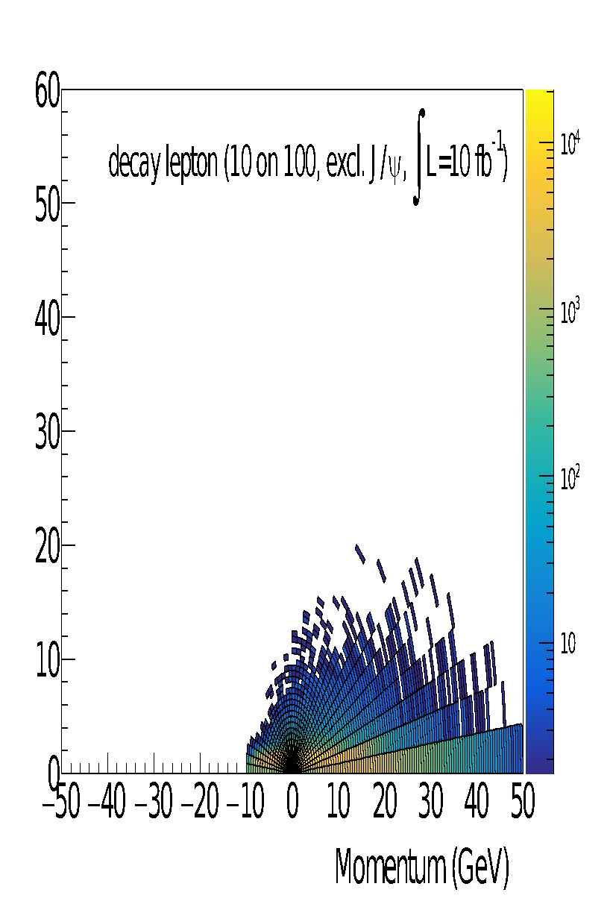
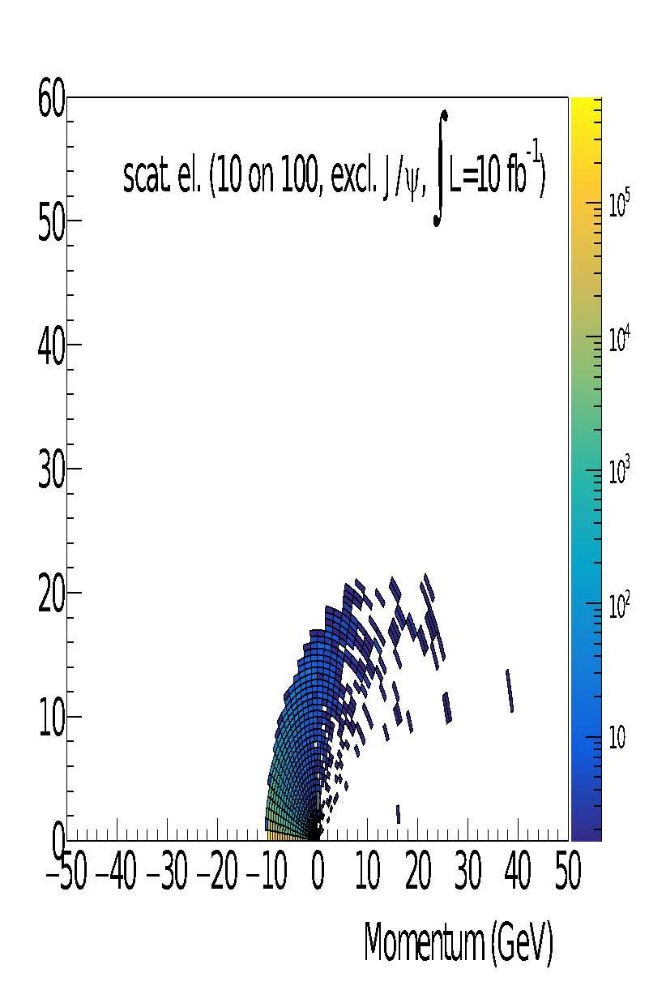
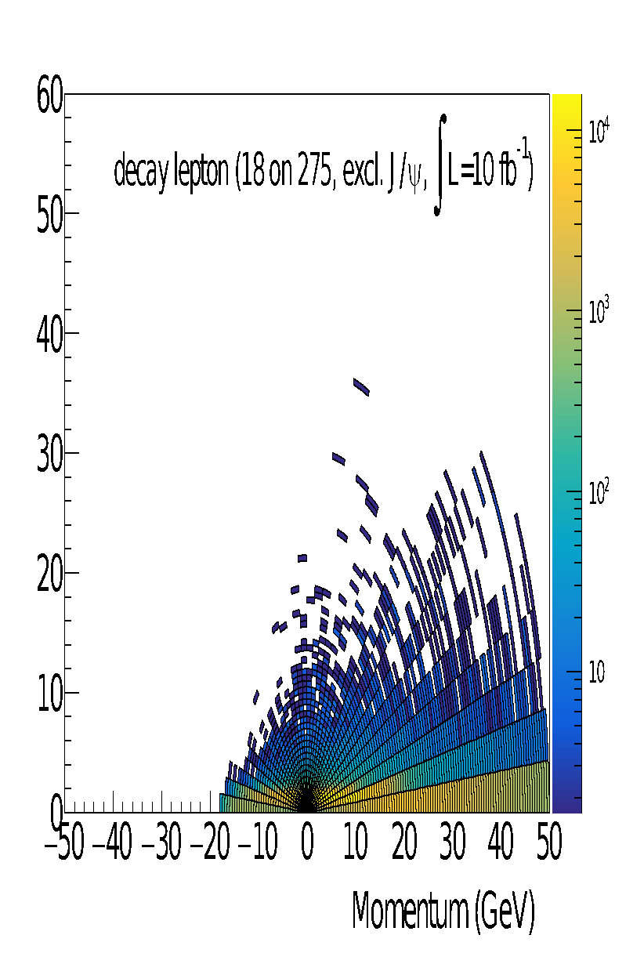
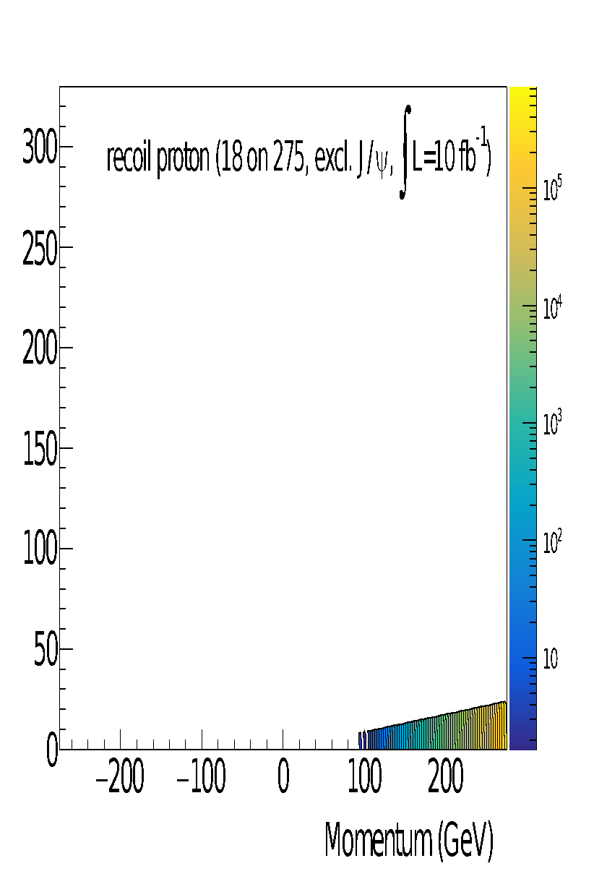
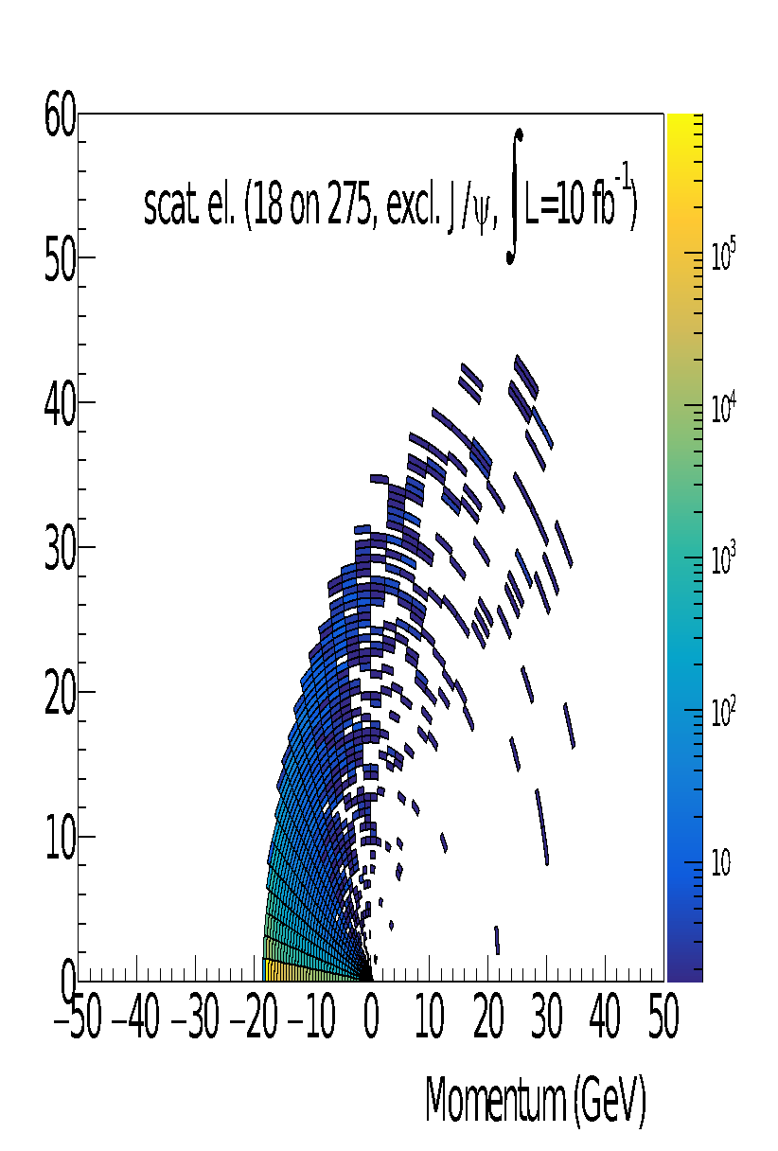
J/𝛙 production in e+p
Sylvester Joosten (ANL)
10 x 100 GeV
18 x 275 GeV

Slide 43
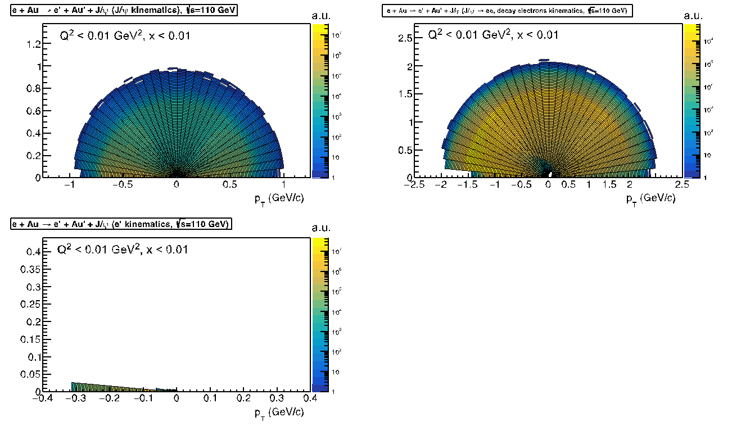
J/𝛙 production in e+Au
Thomas Ullrich (BNL)
90
J/Ψ
J/Ψ -> ee
e’
Q² < 0.01 GeV²
x_{B} < 0.01
z:arbitrary units
1 < Q² < 10 GeV²
x_{B} < 0.01
z:arbitrary units

Slide 44
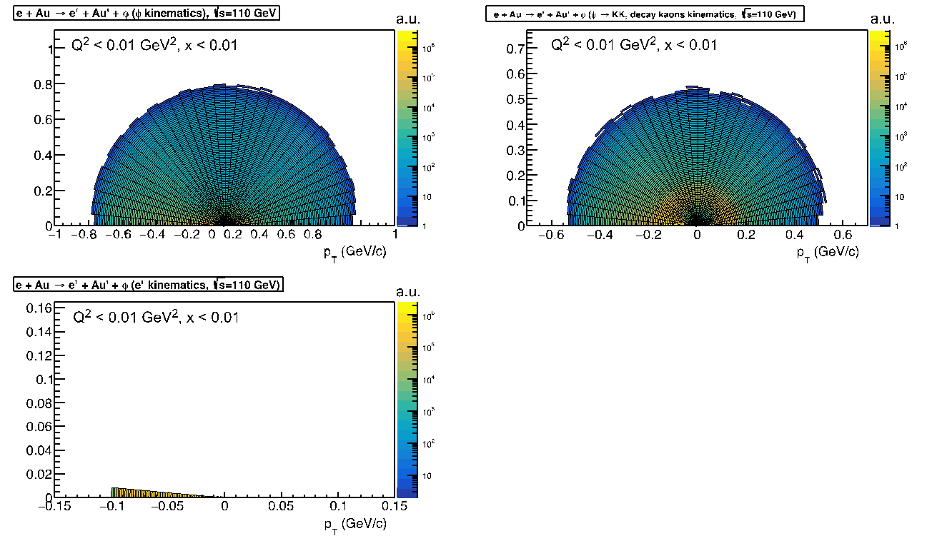
𝛗 production in e+Au
90
Thomas Ullrich (BNL)
φ
φ-> KK
e’
Q² < 0.01 GeV²
x_{B} < 0.01
z:arbitrary units
1 < Q² < 10 GeV²
x_{B} < 0.01
z:arbitrary units

Slide 45
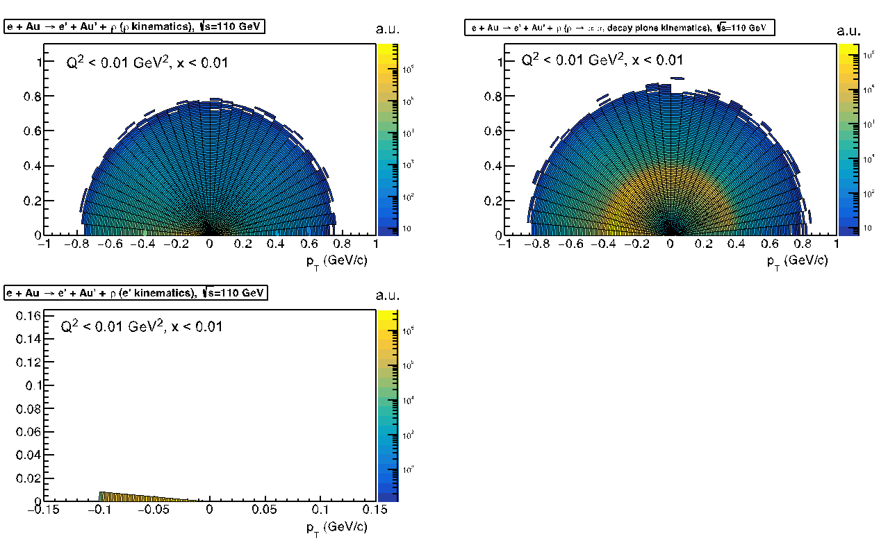
𝛒 production in e+Au
Thomas Ullrich (BNL)
90
ρ
ρ-> ππ
e’
Q² < 0.01 GeV²
x_{B} < 0.01
z:arbitrary units
1 < Q² < 10 GeV²
x_{B} < 0.01
z:arbitrary units

Slide 46
U-channel 𝛑0 production
Li (Bill) Wenliang (BNL)
Backward angle production of pi0 from proton: TDAs.
π⁰ mom: 20-50 GeV. π⁰ angle from above 50 to below 35mrad. Photon opening angle 0.4-0.8 deg.
Q² < 12 GeV, W~ 10 GeV

Slide 47
Charged current pion production
Marat Sidikov, (USM, Valparaiso, Chile)
Process is suppressed in comparison to DVMP, integrated luminosity for the plots is 100 fb⁻¹
Kinematic studies have been carried out on more channels – see weekly meeting slides on Indico!

Slide 48
Diffractive dijet production in e+p
Zhengqiao Zhang (BNL)
Electron
(Pythia8 ,Q²<1)
Proton
Jet

Slide 49
Other channels
Some of the channels which will be worked on but don’t have kinematic distributions yet:
Measurement/process | Main detector requirement (if known/anticipated) | Expected plot for the YR | Physics goal/topic | Contact person | Comments
Exclusive ϕ and ρ in ep and eA | PID for hadronic decay channels |  | GPDs, gluon saturation | F.-X. Girod,
Exclusive production of meson-photon pair (ργ) | Far-forward detectors |  | GPDs | D. Sokhan

Slide 50
Diffraction and Tagging
physics working subgroup
Pavia YR Meeting
Wim Cosyn, Or Hen, Douglas Higinbotham, Spencer Klein, Anna Stasto
May 20, 2020

Slide 51
Summary of studied channels: kinematics
Measurement/process | Main detector requirement (if known/anticipated) | Expected plot for the YR | Physics goal/topic | Contact person | Comments
Sullivan process ep/d -> e + pi/K/X + nucleon | -detection of forward p/n -detection of forward decay products of Λ,Σ -hadronic calorimetry in forward region | -pion and kaon SF projections a la HERA proton structure function plots -pion form factor at large Q² | Meson structure | T.Horn | fast simulations in progress
ep/A-> e + X+p/A | Roman pot for leading protons | Roman pot acceptance, diffractive kinematics, structure function pseudodata, diffractive PDFs | diffractive structure functions and PDFs in protons and nuclei | N.Armesto P.Newman,W.SlominskiA.Stasto | To do: PDFs in nuclei

Slide 52
Summary of studied channels: kinematics
Measurement/process | Main detector requirement (if known/anticipated) | Expected plot for the YR | Physics goal/topic | Contact person | Comments
ep/A-> e + VM+rapidity gap+Y inelastic diffraction of vector mesons | excellent acceptance for forward region for measurement of large rapidity gaps | cross section growth with rapidity gap size, dependence on t, angular vs pT acceptance | Pomeron trajectory, energy and t-dependence of the cross section on the rapidity gap size | M. Deak, M.Strikman, A.Stasto | To do: angular acceptance plots, simulations
Electro/Photo-production J/ψ Upsilon 1S, 2S, 3S | Central Detector Scattered Electron Forward Detector for nuclear fragments to separate coherent/incoherent | Gluon distributions as a function of x and b⊥ | Gluon Dist. 3D Gluon imaging | S. Klein S. Heppelmann | ep 18X100, 100x250 eA 18x100

Slide 53
Summary of studied channels: kinematics
Measurement/process | Main detector requirement (if known/anticipated) | Expected plot for the YR | Physics goal/topic | Contact person | Comments
Diffractive deuteron breakup in J/ψ production | deuteron internal momenta up to 0.8–1 GeV/c can be detected with good acceptances and excellent resolutions with current far forward design | number of events vs p_miss with p and n spectators | Various: study is proxy for processes with single and double nucleon tagging in deuteron | Kong Tu Alex Jentsch | arXiv imminent
eA QE 2N knockout | Acceptance for far forward nucleons |  | SRC studies | F. Hauenstein
e-p/d elastic scattering | small angle scattered electron detection | FF projections as a function of Q² | elastic FF | B.Schmookler

Slide 54
Summary of studied channels: fast simulations
Measurement/process | Main detector requirement (if known/anticipated) | Expected plot for the YR | Physics goal/topic | Contact person | Comments
Electro/Photo-production J/ψ Upsilon 1S, 2S, 3S | Central Detector Scattered Electron Forward Detector for nuclear fragments to separate coherent/incoherent | Gluon distributions as a function of x and b⊥ | Gluon Dist. 3D Gluon imaging | S. Klein S. Heppelmann | EICRoot Framework Detector Setups: LBNL All-Si BeAST
Diffractive deuteron breakup in J/ψ production | deuteron internal momenta up to 0.8–1 GeV/c can be detected with good acceptances and excellent resolutions with current design | number of events vs p_miss with p and n spectators | Various: study is proxy for processes with single and double nucleon tagging in deuteron | Kong Tu Alex Jentsch | arXiv imminent Beagle + current far forward detectors
eA QE 2N knockout | Acceptance for far forward nucleons |  | SRC studies | F. Hauenstein | Beagle + g4e

Slide 55
Meson Structure Functions – Scattered Electron
ep/d -> e +pi/K/X + nucleon
5 on 41
10 on 100 (12 on 135)
Kinematics for meson structure functions

Slide 56
Meson Structure Functions – Scattered Meson
ep/d -> e +pi/K/X + nucleon
5 on 41
10 on 100 (12 on 135)
Kinematics for meson structure functions

Slide 57
Meson Structure Functions – Forward Baryon
ep/d -> e +pi/K/X + nucleon
5 on 41
10 on 100 (12 on 135)
Kinematics for meson structure functions

Slide 58
Inclusive diffraction: Roman pots acceptance
Outgoing proton momentum : (x_{L},p_{T}) with x_{L}P⁺=P^{’+}
-t range up to 2 GeV² is necessary for reliable extraction of t-dependence of diffractive exchanges
Desired detector and machine features:
Proton tagging angle: 0.5 to 7 mrad, for diffractive cross section measurement with t dependence
Outgoing proton : x_{L}<0.6
Additional intermediate energies needed for the precise longitudinal structure function measurement

Slide 59
Inelastic diffraction of vector meson: J/ψ
Need to access rapidity gaps between 2 to 4(4.5) to extract energy dependence and trajectory of Pomeron
Possible, if good angular acceptance in forward region.
Preliminary estimates on angle and p_{T}
For p_{T}=2.6 GeV, Θ=11º for x=0.05, gap up to 3.5 units rapidity
For p_{T}=2.6 GeV, Θ=5.5º for x=0.1
For p_{T}=2.6 GeV, Θ=2.75º for x=0.2 , gap up to 4.5 units rapidity
To do:
angular acceptance plots, with mapping of rapidity gaps
rapidity gap size

Slide 60
Vector Meson Photo/Electro-production: kinematics
e + p
32M events
9K events

Slide 61
Upsilon Events in EICRoot All-Silicon Detector
LBNL All-Silicon Detector
(Developed by LBNL’s eRD16 generic EIC detector project)
Silicon Tracker
6 layers
Silicon Endcap Disks
6 disks
1.5 Tesla
3.0 Tesla
Upsilon peaks are still distinguishable with a lower B-Field

Slide 62
Diffractive deuteron breakup: e+d -> e’ + J/ψ + p + n

Slide 63
Beagle simulations

Slide 64
Elastic ep scattering
(standard plots forthcoming)

Slide 65
Elastic ep scattering
Kinematics:Low Q2 Electron Angle
Kinematics: Proton Angle
(standard plots forthcoming)

Slide 66
eA QE 2N knockout

Slide 67
eA QE 2N knockout

Slide 68
Other channels
Measurement/process | Main detector requirement (if known/anticipated) | Expected plot for the YR | Physics goal/topic | Contact person | Comments
Hadron spectroscopy | central barrel tracking and calorimetry down to 100 MeV | Invariant mass distribution (state TBD) | exotic hadron spectroscopy (i. e. XYZ states) | TBD
Bethe-Heidler | Acceptance for small-angle photons | elastic FF projections | (transition) FF measurements at variable energies exploiting initial state radiation | Ch. Hyde Ch. Weiss | kinematic plots forthcoming
Coherent production of VM in 4He scattering | 0.01 < -t < 0.5 GeV² | Evolution of t-dependence of VM production as a function of Q² | Color transparency, rescattering, color opacity at various Q^{2,} | M. Strikman

Slide 69
Other channels
Measurement/ process | Main detector requirement (if known/anticipated) | Expected plot for the YR | Physics goal/topic | Contact person | Comments
nucleon fragmentation e+p -> e+h(p,n,π)[TF]+X e+p ->e+h+π/dijet[CF]+X | Far forward: -p/n: x_{L} range down to 0.1; p_{T} range: 0 <p_{T} <0.7 GeV/c -Delta production: detection of pions with xL range from 0.3 to 0.1 | leading hadron cross sections as a function of xL (normalized to inclusive) | fracture functions, multiparton nucleon structure, formation time | M. Strikman | Double tagging: detecting π, K, charm, dijet in the current fragmentation region to separate processes with u,d,g
ep/A-> e + 2 jets + X + Y | Roman pot for leading protons, forward neutron calorimeter for pion exchange, nuclei | Differential diffractive cross section for jet production, i.e. Figs. 5d, 6d; 8b and 9d from 2004.06972 | diffractive PDFs in protons and nuclei, pion PDFs, nuclear excitation | M. Klasen V.Guzey | NLO calculations finished, must still optimise YR plot(s) Pass through simulations?

Slide 70
Summary
Many channels are under study, progressing well
Many kinematic maps for physics objects completed/near completion;
cross-group cross-checks are next step (at/after Pavia)
Fast simulations of many channels are well underway
Initial constraints on detectors are starting to come out (and being communicated to the DWG)

