Slide 1
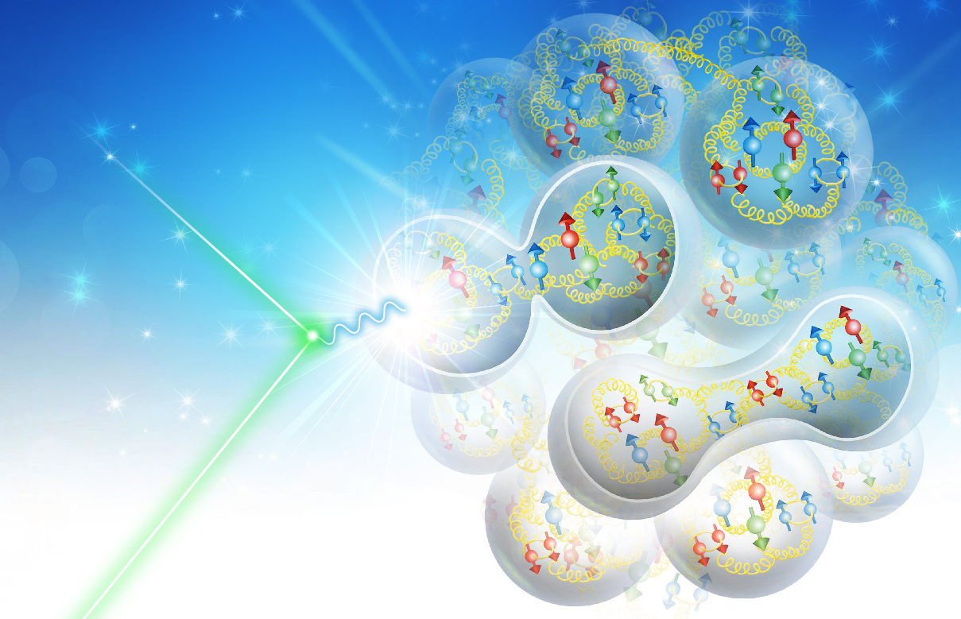
Magic Energies for Deuteron Polarization in the EIC
By Douglas W. Higinbotham
With many thanks to Fanglei Lin and Vasiliy Morozov
Pavi Yellow Report Meeting: 21 May 2020

Slide 2
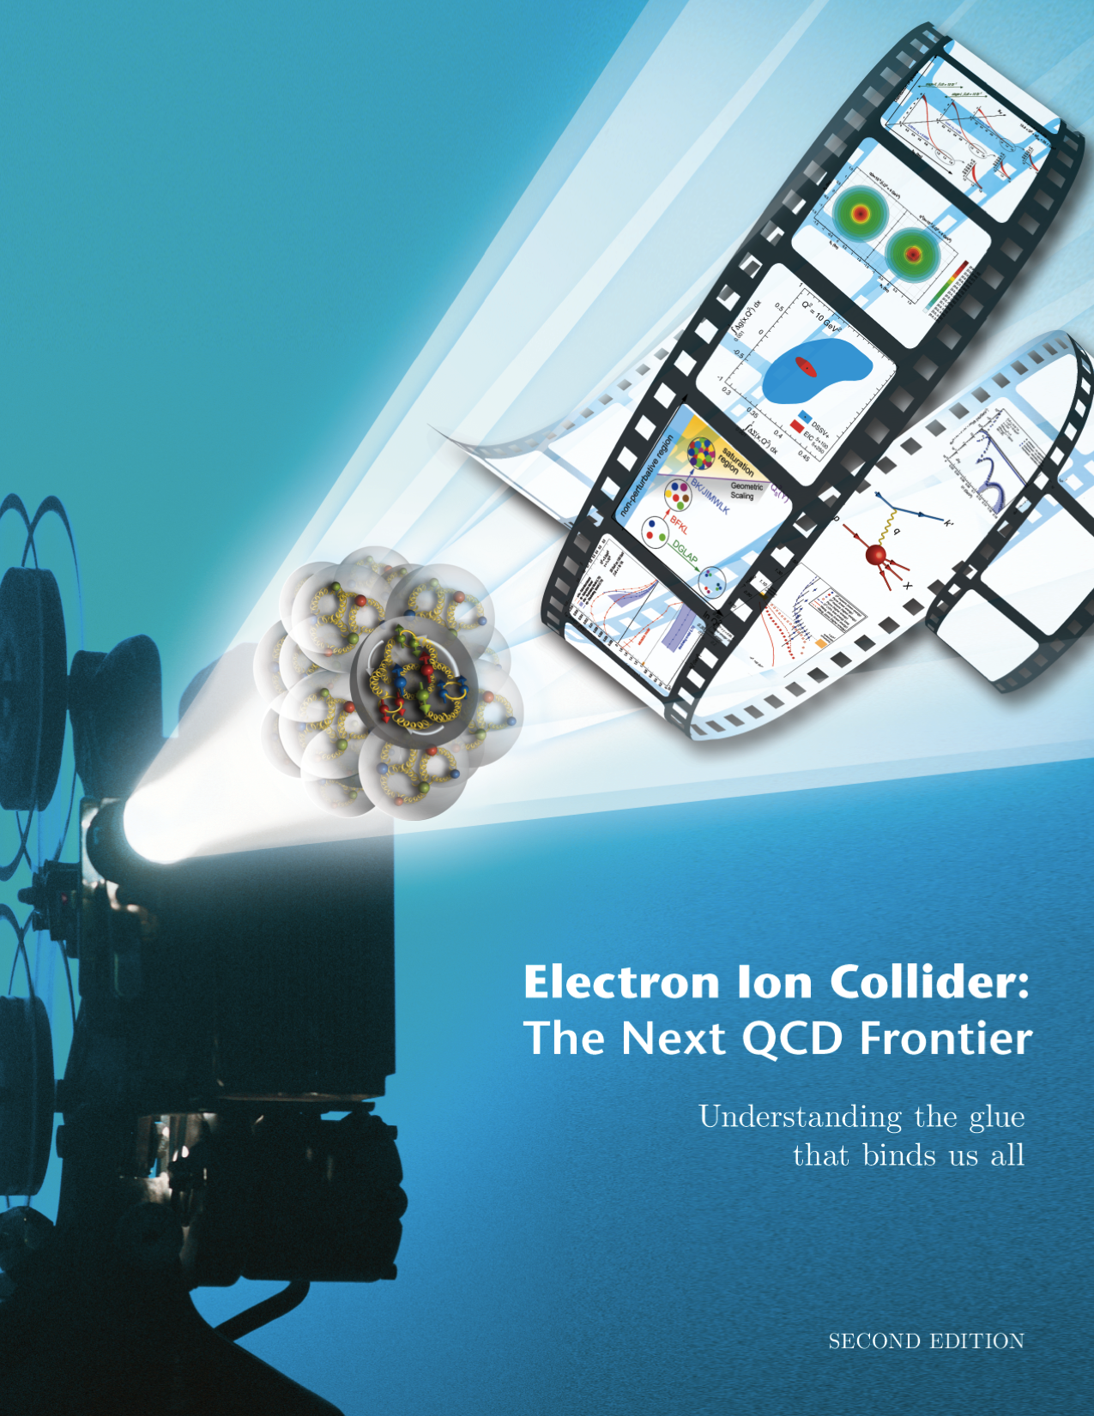
The Classic EIC Designs from Oct. 2019
For e-N collisions at the EIC:
Polarized beams: e, p, d/³He
e beam 5-10(20) GeV
Luminosity L_{ep} ~ 10³³⁻³⁴ cm⁻²sec⁻¹
100-1000 times HERA
20-100 (140) GeV Variable Center of Mass Energy
For e-A collisions at the EIC:
Wide range in nuclei
Luminosity per nucleon same as e-p
Variable center of mass energy
eRHIC Design Group
1212.1701.v3
Accardi et al
Eur. Phy. J. A, 52 9(2016)
Both design could provide
Polarized electron-proton/light ion
and electron-Nucleus collider
Both designs proposed using DOE’s significant investments in infrastructure
JLEIC Collaboration
One strength of the figure eight design was the ease with which one could store polarized hadrons including the spin-1 deuteron.
2
2
Notes:
Contrast with HERA could be made more explicit. Table/column presentation.

Slide 3
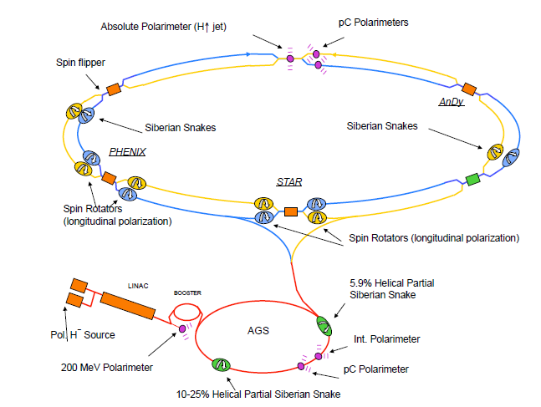
Polarized Protons ( spin-1/2 particles) in the EIC
Present polarization performance (approximate)
  Source polarization: 80%
  AGS at top energy 70%
  RHIC at top energy 60%
Some improvements are needed to meet EIC
requirements
  Two partial snakes in AGS
  Four more full snakes in ion ring
With these upgrades (and some tricks to get past depolarizing resonances) EIC should be able achieve very close to the source polarization
3

Slide 4
Electron Polarization @ NIKHEF with a Full and Partial Snake
The NIKHEF storage ring with a full Siberian Snake could provide stored, longitudinally polarized electrons
When the NIKHEF Snake broke, we were able to continue doing physics by going to 440.65 MeV along with a partial snake.
https://doi.org/10.1103/PhysRevLett.84.3855
4

Slide 5
Deuteron Polarization at the EIC
Same idea can be used to allow longitudinal deuteron polarization at the interaction regions in the EIC by again going to the “magic” energies (with the snakes included in the baseline project)
Assuming an EIC deuteron energy range of 20.5 to 137.5 GeV/nucleon, there are a total of 17 energies where the deuteron polarization can in principle be made longitudinal at least at one interaction point: 26.2, 32.8, 39.4, 45.9, 52.5, 59.0, 65.6, 72.1, 78.7, 85.3, 91.8, 98.4, 104.9, 111.5, 118.1, 124.6, and 131.2 GeV/nucleon.
Of these energies, there are 5 where the deuteron polarization can be made longitudinal at both interaction points: 39.4, 59.0, 78.7, 98.4 and 118.1 GeV/nucleon.
Two of those are very close to the yellow report energies of 41 and 110 GeV/nucleon.
Assuming 39.4 GeV/nucleon is possible and not risky to the project, changing the lower energy from 41 to 39.4 GeV/nucleon seems like an item to consider for an official change request and is certainly a finding of yellow report exercise.
5

Slide 6
MATERIAL IN BACKUP SLIDES
AGS Upgrade
Ion Ring Upgrades
Interaction Region Spin Manipulation
Overview of RHIC -> EIC Transition
6

Slide 7
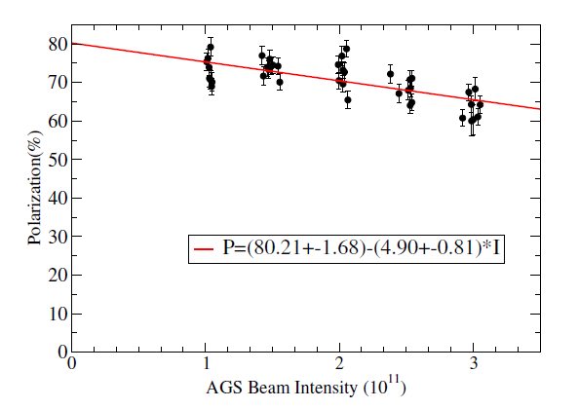
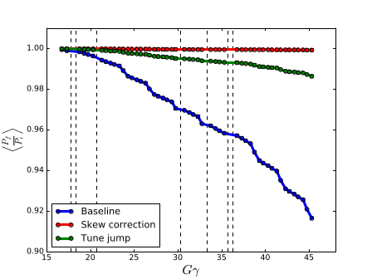
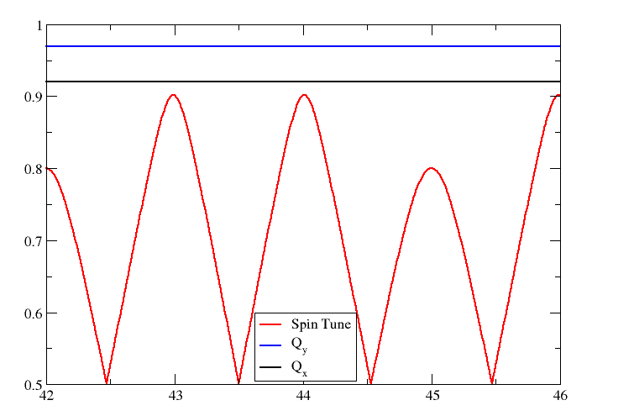

AGS Polarization Improvement
Two partial snakes eliminate polarization loss due to imperfection and vertical intrinsic resonances
Horizontal tune jumps mitigate a half of polarization loss due to horizontal intrinsic resonances
Two options to attain nearly 100% polarization transmission in AGS
  Fast ramping skew quads to compensate the horizontal resonances
  Increase injection energy from $Gγ=4.5$ to $7.5$ and increase the partial snake strength for a wider spin tune gap so that both betatron tunes are in the spin tune gap and all depolarizing resonances are avoided
7

Slide 8
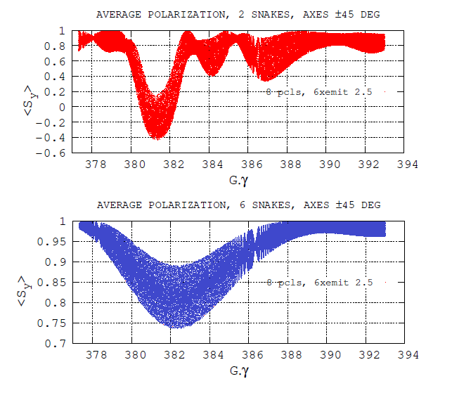
Polarization Improvement in Ion Collider Ring
Issue: 3 depolarizing resonances near top energy reduce polarization from 70% to 60%
Solution: introduce four more full snakes (transferred from the blue ring)
With two snakes, three depolarizing resonances at high energy depolarize from ~70% to ~60%
With six snakes, three depolarizing resonances cause no polarization loss
8

Slide 9
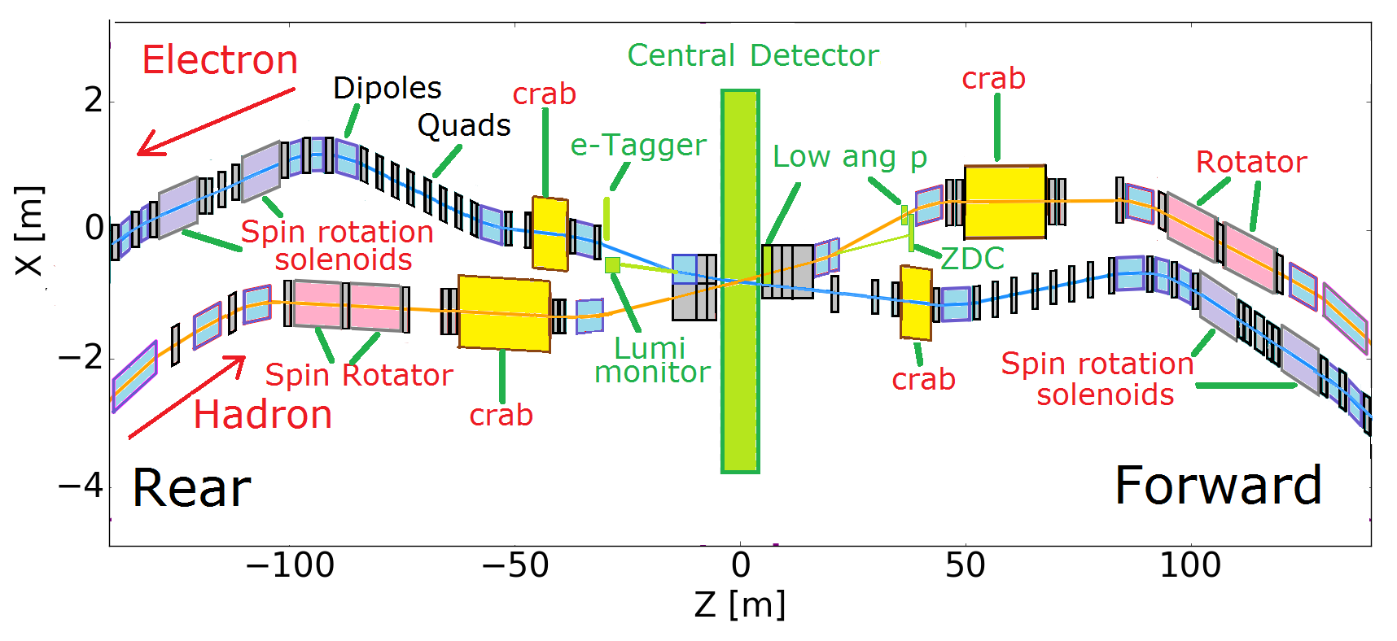
Ion Spin Rotator Locations
Independent control of proton polarization direction at each IP
9

Slide 10
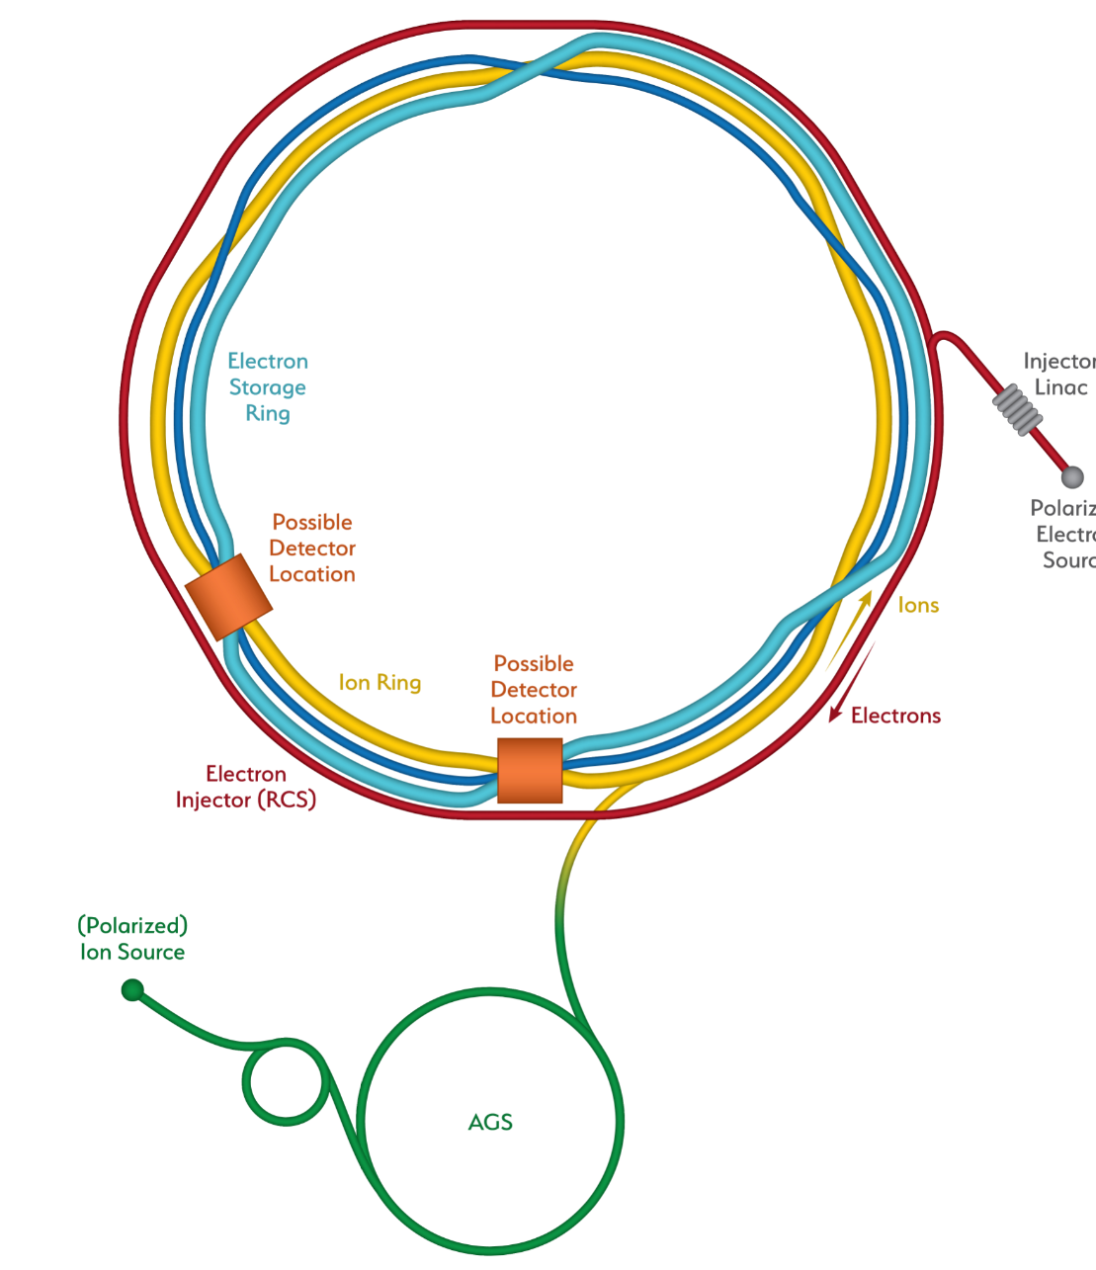

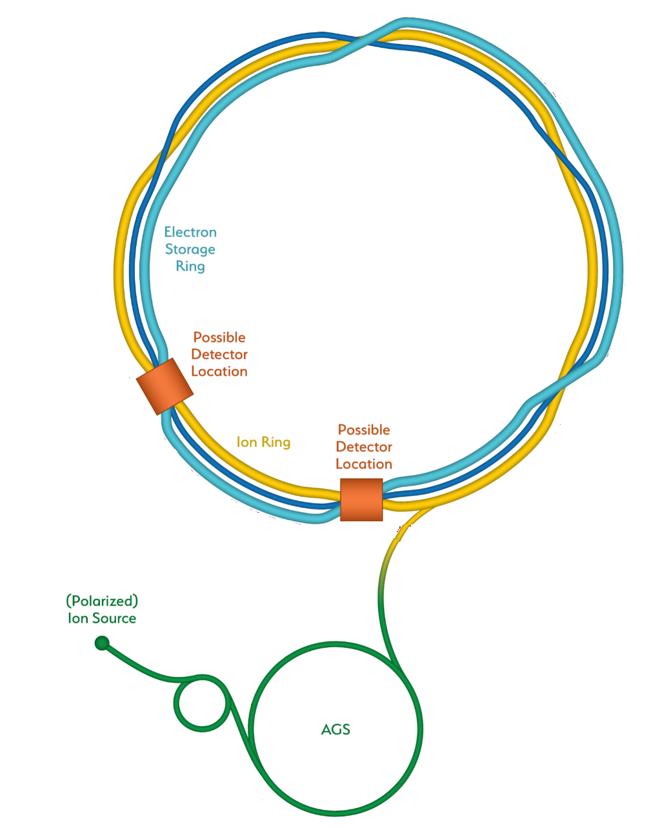
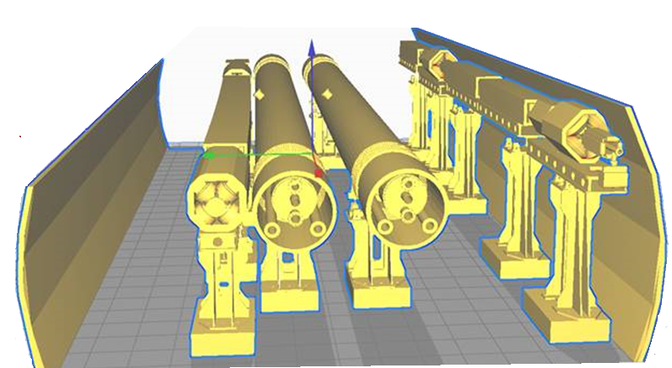
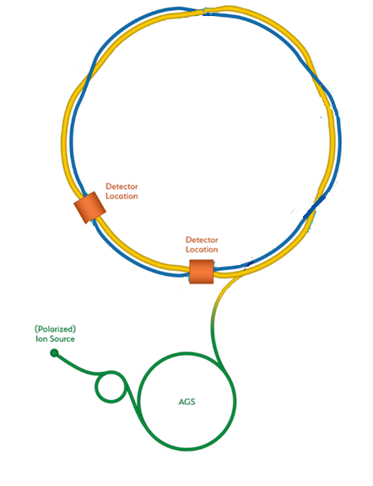
Upgrade from RHIC to the EIC
Add electron storage ring
Which holds the electrons which collide with hadrons
We add an electron
Injector complex which delivers full energy electrons to the storage ring
The strong hadron cooling facility completes the facility
Existing RHIC with
Blue and Yellow ring
Hadron Storage Ring
Electron Storage Ring
Electron Injector Synchrotron
Possible on-energy Hadron
injector ring
Hadron injector complex

