Slide 1
SIDIS Subgroup Summary
Ralf Seidl (RIKEN), Justin Stevens (William & Mary), Alexey Vladimirov (Regensburg), Anselm Vossen (Duke), Bowen Xiao (Central China Normal University)

Slide 2
Reminder of channels
Single Hadron SIDIS →TMD PDFs, unpol PDFs, helicities and (n)FFs
Di-hadron SIDIS →PDFs
Di-hadrons to constrain Gluon Sivers
Di-hadrons/Di-jets to constrain Gluon Saturation
Opportunities in Spectroscopy
Polarized Lambda

Slide 3
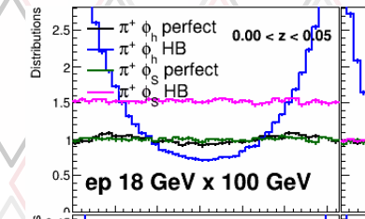
Progress status
Fast simulations and acceptance plots for all channels (as shown in Wednesday overview talk)
Additionally
Significant theory work on all channels (see some discussed here in following slides)
Fast smearing studies advanced to study physics signals and asymmetry projections
Implementation of physics signals for single hadron TMDs, FFs, Gluon Sivers,
Integration of dedicated MC for Spectroscopy (see next slides)
Example:
Impact of electron smearing
on $φ_{h}$ reconstruction
(R.Seidl)

Slide 4
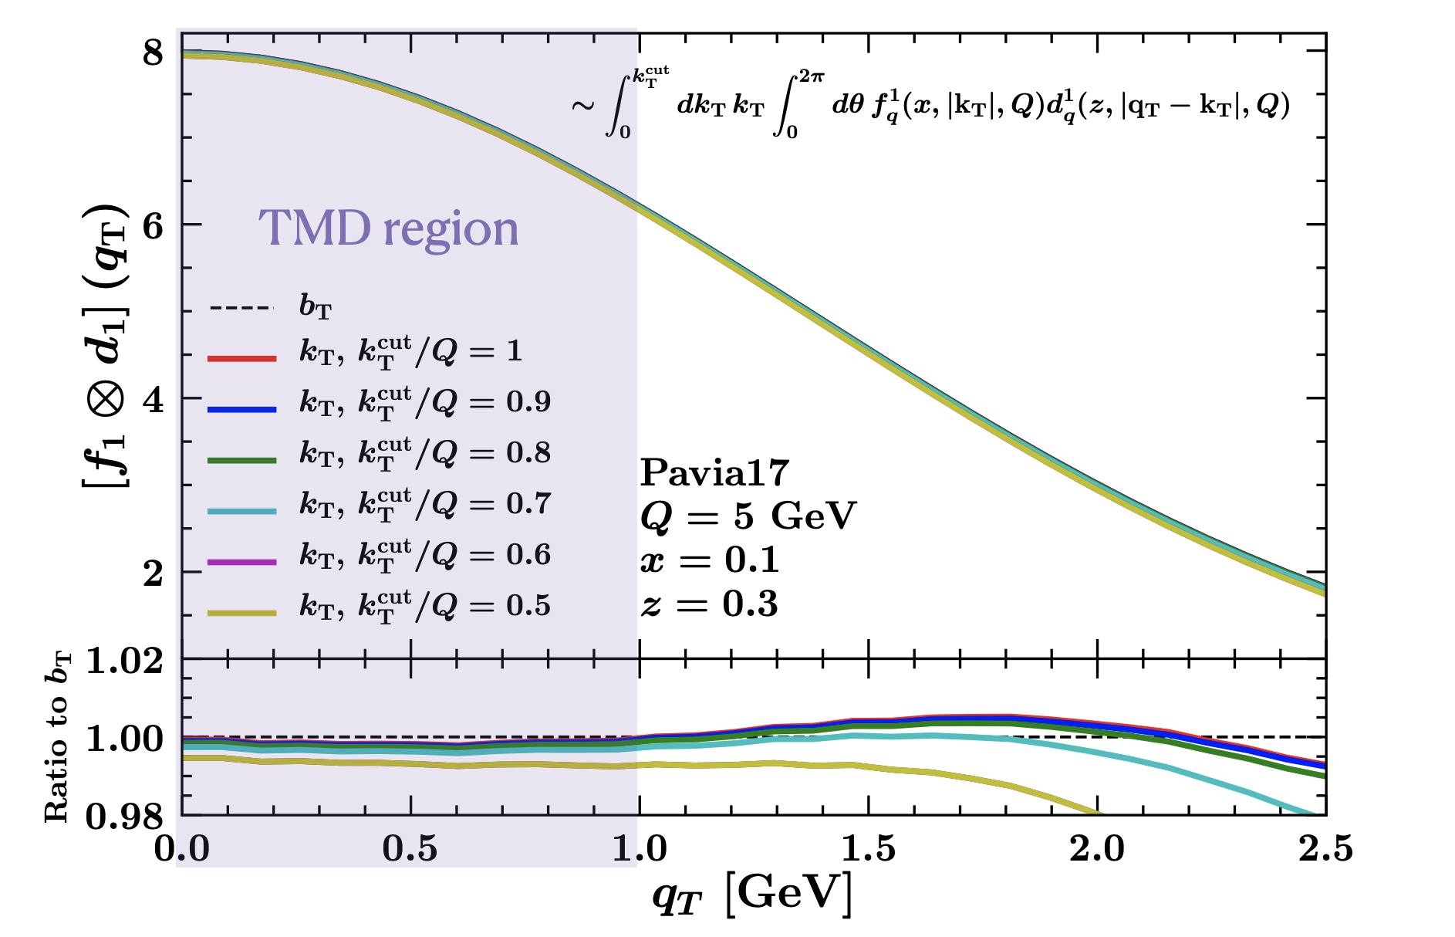
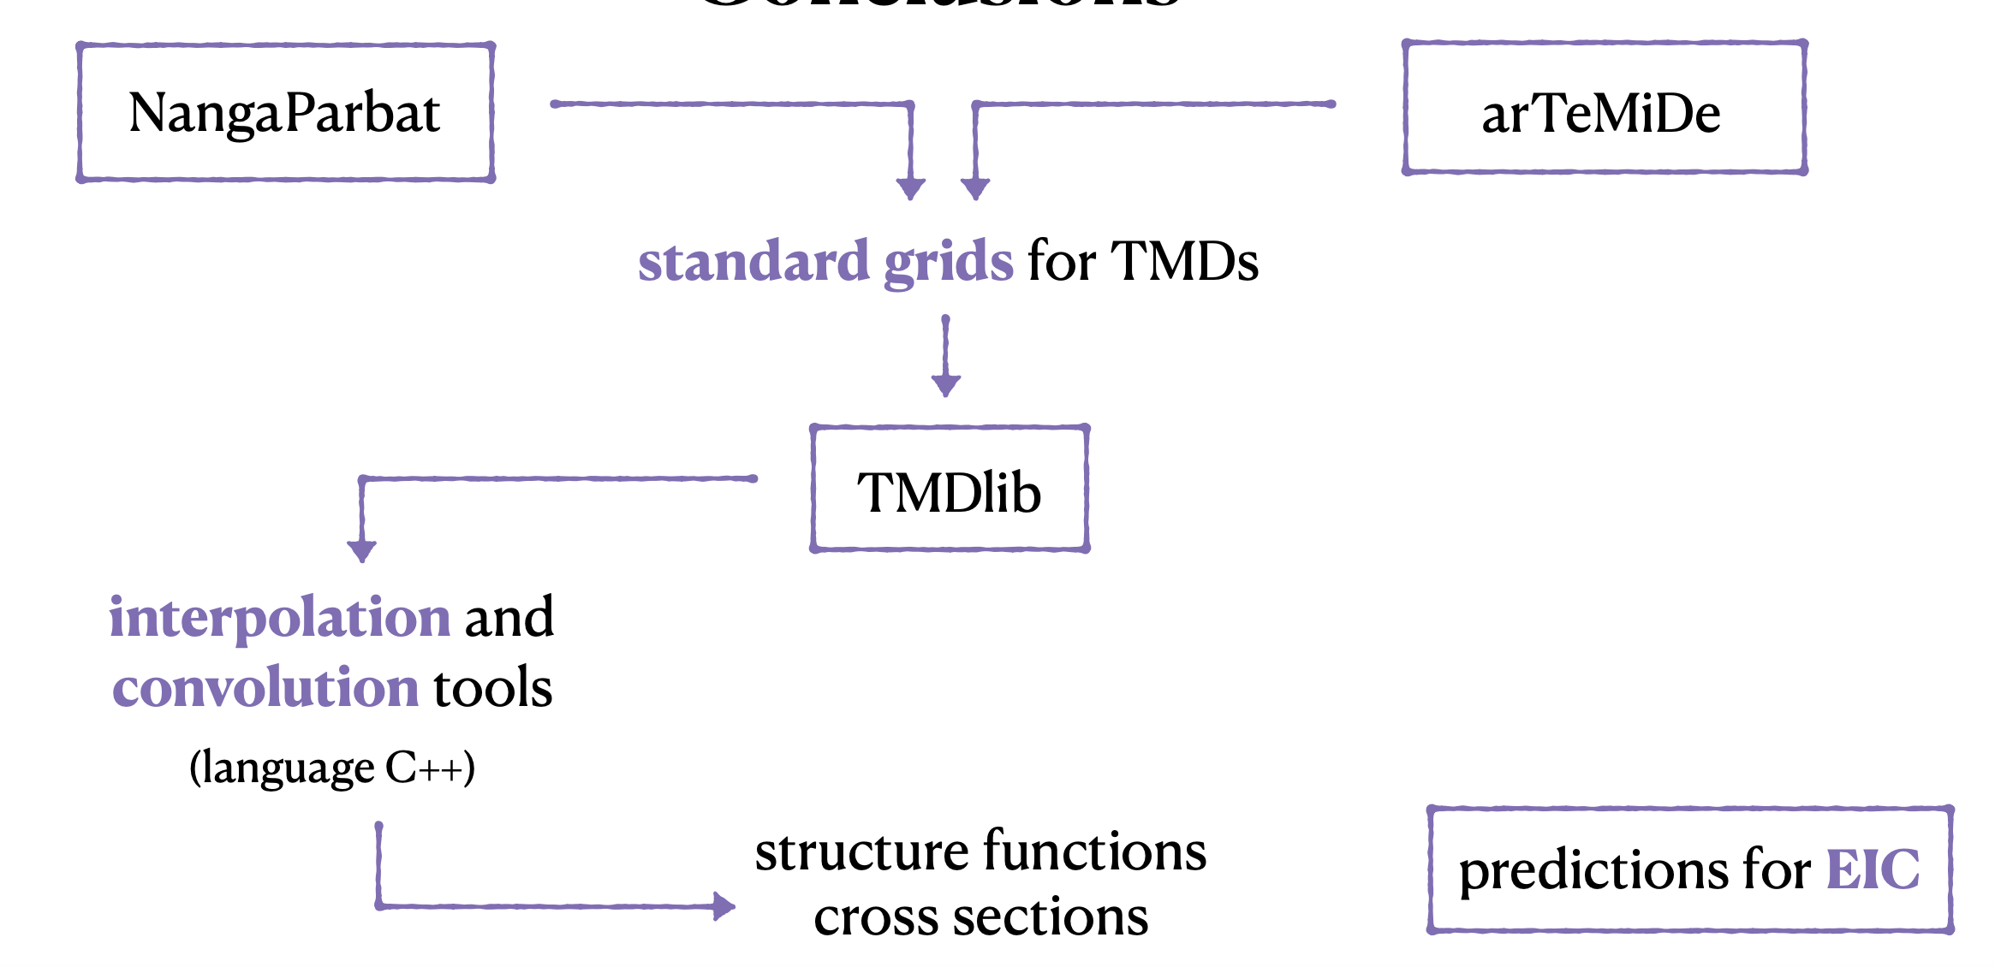

Slide 5
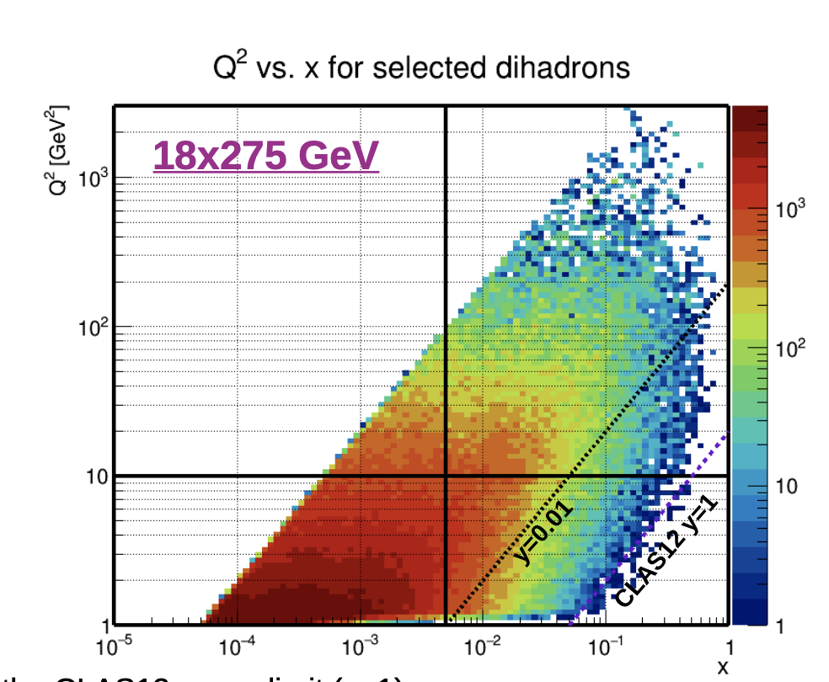
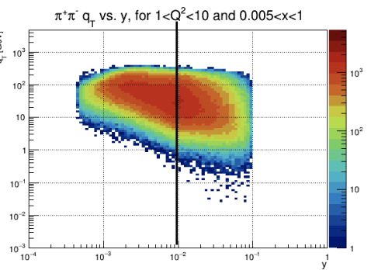
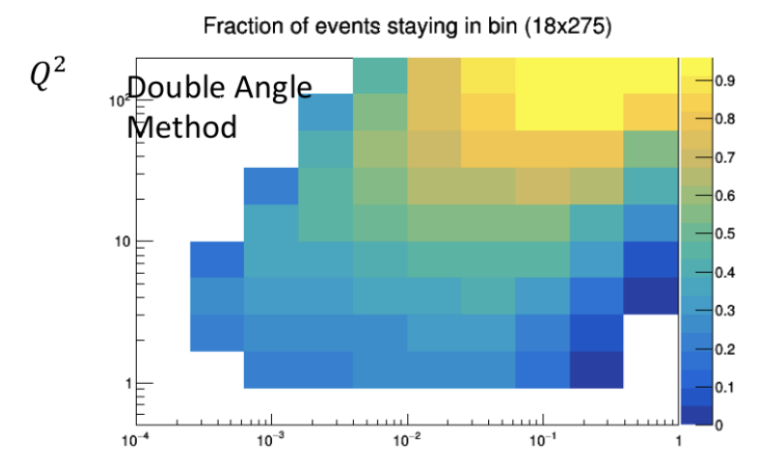

Slide 6
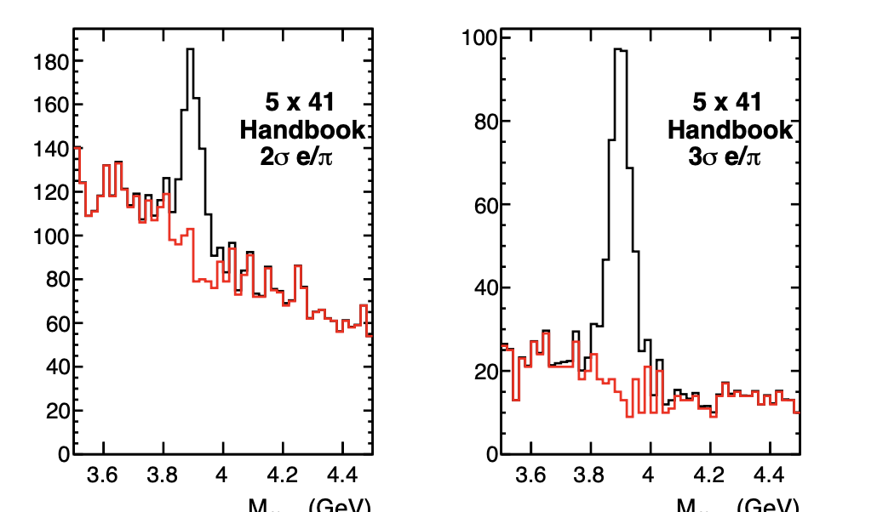
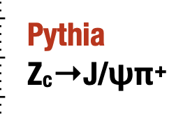
Significant progress on modeling and event generator in collaboration with
Integration of MC generators in EICSmear →Strong dependence of requirements on CME
First Background studies
Spectroscopy group grew significantly, now JPAC, JLab, Florida State, Indiana, W&M, Glasgow, INFN, Regina…

Slide 7
Jet/HF/Inclusive/SIDIS WG Joint Session
Overlap in interest in TMDs/saturation with Jets, DP gluon distribution
Discussion in particular overlapping interest in CC events (Jet/DIS/SIDIS) →need for hermeticity, resolution of hadronic final state
Interest in evaluation of relative impact of different CC probes
Impact of DIS/Jet/SIDIS on (polarized) strangeness →SIDIS will likely be needed
DIS group already advanced studies on radiative effects → lessons for SIDIS?

Slide 8
Detector WG Joint Session
SIDIS group is studying requirements for
Tracking
PID
Displaced vertices
Hermiticity/Homogeneity
Since requirements are correlated, main request: Provide several ”reasonable variations” of detector versions that are consistent with themselves
Additional question to far forward implementation

Slide 9
Summary and Future Steps
SIDIS group has made progress for all channels
Significant next steps
Implementation and extraction of physics signals
Exploration of possible detector configurations
Refinement of physics models (e.g. radiative effects) and detector responses (PID, vertexing, forward instrumentation)
Systematics from unfolding
Impact studies

