Slide 1
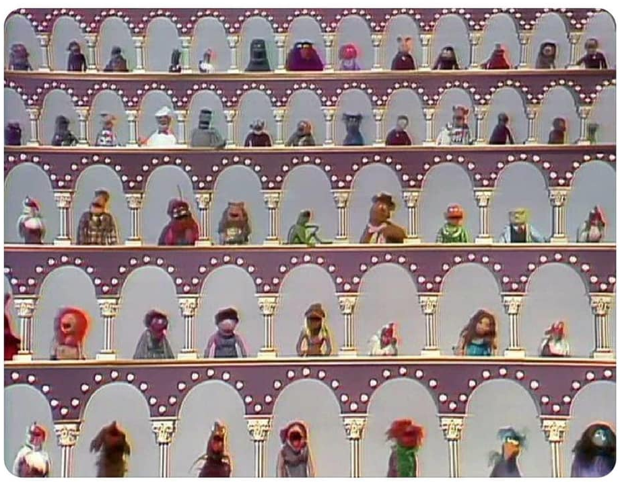
Complementary Detector
Goal:
Collect crisp and clear arguments why two detectors will enhance the physics output of the EIC
complementarity includes the IR design, but keeping consistency with accelerator design in mind
Approach:
Started to meet with the conveners of the different PWGs and discuss a set of questions
documented at https://wiki.bnl.gov/eicug/index.php/Yellow_Report_Complementarity
Open MIC session
Friday, 22nd of May
at 8:45 am EDT
submit slides to
elke@bnl.gov &
paul.newman@cern.ch
by Thursday 4 pm EDT
Questions to address :
Have you / your WG group identified requirements which conflict with the current baseline detector and IR design
Do you have suggestion how to most effectively reach the goal
→ not more than 3 slides

