Slide 1



PID
PID Deliverables to Pavia:
Requirements on “external” systems
Pro/Con matrix (e-Arm, Barrel, h-Arm)
Physics requirements.
Physics
Community
PID
:
Detectors
Machine
Others
mRICH
TOF
RICH
DIRC
Patrizia Rossi
Thomas K Hemmick

Slide 2
Were we are: Summary Table
 | p-Range @ Radiator L | Contr. ϑ_{c} | Param. | Pro/Con | Ext Const | MONTECARLO Simulatoin
psec TOF LGAD TOF | Up to 10 Depends on σ_{T} and L | NO | ~YES | YES | ~ YES | NO
dual RICH (aerogel, gas) | 2-60 @ 1.6 m | YES Chroma Emission Pixel Field Tracking | YES | YES | YES Simulated constant w/ momentum | YES GEMC/Geant4 AI-driven Optimization
GEM RICH (Gas Electron Multipliers) | 20-50 @1m | Chroma (Emission) Pixel Tracking | YES | YES | YES | YES (Simplified)
modular RICH (mRICH) | 2-10 @ 3 cm | YES Chroma Emission Pixel Tracking | ~YES | YES | YES (tracking) | ~YES GEMC/Geant4 work in progress
Detection of Internally Reflected Cherenkov (DIRC) | 0.8-6 @ 1.7 cm | YES Tracking Mult. Scat Chroma, Emission, pixel | YES | YES | YES | YES GEMC/Geant4 without B-field
:

Slide 3
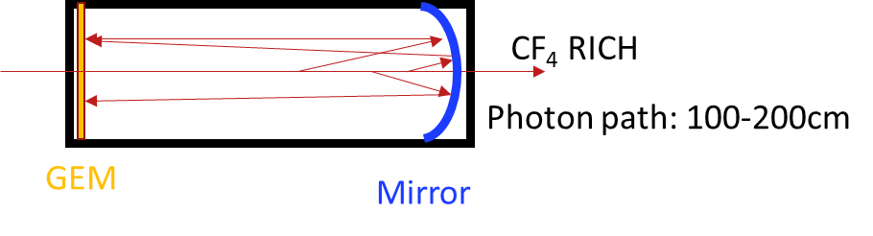
High Momentum GEM RICH
H. Klest
1m of CF₄ radiator at 1.003 bar (slightly overpressure)
CsI Photocathode on top GEM
Mirror in deep UV → MgF₂ coating
Single Photon Capability → quintuple GEM stack with APV25-SRS
Particles ~perpendicularly incident on spherical mirror, focused onto a GEM stack directly
Pro
  Sensor insensitive to B-field
  Short (12pe/m windowsless)
  Thin photo-cathode leads to more ideal optics.
Con
  Unknown how to bridge the gap in π-K
    High pressure??
    Different gas??
  Loses light with contaminants @ few ppm level (round trip; tougher than PHENIX HBD...)
    Requires superb gas system (OK)
    Requires better detector materials
  Photo-cathode in high radiation zone.
:

Slide 4
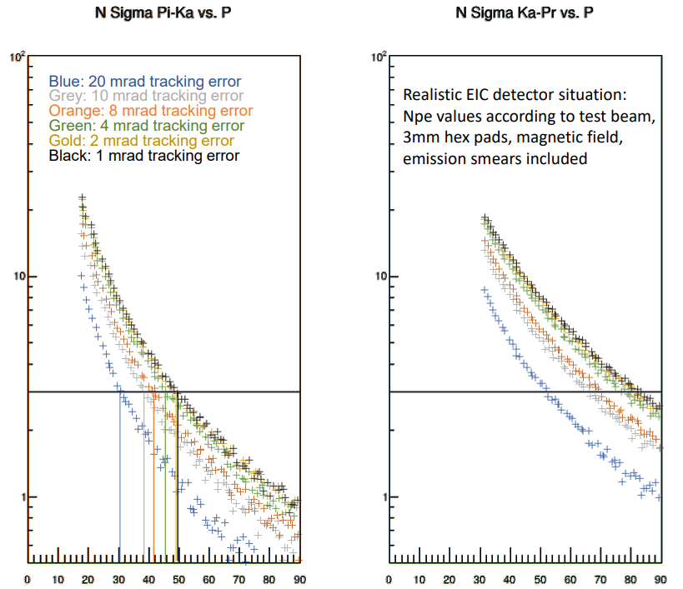
H. Klest
High Momentum GEM RICH
Tracking is leading error contribution if worse than ~7mrad.
Negligible resolution factor around 2 mrad.
Between 2 and 7mrad , more detailed investigation is required.
Plot shows viscerally the effect.
More detailed simulation required.
hmm
OK
:
:
4

Slide 5
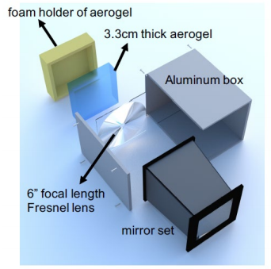
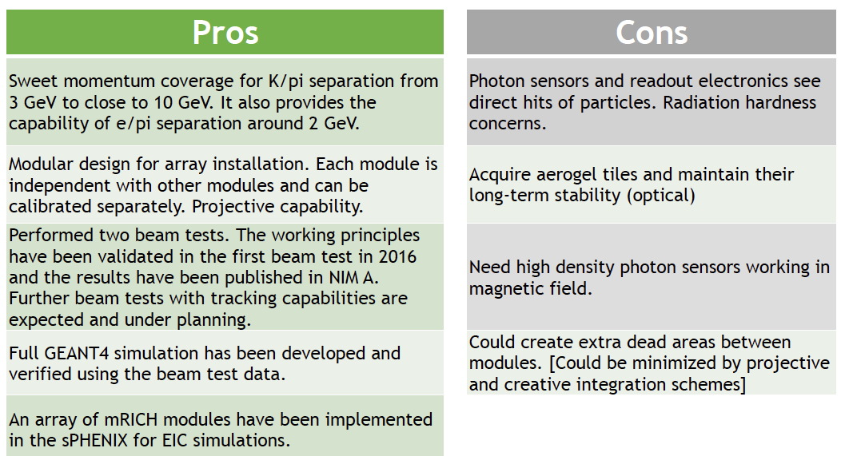
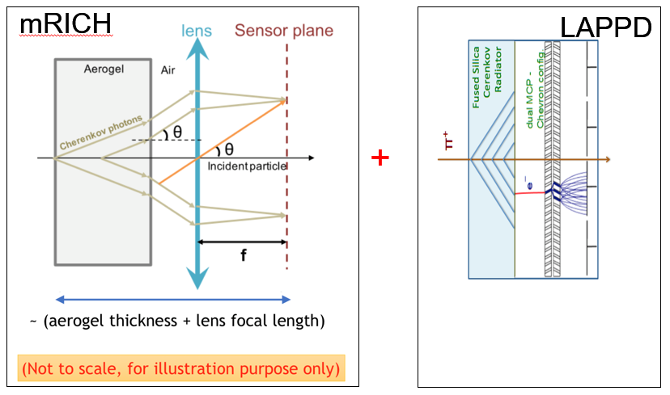
mRICH
X. He
M. Sarsour
Cherenkov radiator
Aerogel, n = 1.03
Radiator length, L = 3cm
Lens with focal length, 𝑓= 6”
Photon Detector
3 mm pixel size
Provide a time meas. with proper sensor?
Utility of the device is expanded if it provides picosec TOF & Cherenkov
More quantitative estimate of dead area (foam holder/box/Fresnel corners)
Sensor issue is general, independent of radiator and optics.

Slide 6
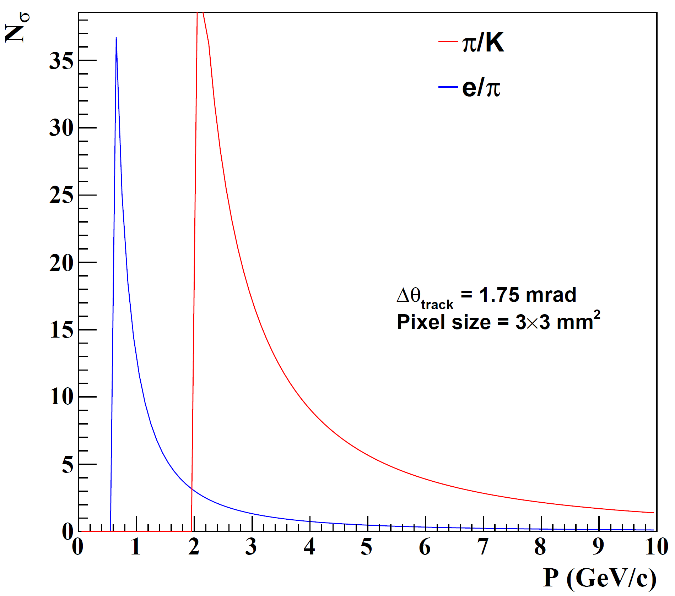
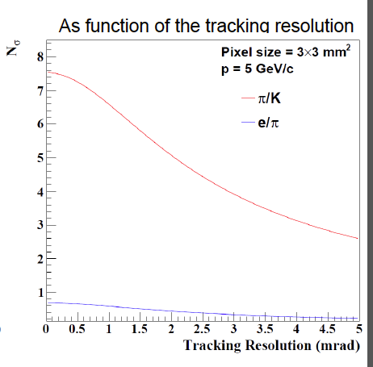
mRICH
X. He
M. Sarsour
e/π excellent at lowest p
Tracking influence minor
Tracking influence major
6

Slide 7
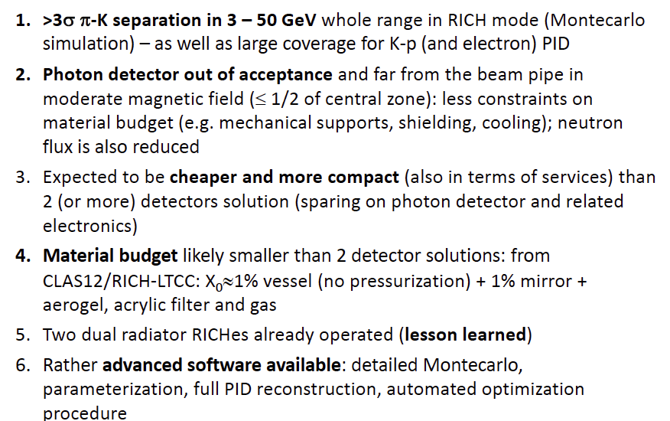
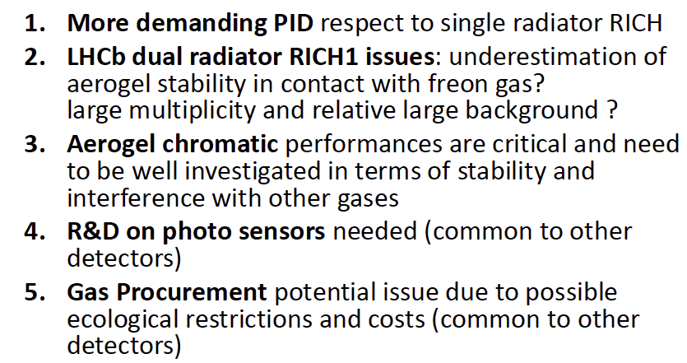
dRICH
E. Cisbani
M. Contalbrigo
Cherenkov radiator
○ Refractive Index
n = 1.02 (aerogel) 1.0008 (C₂F₆)
○ length of the radiator
L = 4 cm (aerogel) , 160 cm (C₂F₆)
Mirrors
Photon Detector
3 mm pixel size; 200-500 nm MAPMT
Particle Generation
Originate from the vertex
Pro
Con

Slide 8
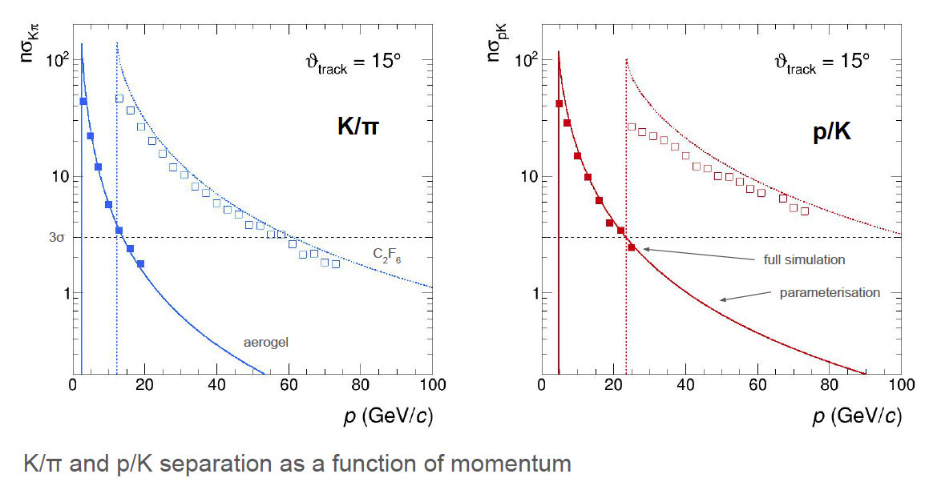
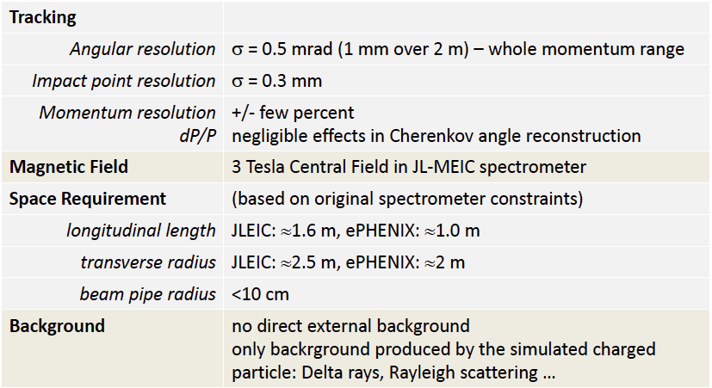
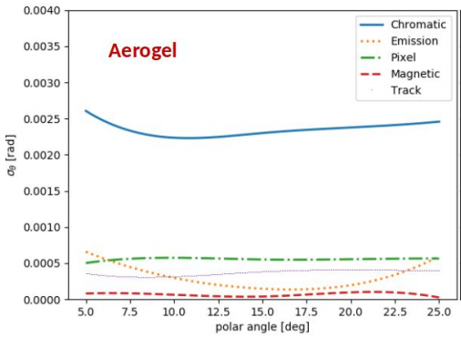
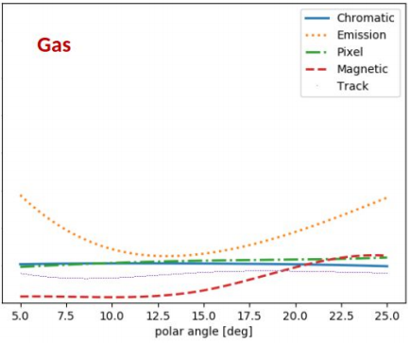
dRICH
E. Cisbani
M. Contalbrigo
Exquisite detail in simulation.
AI-based optimization.
Good parametrization
Uses constant external angular resolution assumption.
External assumption
ϑ_{c} contributions
Material budget evaluation
Sensors in the acceptance

Slide 9
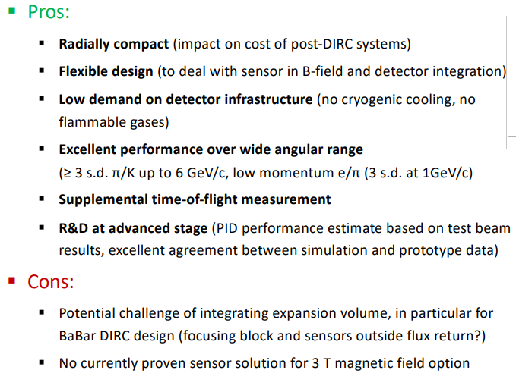
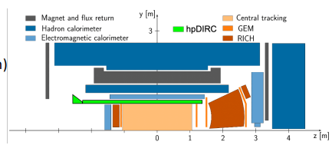
DIRC
G. Kalicy
J. Schwiening
Generic reference design: 1m barrel radius, 16 sectors
176 bars: synthetic fused silica,17mm (T) ´ 32mm (W) ´ 4200mm (L)
Photo sensors: MCP-PMTs -3x3mm2 pixels

Slide 10
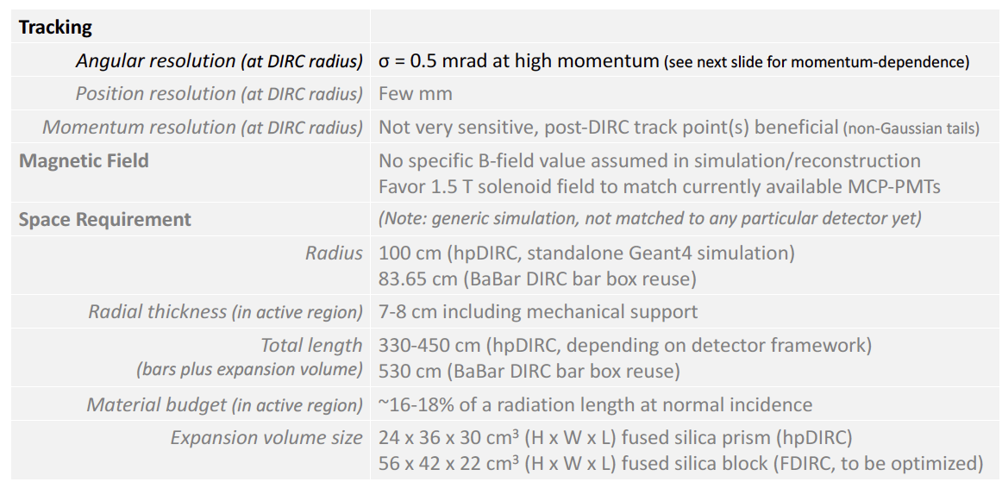
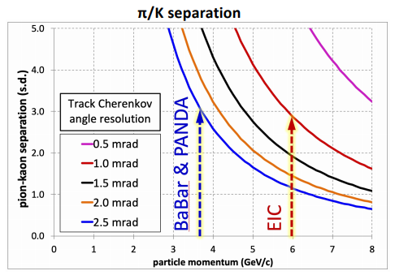
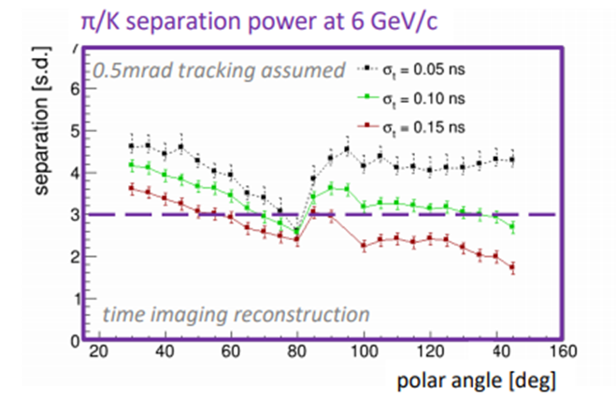
DIRC
G. Kalicy
J. Schwiening
External assumption
NOTE:
DIRC optics design-level adaptable to magnetic field orientation at the sensors.
Need ~settled field direction prior to construction.
Performance ~independent of device radius.

Slide 11
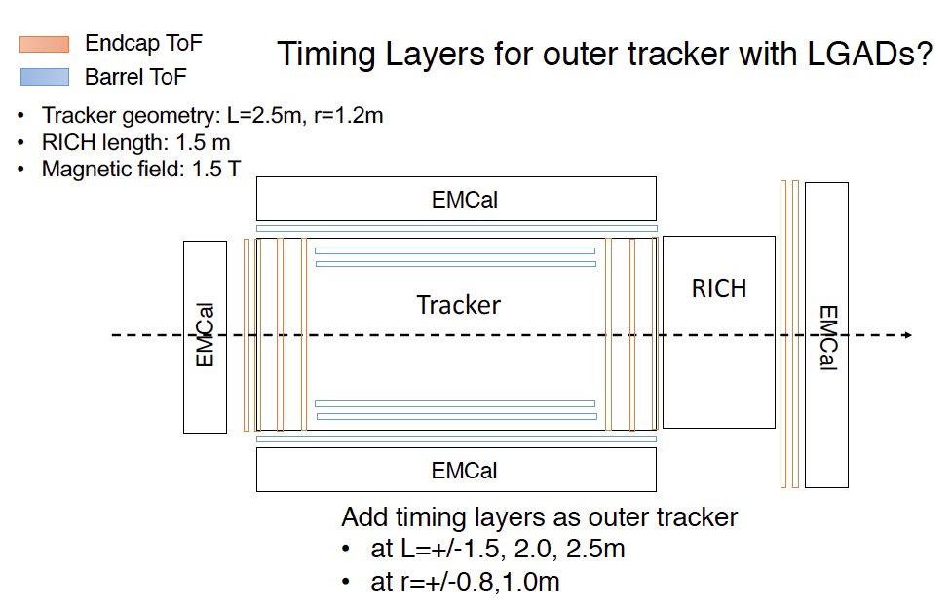
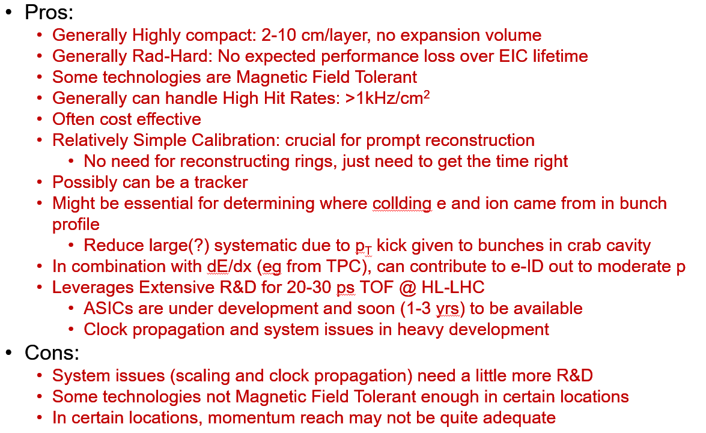
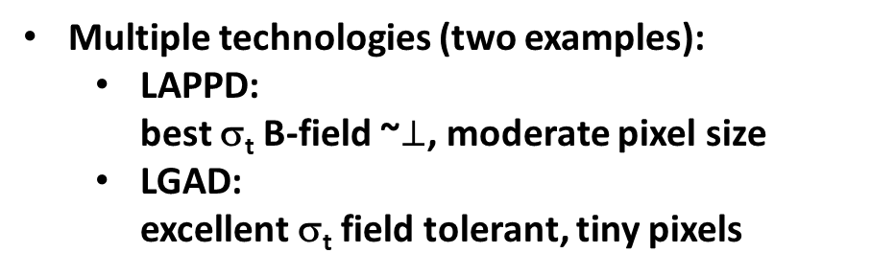
psTOF
M. Chiu
W. Li
Multiple technologies (two examples):
  LAPPD:
  best σ_{t} B-field ~$⊥$, moderate pixel size
  LGAD:
  excellent σ_{t} field tolerant, tiny pixels

Slide 12
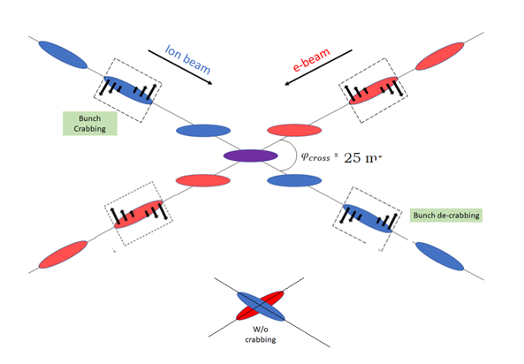
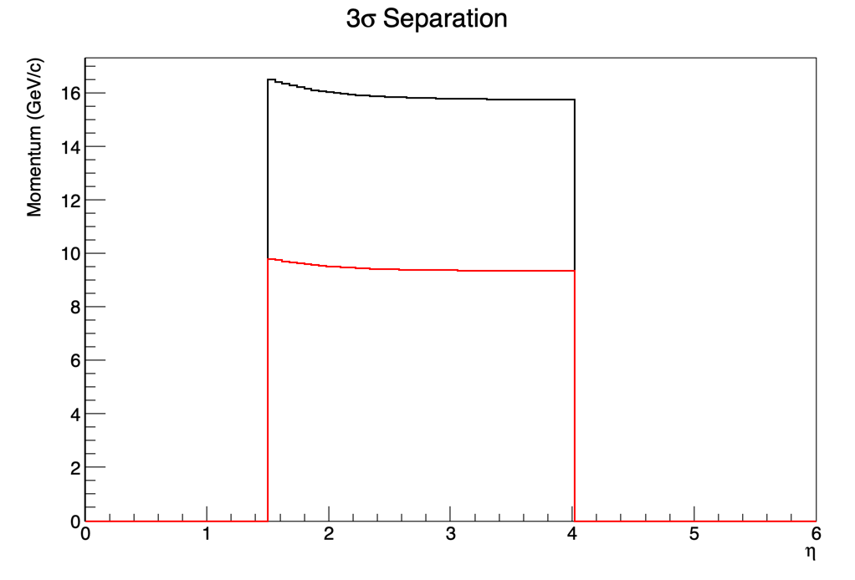


psTOF
M. Chiu
W. Li
K/p
LGAD
20 psec
𝜋/K
LAPPD
5 psec
Not TOF, but really “t₀”
Assumes 4m flight path (conflict?)
Time resolution very challenging
Multiple scattering may contribute path length uncertainty (coupling to tracking).
External start time provided by forward detectors could be helpful
Study of self-timing (Internal) using tracks
$${ early p}_{T}\left(Z\right)$$
$${ late p}_{T}\left(Z\right)$$
Crab limit vs emittance limit?
Physics p_{T} resolution required?
Polarization variation within bunch?
Needs additional study
Measure (Z,t₀); Learn Collision p_{T}

Slide 13
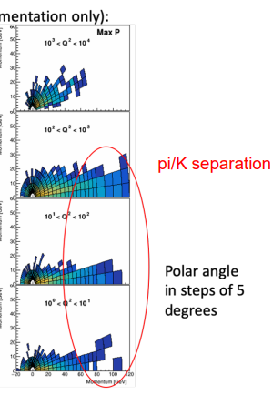
Conclusions
PID is challenging!
Tracking requirement for Cherenkov
  Parameterizations of gas Cherenkov indicate pointing required at 0.5-1.0 mrad level while inside the radiator.
  Calculations of aerogel devices indicate 0.5 -1.0 mrad level.
  Calculations of DIRC indicate 0.5 mrad level or better.
Good progress but still some open questions:
  Simulations are still preliminary except for a few detectors
  Sensors and electronics in the detector require an evaluation of radiation hardness.
  R&D on photon sensors is on going (magnetic field tolerance a primary concern:
  Visible light sensor solution for 3T magnetic field problematic.)
  No discussion on the material budget
  Available space is a driving concern for some technologies.
    Shifting vertex is expensive, but helps most technologies in hadron arm.
    Need quantitative optimization of cost/benefit
  Resolution for TOF includes multiple terms in addition to superb σ_{t}
    Clock reference/distribution
    Path length.
:

