Slide 1

Particle Identification (PID)
Barrel, h-Arm, e-Arm
  GEM RICH, mRICH, dRICH, DIRC, TOF
    Pro/Con matrix
    Requirements on “external” systems
:
Thomas K. Hemmick
Patrizia Rossi

Slide 2
Summary Table
 | p-Range (GeV) @ Radiator L | Contr. ϑ_{c} | Param. | Pro/Con | Ext Const | MONTECARLO Simulatoin
psec TOF LGAD TOF | Up to 10 Depends on σ_{T} and L | NO | ~YES | YES | ~ YES | NO
dual RICH (aerogel, gas) | 2-60 @ 1.6 m | YES Chroma Emission Pixel Field Tracking | YES | YES | YES Simulated constant w/ momentum | YES GEMC/Geant4 AI-driven Optimization
GEM RICH (Gas Electron Multipliers) | 20-50 @1m | Chroma (Emission) Pixel Tracking | YES | YES | YES | YES
modular RICH (mRICH) | 2-10 @ 3 cm | YES Chroma Emission Pixel Tracking | ~YES | YES | YES (tracking) | ~YES GEMC/Geant4 work in progress
Detection of Internally Reflected Cherenkov (DIRC) | 0.8-6 @ 1.7 cm | YES Tracking Mult. Scat Chroma, Emission, pixel | YES | YES | YES | YES GEMC/Geant4 without B-field
:

Slide 3
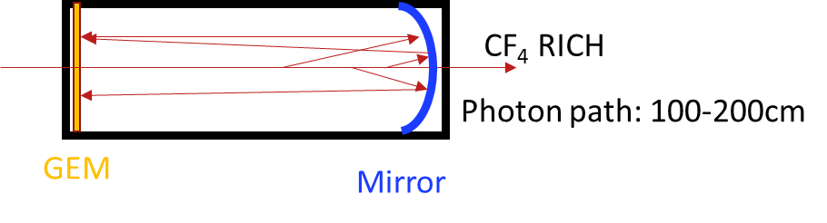
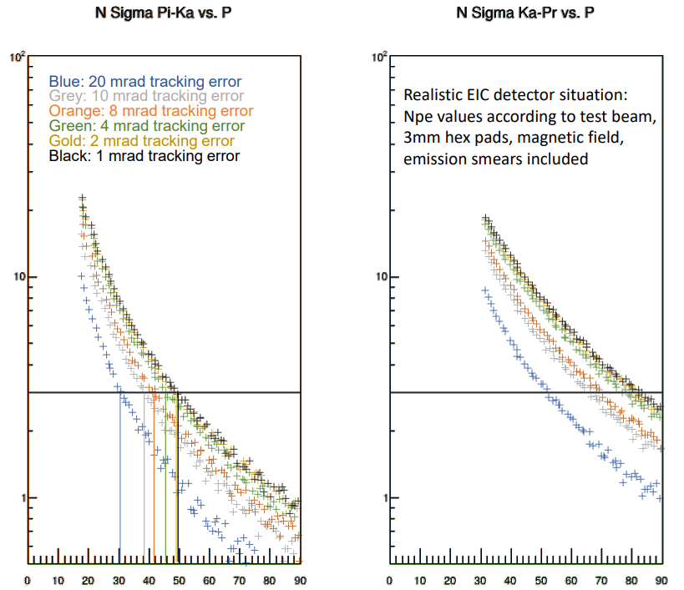
High Momentum GEM RICH
H. Klest
1m of CF₄ radiator at 1.003 bar (slightly overpressure)
CsI Photocathode on top GEM
Particles ~perpendicularly incident on spherical mirror, focused onto a GEM stack directly
γ path: 100-200 cm
Pro
  Sensor insensitive to B-field
  Short (12pe/m windowsless)
  Thin photo-cathode leads to more ideal optics.
Con
  Unknown how to bridge the gap in π-K
  Loses light with contaminants @ few ppm level -> requires superb gas system
  Photo-cathode in high radiation zone.
:
Tracking is leading error contribution if worse than ~7mrad.
Negligible resolution factor around 2 mrad.
Between 2 and 7mrad , more detailed investigation is required.
More detailed simulation required

Slide 4
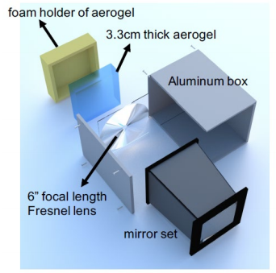
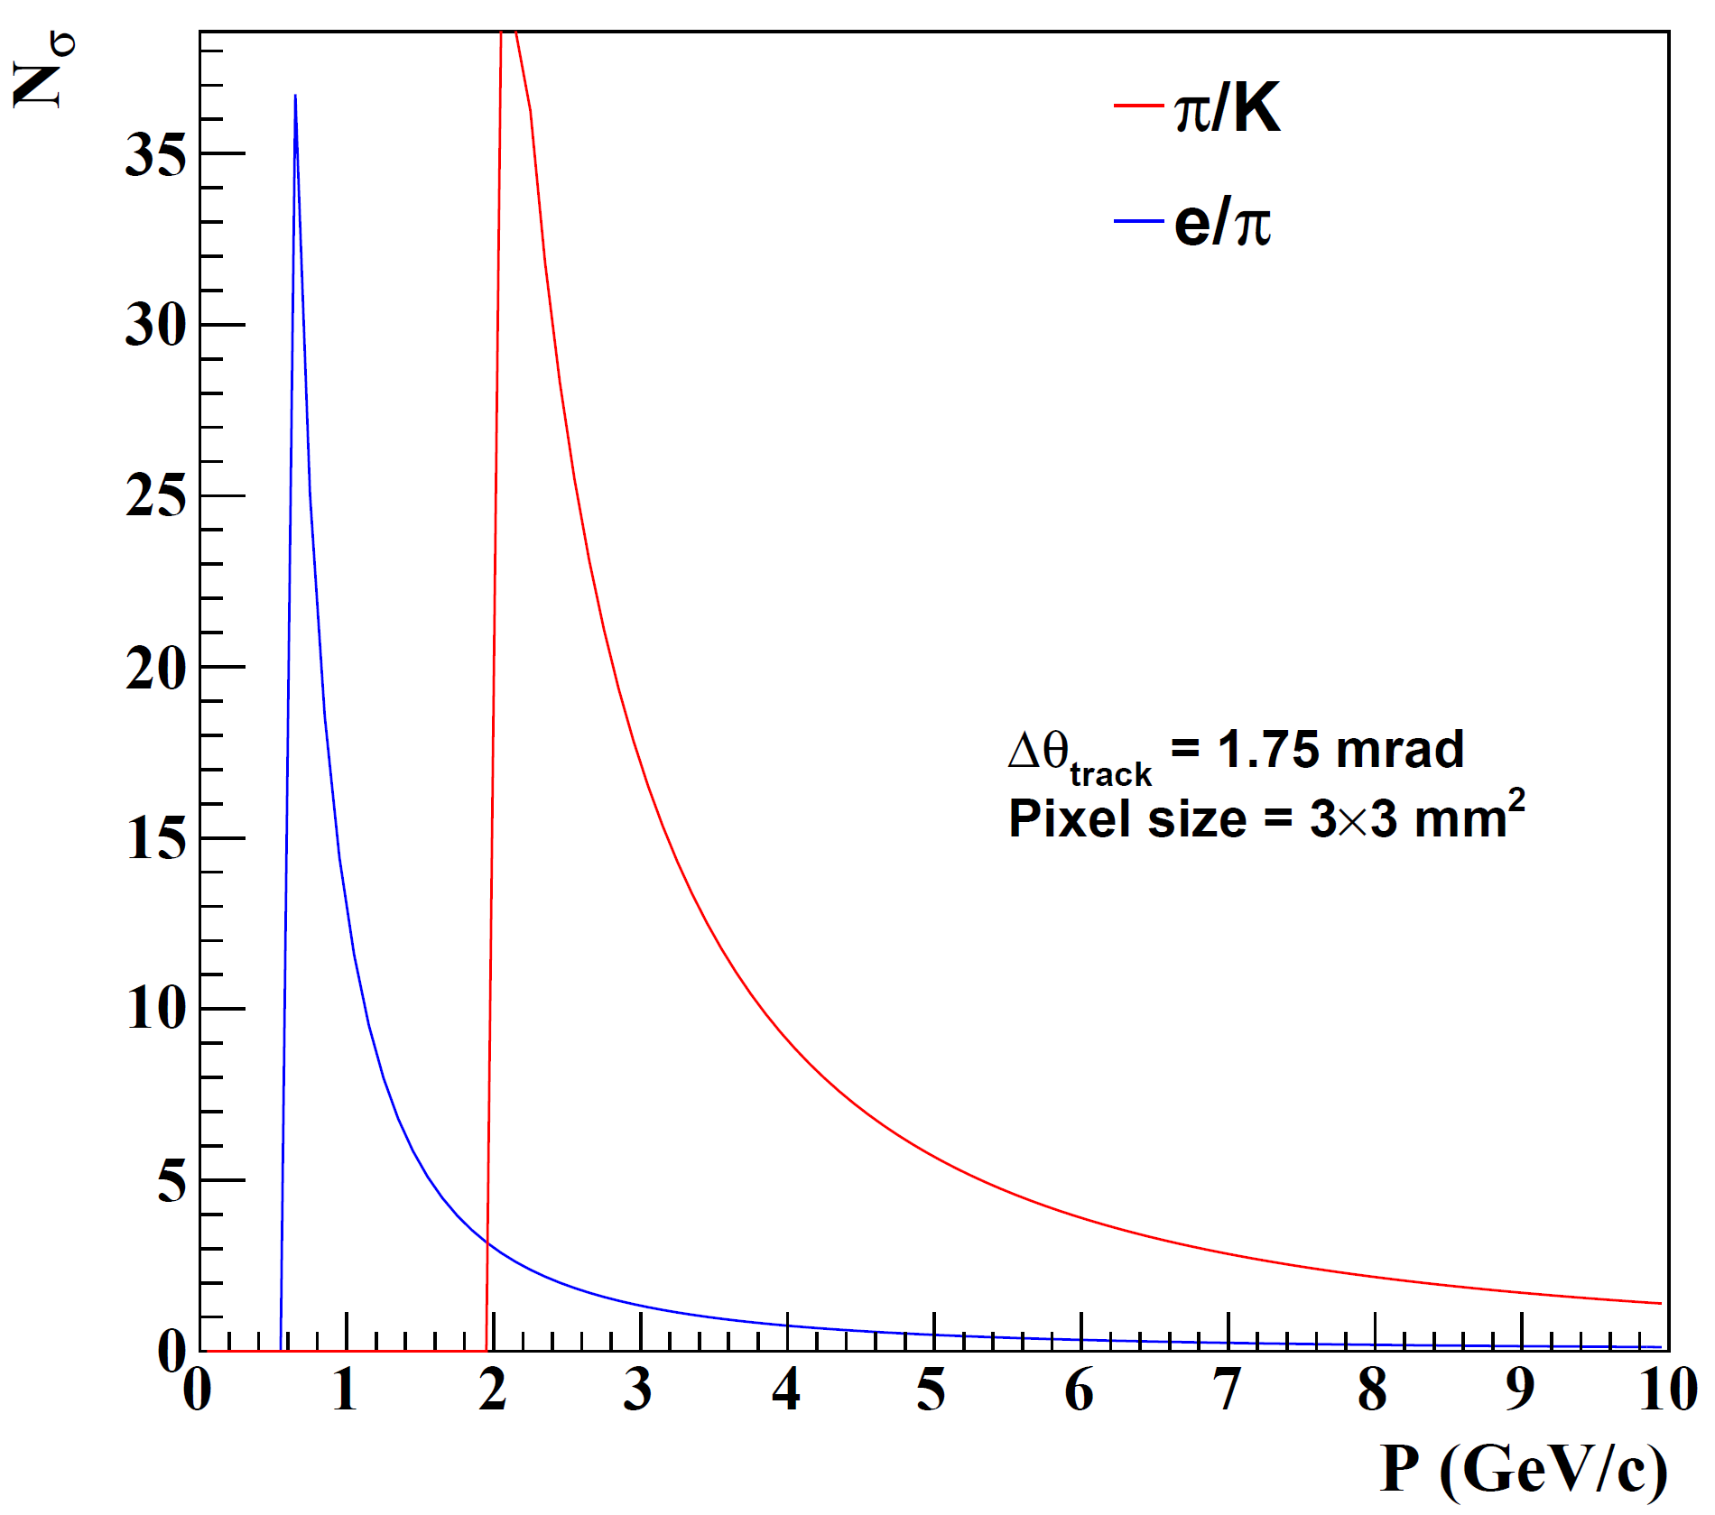
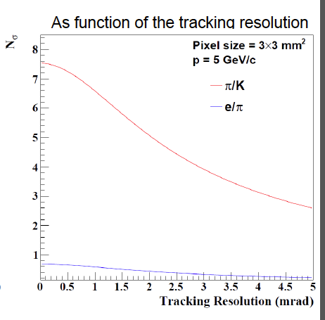
mRICH
X. He
M. Sarsour
3 cm aerogel radiator (n=1.03)
Lens with focal length, 𝑓= 6”
3mm pixel size photon detector
Pro
  Momentum coverage 3-10 GeV/c
  Modular design
  Can provide time measurements with proper sensors?
e/π excellent at lowest p
Can be configured differently for e/π or π /k separation
Tracking resolution not highly demanding
Con
  Photon sensors in high B field
  Sensors and readout electronics in the detector acceptance -> radiation hardness concern
More quantitative estimate of dead area (foam holder/box/Fresnel corners).

Slide 5
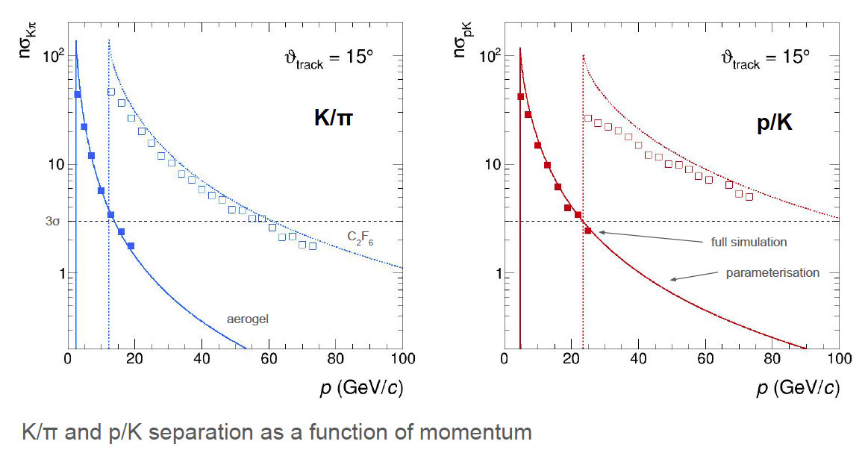
dRICH
E. Cisbani
M. Contalbrigo
R. Preghenella
4 cm aerogel (n=1.03) + 160 cm C₂F₆
Mirrors
3mm pixel size 200-500 nm MAPMT
Pro
  > 3σ π/K separation in 3-50 GeV/c
  Photon detector out of acceptance
  Material budget likely smaller than 2 detectors solution
Con
  More demanding PID
  R&D on photon sensors needed
  Aerogel chromatic performance critical
  Gas procurement could be an issue
Exquisite detail in simulation
AI-based optimization
Good parametrization
External assumption
Constant external angular resolution: s=0.5mrad
Momentum resolution:+/- few %
Magnetic field : 3 Tesla.
More quantitative estimate of the material budget

Slide 6
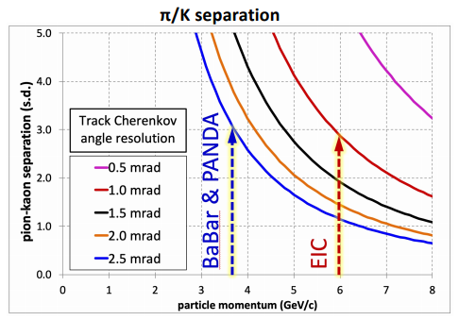
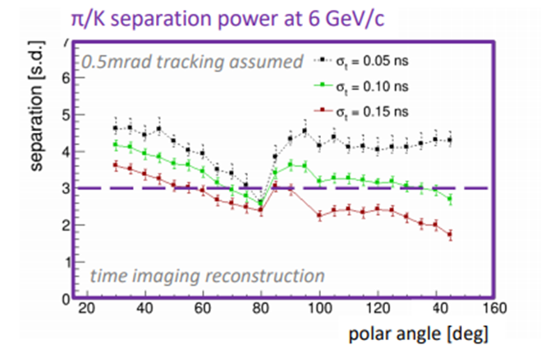
DIRC
G. Kalicy
J. Schwiening
1m barrel radius, 16 sectors
176 bars of synthetic fused silica,17mm (T) ´ 32mm (W) ´ 4200mm (L)
Photo sensors: MCP-PMTs -3x3mm2 pixels
Pro
  Excellent performance over wide angular range: >3σ π/k up to 6 GeV/c; low mom e/π (3σ @ 1 GeV/c)
  Radially compact
  Supplemental ToF measurement
Con
  Potential challenge of integrating expansion volume
  No currently proven sensor solution for 3 T magnetic field
More R&D on sensors

Slide 7
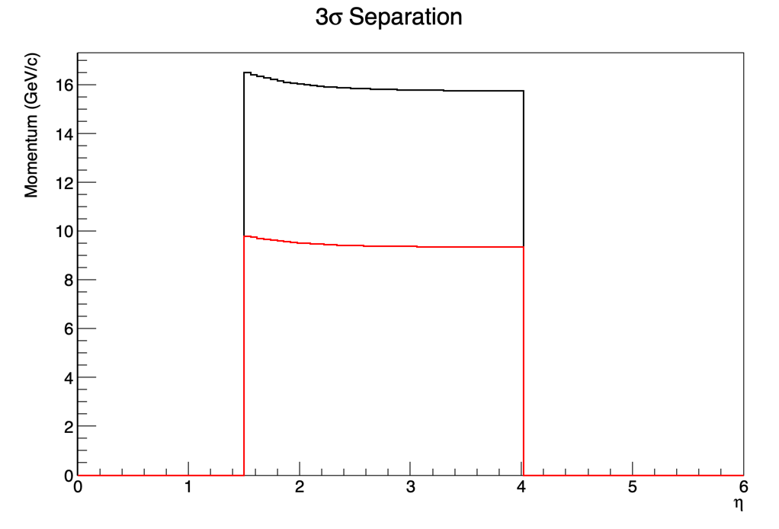
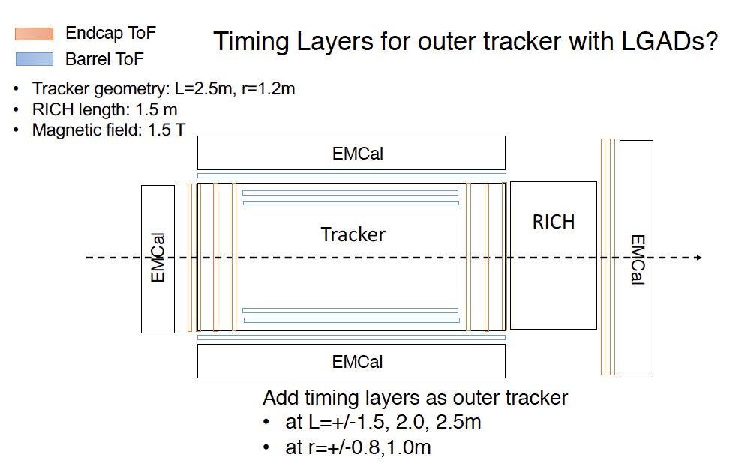
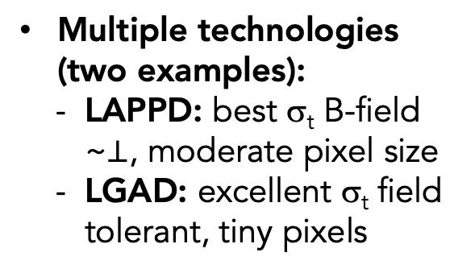
psTOF
M. Chiu
W. Li
K/p
LGAD
20 psec
𝜋/K
LAPPD
5 psec
Assumes 4m flight path (conflict?)
Time resolution very challenging
Multiple scattering may contribute path length uncertainty (coupling to tracking)
Requires understanding of t₀ counter
Multiple technologies (two examples):
  LAPPD: best σ_{t} B-field ~$⊥$, moderate pixel size
  LGAD: excellent σ_{t} field tolerant, tiny pixels

Slide 8
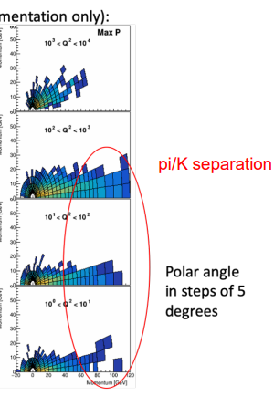
Conclusions
PID is challenging!
Tracking requirement for Cherenkov indicates 0.5 -1.0 mrad level
Good progress but still some open questions:
  Simulations are still preliminary except for a few detectors
  Sensors and electronics in the detector require an evaluation of radiation hardness.
  R&D on photon sensors is on going (magnetic field tolerance a primary concern:
  Visible light sensor solution for 3T magnetic field problematic.)
  No discussion on the material budget
  Available space is a driving concern for some technologies.
    Shifting vertex is expensive, but helps most technologies in hadron arm.
    Need quantitative optimization of cost/benefit
  Resolution for TOF includes multiple terms in addition to superb σ_{t}
    Clock reference/distribution
    Path length.
Address e-π separation between now and the next YR meeting
Work on PID detector envelop
:

