Slide 1
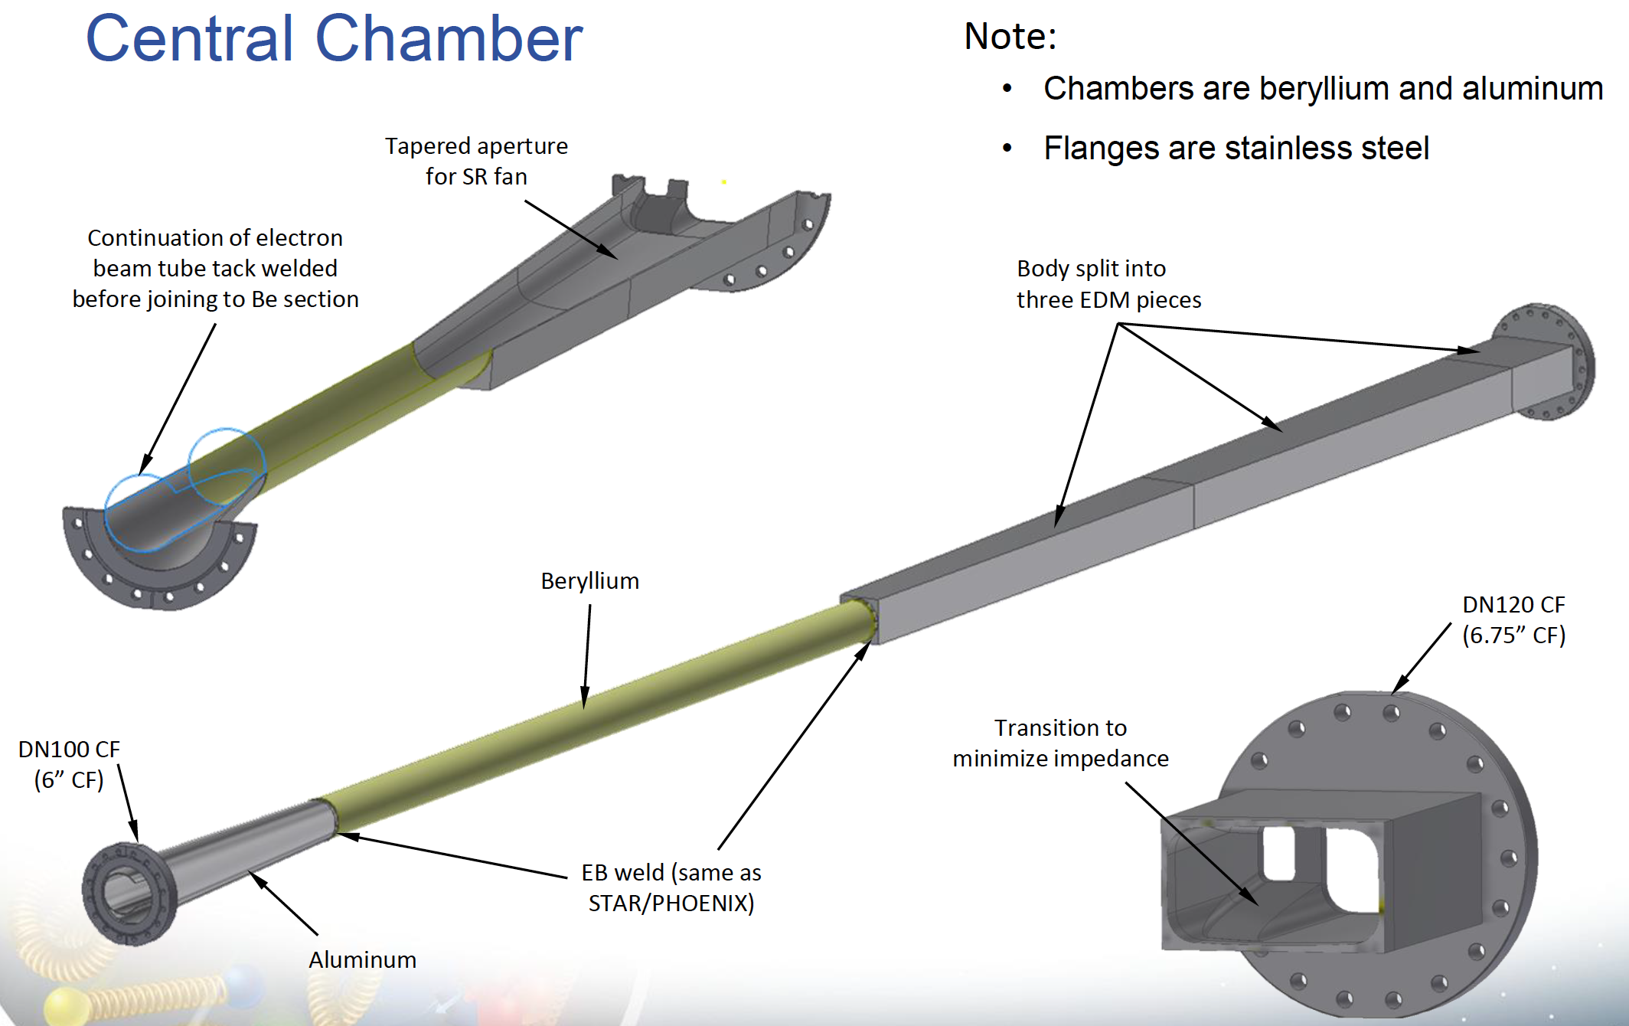
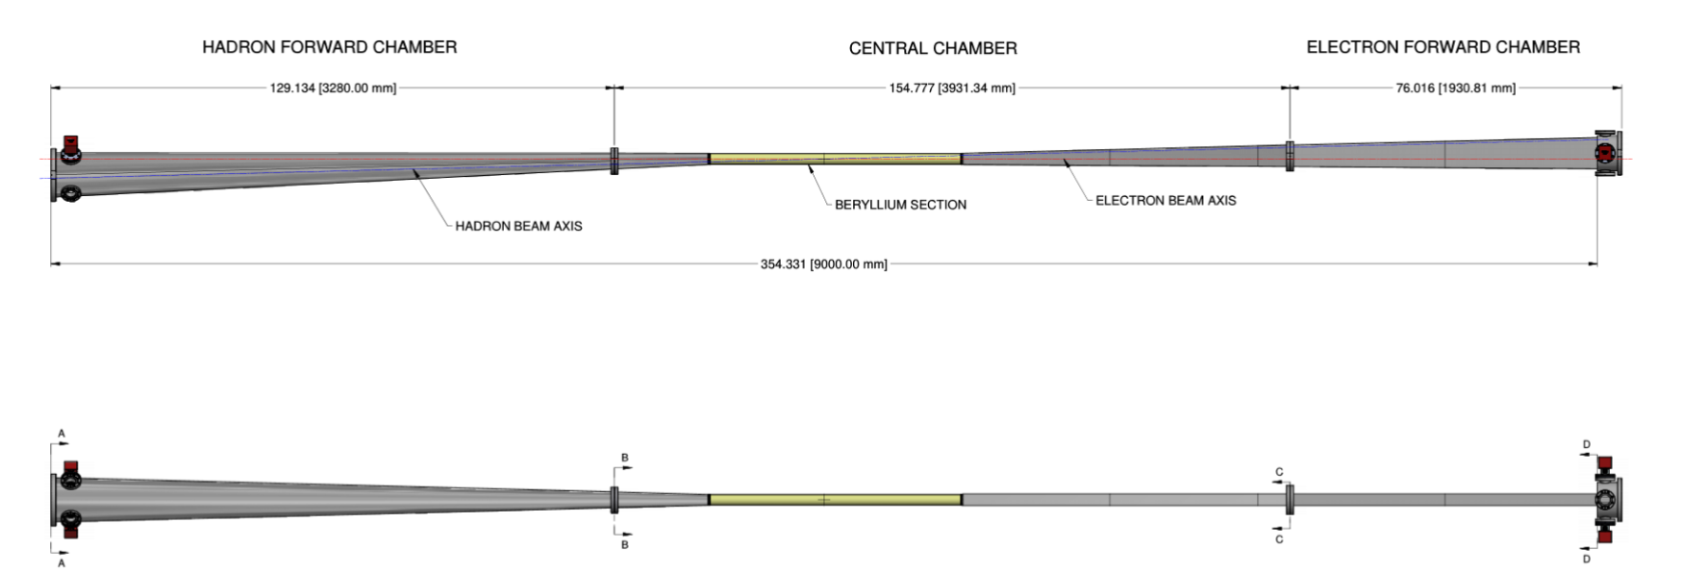
Beampipe, electron acceptance
Material in acceptance, [%]
First Si disk at this distance, [cm]
Central area ( around IP) ok
Beryllium beampipe
Diameter 62.0 mm inner, 63.5 mm outer
Later: water cooling
Cones & rectangles: Al (needs improvement)
Plots: -4.5 < η < -3.5 band; white circle: η = -4.0
+/- 60 mrad
+/- 60 mrad
+/- 60 mrad
+/- 4.5 m
< 1.5 m
Side view

Slide 2
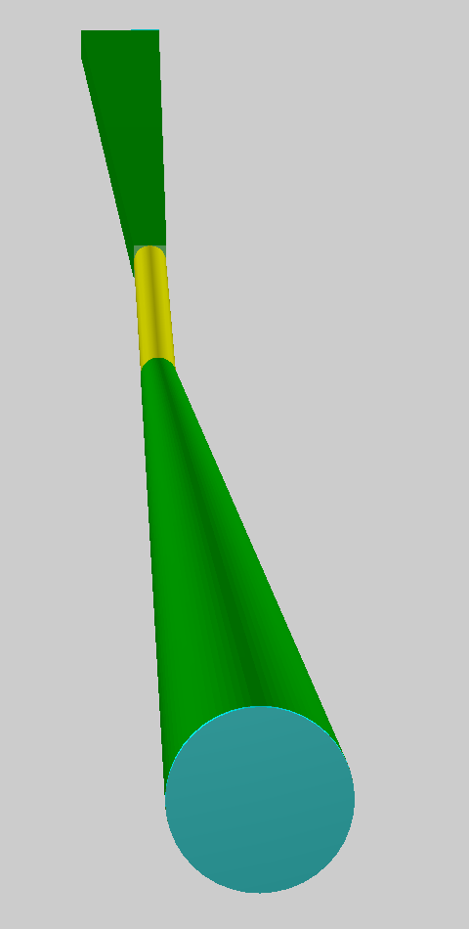
Beampipe, hadron acceptance
Material in acceptance, [%]
First Si disk at this distance, [cm]
Central area ( around IP) ok
Beryllium beampipe
Diameter 62.0 mm inner, 63.5 mm outer
Later: water cooling
H-pipe cone: Al (needs improvement)
Plots: 3.5 < η < 4.5 band; white circle: η = 4.0
+/- 60 mrad
ROOT TGeo model used for the scans
+/- 60 mrad
+/- 60 mrad
+/- 4.5 m
< 1.5 m
Top view

