Slide 1
The EIC IR and diffractive eA physics
Wan Chang
2020/05/21

Slide 2
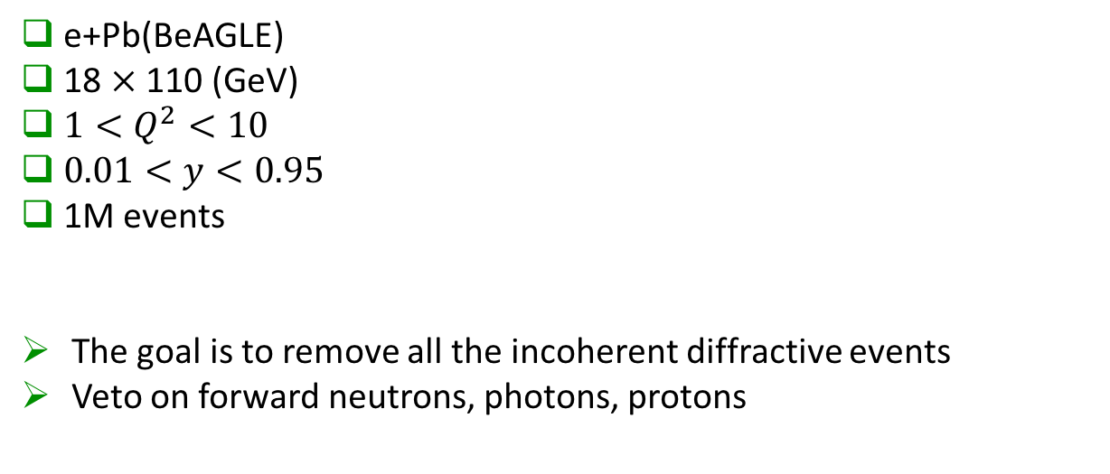
Data sample
e+Pb(BeAGLE)
18 $×$ 110 (GeV)
$1<Q^{2}<10$
$0.01<y<0.95$
1M events
The goal is to remove all the incoherent diffractive events
Veto on forward neutrons, photons, protons

Slide 3
Neutron
Beagle Distribution before cuts
4
cut
Neutrons to be detected in
ZDC: Θ < 5.5 mrad

Slide 4
Photon
Beagle Distribution before cuts
50 MeV
150 MeV
Photons to be detected in ECal part of ZDC Θ < 5.5 mrad
Challenge lowest detectable photon energy
cut

Slide 5
Proton
Beagle Distribution before cuts
Protons to be detected in
Roman Pots: 0 – 5 mrad
B0-Si detectors: 5.5 – 20 mrad
off-p Si Detectors: 0 – 5 mrad

Slide 6
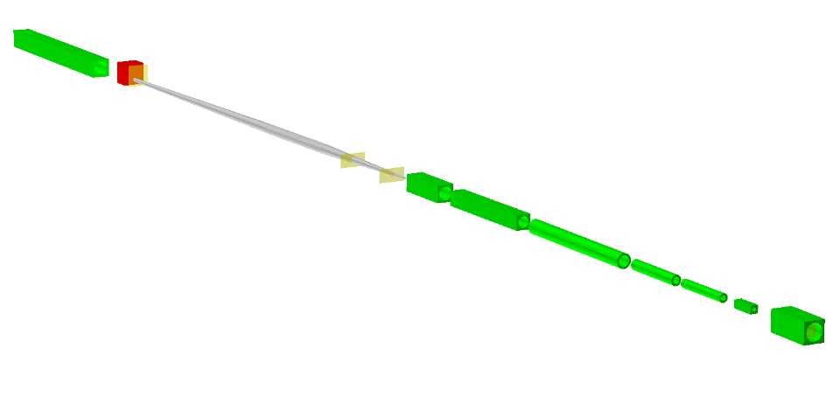

Layout and Acceptances
IR: Outgoing Hadron Beam
ZDC
Roman pots (inside pipe)
B1apf dipole
Hadron beam coming from IP
Off-Momentum Detectors
B0pf dipole
B0 Silicon Detector
Detector | Angular Acceptance | Notes
ZDC | 𝜽 < 5.5 mrad | About 4.0 mrad at ϕ ~ 𝜋
Roman Pots | 0.0 < 𝜽 < 5.0 mrad | Need 10σ cut.
Off-Energy Detectors | 0.0 < 𝜽 < 5.0 mrad | .4 < x_{L} < .6
B0 Sensors | 5.5 < 𝜽 < 20.0 mrad | .4 < x_{L} < .6
$$x_{L}=\frac{p_{z, nucleon}}{p_{z, beam}}$$

Slide 7
Event distribution
The impact of the different detectors is studied by adding one requirement / cut after the other.
Cut1:
no neutron in ZDC
Cut2 :
Cut1 + no photon E>50MeV in ZDC
Cut3:
Cut2 + no proton in Roman Pots
Cut4:
Cut3 + no proton in off-energy detector
Cut5:
Cut4 + no proton in B0
The survived events count after Cut2 with different energy cut on photon:
Survived event count
Total events | 1000000
Cut1 | 132127
Cut2 | 66101
Cut3 | 66099
Cut4 | 61487
Cut5 | 55792
Survived event count
E>150 MeV | 71773
E>50MeV | 66101
E>0 MeV | 65278

Slide 8
Back up

Slide 9
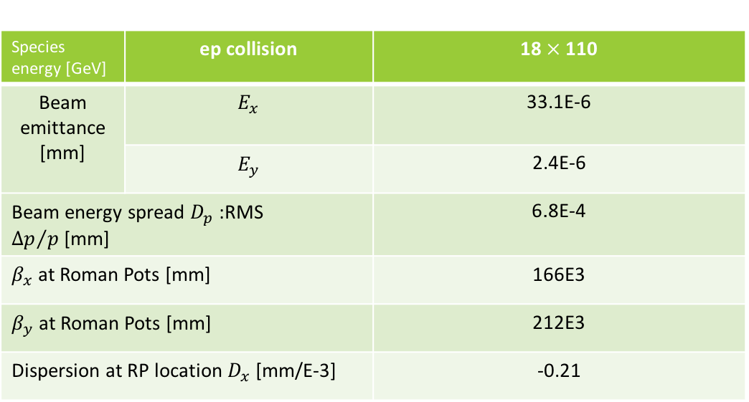
Beam parameters set up
Species energy [GeV] | ep collision | 18 $×$110
Beam emittance [mm] | $$E_{x}$$ | 33.1E-6
 | $$E_{y}$$ | 2.4E-6
Beam energy spread $D_{p}$ :RMS ${∆p}/{p }$[mm] |  | 6.8E-4
$β_{x}$ at Roman Pots [mm] |  | 166E3
$β_{y}$ at Roman Pots [mm] |  | 212E3
Dispersion at RP location $D_{x}$ [mm/E-3] |  | -0.21

Slide 10



Rigidity
rigidity is the effect of particular magnetic fields on the motion of the charged particles, it refers to the fact that a higher momentum particle will have a higher resistance to deflection by a magnetic field.
$$Rigidity=\frac{p}{q}\sim \frac{A}{Z}$$
$$\frac{mv^{2}}{r}=qvB$$
$$\frac{p}{q}=Br$$
p: momentum
q: charge
A: mass number
Z: proton number
Pb: A$→$208, Z$→$82
Proton: A$→$1, Z$→$1
Dipole magnet
n ($θ$=0)
p
n ($θ$=0)
A (beam)
p
Forward proton acceptance in e+A is DIFFERENT from e+p.

