Slide 1
Material Budget requirements
(kickoff meeting)
Yulia Furletova

Slide 2
Outline
We need as less as possible material at all directions !
End of the talk.

Slide 3
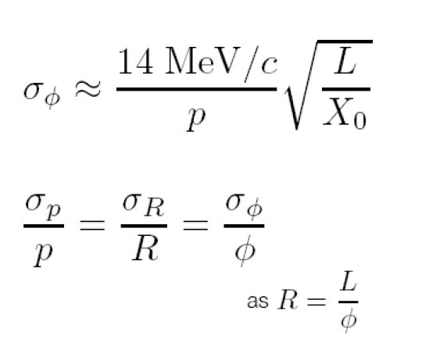
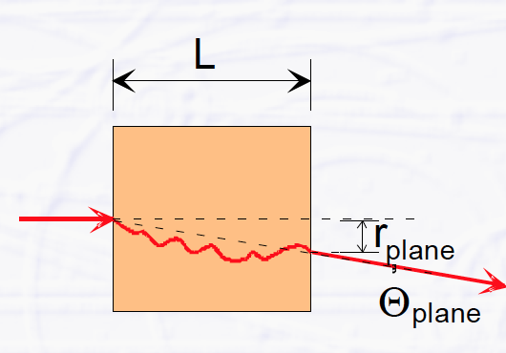
Multiple scattering
-Multiple scattering change the trajectory of charged particle (that’s why we hate it! )
-The smaller the momentum of the particle, the higher the effect of multiple scattering
-Depends on distance and density of a material
Momentum independent!

Slide 4
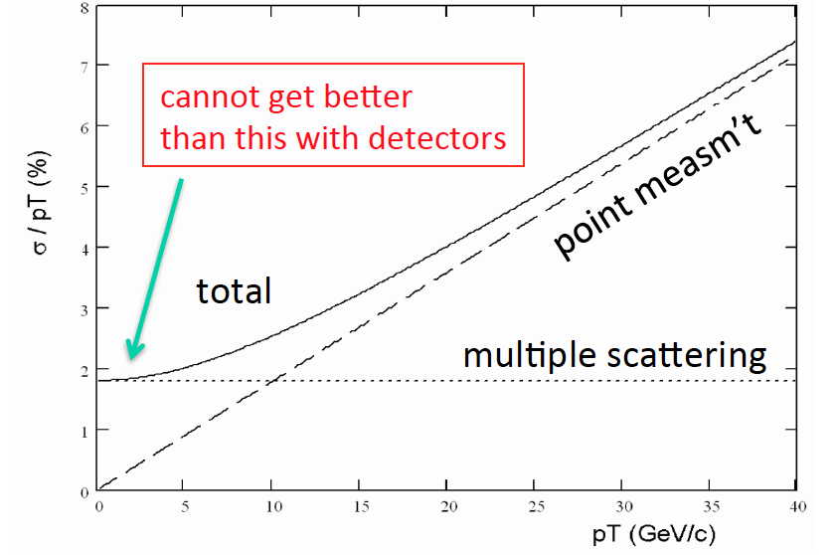
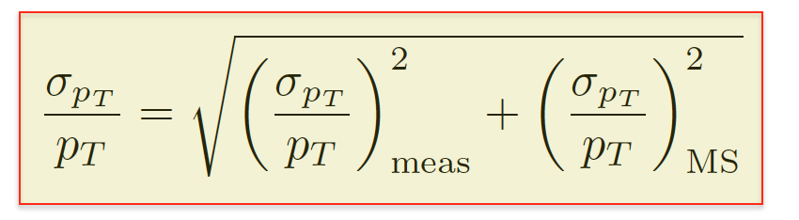
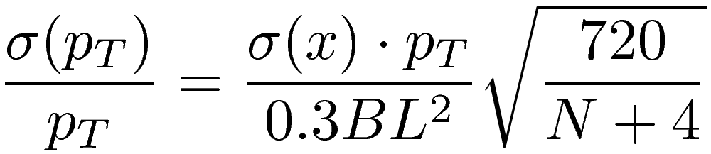
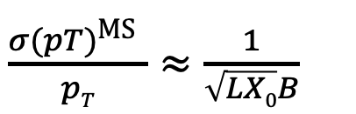

Momentum resolution
example
Position resolution (N>10) :
meas
Multiple scattering:
$\frac{σ(pT)\text{MS} }{pT}≈\frac{1}{\sqrt{LX0}B}$
Conclusion:
-Optimize material effects (multiple scattering )
optimize amount of material along particle track (sensitive area (Si), support structure, cables.. )
p_{T} [GeV] = 0.3$∙$ B [T] $∙$ R [m]

Slide 5
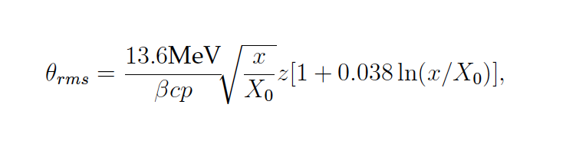
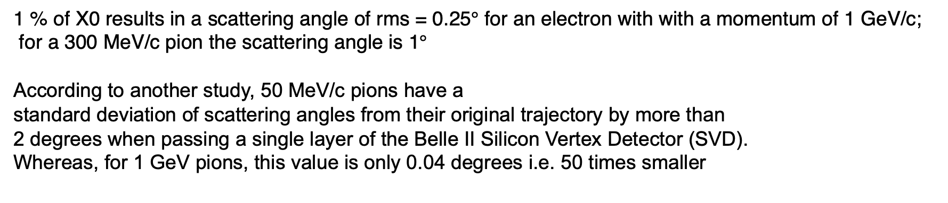
Multiple scattering angle
1 % of X0 results in a scattering angle of rms = 0.25$°$ for an electron with with a momentum of 1 GeV/c;
for a 300 MeV/c pion the scattering angle is 1$°$
According to another study, 50 MeV/c pions have a
standard deviation of scattering angles from their original trajectory by more than
2 degrees when passing a single layer of the Belle II Silicon Vertex Detector (SVD).
Whereas, for 1 GeV pions, this value is only 0.04 degrees i.e. 50 times smaller
Waleed Ahmed thesis “Material Budget Studies for the Belle II Detector”

Slide 6
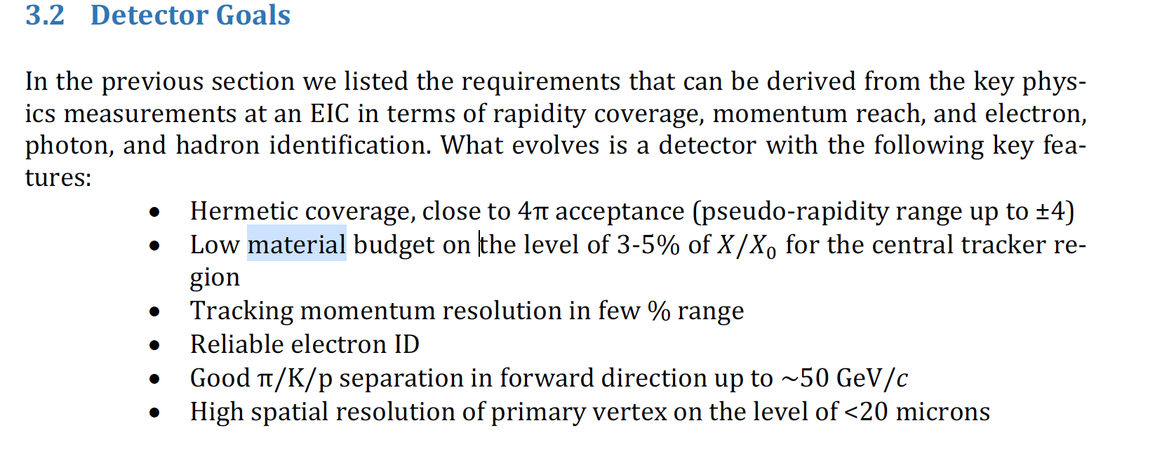
Why it is important to keep low material budget for EIC detector and requirements:
Compared to HEP, EIC is a low energy machine => with much lower momenta for charged particles
Minimize multiple scattering for low-momenta charged particles in central detector
Minimize unwanted photon conversion in front of calorimeter
EIC HANDBOOK:

Slide 7
Electron-endcap

Slide 8
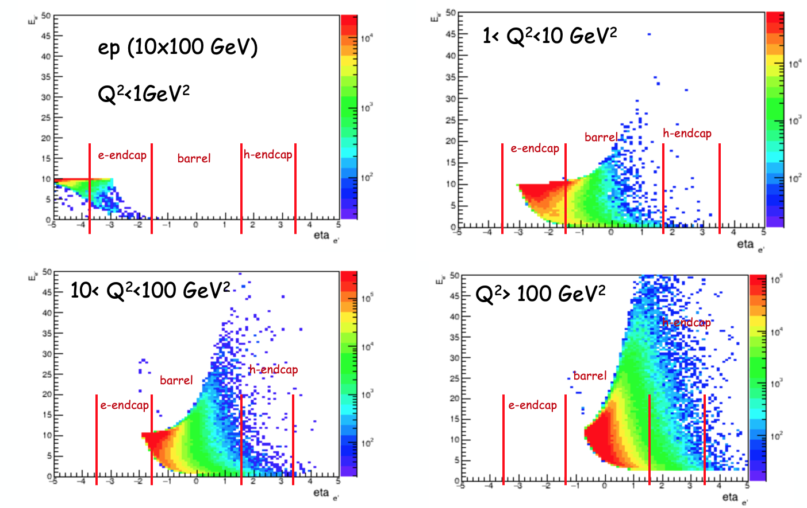
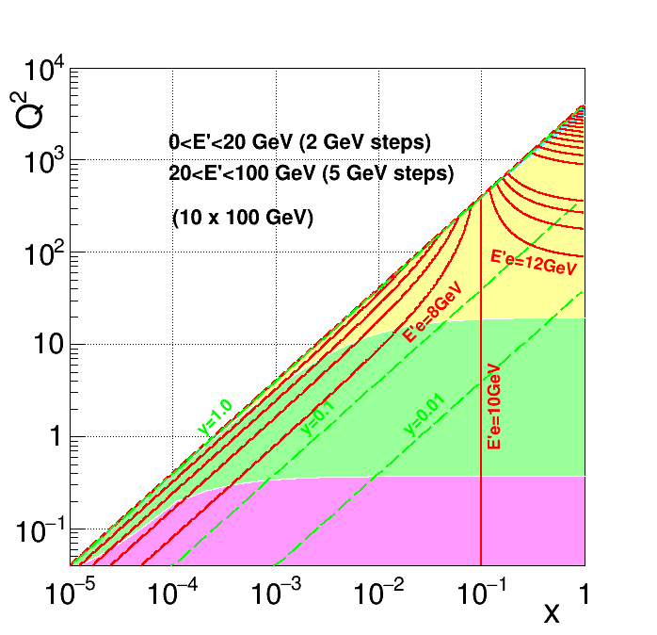
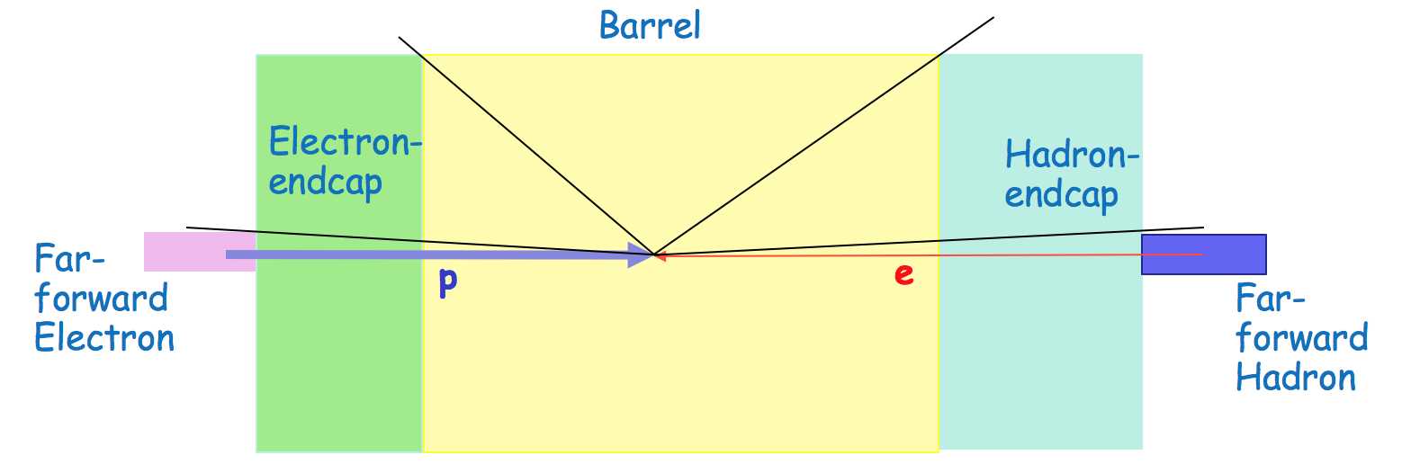
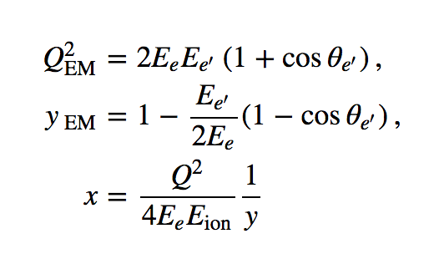



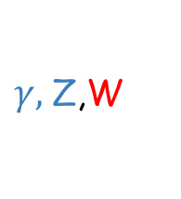
Electron Endcap
e’, $ν$
e
$γ,$Z,W
p/A
q
p remnant
Electron endcap
(green)
~147$°$
$η\sim$-1.2
Electrons mostly scatters to electron-endcap (green),
Their energy/momentum are low (below initial e-beam energy)
Precision measurements of the electron scattered angle => defines precision measurements of Q²
~176$°$
$η\sim −3$.5
Scattered angle => Q²

Slide 9
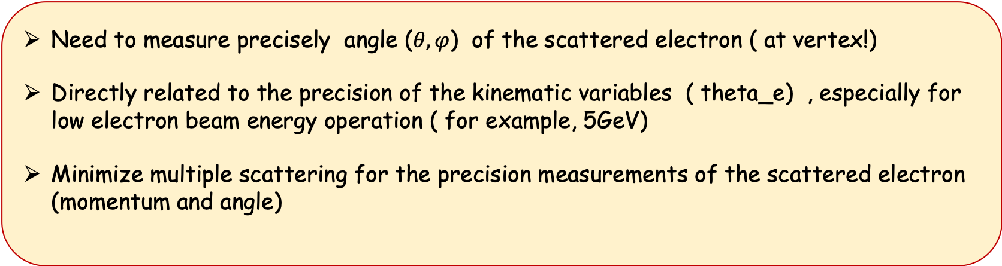
Electron Endcap
Need to measure precisely angle ($θ,φ$) of the scattered electron ( at vertex!)
Directly related to the precision of the kinematic variables ( theta_e) , especially for low electron beam energy operation ( for example, 5GeV)
Minimize multiple scattering for the precision measurements of the scattered electron (momentum and angle)

Slide 10
Barrel

Slide 11


Barrel
Scattered electrons: from very low to very high ( above initial beam energy) - depending on Q²
Barrel (yellow)
~147$°$
$η\sim$-1.2
~176$°$
$η\sim −3$.5
minimize multiple scattering for the precision measurements of the scattered electron / kinematics
Scattered angle => Q²

Slide 12

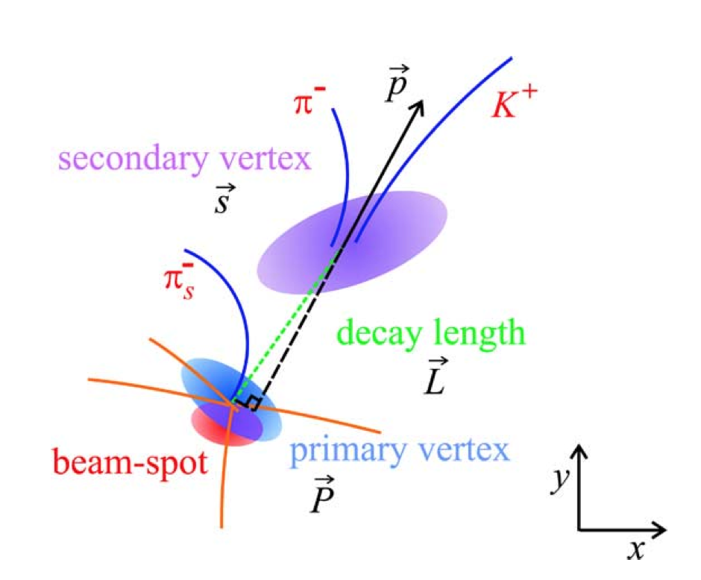
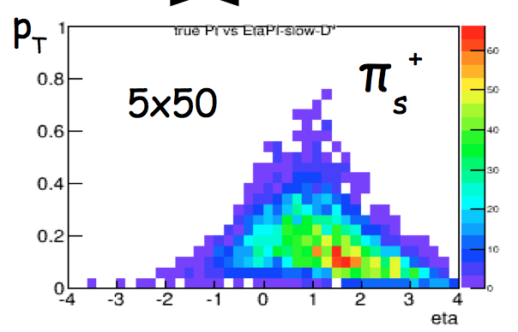
Barrel
Beampipe: Beryllium!
First few layers of Vertex detector with minimum material (including sensitive area, support structure, cooling, cabling, readout, etc.
=> “Vertex detector are going towards 0.1-0.2% X₀ per layer”
(EIC detector HANBOOK)
“To protect sensitive detector from beam-induced background beampipe needs proper cooling and isolation, which increases both the material budget and the effective beam pipe radius”(EIC detector HANBOOK)
[GeV]
Need minimum material in the barrel, to minimize multiple scattering for low-pt particles
(invariant mass resolution)

Slide 13
Hadron endcap

Slide 14
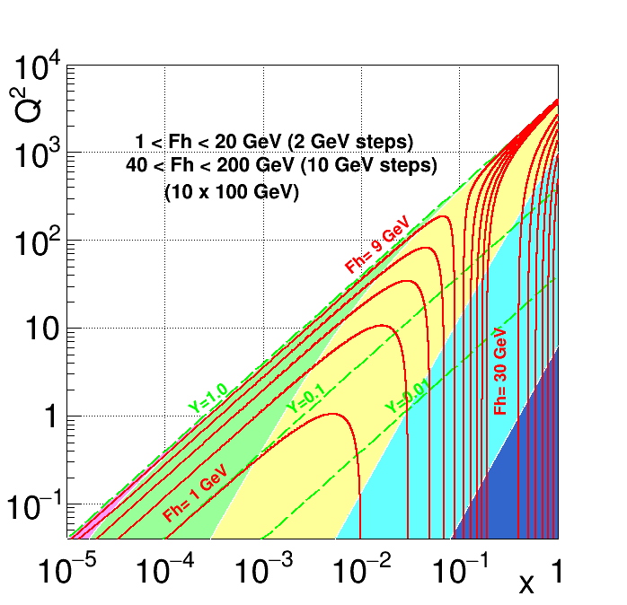




Hadron-endcap
Hadron endcap
(blue)
~176.5$°$
$η\sim −3$.5
~147$°$
$η\sim$-1.2
~21$°$
$$η\sim 1.7$$
~3.5$°$
$η\sim 3$.5
Scattered electron’s energy/momentum is very high… hadrons/jets energies are high … but !

Slide 15
Hadron-endcap
But…. Due to the kinematic boost, most of the decay particles also goes into the hadron-endcap ( decay products of J/PSI, Charm, etc…)
Their energy/momentum are not so high …. and a multiple scattering will effect an invariant mass resolution
Since we relay only on solenoid filed, and measure Pt, which is small … a multiple scattering will play a role for reconstruction of the total momenta.

Slide 16
Preliminary estimates

Slide 17
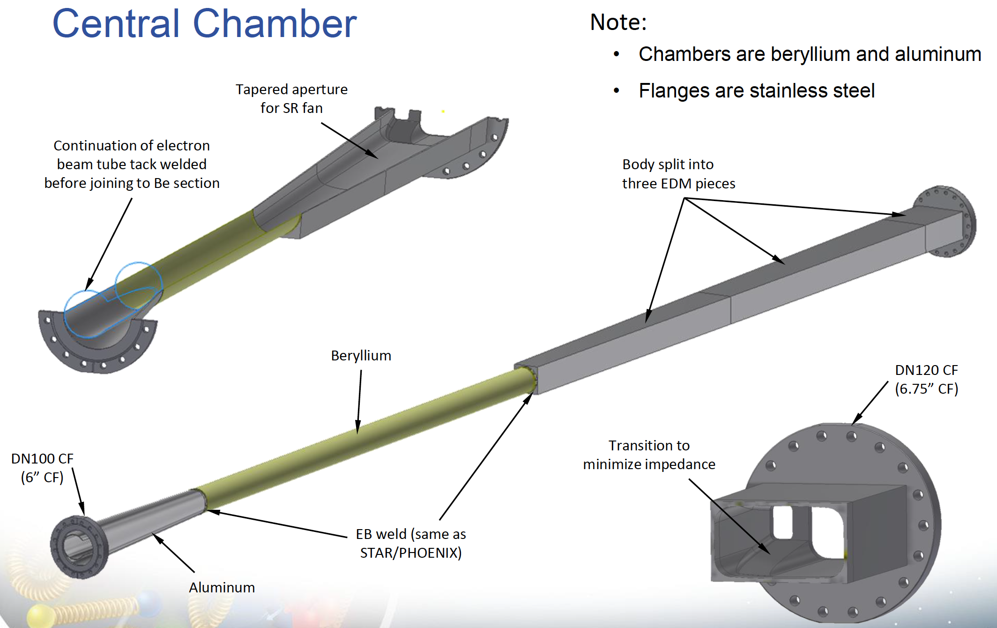
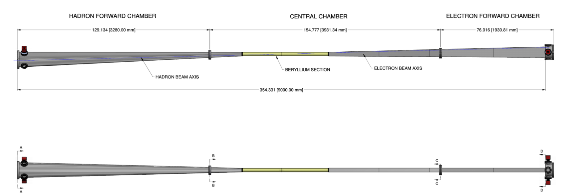
Beampipe, electron acceptance
A. Kiselev
Material in acceptance, [%]
First Si disk at this distance, [cm]
Central area ( around IP) ok
Beryllium beampipe
Diameter 62.0 mm inner, 63.5 mm outer
Later: water cooling
Cones & rectangles: Al (needs improvement)
Plots: -4.5 < η < -3.5 band; white circle: η = -4.0
+/- 60 mrad
+/- 60 mrad
+/- 60 mrad
+/- 4.5 m
< 1.5 m
Side view

Slide 18
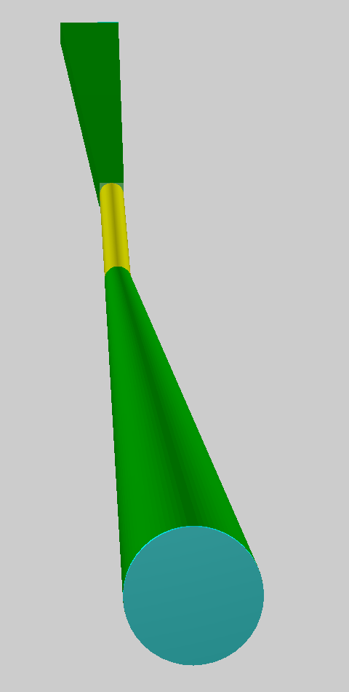
Beampipe, hadron acceptance
A. Kiselev
Material in acceptance, [%]
First Si disk at this distance, [cm]
Central area ( around IP) ok
Beryllium beampipe
Diameter 62.0 mm inner, 63.5 mm outer
Later: water cooling
H-pipe cone: Al (needs improvement)
Plots: 3.5 < η < 4.5 band; white circle: η = 4.0
+/- 60 mrad
ROOT TGeo model used for the scans
+/- 60 mrad
+/- 60 mrad
+/- 4.5 m
< 1.5 m
Top view

Slide 19
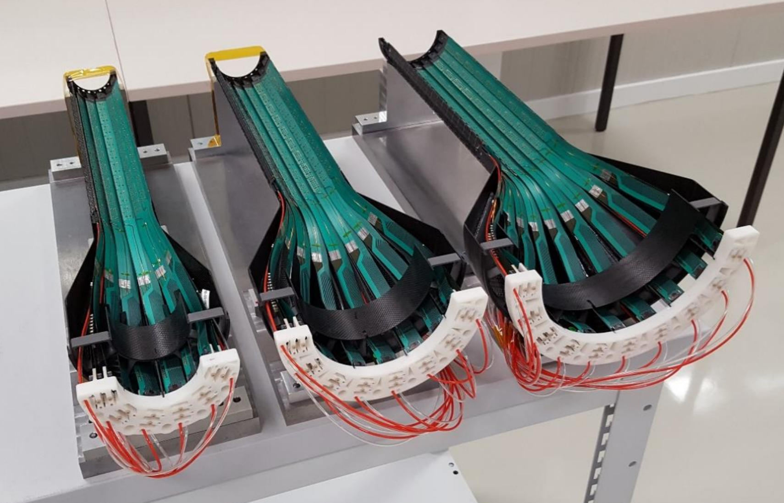
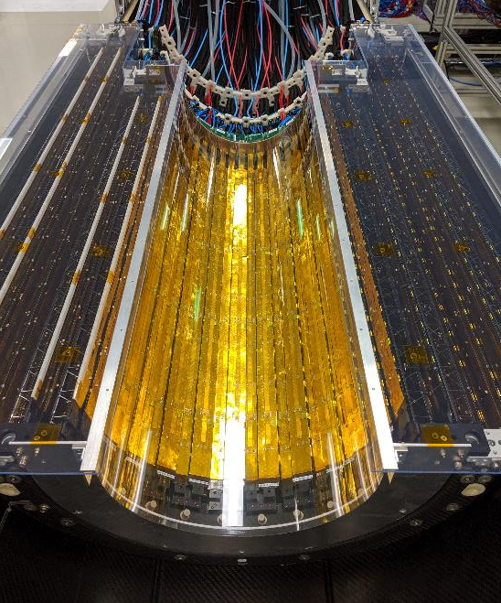
Leo Greiner
(see next talk)
What to expect for radiation lengths for EIC structures - Current SOTA
ALICE ITS layers 0-2
0.3% per layer
ALICE ITS layers 3-6
~1.1% per layer
ITS2 Vertexing:
ITS2 Barrel:
50 um thick silicon
Water cooled
Aluminum conductor data/power flex-PCBs

Slide 20
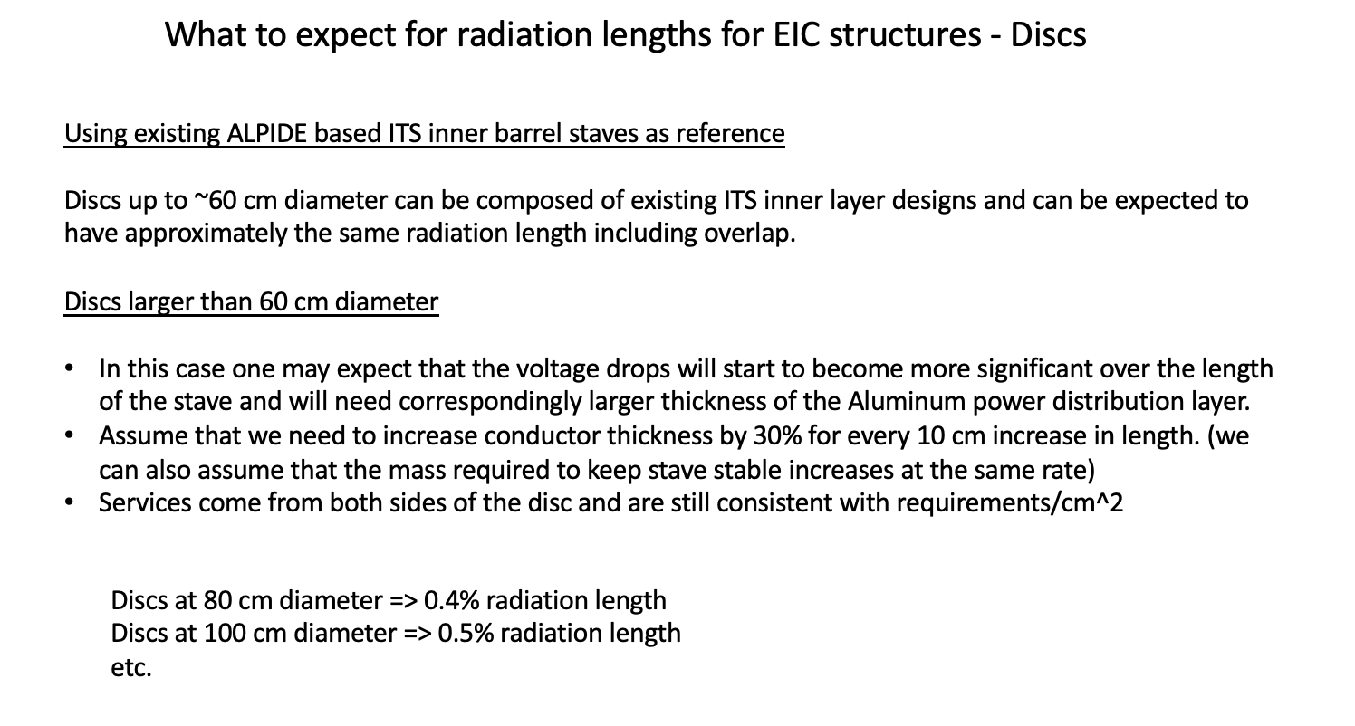
Leo Greiner
(see next talk)

Slide 21
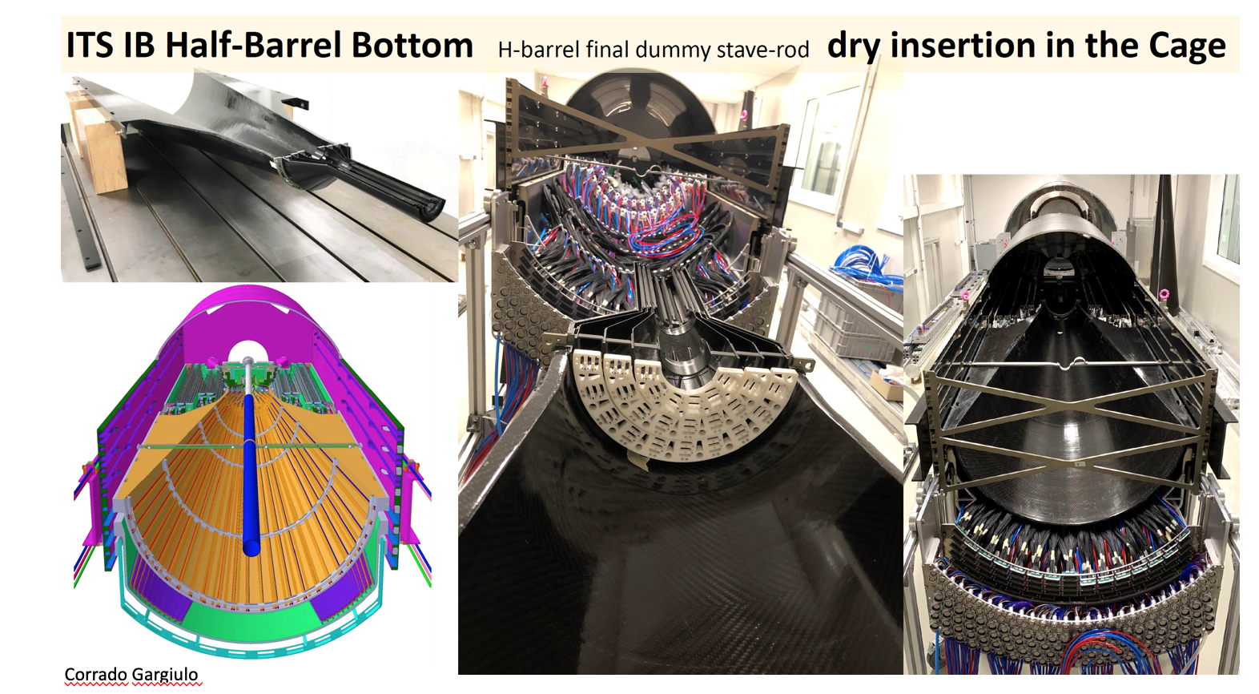
Leo Greiner
( see next talk)

Slide 22
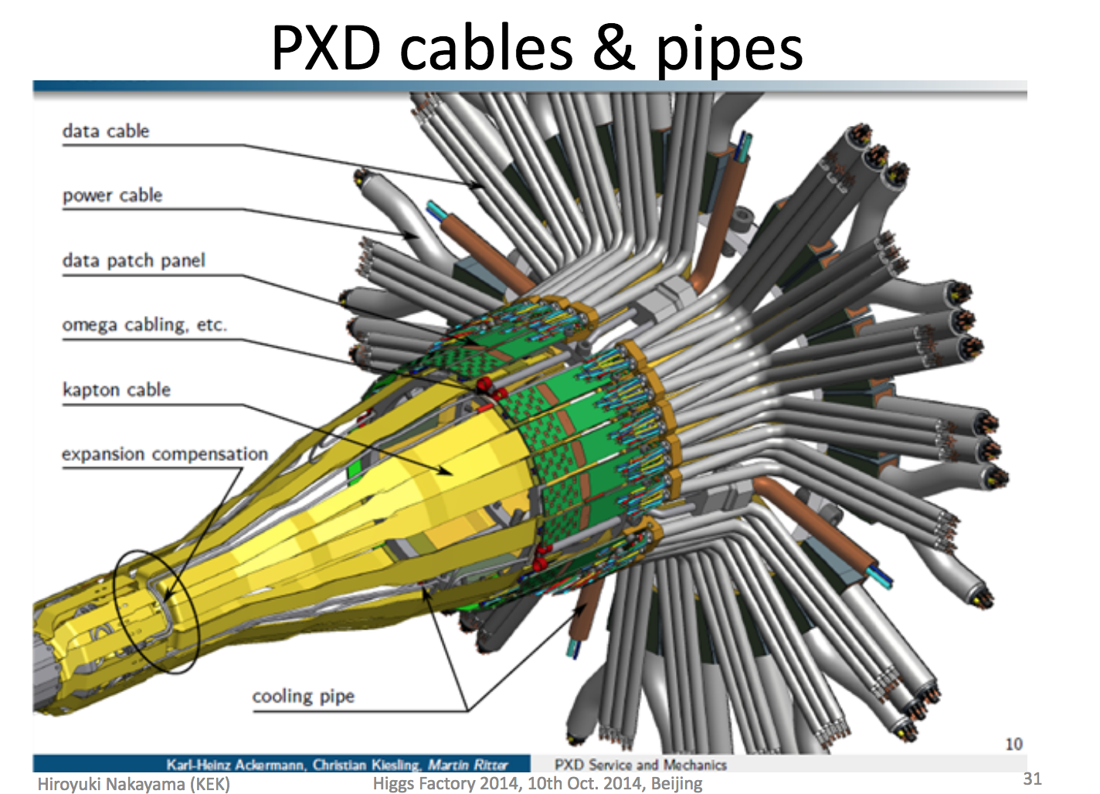
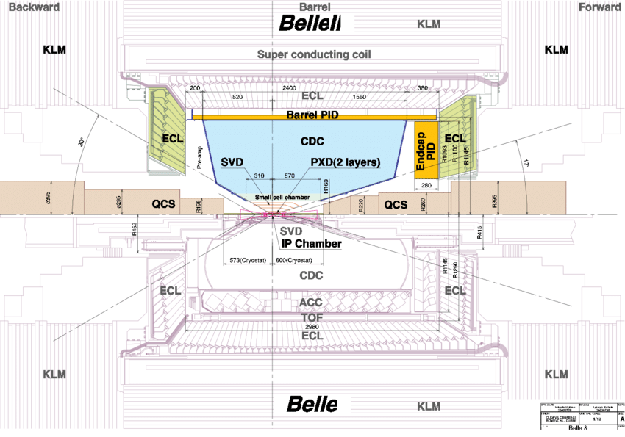
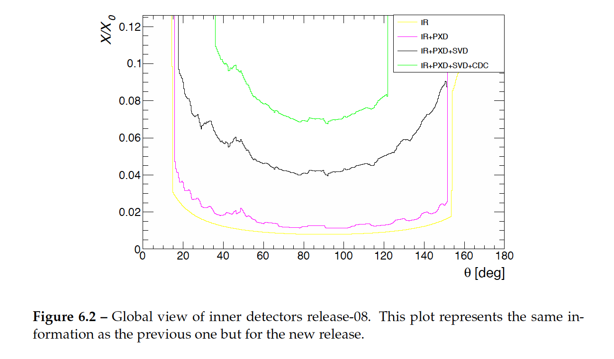
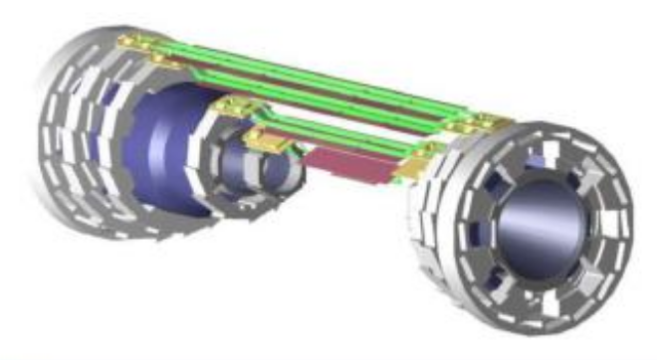
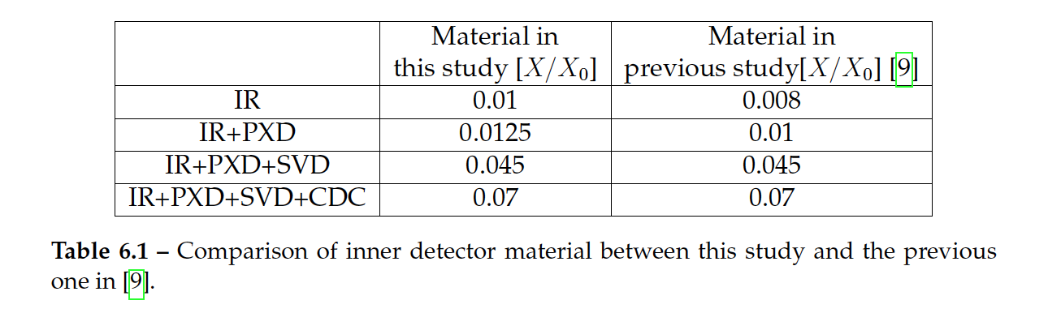
Belle-II PXD
Cables, pipes, support structures for vertex detector
Relatively symmetric accelerator energy design, mosty measure at central rapidity.
2 layers PXD ~ 0.2 % X₀!!!
Waleed Ahmed

Slide 23
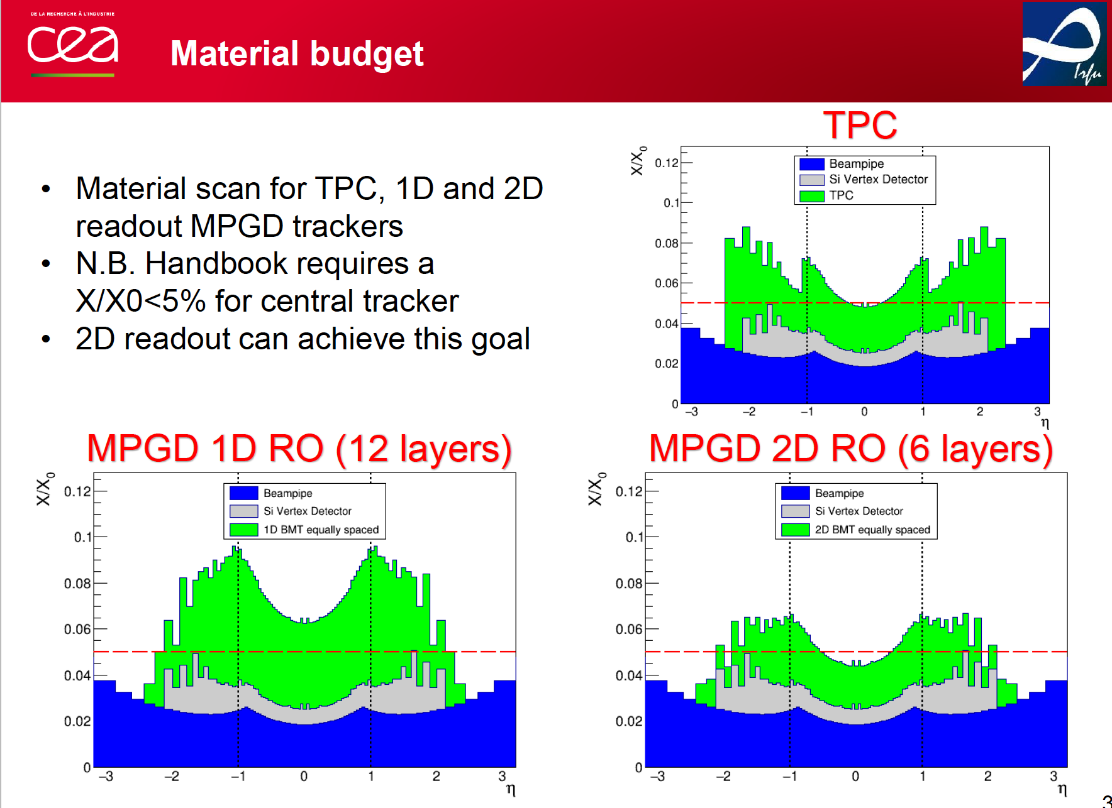
Tracking
Qinhua Huang for CEA Saclay’sEIC group

Slide 24
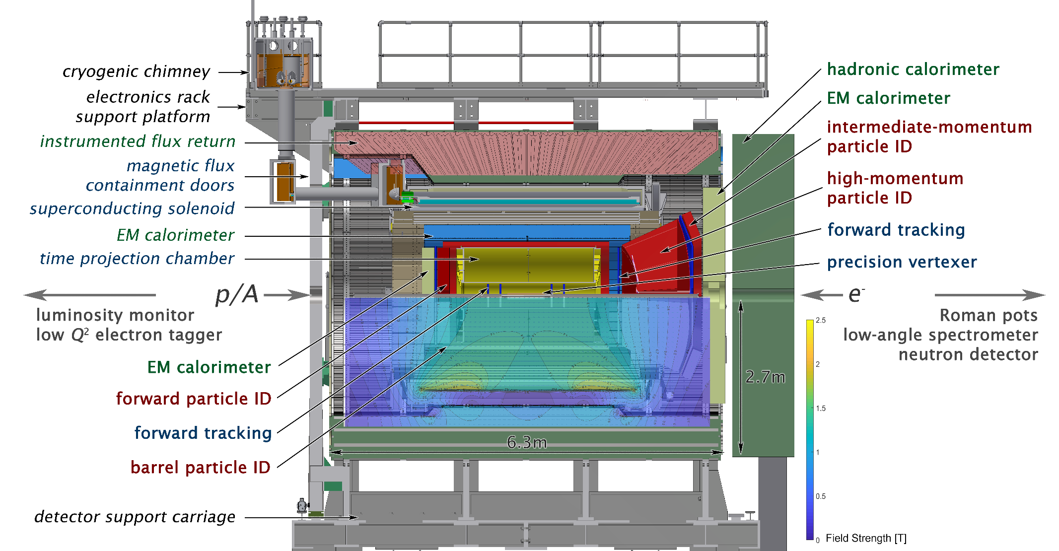
One detector model used in this study
Jin Huang
2014 concept: arXiv:1402.1209 [nucl-ex], 2018 update: sPH-cQCD-2018-001

Slide 25
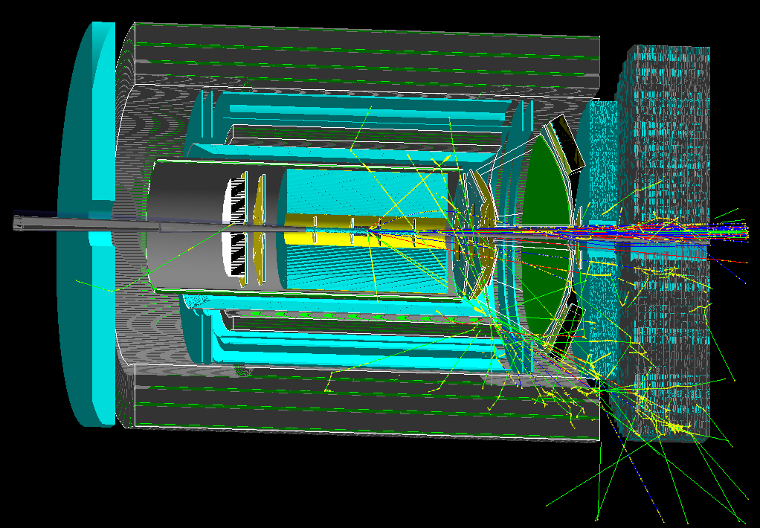
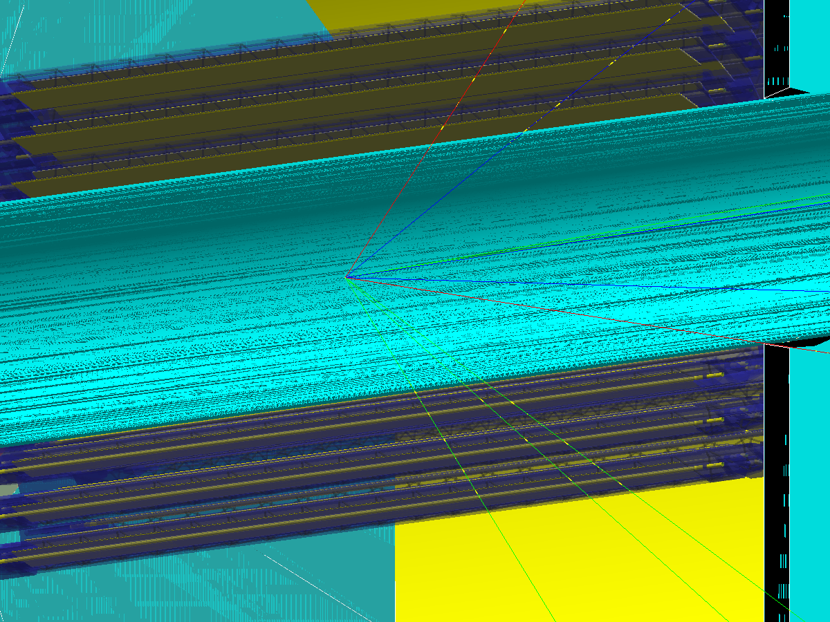
The detector model in simulation
Geant4-Material scan in simulation in Fun4All
https://github.com/eic/Singularity
Be beam pipe
←Collision point
3-layer MAPS pixel tracker
DIS e x p @ 18x275 GeV/c, 25mrad crossing, x~0.5, Q^2 ~ 5000 (GeV/c)^2, horizontal cut away

Slide 26
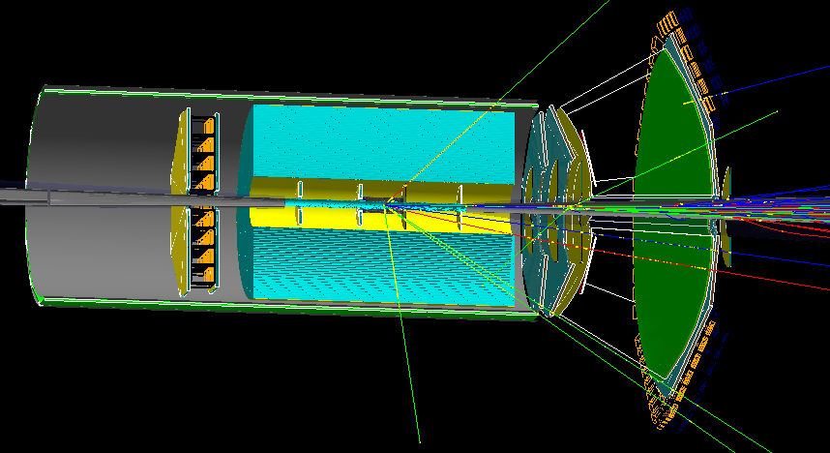
Only tracker + PID are scanned
Reproduce: https://github.com/blackcathj/macros/tree/display-EIC-BeamPipe-materialscan/macros/g4simulations
TPC end-cap not include (15% X0 Al?). Hope can be thinned with carbon fiber
mRICH support not included
All off-active area cabling not included. To be implemented from Leo
Air disabled (0.3% X0 per meter)

Slide 27
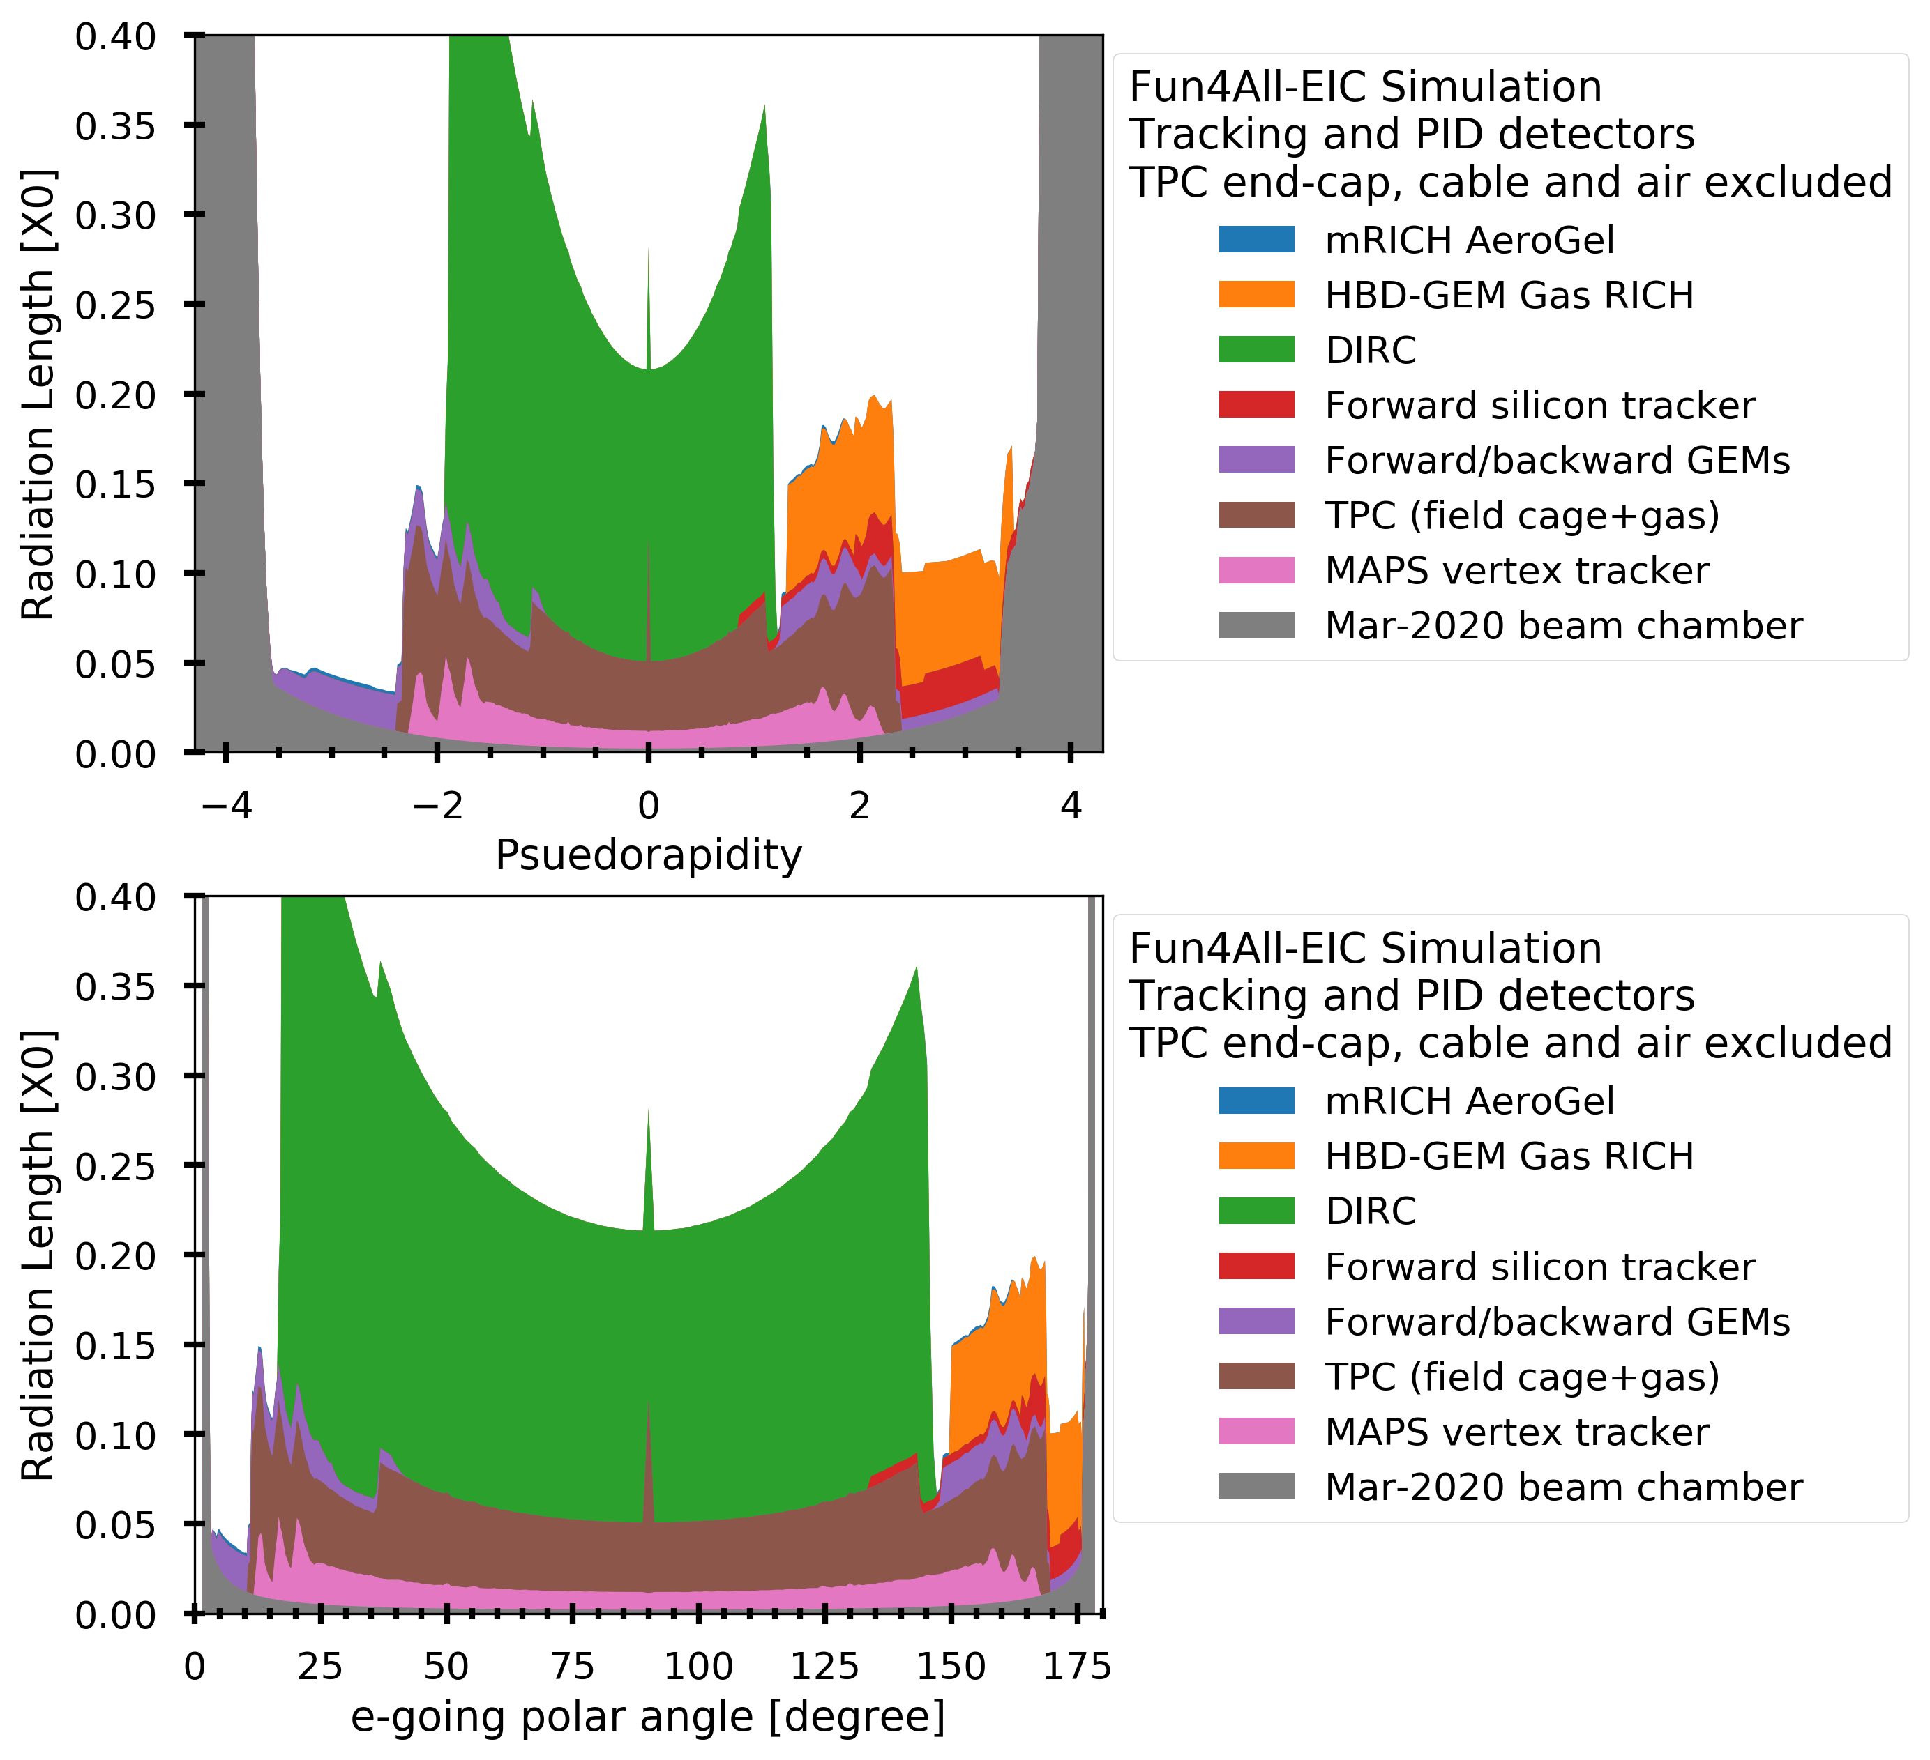
Results
Reproduce: https://github.com/blackcathj/macros/tree/display-EIC-BeamPipe-materialscan/macros/g4simulations

Slide 28
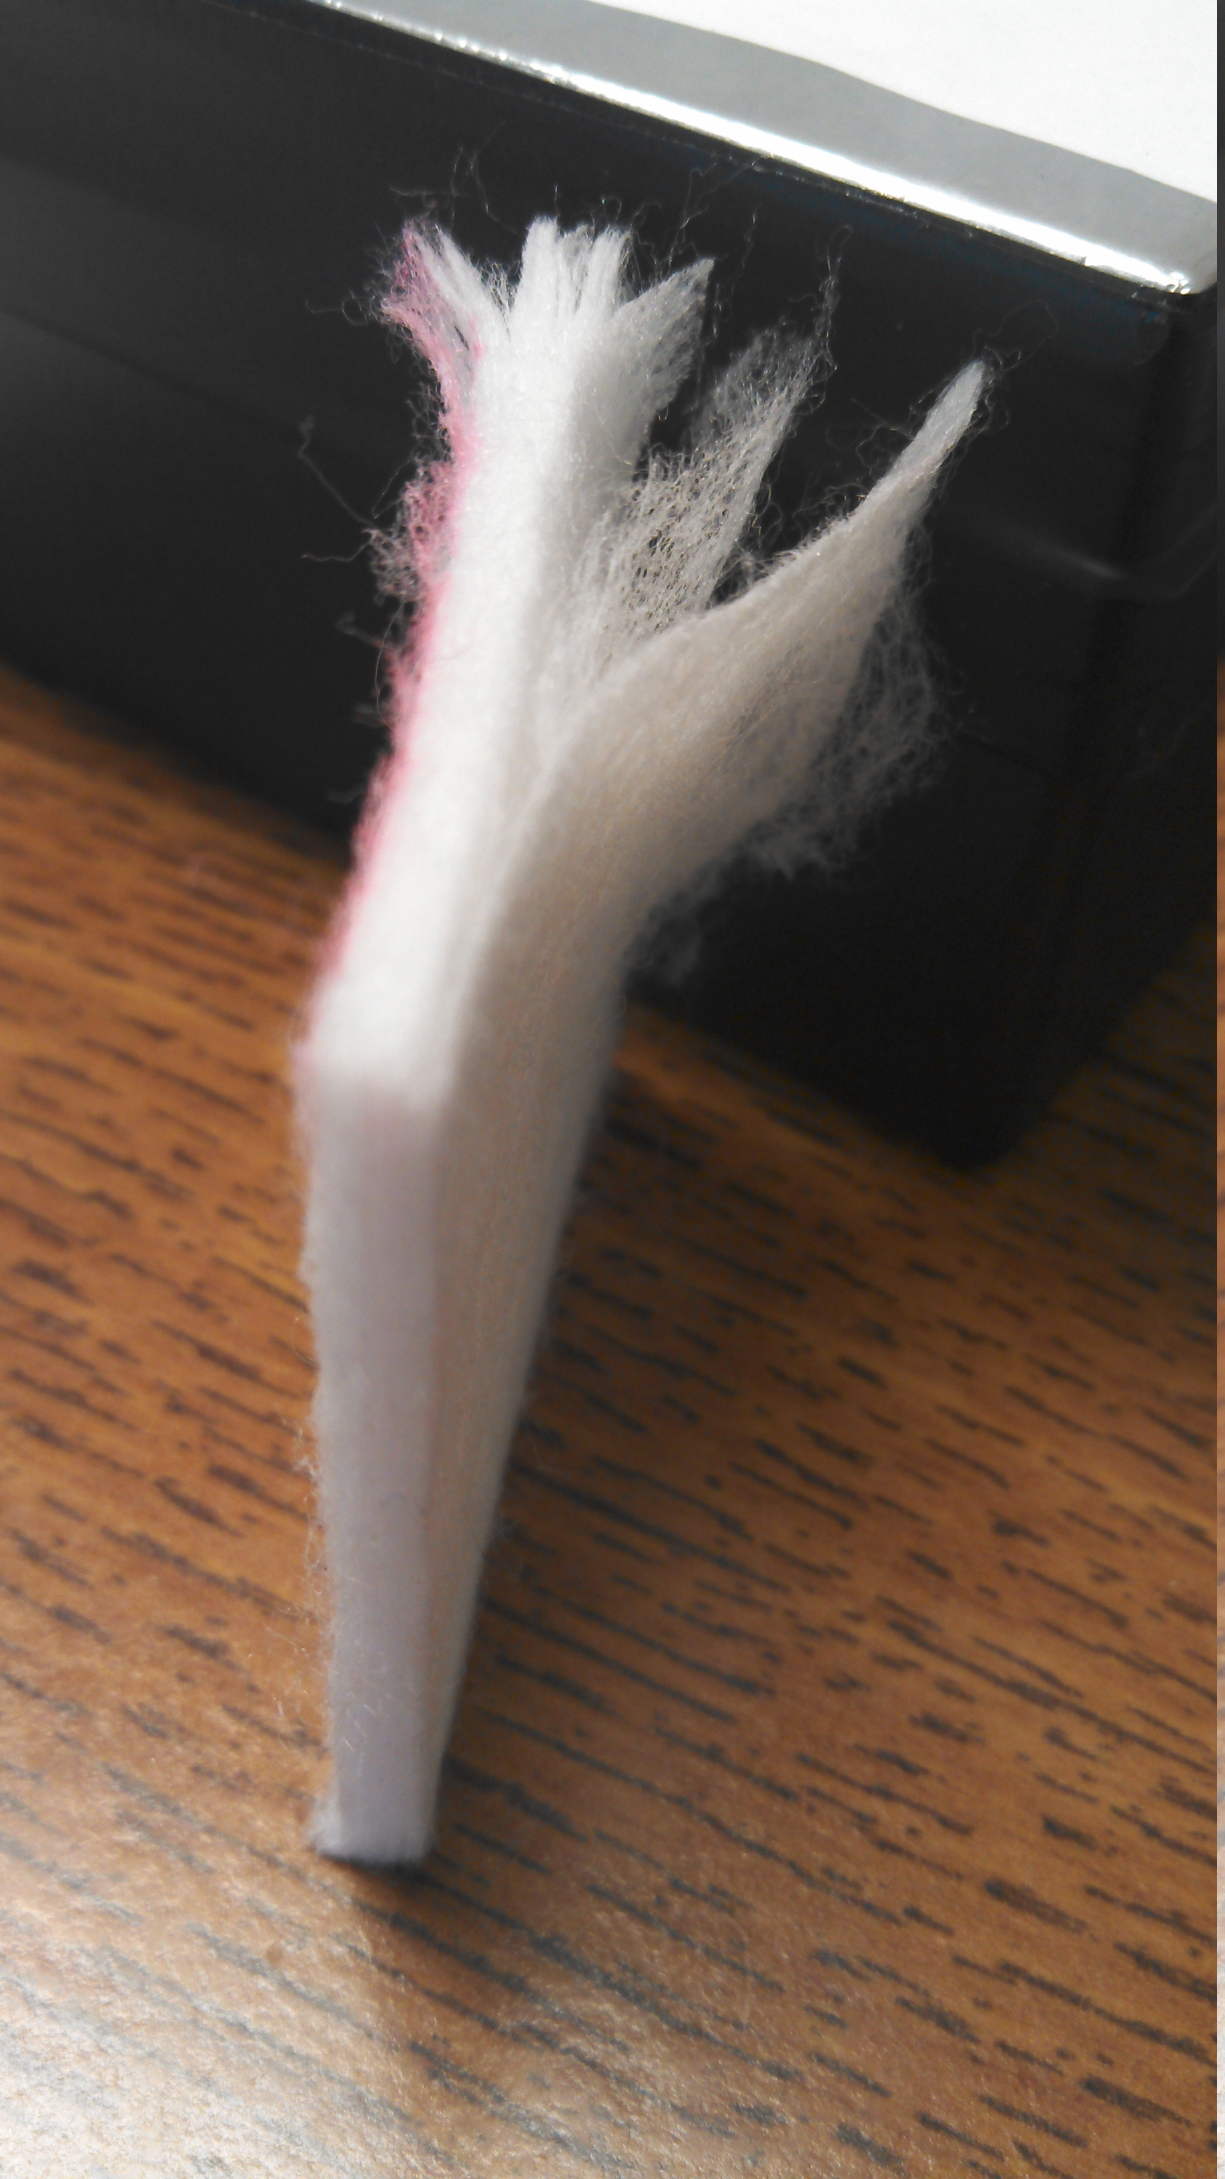
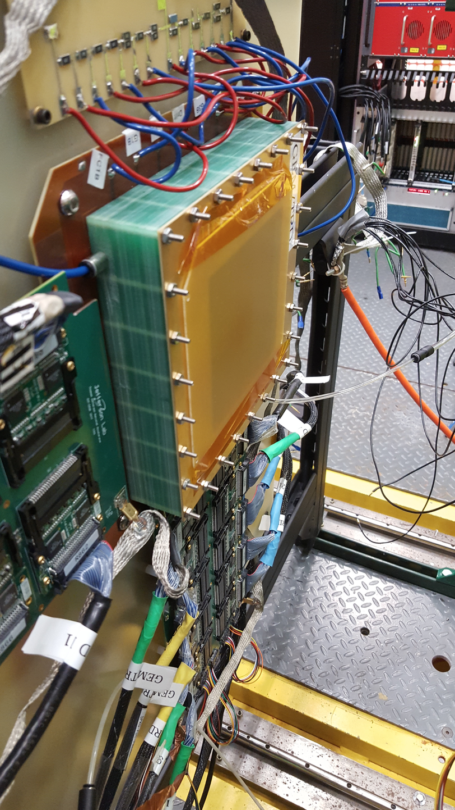
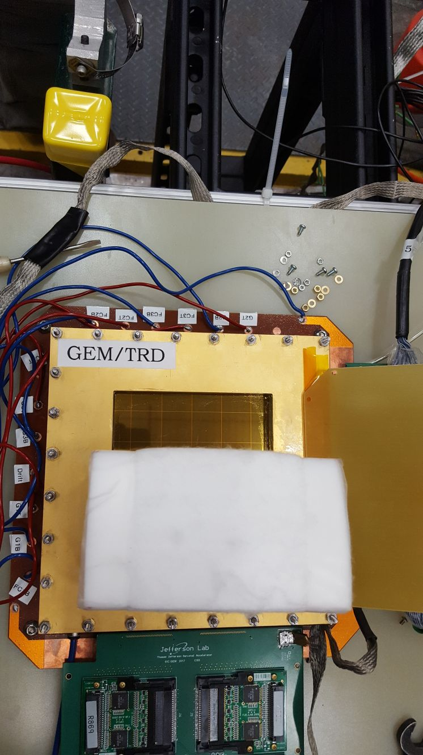
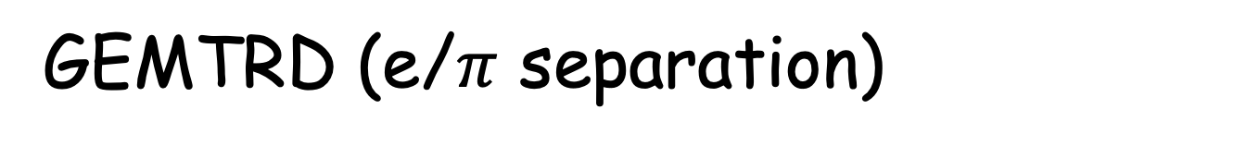
GEMTRD (e/$π$ separation)
Single module (X/X0) :
Radiator ( 10cm) ~ 1.5 % X₀ ( for fleece, could go down with mylar foils )
Xenon gas (2.0 cm) ~ 0.1% X₀
Triple GEM with readout at active area ~ 0.7% X₀
( could go down to 0.4%, current eRD6 )

Slide 29
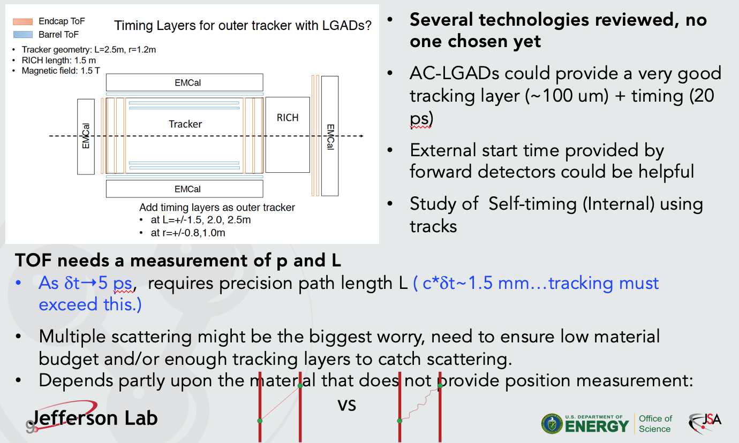
PID
Thomas Hemmick
PID detectors (DIRC, mRICH, dRICH) relay on precise momentum and angular resolutions from tracker at the entry and exit point of a PID detector, and require “ very low material budget between the interaction point and the calorimeters” ( EIC detector HANDBOOK.

Slide 30
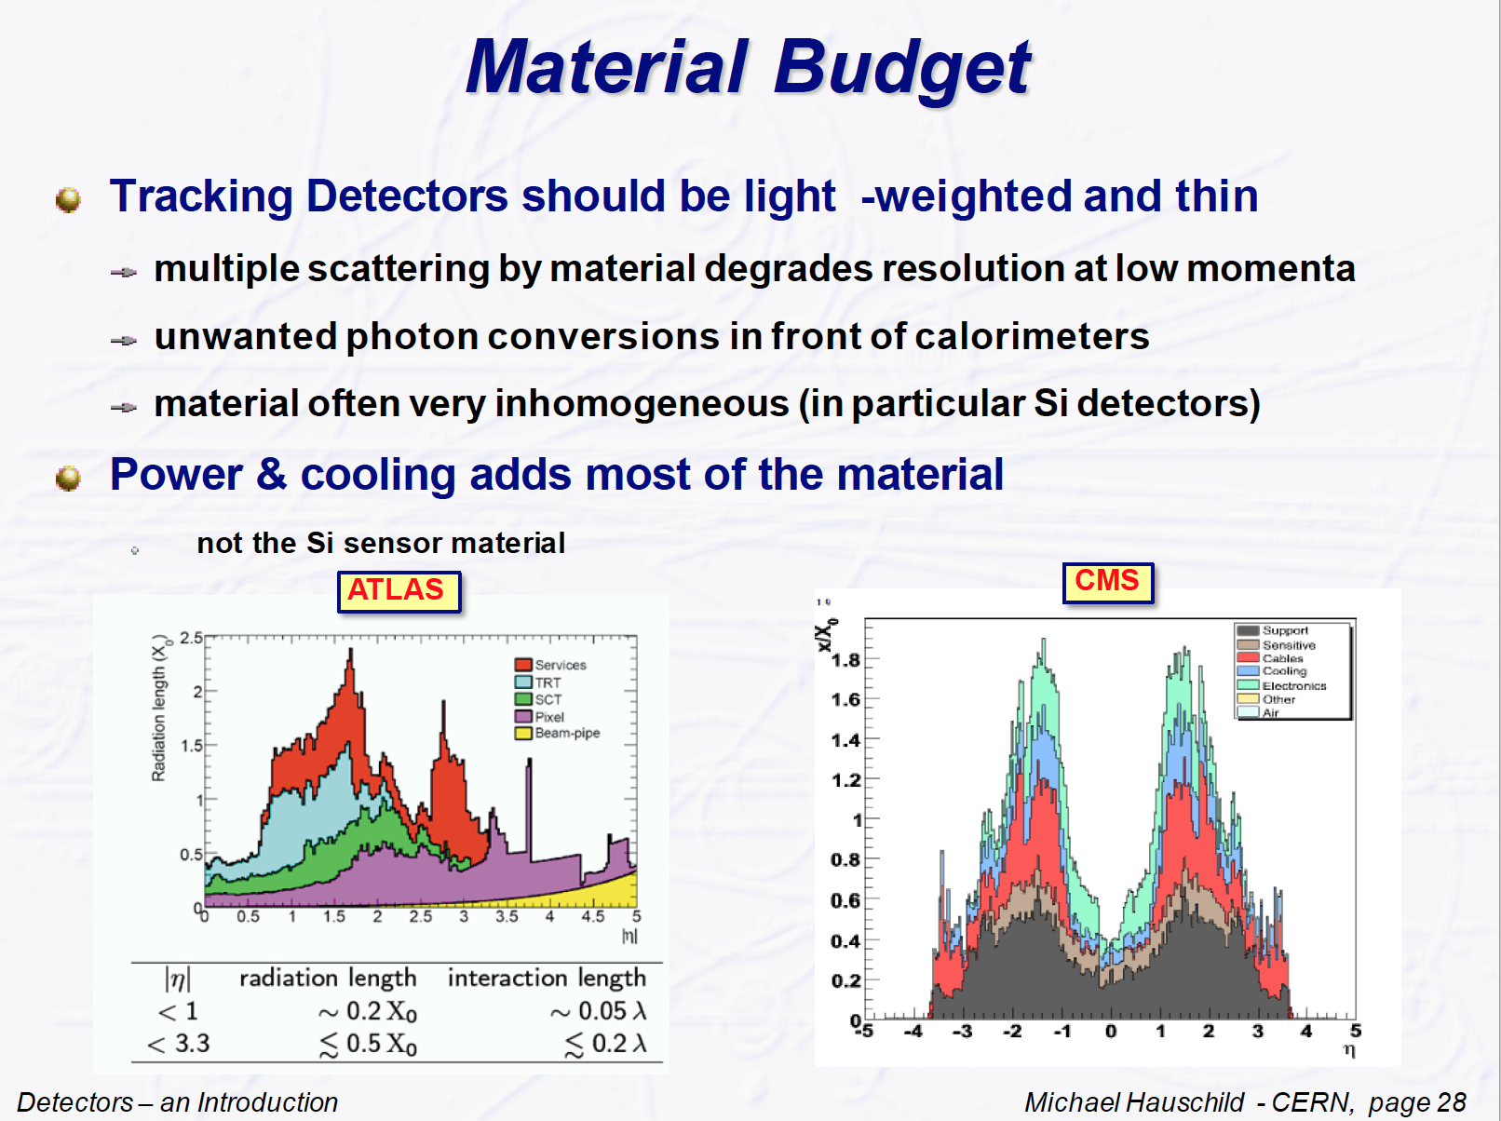
CMS/ATLAS comparison

Slide 31
Conclusion/plans/to-do list
We need to minimize amount of material at all directions!
Important for low-momenta particles
Minimize unwanted photon conversion in front of calorimeter
Need to keep in mind an asymmetric beam energy setting at EIC ( example, 5x100 GeV)
For each detector ( subdetector ) setup/configuration we need to make a connection how it would affect physics ( Q2, inv mass, etc) , and find a way how to minimize amount of material.
Include support structures
Include cooling
Include HV, low voltage cabling ….
Include readout cabling ( or maybe wireless ?? ) ;-)
Etc.
next contribution talks :
Matt Posik -> eRD6
Leo Greiner -> Silicon

Slide 32
Backup

Slide 33
eRD6
Matt Posik

Slide 34
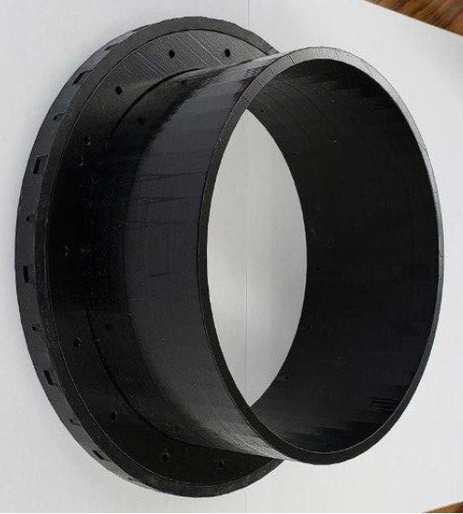

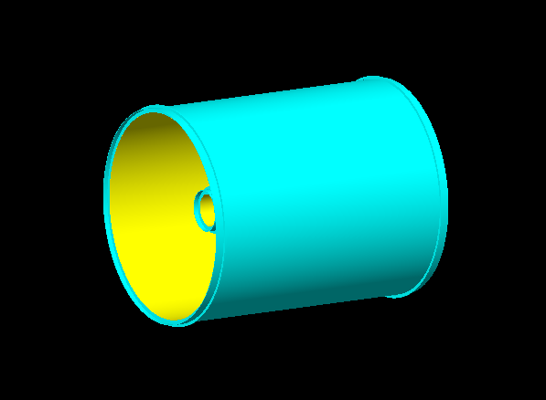
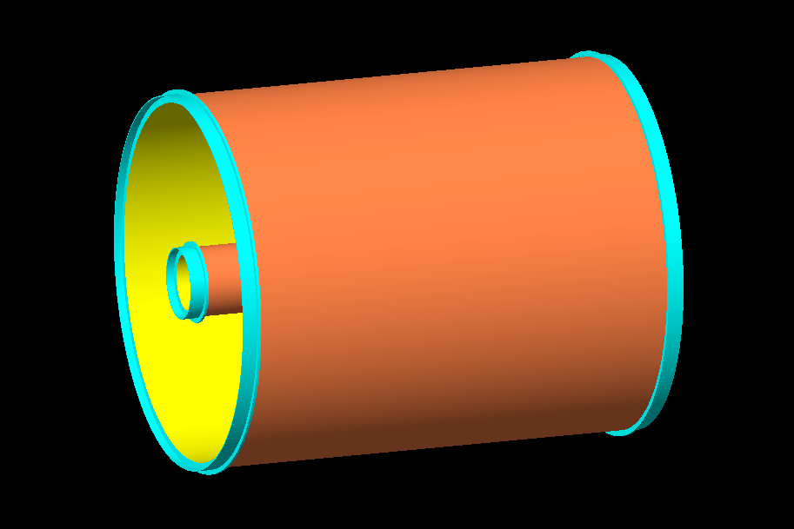
Tracking
Matt Posik for eRD6
FIT mock prototype (support ring)
Simulation implementation
Support Ring Structure Geometry
  Tube: thickness = 0.5 cm, length = 7.2 cm
  Ring (inner): thickness = 1.6 cm, length = 1.2 cm
  Ring (outer): thickness = 0.5 cm, length = 1.2 cm
Material Scan
  2 micro-Rwell cylinders
    Inner det. radius = 12.5 cm (length = 120 cm)
    Outer det radius = 80.0 cm (length = 200 cm)
Inner tracker length = 120 cm
Inner tracker length = 200 cm

Slide 35
Tracking
Matt Posik for eRD6
Next Steps Implement
  supports every ~ 50 cm
  Readout card material
  endcap
Inner tracker length = 2.0 m
Outer tracker length = 2.0 m
Inner tracker length = 1.2 m
Outer tracker length = 2.0 m
  Blue: PEEK
  Red: Carbon Fiber
  Black: No Support
  Blue: PEEK
  Red: Carbon Fiber
  Black: No Support

