Slide 1
Estimates for material in for EIC Si structures/services
Radiation lengths for common materials
material | material radiation length (g*cm^-2) | density (g/cm^3) | X0 (cm)
Cu | 12.86 | 8.96 | 1.43527
PVC | 25.51 | 1.45 | 17.5931
FR4 | 30.17 | 1.8 | 16.7611
chip ceramic caps | 11.16 | 6.02 | 1.85382
kapton | 40.58 | 1.42 | 28.5775
PEEK | 39.6 | 1.32 | 30
polyethylene | 44.7 | 0.92 | 48.587
water | 36.08 | 1 | 36.08
Al | 24.01 | 2.7 | 8.89259
Carbon fiber (M55J, resin is similar) | 42.70 | 1.55 | 27.5484
Silicon | 21.82 | 2.33 | 9.356
https://cds.cern.ch/record/1279627/files/PH-EP-Tech-Note-2010-013.pdf

Slide 2
Estimates for material in for EIC Si structures/services
3 components to EIC tracking detector:
Vertexing layers – 2-3 layers close to beam pipe with limited length (active area ~30 cm in z)
Barrel layers – as many layers as needed. Generally built from “staves”. Lengths up to 2m.
Discs – usually constructed of overlapping “staves” . Diameters up to 1m.
For all of the above structures, the lowest radiation length Silicon based constructions have been made with MAPS.
Estimates here follow the method used in the initial estimates described in:
https://indico.bnl.gov/event/7449/contributions/36038/attachments/27241/41530/2020_03_20_EIC_Si_services_parametrization_for_sim.pdf

Slide 3
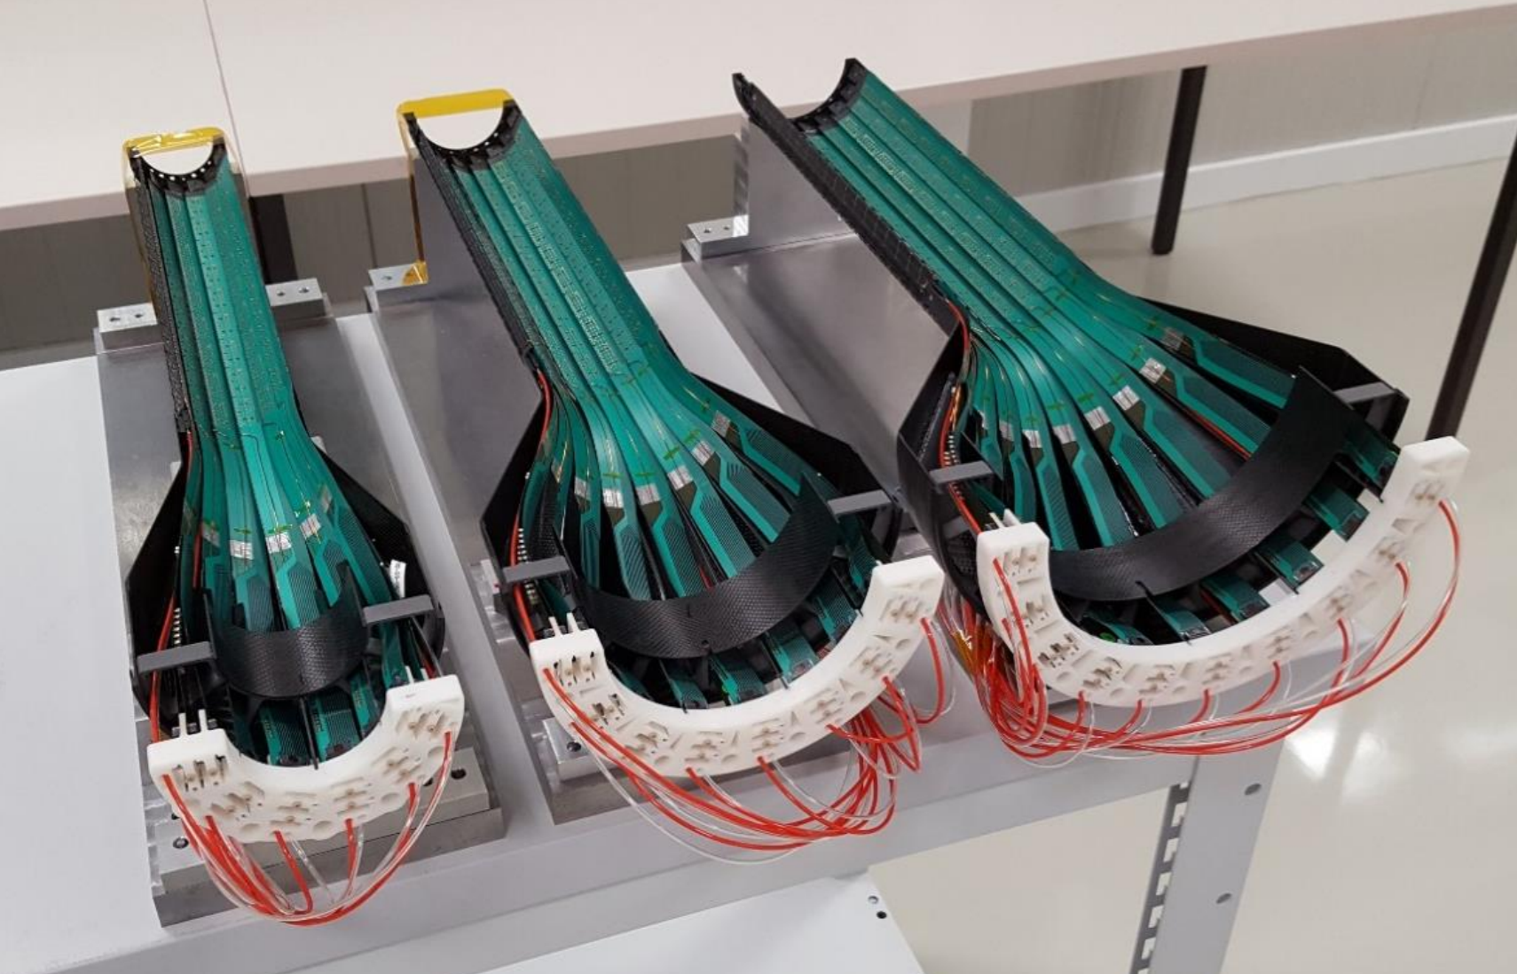
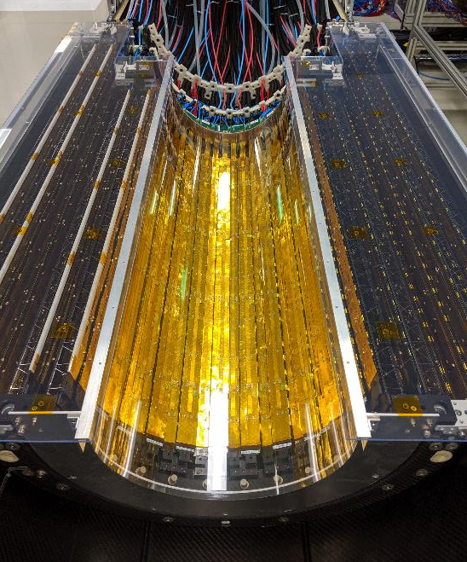
Estimates for material in for EIC Si structures/services – current SOTA
ALICE ITS layers 3-6
~1.1% per layer
ALICE ITS layers 0-2
0.3% per layer
ITS2 Barrel:
ITS2 Vertexing:
50 um thick silicon
Water cooled
Aluminum conductor data/power flex-PCBs
Silicon thinned to 100 um
Water cooled
Copper based signal flex-PCB
Aluminum based power flex-PCB

Slide 4
Estimates for material in for EIC Si structures/services
Three case types estimated:
ITS2 like:
Corresponds to the existing ALICE ITS2 detector using ALPIDE sensors
Services and sensor barrel/vertexing layer X/X0 are as exist for ALPIDE ITS2
Discs are based on extrapolation of ITS inner layer staves with appropriate scale up for diameter above 30 cm.
ITS2 like – reduced mass:
Corresponds to the existing ALICE ITS2 detector using ALPIDE sensors
Cu power supply cables replaced with Cu clad Al conductors
Discs are based on extrapolation of ITS inner layer staves with appropriate scale up for diameter above 30 cm.
ITS3 like:
Corresponds to using ITS3 type sensors
Services and sensor barrel/vertexing layer X/X0 are scaled from ITS2 based on as power/cooling, sensor thickness, etc
Discs are still based on extrapolation of ITS2 inner layer staves with appropriate scale up for diameter above 30 cm.
Additional measures can be considered with targeted R&D such as serial powering and air cooling.

Slide 5
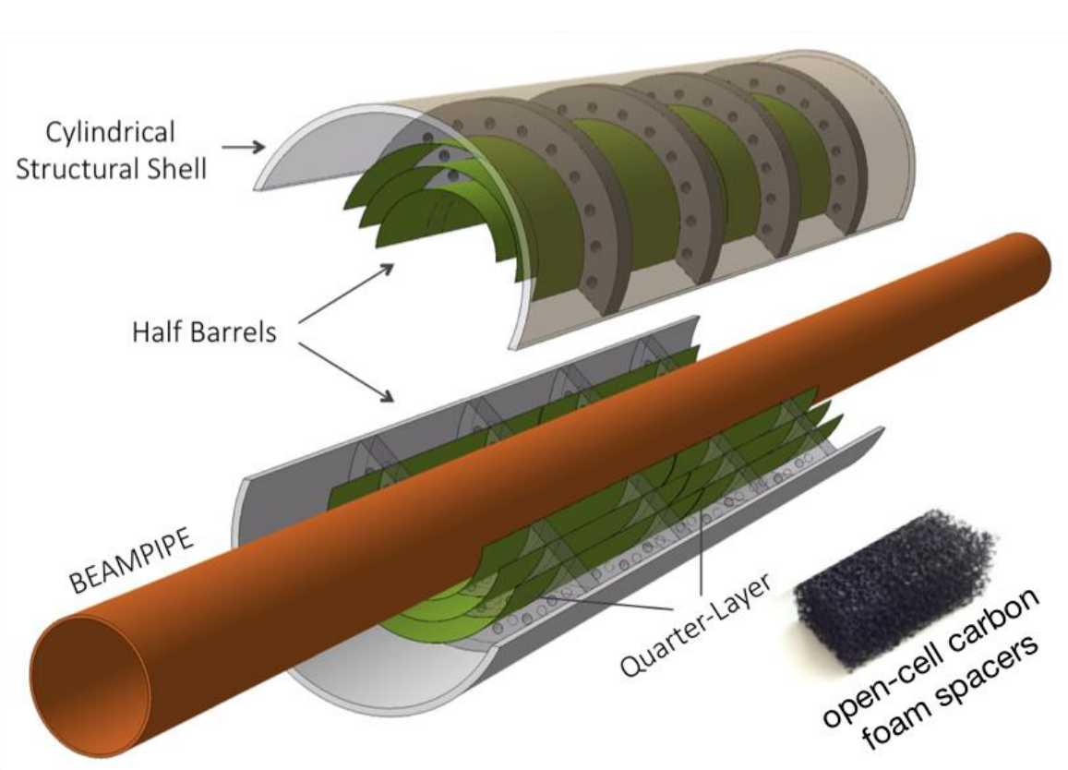
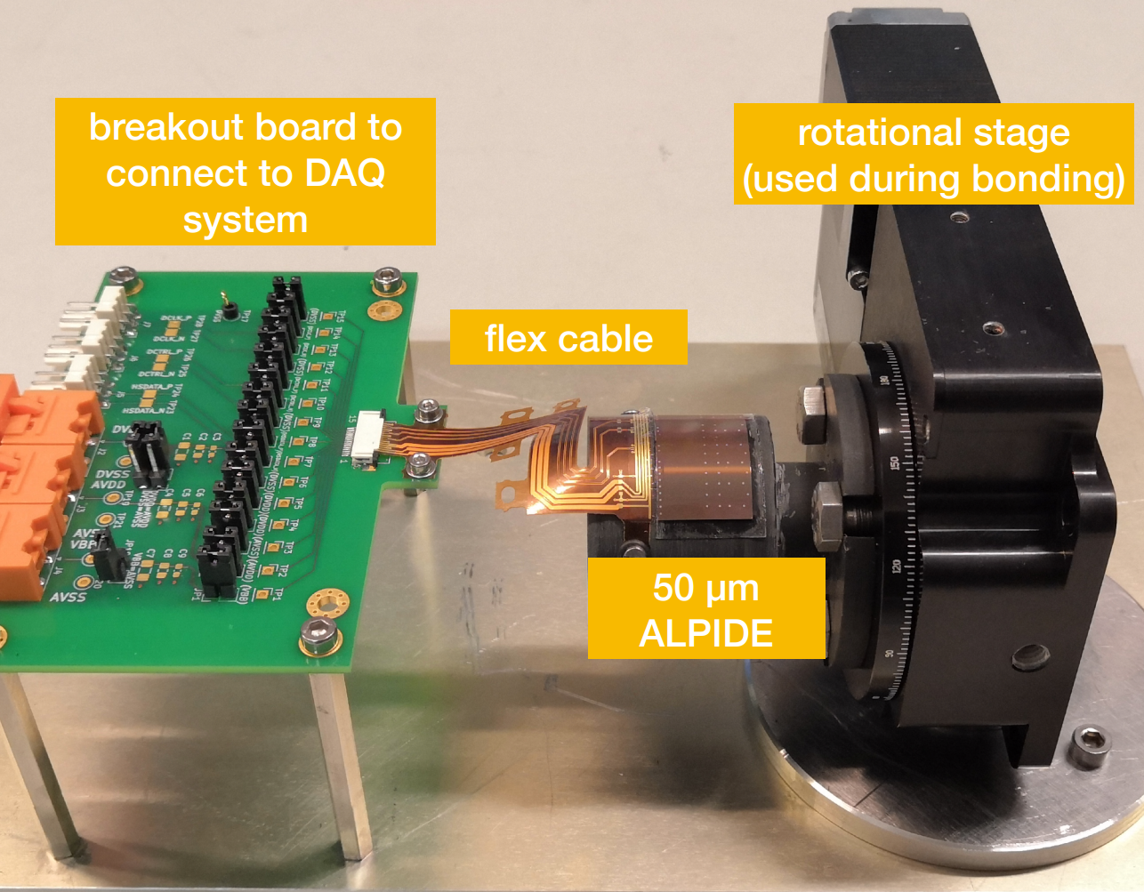
Estimates for material in for EIC Si structures/support - vertexing
Can we do better?
Vertexing:
ITS3 concept
Potentially X/X0 ~ 0.05%
“bent” silicon
Detector concept
We will still have material at the end of the vertexing layers.
Reduced services compared to existing ITS layer 0-2 services. (less power needed)
Silicon thinned to <40um
Air cooled
Stitched – no connecting/power cable
Carbon foam as support for layers

Slide 6
What to expect for radiation lengths for EIC structures - Vertexing
Reduction in services for lower power dissipation or ITS3 type structures:
This is still a system where power is delivered at ~1.2V (ITS3) versus ~1.8V for ITS2
The current will still be ~2/3 of the current needed for ITS2.
Possible reduction of needed conductor by 1/3.
Can still convert to Aluminum based power delivery to staves (Aluminum flex PCB delivers power on the staves already).
Typical hybrid Aluminum/copper conductors can be ~80% Al jacketed in ~20% copper for making solder connections. Considering insulation and water propagation, reduce X/X0 factor of 4, increase volume by 1.4.
Disadvantages are larger conductor size, more difficult to work with, more expensive.
Signal requirements still mandate highly engineered copper signal conductors like Samtec Firefly.

Slide 7
What to expect for radiation lengths for EIC structures - Discs
Using existing ALPIDE based ITS inner barrel staves as reference
Discs up to ~60 cm diameter can be composed of existing ITS inner layer designs and can be expected to have approximately the same radiation length including overlap.
Discs larger than 60 cm diameter
In this case one may expect that the voltage drops will start to become more significant over the length of the stave and will need correspondingly larger thickness of the Aluminum power distribution layer.
Assume that we need to increase conductor thickness by 30% for every 10 cm increase in length. (we can also assume that the mass required to keep stave stable increases at the same rate)
Services come from both sides of the disc and are still consistent with requirements/cm^2
Discs at 80 cm diameter => 0.4% radiation length
Discs at 100 cm diameter => 0.5% radiation length
etc.

Slide 8
Summary of ITS2 like Si tracking
stave
 | Stave X/X0 | Stave transition (per 100 cm^2 of Si surface)* | Services (per 100 cm^2 of Si surface)* | Patch panel (per 100 cm^2 of Si surface)*
ITS2 like vertexing | 0.3% | 7.4 cm^3 of material with X/X0 of 0.0874 per traversed cm | 2.47 cm^2 cross section with X/X0 of 0.0913 per traversed cm | 4.94 cm^3 with 0.102 X/X0 per traversed cm
ITS2 like barrel (up to 1.5m length) | 1.0 % | 4.762 cm^3 of material with X/X0 of 0.0874 per traversed cm | 1.587 cm^2 cross section with X/X0 of 0.0913 per traversed cm | 3.175 cm^3 with 0.102 X/X0 per traversed cm
ITS2 like disc (up to 60 cm diameter) | 0.3% | 7.4 cm^3 of material with X/X0 of 0.0874 per traversed cm | 2.47 cm^2 cross section with X/X0 of 0.0913 per traversed cm | 4.94 cm^3 with 0.102 X/X0 per traversed cm
ITS2 like disc (up to 80 cm diameter) | 0.4% | As above | As above | As above
ITS2 like disc (up to 100 cm diameter) | 0.5% | As above | As above | As above
Stave
transition
services
Patch panel
* Corrected 2021_03_13

Slide 9
Summary of ITS2 like Si tracking – reduced mass
stave
 | Stave X/X0 | Stave transition (per 100 cm^2 of Si surface)* | Services (per 100 cm^2 of Si surface)* | Patch panel (per 100 cm^2 of Si surface)*
ITS2 like vertexing | 0.3% | 7.41 cm^3 of material with X/X0 of 0.0875 per traversed cm | 3.46 cm^2 cross section with X/X0 of 0.022 per traversed cm | 6.17 cm^3 with 0.102 X/X0 per traversed cm
ITS2 like barrel (up to 1.5m length) | 1.0 % | 4.762 cm^3 of material with X/X0 of 0.0874 per traversed cm | 2.22 cm^2 cross section with X/X0 of 0.022 per traversed cm | 3.97 cm^3 with 0.102 X/X0 per traversed cm
ITS2 like disc (up to 60 cm diameter) | 0.3% | 7.41 cm^3 of material with X/X0 of 0.0874 per traversed cm | 3.46 cm^2 cross section with X/X0 of 0.022 per traversed cm | 6.17 cm^3 with 0.102 X/X0 per traversed cm
ITS2 like disc (up to 80 cm diameter) | 0.4% | As above | As above | As above
ITS2 like disc (up to 100 cm diameter) | 0.5% | As above | As above | As above
Stave
transition
services
Patch panel
* Corrected 2021_03_13

Slide 10
Summary of ITS3 like Si tracking
stave
 | Stave X/X0 | Stave transition (per 100 cm^2 of Si surface)* | Services (per 100 cm^2 of Si surface)* | Patch panel (per 100 cm^2 of Si surface)*
ITS3 like vertexing | ~0.1% | 6.66 cm^3 of material with X/X0 of 0.0684 per traversed cm | 2.96 cm^2 cross section with X/X0 of 0.022 per traversed cm | 4.32 cm x 1cm x 1 cm with 0.102 X/X0 per traversed cm
ITS3 like barrel (up to 1.5m length) | 0.55 % | 4.286 cm^3 of material with X/X0 of 0.0684 per traversed cm | 1.905 cm^2 cross section with X/X0 of 0.022 per traversed cm | 2.778cm x 1cm x 1 cm with 0.102 X/X0 per traversed cm
ITS3 like disc (up to 60 cm diameter) | 0.24% | 6.66 cm^3 of material with X/X0 of 0.0684 per traversed cm | 2.96 cm^2 cross section with X/X0 of 0.022 per traversed cm | 4.321 cm x 1cm x 1 cm with 0.102 X/X0 per traversed cm
Stave
transition
services
Patch panel
* Corrected 2021_03_13

Slide 11
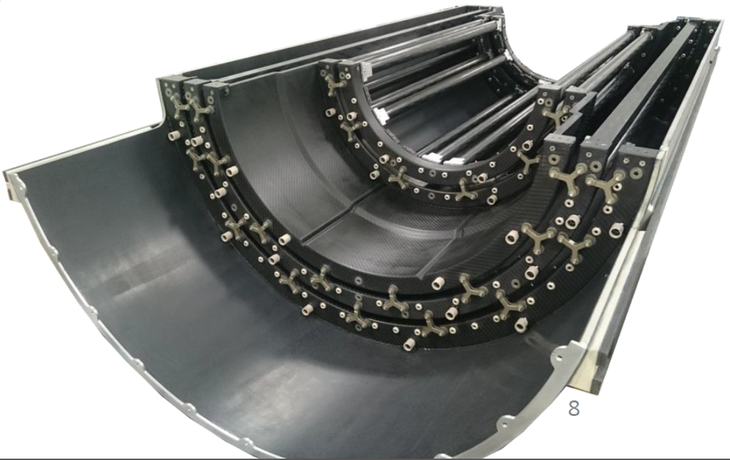
Silicon support structures
Modern Si tracking detectors are highly integrated objects and are installed as packages, with the services already installed and brought out to patch panels and the sensors already tested and characterized. These packages are self-supported mechanical objects.
As such, the integration into the overall detector can be described as an exercise in supporting and locating internally calibrated packages into the overall detector envelopes.
This is an engineering problem that has generally been solved for cylindrical detector volumes in similar ways at STAR, ALICE, ATLAS, etc.
ALICE ITS2 OL half-barrel mechanical support
Half-barrels slid into place with rollers on rails
Strong Rails are affixed to the inner supports of the TPC field cage (or equivalent)
Support rails extend on each side of the half-barrel with wheels.
Adjustment and locking provided.
The support barrel and services cones are strong but not structurally sufficient for holding stave/sensor position.
The main positioning and locating structures are very solid half rings and spacer bars.

Slide 12
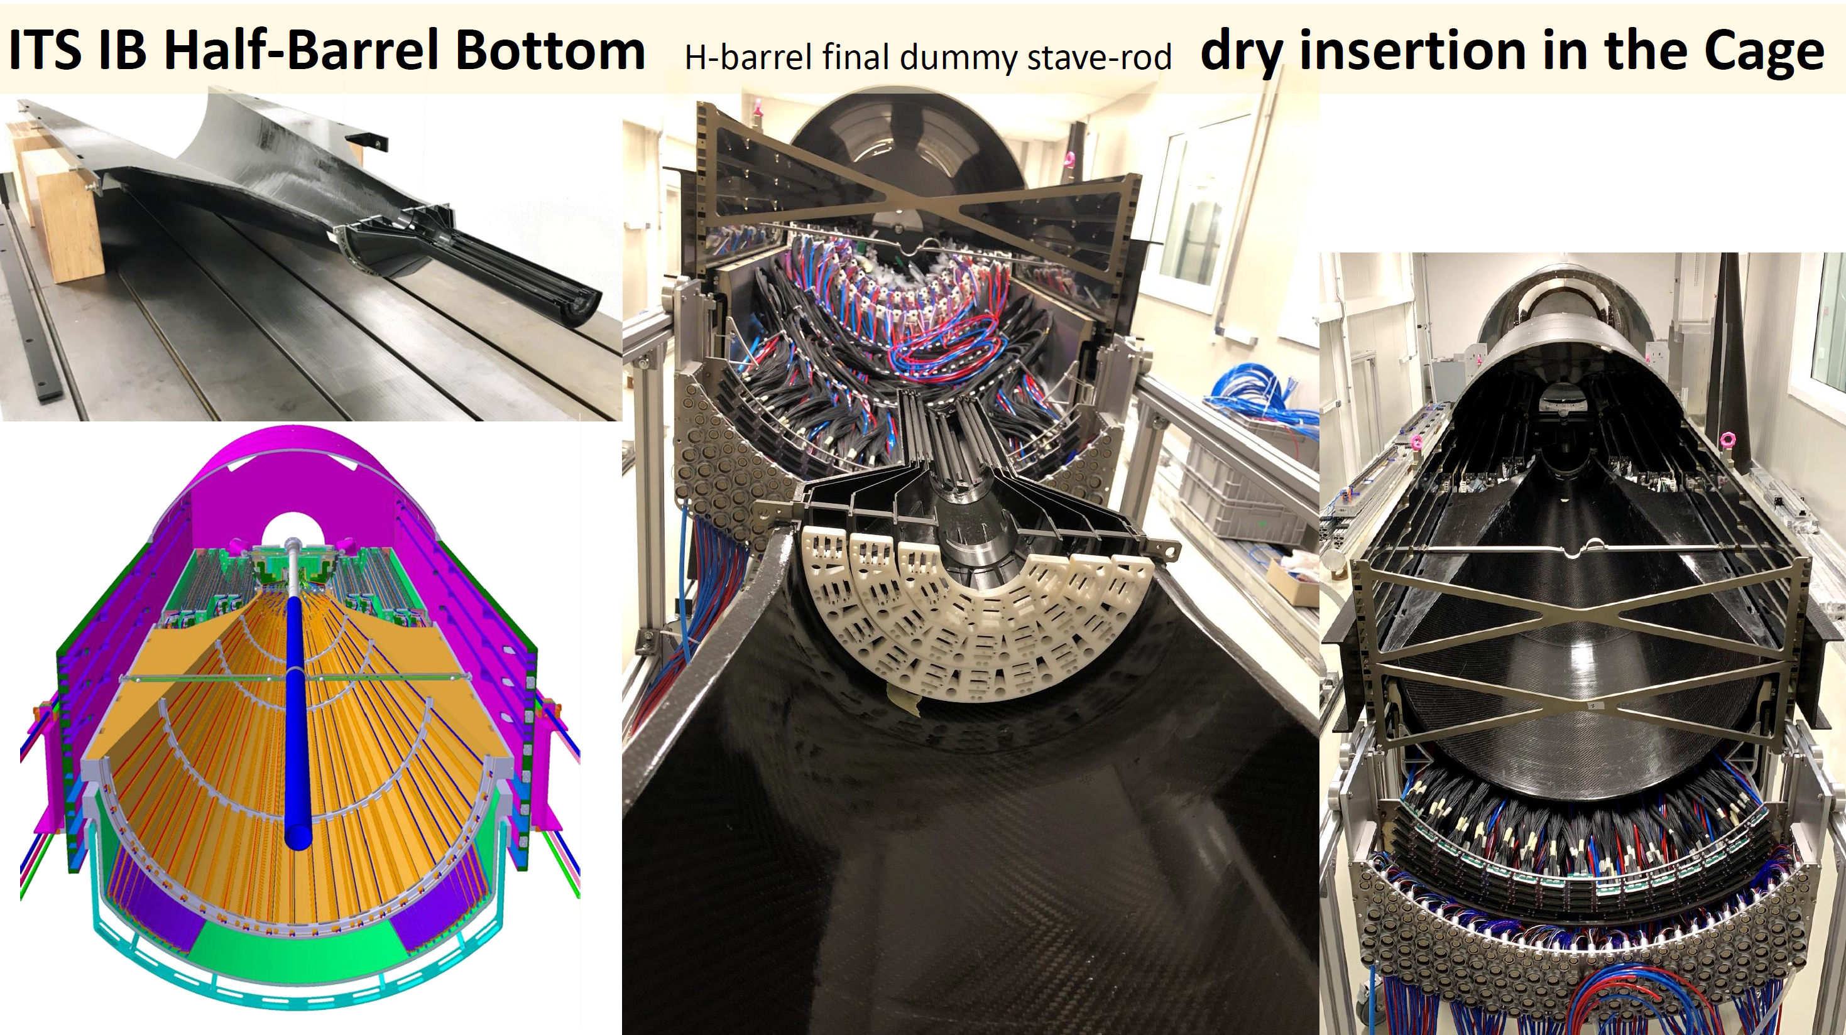
ITS2 Silicon support structures
rails
Vertexing layers
Support structure
Corrado Gargiulo

Slide 13
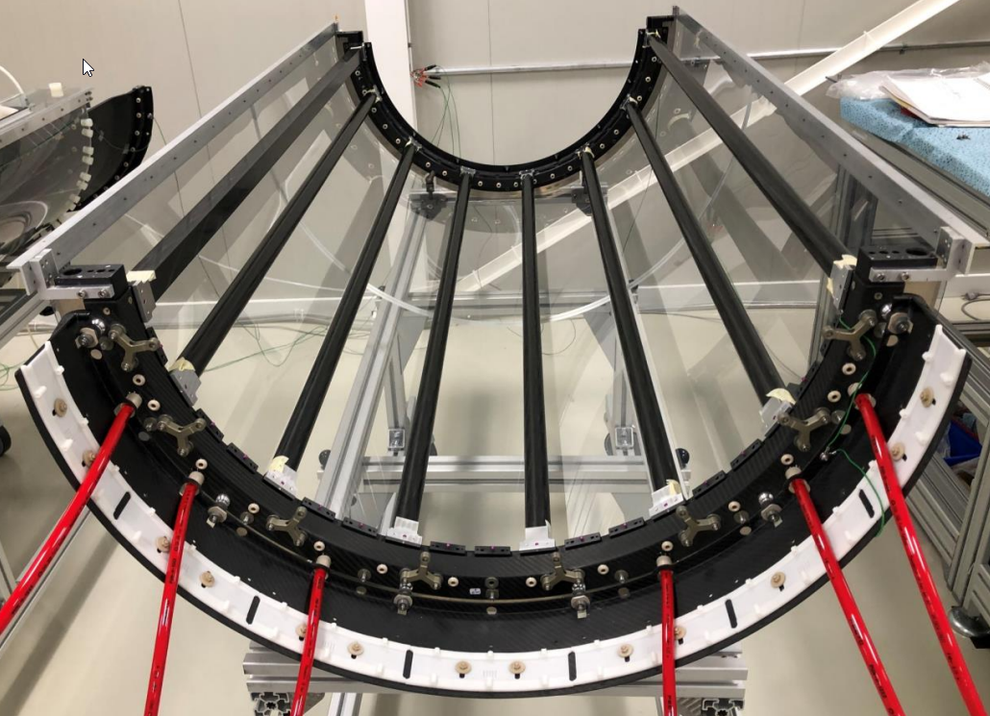
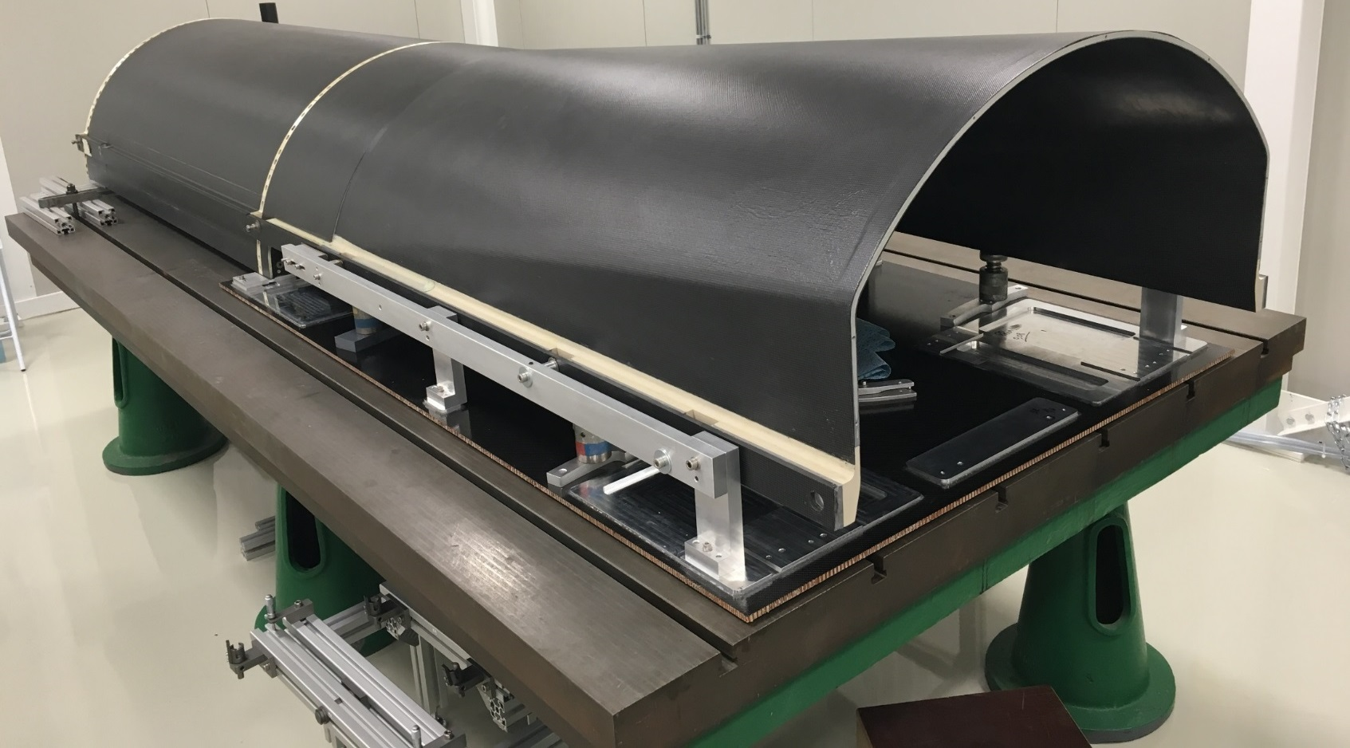
ITS2 Silicon support structures to be mocked up in simulation
Structural half-rings and spacers for stave mounting
Idea is to represent these structures as simple geometric objects (cylinders, cones, bars, etc.)
Mated ALICE ITS support cylinder and services cone
Fully assembled ALICE ITS OL half-barrel (4 layers)

Slide 14
ITS2 Silicon support structures to be mocked up in simulation
Rail support bracket
Corrado Gargiulo

Slide 15
Silicon support structures
Prudent to assign the major pieces of support to the simulations (all carbon fiber composite):
Barrel layers:
2 x Support half-cylinders – carbon fiber cylinder 1.0 mm (0.24% X/X0) thick at the largest radius that supports the barrel with 1.5 cm x 4.0 cm (3.4% X/X0) flanges at each end.
Stave support rings – hoop rings at the end of each barrel layer (except vertexing) 1.5 cm thick covering the gap between layers with a 70% fill factor.
Services half-cones – bolts to the support cylinders with with 1.5 cm x 4.0 cm flanges at each end. Follows path for services out (eta = 1 surface?)
Rails with 4 x 5cm titanium wheels 1 cm x 10 cm on each edge of each half cylinder support and services support
Rails on the inside field cage of the TPC 1.5 cm x 25 cm extending the full length + rail support brackets.
Vertexing layers:
Support cylinder – carbon fiber cylinder 1.0 mm thick at the largest radius that supports the barrel with 1.0 cm x 4.0 cm flanges at each end.
Stave support rings – hoop rings at the end of each vertexing layer 1.0 cm thick covering the gap between layers with a 70% fill factor.
Services half-cones – bolts to the support cylinders with with 1.0 cm x 4.0 cm flanges at each end. Follows path for services out to join services path from barrel.

Slide 16
Silicon support structures
Prudent to assign the major pieces of support to the simulations (all carbon fiber composite):
Disc layers:
2 x Support half-cylinder – carbon fiber cylinder 1.0 mm thick at the largest radius that supports the discs with 1.5 cm x 4.0 cm flanges at each end.
Disc support rings – hoop rings at the z position of end disc at the radius of the support half-cylinder 1.5 cm thick covering the gap between layers with a 70% fill factor extending to the radius of the disc at that location.
Services half-cones – bolts to the support cylinders with with 1.5 cm x 4.0 cm flanges at each end 2 mm thick carbon fiber. Follows path for services out (eta = 1 surface?)
Tubular rails (carbon fiber 2 mm thick) with corresponding supports and linear bearings placed on the barrel support half-cylinders for the discs to slide in on.

Slide 17
Some comments
This work is intended to benefit the overall simulation by providing reasonable estimates for the amount of material and services required to support and service the inner silicon tracking system.
Disclaimer – The estimates made are educated guesses as to what is possible for current detectors.
Clearly most of the material in these examples is out of the eta ~ +/-1.1 precision tracking acceptance for ALICE, but not for EIC planned systems.
The support material recommendations are an underestimate, but thickness can be varied to examine the effects of support services.
This can then be used based on overall simulations to assess the impact on the physics. If there are degradations, this can help indicate where we will need targeted R&D to address mass issues.
It would be useful to have these estimates for other proposed detector systems as a way of moving to a more complete simulation.

Slide 18
backup

Slide 19
What to expect for radiation lengths for EIC structures - Vertexing
stave
If we use ALPIDE (existing technology) we can estimate services as below
Average of 0.3 % X/X0 in simulation
Stave
transition
Area of (40.5 cm^2) of sensor requires 3 cm^3 material with an X/X0 of 0.0383 per traversed cm.
services
Area of (40.5 cm^2) of sensor requires a cross section of 1 cm^2 with a X/X0 of 0.007861 per traversed cm of length.
(can be reduced to 1.5 cm^2 with X/X0 of ~0.002 per traversed cm of length with aluminum power conductors)
Patch panel
Area of (40.5 cm^2) of sensor requires a block of 2cm x 1 cm x 1 cm with 0.03423 X/X0 per traversed cm.

Slide 20
What to expect for radiation lengths for EIC structures - Vertexing
stave
If we use ITS3 technology we can estimate services as below
Average of 0.05 – 0.1 % X/X0 in simulation
Stave
transition
Area of (40.5 cm^2) of sensor requires 3 cm^3 material with an X/X0 of 0.0383 per traversed cm. (still requires capacitors and firefly cables)
services
Area of (40.5 cm^2) of sensor requires a cross section of 1 cm^2 with a X/X0 of 0.00132 per traversed cm of length.
(with aluminum power conductors)
Patch panel
Area of (40.5 cm^2) of sensor requires a block of 2cm x 1 cm x 1 cm with 0.03423 X/X0 per traversed cm.

