Slide 1
Questions on IR and EIC optimization
E.C. Aschenauer
Electron Ion Collider

Slide 2
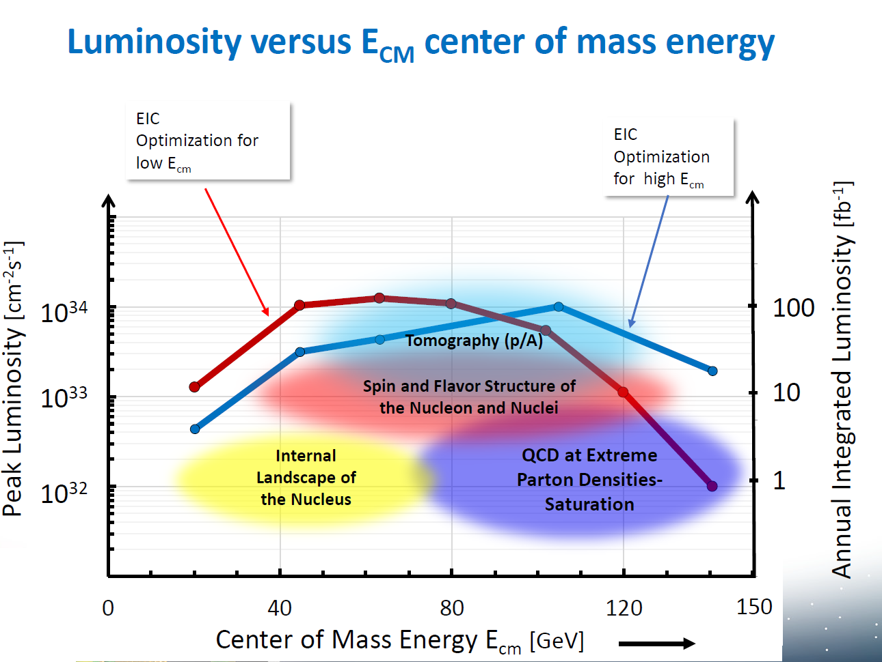
Questions mailed to Paul and me
The optimizations indicated here means:
no hardware modification, in particular IR, and only optics optimization OR
different hardware, most likely with reference to IR? The question, differently phrased is: is the blue curve in the plot the default and the red
one a further options or both blue and red are
embedded in the project base-line?
In the hypothesis of two identical IR (same design) from the machine point of view, can both be served in parallel, namely dating data in parallel? If YES, the quoted luminosity is the total one, namely adding up the luminosity at the 2 interaction points or each experiment will the the design luminosity resulting in a total multiplied times 2?
In the hypothesis of two different IR (different design) from the machine point of view, can both be served in parallel, namely dating data in parallel? If YES, what about the luminosity of each one?
Which realistic degrees of freedom do we have for scenarios of IRs different from the current design ( I refer to the presentations at the Temple meeting)? In particular, about the length that seems to impose sever constrains to the detectors in the forward direction, with the risk to limit the precision.
Assuming the current scenario, can we have a small compilation of luminosity vs energy also for 3He, D and some heavy nuclei, for instance those selected for the physics studies?

Slide 3
What are the space limitations in both transverse and longitudinal dimensions for the tracking detectors?
What are the central magnet options and magnetic field range?
What are the forward magnet options and magnetic field range?
Are there any IR parameters that could be adjusted?
Could the central beam pipe radius be reduced from 3cm to 2cm to cover more forward rapidity region?
Is one actively considering an asymmetric collision point in z
How far from the center of the +/- 4.5 m zone can the collision Zed move?
Is this motion coupled between interaction points around the ring?
An email by Patrizia with several more general points
A second interaction region optimized for higher luminosities and lower center of mass energies requires several changes: doubled number of bunches, double crossing angle, changing the magnetic element closer to IP, to cite some. Not being an expert in accelerator physics my simple question is “does the RHIC accelerator complex allow in principle such a flexibility?
Are (un)polarized positron beams possible and if yes on which timeline

