Slide 1
EIC PID Meeting
TK Hemmick, P Rossi April 15, 2020

Slide 2
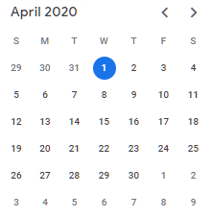
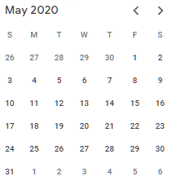
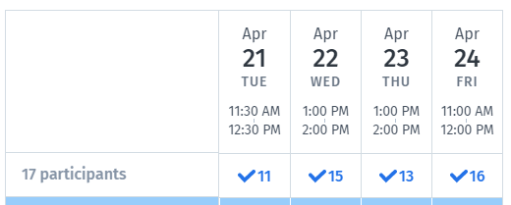
Looking forward at the Calendar.
Decide agenda one week in advance. (based upon Email status report)
Posting Slides: (minimum draft form) in 24 hours in advance.
11:53 AM today
There are few convenient times that work across broad time zones.
Yellow Report groups have now collided in noon timeslots.
Convenors asked groups with narrow topics (us) to give way to broad topics.
A Doodle poll will be sent shortly to assess feasibility of moving our meeting.

