Slide 1
Craig Roberts … http://inp.nju.edu.cn/
Pion & Kaon Structure
– Window onto EHM

Slide 2
Character of Mass
Key questions posed to modern science:
What is the origin of mass?
What are the consequences of the appearance of mass?
When considering the source of mass, many people think of explicit mass, generated via the Higgs-mechanism
especially because the Higgs boson was discovered relatively recently at CERN (2012)
importance acknowledged by the Nobel Prize awarded to Englert and Higgs:
for the theoretical discovery of a mechanism that contributes to our understanding of the origin of mass of subatomic particles …

Slide 3
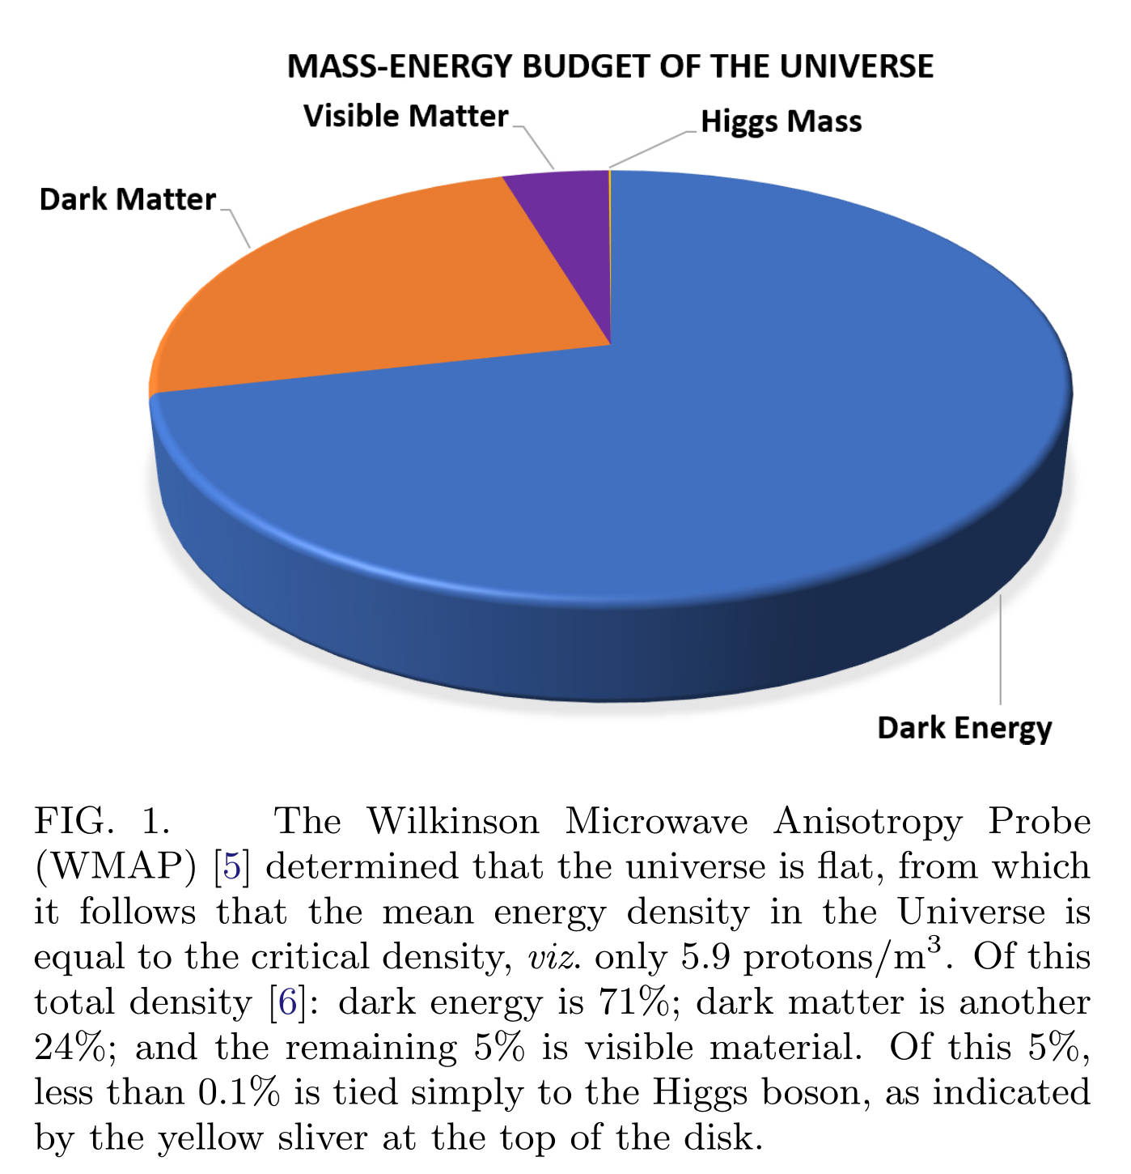
Character of Mass
Discovery of the Higgs was a watershed.
However, it should be placed in context.
Therefore, consider the mass-energy budget of the Universe
Dark energy = 71%
Dark Matter = 24%
Visible material = 5%
Higgs effect is just 0.1% of the visible matter
Little is known about the first two
Science can say almost nothing about 95% of the mass-energy in the Universe.
The explanation lies outside the Standard Model.

Slide 4
Character of Mass
Little is known about Dark Energy and Dark Matter …
Science can say almost nothing about 95% of the mass-energy in the Universe.
On the other hand, the remaining 5% has forever been the source of everything tangible.
Yet, amongst this 5%, less-than 0.1% is tied directly to the Higgs boson
Hence, even concerning visible material, too much remains unknown.

Slide 5
Visible Mass
More than 98% of visible mass is contained within nuclei.
First approximation:
atomic weights = sum of the masses of all the nucleons they contain.
Each nucleon has a mass m_{N} ∼ 1 GeV ≈ 2000 m_{e}
Higgs boson produces m_{e} the latter, but what produces m_{N} ?
This question is the crux of modern physics
How can science explain the emergence of hadronic mass (EHM)?

Slide 6
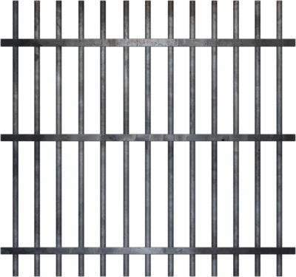
Standard Model
Strong interactions are described by quantum chromodynamics (QCD).
QCD: hadrons are composites,
built from quarks and/or antiquarks (matter fields)
held together by forces produced by the exchange of gluons (gauge fields).
These forces are unlike any previously encountered.
become very weak when two quarks are brought close together within a nucleon
but all experimental attempts to remove a single quark from within a nucleon and isolate it in a detector have failed.
Seemingly, then, the forces become enormously strong as the separation between quarks is increased
Modern science is encumbered with The Confinement Problem
confinement
Google Scholar:
25,000 mentions of quark confinement since 2000

Slide 7
Confinement Problem
Modern science is encumbered with The Confinement Problem
Confinement is crucial because it ensures absolute stability of the proton.
In the absence of confinement:
protons in isolation could decay;
the hydrogen atom would be unstable;
nucleosynthesis would be a chance event, having no lasting consequences;
and without nuclei, there would be no stars and no living Universe.
Without confinement, our Universe could not exist.
confinement
Google Scholar:
25,000 mentions of quark confinement since 2000

Slide 8
Confinement Problem
Modern science is encumbered with The Confinement Problem
As the 21st Century began, the Clay Mathematics Institute established seven Millennium Prize Problems
Each represents one of the toughest challenges in mathematics.
The set contains the problem of confinement; and presenting a sound solution will win its discoverer $1,000,000
Even with such motivation, today, almost 50 years after the discovery of quarks, no rigorous solution has been found
Confinement and EHM are inextricably linked
Consequently, as science plans for the next thirty years, solving the problem of EHM has become a Grand Challenge
confinement
Google Scholar:
25,000 mentions of quark confinement since 2000

Slide 9
QCD is full of surprises
$$L= \frac{1}{4}G_{μν}^{a}\left(x\right)G_{μν}^{a}\left(x\right)+\overline{ψ}\left[γ⋅∂_{x}+m+ig \frac{λ^{a}}{2}γ⋅A^{a}\left(x\right)\right]ψ\left(x\right)$$
$$G_{μν}^{a}\left(x\right)=∂_{μ}A_{ν}^{a}(x)−∂_{ν}A_{μ}^{a}(x)−f^{abc}A_{μ}^{b}{(x)A}_{ν}^{c}(x)$$
In appearance, QCD is simple.
QCD is also unique.
Fundamental theory with the capacity to sustain massless elementary degrees-of-freedom, viz. gluons and quarks;
Yet gluons and quarks are predicted to acquire mass dynamically
And nucleons and almost all other hadrons likewise
Only massless systems in QCD = composite Nambu-Goldstone (NG) bosons,
e.g. pions and kaons.
Pions responsible for binding systems as diverse as atomic nuclei and neutron stars
Energy associated with the gluons and quarks within the NG modes is not readily apparent.
Stark contrast with all other “everyday” hadrons:
systems constituted from u, d, s quarks possess nuclear-size masses
masses far in excess of anything that can directly be tied to the Higgs boson

Slide 10
QCD is full of surprises
$$L= \frac{1}{4}G_{μν}^{a}\left(x\right)G_{μν}^{a}\left(x\right)+\overline{ψ}\left[γ⋅∂_{x}+m+ig \frac{λ^{a}}{2}γ⋅A^{a}\left(x\right)\right]ψ\left(x\right)$$
$$G_{μν}^{a}\left(x\right)=∂_{μ}A_{ν}^{a}(x)−∂_{ν}A_{μ}^{a}(x)−f^{abc}A_{μ}^{b}{(x)A}_{ν}^{c}(x)$$
In trying to match QCD with Nature, one confronts the many complexities of strong, nonlinear dynamics in relativistic quantum field theory, e.g.:
loss of particle number conservation
frame and scale dependence of the explanations and interpretations of observable processes
evolving character of the relevant degrees-of-freedom
Electroweak theory and phenomena are essentially perturbative; hence, possess little of this complexity.
Science has never before encountered an interaction such as that at work in QCD.
Understanding this interaction, explaining everything of which it is capable, can potentially change the way we look at the Universe.

Slide 11
QCD is full of surprises
$$L= \frac{1}{4}G_{μν}^{a}\left(x\right)G_{μν}^{a}\left(x\right)+\overline{ψ}\left[γ⋅∂_{x}+m+ig \frac{λ^{a}}{2}γ⋅A^{a}\left(x\right)\right]ψ\left(x\right)$$
$$G_{μν}^{a}\left(x\right)=∂_{μ}A_{ν}^{a}(x)−∂_{ν}A_{μ}^{a}(x)−f^{abc}A_{μ}^{b}{(x)A}_{ν}^{c}(x)$$
Comparison with QED
One essential difference = circled term, describing gluon self-interactions.
If QCD is correct, then this term must hold the answers to an enormous number of Nature's basic questions, e.g.:
what is the origin of visible mass?
how is mass distributed within atomic nuclei?
what carries the proton's spin?
how can the same degrees-of-freedom combine to ensure the pion is spinless?
Nowhere are there more basic expressions of emergence in Nature

Slide 12
QCD is full of surprises
$$L= \frac{1}{4}G_{μν}^{a}\left(x\right)G_{μν}^{a}\left(x\right)+\overline{ψ}\left[γ⋅∂_{x}+m+ig \frac{λ^{a}}{2}γ⋅A^{a}\left(x\right)\right]ψ\left(x\right)$$
$$G_{μν}^{a}\left(x\right)=∂_{μ}A_{ν}^{a}(x)−∂_{ν}A_{μ}^{a}(x)−f^{abc}A_{μ}^{b}{(x)A}_{ν}^{c}(x)$$
Treated as a classical theory, chromodynamics is a non-Abelian local gauge field theory.
Formulated in four spacetime dimensions, such theories do not possess any mass-scale in the absence of Lagrangian masses for the quarks.
There is no dynamics in a scale-invariant theory, only kinematics.
Bound states are therefore impossible
Accordingly, our Universe cannot exist.
A Spontaneous breaking of symmetry - Higgs mechanism - does not solve this problem
m_{N} ≈ 100-times larger than Higgs-generated current-masses of the light u- and d-quarks, the valence constituents of nucleons

Slide 13
QCD is full of surprises
$$L= \frac{1}{4}G_{μν}^{a}\left(x\right)G_{μν}^{a}\left(x\right)+\overline{ψ}\left[γ⋅∂_{x}+m+ig \frac{λ^{a}}{2}γ⋅A^{a}\left(x\right)\right]ψ\left(x\right)$$
$$G_{μν}^{a}\left(x\right)=∂_{μ}A_{ν}^{a}(x)−∂_{ν}A_{μ}^{a}(x)−f^{abc}A_{μ}^{b}{(x)A}_{ν}^{c}(x)$$
On the other hand … NG bosons are (nearly) massless
In these systems, the strong interaction’s m_{N} ≈ 1 GeV mass-scale is hidden.
Chiral limit, when Higgs-generated masses are omitted, NG modes are massless
Exactly massless … no fine tuning … no danger of tachyons
In this case, perturbative QCD predicts that strong interactions cannot distinguish between quarks with negative or positive helicity – chiral symmetry
Such a chiral symmetry would have numerous corollaries, e.g.
pion would be partnered with a scalar meson of equal mass.
However, no such state is observed
No consequences of this chiral symmetry found in Nature – symmetry broken by interactions.
Dynamical chiral symmetry breaking (DCSB) ensures both
massless quarks in QCD's Lagrangian acquire large effective masses
interaction energy between those quarks cancels their masses exactly so that m_{π} = 0

Slide 14
QCD is full of surprises
$$L= \frac{1}{4}G_{μν}^{a}\left(x\right)G_{μν}^{a}\left(x\right)+\overline{ψ}\left[γ⋅∂_{x}+m+ig \frac{λ^{a}}{2}γ⋅A^{a}\left(x\right)\right]ψ\left(x\right)$$
$$G_{μν}^{a}\left(x\right)=∂_{μ}A_{ν}^{a}(x)−∂_{ν}A_{μ}^{a}(x)−f^{abc}A_{μ}^{b}{(x)A}_{ν}^{c}(x)$$
Restore the Higgs mechanism = add realistic current-quark masses
DCSB is responsible for, inter alia:
physical size of the pion mass
m_{π} ≈ 0.15 m_{N}
large mass-splitting between pion and its valence-quark spin-flip partner, ρ-meson
m_{ρ} > 5 m_{π}
neutron and proton possessing masses
m_{N} ≈ 1 GeV
Interesting things also happen to the kaon
Like a pion, but with one light quark replaced by s-quark, K possesses a mass m_{K} ≈ 0.5 GeV
Here a competition is taking place, between dynamical and Higgs-driven mass-generation.

Slide 15
Fundamental Mysteries
These phenomena and features, their origins and corollaries, entail that the question
how did the Universe evolve?
is inseparable from the questions
how does the m_{N} ≈ 1 GeV mass-scale that characterises atomic nuclei appear?
why does it have the observed value?
and, enigmatically, why does the dynamical generation of m_{N} have seemingly no effect on the composite NG bosons in QCD?
i.e. whence the near-absence of the pion mass?

Slide 16
Confinement
Confinement is one of the most fascinating aspects of QCD
At issue is the definition.
When communicating about confinement, a typical practitioner has a notion in mind; yet the perspectives of any two different practitioners are often distinct
e.g., [Wilson:1974sk, Gribov:1998kb, Cornwall:1981zr].
The proof of one expression of confinement will be contained within demonstration that quantum SU_{c}(3) gauge field theory is mathematically well-defined,
i.e. a solution to the “Millennium Problem” [Clay Mathematics Institute $1,000,000]
However, that may be of limited utility because
Nature has provided light-quark degrees-of-freedom
They seemingly play a crucial role in the empirical realisation of confinement,
Perhaps because they enable screening of colour at low couplings [Gribov:1998kb].

Slide 17
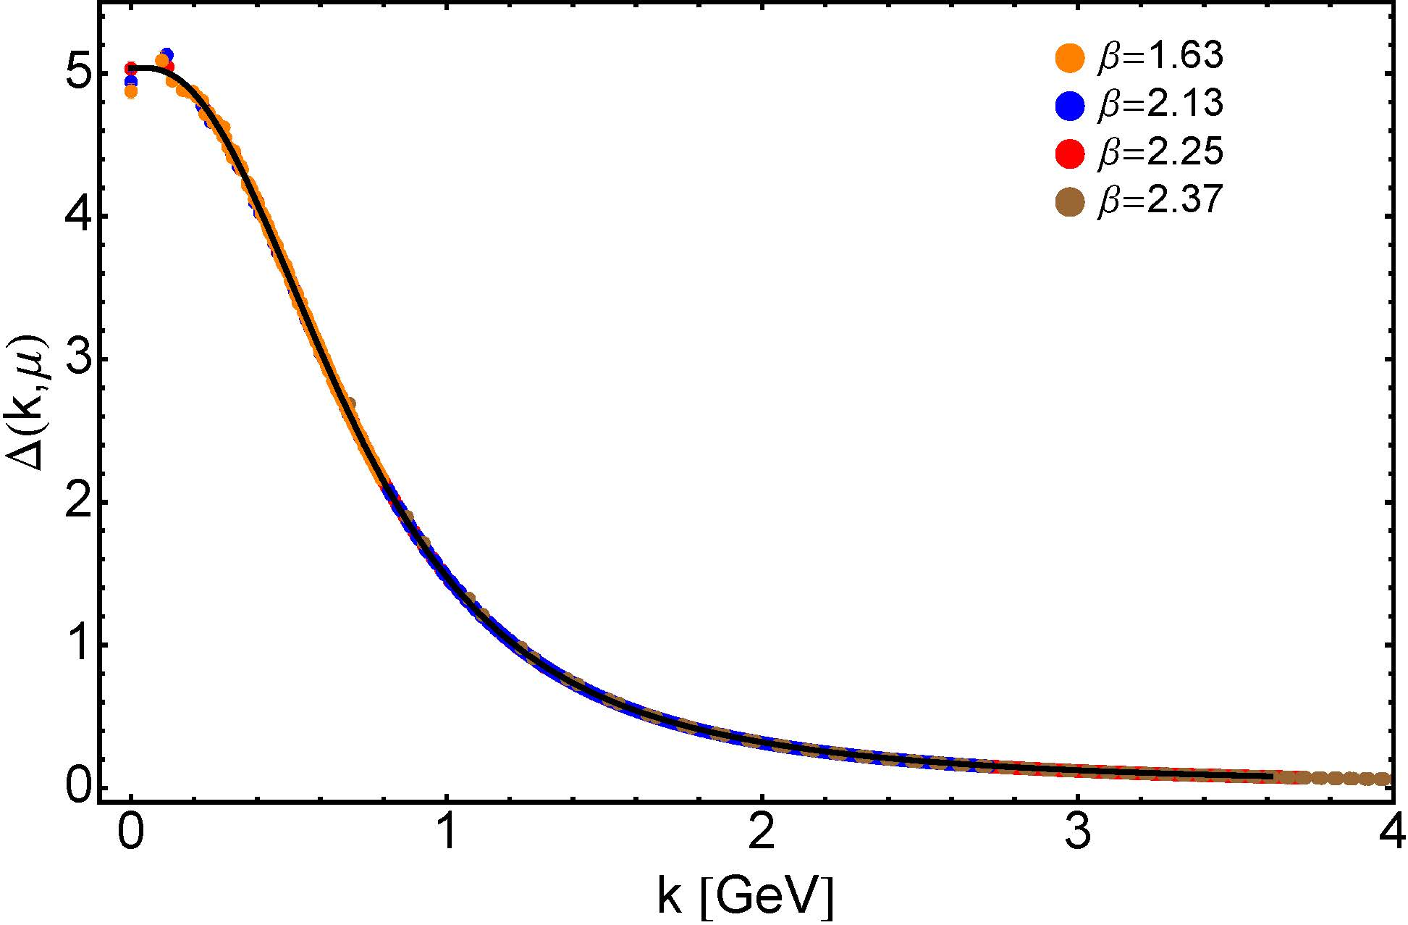
IR Behaviour of QCD
Gluons are supposed to be massless … This is true in perturbation theory
Not preserved non-perturbatively!
No symmetry in Nature protects four-transverse gluon modes … $qμ Πμν\left(q\right)≡0$
Gluons acquire a running mass, which is large at infared momenta
⇒ Prediction: Gluon two-point function is nonzero and finite at q² = 0
Continuum and lattice studies agree that this true
RGI mass-scale
${\hat{m}}_{0}=0.43(1) GeV≈\frac{1}{2}m_{p}$
Dynamical mass generation in continuum quantum chromodynamics
J.M. Cornwall, Phys. Rev. D 26 (1981) 1453 … ~ 1000 citations … approach modernized and sketched results are confirmed

Slide 18
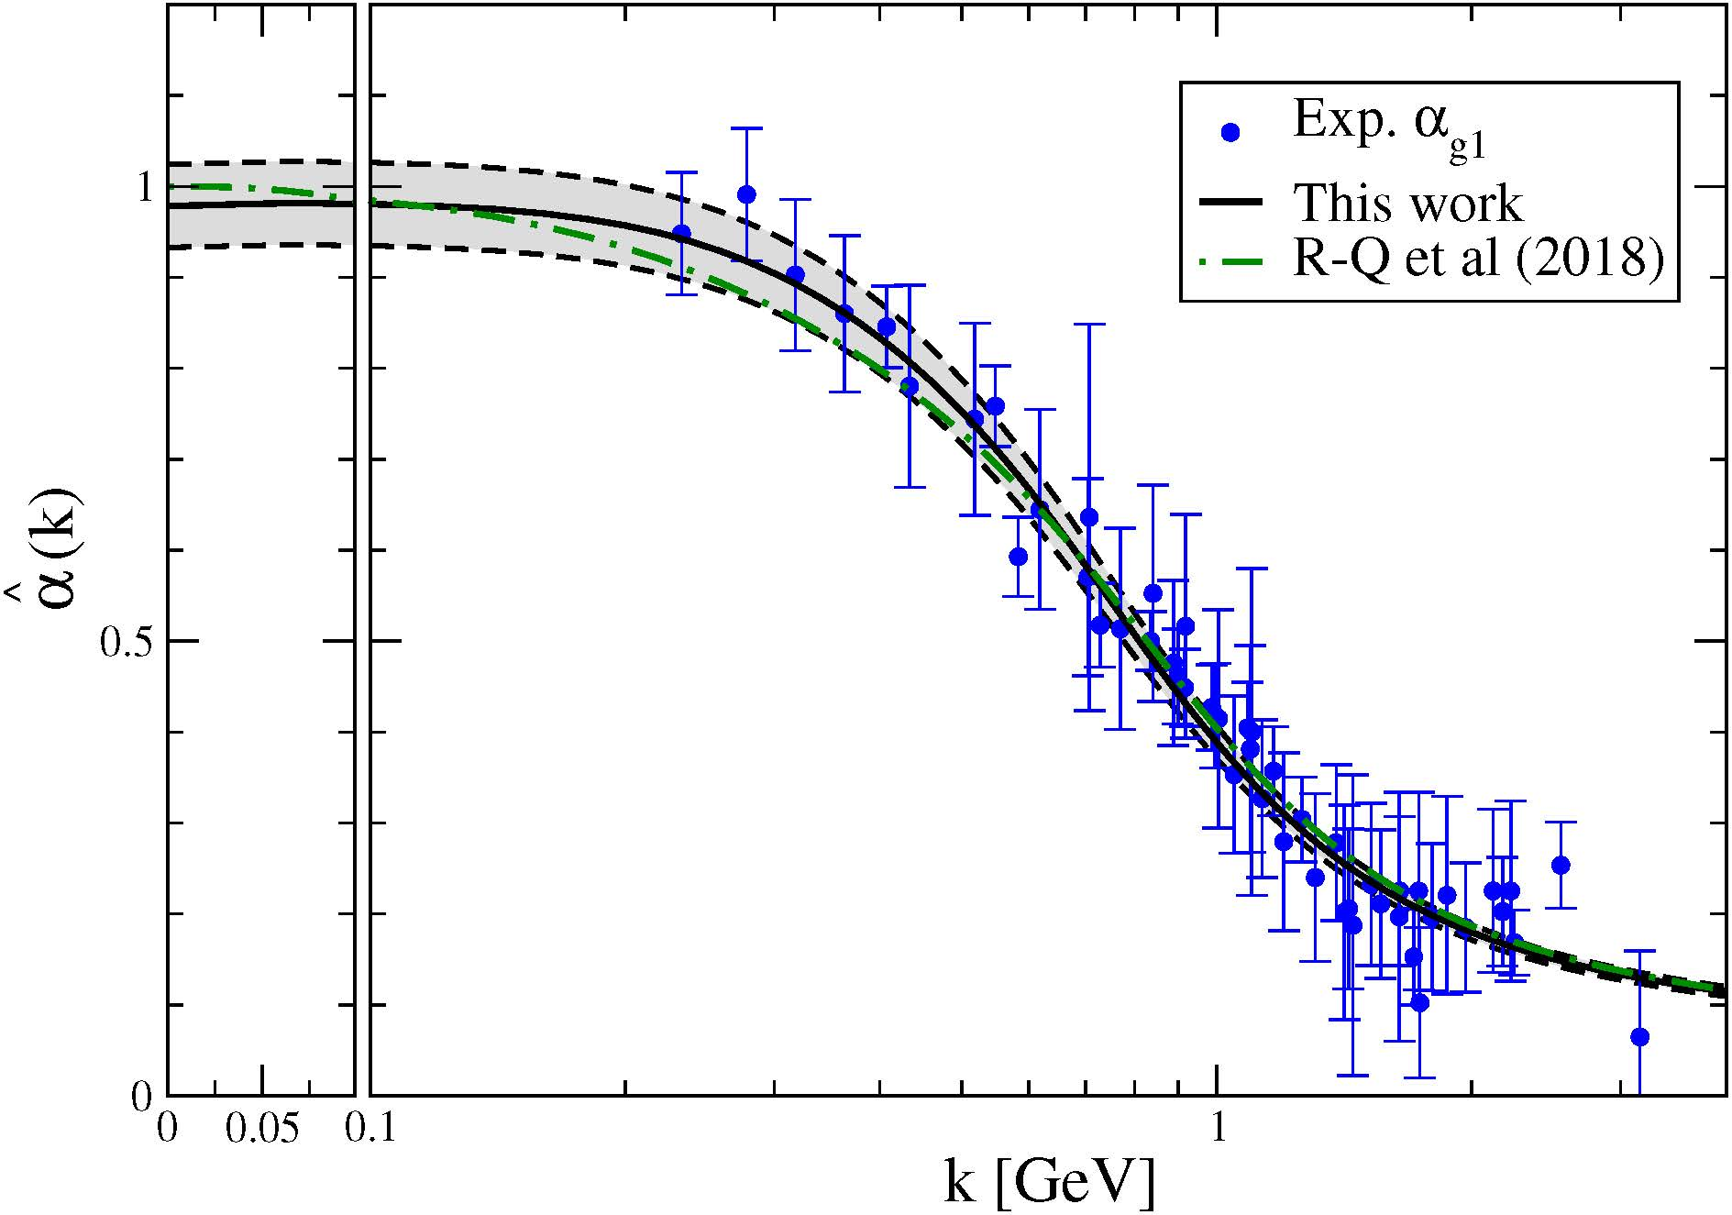
RGI PI Effective Charge
RGI PI strong coupling
$α_{0}=0.97\left(4\right)π$
Gluon vacuum polarization can be translated into a RGI process independent effective charge for QCD
Use pinch technique and background field method
Unique analogue of Gell-Mann – Low running coupling in QED
Parameter-free prediction
The QCD Running Coupling,
A. Deur, S. J. Brodsky and G. F. de Teramond, Prog. Part. Nucl. Phys. 90 (2016) 1-74
Process independent strong running coupling
Daniele Binosi et al., arXiv:1612.04835 [nucl-th], Phys. Rev. D 96 (2017) 054026/1-7
Process-independent effective coupling. From QCD Green functions to phenomenology,
Jose Rodríguez-Quintero et al., arXiv:1801.10164 [nucl-th]. Few Body Syst. 59 (2018) 121/1-9
Effective charge from lattice QCD, Zhu-Fang Cui, Jin-Li Zhang et al., NJU-INP 014/19, arXiv:1912.08232 [hep-ph]. Chin. Phys. C 44 (2020) 083102/1-10

Slide 19
RGI PI Effective Charge
RGI PI strong coupling
$α_{0}=0.97\left(4\right)π$
Also, $\hat{α}(k^{2})$is:
pointwise (almost) identical to the process-dependent (PD) effective charge,$α_{g_{1}}$, defined via the Bjorken sum rule;
capable of marking the boundary between soft and hard physics;
that PD charge which, used at one-loop in the QCD evolution equations, delivers agreement between pion parton distribution functions calculated at the hadronic scale and experiment.

Slide 20
RGI PI Effective Charge
RGI PI strong coupling
$α_{0}=0.97\left(4\right)π$
In playing so many diverse roles, $\hat{α}(k^{2})$ is a strong candidate for that object which properly represents the interaction strength in QCD at any given momentum scale.
Landau pole, a prominent feature of perturbation theory, is screened (eliminated) in QCD by the dynamical generation of a gluon mass-scale
Theory possesses an infrared stable fixed point.
Accordingly, with standard renormalisation theory ensuring that QCD's ultraviolet behaviour is under control, QCD emerges as a mathematically well-defined quantum field theory in four dimensions.

Slide 21
Matter Sector
Dynamical violation of scale invariance in QCD enables emergence of gluon mass
What about the matter sector?
Inspired by BCS theory, Nambu developed simple model … won him Nobel Prize
fermion & antifermion form a “Cooper pair” so long as coupling is strong enough
Studied via Dyson’s Gap Equation – describes emergence of quasiparticle in many body systems & quantum field theories are systems with infinitely many bodies
If and only if $α_{0}≥0.3π$, then this gap equation produces a nonzero fermion mass even in the absence of a Higgs coupling
Dynamical chiral symmetry breaking – emergence of a fermion mass from nothing

Slide 22
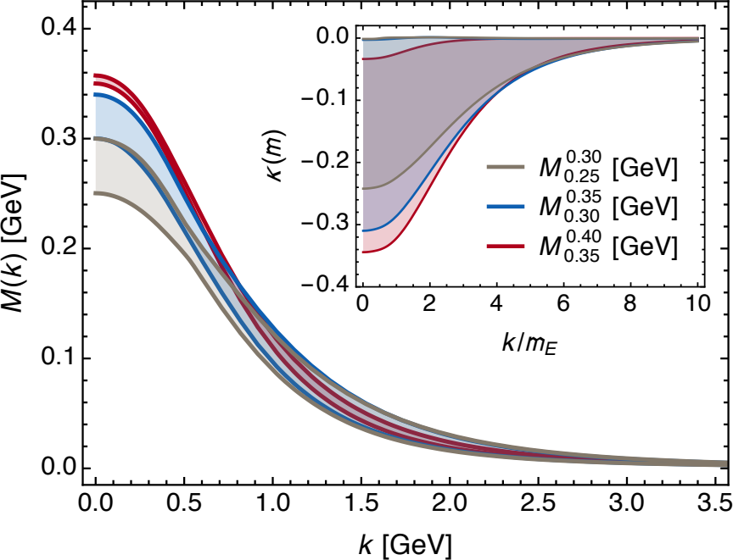
Matter Sector
$α_{0}=0.97 π$
Dressed-quark quasiparticles emerge
Characterised by a running mass M(k)
Vanishes in ultraviolet, following the pattern predicted by Lane (1974) and Politzer (1976)
Large at infrared momenta, i.e. $M\left(0\right)≈\frac{1}{3}m_{p}$
Just like constituent quark
Dressed-quark is a bare parton at ultraviolet momenta
But that parton carries a cloud of sea and glue with it in the infrared

Slide 23
Empirical Consequences of EHM
QCD's interactions are universal … same in all hadrons
However, expression need not be the same in all hadrons
DCSB in chiral limit ensures SUM of different trace-anomaly operator-contributions cancel amongst each other to yield $m_{π}=0$
Individual terms do not vanish separately
In proton, no symmetry requires cancellations to be complete
Thus, value of proton's mass is typical of the magnitude of scale breaking in one body sectors = dressed-gluon and -quark mass scales
This “DCSB paradigm” provides basis for understanding why:
mass-scale for strong interactions is vastly different to that of electromagnetism
proton mass expresses that scale
pion is nevertheless unnaturally light

Slide 24
Pion mass – a decomposition?
Rest frame decomposition of the trace anomaly has been used [Yang:2014qna] to separate the pion’s mass into contributions from pieces defined as the
m_{q}-term,
H_{A} = trace-anomaly,
H_{KU} = quark E_{K}+E_{U},
H_{g} = gluon energy
Conclusion:
“For the light PS mesons, the m_{q}-term is about 50% of the total mass. This implies that H_{A} contributes ∼ 12% of the mass.
The remaining contributions from H_{g} and H_{KU} are ∼ 30% and ∼ 8% respectively.
It is interesting to observe that all these contributions are positive which suggests that they all approach zero at the chiral limit when the pion mass approaches zero.”
Unfortunately … none of this makes sense.

Slide 25
Pion mass – problems
Rest frame decomposition in this form leads to a precarious position because
Any conclusions are frame- and scale-dependent
the gluons in the trace anomaly and in the kinetic and potential energy are seemingly being treated as separate entities, which, of course, they’re not
chiral limit – massless particle does not have a rest frame – no simple-minded limit of separate terms is meaningful
No quantum mechanics picture of a bound-state’s mass has all terms positive:
kinetic energy and mass terms are positive
binding energy is negative
Gell-Mann – Oakes – Renner [GellMann:1968rz] … known for > 50 years:
$m_{π}^{2}∝m×DCSB enhancement factor$ … explicitly,
If ALL of $m_{π}^{2}$ owes to the current-quark mass term in a Poincaré-invariance statement
Then what possible meaning can one associate with “rest frame” statement that only half $m_{π}$ comes from the quark mass term, i.e. m_{q}-term produces 0.25 $m_{π}^{2}$ ?!
Huge EHM enhancement factor ≈ 200 $(m_{u}+m_{d})$
$$m_{π}^{2}=(m_{u}+m_{d})\frac{−⟨\overline{q}q⟩}{f_{π}^{2}}$$

Slide 26
Decompositions of mass – Solution
Avoid a Mass Crisis
Stay away from decompositions whose definitions and interpretations are muddled by frame- and scale- dependence
Cleanest statement of the origin of mass
There is a trace anomaly: Θ₀ = β(α) ¼G_{μν} G_{μν} = T_{ρρ}
In the chiral limit
Understand, explain and explicate how this dichotomy is resolved.

Slide 27
Empirical Consequences of EHM
No significant mass-scale is possible unless one of similar size is expressed in the dressed-propagators of gluons and quarks.
Follows that the mechanism(s) responsible for emergence of mass can be exposed by measurements sensitive to such dressing
This potential is offered by many observables:
Spectra and static properties
Form factors, elastic and transition
All types of parton distributions
Describe some examples … π & K structure

Slide 28
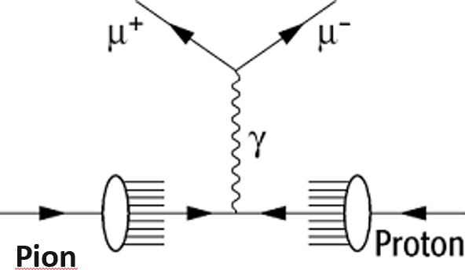
QCD prediction of meson valence-quark distributions
Owing to absence of stable pion targets, the pion’s valence-quark distribution functions have hitherto been measured via the Drell-Yan process:
π p → μ⁺ μ⁻ X
Consider a theory in which quarks scatter via a vector-boson exchange interaction whose k²>>m_{G}² behaviour is (1/k²)^{β}
Then at a resolving scale ζ_{H} … u_{π}(x; ζ_{H}) ~ (1-x)^{2β}
Namely, the large-x behaviour of the quark distribution function is a direct measure of the momentum-dependence of the underlying interaction.
In QCD, β=1 and hence
QCD: Q > ζ_{H} ⇒ 2 → 2+γ, γ > 0
^{QCD} u_{π}(x; ζ_{H}) ~ (1-x)²

Slide 29
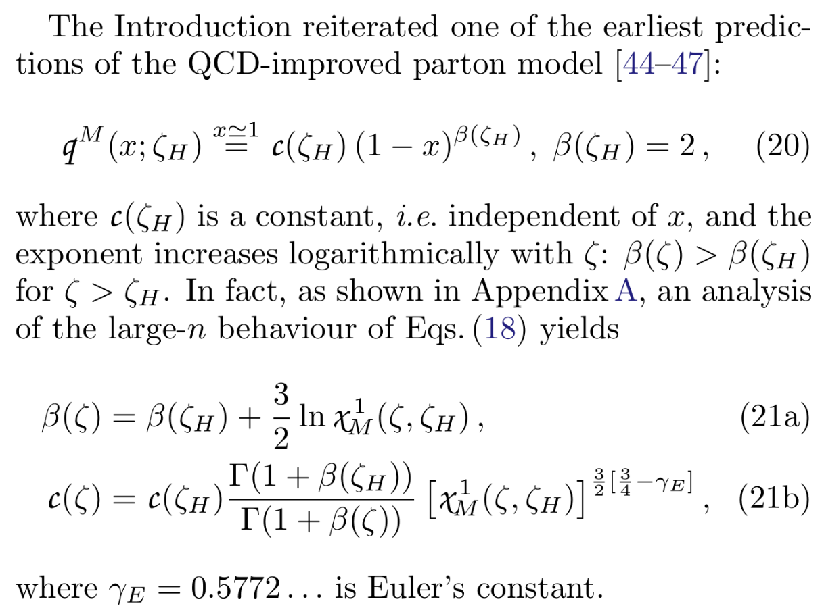
QCD prediction of meson valence-quark distributions
Fact 1: After 40 years, no flaw has been found in the proof
Fact 2: Power law fixed by asymptotic behaviour of bound-state wave function
Fact 3: Gluon corrections do NOT change power laws.
They only modify anomalous dimensions.
Again, proof is 40 years old and no flaw has been found. Rather, it has been confirmed in numerous continuum calculations.
Exact statement – in textbooks, but often overlooked:
β(ζ) increases logarithmically with inverse of valence-quark momentum fraction
Coefficient decreases also, but at a different rate

Slide 30
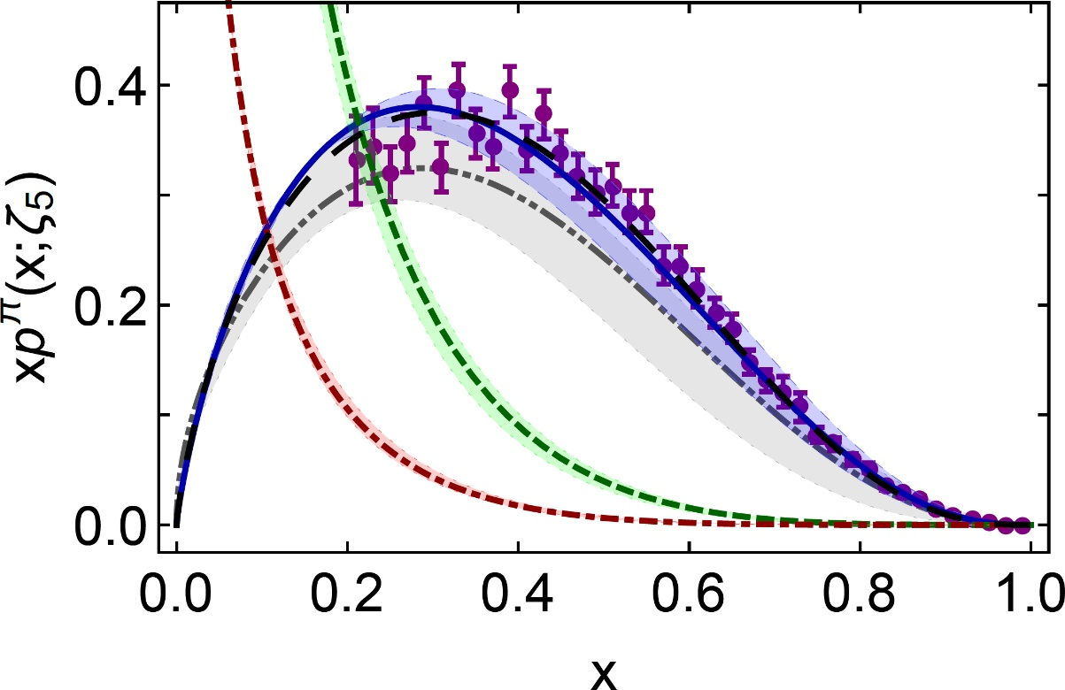
π valence-quark distributions 20 Years of Evolution → 2019
β^{contm}(ζ₅) = 2.66(12)
β^{lattice}(ζ₅) = 2.45(58)
Novel lattice-QCD algorithms beginning to yield results for pointwise behaviour of $uπ(x;ζ)$
Developments in continuum-QCD have enabled 1st parameter-free predictions of
valence, glue and sea distributions within the pion
Reveal that $uπ(x;ζ)$is hardened by emergent mass
Agreement between
new continuum prediction for $uπ(x;ζ)$ [Ding:2019lwe] and recent lattice-QCD result [Sufian:2019bol]
Real strides being made toward understanding pion structure.
Standard Model prediction is stronger than ever before
Now – after 30 years – new era dawning in which the ultimate experimental checks can be made

Slide 31
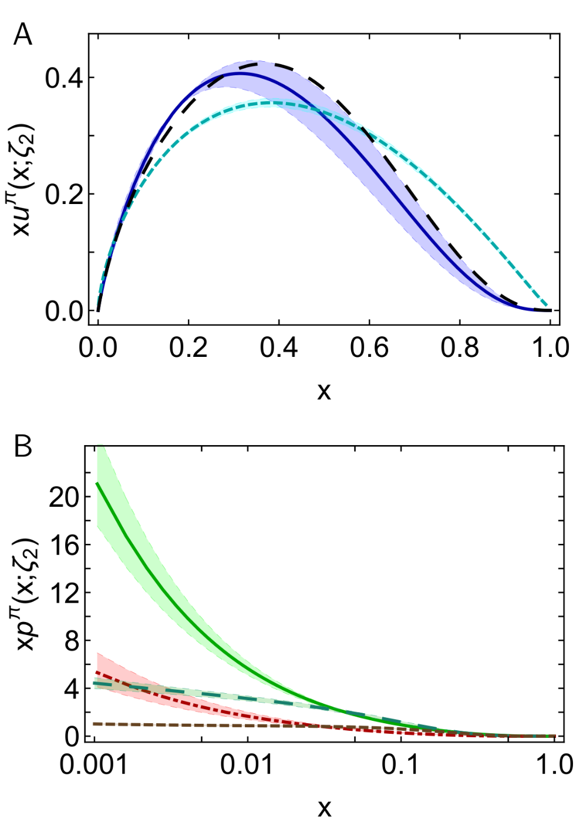
π valence-quark distributions Comparison with JAM fits
DSE prediction
Valence:
momentum fraction similar
JAM profile much harder & inconsistent with QCD prediction
Glue:
Pointwise agreement on x ≥ 0.05, but marked disagreement on important complementary domain
Both continuum prediction and JAM fit are very different from early phenomenology
Should be tested in new experiments that are directly sensitive to the pion’s gluon content.
Perhaps, prompt photon & J/Ψ production
Sea:
Prediction and fit disagree on entire x-domain
If pion’s gluon content is considered uncertain, then fair to describe sea-quark distribution as empirically unknown
Motivation for the collection and analysis of DY data with π± beams on isoscalar targets
JAM valence
DSE prediction
glue & sea
JAM:
glue & sea

Slide 32
Kaon Distribution Functions
Improved & extended approach used for pion DFs
Unified distribution amplitudes and functions for pion and kaon – connect with pion and kaon form factors
Introduced mass-dependence into splitting functions
valence momentum fraction at ζ₅ = 0.39(3)
💣 One lQCD calculation (2003.14128 [hep-lat]):
Fractions systematically larger than continuum predictions, especially for s̅:
u – 5.6(5)%, 30(6)%, 55(4)%
s̅ – 31(7)%, 67(12)%, 106(16)%
lQCD vs. with DSE predictions, lQCD DFs = much harder.
lQCD DFs inconsistent with QCD prediction

Slide 33
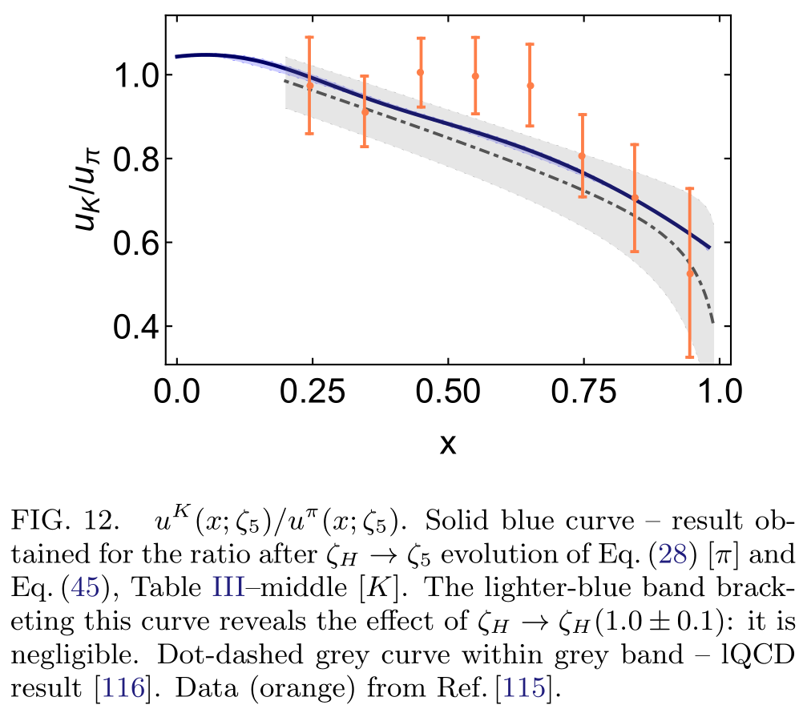
Kaon Distribution Functions: ${u_{K}(x)}/{u_{π}\left(x\right)}$
Uncertainty in continuum predictions for DFs cancels in ratio
First lQCD results for ratio also drawn
Relative difference between the central lQCD result and DSE prediction is ≈ 5% … despite fact that individual lQCD DFs are very different from continuum results
Long known fact, i.e. ${u_{K}(x)}/{u_{π}\left(x\right)}$ is very forgiving of even large differences between the individual DFs used to produce the ratio
More precise data crucial if ratio is to be used effectively to inform and test the modern understanding of SM NG modes
Results for u_{π}(x;ζ₅), u_{K}(x;ζ₅) separately have greater discriminating power.
DSE prediction
lQCD prediction

Slide 34
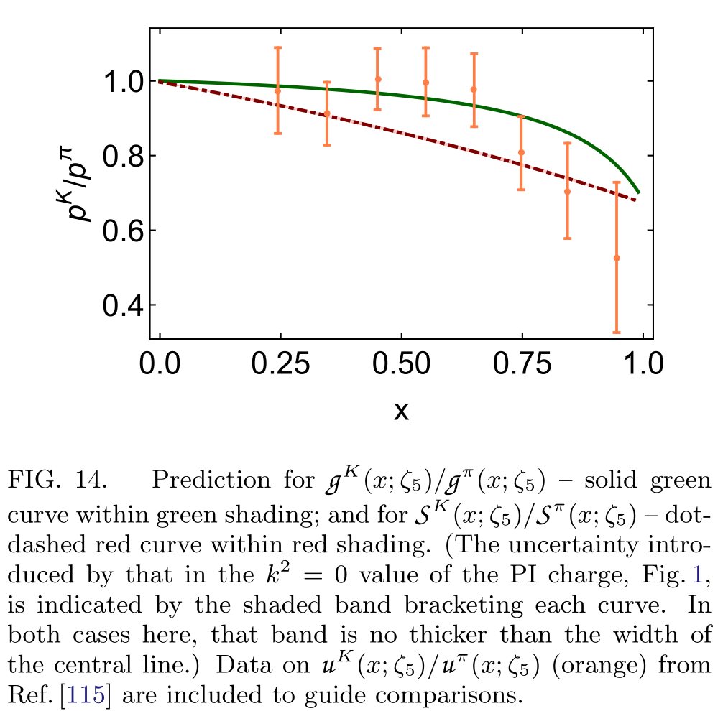
Glue and Sea in Kaon
Glue and sea distributions in the kaon differ from those of the pion only on the valence region x > 0.25.
Not surprising
Mass-dependent splitting functions act primarily to modify valence DF of heavier quark
Valence DFs are negligible at low-x, where glue and sea distributions are large, and vice versa
Hence biggest impact of a change in the valence DFs must lie at large-x.
 | valence quark | valence antiquark | glue | sea
Kaon | 0.18(2) | 0.22(2) | 0.45(1) | 0.15(2)
Pion | 0.19(2) | 0.19(2) | 0.46(1) | 0.15(2)

Slide 35
Status: pion and kaon structure functions
Pion
Pointwise behaviour of pion’s valence-quark distribution function: agreement between predictions from lQCD and symmetry-preserving QCD-consistent continuum analyses
Amongst existing phenomenological studies of pion structure functions, only one employs a next-to-leading-order analysis that includes threshold resummation. This study is unique in producing a valence-quark DF that is consistent with large-x QCD and matches continuum and lattice prediction
General disagreement between phenomenological results and theory predictions for the pion’s valence-quark DF feeds into uncertainty about pion’s glue and sea distributions
Resolution of these conflicts must await
Improved phenomenological analyses that include threshold resummation
New data that constrains the pion’s glue and sea distributions.

Slide 36
Status: pion and kaon structure functions
Kaon
Very little empirical information available on K DFs ⇒ no recent phenom. inferences.
Valence-quark distributions: results from models and a single, recent lQCD study
Kaon’s glue and sea distributions: no results
Hence, symmetry-preserving continuum QCD predictions sketched here for entire array of kaon DFs currently stand alone.
One piece of available experimental information: ${u_{K}(x)}/{u_{π}\left(x\right)}$
Continuum prediction for ratio is consistent with the data.
But, given the large errors, this ratio is very forgiving of even large differences between various calculations of the individual DFs used to produce the ratio.
Modern, precise data is critical if this ratio is to be used as a path to understanding the Standard Model’s Nambu-Goldstone modes;
Results for u_{π}(x;ζ₅), u_{K}(x;ζ₅) separately would be better.

Slide 37
Status: pion and kaon structure functions
Kaon
Glue and Sea – Predictions:
DFs very similar to those in the pion
Detailed comparison requires the use of mass-dependent splitting functions.
Development underway … Preliminary conclusions:
Light-front momentum fraction carried by s-quarks in the kaon increases by ∼ 10%;
Compensated by a commensurate decrease in fractions carried by glue (−1%) and sea (−2%).

Slide 38
NEEDS: pion and kaon structure functions
Standard Model’s (pseudo-) Nambu-Goldstone modes – pions and kaons – are basic to the formation of everything from nucleons, to nuclei, and on to neutron stars.
Hence, new-era experiments capable of discriminating between the results from models, phenomenology and QCD-connected predictions should have high priority.
Phenomenological methods needed to proceed from data to DFs must match modern experiments in precision.
Theory: continuum and lattice analyses of the pion’s valence-quark DF are converging on the same form, confirming the longstanding QCD expectation
But, lattice results for the pion’s glue and sea distributions would be very valuable.
Even more true for the kaon.
Only one extant lattice study of kaon DFs
Addressing solely valence distributions
Disagreeing in many respects with continuum predictions
Conflict with large-x QCD
⇒ Many opportunities are available.

Slide 39
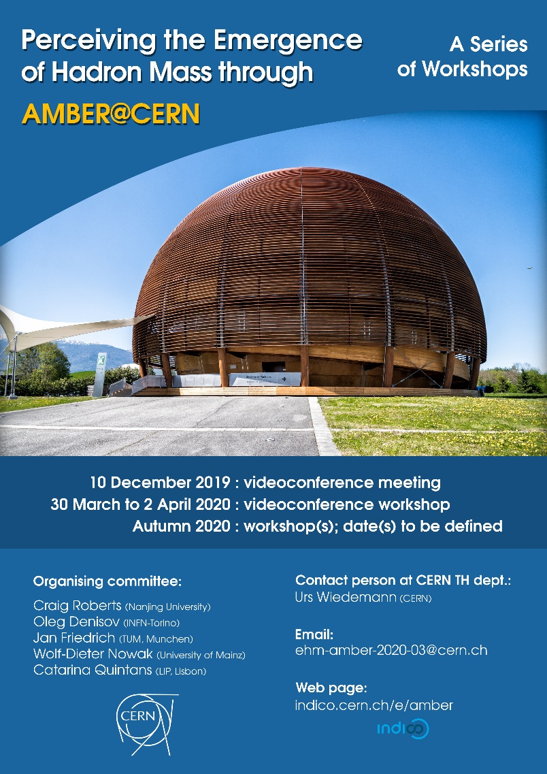
Future
Challenge: Explain the Origin & Distribution of the Bulk of Visible Mass
Progress and Insights being delivered by amalgam of
Experiment … Phenomenology …Theory
Continued exploitation of synergies essential
to capitalise on new opportunities provided by existing & planned facilities
This Discussion … join theorists from high-energy nuclear & particle physics in dialogue with the experimentalists … address the Emergence of Hadron Mass
Consolidate & expand collaboration between experimentalists proposing new measurements, phenomenologists doing global data analyses, & hadron-structure theorists.

Slide 40
Future
Challenge: Explain the Origin & Distribution of the Bulk of Visible Mass
Progress and Insights being delivered by amalgam of
Experiment … Phenomenology …Theory
Next Steps …
Ongoing efforts/meetings toward
Entering a significant new element into the EIC User Group Physics and Detector Handbook
Developing contributions as part of Yellow Report Initiative.
Discussions to explore EicC reach into pion and kaon structure
∼ 20th July … Tele-conversation: EHM through AMBER @ CERN
Oct. 2020 … 1-week workshop Exploring QCD with Tagged Processes – Université Paris-Saclay
Thank you
Autumn 2020 … Hopefully, a face-to-face meeting at CERN in Autumn.
April 2021 … ECT* Trento

