Slide 1
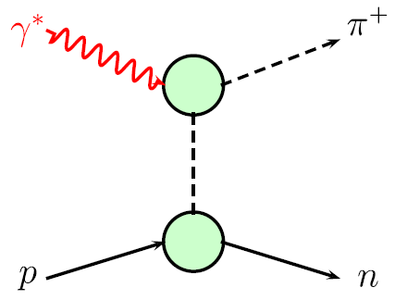
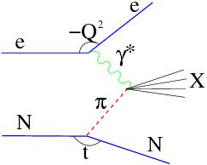


Pion and Kaon Structure at an EIC – White Paper
Q²
π, K, etc.
F_{π}
W
Tanja Horn
g_{πNN}
N(p)
t
N(p’)
Workshop on Pion and Kaon Structure at the EIC
CFNS, Stonybrook U., 2-5 June 2020
Notes:
1

Slide 2
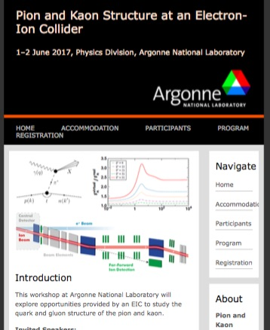
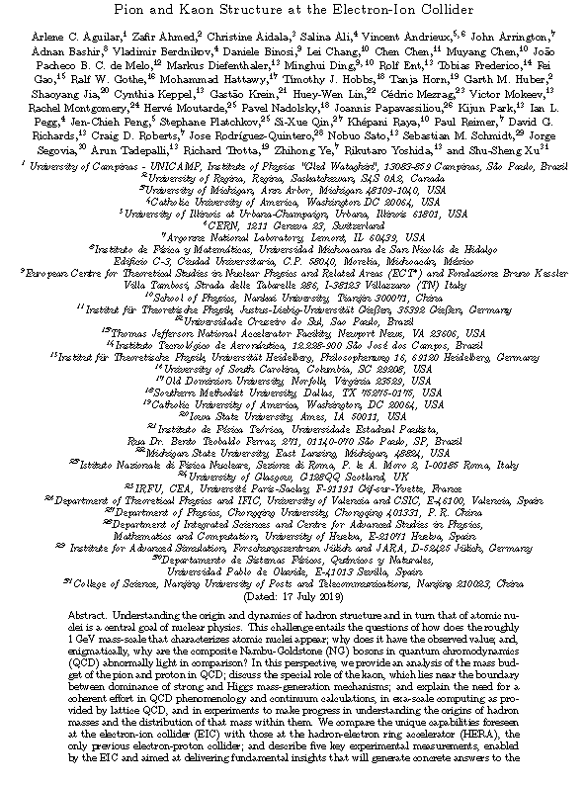
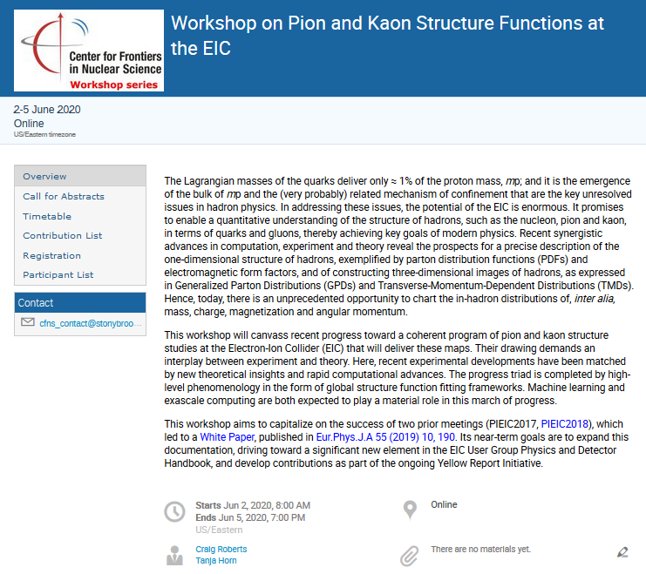
Pion and Kaon Structure at an EIC and Understanding Mass
PIEIC Workshops hosted at ANL (2017) and CUA (2018)
ECT* WS: Emergent Mass and its Consequences (2018)
PIEIC White Paper (2019)
Pion and Kaon Structure at an EIC
Eur. Phys. J. A 55 (2019) 10, 190
AMBER/CERN Workshop (2020)
CFNS Workshop (2020)
ECT*: Workshop on Mass in the Standard Model and Consequences of its Emergence (2021)
Notes:
2

Slide 3

Meson Structure Functions Yellow Report Working Group
Formed in 2019 in context of the EIC User Group Yellow Report Effort
Meson SF WG: 22 members, 13 institutions, 7 countries
Meson SF Working group members:
John R. Arrington (ANL), Carlos Ayerbe, Daniele Binosi (ECT*), Lei Chang (Nankai U.), Rolf Ent (Jlab), Tobias Frederico (Instituto Tecnologico de Aeronautica), Timothy Hobbs (SMU), Tanja Horn (CUA), Garth Huber (U. Regina), Stephen Kay (U. Regina), Cynthia Keppel (Jlab), Bill Lee (W&M) ), Huey-Wen Lin (MSU), Rachel Montgomery(U. Glasgow), Ian L. Pegg (CUA), Paul Reimer (ANL), David Richards (Jlab), Craig Roberts(Nanjng U.), Jorge Segovia (Universidad Pablo de Olavide), Arun Tadepalli (JLab), Richard Trotta (CUA), Rik Yoshida (ANL)
BJ meetings every 2-3 weeks, 9 meetings since January 2020 (meeting archive: http://www.vsl.cua.edu/cua_phy/index.php/EIC_Meson_Structure_WG_Meetings)
To join the Meson Structure Functions WG mailing list, contact T. Horn (hornt@cua.edu)
Part of the EIC Diffractive Reactions & Tagging PWG
Notes:
3

Slide 4
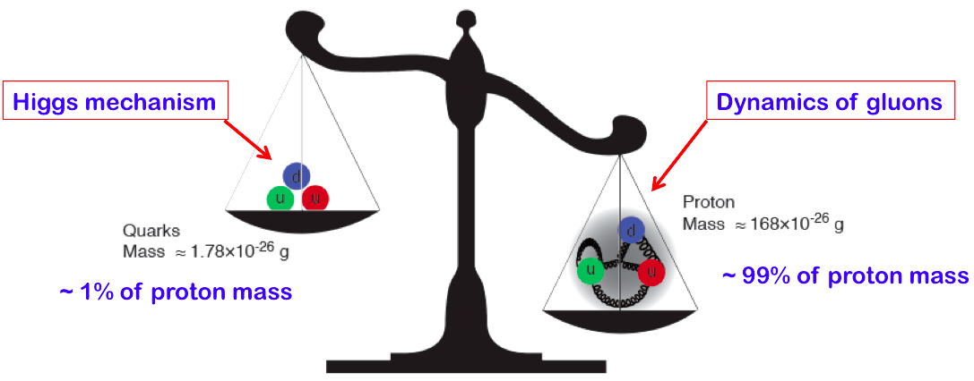
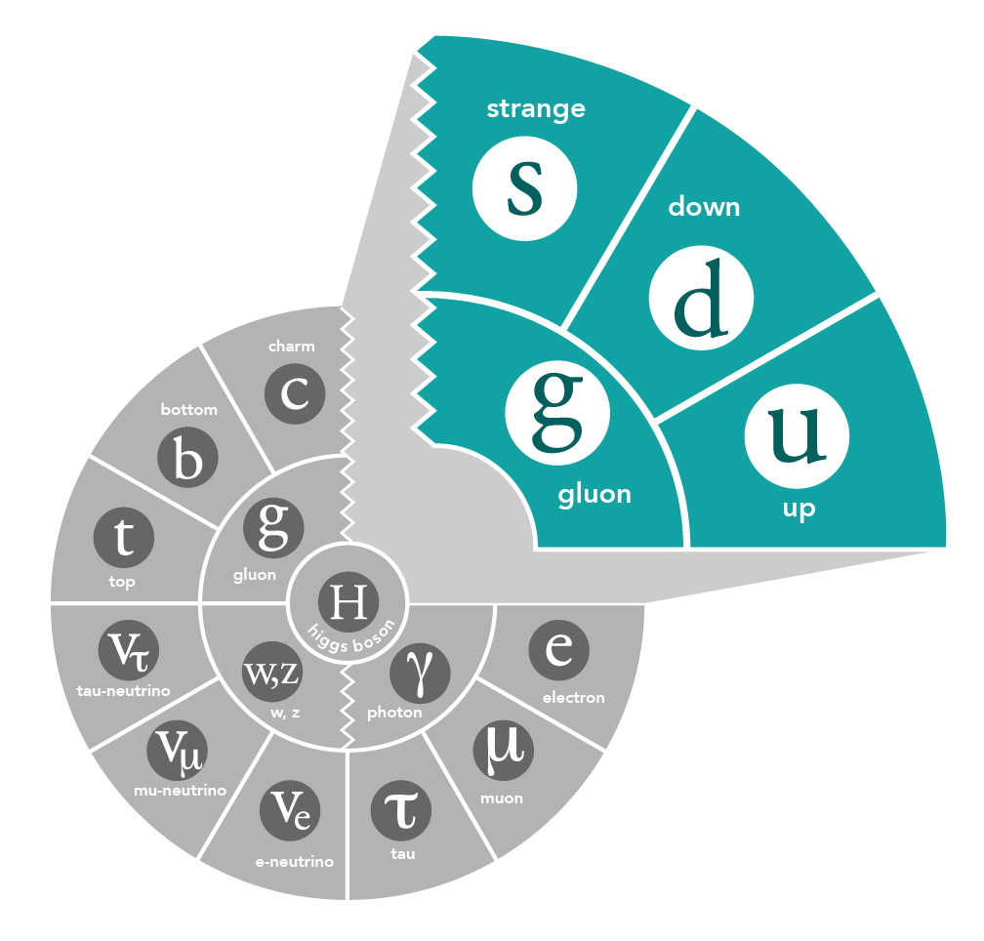
The incomplete Hadron: Mass Puzzle
“Mass without mass!”
The light quarks acquire (most of) their masses as effect of the gluon cloud.
The strange quark is at the boundary - both emergent-mass and Higgs-mass generation mechanisms are important.
Proton: Mass ~ 940 MeV
  preliminary LQCD results on mass budget, or view as mass acquisition by DCSB
Kaon: Mass ~ 490 MeV
  at a given scale, less gluons than in pion
Pion: Mass ~ 140 MeV
  mass enigma – gluons vs Goldstone boson
{
Emergent mass of the visible universe
4
→ also see talks by Craig Roberts, Jianwei Qiu, …

Slide 5
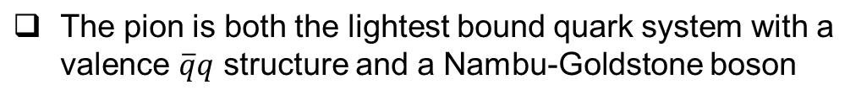


Origin of Mass of QCD’s Pseudoscalar Goldstone Modes
There are exact statements from QCD in terms of current quark masses due to PCAC (Phys. Rep. 87 (1982) 77; Phys. Rev. C 56 (1997) 3369; Phys. Lett. B420 (1998) 267)
From these exact statements, it follows the mass of bound states increases as √m with the mass of the constituents.
In contrast, in, e.g. the CQM, bound state mass rises linearly with constituent mass, e.g., with constituent quarks Q: in the nucleon m_{Q} ~ ⅓m_{N} ~ 310 MeV, in the pion m_{Q} ~ ½m_{π} ~ 70 MeV, in the kaon (with one s quark) m_{Q} ~ 200 MeV – This is not real.
In both DSE and LQCD, the mass function of quarks is the same, regardless what hadron the quarks reside in – This is real. It is the Dynamical Chiral Symmetry Breaking (DχSB) that makes the pion and kaon masses light.
Pseudoscalar masses are generated dynamically
Notes:
5

Slide 6
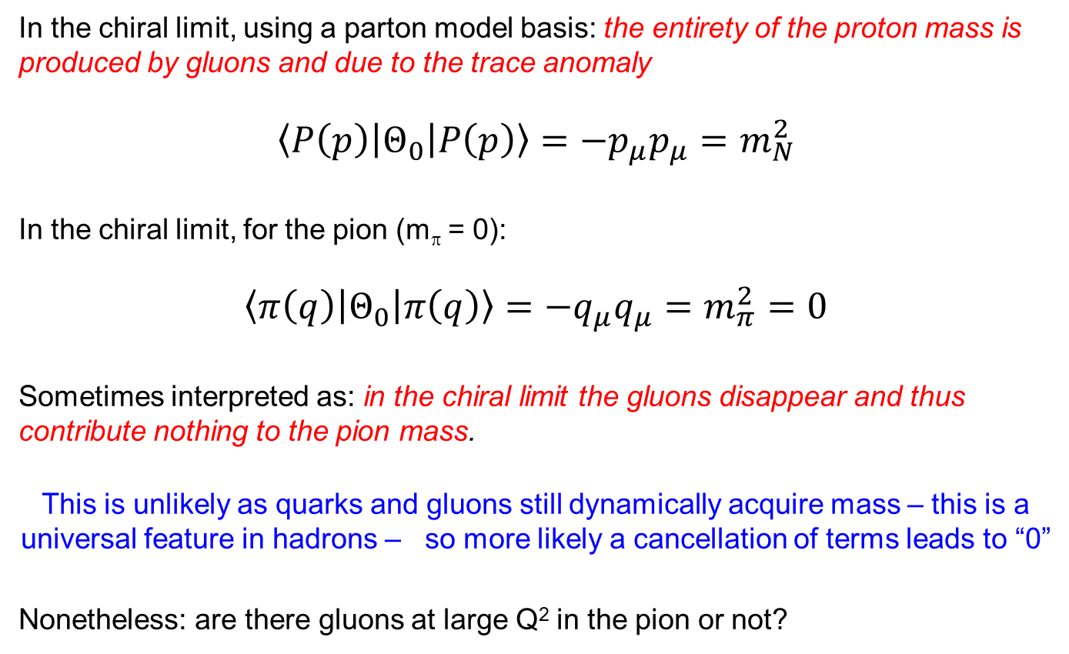
The role of gluons in the chiral limit
6

Slide 7
Fundamental Questions
For understanding the origin of hadron masses and distribution of that mass within
How do hadron masses and radii emerge for light-quark systems from QCD?
What is the origin and role of dynamical chiral symmetry breaking?
What is the interplay of the strong-mass and Higgs generation mechanisms?
What are the basic mechanisms that determine the distribution of mass, momentum, charge, spin, etc. within hadrons?
Requires coherent effort in QCD phenomenology and continuum calculations, exa-scale computing as provided by lattice QCD, and experiment
Notes:
7

Slide 8
At some level an old story…
A model for nucleon, pion and kaon structure functions
F. Martin, CERN-TH 2845 (1980)
NA3 data
u_{V}(x,Q₀²)
u_{V}(x,Q² =20 GeV²)
Nucleon
DIS
Kaon
Pion
Predictions based on non-relativistic model with valence quarks only
u^{K-}_{V}(x,Q² =20 GeV²)/u^{π-}_{V}(x,Q² =20 GeV²)
pion/kaon differs from proton: 2- vs. 3- quark system
kaon differs from pion owing to one heavy quark
x
Notes:
8

Slide 9
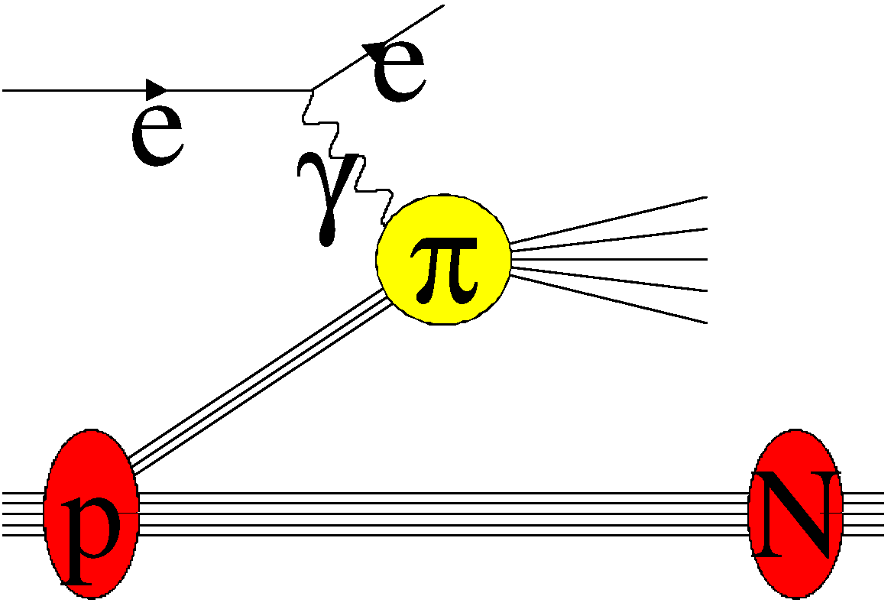

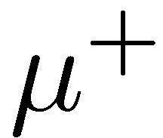

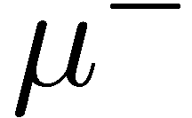
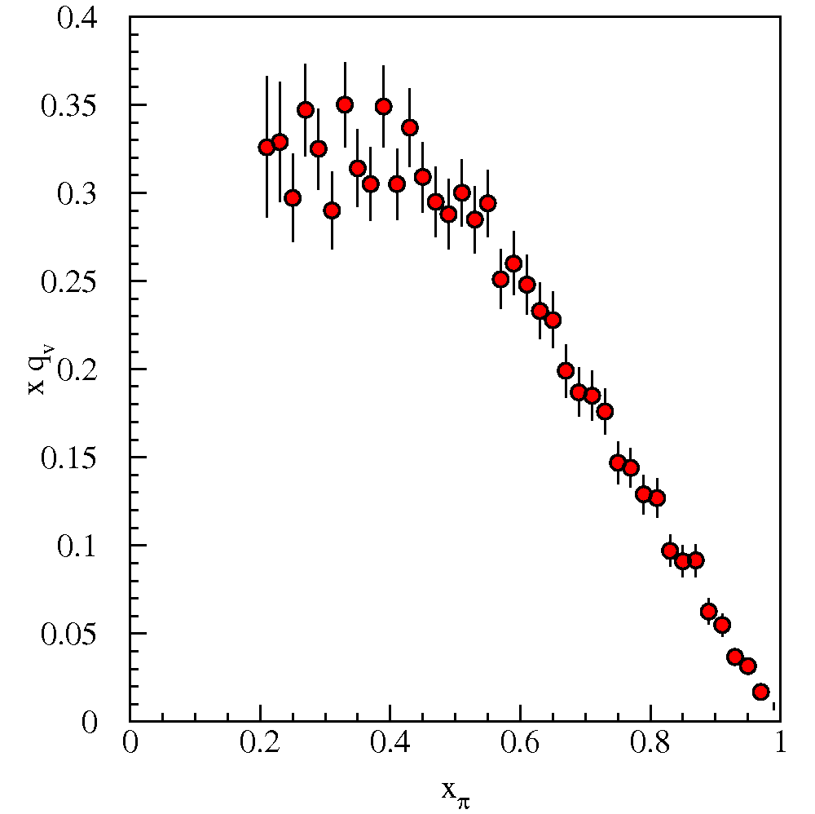
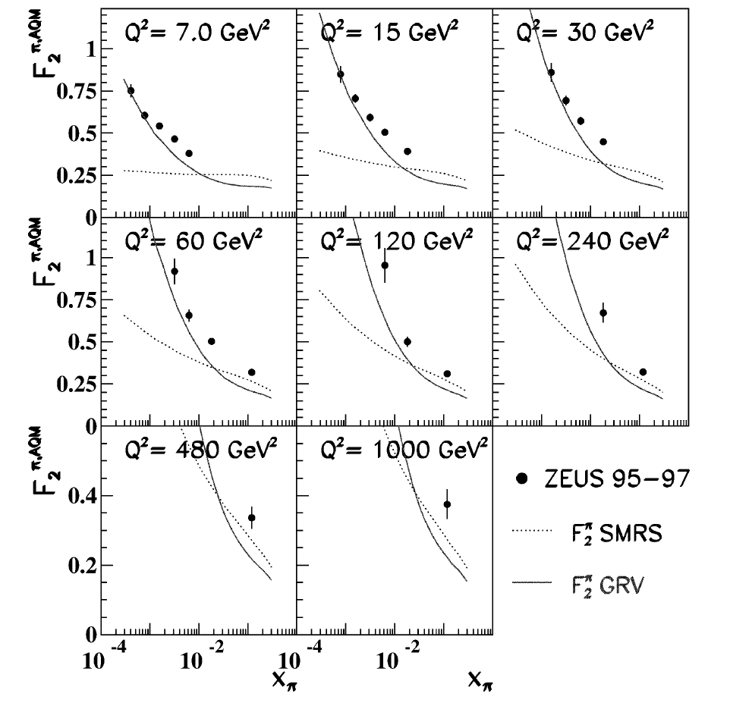
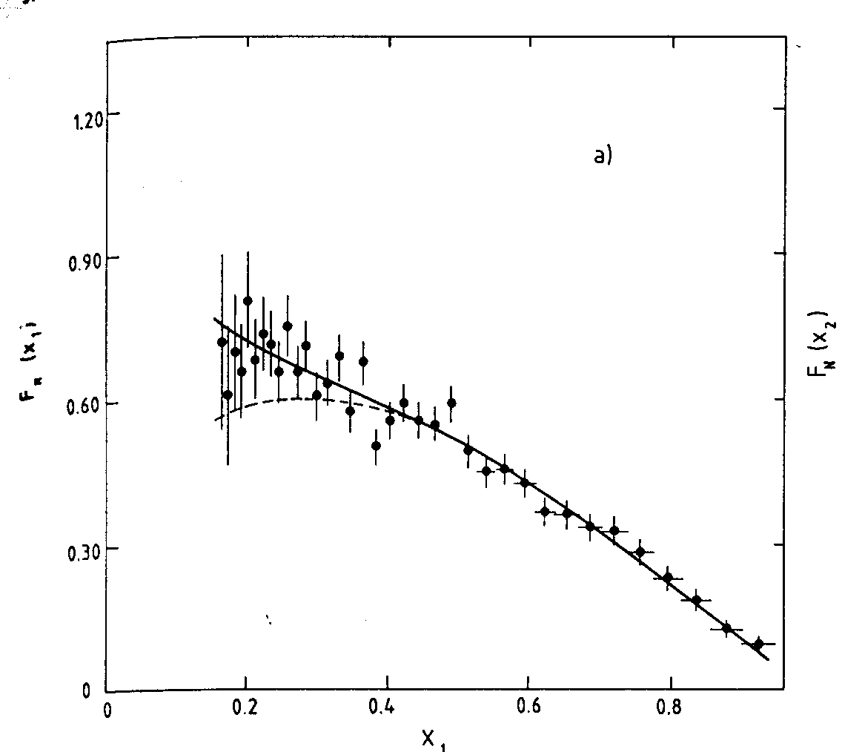
World Data on pion structure function F₂^{π}
Pion Drell-Yan
DIS (Sullivan Process)
Amount of data is limited…
FNAL E615
CERN NA3
[HERA data [ZEUS, NPB637 3 (2002)]
→ also see talks by Oleg Denisov, Vincent Andrieux, Richard Trotta, Rachel Montgomery, …

Slide 10
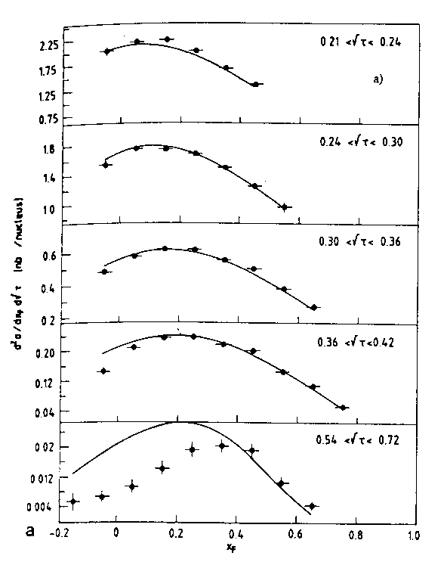
Pion Drell-Yan Data: CERN NA3 (π^{+/-}) NA10 (π⁻)
NA3 200 GeV π⁻ data (also have 150 and 180 GeV π⁻ and 200 GeV π⁺ data). Can determine pion sea!
NA10 194 GeV π⁻ data
quark sea in pion is small – few %
Notes:
10

Slide 11
Key Experimental Efforts at an EIC
Hadron masses in light quark systems
Pion and kaon parton distribution functions (PDFs) and generalized parton distributions (GPDs)
Gluon (binding) energy in Nambu-Goldstone modes
Open charm production from pion and kaon
Mass acquisition from Dynamical Chiral Symmetry Breaking (DCSB)
Pion and kaon form factors
Strong vs. Higgs mass generating mechanisms
Valence quark distributions in pion and kaon at large momentum fraction x
Timelike analog of mass acquisition
Fragmentation of a quark into pions or kaons
Notes:
11

Slide 12
Pion and Kaon Sullivan Process
The Sullivan process can provide reliable access to a meson target as t becomes space-like if the pole associated with the ground-state meson remains the dominant feature of the process and the structure of the related correlation evolves slowly and smoothly with virtuality.
To check these conditions are satisfied empirically, one can take data covering a range in t and compare with phenomenological and theoretical expectations.
Recent theoretical calculations found that for -t ≤ 0.6 GeV², all changes in pion structure are modest so that a well-constrained experimental analysis should be reliable Similar analysis for the kaon indicates that Sullivan processes can provide a valid kaon target for -t ≤ 0.9 GeV²
[S.-X. Qin, C. Chen, C. Mezrag and C. D. Roberts, Phys. Rev. C 97 (2018) 015203.]

Slide 13
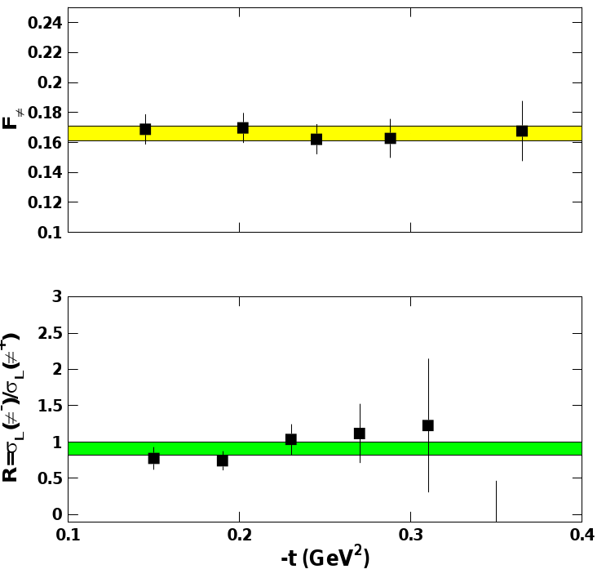
Experimental Validation (Pion Form Factor example)
Experimental studies over the last decade have given confidence in the electroproduction method yielding the physical pion form factor
Experimental studies include:
F_{π}
Take data covering a range in –t and compare with theoretical expectation
F_{π} values do not depend on -t – confidence in applicability of model to the kinematic regime of the data
-t [GeV²]
Verify that the pion pole diagram is the dominant contribution in the reaction mechanism
R_{L} (= σ_{L}(π⁻)/σ_{L}(π⁺)) approaches the pion charge ratio, consistent with pion pole dominance
-t [GeV²]
[G. Huber et al, PRL112 (2014)182501]
[T. Horn, C.D. Roberts, J. Phys. G43 (2016) no.7, 073001]
[R. J. Perry et al., PRC100 (2019) 2, 025206.]

Slide 14
EIC – Versatility and Luminosity is Key
Why would pion and kaon structure functions, and even measurements of pion structure beyond (pion GPDs and TMDs) be feasible at an EIC?
A.C. Aguilar et al., EPJ A 55 (2019) 10, 190
L_{EIC} = 10³⁴ = 1000 x L_{HERA}
Detection fraction @ EIC in general much higher than at HERA
Fraction of proton wave function related to pion Sullivan process is roughly 10⁻³ for a small –t bin (0.02).
Hence, pion data @ EIC should be comparable or better than the proton data @ HERA, or the 3D nucleon structure data @ COMPASS
If we can convince ourselves we can map pion (kaon) structure for –t < 0.6 (0.9) GeV2, we gain at least a decade as compared to HERA/COMPASS.
Ratio of the F₂ structure function related to the pion Sullivan process as compared to the proton F₂ structure function in the low-t vicinity of the pion pole, as a function of Bjorken-x (Jefferson Lab TDIS Collaboration, JLab Exp. C12-15-005)
→ see talk by Thia Keppel
Notes:
14

Slide 15
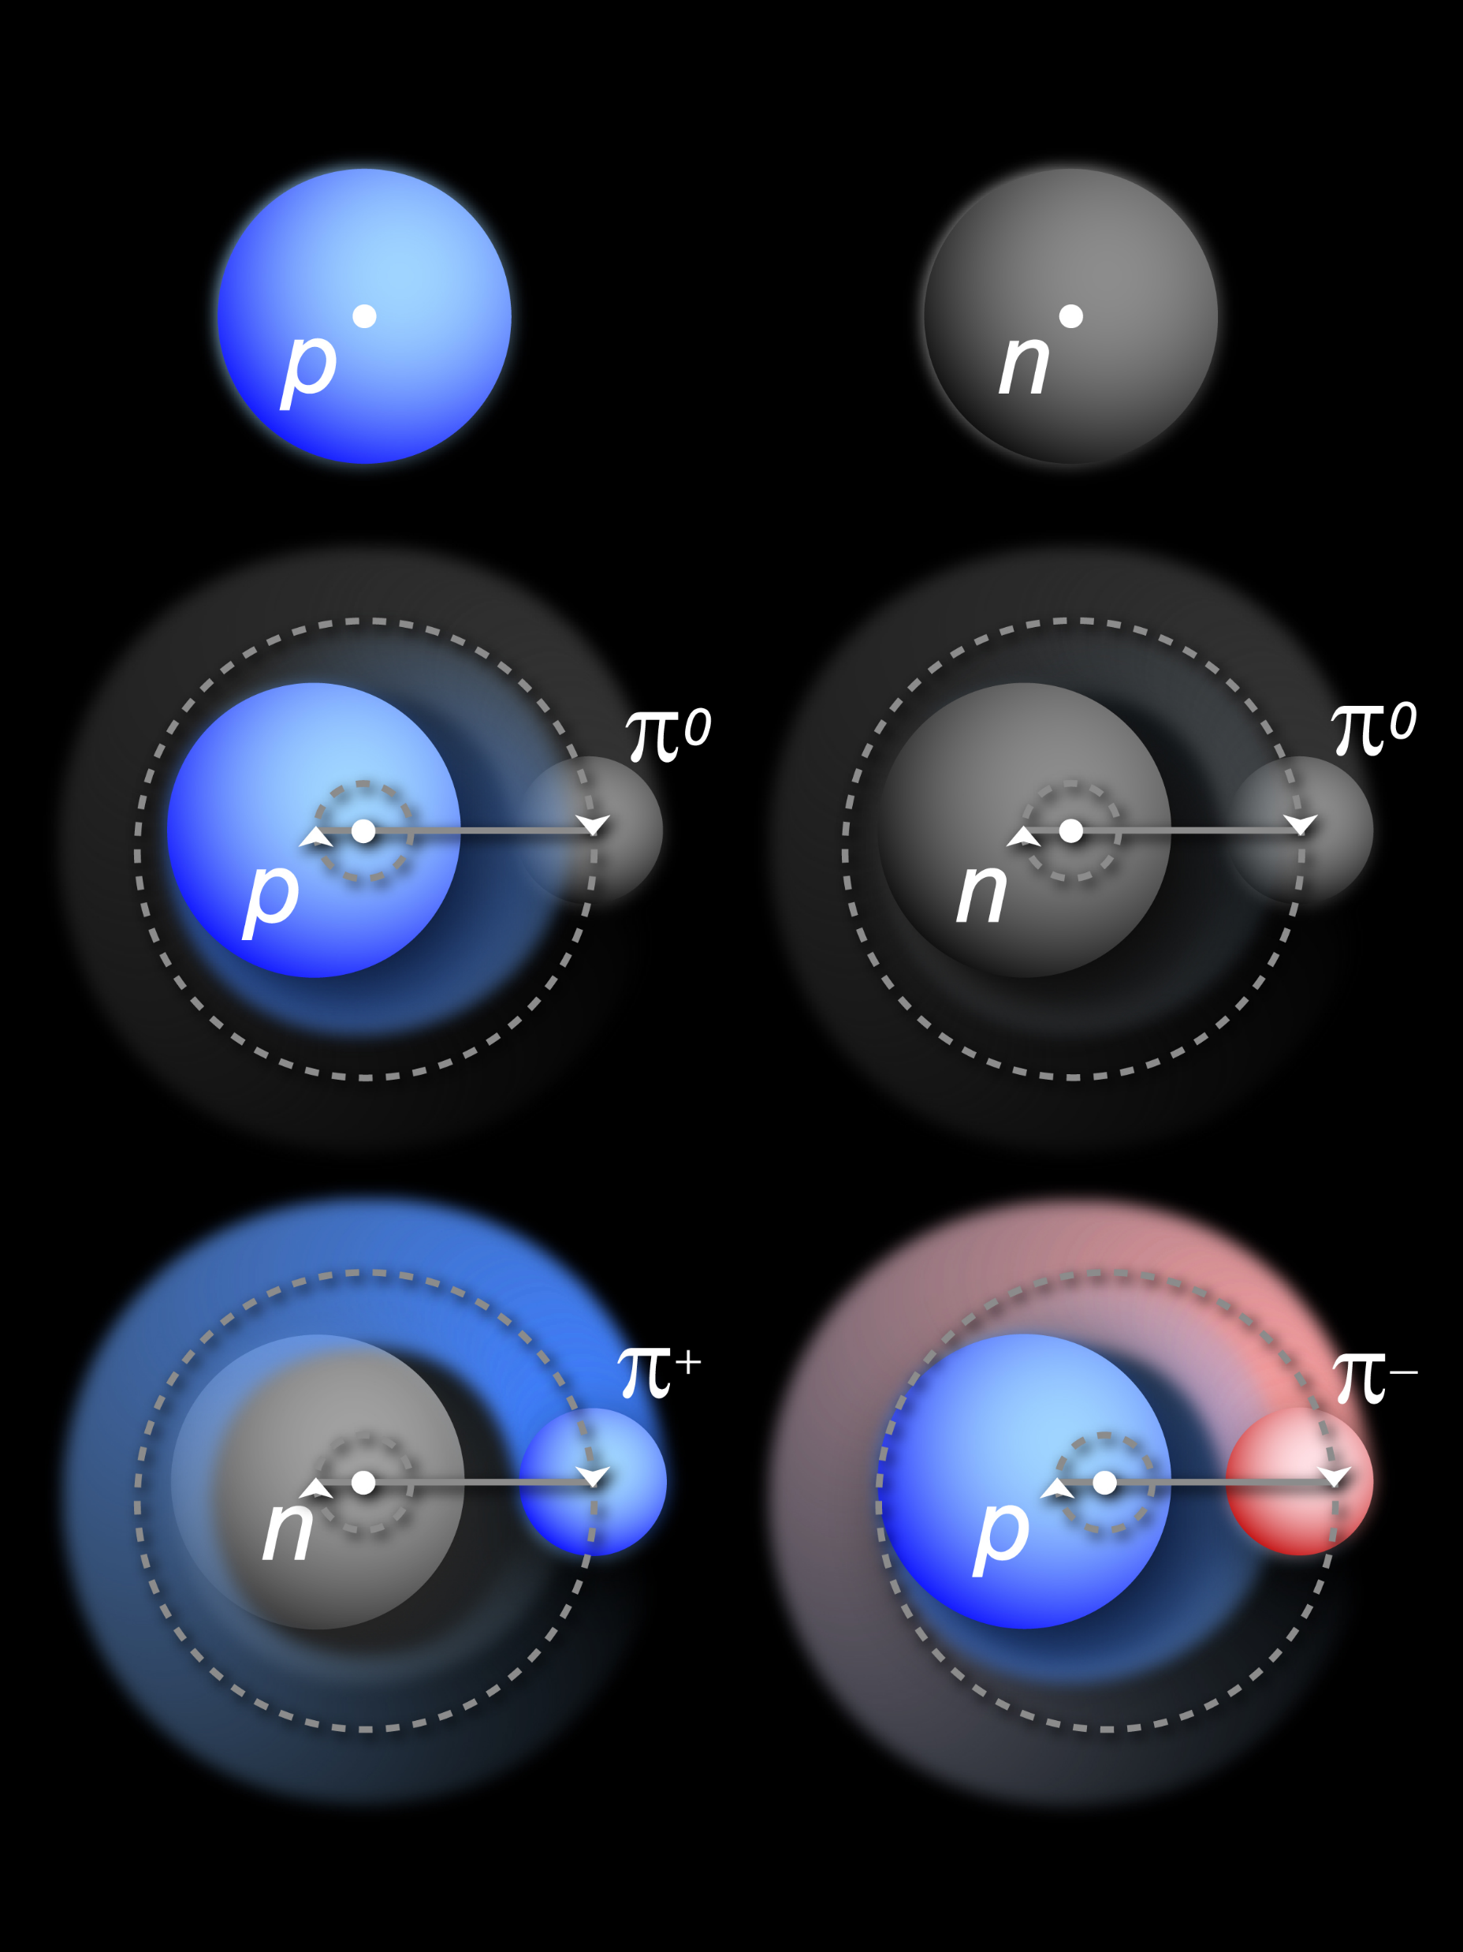
Physics Objects for Pion/Kaon Structure Studies
Sullivan process – scattering from nucleon-meson fluctuations
Detect scattered electron
DIS event – reconstruct x, Q², W², also M_{X} (W_{π}) of undetected recoiling hadronic system
Pion/Kaon target (undetected)
Detect “tagged” neutron/lambda

Slide 16
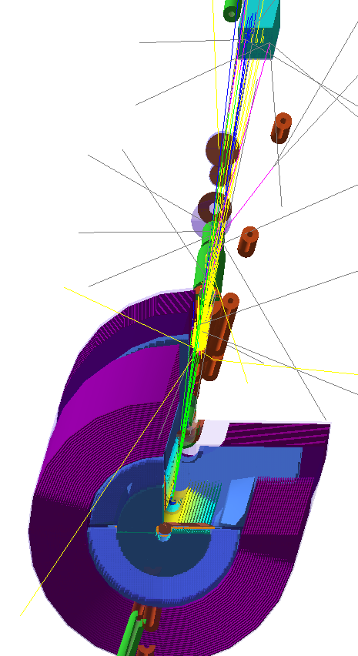

Summary of Detector Requirements
ZDC
For π-n:
→ see talk by Yulia Furletova
For all energies, the neutron detection efficiency is 100% with the planned ZDC
Lower energies (5 on 41, 5 on 100) require at least 60cm x 60cm to access wider range of energies
Virtual tracker after B1
For π-n and K⁺/Λ:
All energies need good ZDC angular resolution for the required -t resolution
High energies (10 on 100, 10 on 135, 18 on 275) require resolution of 1cm or better
K⁺/Λ benefits from low energies (5 on 41, 5 on 100) and also need:
𝜦→𝒏+𝝅^{𝟎} : additional high-res/granularity EMCal+tracking before ZDC – seems doable
    $Λ→p+π−$: additional trackers in opposite direction on path to ZDC – more challenging
Standard electron detection requirements
Good hadron calorimetry for good x resolution at large x

Slide 17
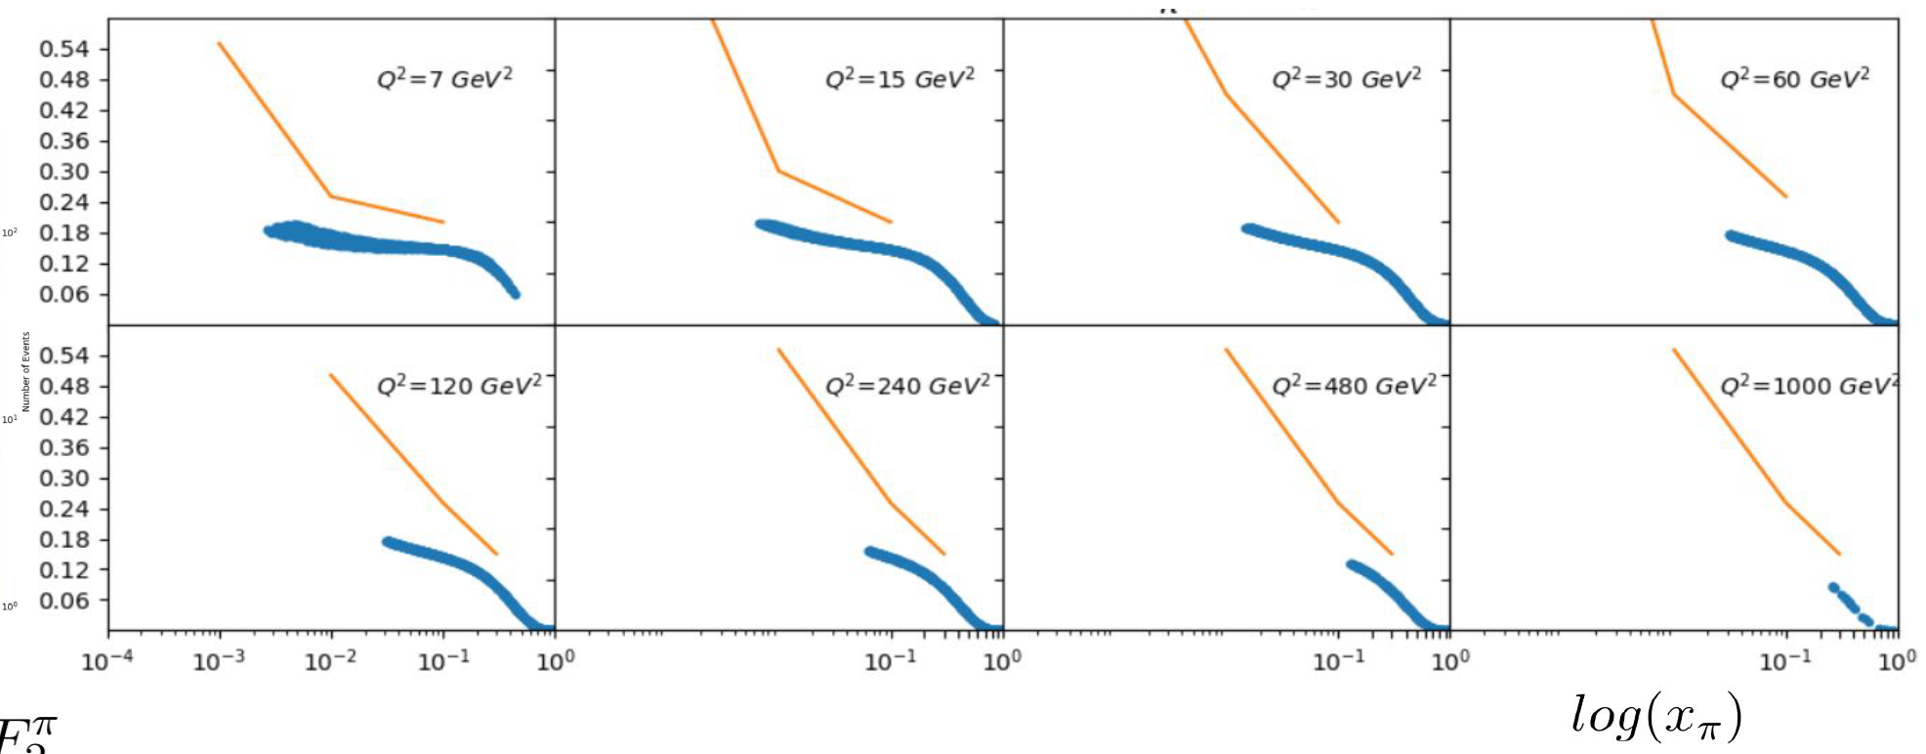
World Data on pion structure function F₂^{π}
HERA
~x_{min} for EIC
EIC
Example for 5 GeV e⁻ and 100 GeV p
Q²=7.0 GeV²
Q²=15 GeV²
Q²=30 GeV²
Q²=60 GeV²
Q²=120 GeV²
Q²=240 GeV²
Q²=480 GeV²
Q²=1000 GeV²
EIC kinematic reach down to a x = few 10⁻³
Lowest x constrained by HERA
→ see talk by Richard Trotta

Slide 18
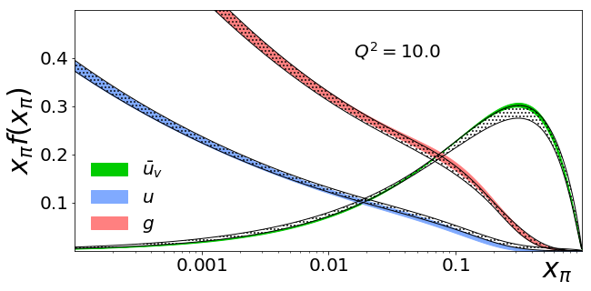
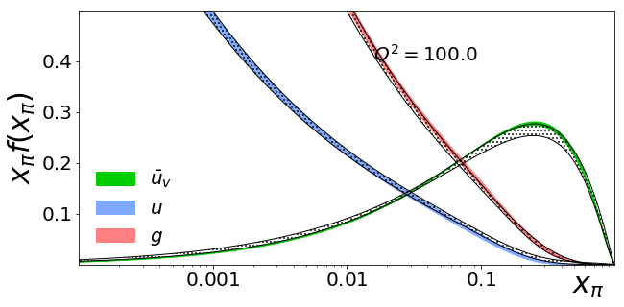
Global pion PDF fit with EIC pseudodata
A.C. Aguilar et al., EPJ A 55 (2019) 10, 190
Gray: existing D-Y and LN data
5 GeV (e-) on 50 GeV (p)
0.1 < y < 0.8
EIC pseudodata fitted using self-serve pion PDF framework
Q²=10 GeV²
EIC
EIC will improve the PDFs, especially for kaons as will have similar-quality data.
Q²=100 GeV²
DY measurements by COMPASS++/AMBER could constrain x>0.02
Precision gluon constraints of pion and kaon PDFs are possible.
Notes:
18

Slide 19
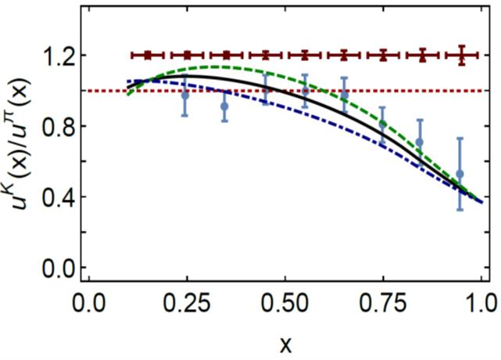
Kaon structure functions – gluon pdfs
A.C. Aguilar et al., EPJ A 55 (2019) 10, 190
Based on Lattice QCD calculations and DSE calculations:
Valence quarks carry 52% of the pion’s momentum at the light front, at the scale used for Lattice QCD calculations, or ~65% at the perturbative hadronic scale
At the same scale, valence-quarks carry ⅔ of the kaon’s light-front momentum, or roughly 95% at the perturbative hadronic scale
EIC Projections
0%
10%
1st DSE analysis (Tandy et al., fully numerical DSE solutions)
gluon content of the kaon
Thus, at a given scale, there is far less glue in the kaon than in the pion:
  heavier quarks radiate less readily than lighter quarks
  heavier quarks radiate softer gluons than do lighter quarks
  Landau-Pomeranchuk effect: softer gluons have longer wavelength and multiple scatterings are suppressed by interference.
  Momentum conservation communicates these effects to the kaon's u-quark.
→ also see talks by Huey-Wen Lin, David Richards, …
19

Slide 20
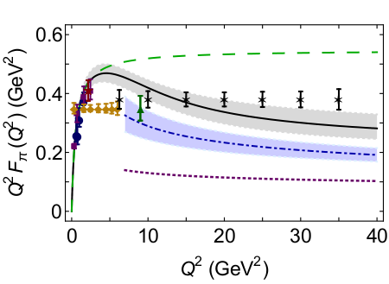
Pion Form Factor Prospects
1. Models show a strong dominance of σ_{L} at small –t at large Q².
2. Assume dominance of this longitudinal cross section
3. Measure the π⁻/π⁺ ratio to verify – it will be diluted (smaller than unity) if σ_{T} is not small, or if non-pole backgrounds are large
A.C. Aguilar et al., EPJ A 55 (2019) 10, 190
Assumed 5 GeV(e⁻) x 100 GeV(p) with an integrated luminosity of 20 fb⁻¹/year, and similar luminosities for d beam data
R=σ_{L}/σ_{T} assumed from VR model – and assume that π pole dominance at small t confirmed in ²H π⁻/π⁺ ratios
Assumed a 10% experimental systematic uncertainty, and a 100% systematic uncertainty in the model subtraction to isolate σ_{L}
Can we measure the kaon form factor at EIC?
Not clear – needs guidance from JLab 12- GeV
→ see talk by Stephen Kay
Notes:
20

Slide 21
Conclusions – Pion and Kaon Structure
Nucleons and the lightest mesons - pions and kaons, are the basic building blocks of nuclear matter. We should know their structure (functions).
The distributions of quarks and gluons in pions, kaons, nucleons will differ.
  Utilizing electroweak processes, be it through parity-violating processes or neutral vs charged-current interactions, some flavor dependence appears achievable.
  If we can convince ourselves off-shellness considerations are under control, one could also access pion GPDs and TMDs.
Is the origin of mass encoded in differences of gluons in pions, kaons and nucleons (at non-asymptotic Q²)?
  How much glue is in the pion?
The pion form factor may be measured at an EIC up to Q² = 35 GeV², and could provide a direct connection to mass generation in the Standard Model.
Some effects may appear trivial – the heavier-mass quark in the kaon “robs” more of the momentum, and the structure functions of pions, kaons and protons at large-x should be different, but confirming these would be textbook material.
Notes:
21

