Slide 1
Two issues on Pion PDF
Lei Chang(常雷)
leichang@nankai.edu.cn
Nankai University
Workshop on Pion and Kaon Structure Functions at the EIC, CFNS - Stony Brook University

Slide 2
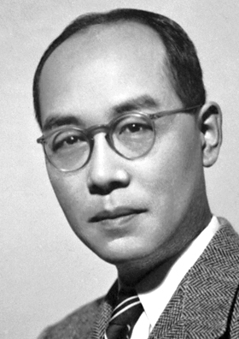
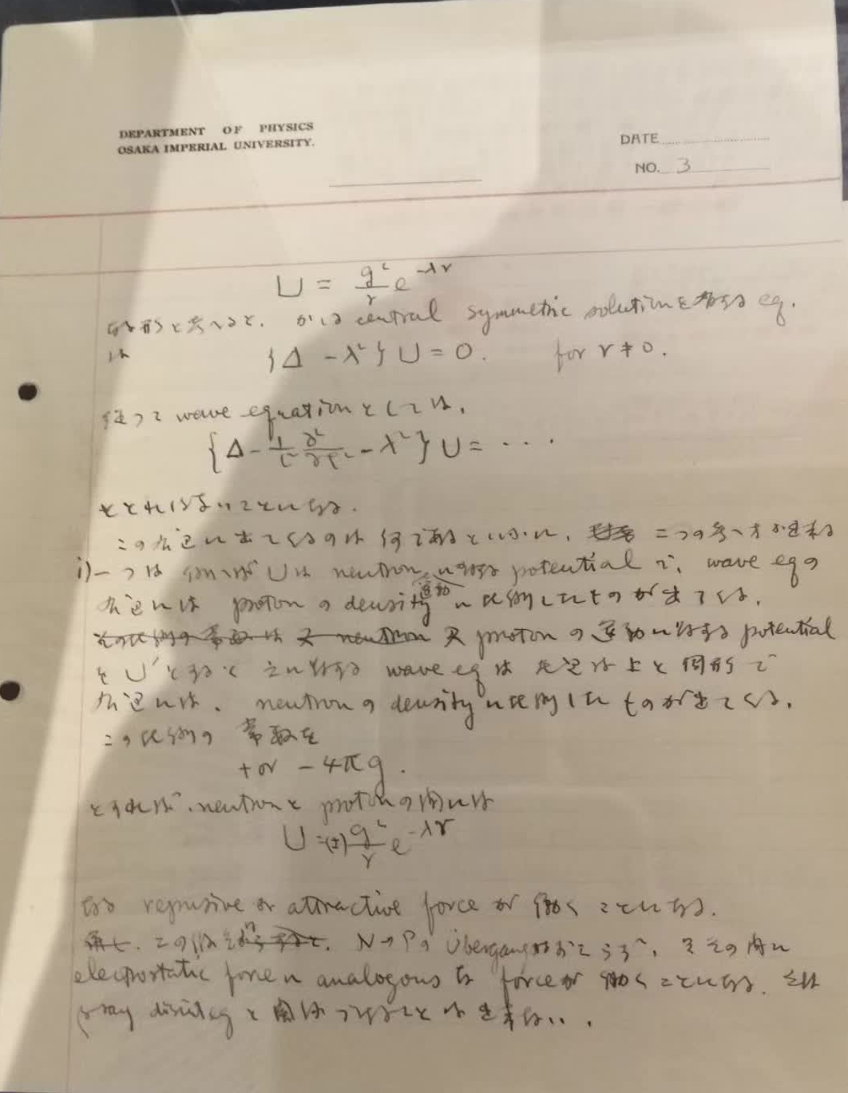
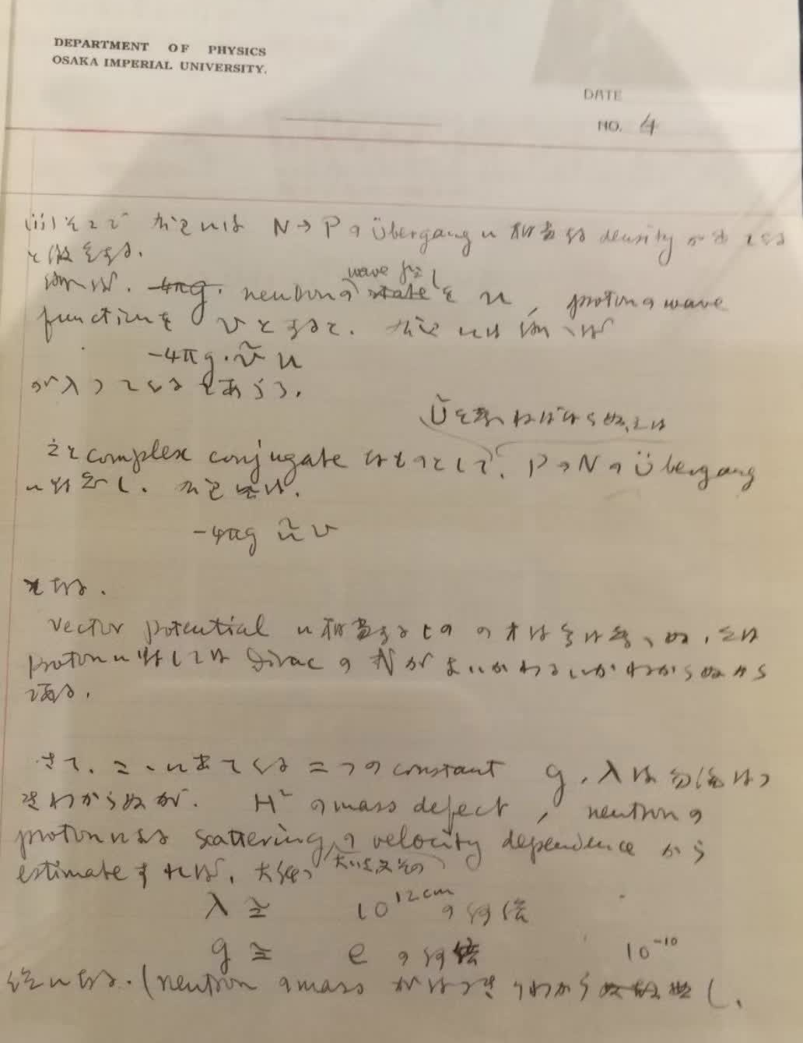
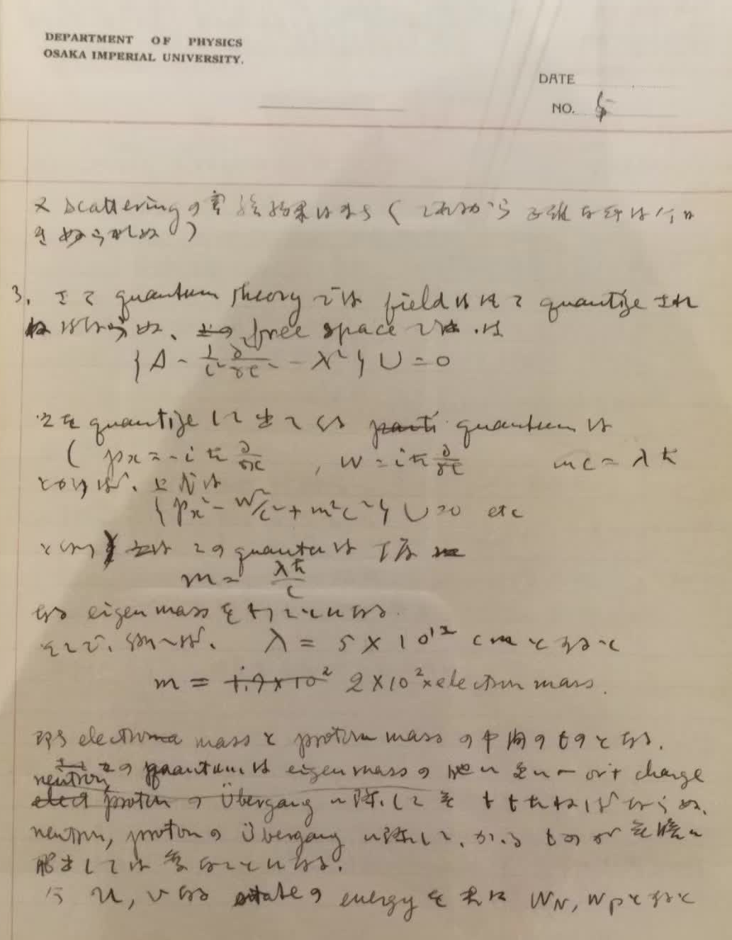
Messager of QCD
In October 1934, Hideki Yukawa predicated the existence of a “heavy quantum” meson, exchanging nuclear force between neutrons and protons.

Slide 3
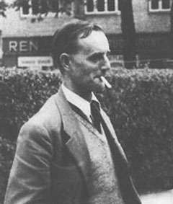
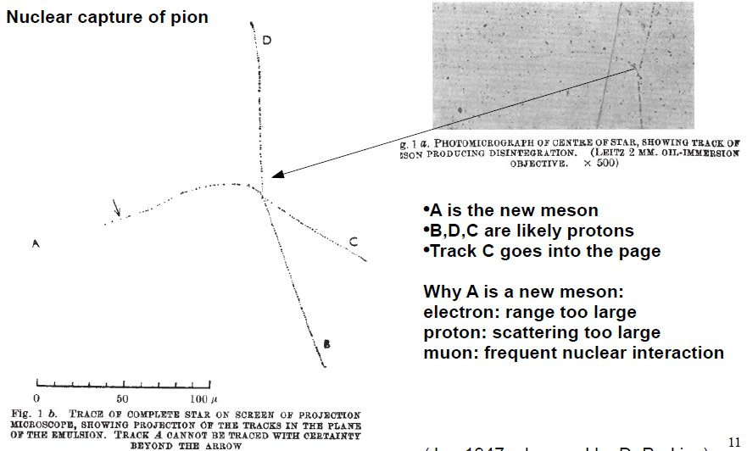
Messager of QCD
It was discovered by Cecil Powel in 1949 in cosmic ray tracks in a photographic emulsion.
Mass measured in scattering
≈ 250-350 m_{e}

Slide 4
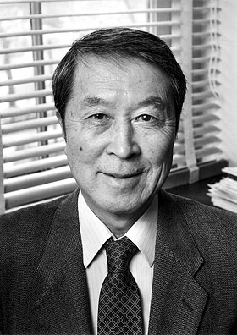
Messager of QCD
Yoichiro Nambu associated it with CSB in 1960.
E. Shuryak, arXiv:1908.10270

Slide 5
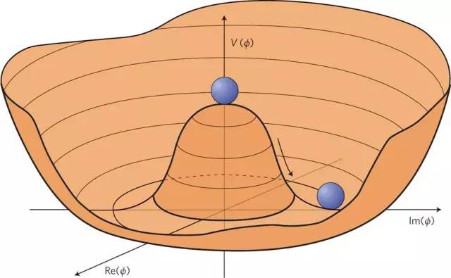

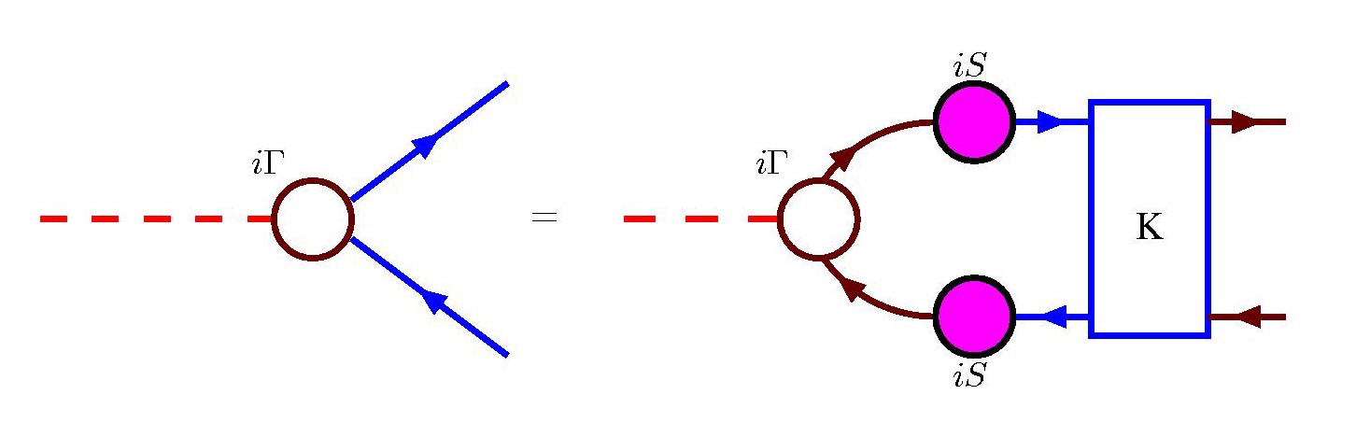
Messager of QCD
PION’s dichotomy
Goldstone Boson
Bound State
Bethe-Salpeter equation

Slide 6
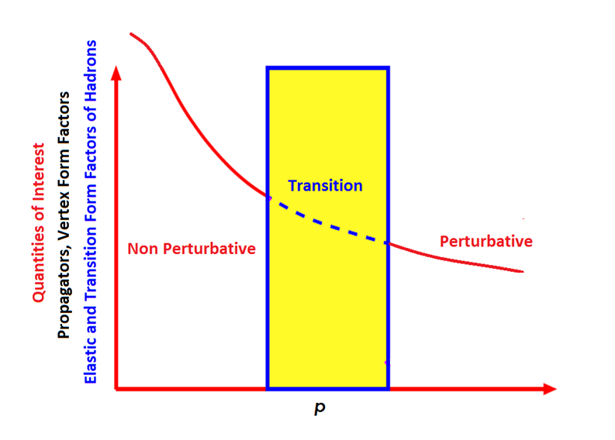
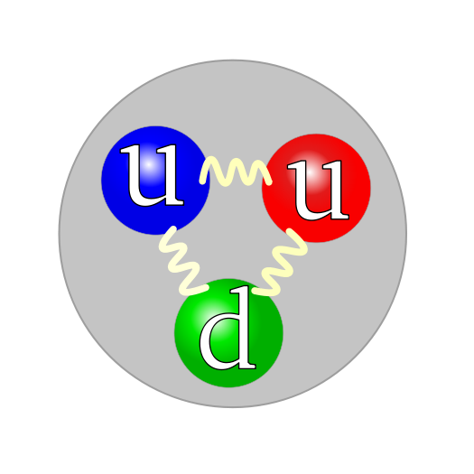
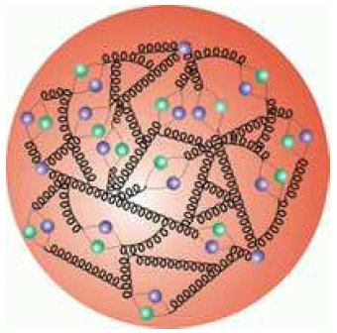

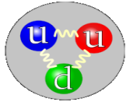
Hadron bound state problem
Constituent quark model-> intuitive understanding of many low energy observables.
Minimum number of constituents required
Feynman’s parton model-> intuitive understanding of high-energy phenomena.
Constituent picture;
Probabilistic interpretation of distribution functions
QCD vacuum in the hadron is very complicated medium
Individual quarks and gluons are lost in the sea
Both the constituent quark model and the parton model are put in peril by QCD with a possible complicated vacuum structure.

Slide 7
Overview
Owing to absence of pion targets, the pion’s valence-quark distribution functions have hitherto been measured via the Drell-Yan process(CERN(1983&1985), FNAL(1989)):
1989…Conway et al. Phys. Rev.D 39 (1989) 92
Leading-order analysis of Drell-Yan data
2010...Aicher et al. Phys. Rev. Lett.105 (2010) 252003
Consistent next-to-leading order anaylsis

Slide 8
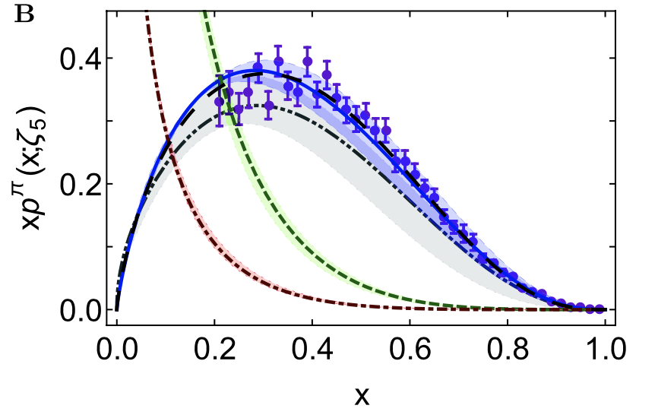
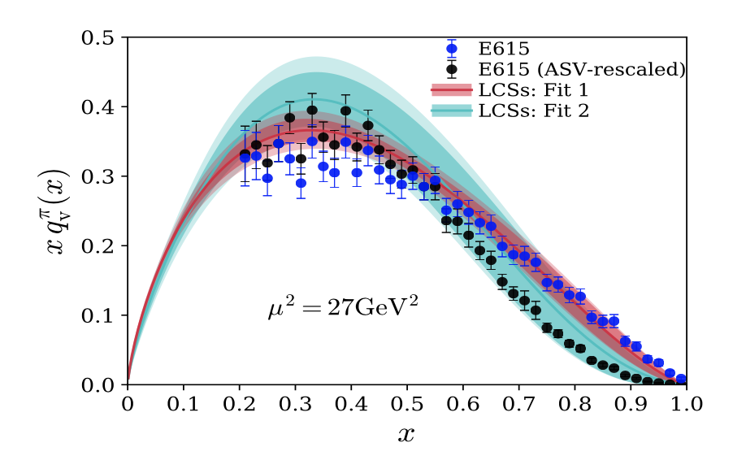
DSEs meet lQCD
DSEs
lQCD
Minghui Ding, et al.
CPC 44 (2020) 031002
Raza Sabbir Sufian, et al.
arXiv: 2001.04960

Slide 9
Issue-1
Large-x dependent

Slide 10
Issue-1
Model and Model
Nambu – Jona-Lasinio model, translationally invariant regularisaion
q^{π}(x) ∼ (1-x)⁰,
which becomes “1” after evolving from a low resolution scale
NJL models with a hard cutoff & also some duality arguments:
q^{π}(x) ∼ (1-x)¹
Relativistic constituent quark models:
q^{π}(x) ∼ (1-x)^{0…2}
depending on the form of model wave function
Instanton-based models
q^{π}(x) ∼ (1-x)^{1…2}

Slide 11
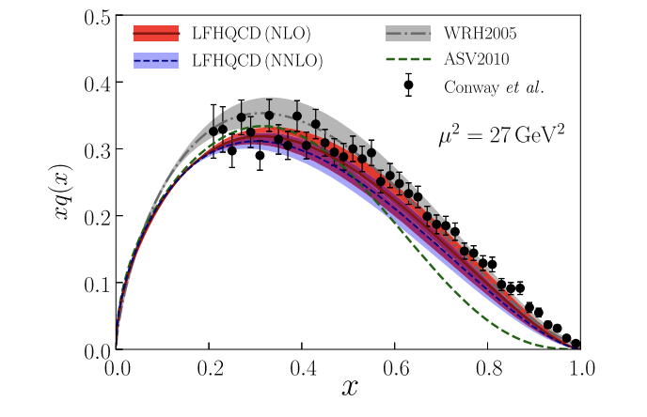
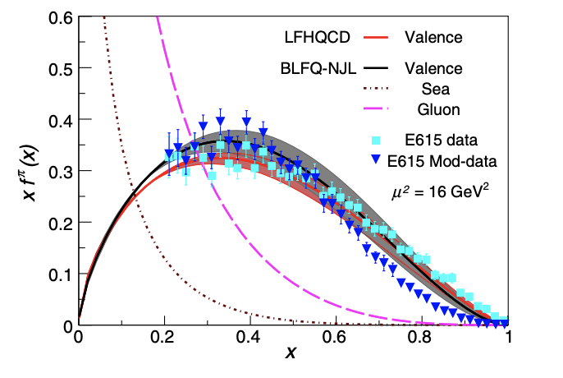
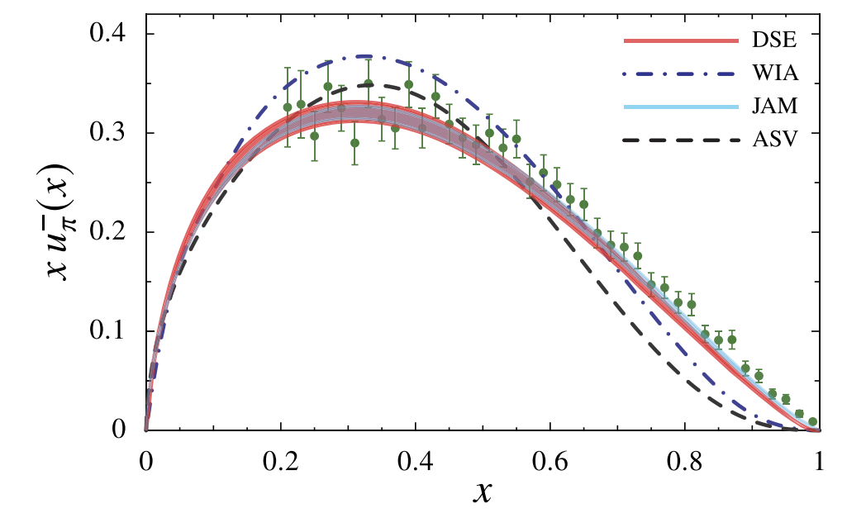
PRLs matching original data
Guy F. de Teramond, et al, LFHQCD
Jiangshan Lan, et al, Light front Hamitonian
Kyle D. Bendner, et al, DSEs

Slide 12
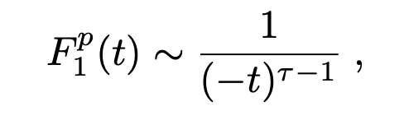

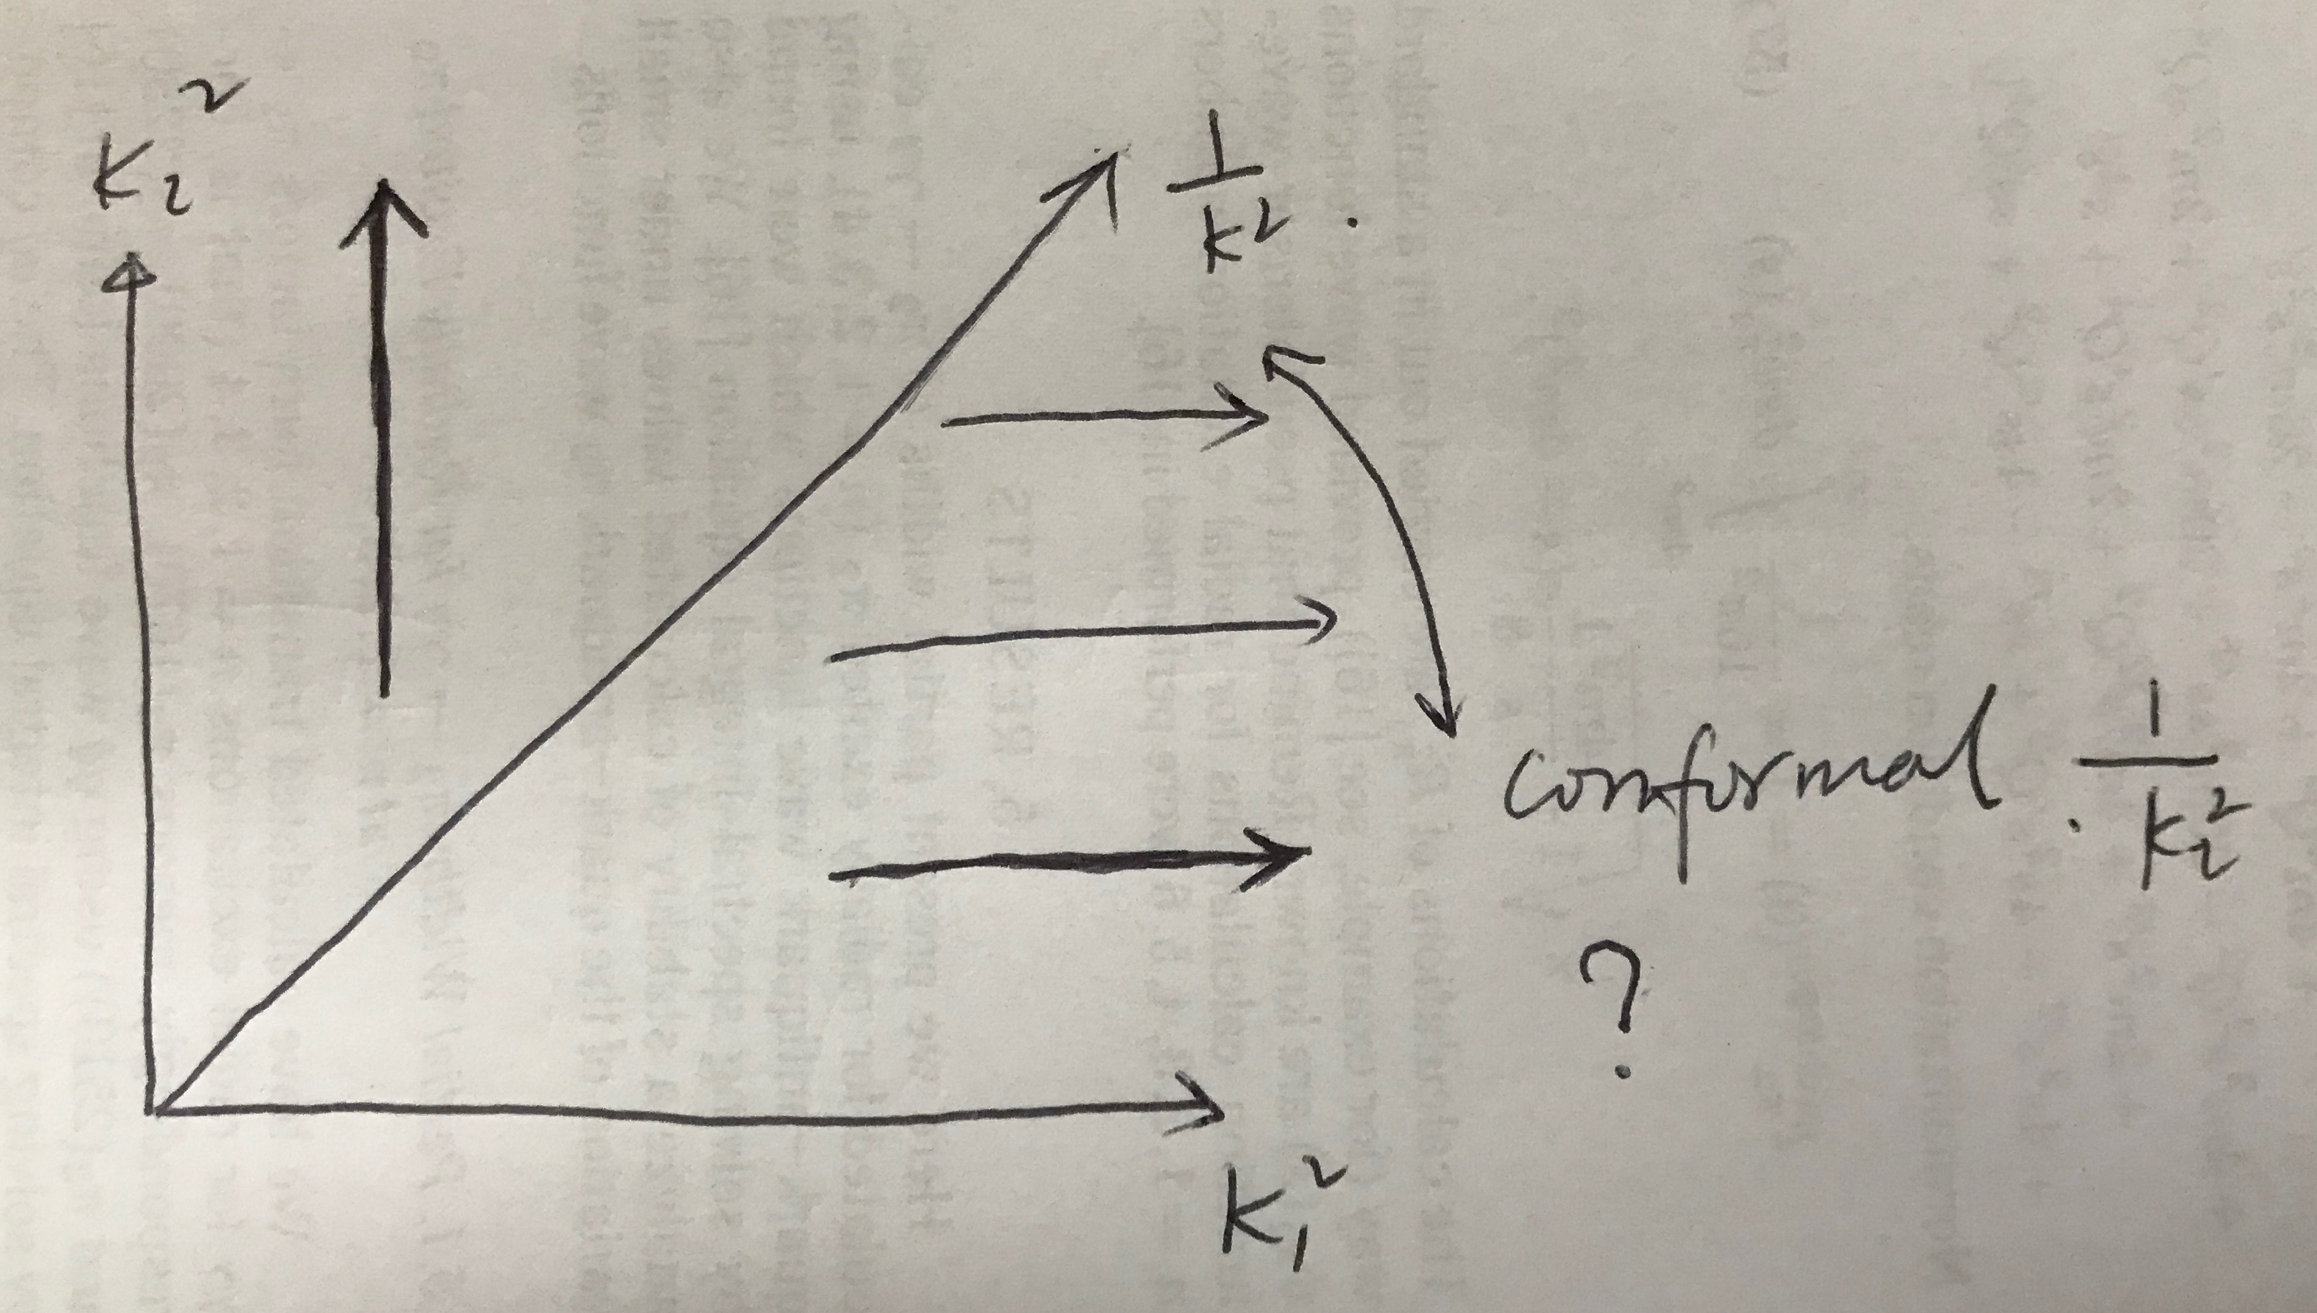
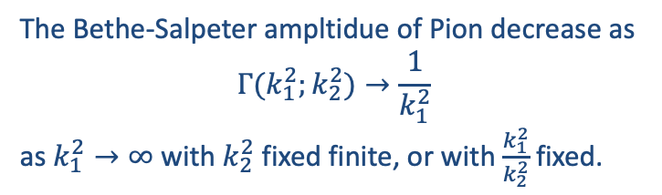



Drell-Yan-West relation
PRL24(1970)181, PRL24(1970)1206
Form factor
Structure function
Spin-1/2
Z. F. Ezawa, Nuovo Cim. A 23 (1974)271
Bound state function$∝$
Form factor
Structure function
Spin-0
$τ$the number of quarks inside the hadron

Slide 13
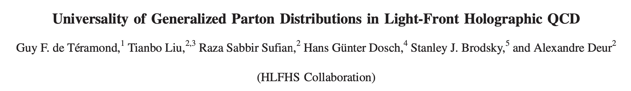

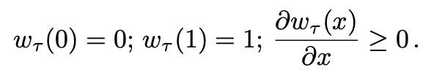
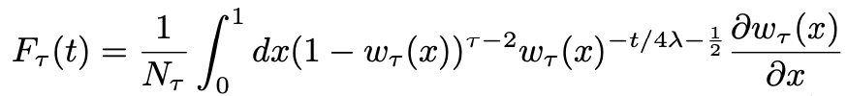


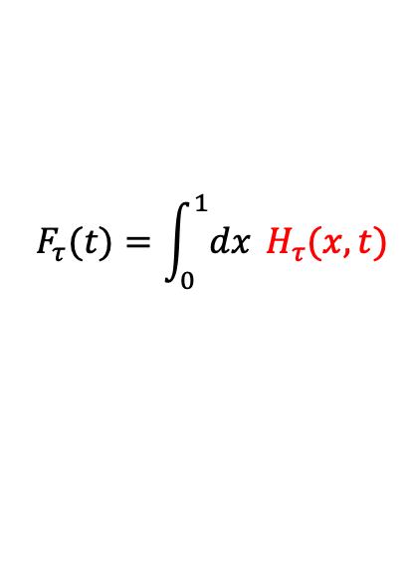

LFHQCD
A way to parameterize GPD/PDF
Starting Point
Change $y=ω(x)$
+
$$F_{τ}(t)=\int_{0}^{1}{dx} H_{τ}(x,t)$$
Parton Distribution Function

Slide 14
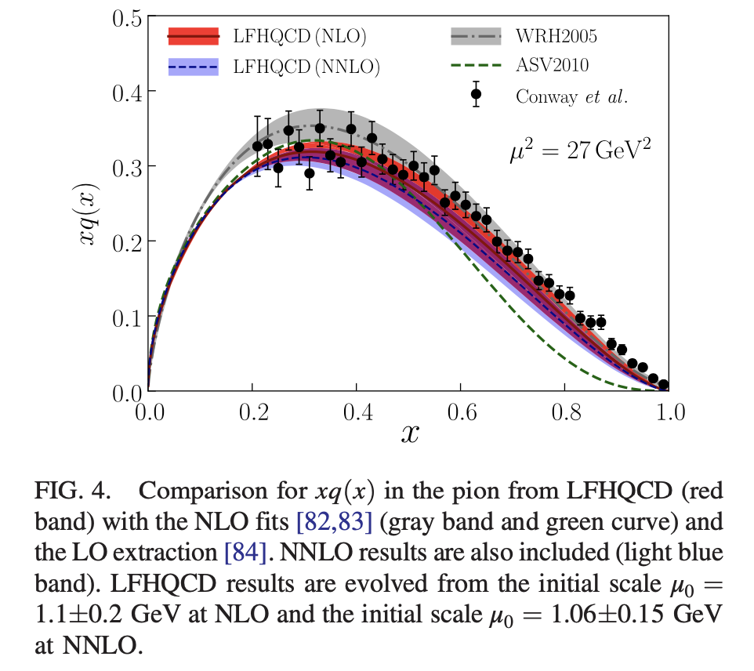
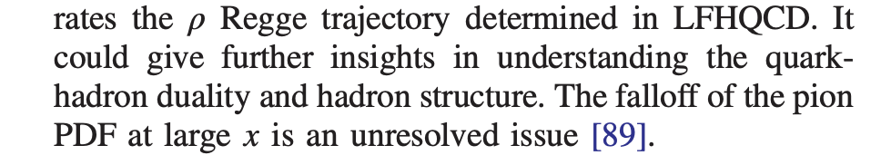
LFHQCD

Slide 15


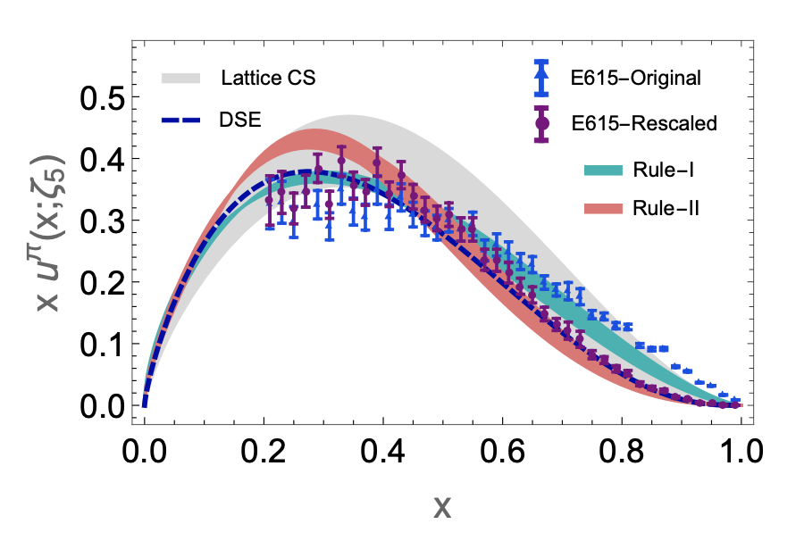
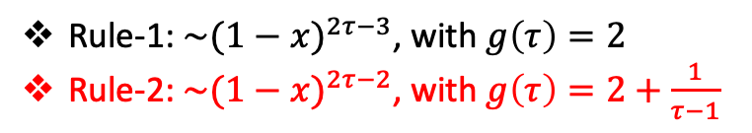

$Note：ω$could be $τ$dependent generally
Rule-1: $\sim {(1−x)}^{2τ−3}$, with $g\left(τ\right)=2$
Rule-2: $\sim {(1−x)}^{2τ−2}$, with $g\left(τ\right)=2+\frac{1}{τ−1}$

Slide 16
Electromagnetic Form Factor of Pion

Slide 17

DSEs
Lattice
LFHQCD
$${No answer for (1−x)}^{1 or 2 or others}$$
DCSB has never become tame

Slide 18
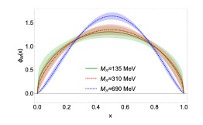
Issue-2
BROADER

Slide 19
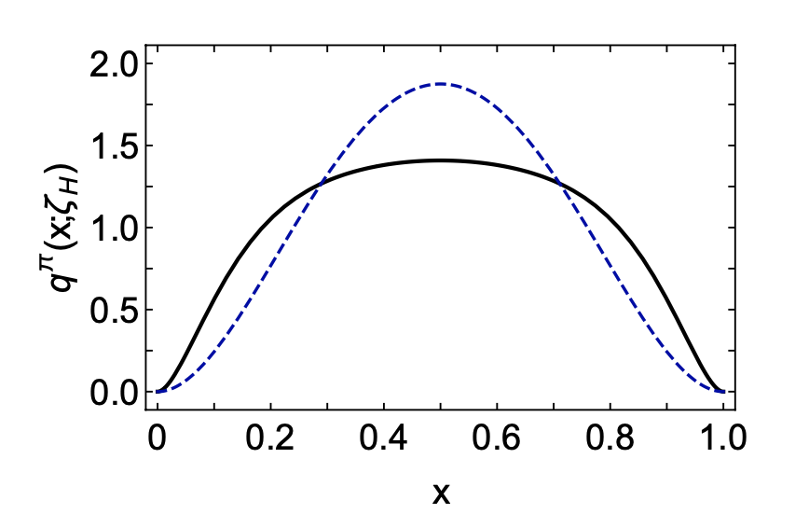
PDF at the hadronic scale(DSEs)
Minghui Ding, et al, arXiv:1905.05208, PRD 101 (2020) 054014
Confinnement/DCSB
Emergent Mass
Wave Function
Vertex
Function
DCSB
observables
The cause is the same, the valence-quark distribution function is hardened owing to DCSB, which is a realisation of the mechanism responsible for the emergence of mass in the Standard Model. Emergent mass is expressed in the momentum-dependence of all QCD Schwinger functions. It is therefore manifest in the pointwise behaviour of wave functions, elastic and transition form factors, etc.; and as we have now displayed, also in parton distributions.

Slide 20

DCSB
Bethe-Salpeter Amplitude
Model independent?

Slide 21

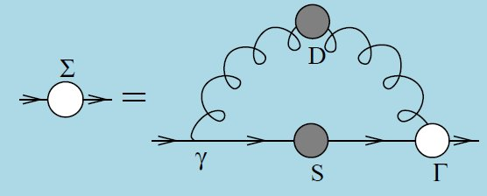


Ultraviolet behavior of quark propagator(Landau Gauge)
INPUT
REDUCED TO
$$B\left(x\right)\sim c_{1}x^{−1}{(\ln{x})}^{γ_{m}−1}$$
Condensate, DCSB

Slide 22

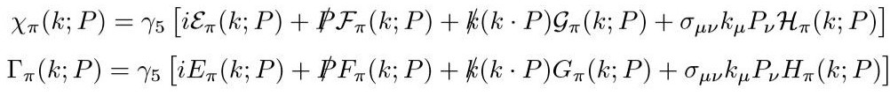
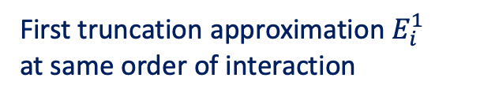
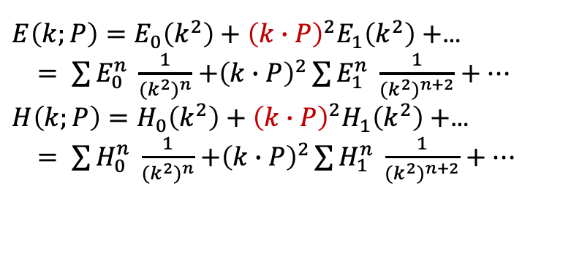
Ultraviolet behavior of Pion BS amplitude
在紫外：F and G构成封闭方程；E and H构成封闭方程
$E\left(k;P\right)=E_{0}\left(k^{2}\right)+{\left(k∙P\right)}^{2}E_{1}\left(k^{2}\right)+$…
$= \sum{E_{0}^{n} \frac{1}{{(k^{2})}^{n}}}$ $+{\left(k∙P\right)}^{2}\sum{E_{1}^{n} \frac{1}{{(k^{2})}^{n+2}}+…}$
$H\left(k;P\right)=H_{0}\left(k^{2}\right)+{\left(k∙P\right)}^{2}H_{1}\left(k^{2}\right)+$…
$= \sum{H_{0}^{n} \frac{1}{{(k^{2})}^{n}}}$ $+{\left(k∙P\right)}^{2}\sum{H_{1}^{n} \frac{1}{{(k^{2})}^{n+2}}+…}$
EFGH_{0} have been analyzed in literature;
k.P dependence is critical for bound states;
All the k.P terms would be 1/k^2-like order.
First truncation approximation $E_{i}^{1}$
at same order of interaction

Slide 23
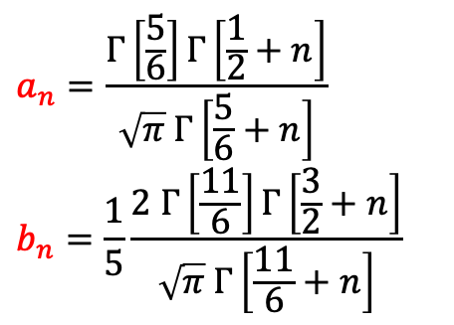
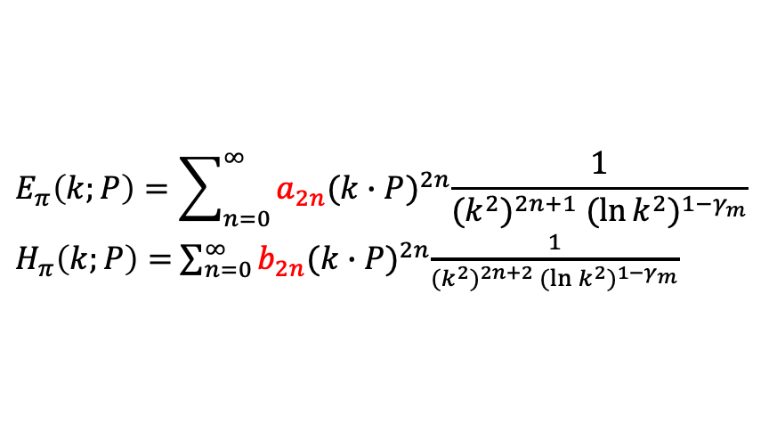
E,H family
$$E_{π}\left(k;P\right)=\sum_{n=0}^{∞}{a_{2n}{(k∙P)}^{2n}\frac{1}{{(k^{2})}^{2n+1} {(\ln{k^{2}})}^{{1−γ}_{m}}}}$$
$H_{π}\left(k;P\right)=$ $\sum_{n=0}^{∞}{b_{2n}{(k∙P)}^{2n}\frac{1}{{(k^{2})}^{2n+2} {(\ln{k^{2}})}^{{1−γ}_{m}}}}$
$$a_{n}=\frac{Γ\left[\frac{5}{6}\right]Γ\left[\frac{1}{2}+n\right]}{\sqrt{π} Γ\left[\frac{5}{6}+n\right]}$$
$$b_{n}=\frac{1}{5}\frac{2 Γ\left[\frac{11}{6}\right]Γ\left[\frac{3}{2}+n\right]}{\sqrt{π} Γ\left[\frac{11}{6}+n\right]}$$

Slide 24

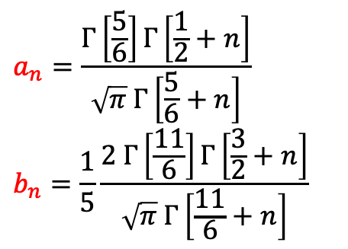
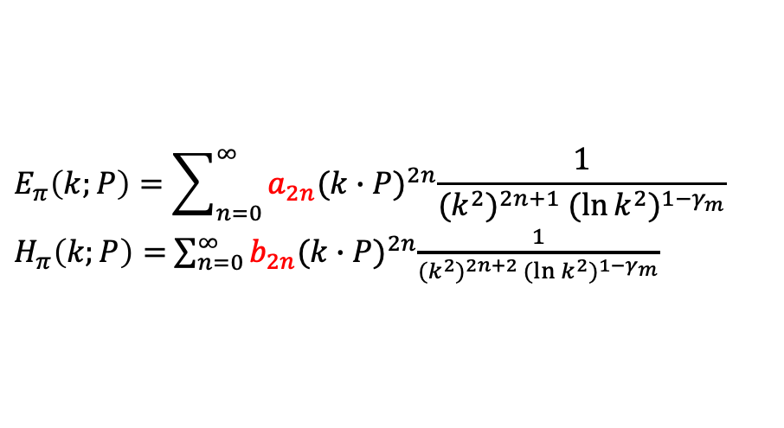
E,H family
$$a_{n}=\frac{Γ\left[\frac{5}{6}\right]Γ\left[\frac{1}{2}+n\right]}{\sqrt{π} Γ\left[\frac{5}{6}+n\right]}$$
$$b_{n}=\frac{1}{5}\frac{2 Γ\left[\frac{11}{6}\right]Γ\left[\frac{3}{2}+n\right]}{\sqrt{π} Γ\left[\frac{11}{6}+n\right]}$$
$$E_{π}\left(k;P\right)=\sum_{n=0}^{∞}{a_{2n}{(k∙P)}^{2n}\frac{1}{{(k^{2})}^{2n+1} {(\ln{k^{2}})}^{{1−γ}_{m}}}}$$
$H_{π}\left(k;P\right)=$ $\sum_{n=0}^{∞}{b_{2n}{(k∙P)}^{2n}\frac{1}{{(k^{2})}^{2n+2} {(\ln{k^{2}})}^{{1−γ}_{m}}}}$
$E_{π0}(x) \underset{→}{x→∞} a_{2}x^{−1}{(\ln{x})}^{γ_{m}−1}$ vs $B\left(x\right)=f_{π} E(x) (WTI)$
$$B\left(x\right)\sim c_{1}x^{−1}{(\ln{x})}^{γ_{m}−1}$$
The parameter a2 has a closed relation to DCSB

Slide 25
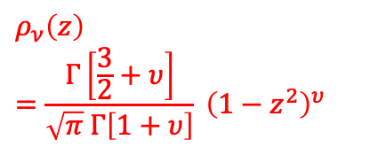
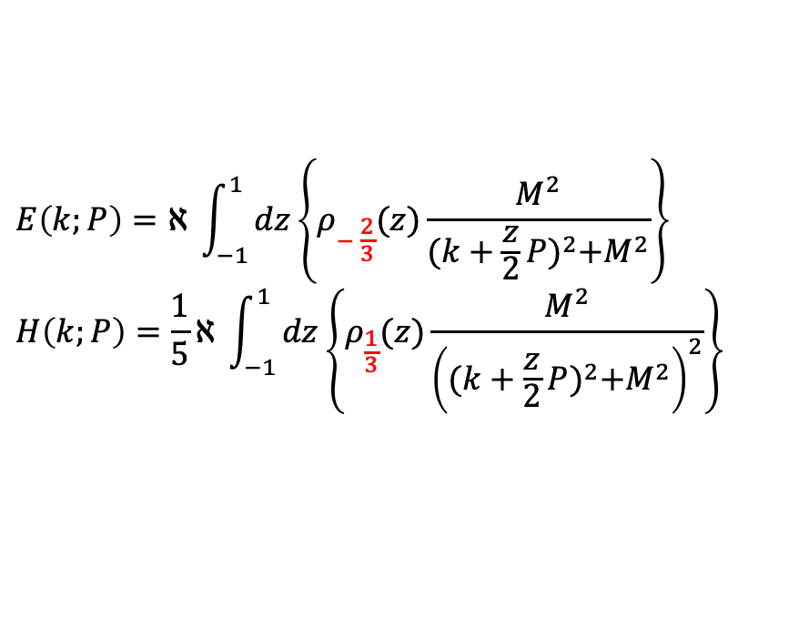
E,H family
$$a_{n}=\frac{Γ\left[\frac{5}{6}\right]Γ\left[\frac{1}{2}+n\right]}{\sqrt{π} Γ\left[\frac{5}{6}+n\right]}$$
$$b_{n}=\frac{1}{5}\frac{2 Γ\left[\frac{11}{6}\right]Γ\left[\frac{3}{2}+n\right]}{\sqrt{π} Γ\left[\frac{11}{6}+n\right]}$$
$$E_{π}\left(k;P\right)=\sum_{n=0}^{∞}{a_{2n}{(k∙P)}^{2n}\frac{1}{{(k^{2})}^{2n+1} {(\ln{k^{2}})}^{{1−γ}_{m}}}}$$
$H_{π}\left(k;P\right)=$ $\sum_{n=0}^{∞}{b_{2n}{(k∙P)}^{2n}\frac{1}{{(k^{2})}^{2n+2} {(\ln{k^{2}})}^{{1−γ}_{m}}}}$
$$E\left(k;P\right)=ℵ \int_{−1}^{1}{dz\left\{ρ_{− \frac{2}{3}}(z)\frac{M^{2}}{{(k+\frac{z}{2}P)}^{2}+M^{2}}\right\}}$$
$$H\left(k;P\right)=\frac{1}{5}ℵ \int_{−1}^{1}{dz\left\{ρ_{\frac{1}{3}}(z)\frac{M^{2}}{{\left({(k+\frac{z}{2}P)}^{2}+M^{2}\right)}^{2}}\right\}}$$
$$ρ_{ν}\left(z\right)=\frac{Γ\left[\frac{3}{2}+υ\right]}{\sqrt{π} Γ\left[1+υ\right]} {\left(1−z^{2}\right)}^{υ}$$

Slide 26
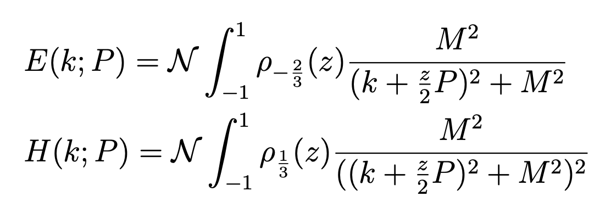
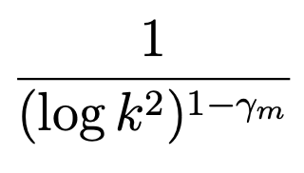
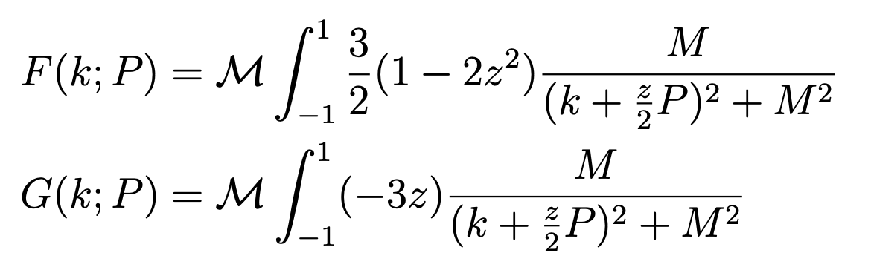
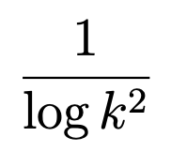
E, H and F, G---summary

Slide 27
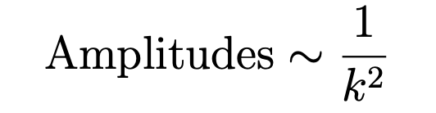
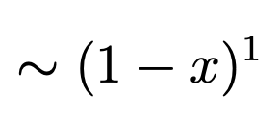
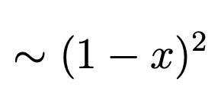
limit information on PDA/PDF(first stage)
Approximation-I: neglecting all the k.P dependence
x->1
PDA
PDF

Slide 28
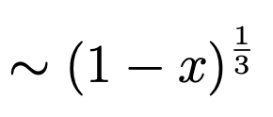
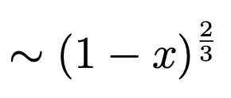
limit information on PDA/PDF(second stage)
Approximation-II: contain all the k.P dependence
x->1
PDA
PDF

Slide 29

Parton Distribution Function
Considering the fact of E,H related to DCSB~M(Q²)
Suppose PDA/PDF at x->1 dominated by leading power of BS amplitudes
At small scale PDF enhanced at x->1…indicates broad picture

Slide 30
Full information on PDA/PDF
Approximation-III: beyond the leading order of interaction?

Slide 31

Accommodate proton and pion DYW relation in LFHQCD
Rule-1: $\sim {(1−x)}^{2τ−3}$, with $g\left(τ\right)=2$
Rule-2: $\sim {(1−x)}^{2τ−2}$, with $g\left(τ\right)=2+\frac{1}{τ−1}$
DCSB effect on PDA and PDF…not whole story
Thanks for your attention

