Slide 1
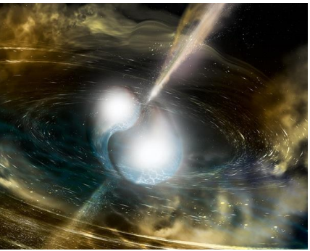
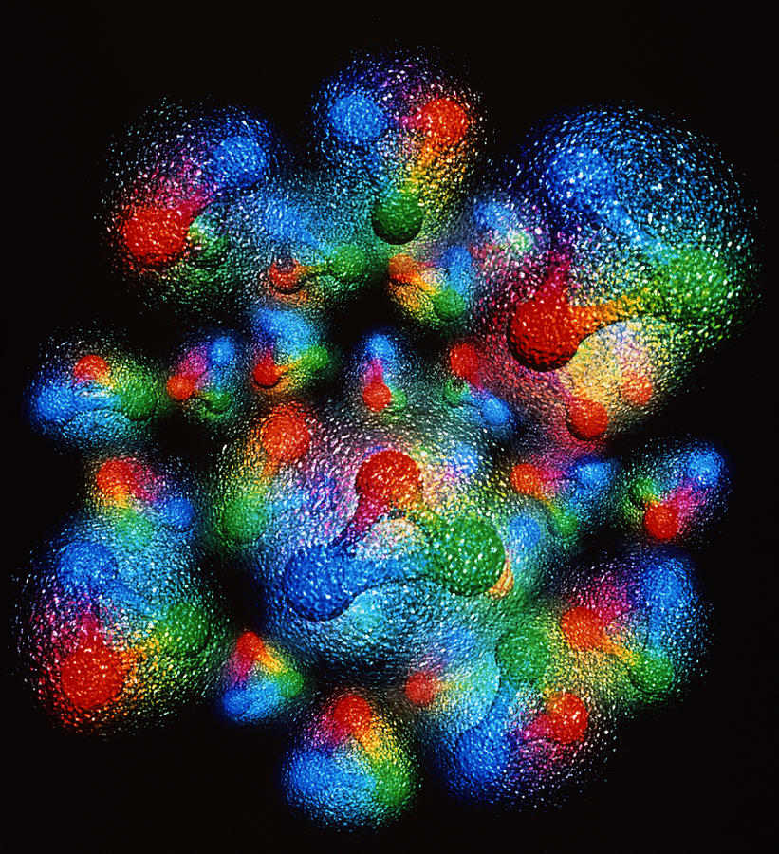
Perturbative QCD Analysis in a Fixed-W² Framework
Simonetta Liuti
University of Virginia
Pion and Kaon at the EIC
online workshop
June 3 2020

Slide 2
Scales in Deep Inelastic Scattering
Q² = -(k – k’)²
ν = (Pq)/M
x = Q² /(2M ν)
W² = M_{X}² = M² + Q² (1/x-1)

Slide 3
ν = 0.53 GeV²
x=1
I. Schienbein

Slide 4
A longstanding problem
The problem of Final State Interactions/
Higher Twists is present from the inception
1980’s with repeated experimental confirmations of asymptotic freedom, QCD becomes the established theory of the strong interactions

Slide 5
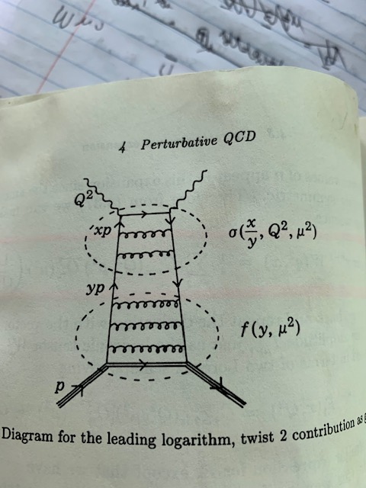
Factorization at NLO
$$d σ=d{\hat{σ}}_{γ^{∗}q→q^{′}}⊗f_{q}(x,μ^{2})$$
$$d σ_{n}={\left[d{\hat{σ}}_{γ^{∗}q→q^{′}}\right]}_{n}M_{q,n}\text{(}μ^{2})$$
Mellin Moments
$$\int{dy y^{n−1}d{\hat{σ}}_{γ^{∗}q→q^{′}}=C_{τ,n}(Q^{2})}$$
$\sum_{τ=2}^{∞}{C_{τ,n}(Q^{2})}$ $M_{τ=2,n}(μ^{2}$)${\left(\frac{1}{Q^{2}}\right)}^{\frac{τ}{2}−1}$
$$\int{dx x^{n−1}f_{q}\text{(}x,μ^{2}) =M_{q,τ=2,n}(μ^{2})}$$
OPE/Twist Expansion

Slide 6
Example: Calculate coefficient C_{n} in pQCD at LO
$M_{q,n}(Q^{2})$= $M_{q,n}{\left(Q_{o}^{2}\right)\left[\frac{α_{S}\left(Q^{2}\right) }{α_{S}\left(Q_{o}^{2}\right) }\right]}^{dn}$
(1983)

Slide 7
1999-2001: Re-analysis of world data including large x_{BJ}
I.Niculescu, C.Keppel, S.Liuti and G.Niculescu,
Phys. Rev. D60, 094001 (1999)
Deviations from linearity at Q² < 10 GeV²
C.Armstrong, R. Ent, C. Keppel, S. Liuti, G. Niculescu and I. Niculescu, Phys.Rev. D63, 094008 (2001)
Normalized Cornwall Norton moments

Slide 8
Large x_{Bj} at fixed Q² and the continuation of the pQCD curve into the resonance region
Target Mass Corrections
Large x/Large n structure of
PQCD evolution equations beyond LO
Main question: how to continue pQCD curve? What defines the pQCD curve?
Higher Twists
Nuclear corrections
(for neutron)

Slide 9
Effects of threshold resummation
W. Vogelsang, G. Sterman, F. Ringer, D. Anderle, A. Accardi….
Impact on global fits (talks by F.Olness and )
W. Vogelsang and G. Sterman, 1999

Slide 10
First hint of W² dependent effects
C_{HT}
ΔH
NLO+TMC
S. Liuti, R. Ent, C.E. Keppel, and I. Niculescu,
Phys. Rev. Lett. 89, 162001 (2002)

Slide 11
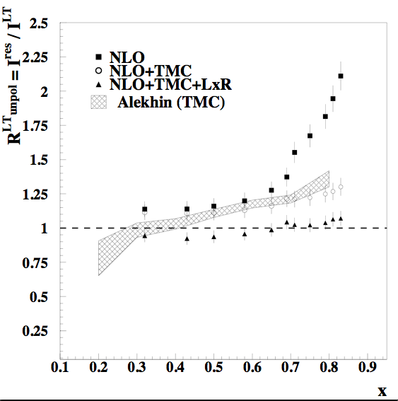
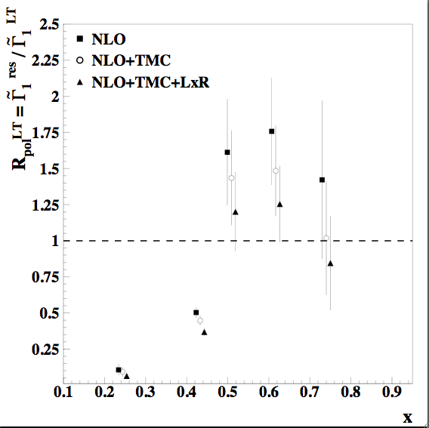
Unpolarized Jlab+SLAC data
Polarized HERMES+Jlab+SLAC data
TMC
Large x Res.
N. Bianchi, A. Fantoni, and S. Liuti
Phys. Rev. D 69, 014505 (2004)

Slide 12
Comparison with previous analysis
PDF Parametrization uncertainty
N. Bianchi, A. Fantoni, and S. Liuti
Phys. Rev. D 69, 014505

Slide 13
Fast forward……
Tension between PDF, LQCD and experiment
I.Albayrak et al. [E06-009],
Phys. Rev. Lett. 23, no.2, 022501 (2019)

Slide 14
Understanding the dynamical origin of this behavior remains one of the unsolved questions in QCD

Slide 15
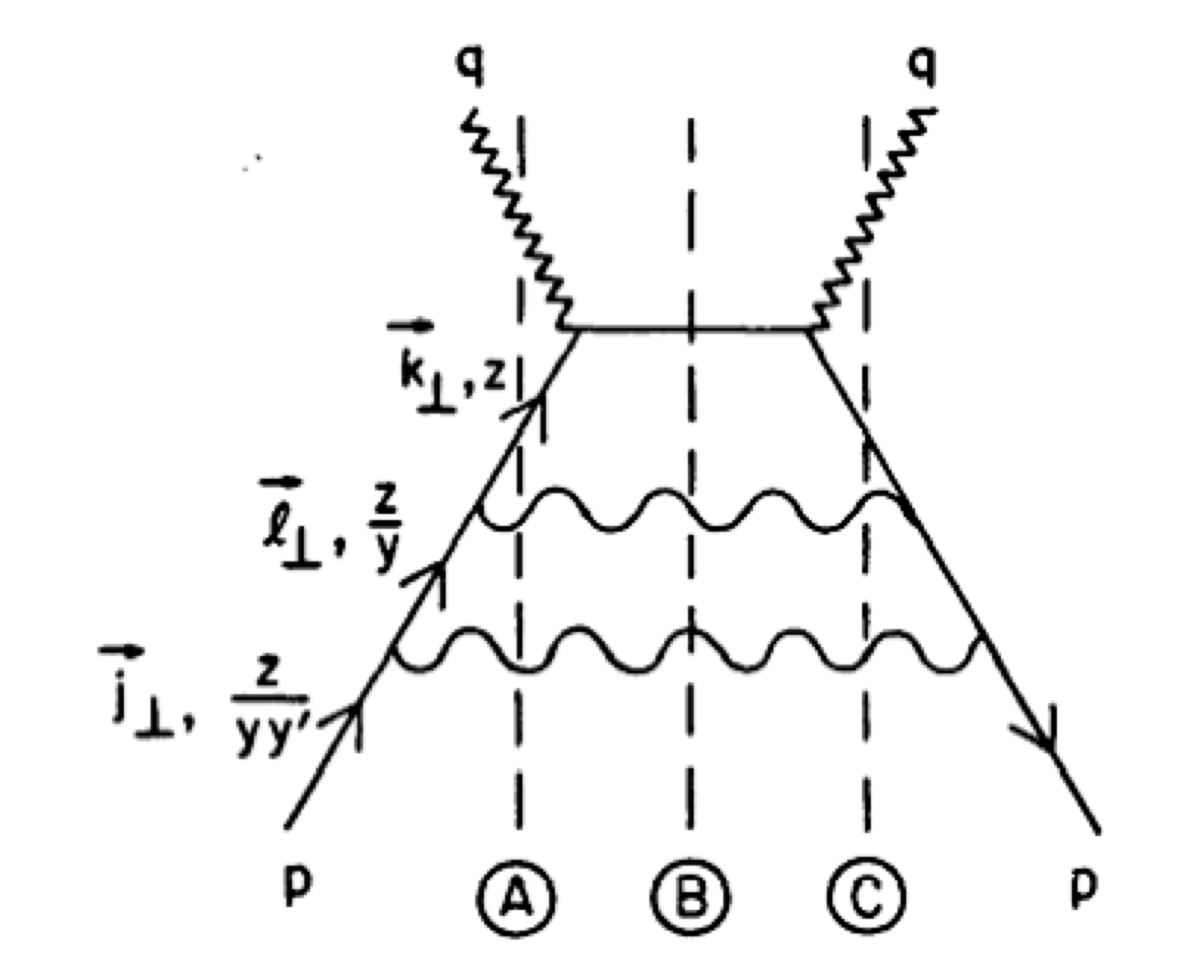
monitoring the transition from its perturbative to
non-perturbative regimes (including the behavior of α_{S} in the non-perturbative limit)
Large x_{Bj} evolution
(S. Brodsky, P. Lepage McKenzie)

Slide 16
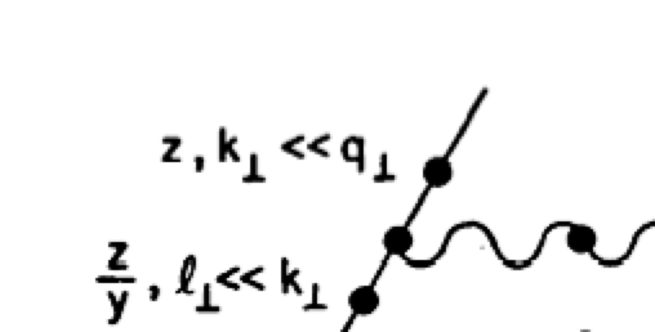
γ*q → q’ g
k’
q
γ*
θ
k
l
g
⇒
Invariant mass!

Slide 17
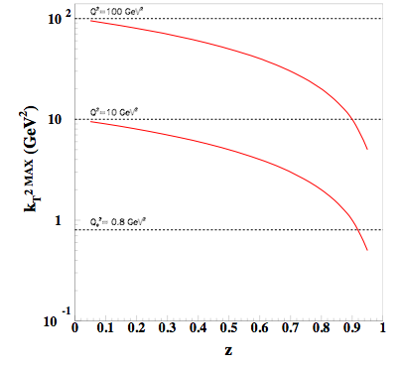
It matters at large x!
z-dependent upper limit in pQCD evolution equations
k_{T}²=Q²=10 GeV²
initial scale

Slide 18
Resummation to NLO
This takes care of the large log term in the Wilson coefficient f. (NLO, MS-bar)
The scale that allows one to annihilate the effect of the large ln(1-z) terms at large x at NLO is the invariant mass, W²

Slide 19
Analysis of α_{S} in fixed W² framework
A. Courtoy and S.Liuti, PLB 276 (2013)
z=0.7

Slide 21
From large x resummation
From GDH sum rule (Brodsky, Deur et al.)
``By tuning the scaling structure functions to the averaged data in the resonance region, we parametrize the realization of duality through an infrared fixed-point below which the strong coupling constant stops running. The value we have found for the transition scale is situated around 1 GeV². The uncertainties on that value are, however, still important”

Slide 22
Conclusions
Perhaps the most interesting aspect of the “fixed W² " analysis that we propose is that the values of the strong coupling from different measurements/observables namely the GDH sum rule, and the large-x-DIS/resonance region are in very good agreement with the values obtained from the extension of the commensurate scale relations (see Brodsky and Deur; Grunberg) to the IR region suggested in Ref.[46,48].
The issue of the extension of the scheme/observable dependence to low values of the scale is what makes our new extraction interesting and open to further studies.
While our conclusion ensues from a perturbative analysis, it would be interesting to compare with non-perturbative effective couplings (see work by C. Roberts and collaborators).

