Slide 1
Jets and Heavy Flavor WG Meeting
April 20, 2020
Talk by Fred Olness about tools for global analysis, nucleon/nuclear structure and the extraction of heavy flavor from e+p/A measurements
2. Talk by Christian Weiss about simulations of heavy flavor,
using charm to probe nuclear gluon densities and EIC
impact
3. Discussion of progress needed for the Pavia meeting,
kinematic maps, detector requirements communication to
the detector WG, etc
4. Discussion of the Pavia meeting structure (Jets and
Heavy Flavor group & combined sessions)

Slide 2
Progress toward Pavia
Kinematic maps – light nuclei added but energies remain the same. Further suggestions?
18

Slide 3
Progress toward Pavia
Several items accomplished – existing work and table of measurements
Focus on kinematic maps for final states
Discussion of writing tools -Word, Latex (with Overleaf as possibility)

Slide 4
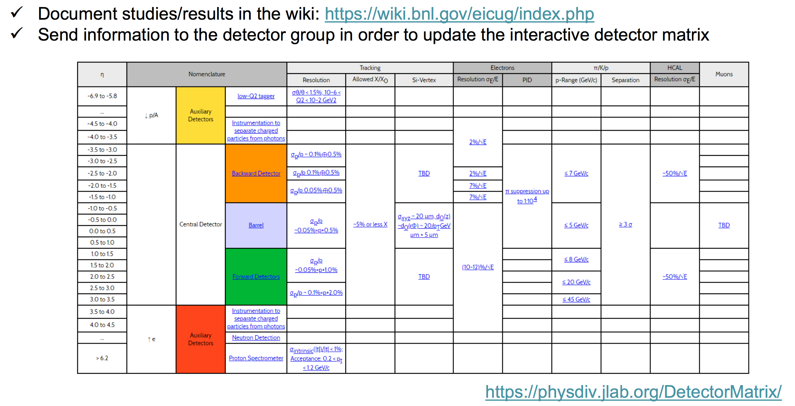
Progress toward Pavia
Discussion of simulation tools
Communicate detector needs to the detector WGs

Slide 5
Pavia meeting

Slide 6
Pavia meeting
How do we organize the allocated time?
2. Shall we focus primarily on joint sessions?
3. Joint session between physics groups. Joint sessions with detector working groups?

