Slide 1
Final Design and Safety Review of the INTT Ladder and Barrels
Ladder Electronic Components:
HDI, Chips and Sensors
WBS: 3.0X
Itaru Nakagawa, RIKEN
May 27, 2020

Slide 2
Ladder Overview
INTT Full Ladder
Tracking System: MVTX+INTT+TPC
Silicon strip sensors
Type-A
Type-B
½ Ladder
Type-A
Type-B
HDI Readout Cable
Silicon Sensors
Silicon
FPHX Chip
Wirebonding
FPHX Chip
HDI

Slide 3
Silicon Sensors
Tracking System: MVTX+INTT+TPC
Sensor | Make | Coupling | Bias | Thickness | Strip Pitch | Depletion Volt.
Strip Strip | Hamamatsu | AC | Poly-Si Bias | 320±15 μm | 78 μm | Max 120V
Readout orientation
128 strips
Strip orientation
128 strips
Readout orientation
Type | # of Blocks | Active Area
A | 8 x 2 | 128mm x 19.96mm
B | 5 x 2 | 100mm x 19.96mm
Type-A
Type-B

Slide 4
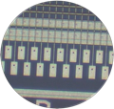
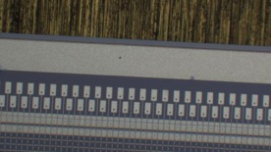
Silicon Sensors
Tracking System: MVTX+INTT+TPC
Type-A
Type-B
40 % of pad
60 % of pad are secured for wirebonding
probe trace
AC readout pads

Slide 5
FPHX Chip
Developed for Forward Vertex Detector for PHENIX at Fermi Lab.
Tracking System: MVTX+INTT+TPC
Specification | FPHX
ADC/channel | 3 bits
Power Consumption | 64 mW
Number of channels | 128
Data Transmission | 200Mbps
Front end
(Analog section)
Each FPHX chip integrates and shapes (CR-RC) signals, digitizes and sparsifies the hit channels each beam crossing (106ns beam clock), and serially pushes out the digitized data.

Slide 6
FPHX Chip (Analog Section)
Tracking System: MVTX+INTT+TPC
T-peak ~ 60 ns (programmable)
128 channel
46, 50, 60, 67, 85, 100, 150, or 200 mV/fC
60 ns peak time (rt- pgmbl)
3—bit ADC (th-pgmbl)
Optimized to 1 to 2.5 pf input
115e + 134e/pf
~ 70 to 140 μW/ch (dep. gain)
Program gain and Vref
Disc outputs
3-bit ADC
Vref
+
Shaper
Integrator
_
Comp
Input
Vth0
Comp
At max. input transistor bias of 38uA: 115e + 134e/pF
Silicon strip + readout line capacitance ~ 6pF
Predicted noise ~ 115e + 134e/pF * 6pF ~ 1,000e
Signal ~ 20,000e
Expected S/N ~ 20/1
Vth1
Comp
Programmable Thresholds
Vth7

Slide 7
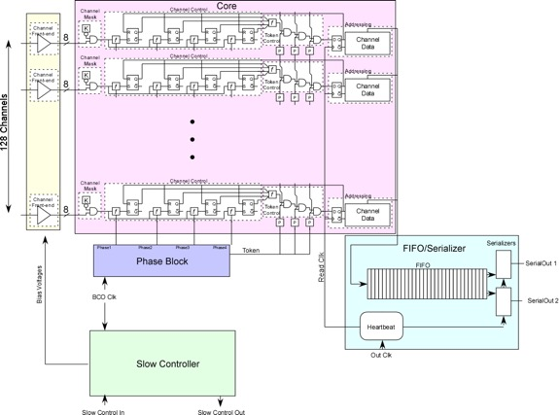

FPHX Chip (Digital Section)
Analog
Tracking System: MVTX+INTT+TPC
Data Processing
Data Output
20 bit Serial data word structure

Slide 8
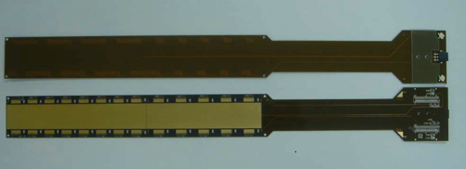
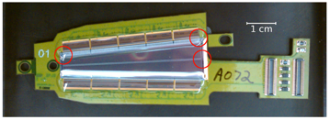
High Density Interconnect (HDI) Cable
Tracking System: MVTX+INTT+TPC
INTT HDI (Manufactured by Yamashita co.)
M20-7910342R
Thermistat 3pin readout
Bias connector
Hirose DF18 connector
Data, slow control, FPHX power
Analog GND pad
 | FVTX | INTT
# Layers | 7 | 7
Length [cm] | ~20 | 40
Pitch [μm] | 40 | 60
The design is based on HDI’s of FVTX. The cable length is longer, but the pitch of the signal line is somewhat relaxed 60 [μm] instead of 40 [μm].
FVTX HDI
Analog and digital pads are used for grounding in the final barrel configuration.
Digital GND pad

Slide 9
High Density Interconnect (HDI) Cable
7 cupper layers
High signal line density in 2 layers
Solid ground outer layers to shield signal layers
Tracking System: MVTX+INTT+TPC
L1
Bias
L2
Analog GND
L3
Clock Signal
L4
Power
L5
Signal
L6
Digital GND
L7
Thermistats & RF

Slide 10
High Density Interconnect (HDI) Cable
Due to spatial limit of signal layers, some part of signal lines have to run unshielded layer-7 for a few cm.
Tracking System: MVTX+INTT+TPC
Cu Layer-1
The corresponding frequency is 10 – 30GHz, which is at least an order of magnitude higher frequency than the highest frequency (100×2MHz BCLK) signal transmits layer-7.
Cu Layer-7
No problem has found in the past 2 beam test.
~1cm
100×2MHz BCLK

Slide 11
Summary
• The INTT Ladder consisted of Silicon strip sensors, FPHX chips, HDIs and stave.
• The INTT Silicon strip sensors are manufactured by Hamamatsu photonics. Basic design is based on FVTX silicon strip sensors. The primary difference is the dimension of the strip and sensors. The thickness is standard 320μm.
• FPHX chips are developed by Fermi lab for FVTX detector for PHENIX. Some programmable parameters will be optimized for INTT.
• The HDI cable is also designed based on the one of FVTX. The cable consisted of 7 layers and signal layers are kept inner layers to be shielded by ground or bias layers. Some signals lines are exposed in the layer-7, but they are kept short. So far we haven’t observed any problem throughout beam tests.

Slide 12
Back Up

