Slide 1
sPHENIX INTT Assembly
Ladder Assembly Fixture and HDI
Connor Miraval
March 24, 2020
BNL

Slide 2
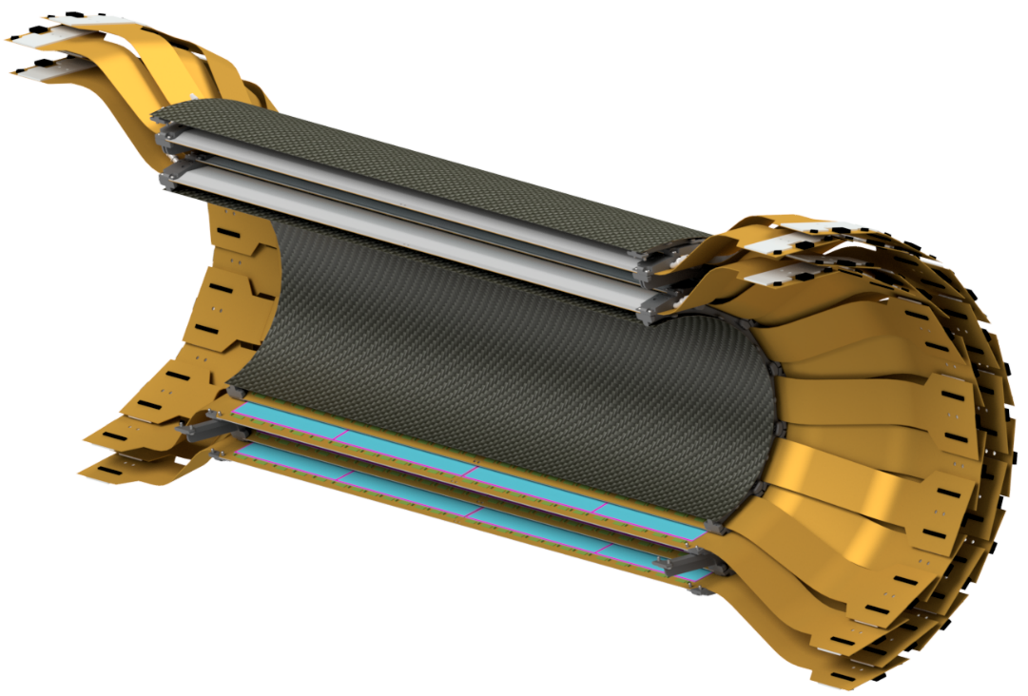
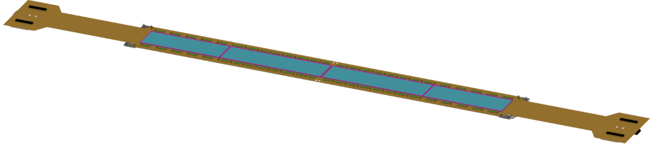
INTT Assembly Components
A. Ladder
B. Barrel
Detector Assembly
Ladder Assembly
Silicon Sensors
Ladder Assembly Ladder Assembly Fixtures Ladder Assembly Procedure | Detector Assembly Detector Assembly Procedure

Slide 3
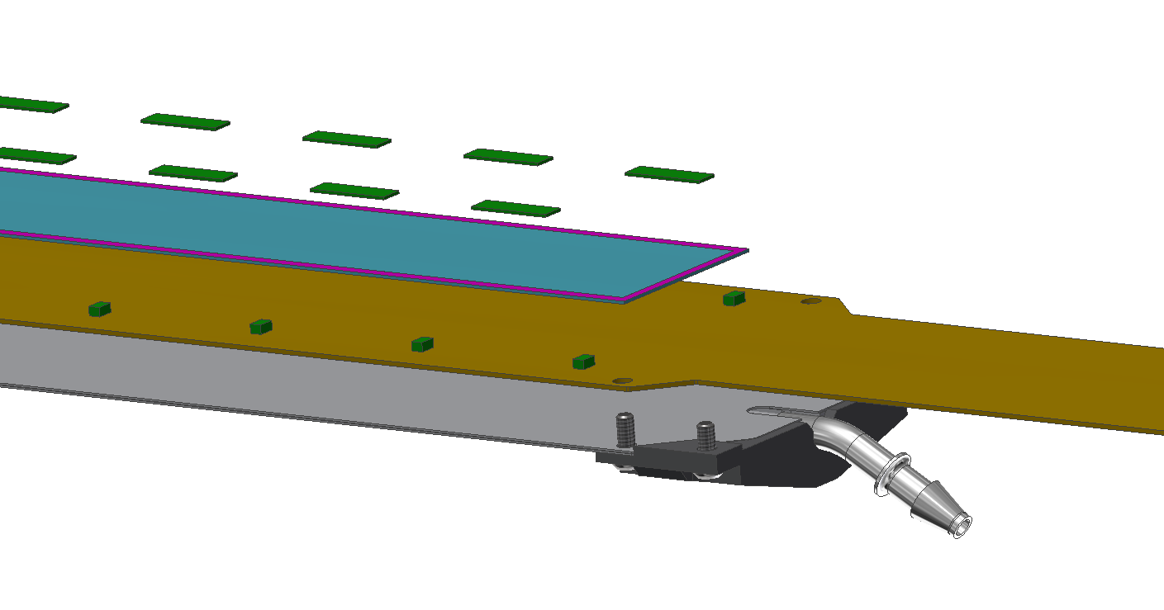
INTT Ladder Components
Ladder = 1 CFC Stave + 2 HDIs + 52 Chips + 4 Silicon Sensors
Cross Section of Ladder
Chips (FVTX)
Silicon Sensors
CFC Stave
(M55J)
HDI
(High Density Interconnect)
Stave Endcap
(Carbon PEEK)
Cooling Barb
(304 Stainless Steel)

Slide 4
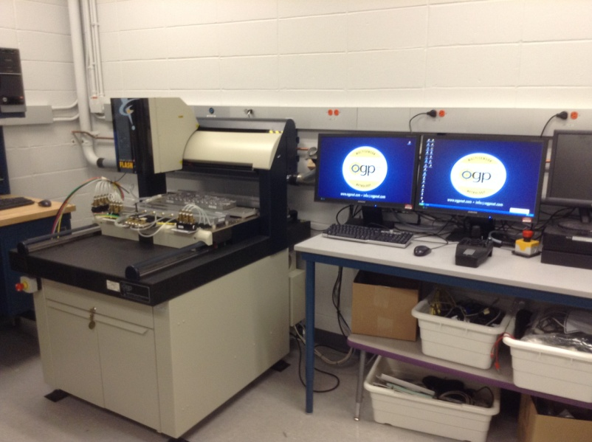
INTT Ladder Assembly Steps
1. Parts kitted and S/N’s logged in database.
2. Laser scan CFC stave for flatness.*
3. HDI’s aligned and epoxied to CFC stave.*
4. Set and epoxy chips to HDI.*
5. Chip wire-bonding to HDI.
6. Chip/HDI testing.
7. Set and epoxy silicon sensors to HDI.*
8. Silicon sensor wire-bonding and encapsulation to HDI.
9. Full assembly testing.
(* - Completed with OGP machine assistance)
INTT Ladder Assembly Station
OGP Laser-Optical Measurement

Slide 5
Inspection
HDI Epoxy
Chips Wire-Bond
Chips Epoxy
Chip/HDI Test
Sensor Epoxy
Sensor Wire-Bond
Full Assembly Test

Slide 6
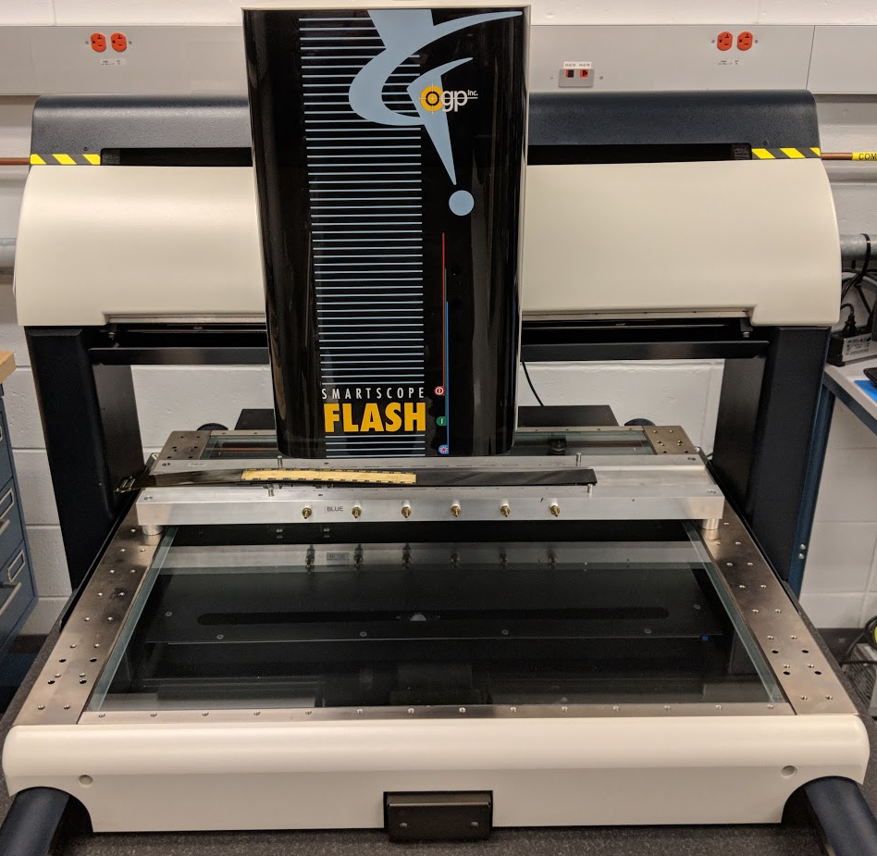
INTT Technical Overview – Laser OGP Machine
With a wingspan of 31.5 inches, the staves require a large measurement system to survey the flatness throughout assembly.
BNL’s on-hand OGP Smartscope Flash 500 is the perfect tool for the job.
  Large travel bridge with a support span of 33.125 inches.
  Measurement platen can accommodate multiple assembly fixtures at once.
  Top-down laser optical measurement system with potential Z accuracy of 2 microns.

Slide 7
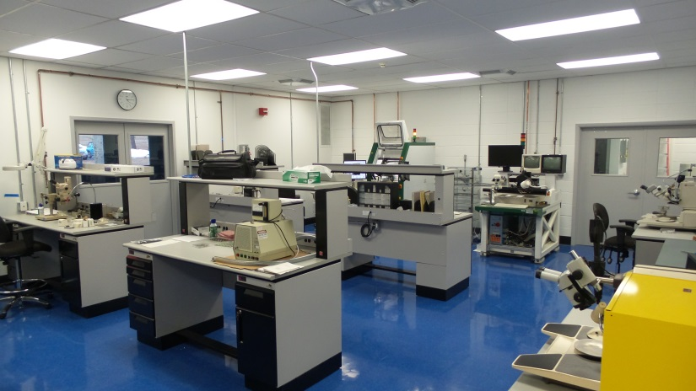
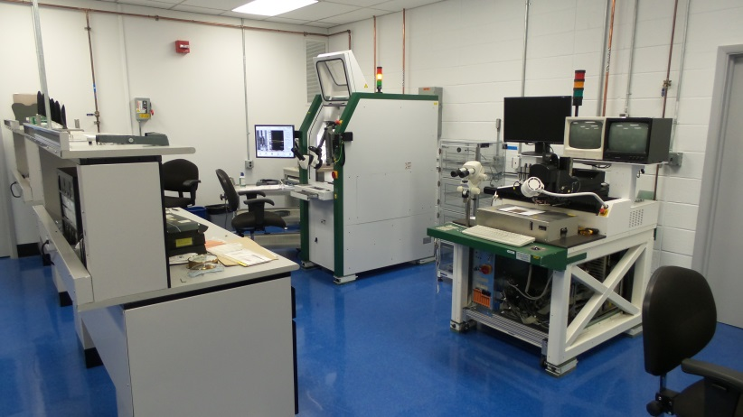
On-Hand Expertise
The BNL group has experience assembling VTX staves.
Experienced wirebonding services are available on site.
  Multiple rounds of wirebonding is required at different stages of the stave assembly.
  2017 newly renovated lab (photos).
Users familiar with OGP measurement systems are available for metrology throughout the assembly process.

Slide 8
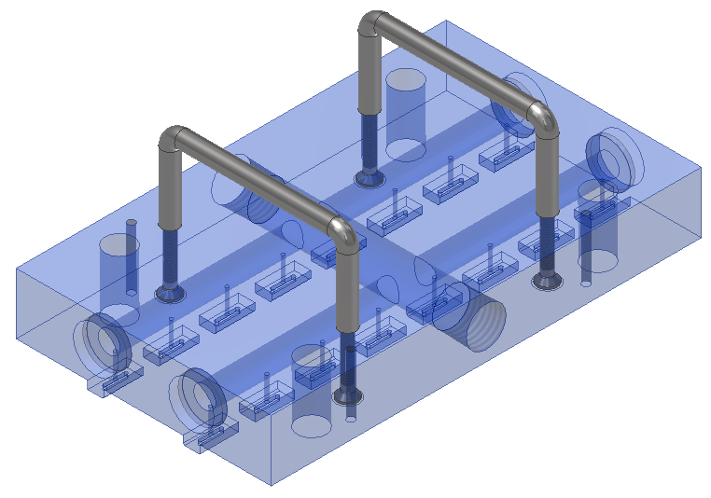
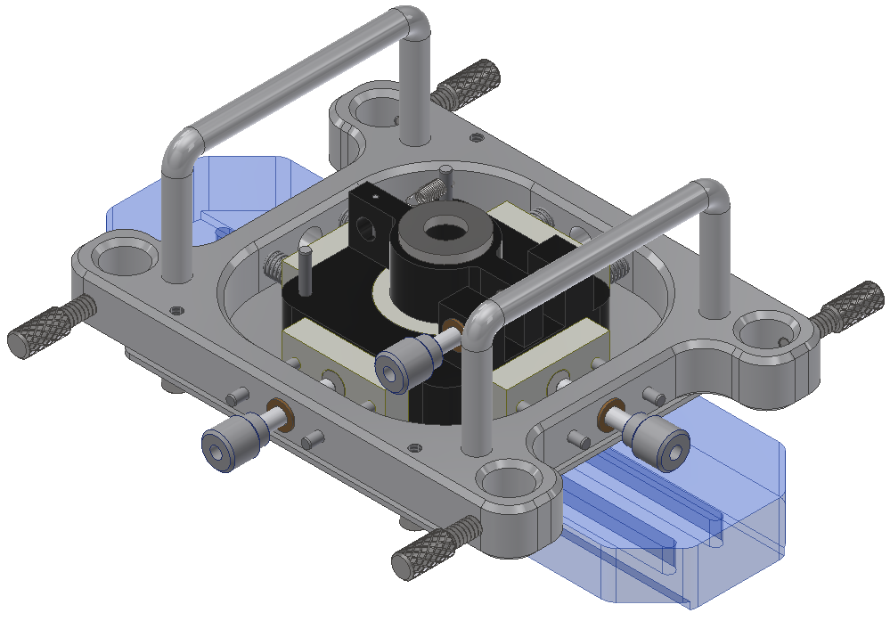
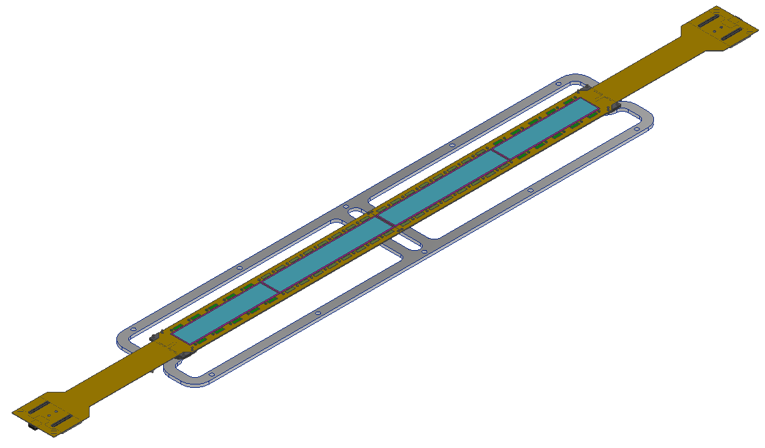
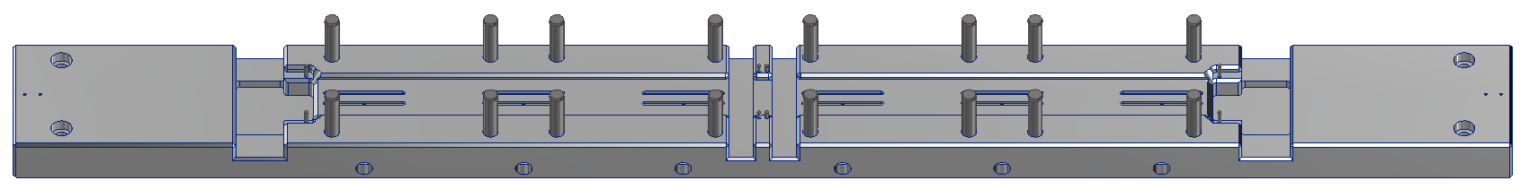
INTT Ladder Assembly Fixtures
Chip Placement Tool
Sensor Placement Tool
Base Vacuum Fixture
Ladder on
Stave Frame

Slide 9
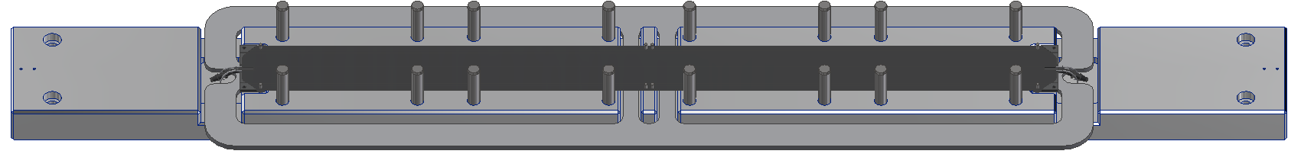

INTT Technical Overview – HDI Placement
1. CFC stave is installed on the base fixture, and scanned by the OGP for flatness.
2. Glue mask is applied to prevent overspill of epoxy during and after application.

Slide 10
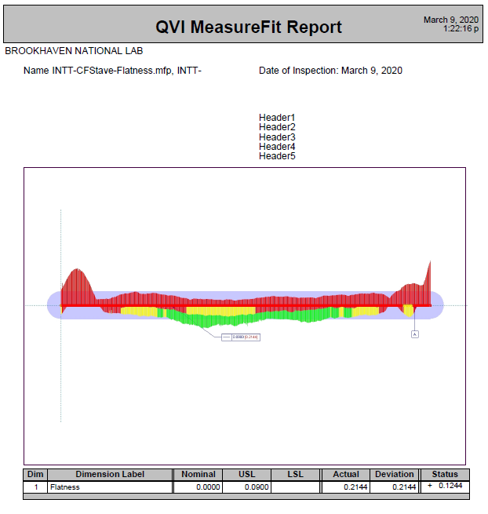
INTT Technical Overview – HDI Placement
First article HDIs were received and analyzed.
  Data (below), and example report (right).
First Article Staves | Flatness (Vacuum)
S/N 0001 | 0.3297 mm
S/N 0002 | 0.3056 mm
S/N 0003 | 0.4818 mm
S/N 0004 | 0.3680 mm
S/N 0005 | 0.2144 mm
S/N 0006 | 0.4427 mm

Slide 11
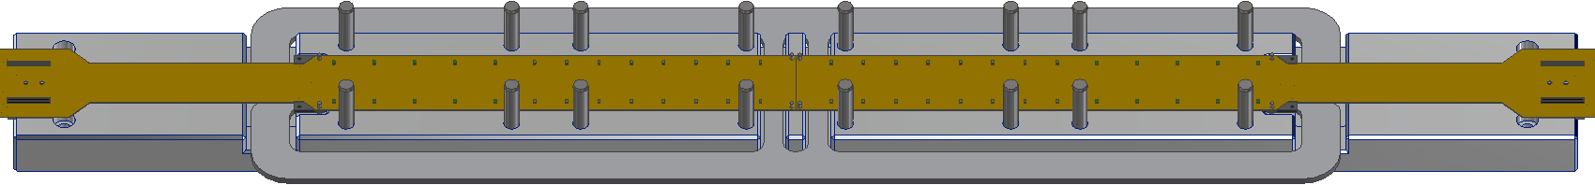
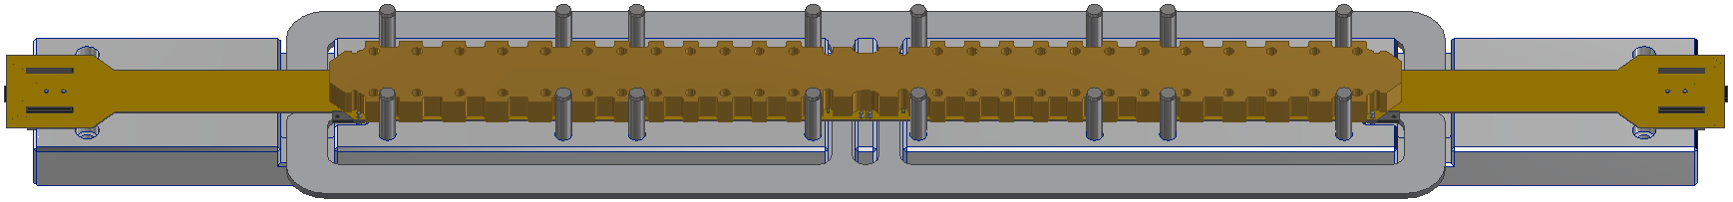
INTT Technical Overview – HDI Placement
3. Glue mask is removed and both HDIs are installed on the stave, located by 2mm pins.
4. Glue weight is applied to the top surface of the HDIs and remains throughout curing.

Slide 12
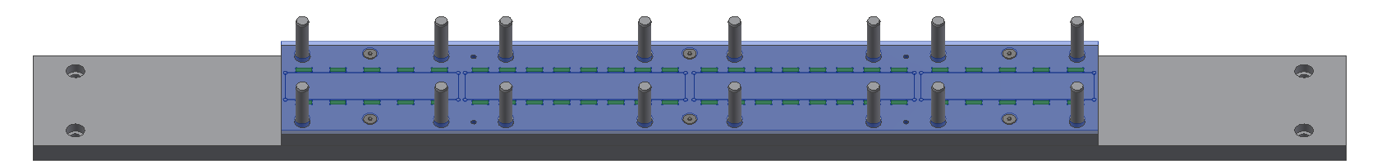
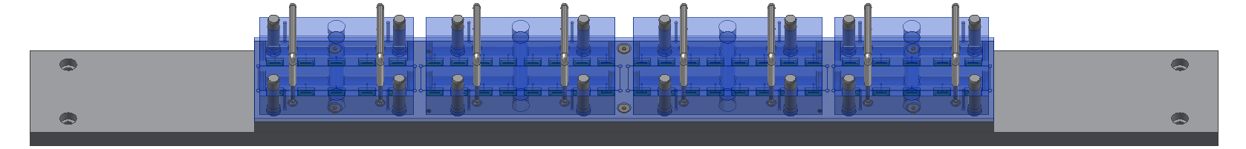
INTT Technical Overview – Chip Placement
5. Chips are placed in the base pockets of the base fixture.
6. The pickup tools interface with the base fixture so that the chips are accurately picked and placed on the HDIs.

Slide 13
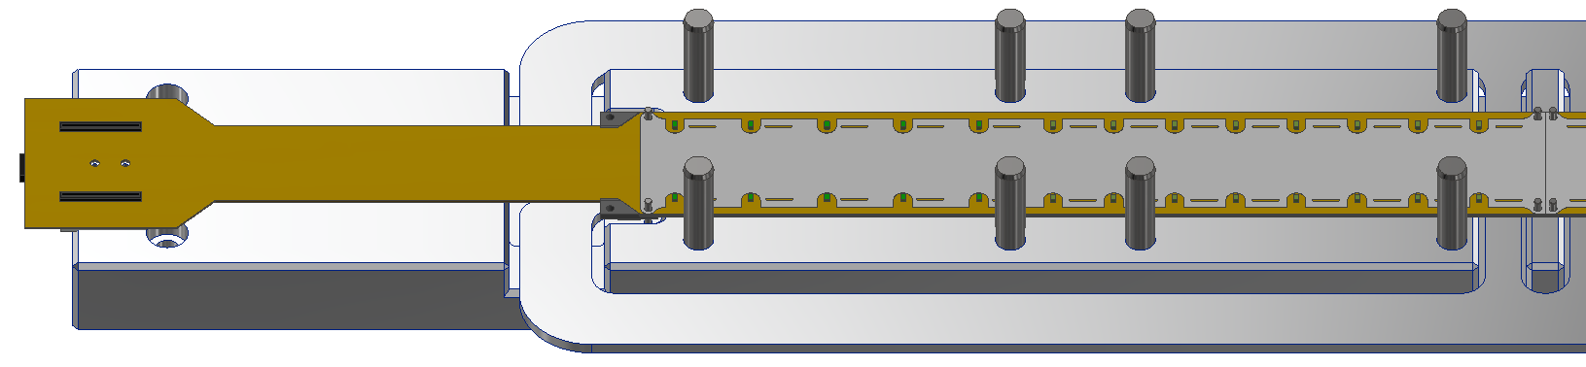
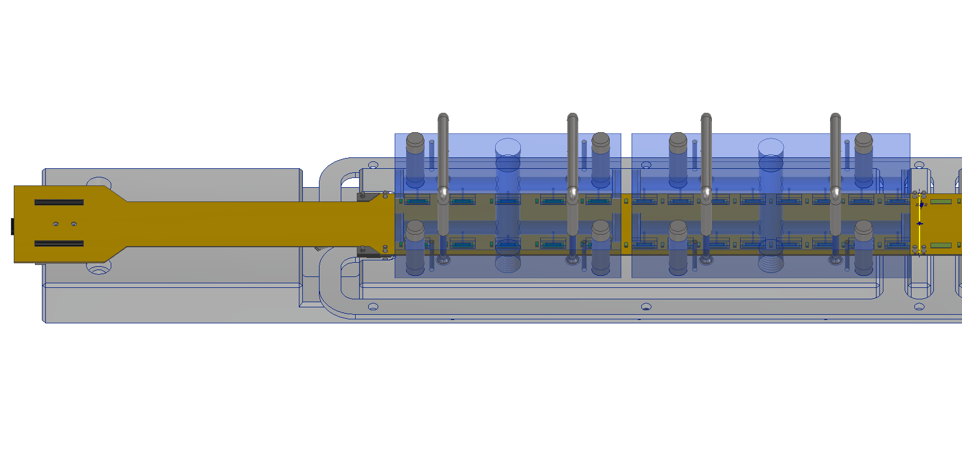
INTT Technical Overview – Chip Placement
7. Chip glue mask is installed for precision epoxy application.
8. Glue mask is removed and chip installation tool is used to accurately place the chips.

Slide 14
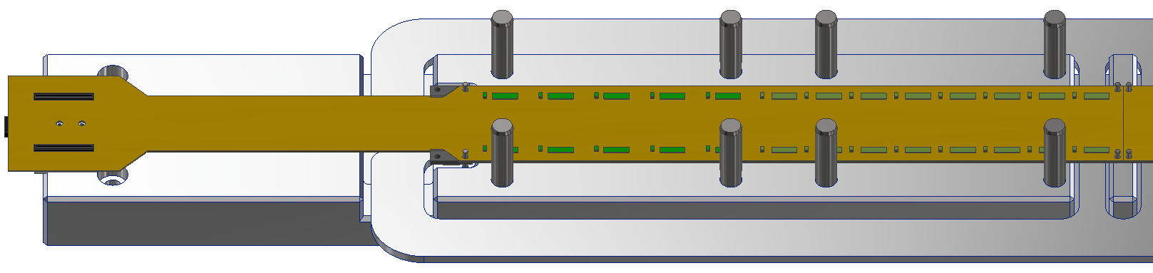
INTT Technical Overview – Chip Placement
9. All chips are installed at the same time and the placement fixtures remain throughout cure.
10. Once curing is complete, the fixtures are removed and the ladder is sent for wire-bonding.

Slide 15
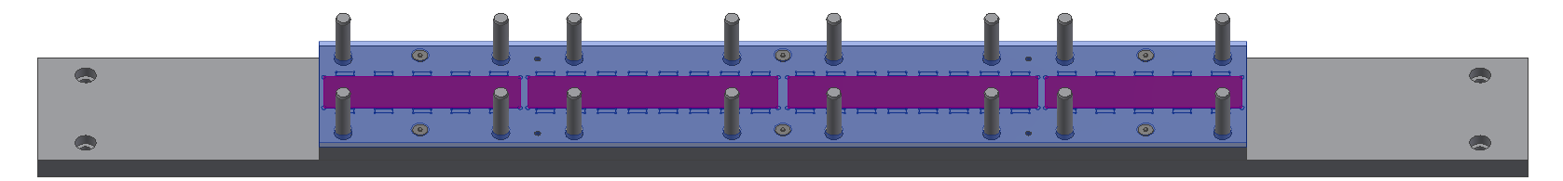
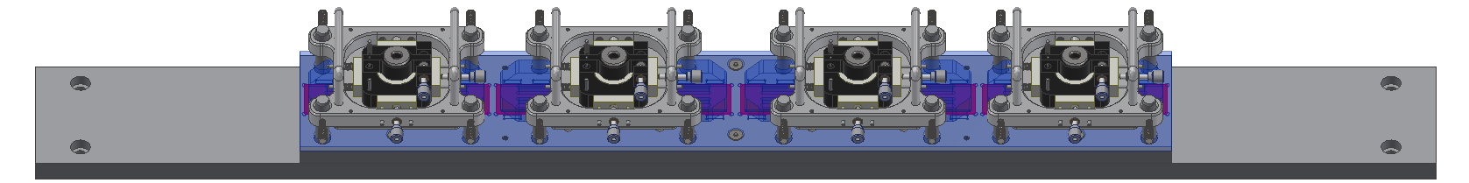
INTT Technical Overview – Sensor Placement
11. Sensors are placed in the base pockets of the base fixture.
12. The pickup tools interface with the base fixture so that the sensors are accurately picked and placed on the HDIs.

Slide 16
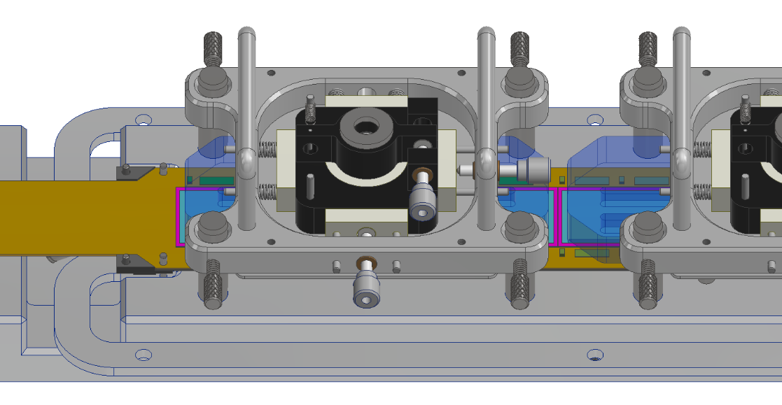
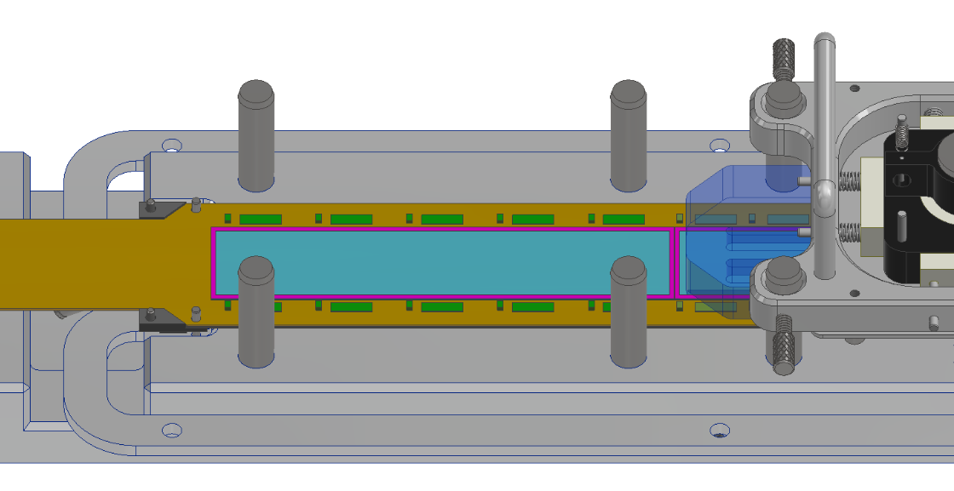
INTT Technical Overview – Sensor Placement
13. In the same manner as the chips, the silicon sensors are placed with a vacuum fixture.
14. The micrometer dials are adjusted to properly position the sensor on the epoxy.
15. OGP optical camera is used to verify accurate sensor positioning.
16. Once cured, the assembly is sent for additional wire-bonding.
Notes:
After wire-bonding of the chips is complete, the ladder tested and returned to the OGP machine for sensor placement.
The placement of the sensors is completed using the same vacuum fixture action as the chip placement.
Once the sensors are placed on the HDI surface, the positioning can be adjusted using the micrometer dials. This is done to achieve accurate placement which is verified by the OGP’s optical camera which peers through openings and cutaways in the placement tool that reveal alignment markings on both the sensor and the HDI.
After the sensor epoxy cures the assembly is sent for additional wire-bonding and encapsulation, followed by full ladder testing.

Slide 17
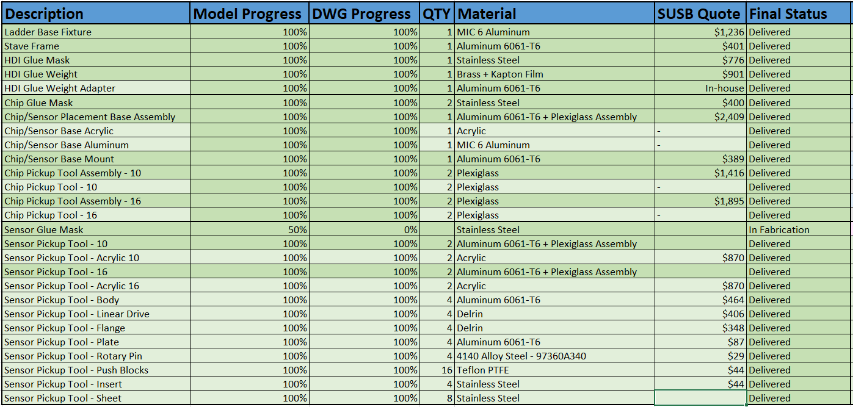
BOM and Quotes
Note: SUSB Quote is for single quantity parts. Quoted price per piece includes custom fabrication fixtures so additional parts in the future will cost less.

Slide 18
Back Up

Slide 19
First Article Carbon Fiber Staves
6x Carbon Fiber Staves
  Part Number : 205-310-0100-01
    01 signifies that the stave belongs to ladder barrel 1.
  Serial Numbers : SN0001 through SN0006.
Flatness measured on OGP fixture with and without vacuum running.

Slide 20
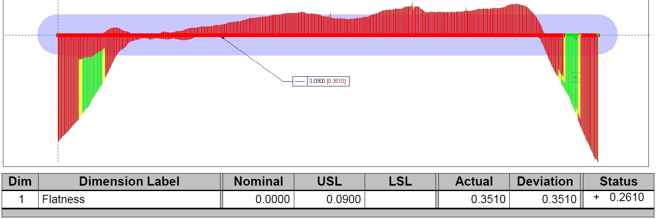
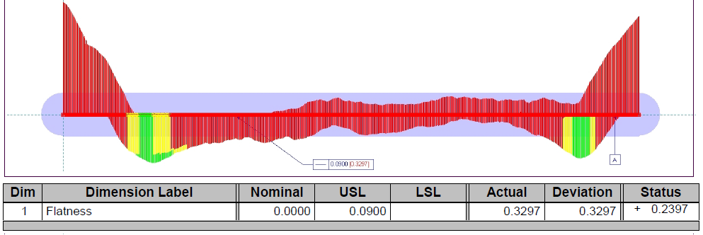
SN0001_205-310-0100-01
Flatness
  No Vacuum
    0.3510 mm
  With Vacuum
    0.3297 mm
  Vendor
    0.314 mm

Slide 21
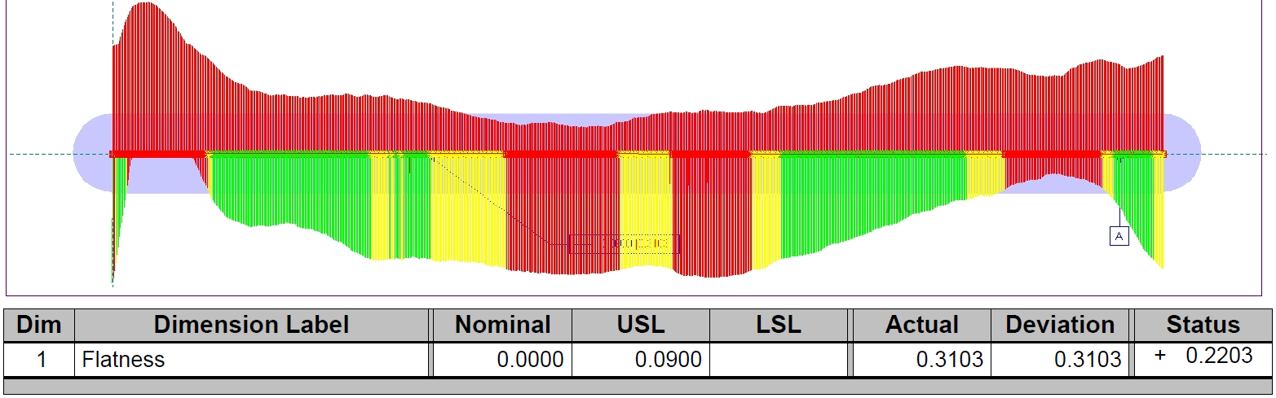
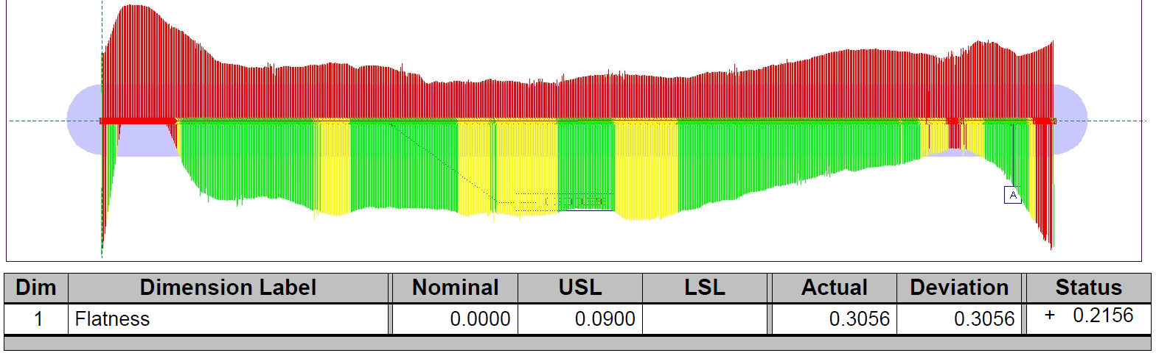
SN0002_205-310-0100-01
Flatness
  No Vacuum
    0.3103 mm
  With Vacuum
    0.3056 mm
  Vendor
    0.290 mm

Slide 22
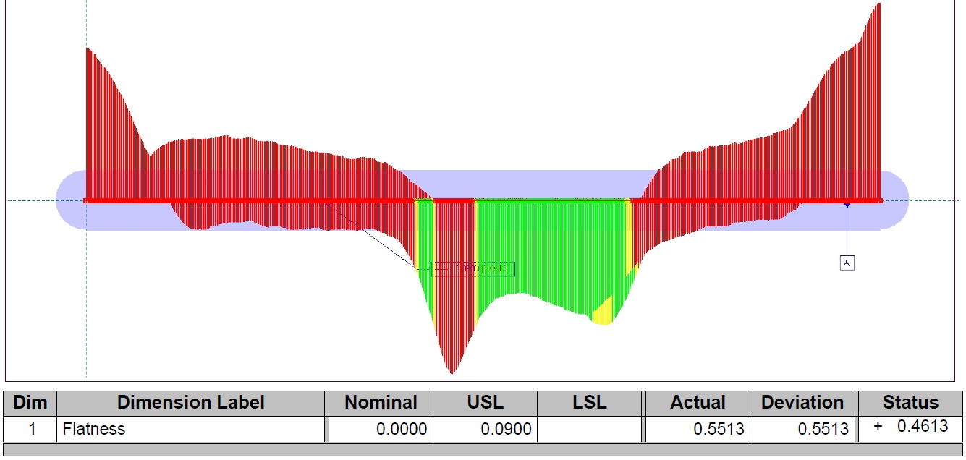
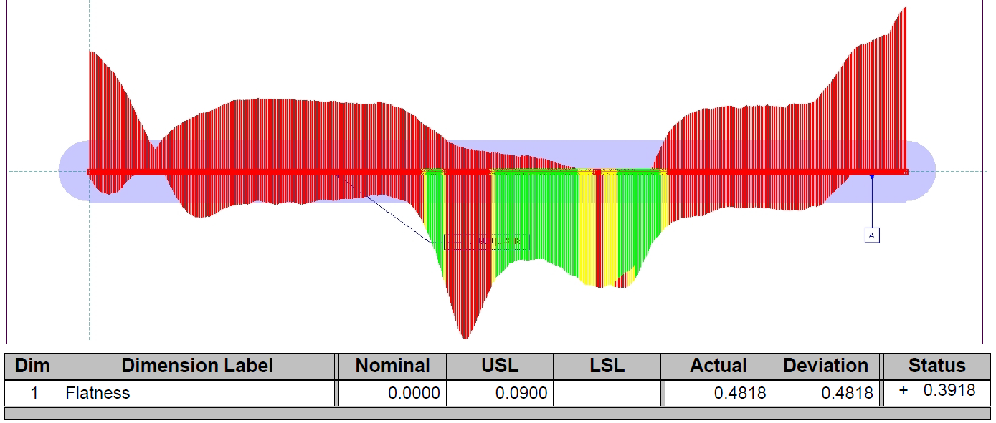
SN0003_205-310-0100-01
Flatness
  No Vacuum
    0.5513 mm
  With Vacuum
    0.4818 mm
  Vendor
    0.428 mm

Slide 23
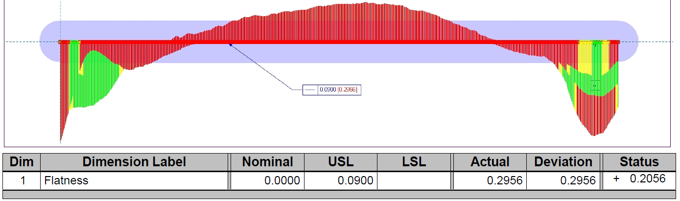
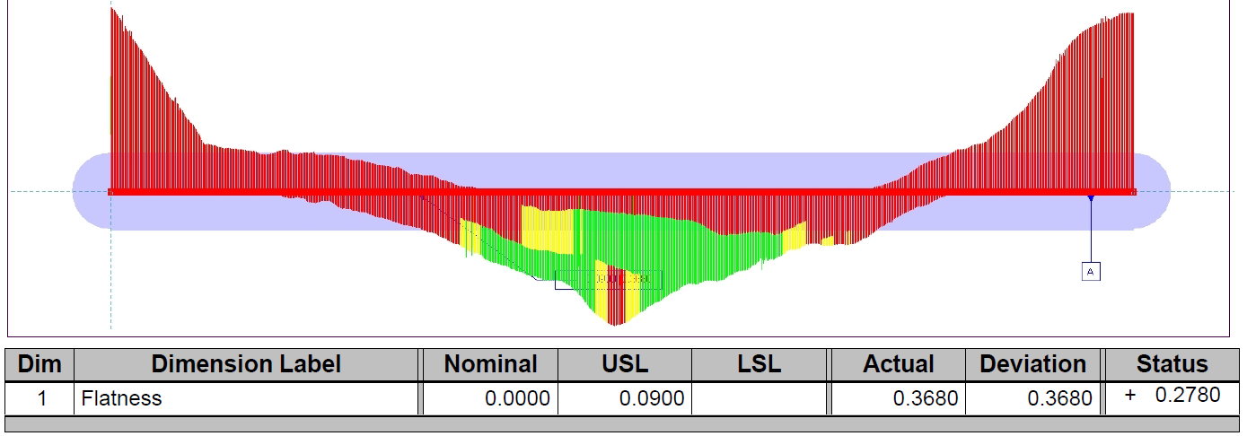
SN0004_205-310-0100-01
Flatness
  No Vacuum
    0.3902 mm
  With Vacuum
    0.3680 mm
  Vendor
    0.315 mm

Slide 24
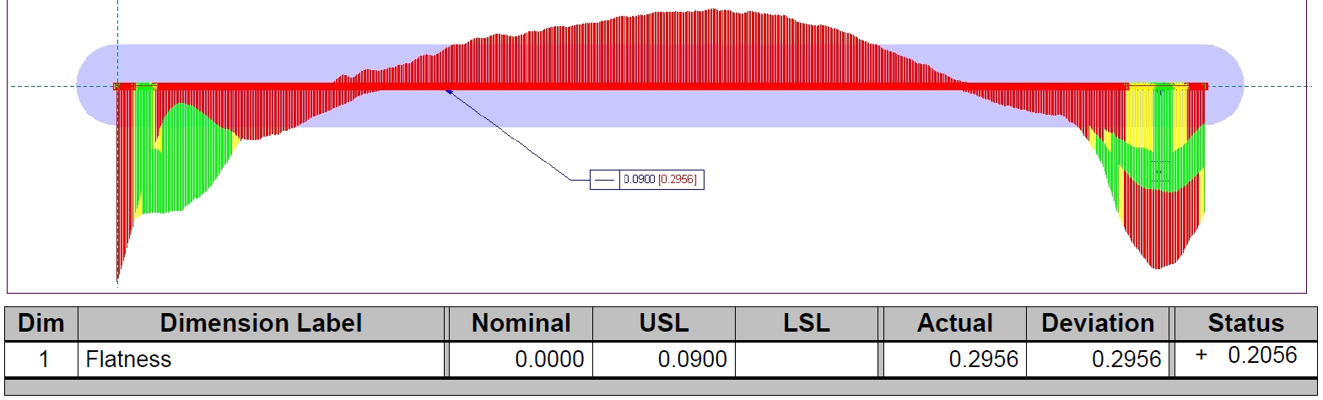
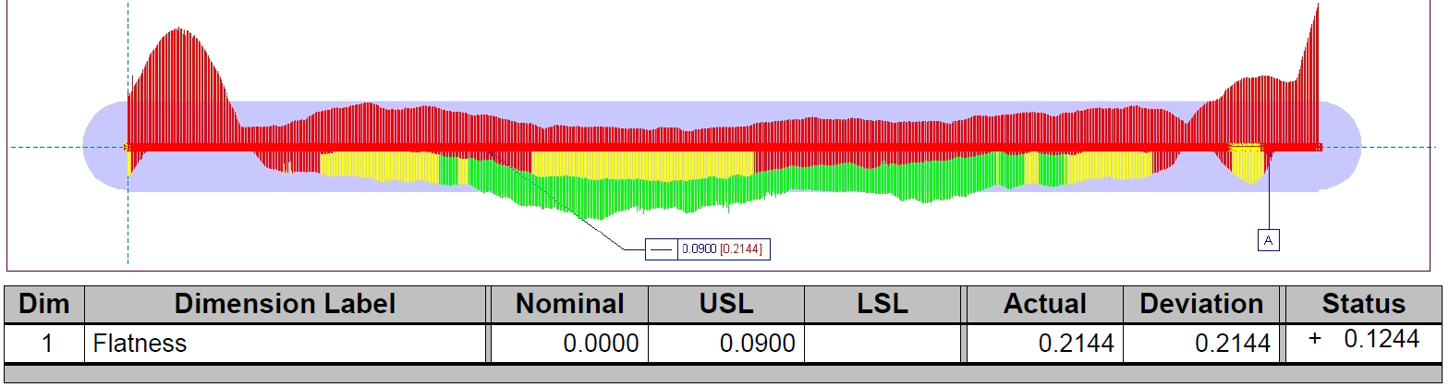
SN0005_205-310-0100-01
Flatness
  No Vacuum
    0.2956 mm
  With Vacuum
    0.2144 mm
  Vendor
    0.305 mm

Slide 25
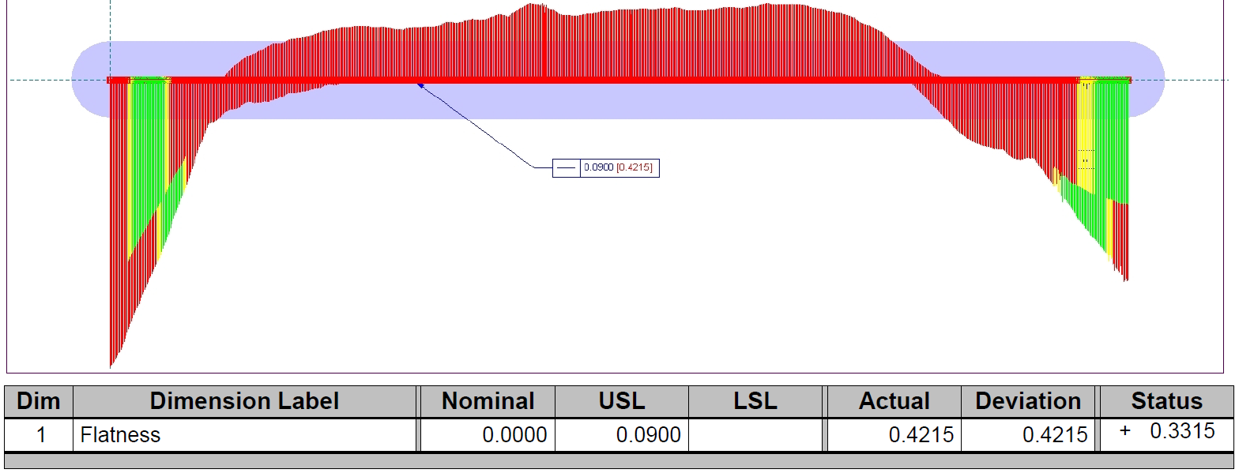
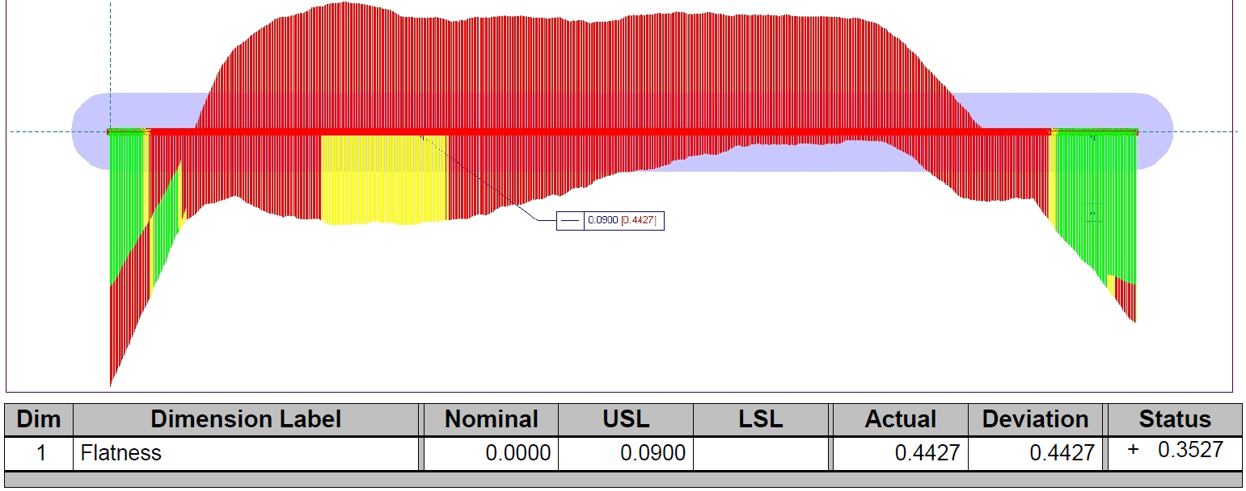
SN0006_205-310-0100-01
Flatness
  No Vacuum
    0.4215 mm
  With Vacuum
    0.4427 mm
  Vendor
    N/A

Slide 26
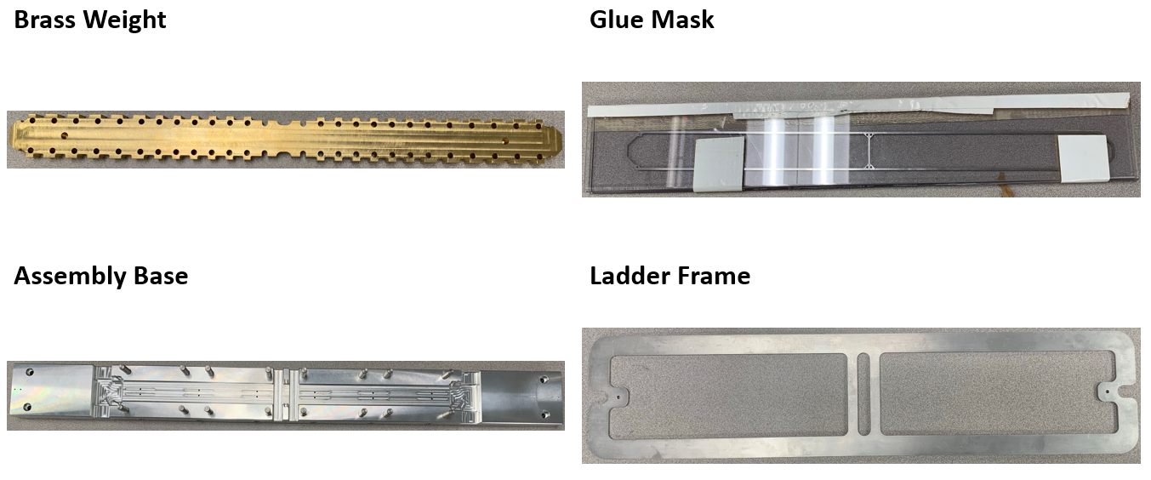
Procured Parts

Slide 27
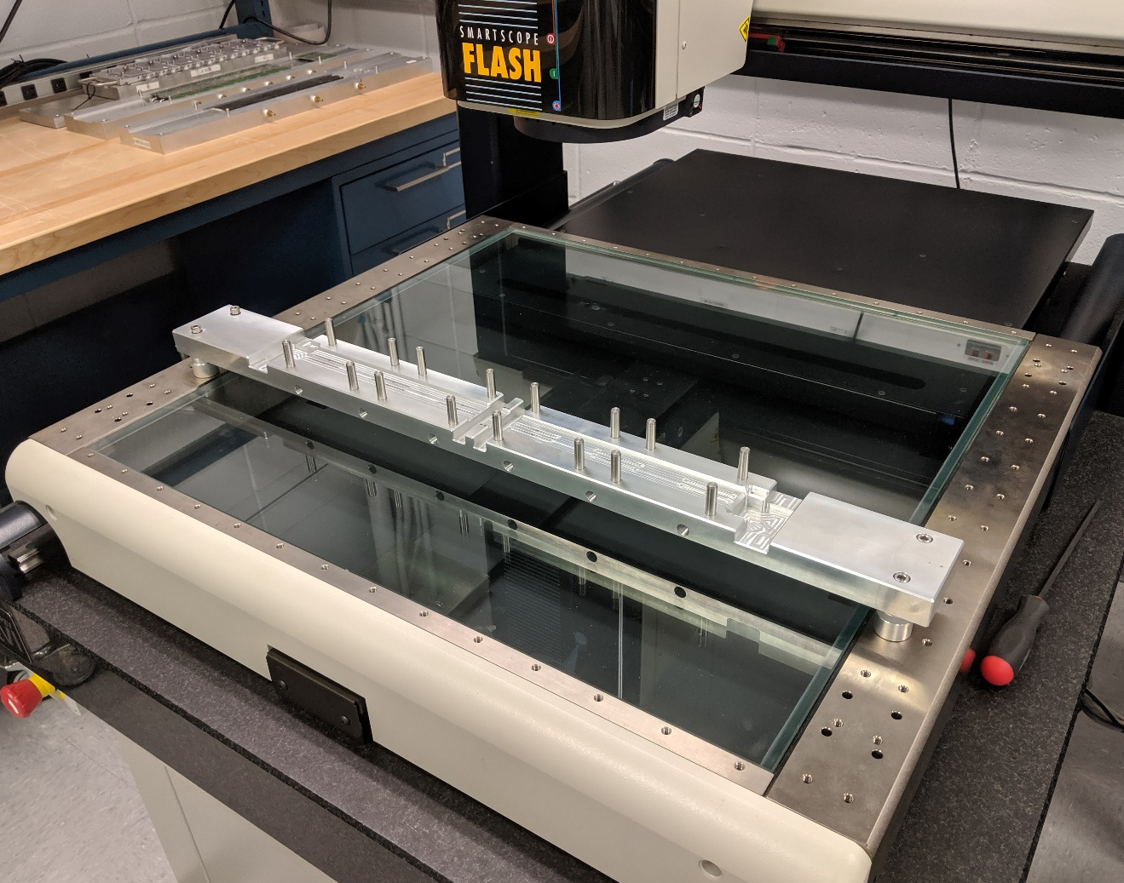
Procured Parts (cont.)

Slide 28
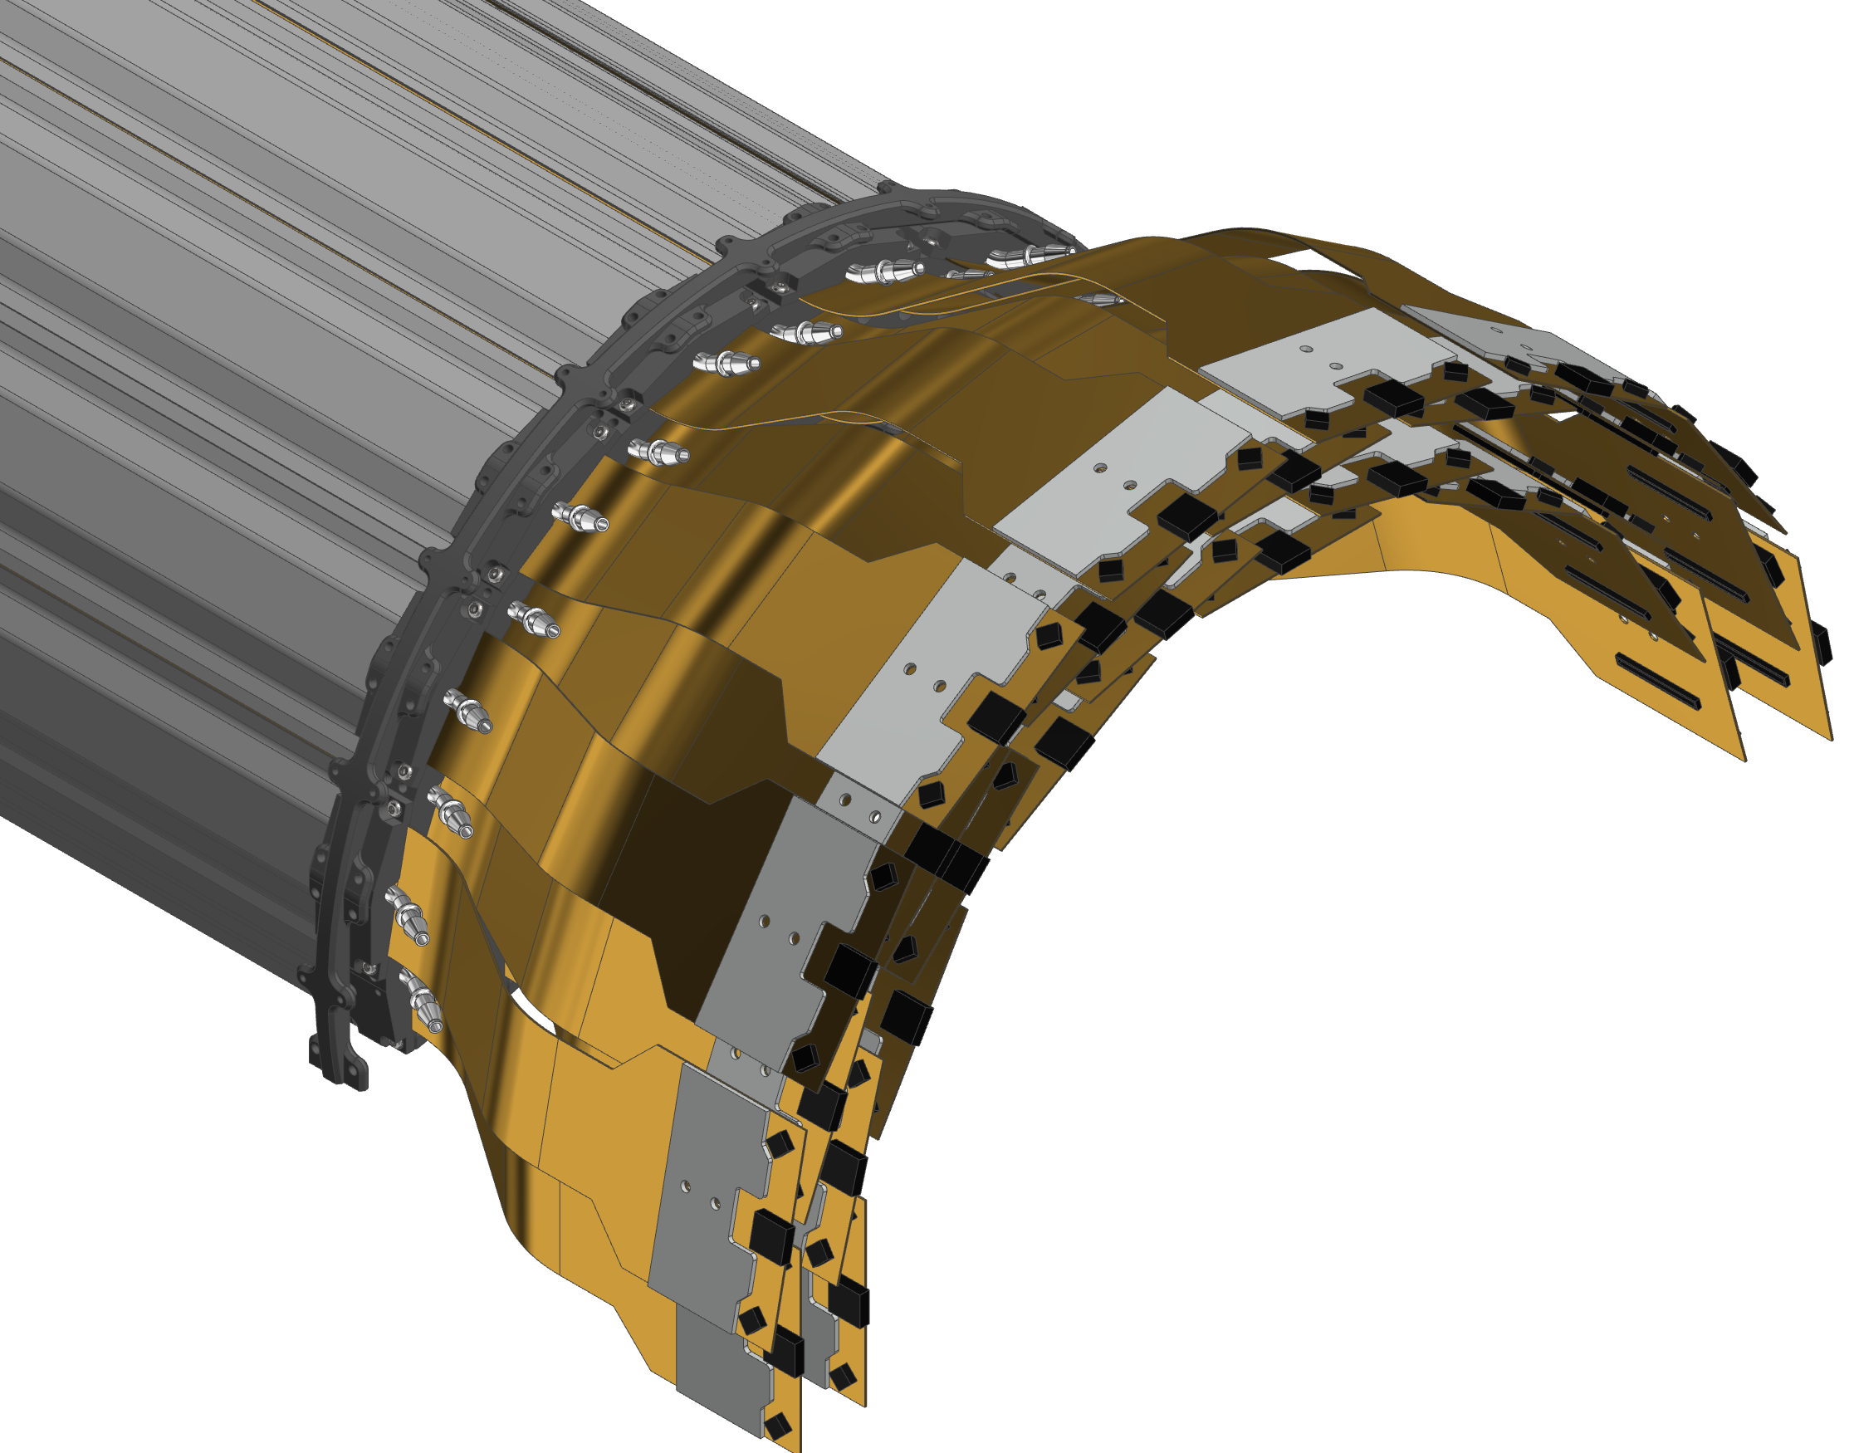

INTT Detector Components
INTT Half Barrel Assembly
Endcap Rings
Notes:
Once we have our ladders assembled we are tasked with assembling both INTT half barrels. The half barrels consist of two layers of ladders with each layer consisting of two sub-layers. These ladders are supported by endcap rings.

Slide 29
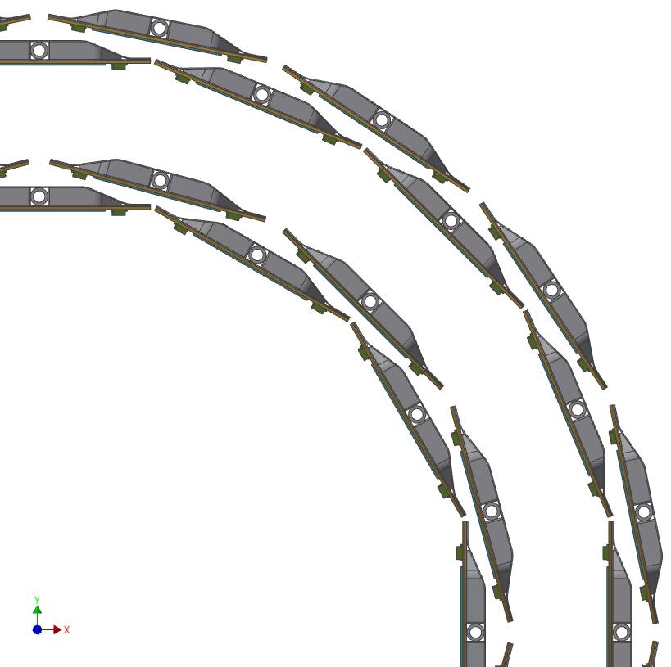
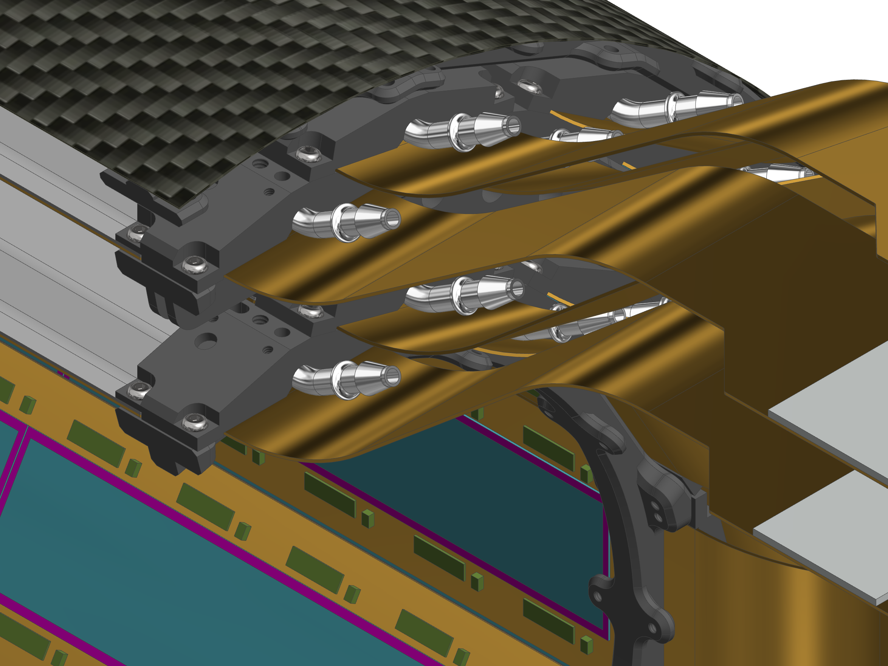
INTT Detector Components (cont.)
CFC Outer Shell (254 um) With Aluminum Ground Plane (25 um)
(Inner Shell not shown)
Outer Layer
Inner Layer
Endcap Ring
(Carbon PEEK)
Ladder Assembly
Notes:
Shown in the image here are the components that makeup the detector assembly. You can see the separation of the inner and outer layer that make up the two layers of the barrel assembly. The layers are surrounded by an outer and inner CFC shell, the inner shell is not shown here so that the ladder assembly can be seen.

Slide 30
INTT Detector Assembly Components
The detector assembly fixtures are in conceptual design but will consist of a mandrel and guide fixture.
  Mandrel
    Inner-most endcap rings will screw down to a mandrel, allowing all ladders to be assembled at the 12 o’clock position (vertically).
    After the assembled half barrels are removed from the mandrel, the inner shells will be installed, completing the assembly.
  Guide
    A guide fixture will prevent any twists or deflections in the ladder that could damage the thin silicon sensors.
Notes:
The detector assembly fixtures are in conceptual design but the goal is to build a mandrel and guide assembly fixture.
A cylindrical mandrel will have interfaces so that the inner-most endcap rings can be screwed down. The mandrel will ride on an axel so that each ladder can be lowered down in the same orientation, perpendicular to normal-axis at the 12 o’clock position.
A guide will ensure proper and even placement without any twisting or deflection.

Slide 31
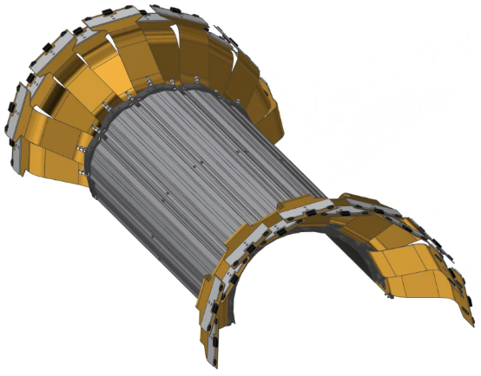
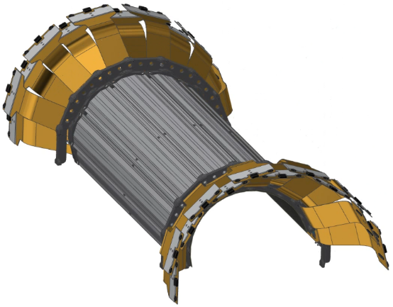
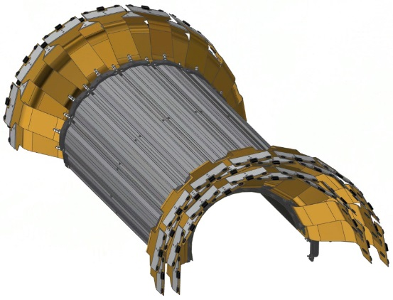
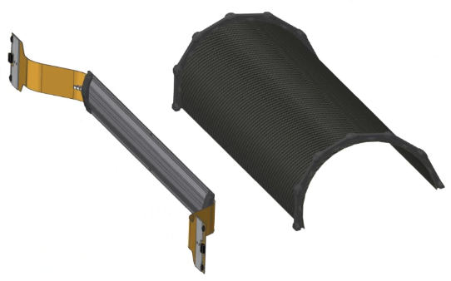
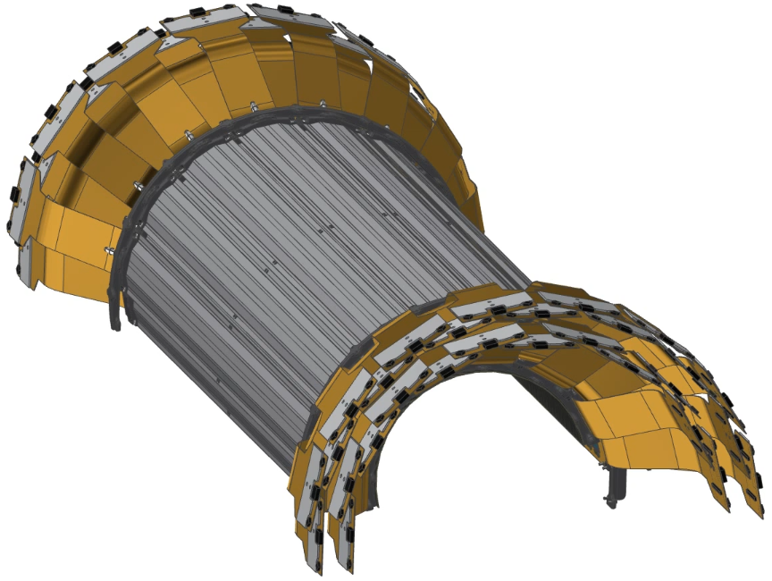
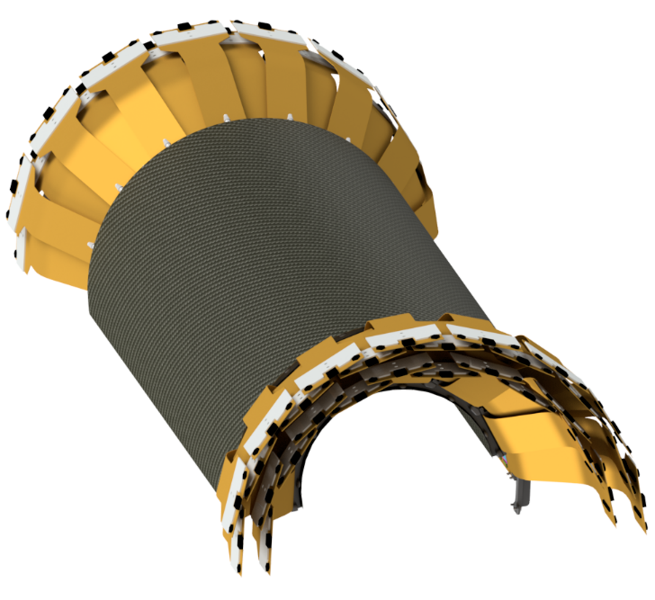
INTT Technical Overview – Half Barrel Assembly
Assembled in layers.
Inner/Outer Layer
  Two Sub-Layers
Inner/Outer CFC Shell
  254 microns thick
  25 micron Al ground plane
Notes:
This slide shows some snapshots of the half barrel during the assembly process. As described earlier, the assembly is complied in sublayers. Following this slide is an animation of the half barrel assembly coming together.

Slide 32

INTT Technical Overview – Half Barrel Assembly
Notes:
This animation shows the production of a half barrel which will begin at the inner most sub layer where the ladders are installed edge-to-edge. The next sub layer is installed with an offset so that the outer ladders are placed with their center-line even with the mating edges of the previous sub layer.
After a layer is completed a new end cap ring is installed.
Once both layers are completed the CFC outer shell is installed.

Slide 33
INTT Ladder/Barrel Assembly Scope
Preparation and operation of OGP machine workstation during pre-production phase.
  Procedure training
  S/N data entry into database
Design, draft and fabrication of assembly fixtures for:
  Ladder assembly
    Base vacuum fixture
    Sensor placement tool
    Chip placement tool
  INTT half barrel
    Barrel assembly fixture
Notes:
The ladder and detector assembly is responsible for the perp and operation of the OGP machine during pre-production which encompasses not only procedural training but S/N database building/logging.
And of course the main responsibility being the design, draft and fabrication of the assembly fixtures concerning the ladder and the INTT half barrel.

Slide 34
INTT Collaborators
Institutions:
BNL, RIKEN, RBRC, Purdue University,
Nara Woman’s University (NWU), and
National Central University (NCU)
Team:
Professors: Takashi Hachiya, Wei Xie, Chia-Ming Kuo
Physicists: Rachid Nouicer, Itaru Nakagawa, Yasuyuki Akiba, Jin Huang, John Haggerty, Martin Purschke, Eric Mannel
Physics Associates: Rob Pisani, Takahito Todoroki
Chief Engineer: Russ Feder
Mechanical Engineers:
Dan Cacace, Connor Miraval
Mechanical Technicians:
Mike Lenz, Bill Lenz
Designers: Rich Ruggiero
Electrical Engineer: Steve Boose
Electrical Technician: Sal Polizzo, Donald Pinelli
Edward O’Brien (BNL)
L1 Manager
Yasuyuki Akiba (RIKEN/RBRC)
Consultant
Dan Cacace (BNL)
L3 Manager
Connor Miraval (BNL)
L3 Manager
Takashi Hachiya (NWU)
L3 Manager
Rachid Noicer (BNL)
Itaru Nakagawa (RIKEN)
L2 Manager
Wei Xie (Purdue U.)
L3 Manager
Chia-Ming Kuo (NCU)
L3 Manager
Ayaka Suzuki
+Undergrads
L4 Manager
Mechanical Design
Assembly
Testing, Monitoring
Silicon Testing, Database
Bus Extender

Slide 35
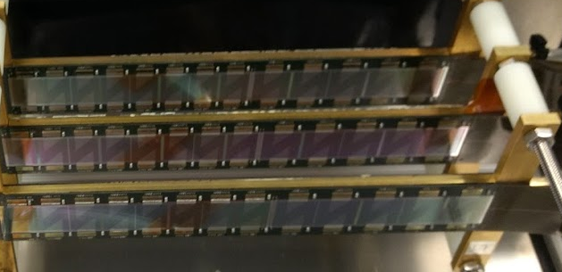
INTT Schedule and Cost Drivers
Main Schedule Drivers:
  Fabrication lead time of assembly fixture parts.
  OGP program development.
  Ladder assembly training.
    Technician training and supervision
  Design and fabrication of wire-bonding fixtures.
  Wire-bonding and encapsulation.
  Maintaining ladder assembly production schedule.
Cost Drivers:
  Fabrication of various custom assembly fixtures.
  Technician FTE.
3 Half Ladders
Assembled at BNL
FNAL Beam Test 2018
Notes:
Our main schedule and cost driver for the assembly process will certainly be the fabrication and lead time of the fixture parts and manpower.
Other factors contributing to schedule time are the OGP program development, assembly training and supervision, fabrication of wire-bonding fixtures, and the ability to adhere to the production schedule.

Slide 36
INTT Status and Highlights
Ladder Assembly
  Assembly fixtures are in an advanced conceptual design backed by previous success with similar fixtures during VTX assembly. Very minor changes pending.
  WIP drawings exist that will be sent for quoting.
  Available collaborators with assembly and wire-bonding expertise.
  Ladder assembly process is well understood and practice is needed.
Detector Assembly
  Detector assembly fixture is conceptual.
  Fixtures are in conceptual design phase, and prototyping is planned for this year.
Notes:
The ladder assembly is in a good place as advanced designs exist, backed with success with similar fixtures used during VTX assembly, with only minor changes pending (addition of set-screws, etc). WIP drawings exist that will be sent for quoting. The team hosts available collaborators with assembly and wire-bonding expertise.
Detector assembly fixtures are conceptual but prototyping is planned for this year.

Slide 37
INTT Issues and Concerns
Issues | Mitigation
As the assembly design and process matures, the need for additional manpower is becoming more apparent. | Increase manpower for production assembly.
There is a need for students/Post-docs for ladder and barrel tests, evaluation and data entry in the database during assembly. | Bring in students from Universities.
Notes:
Two issues we are currently facing with regards to the assembly process is the lack of manpower for pre-production assembly and the need for students/post-docs for testing, evaluation and data entry into the database during assembly.

Slide 38
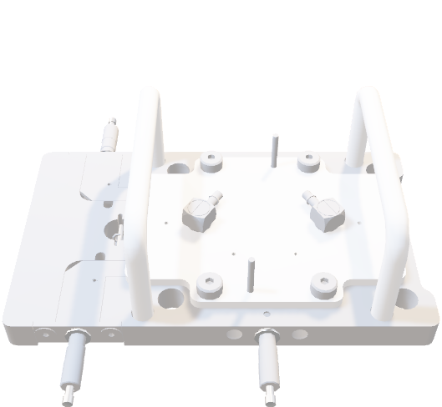
INTT Assembly Activities Over the Next Few Months
Development of assembly database.
Completion of ladder assembly fixtures.
  Procurement.
  Use in pre-production.
Design of wire-bonding fixtures.
  Modeling, drawing, procurement.
  Use in pre-production.
Design of barrel assembly fixture.
  Modeling, drawing, procurement.
  Mock-up of barrel assembly.
  Survey of INTT barrel.

Slide 39

INTT Assembly Summary
Ladder Assembly
  Fixtures are in a good place and are ready to begin procurement, pending minor adjustments to the models.
  The assembly process is tried-and-tested through the successful assembly of VTX.
Detector Assembly
  The plan for the detector assembly is laid out and the design of the fixture will mature over the coming months.

Slide 40


Chip Placement Tools
Chips are placed in the Chip Base with the HDI-mating surface facing down.
The Chip Placement Tool then lifts the chips and places them on the HDIs in their appropriate locations.
Chip Locating Slots
Vacuum Port
Tool Locating Pins
Tool Locating Holes

Slide 41

Sensor Placement Tool Features
Vacuum Ports
Tool Locating Holes
Adjustment Knobs
Center-Locking Pins

Slide 42

Sensor Placement Tool Model

Slide 43



Sensor Base Tool
Similarly to the Chip Placement Process, this tool utilizes a base fixture that locates the sensor to the center of the Placement Tool.

