Slide 1
sPHENIX INTT Assembly Half Barrel Assembly Fixture
Connor Miraval
June 2, 2020
BNL

Slide 2
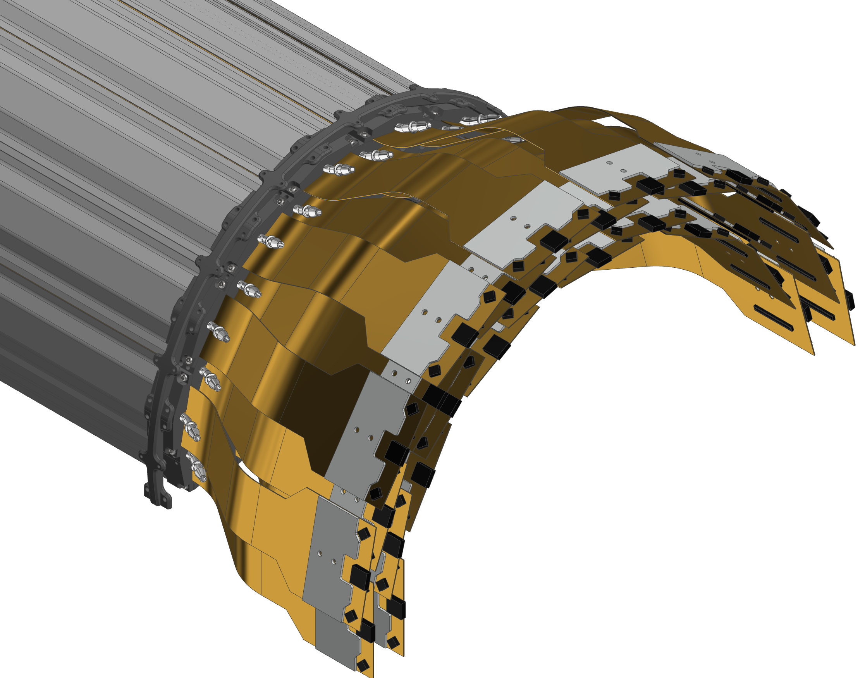

INTT Detector Components
INTT Half Barrel Assembly (Without Shell)
Endcap Rings
Notes:
Once we have our ladders assembled we are tasked with assembling both INTT half barrels. The half barrels consist of two layers of ladders with each layer consisting of two sub-layers. These ladders are supported by endcap rings.

Slide 3
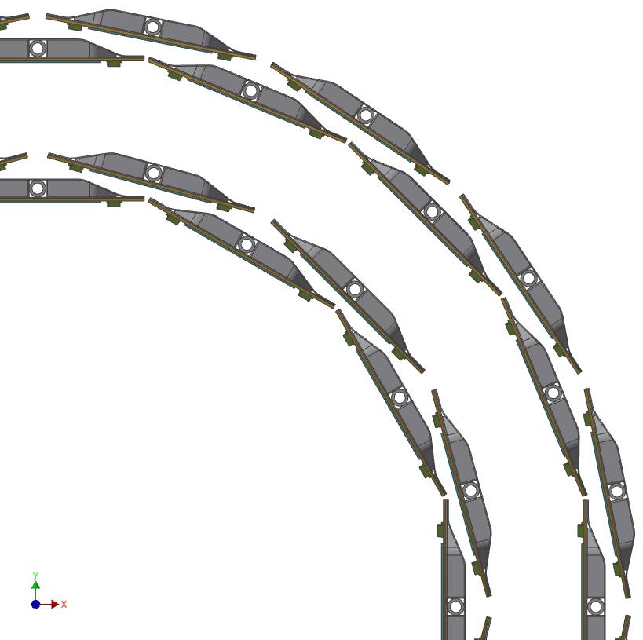
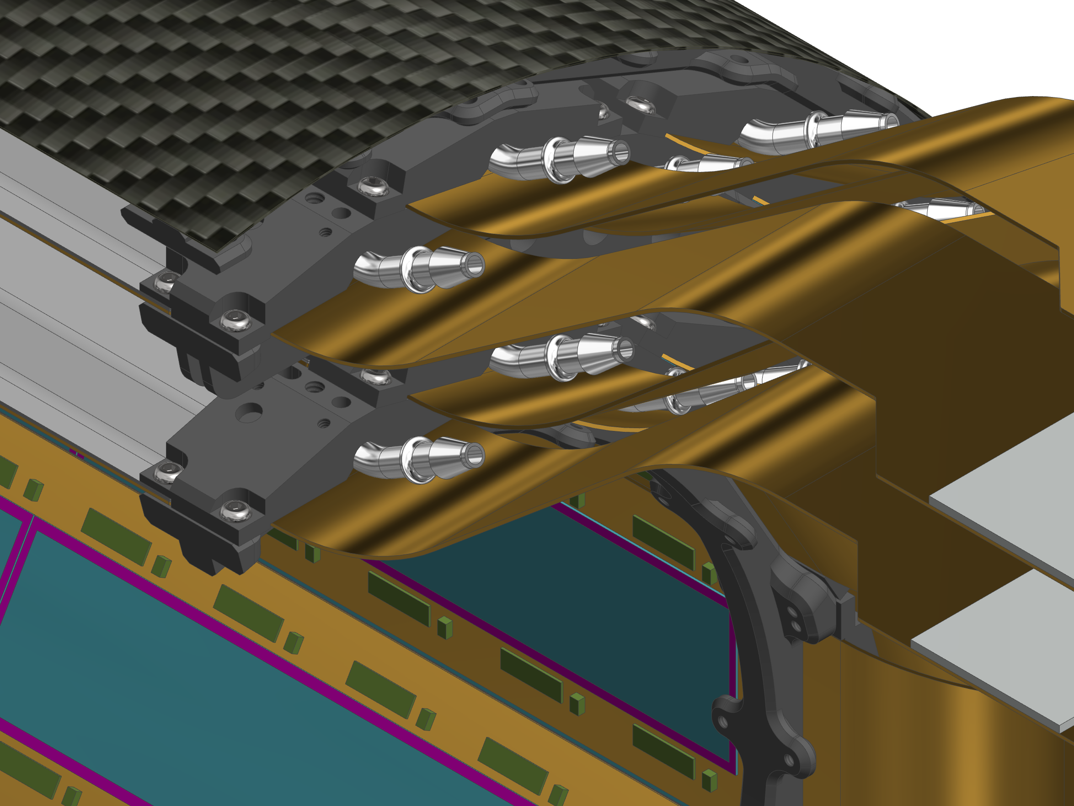
INTT Detector Components (cont.)
CFC Outer Shell (254 um) With Aluminum Ground Plane (25 um)
(Inner Shell not shown)
Outer Layer
Inner Layer
Endcap Ring
(Carbon PEEK)
Ladder Assembly
Notes:
Shown in the image here are the components that makeup the detector assembly. You can see the separation of the inner and outer layer that make up the two layers of the barrel assembly. The layers are surrounded by an outer and inner CFC shell, the inner shell is not shown here so that the ladder assembly can be seen.

Slide 4
INTT Detector Assembly Components
The detector assembly fixtures are in conceptual design but will consist of an assembly cart and a half barrel exoskeleton.
Assembly Cart
A large lift table cart will be used as the building station for the INTT Half Barrel.
Two carts will be produced and will be home to each half barrel from assembly to integration.
Lift Tube
An exoskeleton will provide structural support during integration and act as lift points when the half barrels are combined during installation.
Notes:
The detector assembly fixtures are in conceptual design but the goal is to build a mandrel and guide assembly fixture.
A cylindrical mandrel will have interfaces so that the inner-most endcap rings can be screwed down. The mandrel will ride on an axel so that each ladder can be lowered down in the same orientation, perpendicular to normal-axis at the 12 o’clock position.
A guide will ensure proper and even placement without any twisting or deflection.

Slide 5
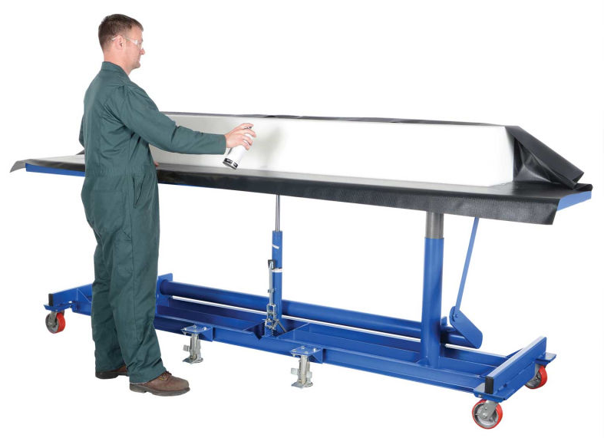
INTT Barrel Assembly Cart
Dimensions
120 x 30 inch Platform
Elevates from 31 inches to 48 inches (Span of 17 inches)
$2,026
Hardware holes can be added to the cart for fixturing.
Cart will host the half barrel assembly and will safely transport the assembly.
Global Industrial Item # WBB54093
Notes:
The detector assembly fixtures are in conceptual design but the goal is to build a mandrel and guide assembly fixture.
A cylindrical mandrel will have interfaces so that the inner-most endcap rings can be screwed down. The mandrel will ride on an axel so that each ladder can be lowered down in the same orientation, perpendicular to normal-axis at the 12 o’clock position.
A guide will ensure proper and even placement without any twisting or deflection.

Slide 6
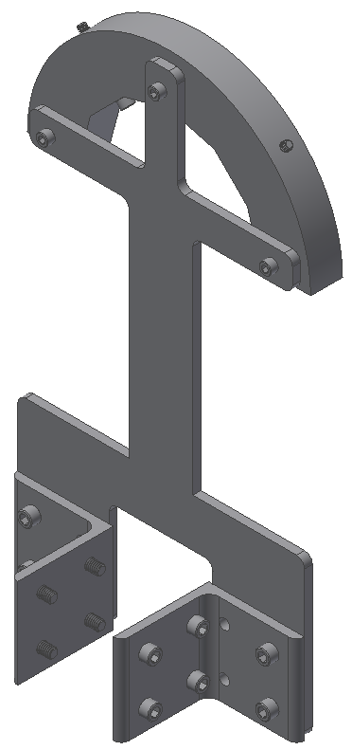
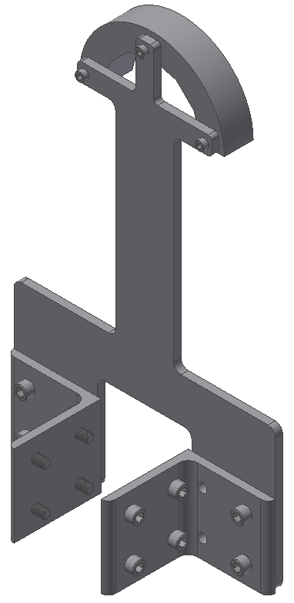
INTT Barrel Cart Supports
Six supports are used to suspend the INTT detector 1 foot off the Barrel Assembly Cart.
Two Inner Supports
Four Outer Supports
The Outer Supports are physically mounted to the ID of the Service Barrel with hardware.
The Inner Supports are contact only to prevent any unnecessary holes in the INTT Inner Skin.
Inner Support
Outer Support
Notes:
The detector assembly fixtures are in conceptual design but the goal is to build a mandrel and guide assembly fixture.
A cylindrical mandrel will have interfaces so that the inner-most endcap rings can be screwed down. The mandrel will ride on an axel so that each ladder can be lowered down in the same orientation, perpendicular to normal-axis at the 12 o’clock position.
A guide will ensure proper and even placement without any twisting or deflection.

Slide 7
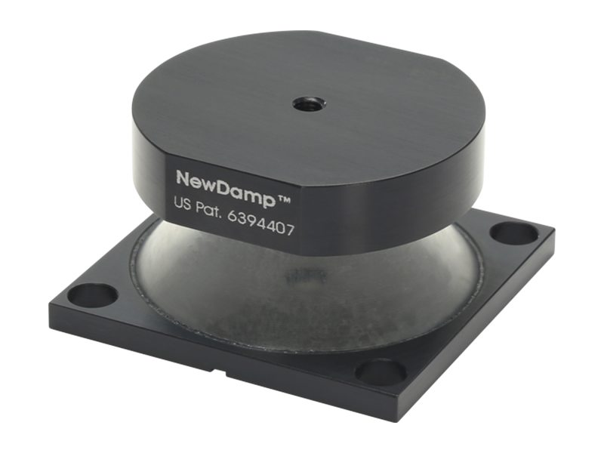
INTT Assembly Cart Isolators
The Newport ND50-A is an elastomeric isolator that supports 8 to 13 kg.
Natural frequencies range between 8 to 12 Hz depending on load and direction.
The total estimated weight of the Half Barrel, Services, and Assembly parts is about 54.5 kg.
Utilizing 6 ND50-A’s, the minimum assembly load would be 48 kg and the maximum load capacity would be 78 kg.
Notes:
The detector assembly fixtures are in conceptual design but the goal is to build a mandrel and guide assembly fixture.
A cylindrical mandrel will have interfaces so that the inner-most endcap rings can be screwed down. The mandrel will ride on an axel so that each ladder can be lowered down in the same orientation, perpendicular to normal-axis at the 12 o’clock position.
A guide will ensure proper and even placement without any twisting or deflection.

Slide 8
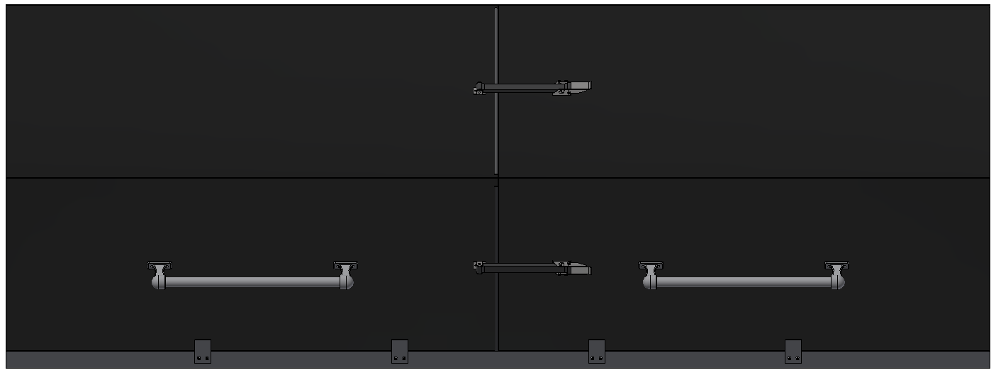
INTT Blackbox
A blackbox constructed from 80/20 Extrusion and powder coated aluminum plates will create a dark environment for the INTT Half Barrel to be tested.
Notes:
The detector assembly fixtures are in conceptual design but the goal is to build a mandrel and guide assembly fixture.
A cylindrical mandrel will have interfaces so that the inner-most endcap rings can be screwed down. The mandrel will ride on an axel so that each ladder can be lowered down in the same orientation, perpendicular to normal-axis at the 12 o’clock position.
A guide will ensure proper and even placement without any twisting or deflection.

Slide 9
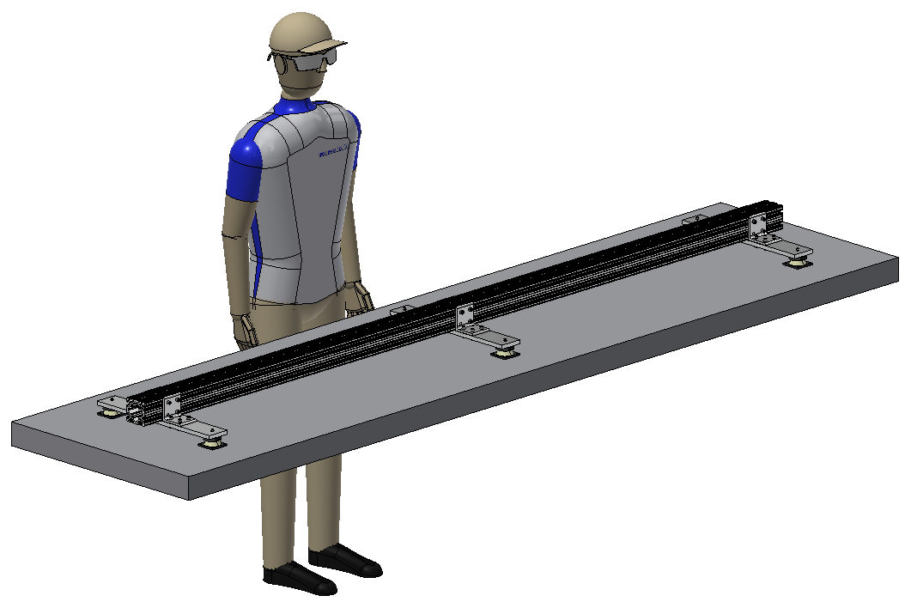
Empty Work Table

Slide 10
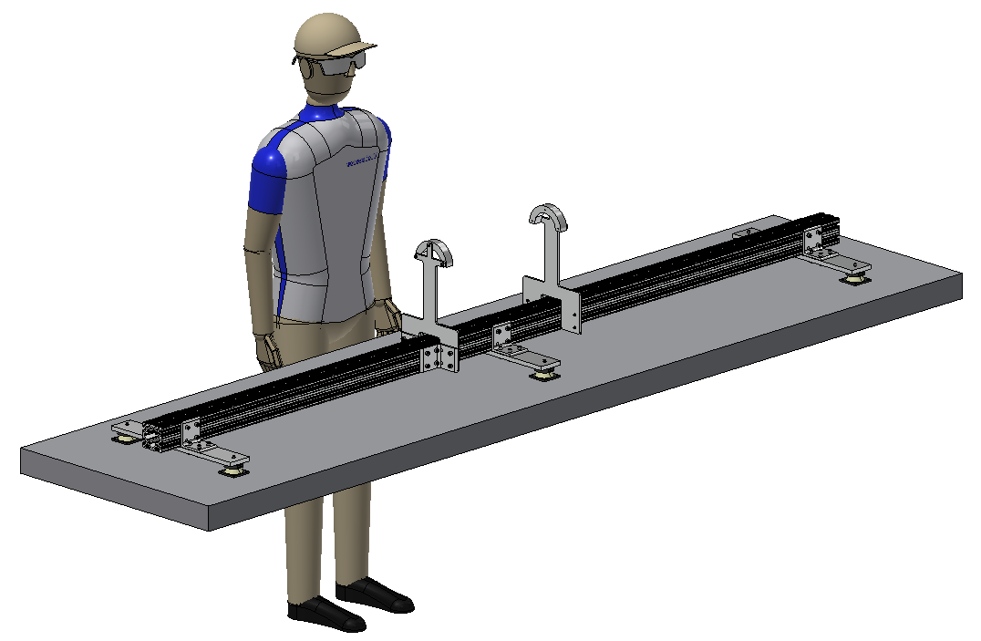
Inner Supports Installed

Slide 11
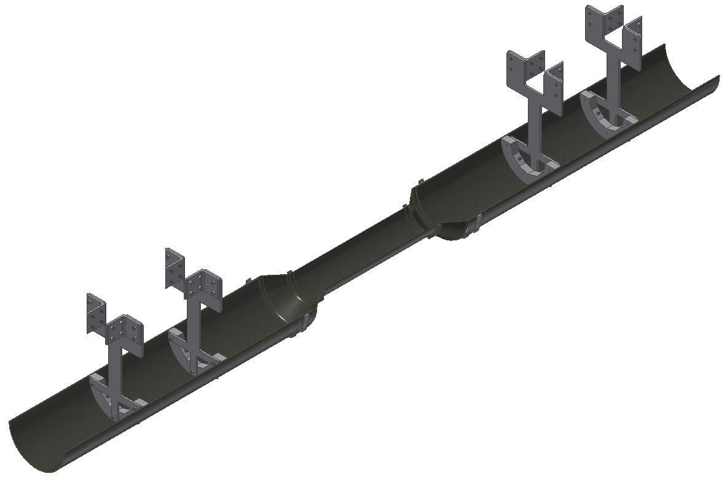
Outer Supports Pre-Installed

Slide 12
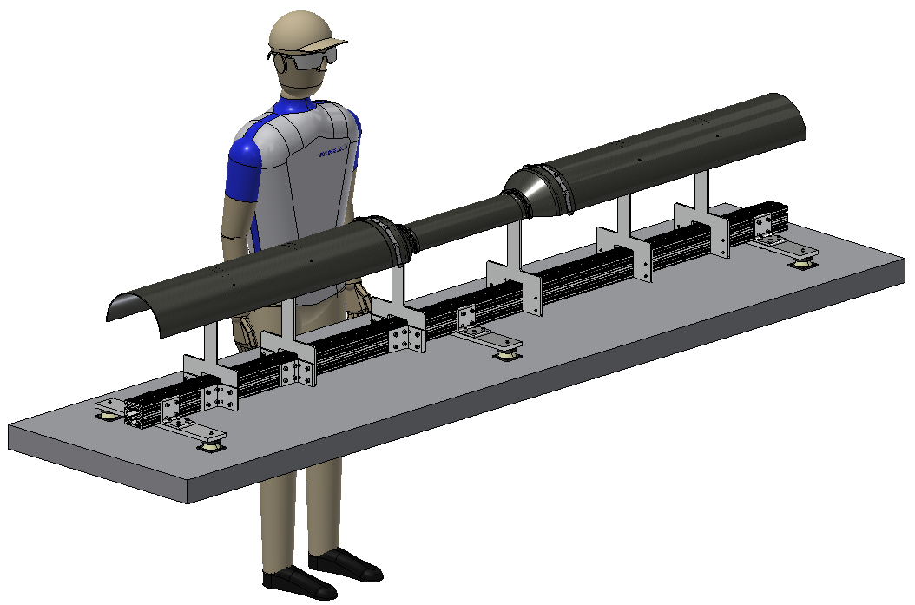
Inner Service Barrel Layer and Inner Skin Installed with Outer Supports

Slide 13
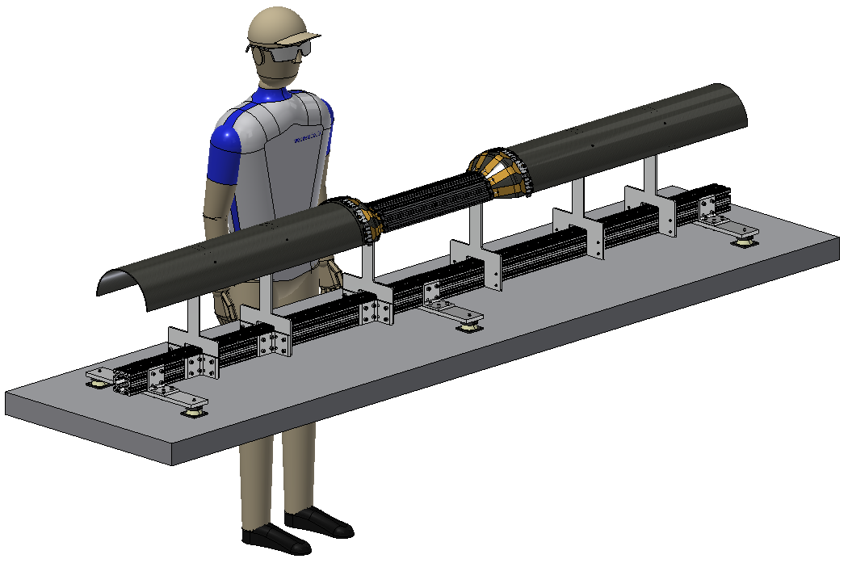
Install Layer 1A

Slide 14
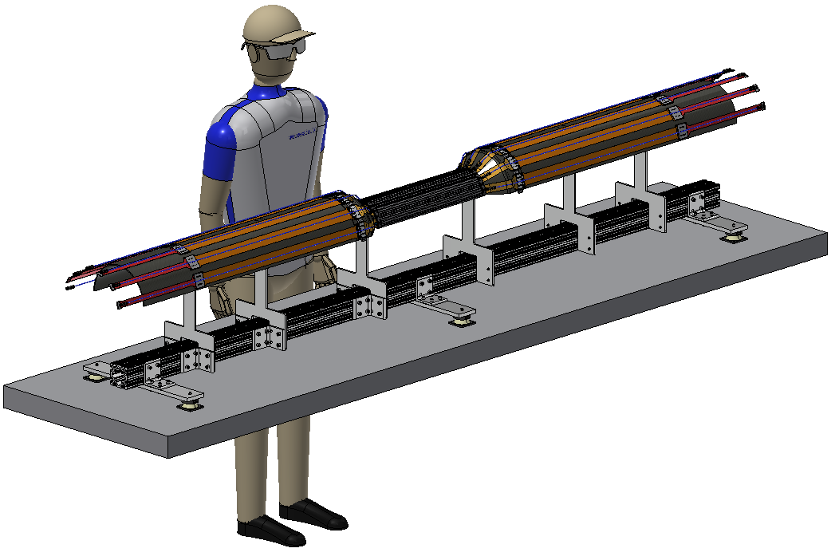
Install Layer 1A Services

Slide 15
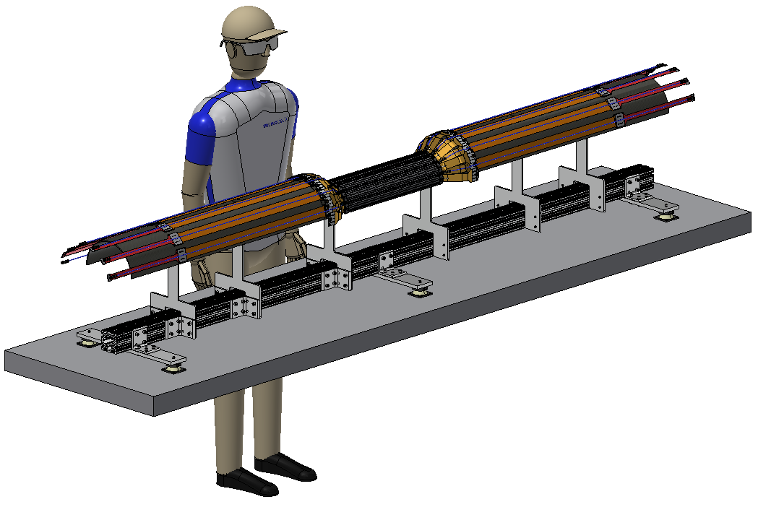
Install Layer 1B

Slide 16

Install Layer 1B Services

Slide 17

Install 2nd Set of EndRings

Slide 18

Install Layer 2A

Slide 19
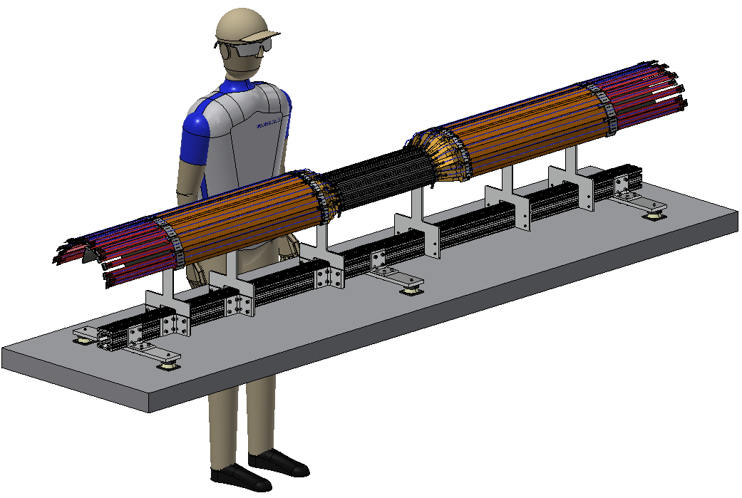
Install Layer 2A Services

Slide 20

Install Layer 2B

Slide 21
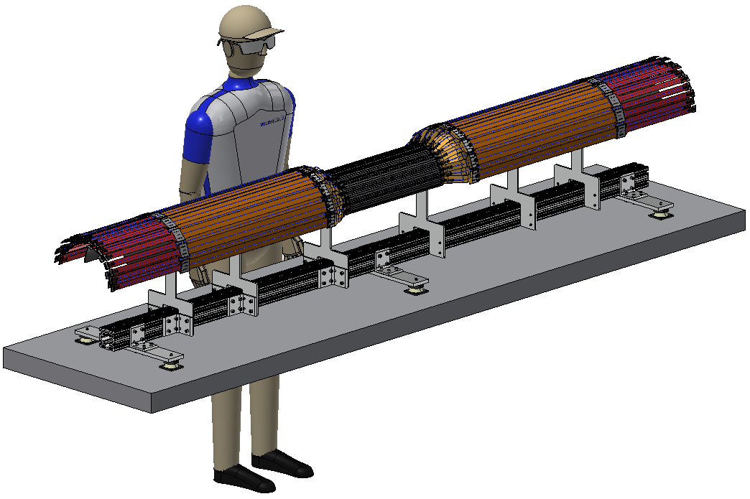
Install Layer 2B Services

Slide 22
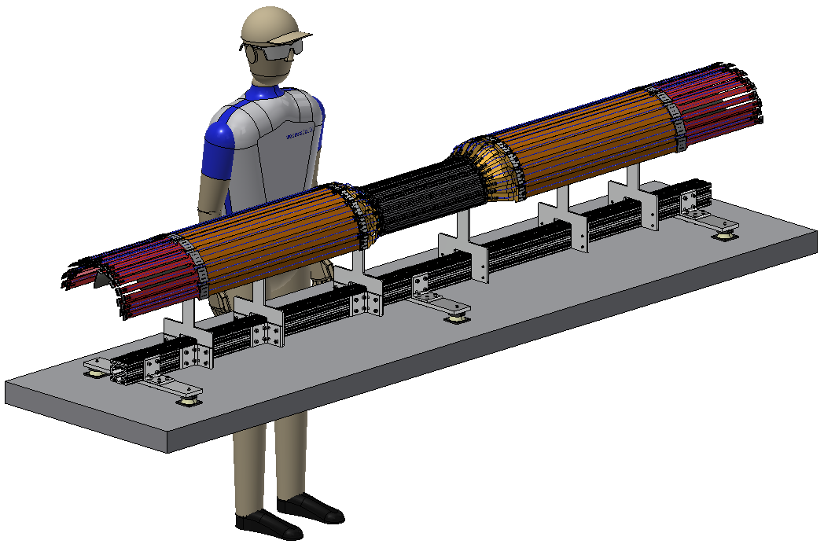
Install 3rd Set of EndRings

Slide 23
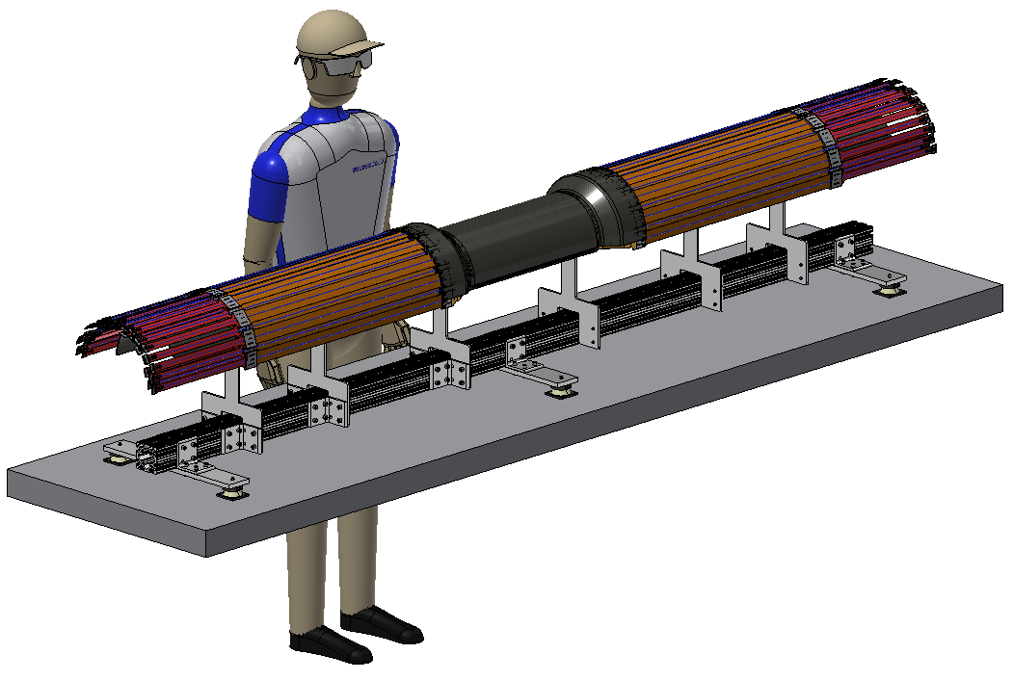
Install Outer Skin

Slide 24
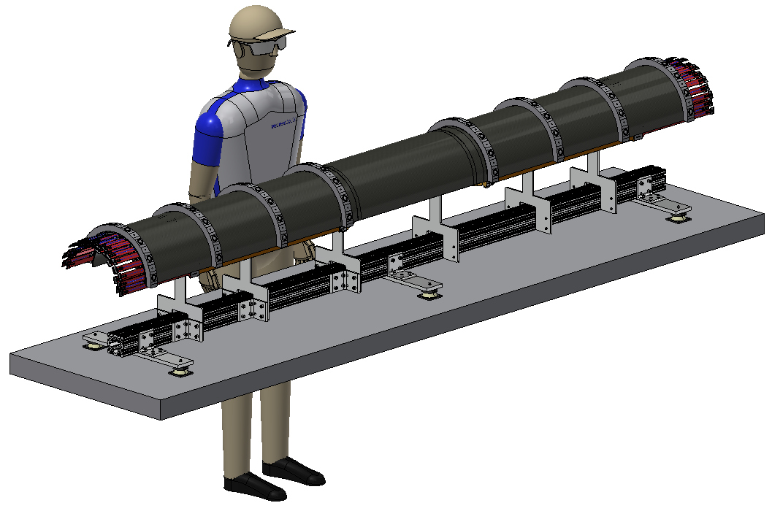
Install Outer Service Barrel Layer

Slide 25
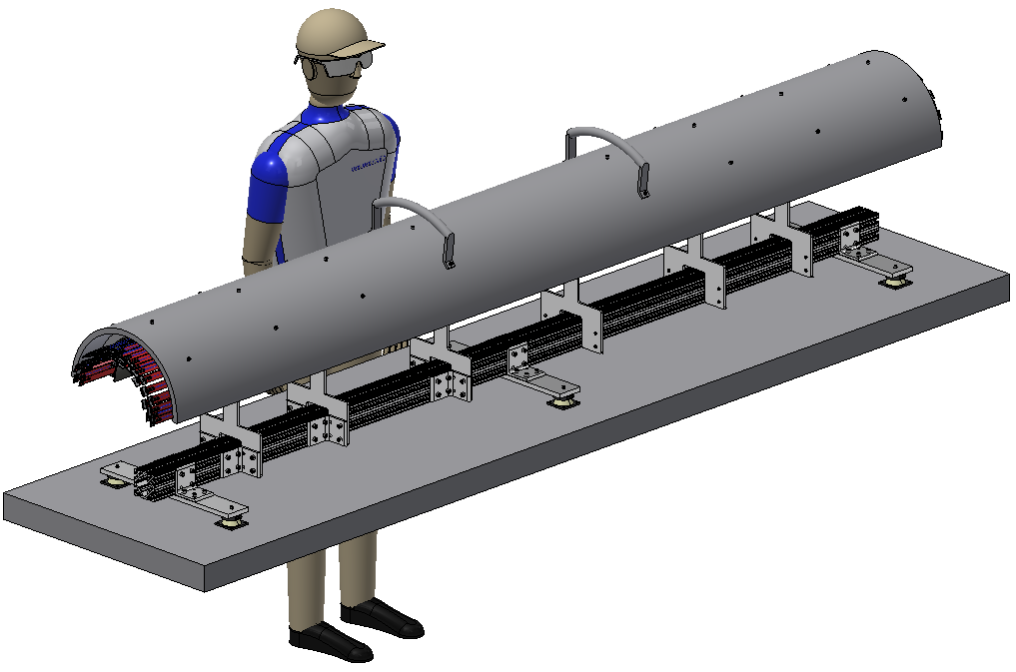
Install Lift Tube

Slide 26
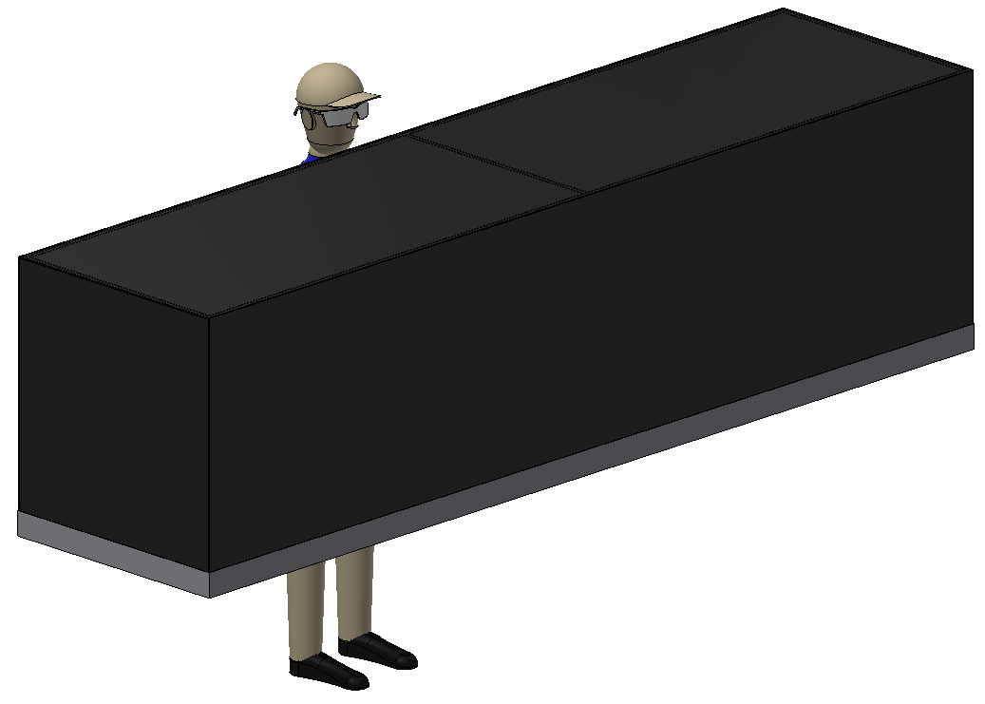
Install Blackbox

Slide 27
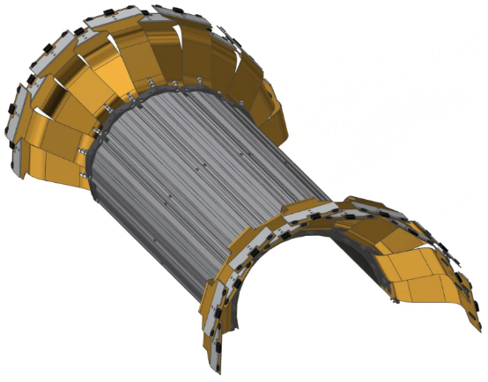
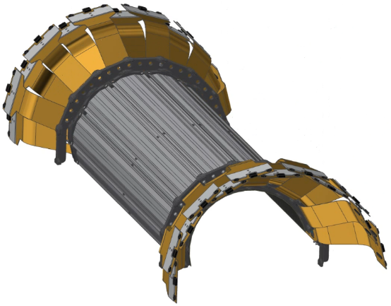
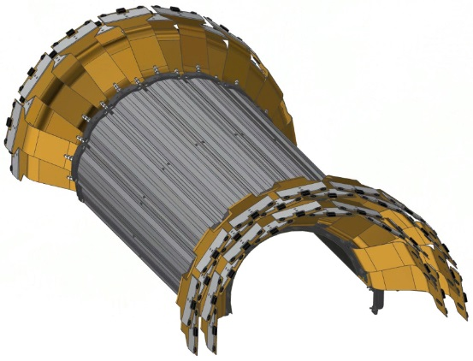
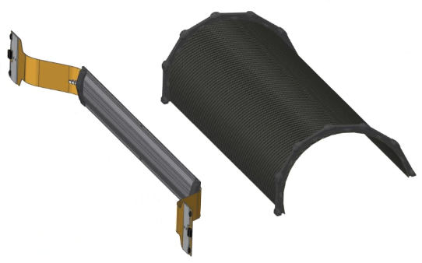
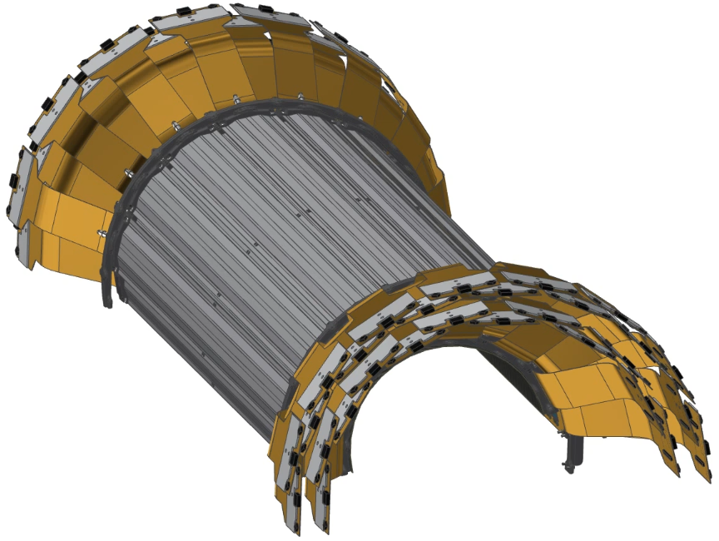
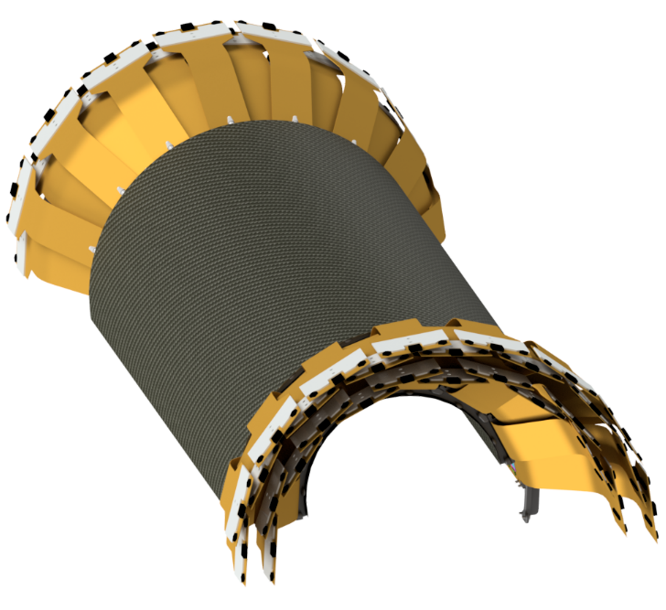
INTT Technical Overview – Half Barrel Assembly
Assembled in layers.
Inner/Outer Layer
Two Sub-Layers
Inner/Outer CFC Shell
254 microns thick
25 micron Al ground plane
Notes:
This slide shows some snapshots of the half barrel during the assembly process. As described earlier, the assembly is complied in sublayers. Following this slide is an animation of the half barrel assembly coming together.

Slide 28

INTT Technical Overview – Half Barrel Assembly
Notes:
This animation shows the production of a half barrel which will begin at the inner most sub layer where the ladders are installed edge-to-edge. The next sub layer is installed with an offset so that the outer ladders are placed with their center-line even with the mating edges of the previous sub layer.
After a layer is completed a new end cap ring is installed.
Once both layers are completed the CFC outer shell is installed.

Slide 29
INTT Ladder/Barrel Assembly Scope
Preparation and operation of OGP machine workstation during pre-production phase.
Procedure training
S/N data entry into database
Design, draft and fabrication of assembly fixtures for:
Ladder assembly
Base vacuum fixture
Sensor placement tool
Chip placement tool
INTT half barrel
Barrel assembly fixture
Notes:
The ladder and detector assembly is responsible for the perp and operation of the OGP machine during pre-production which encompasses not only procedural training but S/N database building/logging.
And of course the main responsibility being the design, draft and fabrication of the assembly fixtures concerning the ladder and the INTT half barrel.

Slide 30
INTT Collaborators
Institutions:
BNL, RIKEN, RBRC, Purdue University,
Nara Woman’s University (NWU), and
National Central University (NCU)
Team:
Professors: Takashi Hachiya, Wei Xie, Chia-Ming Kuo
Physicists: Rachid Nouicer, Itaru Nakagawa, Yasuyuki Akiba, Jin Huang, John Haggerty, Martin Purschke, Eric Mannel
Physics Associates: Rob Pisani, Takahito Todoroki
Chief Engineer: Russ Feder
Mechanical Engineers:
Dan Cacace, Connor Miraval
Mechanical Technicians:
Mike Lenz, Bill Lenz
Designers: Rich Ruggiero
Electrical Engineer: Steve Boose
Electrical Technician: Sal Polizzo, Donald Pinelli
Edward O’Brien (BNL)
L1 Manager
Yasuyuki Akiba (RIKEN/RBRC)
Consultant
Dan Cacace (BNL)
L3 Manager
Connor Miraval (BNL)
L3 Manager
Takashi Hachiya (NWU)
L3 Manager
Rachid Noicer (BNL)
Itaru Nakagawa (RIKEN)
L2 Manager
Wei Xie (Purdue U.)
L3 Manager
Chia-Ming Kuo (NCU)
L3 Manager
Ayaka Suzuki
+Undergrads
L4 Manager
Mechanical Design
Assembly
Testing, Monitoring
Silicon Testing, Database
Bus Extender

Slide 31
INTT Status and Highlights
Ladder Assembly
Assembly fixtures are in an advanced conceptual design backed by previous success with similar fixtures during VTX assembly. Very minor changes pending.
WIP drawings exist that will be sent for quoting.
Available collaborators with assembly and wire-bonding expertise.
Ladder assembly process is well understood and practice is needed.
Detector Assembly
Detector assembly fixture is conceptual.
Fixtures are in conceptual design phase, and prototyping is planned for this year.
Notes:
The ladder assembly is in a good place as advanced designs exist, backed with success with similar fixtures used during VTX assembly, with only minor changes pending (addition of set-screws, etc). WIP drawings exist that will be sent for quoting. The team hosts available collaborators with assembly and wire-bonding expertise.
Detector assembly fixtures are conceptual but prototyping is planned for this year.

Slide 32
INTT Issues and Concerns
Issues | Mitigation
As the assembly design and process matures, the need for additional manpower is becoming more apparent. | Increase manpower for production assembly.
There is a need for students/Post-docs for ladder and barrel tests, evaluation and data entry in the database during assembly. | Bring in students from Universities.
Notes:
Two issues we are currently facing with regards to the assembly process is the lack of manpower for pre-production assembly and the need for students/post-docs for testing, evaluation and data entry into the database during assembly.

