Slide 1
sPHENIX Status
Work continues to get done on project tasks at a slower rate than had been planned.
We are concentrating on what can be done remotely: engineering, procurement, reviews, testing when possible.
The pandemic has had no discernable impact on cost (we have 38% contingency). The impact on schedule particularly tasks that must be done at national labs or universities is obvious.
We’re looking at ways to mitigate the pandemic effects on schedule to catch up as much as practical once universities and national labs reopen.
As of Mar 31 the project had 14 months of schedule float to PD-4 and 3.5 months of 1008 I&F Upgrade float to the start of the RHIC 2023 run (Feb 1, 2023).

Slide 2
Recent Technical Accomplishments
SAMPA v5 chips have passed all tests at USP and Lund – related to a PEMP notable milestone.
SiPM daughter cards for EMCal started assembly at local vendor - related to a PEMP notable
Vendor work on Carriage/Cradle and LHe cryogenic parts continues

Slide 3
EV/PM Status
March SPI reflects minor COVID-19 related delays, CPI is above 1.
EVMS processing complete, shows good cost and schedule performance.
Cobra and P6 monthly reports uploaded to IPD.
March variance reports approved.
Estimate Uncertainty and Risks updated by removing them from completed activities.
Developing a plan to mitigate COVID-19 related delays.
Continue monthly EVMS process and Change Control.
Placing PD-3 orders and monitoring procurements.
Issues:
Worldwide pandemic may impact MIE early completion date, though it is unlikely to affect the PD-4 date.

Slide 4
sPHENIX Project Calendar
  EMCal Sector 13-64 Electronics PRR Apr 8
  ESRC review of sPHENIX cryo system Apr 9
  TPC R3 GEM Pad plane Design Review Apr 16
  TPC FEE Printed Circuit Board Review Apr 20
  DOE Monthly Apr 22
  SAMPA v5 Performance Review (internal) Apr 27
  Final Design Review X-Y Tables Apr 27
  TPC Fee procurement meeting Apr 29
  PMG Apr 30
  POB May 1
  PRR for End Caps/Pole Tips May 27
Engineering Team meetings MWF, BNL subsystem work meetings TuTh
Regular weekly and bi-weekly project and group meetings continuing w/ few exceptions

Slide 5
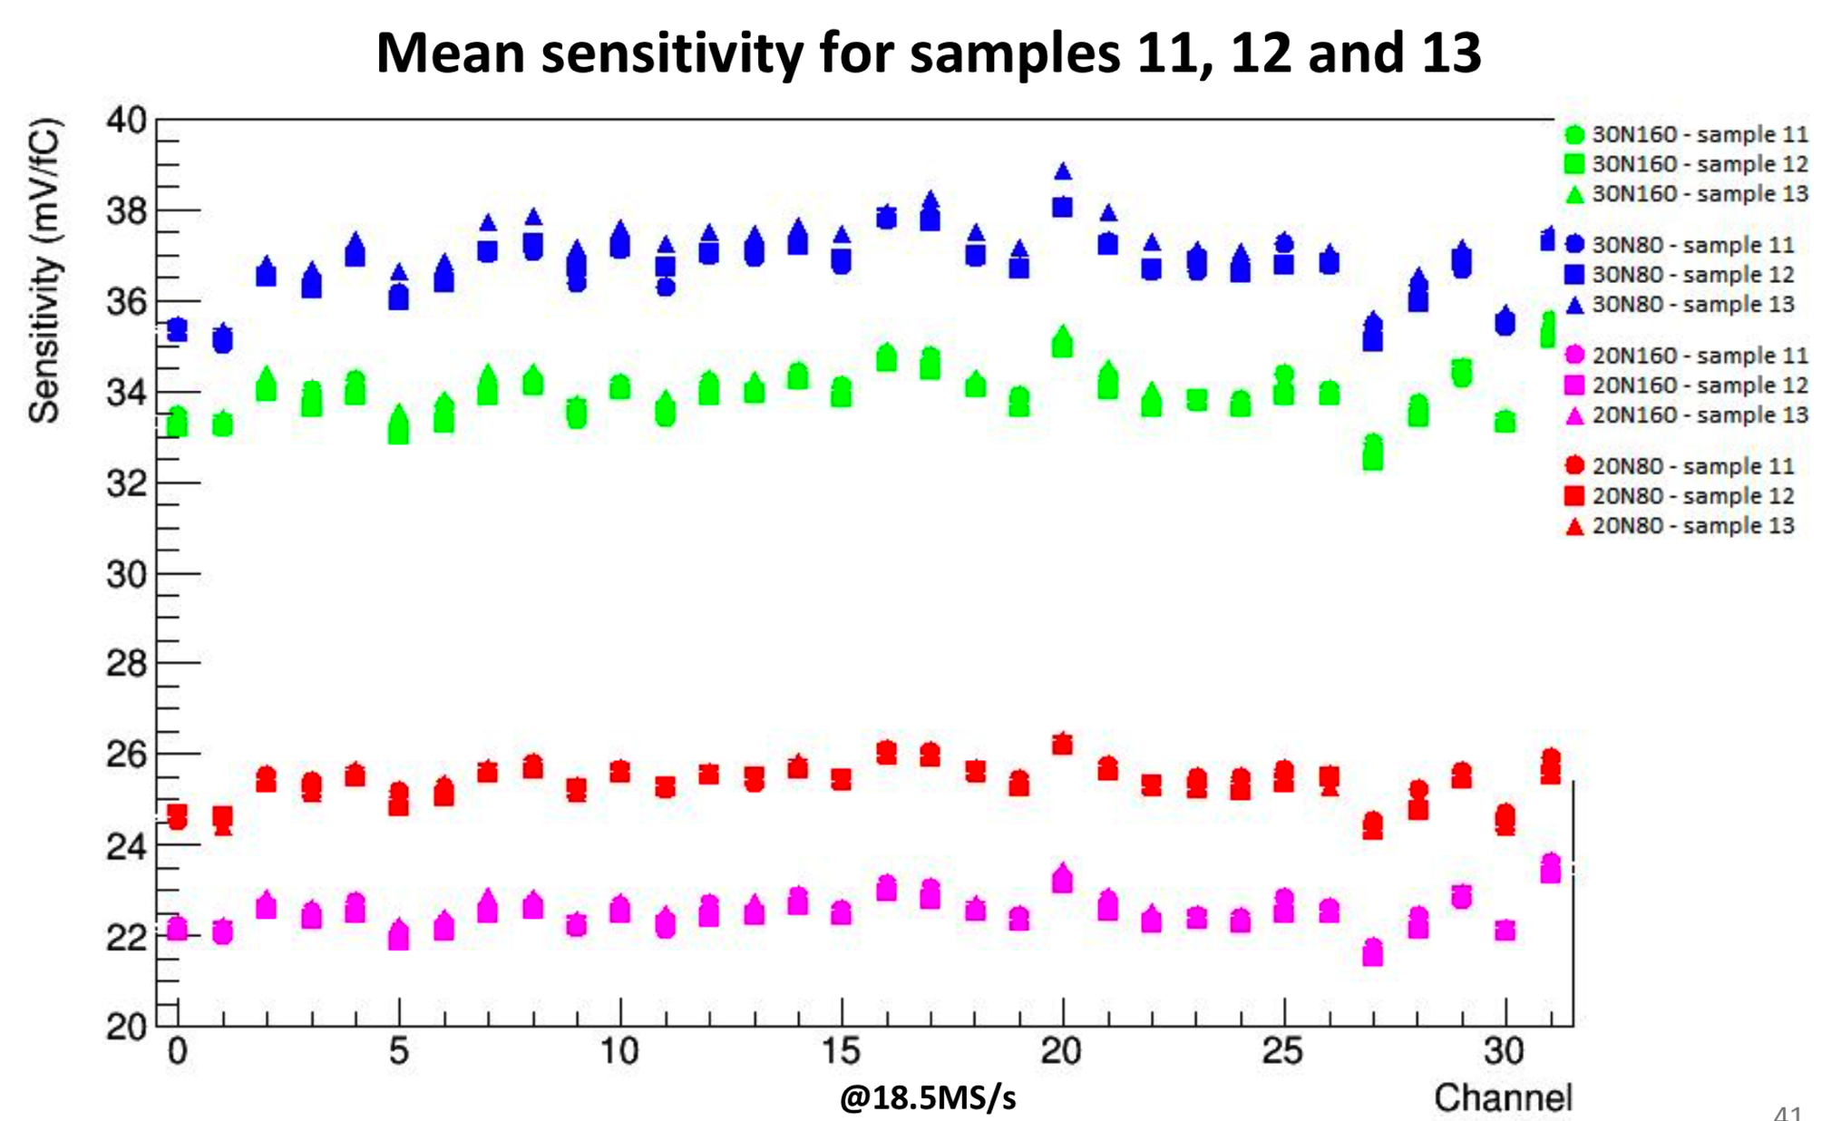
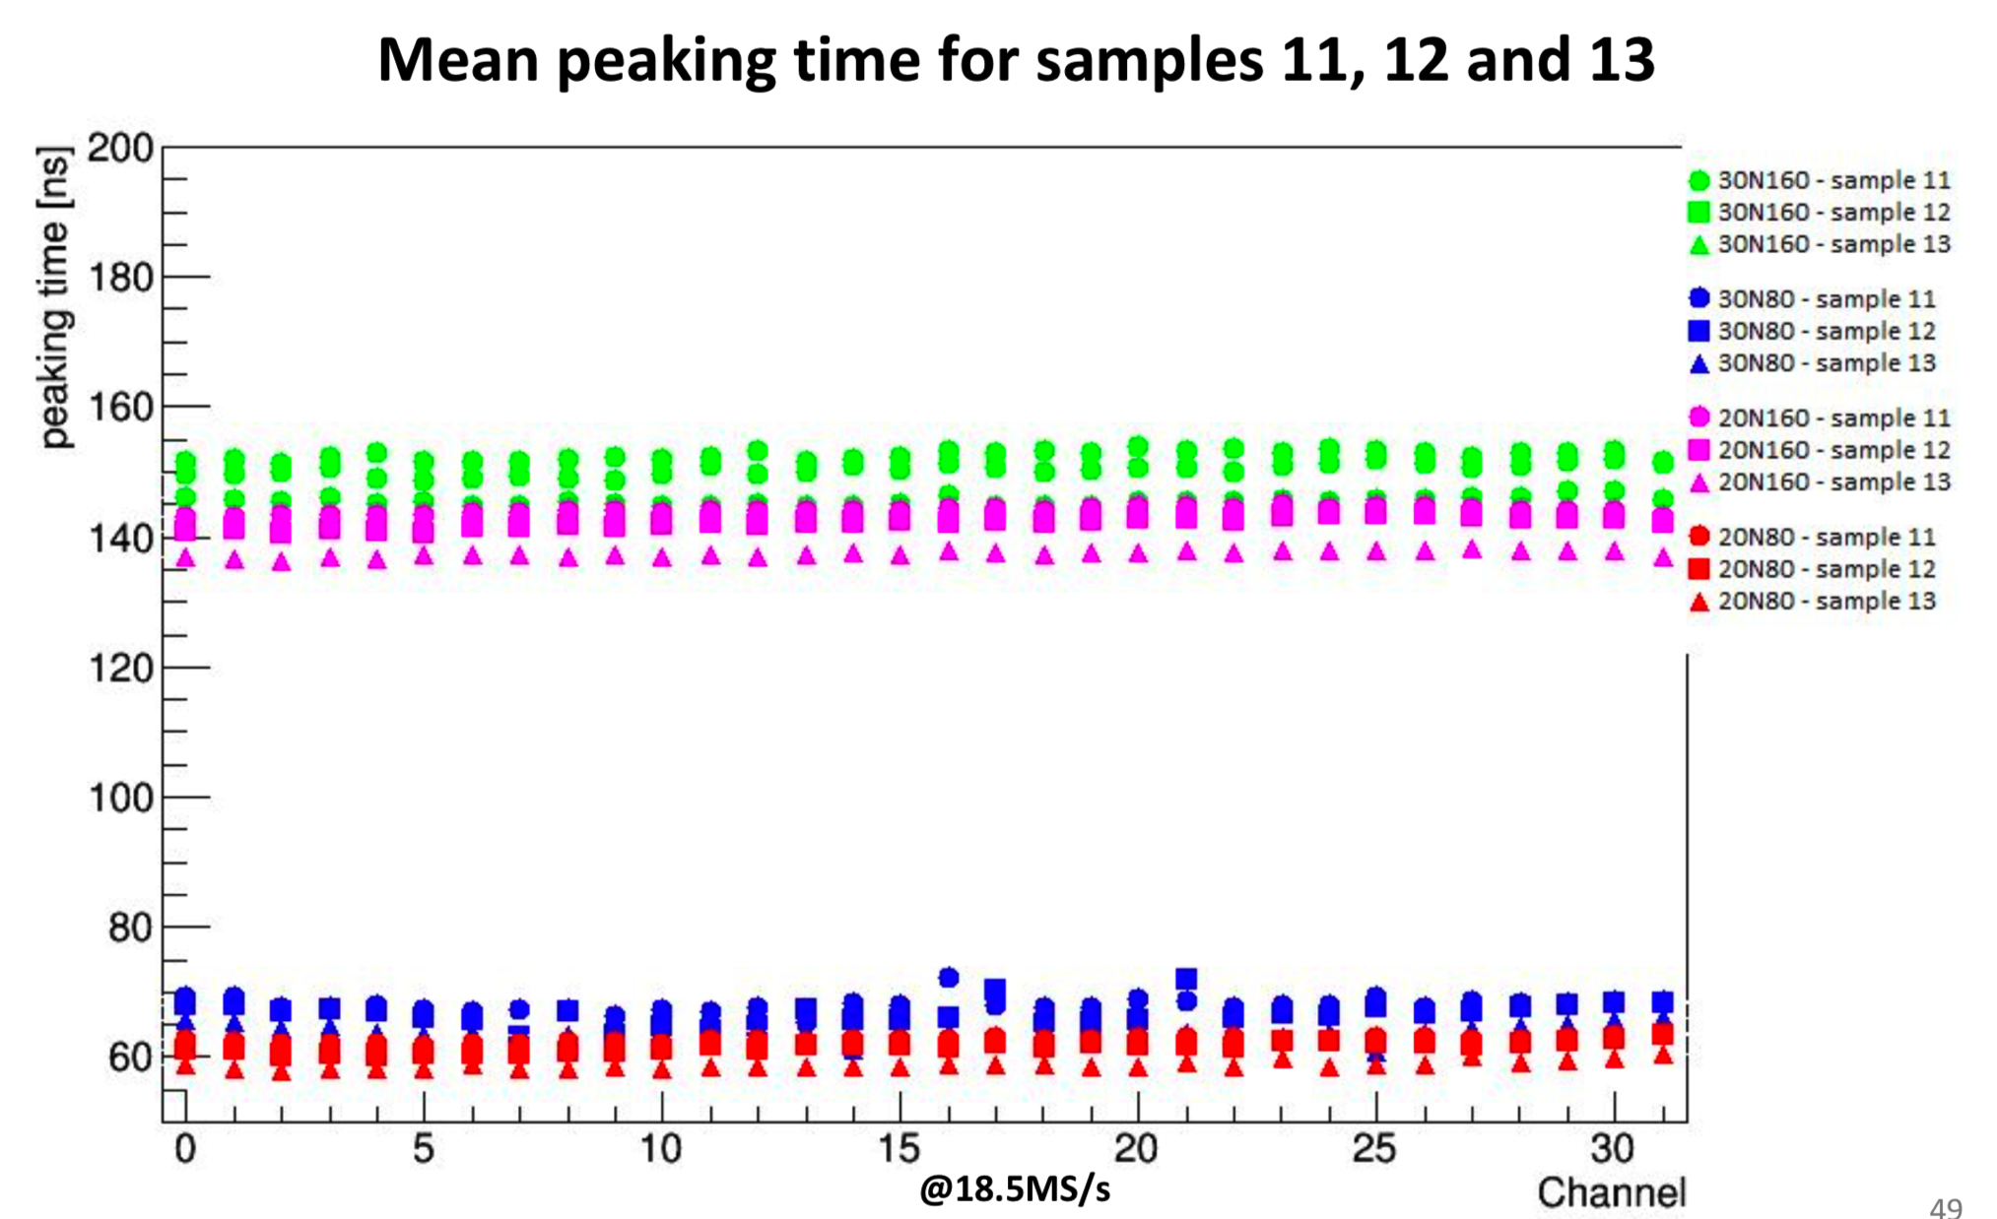
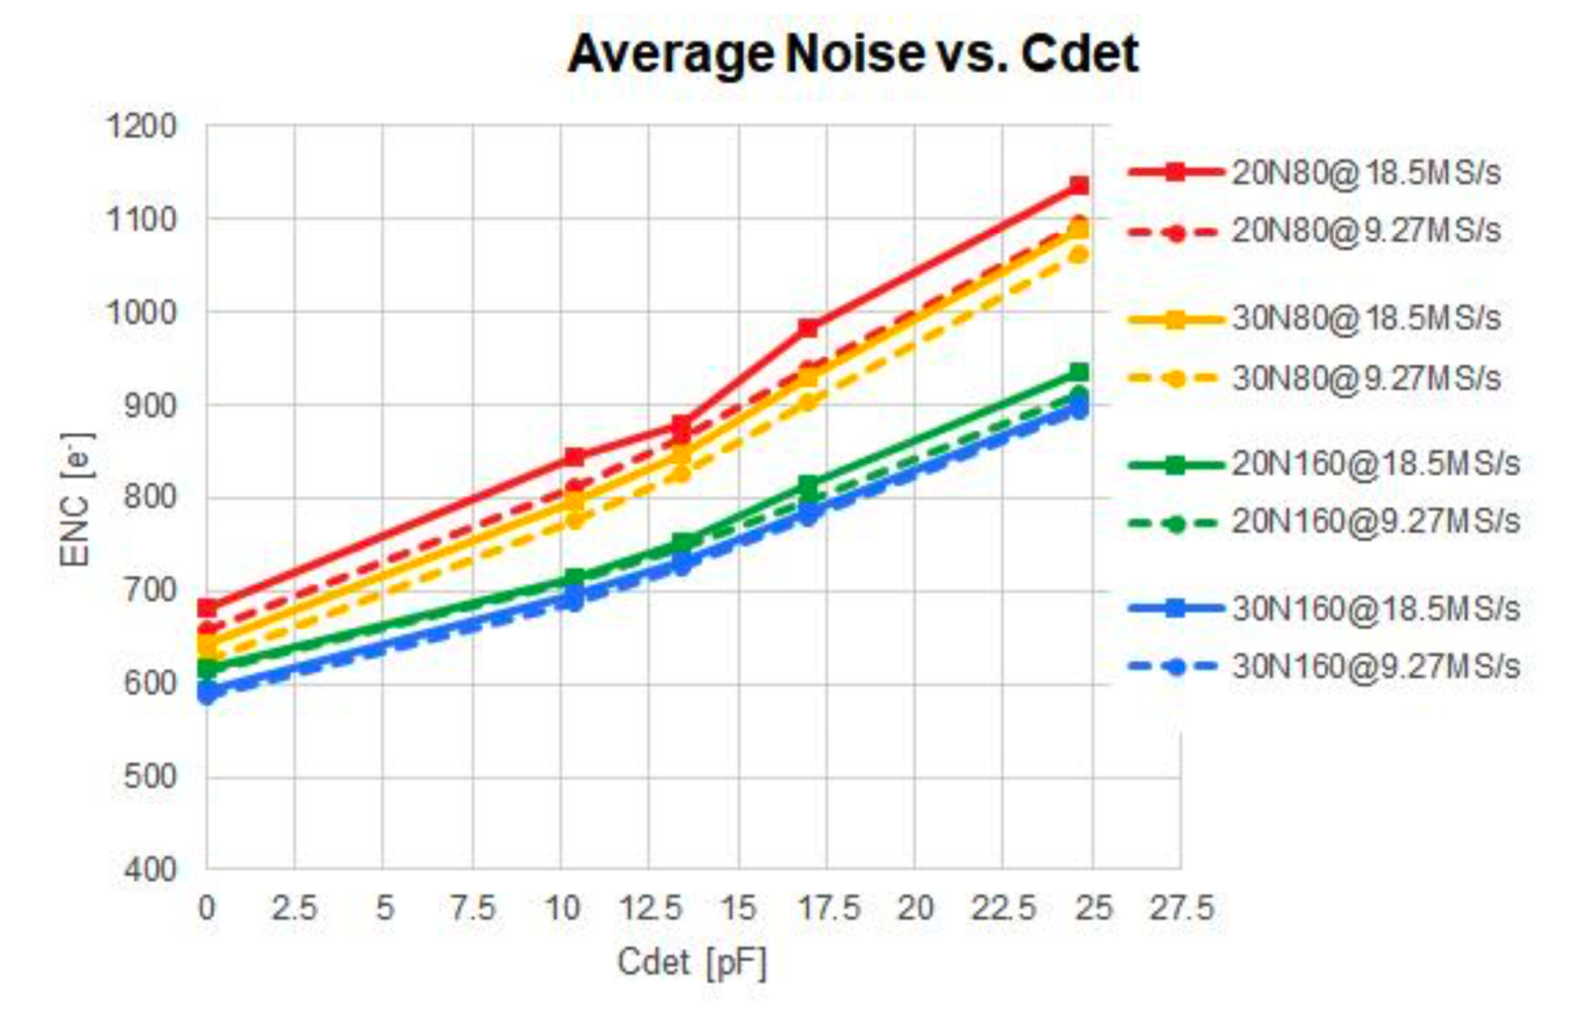
SAMPA v5 Passes All Tests at USP

Slide 6
Impact of Pandemic on sPHENIX
Equipment and material deliveries continue at BNL. sPHENIX components are continuing to come in to Brookhaven.
Work is proceeding remotely at BNL. Remote work will continue at least until May 15
  All but BNL essential personnel are working from home.
  Work that can go on: Engineering design, reviews, documentation, procurement.
  We have set up daily status meetings for BNL engineering and subsystems throughout the week.
  Our standard weekly and biweekly meetings will go on.
  Expect we will lose one week of schedule for each week that BNL is shut. If BNL is shut for > 8 weeks then I would expect there will be an additional ramp-up time to get back to full productivity
All Universities and National Labs on work-pause due to COVID-19
  UIUC (EMCal), GSU(HCal tiles), SBU(TPC), Columbia Univ (Cal Electronics, MBD, DAQ/Trigger) closed
We will re-plan the sPHENIX work in P6 once we understand the plans for re-opening BNL and sPHENIX collaborating universities.

Slide 7
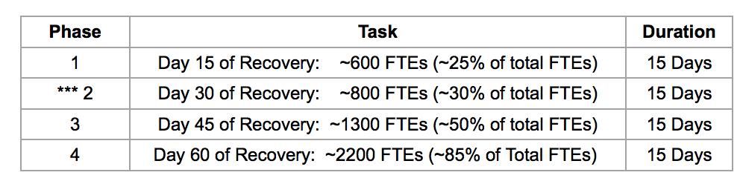
sPHENIX Plans for BNL Reopening
sPHENIX plans for workforce after re-start:
  Complete electronics tests to satisfy PEMP notable milestone
  Restart EMCal and HCal factories which also has a PEMP notable milestone
Aspects of the restart include:
  Low density tech work in the labs
  Whenever possible maintain people working remotely
  All meetings would continue to be remote
  No students or visitors on site until mid-summer but perhaps as late as September
Plan submitted to BNL: sPHENIX having 2 FTEs working in Phase 1, 11 FTEs working in Phase-2, 17 FTEs working in Phase 3, 30 FTEs working in phase 4 (+ 5 rotating contractors, visitors, students)

Slide 8
FY20 Milestones Status (FY20 PEMP notable)
WBS | Milestone Name | Target Milestone Date | Actual Finish | Variance (in work days)
1.01.01 | Approve Project Baseline and Construction PD2/3 | 30-Sep-19 | 20-Sep-19 | 6
1.02.02.02 | Production Readiness Review - TPC Module Factories | 31-Dec-19 | 17-Dec-19 | 8
1.03.02.03.02 | EMCal Preproduction Sector 0 Assembled | 31-Dec-19 | 25-Nov-19 | 23
1.02.06.02 | Production Readiness Review - TPC DAM | 28-Feb-20 | 7-Feb-20 | 14
1.05.02.03 | HCal Preproduction FEE Complete | 30-Apr-20 | 22-Jan -20 | 70
1.05.02.01 | EMCal Electronics Preproduction Complete | 29-May-20
1.03.01.03.01 | EMCal W Powder Acquisition Complete | 30-Jun-20
1.03.02.03.03 | EMCal Prod Readiness Review Blocks/Modules/Sectors Complete | 31-Jul-20
1.02.05.03 | SAMPA ASIC Performance Accepted | 30-Sep-20
May have all the electronics but must be at BNL to test
Due at UIUC June 5
Will meet if BNL re-opens by June 1
USP and Lund tests show SAMPA v5 passes all tests

Slide 9
Continuation of RHIC 2020 Run & Impact on sPHENIX
BNL has announced the final 12 weeks of the RHIC 2020 run will start as soon as practical. Tentative date June 1. Additional 2 weeks of ramp up planned.
This will impact time available for sPHENIX to work in the 1008 IR between now and 2023.
We have 4 tasks for sPHENIX(1008 I&F upgrade) to complete prior to roll-in in January 2022. Some of the tasks are serial, some are parallel. P6 tells us we need 34 weeks of IR access to complete them. To avoid wasting a lot of time by setting up twice we request a 24 contiguous week period as part of the 34 week total.
    Tying in the He system in 1008B to RHIC 2021 shutdown ( 8 weeks)
    Hanging the helium transfer lines on the 1008 west wall 2020 shutdown (12 weeks)
    Installing cryo lines between 1008B and 1008 2020 shutdown (12 weeks)
    Concrete work on 1008 IR tracks 2020 shutdown (12 weeks)

Slide 10
sPHENIX MIE Overview
TPC | Project Director | Last CD Achieved | % Complete | CPI | SPI
$27.0M | Edward O’Brien | PD-2/3 | 42.7% BCWP/BAC @ 3/31/2020 | 1.03 | 0.93
Scope
  Detector systems produced, tested and ready for installation: Time Projection Chamber w/ electronics, Electromagnetic Calorimeter w/ electronics, Hadronic Calorimeter w/ electronics, DAQ/Trigger, Minimum Bias Detector, Project Management
Not in scope
  SC-Magnet, Bldg/Det Infrastructure, Installation and System Commissioning
Schedule
  CD-0 received Sept 2016
  CD-1/3A received Aug 2018
  PD-2/3 received Sept 2019
  Early completion Oct 2021 (14 months float to PD-4)
  PD-4 Dec 2022
Cost
  $27.0M AY TPC 37.8% contingency on BCWR

Slide 11
1008 Infrastructure & Facility Upgrade
TPC | Project Director | % Complete | CPI | SPI
$33.4 M AY | Edward O’Brien | 35.6% BCWP/BAC @ 3/31/2019 | 1.03 | 0.94
Scope
  SC-Magnet support including the Flux Return, Cryogenics into Bldg 1008, Detector Carriage/Cradle, other Bldg 1008 Infrastructure improvements
  sPHENIX Installation, Integration and Commissioning of each Subsystem is part of the scope
Not in Scope
  PreOps prior to RHIC collisions
Schedule
  sPHENIX Ready for Operations Oct 2022
  First RHIC run of sPHENIX Feb 1, 2023
  3.5 months in schedule between sPHENIX ORR and nominal start of RHIC 2023 run.
Cost
  $33.4 M AY Total Project Cost with 17.7% contingency on BCWR

Slide 12
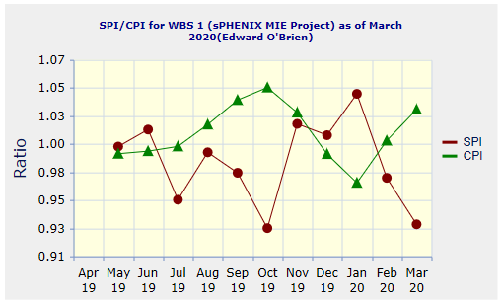
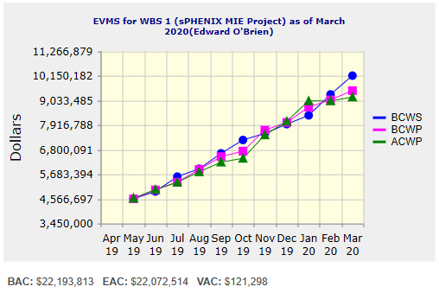
Performance Indices – sPHENIX MIE
Cumulative SPI | Cumulative CPI
0.93 | 1.03
Cumulative BCWS (Scheduled) | $10,156,084
Cumulative BCWP (Performed) | $9,477,895
Cumulative ACWP (Actual) | $9,185,929
DOE SPI or CPI Value Thresholds
0.90 to 1.15
0.85 to 0.89 or 1.16 to 1.25
<0.85 or >1.25

Slide 13
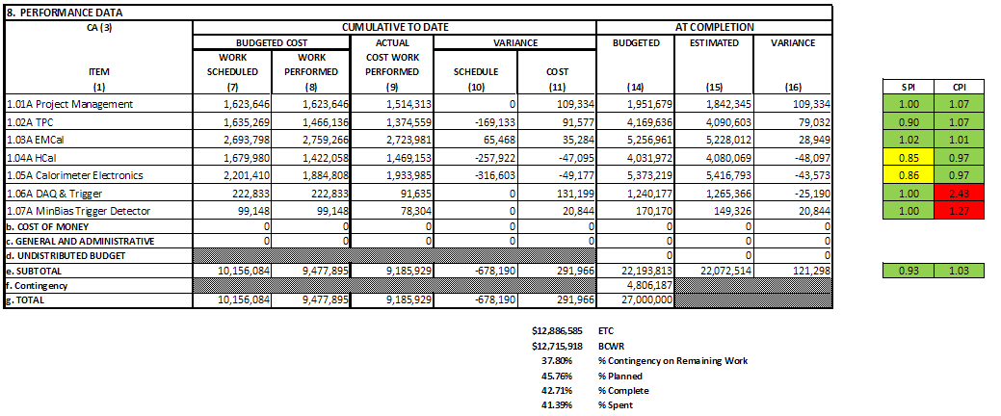
Cost Performance Report (CPR) – sPHENIX MIE
DOE SPI or CPI Value Thresholds
0.90 to 1.15
0.85 to 0.89 or 1.16 to 1.25
<0.85 or >1.25

Slide 14
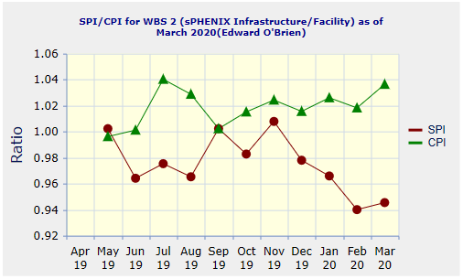
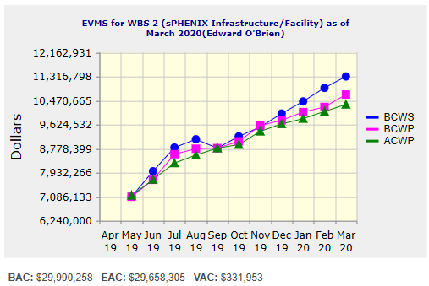
Performance Indices – 1008 Infra and Facility Upgrade
Cumulative SPI | Cumulative CPI
0.94 | 1.03
Cumulative BCWS (Scheduled) | $11,318,105
Cumulative BCWP (Performed) | $10,681,937
Cumulative ACWP (Actual) | $10,333,774
DOE SPI or CPI Value Thresholds
0.90 to 1.15
0.85 to 0.89 or 1.16 to 1.25
<0.85 or >1.25

Slide 15
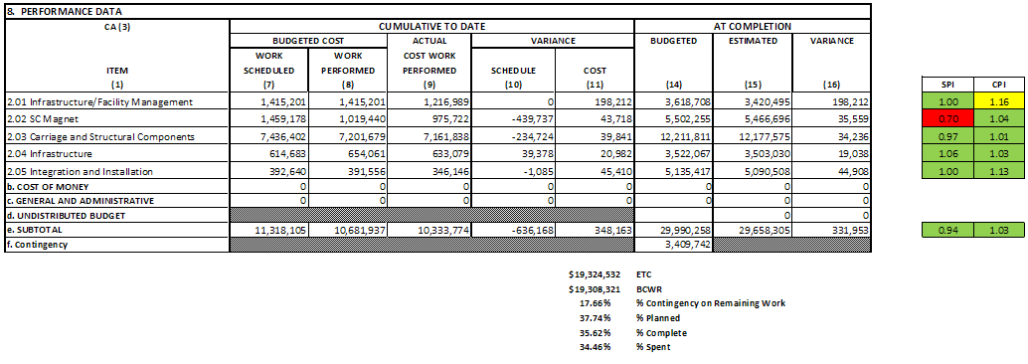
Cost Performance Report (CPR) – 1008 Infra and Facility Upgrade
DOE SPI or CPI Value Thresholds
0.90 to 1.15
0.85 to 0.89 or 1.16 to 1.25
<0.85 or >1.25

Slide 16
Summary Schedule – sPHENIX MIE

Slide 17
Summary Schedule – sPHENIX MIE and 1008 Infra and Facility Upgrade

Slide 18
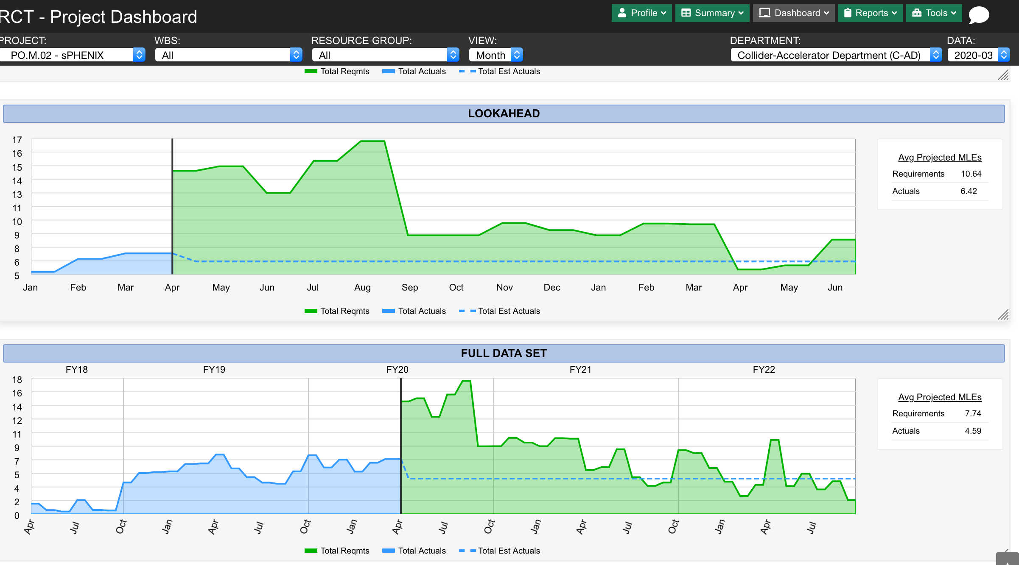
Ways that BNL Can Help the sPHENIX I&F Schedule

Slide 19
How BNL/NPP Can Help the Project
Work with sPHENIX to find a solution for the 34 weeks of access we need in the 1008 IR. With 12 additional weeks of RHIC running for STAR starting June 1 there will not be enough time available to complete all of the IR work.
Help us obtain a pulse of technical labor for the next 9-12 months to catch-up time lost due to COVID-19. 10-15 FTEs of technicians, engineers, designers and computer professionals. Ideally this would be from CAD+SMD so that we could maximum advantage of the EPR. Otherwise we would have to look to IO and Photon Science.

Slide 20
Summary
Work continues to get done on sPHENIX
  Engineering, procurements, outside vendors
  Working from home is not inefficient, but we can’t build anything that way.
The schedule is slipping (BNL has been closed weeks) but there is schedule contingency
Access to the 1008 IR to complete sPHENIX (1008 I&F) installation is a concern. We’ve expressed this to both DOE and BNL Management.
We’re looking at ways to recover some of the time lost once BNL and collaborating institutions reopen, but nothing is definitive yet.
Our goal remains to keep on schedule and be ready at the start of the RHIC 2023 run by using some of our contingency (38% $), MIE has 14 months float, I&F has 3.5 months of float) to do that. Options include more hires into factories, two shifts, outside contracts for some work, etc.

