Slide 1
Second IR Concept
V. Morozov
JLab
Far-Forward and IR Integration YR Bi-Weekly Meeting, April 27, 2020

Slide 2
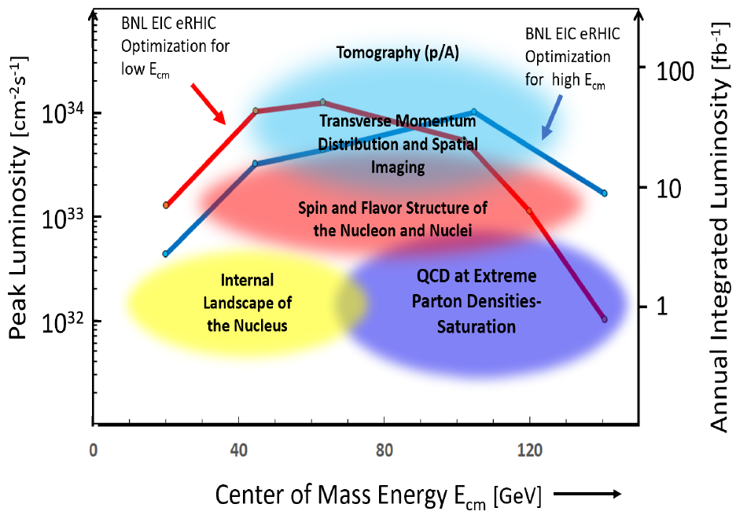
EIC 2nd IR Concept
High-level requirements
High luminosity at a low CM energy of ~60 GeV
Detector acceptance meeting physics requirements (what matters most for the machine design is the forward acceptance requirements)
If possible compatibility with running in parallel with the baseline detector
Differences from the baseline IR that should result in a high luminosity at a low energy
Greater crossing angle of 50 mrad
Doubled collision rate
Closer placement of FFQs
Strong cooling
Stronger focusing at the IP
Shorter bunch length

Slide 3
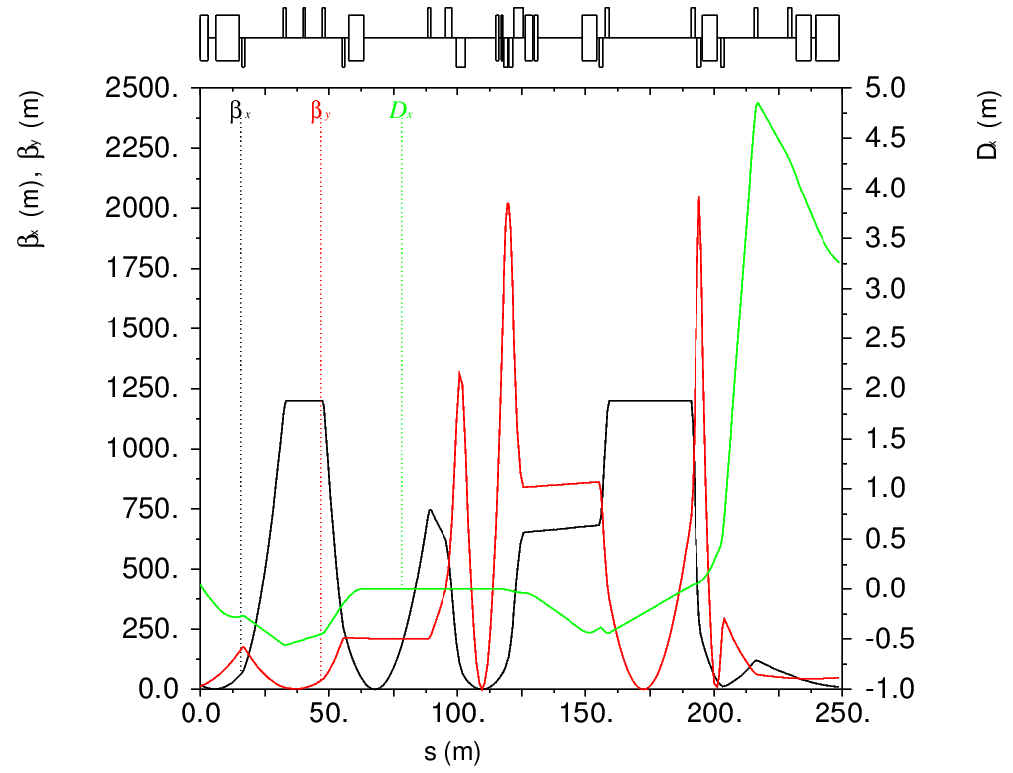
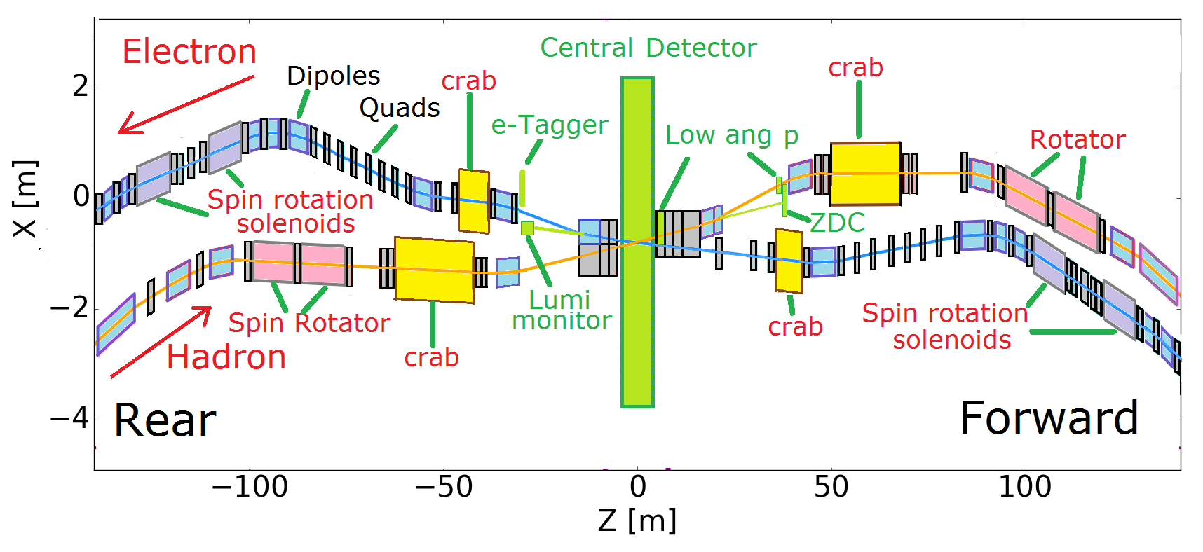
2nd Detector Acceptance
Some parameters affecting the IR design
Forward ion quadrupole aperture size determining the angular acceptance: initial discussions suggest that this parameter is determined primarily by the divergence of the neutron cone
The necessity of the secondary focus: there is dispersion at the roman pot location in the baseline IR, it should allow detection of particles with $x_{L}$ below a certain value; secondary focus should increase the maximum detectable $x_{L}$; will check the $x_{L}$ acceptance of the baseline and 2nd detectors
Need for shift of the IP from the center of the solenoid to allow more space for sub-detectors in the forward direction. This is not a huge effect but affect the ion closed orbit correction.
Roman
pot

Slide 4
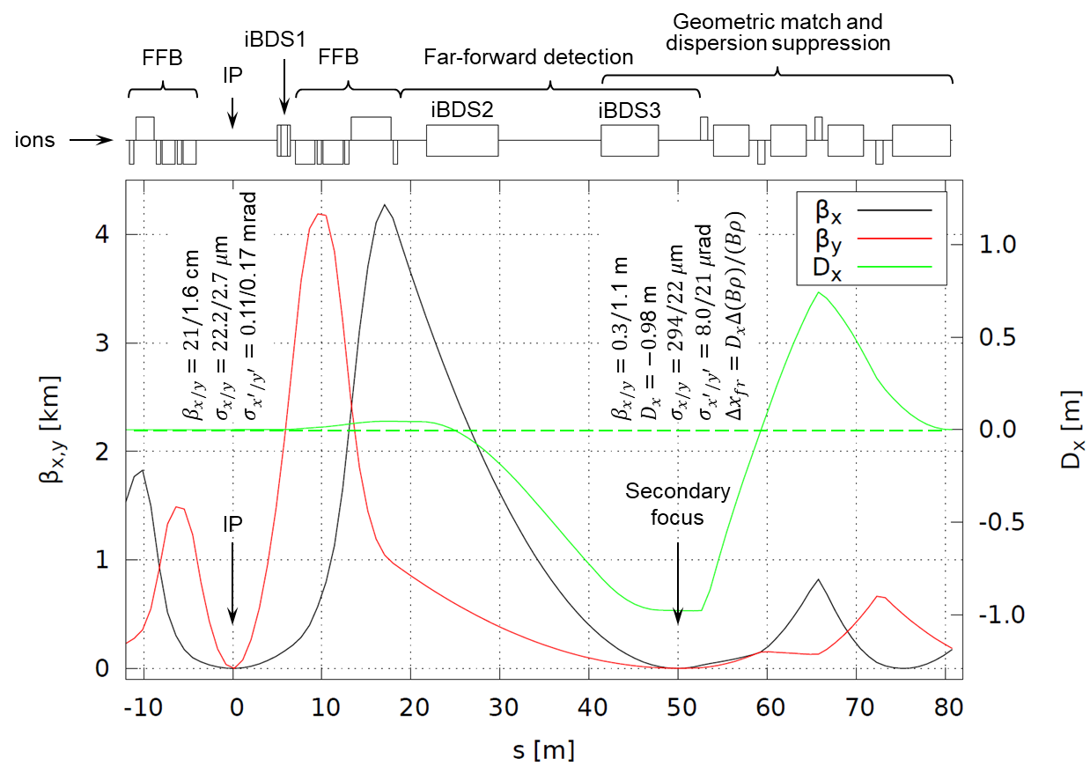
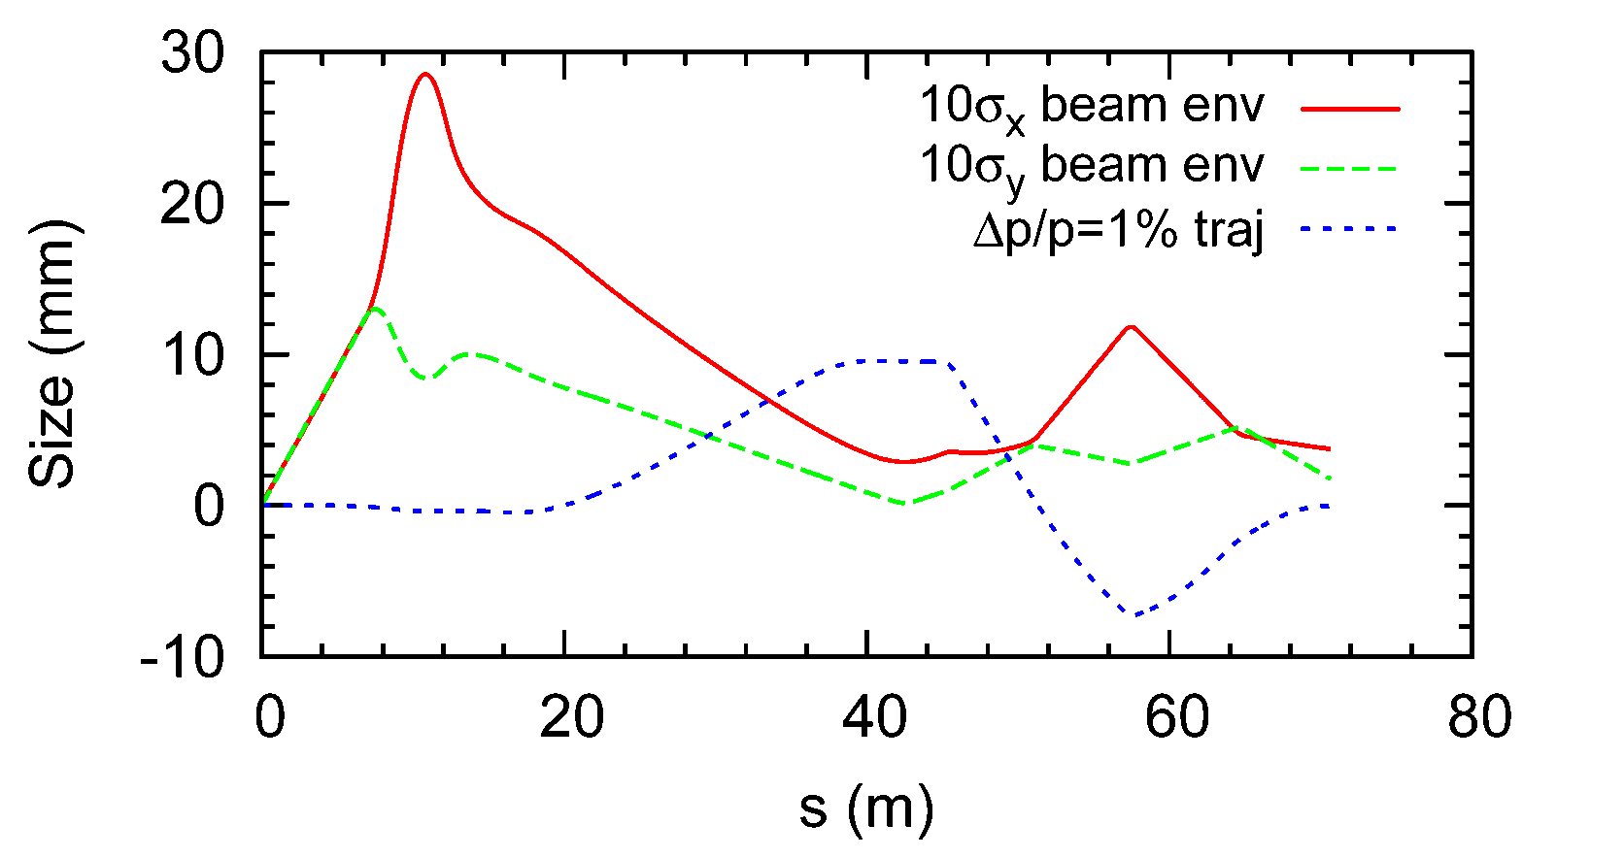
Why Secondary Focus?
It allows one to detect particles up to relatively high-$x_{L}$ even with $p_{⊥}=0$
Needs to be clearly motivated by physics

Slide 5
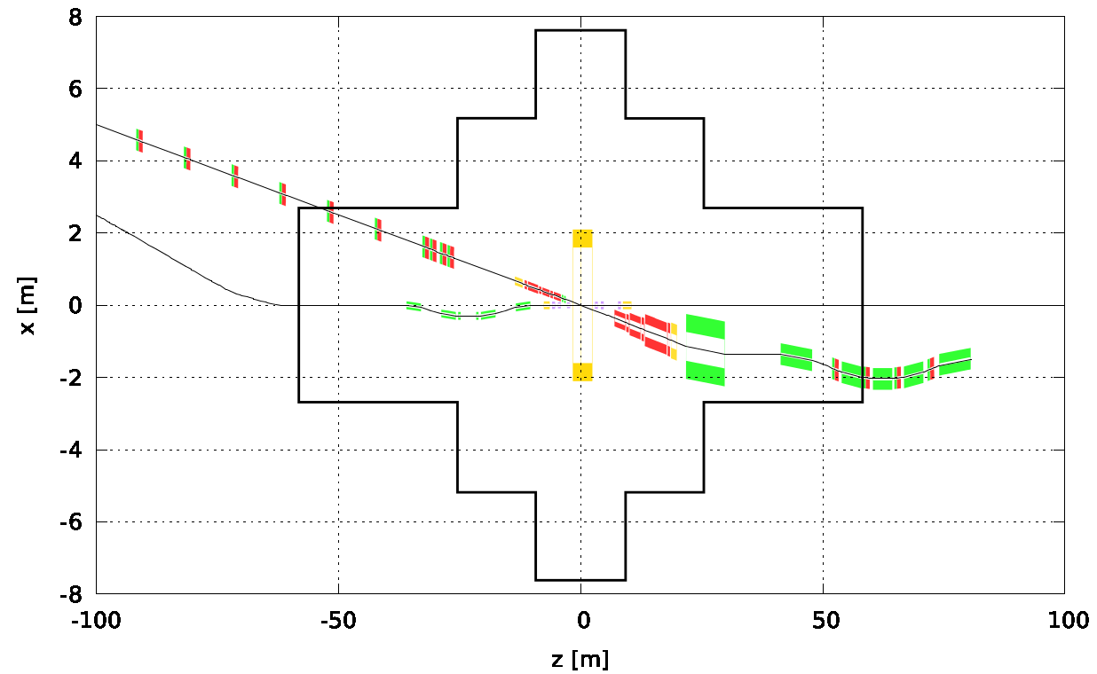
Space Available for 2nd IR
Assuming IP8 experimental hall dimensions
The luminosity curve optimized for low energy adopted JLEIC IR parameters
What if we simply drop the JLEIC 200 GeV IR into the lattice?
Clearly the geometry requires adjustment but it does not seem hopeless
There are additional constraints: crab cavity and spin rotator integration
Need to account for higher energy in case of parallel IR operation

