Slide 1
PID Working Group
Brief Introduction
Status of Presentations
Joint Meeting with Tracking
Schedule until Pavia
:
P Rossi, TK Hemmick

Slide 2
Were we are
 |  | Presentation | Param. | Pro/Con | External Constraint
psTOF | M. Chiu | 5/1/2020
LGAD TOF | W. Li
dRICH | E. Cisbani, M. Contalbrigo, R. Preghenella | 4/15/2020 | YES | YES | YES
High Mom RICH
GEM based RICH
mRICH | X. He | 5/1/2020
DIRC | G. Kalicy
(??)
(??)
1) We have only 1 meeting before Pavia (May 20-21-22) which is in May 15.
2) We still need to assess 3 projects: DIRC, LGAD TOF, GEM based RICH
3) We have to meet with the tracking conveners/WG

Slide 3
Joint Meeting Venue
PID
Integration
Tracking
Proposal to hold Joint Meetings
within the integration group time slot
:
Does not add “one more meeting” to an already busy schedule.
Allows broader input to discussion.
Time slot works for us (used to be us)
Scheme agreed in principle this past Wednesday by Alexander

Slide 4
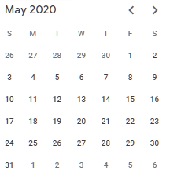
PID Working Group
:
May 8: Remaining Homework (complete initial feedback to tracking)
May 13: Joint with trackers.
May 15: Pro-Con grid iteration.
May 22: Pavia

