Slide 1
Bus Extender updates
Takashi Hachiya
Nara Women’s University & RIKEN BNL

Slide 2
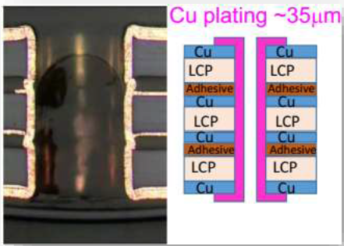
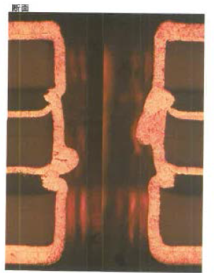
Status
Issues
Making the through holes with Cu-plating
Cu-Plating has nodules (wiggling surface)
This could be caused by the residue of the glue when plating
Glue is de-formed by the chemicals used for Cu-plating
Low production yield – 20% from the prototype productions
Ideas to (try to) fix
Change the glue sheet when laminating the layers
Need to check the peel strength as well
Update the production fixtures
Vacuum pump, Cover sheets and sealing materials for vacuum-tight when exposure the substrate with the light to print the circuit.
Company said that these work nicely and the production yields look improved
No quantitative value is available yet.

Slide 3
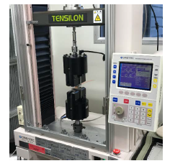
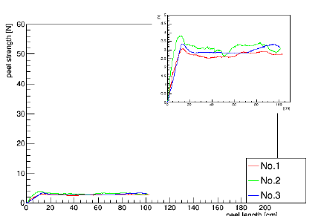
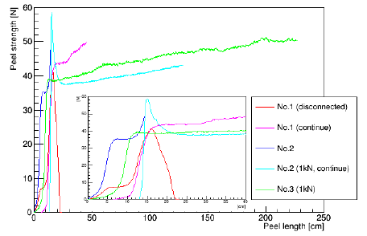
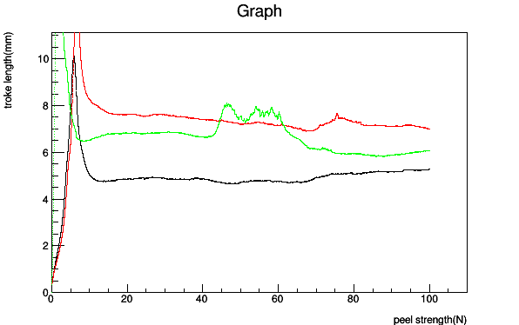
Peel strength measurement
Test 2 glue sheets which are specialized for LCP
Panasonic, Arisawa
Try 2 different pressures for the laminations
Higher pressure is better?
Method
Small sample (2 x 20cm)
Use tensile tester with 180 degree
Results
Panasonic ~ 3N/2cm,
Alisawa ~ 40>/2cm
Current (bad) glue 6N/cm
Alisawa is better than others
Panasonic
Alisawa
Current

Slide 4
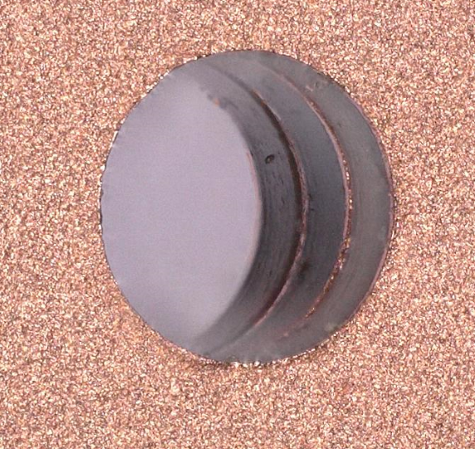
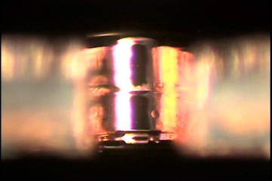
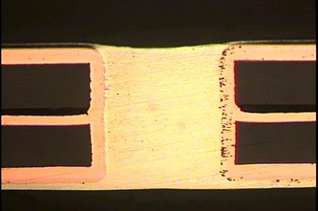
Through hole with Alisawa glue
We made the sample FPC with Alisawa glue and checked the through hole
Alisawa shows good through holes
Hole before Cu-plating
Hole with Cu-plating

Slide 5
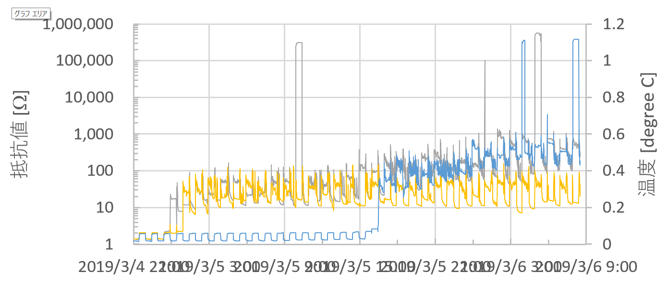
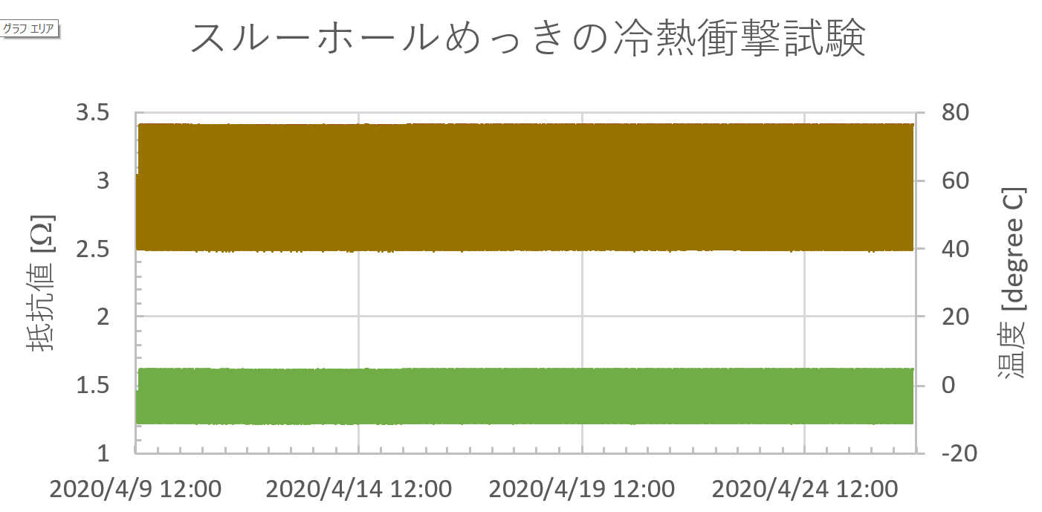
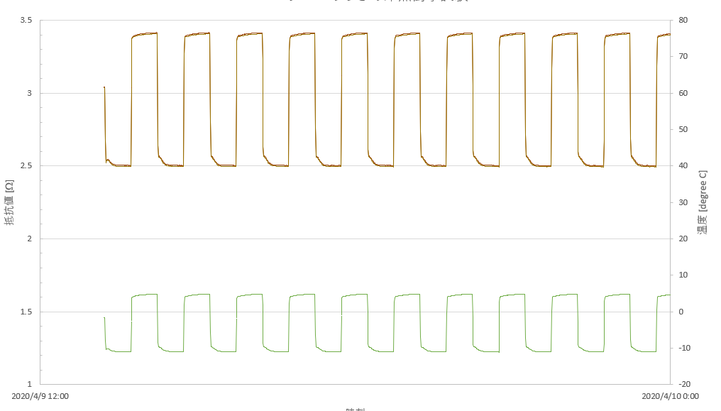
Thermal shock test w/ Alisawa
Bad case w/ current (bad) glue
Thermal shock test
3 samples (one 400x, two 1000x)
Connect multiple holes and measure its resistance
If hole has damage by heat, the resistance get higher
1000 cycle with -15 - 75°C
Temperature range is limited
LCP is expanded by heat 2x more than polyimide
Started from Apr. 9th

Slide 6
Status and Plan
Both issues are fixed (Test results shows)
New prototype production is in progress
Plan to come by end of May
We measure their electrical performance
Signal loss and reflection, cross talk, impedance
Next tests after the Corona shutdown
radiation-hardness (facility is closed)
Checking bubble if the problem still remains

Slide 7
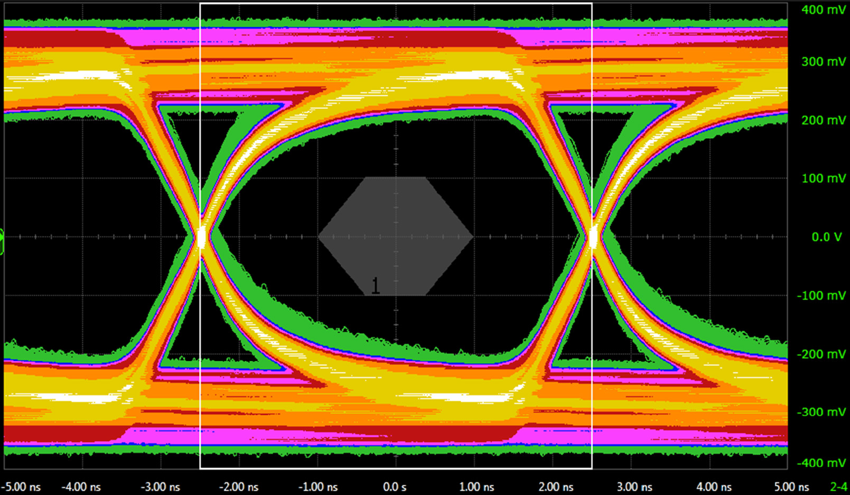
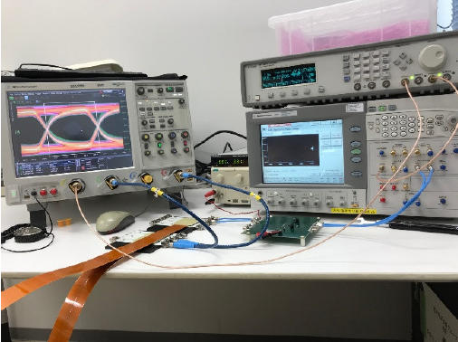
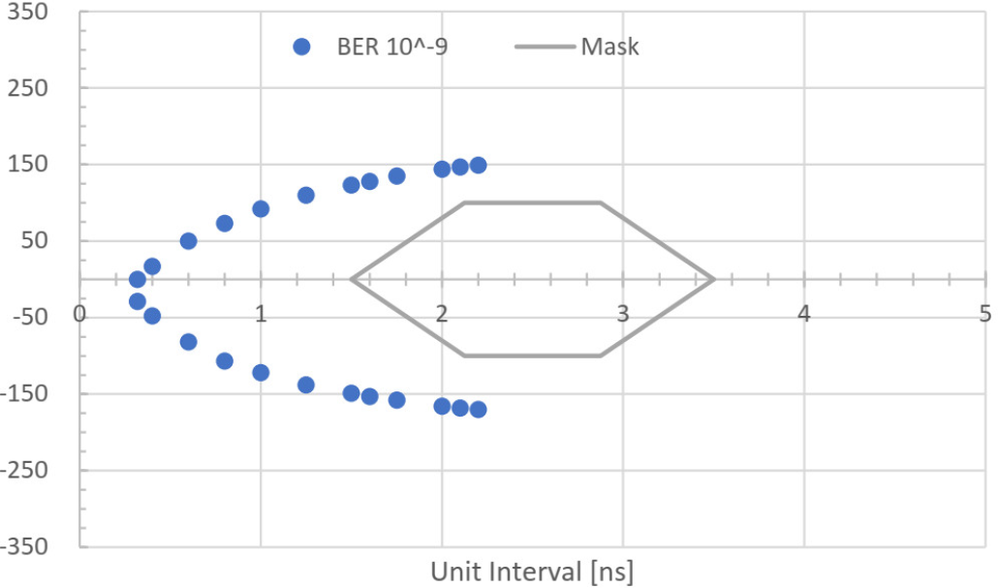
Eye-diagram of the bus extender
The eye diagram and bit-error rate with the prototype bus extender was measured
No INTT module used, instead commercial LVDS driver (MAX9169)
BER ~ 10⁻⁹ is far from the mask

