Slide 1
PID Working Group
Past
Monday 5/4: Convenors.
Wednesday 5/6: Complementarity
Present
DIRC and CF₄ RICH Homework
Future
May 13: Integration Meeting
May 15: PID Meeting before Pavia
P Rossi, TK Hemmick

Slide 2
Past
News from Convenors Meeting
Discussion about level of simulations expectation.
Fully integrated GEANT requires time and either technology choices or multiple implementations.
Current work encouraged as standalone with maximal realism.
Well aligned with our ongoing efforts.
New from complementarity meeting
Just as integration meeting shall host joint detector groups, complementarity hosted joint physics groups.
May 6: Inclusive and SIDIS.
Groups are recognizing that they must provide more specific detector performance guidance
Detailed specs are still in the works…

Slide 3
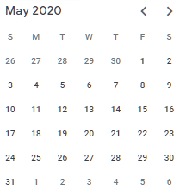
PID Working Group
May 13: Joint with trackers.
Angular resolution of a track in a gas RICH or dRICH.
Angular resolution of a track in aerogel (mRICH or dRICH)
Angular resolution of a track in DIRC
Path length of a track to TOF
TKH and PR will provide slides for feedback in advance.
May 15: PID Weekly
Iterate to produce “Pavia version” of pro/con matrix.
TKH and PR will
Use input from weekly meetings.
Vet slides with internal experts.
Post in advance.

