Slide 1
High Momentum GEM RICH Parameterization
Based on SBU/BNL 2015 Test beam detector Henry Klest on behalf of the SBU GEM-RICH group

Slide 2
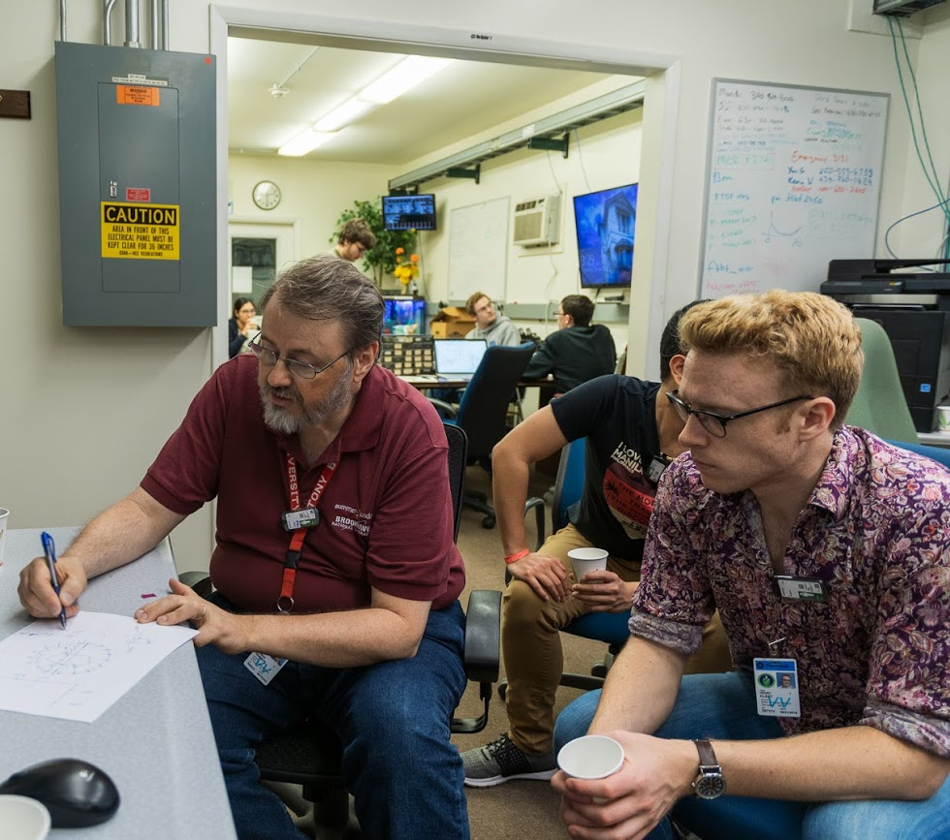
Introduction
Disclaimer: I’m a Ph.D student in the sPHENIX TPC group who is neither a coding expert nor a RICH expert, so please feel free to interject if I say something incorrectly, and excuse the PowerPoint acrobatics to make up for my poor ROOT skills
Goal is to produce a parameterization validated through comparison with test beam and the results of other groups
Comparison with dRICH gas portion simulations is especially helpful
~ One month of my unskilled labor not enough to include all the effects included in dRICH sims, some values (such as magnetic field effect on resolution) stolen to get quicker results
Using the parameterization, we can characterize how the GEM RICH will perform under variation of other parameters (gas, readout, tracking characteristics, pixelation, pressure, optical transparencies, etc.)
Picture of me in the FTBF counting house pretending to understand what Tom is saying

Slide 3
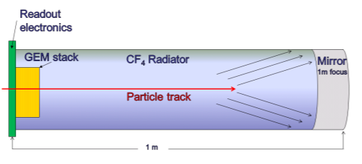
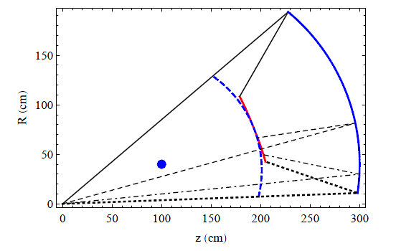
Setup
https://arxiv.org/pdf/1501.03530.pdf
Same physical setup as described at Temple by P. Garg
1m of CF4 radiator at 1.003 bar (slightly overpressure)
Particles perpendicularly incident on spherical mirror, focused onto a GEM stack directly in beam path
Quintuple GEM readout, no need for magnetic shielding, GEMs proven to work in high-B environments
Two test beams, one at SLAC and one at Fermilab, provide realistic conditions that should be in agreeance with a correct parameterization.
RICH Optics
Mirror
Center
Focus
The full detector design has the GEM photodetectors as the window, same as test beam setup

Slide 4
Parameterization - CRK
Generate photons according to Cherenkov spectrum
Efficiencies provide detected Npe
Many efficiencies are functions of wavelength
Smears degrade Cherenkov angle resolution
Modular framework designed to allow for mixing and matching of gases, photodetectors, pressures, etc.
Pi, Ka, Pr, and e all included
Once cleaned up, will be available in the PID GitLab

Slide 5
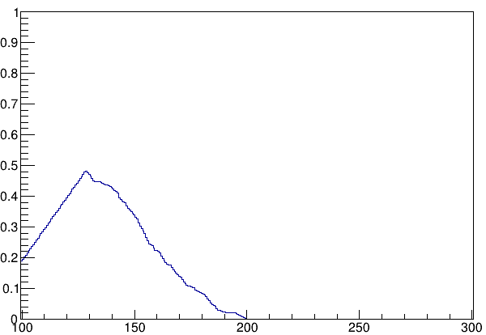
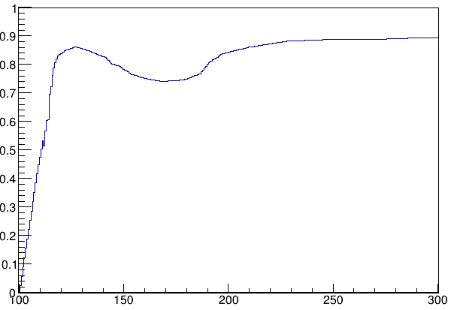
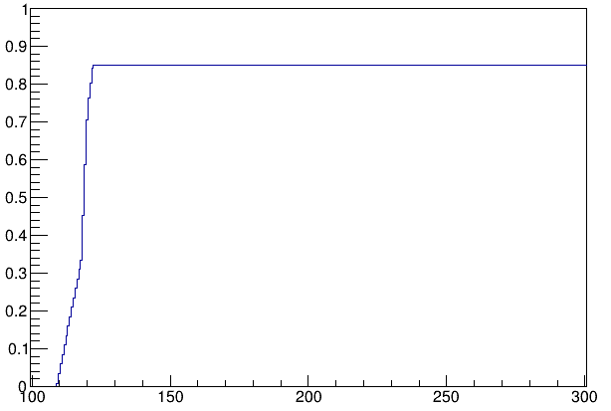
Efficiencies
Green: CF4 Opacity
From PHENIX HBD Performance
https://arxiv.org/pdf/1103.4277.pdf
Orange: Al-MgF2 coated Mirror Reflectivity
From Acton Research
Blue: CsI Photocathode Quantum Efficiency from PHENIX HBD Performance
Yellow: All Lambda Independent Efficiencies from test beam and HBD experience
Wavelength (nm)

Slide 6
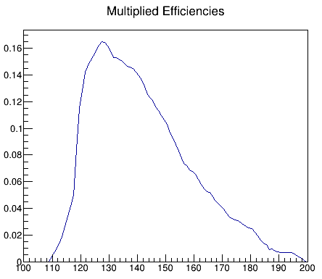
Included:
Functions of Lambda
Mirror Reflectivity
CsI QE
CF4 opacity
Lambda Independent
GEM holes
Mesh transparency
GEM Collection Efficiency
Single Photon Detection
~17 Npe calculated at β=1
Peaked nature of total efficiency provides defense against chromaticity issues near Sellmeier pole
Wavelength (nm)

Slide 7
“Go where the light is” Compared to a PMT, CsI active at much lower wavelengths
Multiplying the overall efficiency by $\frac{1}{λ^{2}}$ shifts the distribution further left and illustrates the relative importance of lower wavelengths. But what about chromaticity?
Wavelength (nm)

Slide 8
Gaseous portion of GEM RICH and dRICH are largely similar, differences in readout (GEM vs PMT), length (100 cm vs 160 cm), and gas choice (CF4 vs C2F6). Haven’t yet implemented polar angle. Comparing to their (more mature and detailed) resolutions as a sanity check:
Chromaticity and wavelength dependence of efficiencies included by design in our parameterization,
Chromatic $σ_{θ}=.00092$
Pixel resolution is padsize/$\sqrt{12}$
Assuming a no-charge-sharing pad arrangement, test beam used 5mm ($σ_{θ}=.00144$) hexagons with intention to go smaller
Emission term sub-leading in our geometry (shorter radiator, no off-axis focusing)
Using conservative estimate of $σ_{θ}=$.0006
Test beam tracking resolution was excellent, effect on $σ_{θ}$ is negligible in quadrature (will vary later)
Comparison to dRICH resolutions
$$σ^{2}≅σ_{Pixel}^{2}+σ_{Chrom.}^{2}+σ_{Emis.}^{2}= .{0018}^{2}$$
For test beam setup
Our test beam pixel resolution
Our Chromaticity

Slide 9
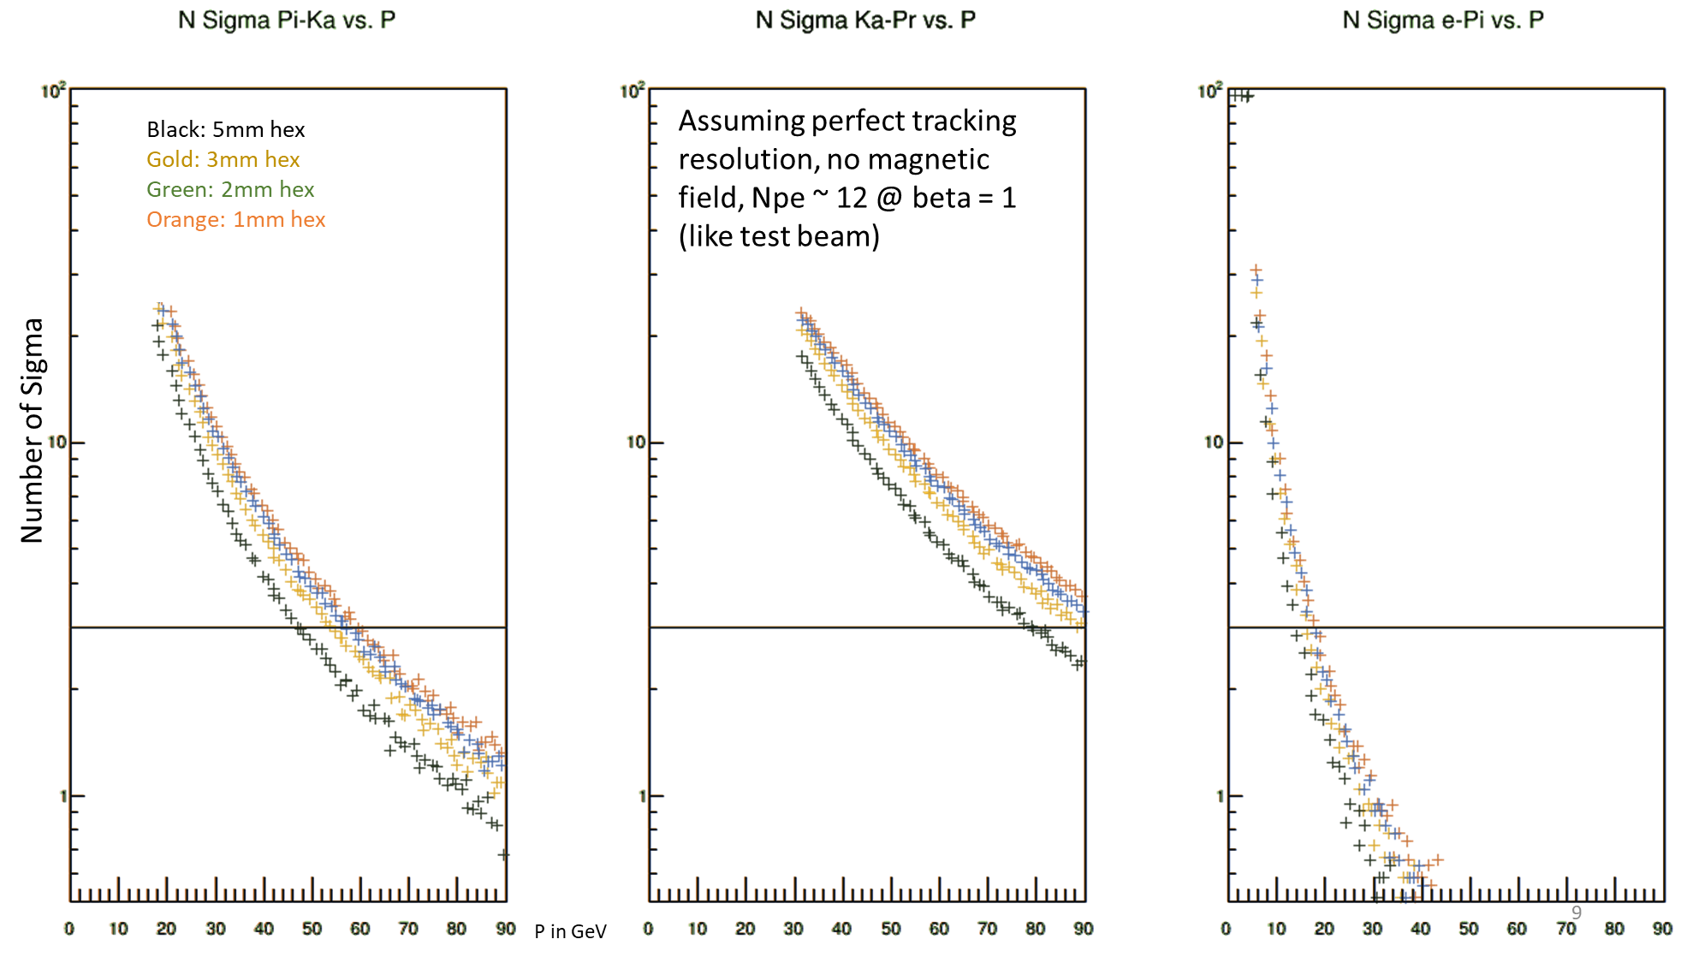
Black: 5mm hex
Gold: 3mm hex
Blue: 2mm hex
Orange: 1mm hex

Slide 10
Pixel Resolution Summary Table
Hex Pixel Size (θ_{c} Resolution) | Pi-K 3 sigma threshold (GeV) | K-Pr 3 sigma threshold (GeV) | e-Pi 3 sigma threshold (GeV)
5mm (.00144) | 47 | 80 | 15
3mm (.000866) | 52 | 90 | 18
2mm (.000577) | 57 | 95 | 19
1mm (.000289) | 60 | 98 | 19
Need to determine cheapest ways to decrease resolution, no use in spending twice as much money on reducing pad sizes if another resolution is already dominant. Note in this case that magnetic, tracking resolutions are neglected.

Slide 11
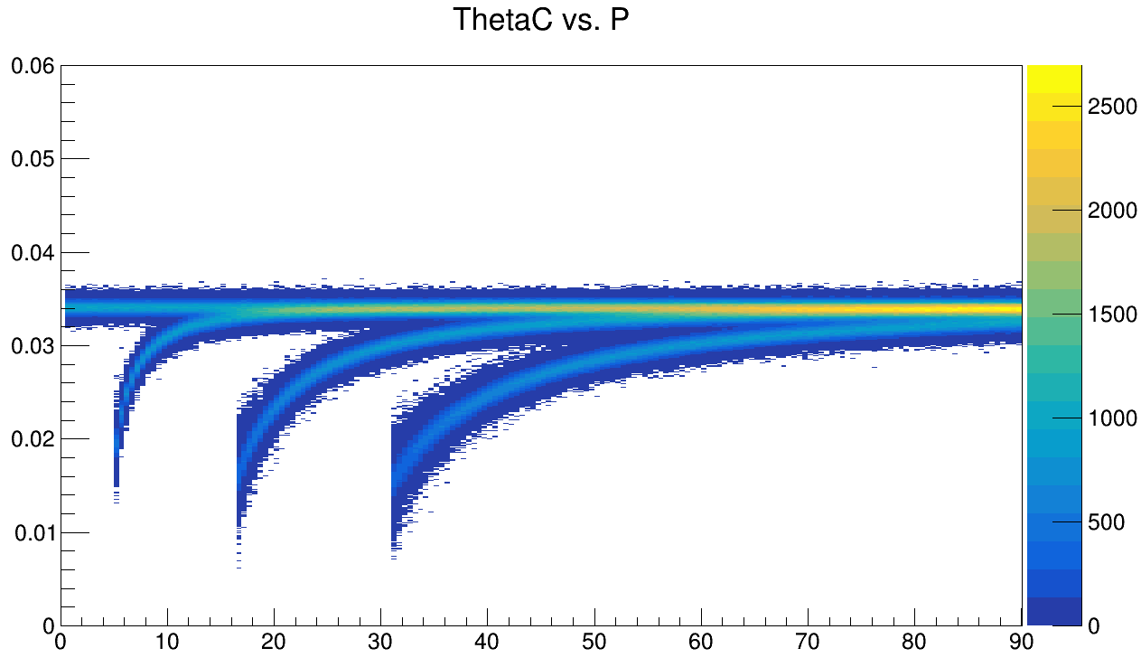
Cherenkov angle bands for 3mm pixels

Slide 12
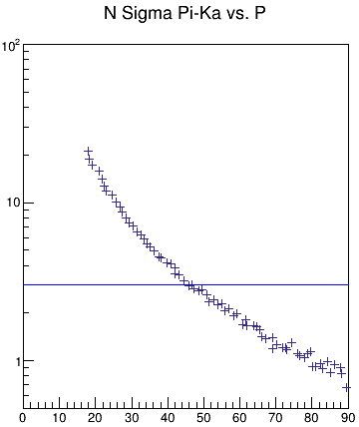
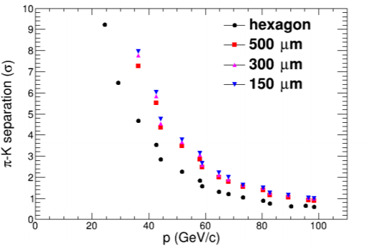
Checking parameterization vs. test beam results…
Test beam results
Npe reduced by a factor of 1.4, θ_{C} resolution scaled to ignore magnetic field component.
Parameterization shows good agreement with test beam.

Slide 13
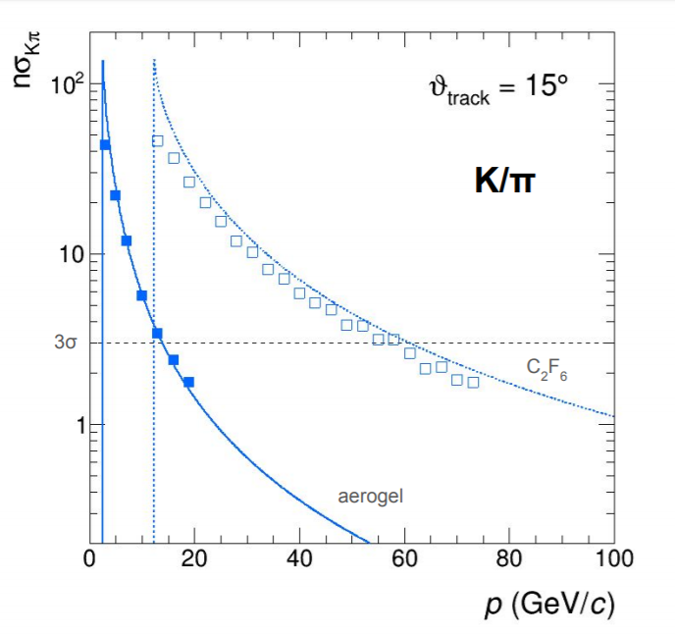
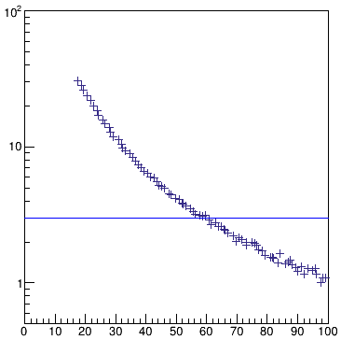
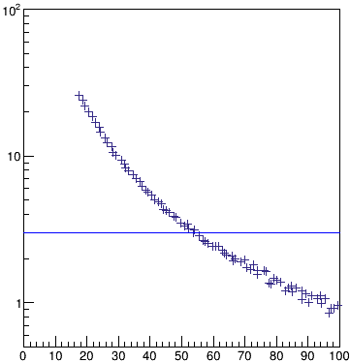
Checking parameterization vs. dRICH results, 3 sigma threshold slightly lower, but close. Possibly due to shorter radiator, less Npe from CF4.
With resolutions set equal to the dRICH averaged over polar angle
Orange: Npe as calculated from parameterization (~17 at beta = 1)
Blue: Npe as calculated from test beam (~12 at beta = 1)

Slide 14
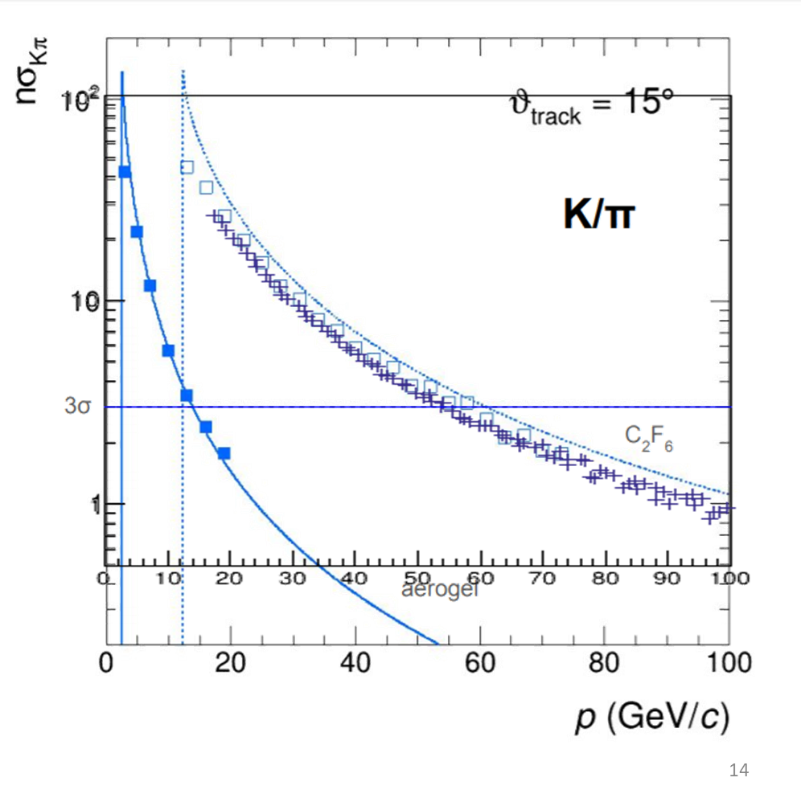
All resolutions except for chromaticity are the same, overlay as a sanity check.
Overlay illustrates broader momentum coverage of gas portion of dRICH due to C2F6 having lower Cherenkov thresholds Possible that averaging over polar angle explains slight discrepancy in the two
Overall very good agreement!
Orange: Npe ~17 at beta = 1
Blue: Npe ~12 at beta = 1

Slide 15
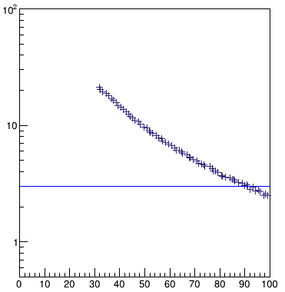
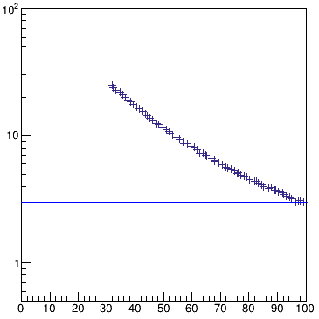
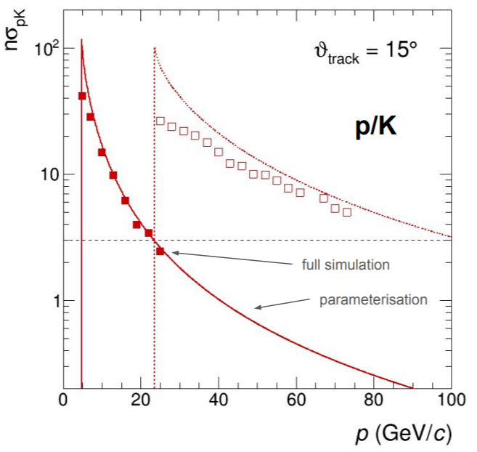
Orange: Npe as calculated from parameterization (~17 at beta = 1)
Blue: Npe as calculated from test beam (~12 at beta = 1)

Slide 16
Blue: Npe ~12 at beta = 1
Orange: Npe ~17 at beta = 1

Slide 17
Tracking error
Tracking angular resolution will contribute to $σ_{θ}$
Tracking $σ_{θ}$ calculated for Pi, Ka, Pr, e at various momenta, no large dependence on momentum or species at momenta of relevance (near saturation limit)
$σ_{θ}$ calculated here for Pions at 30 GeV
Variations in $σ_{θ}$ due to species and momentum can be explored in the future
Tracking angular resolution of 10 mrad (terrible)
Tracking angular resolution of 2 mrad

Slide 18
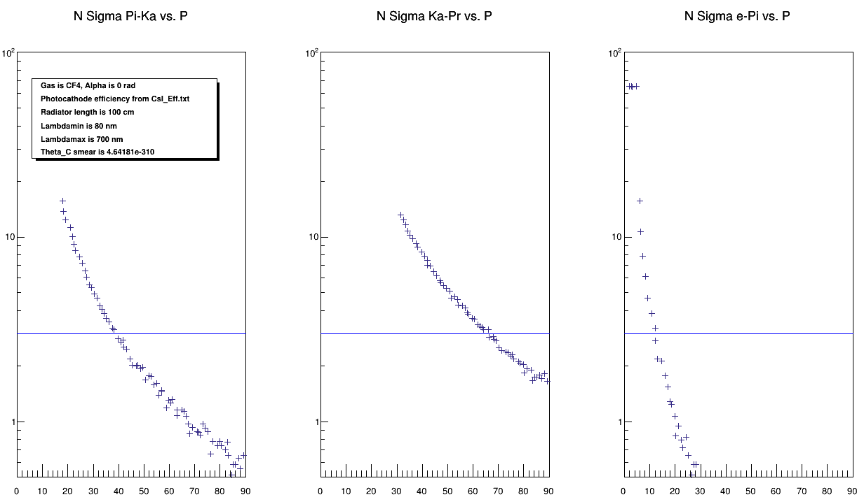
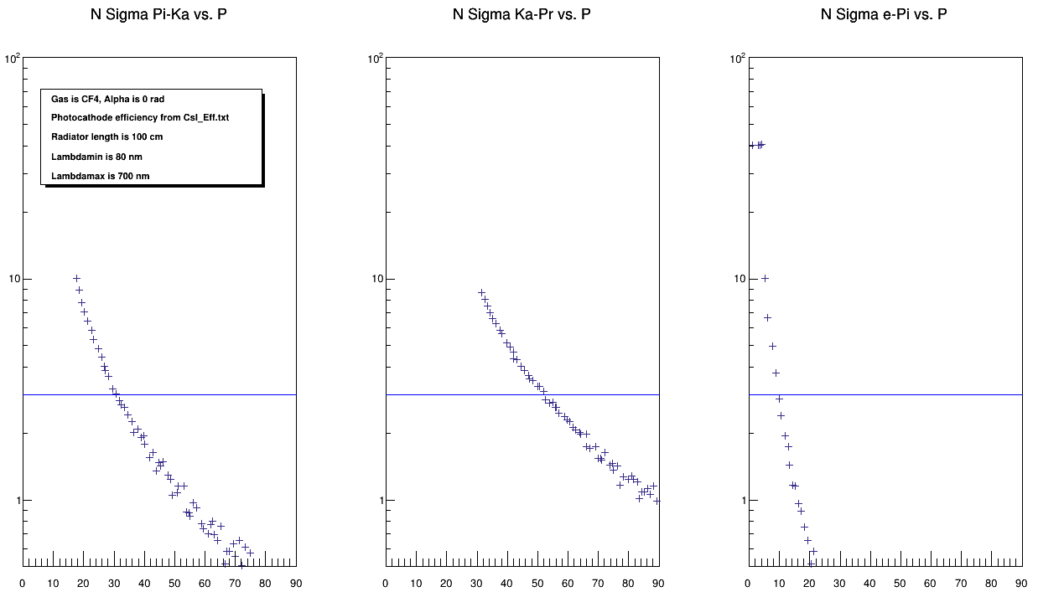
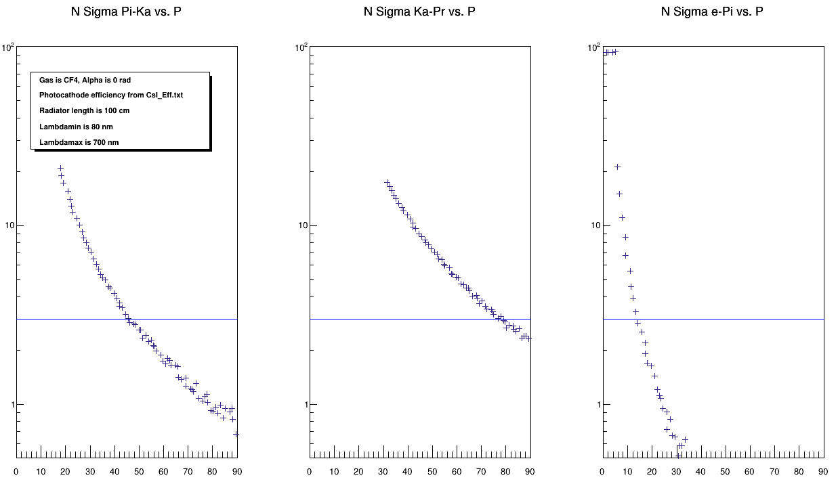
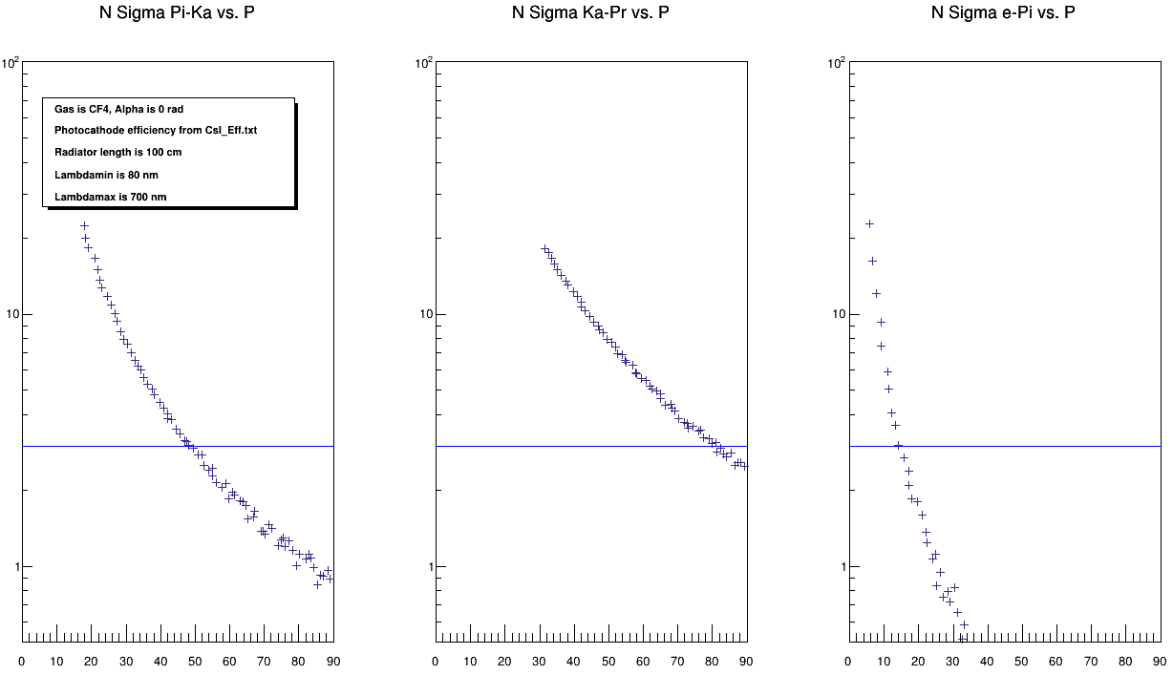
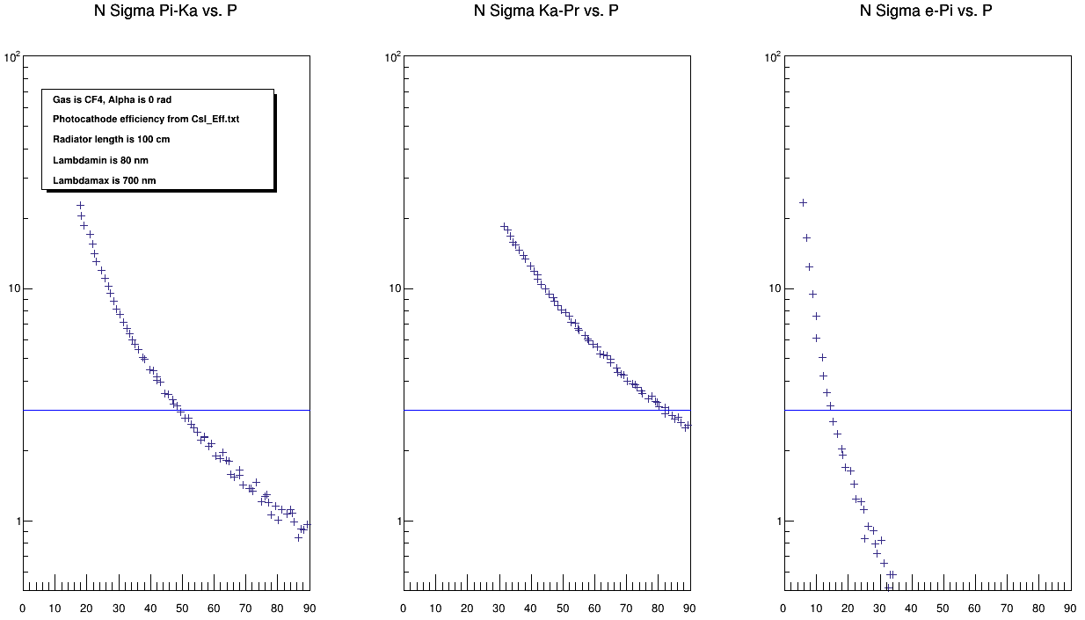
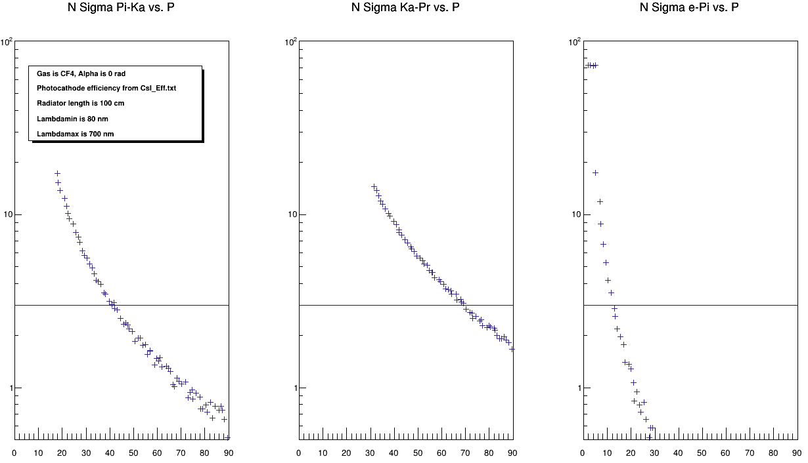
Blue: 20 mrad tracking error
Grey: 10 mrad tracking error
Orange: 8 mrad tracking error
Green: 4 mrad tracking error
Gold: 2 mrad tracking error
Black: 1 mrad tracking error
Realistic EIC detector situation: Npe values according to test beam,
3mm hex pads, magnetic field, emission smears included

Slide 19
Tracking Error Summary Table
Tracking Error (mrad) | Pi-K 3 sigma threshold (GeV) | K-Pr 3 sigma threshold (GeV) | e-Pi 3 sigma threshold (GeV)
20 | 30 | 52 | 10
10 | 38 | 65 | 12
8 | 42 | 68 | 13
4 | 46 | 78 | 14
2 | 49.5 | 80 | 15
1 | 50 | 81 | 15
According to this parameterization, tracking is leading error contribution if worse than ~7 mrad, becomes negligible resolution factor around 2 mrad. Between 2 and 7mrad , more detailed investigation is required.

Slide 20
To-do
Investigate other gases and variations in pressure. Find an optimal index of refraction for EIC physics and see if we can hit it
Learn from physics WG what processes require what capabilities- other than “we need high momentum!” what is high?
Explore backgrounds that produce stray light
Implement some polar angle and momentum resolution dependence
Further study optical aberration in our setup
Clean up the code so others can use it if they want
Other suggestions?

Slide 21
Conclusions
Coding mistakes must not be too bad, reproduce dRICH + test beam results reasonably well
Better than 2mrad for track direction inside radiator looks ok
Worse than 4 mrad looks questionable
Worse than 8 mrad… very bad
Note: Sandwiching RICH with trackers on both sides should produce better than 2mrad, even with inexpensive tracking technology
Note 2: At some point, Tracking can do more harm than good. At that point it’s best to stop seeding rings with tracking and start finding them organically. Finding this point can be a future to-do.
Although PID performance at high momentum is similar to dRICH, dRICH has broader momentum range.
Feedback to trackers

Slide 22
Backup

Slide 23
