Slide 1
Run 15: Polarized Protons 100 GeV
V. Schoefer
RHIC Retreat
8/14/2014

Slide 2
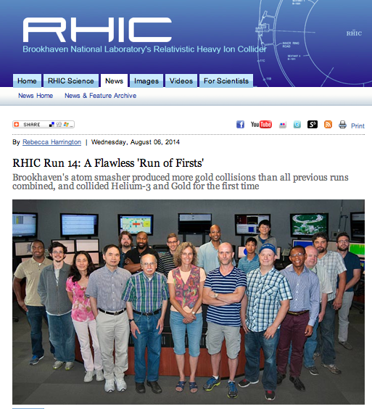

Slide 3
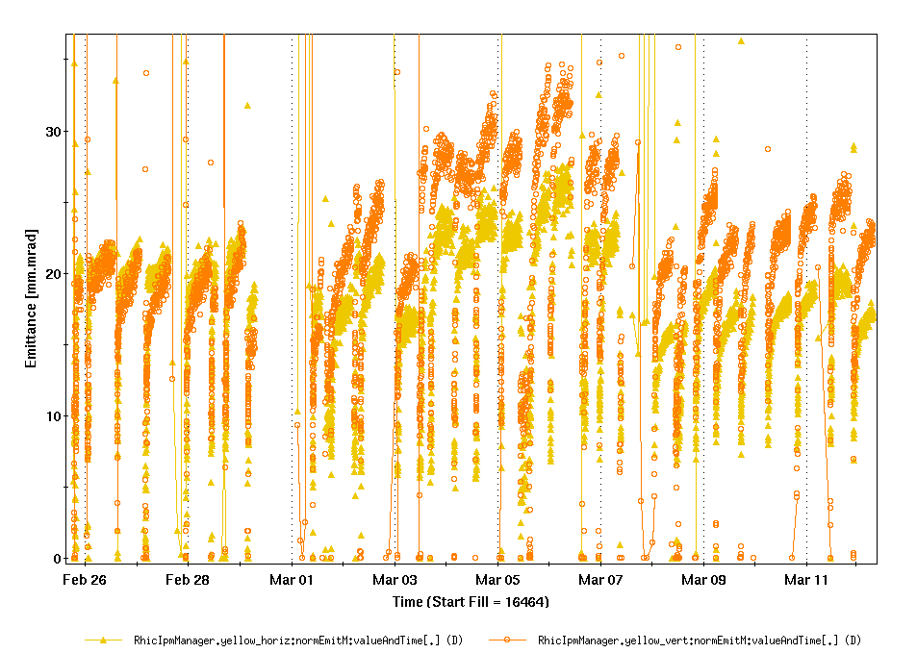
Last time on “100 GeV Protons”…
Longitudinal scraping being used to reduce beam loss during rebucketing at 100 GeV.
Moving to a vertical-only scraping scheme increased beam-beam tune spread, ΔQ_{bb}
Ran into the beam-beam limit:
Transverse emittance blowup
Increase in polarization decay
>2%/hr, compared to ~1%/hr nominal
Vertical
Horizontal
Yellow IPM Emittances
Diminishing tune spread from beam-beam is exactly the goal of the electron lens
Feb 28-Mar 11, Run 12

Slide 4
E-lens Effort
E-lens proper (See earlier talk)
Lattice design for e-lens
First tried (and abandoned) in Run13
Reworked* using ATS principle for
Improved nonlinear chrom
Improved DA
Beam stability with e-lens/BBB damper development
*S. White, W. Fischer, Y. Luo “Optics solutions for pp operation with electron lenses at 100 GeV” (C/AD Note)

Slide 5
E-lens Lattice Requirements
Β* (IP6 and 8) | 0.85 m | Same as Run 12, could push a little
Β* (IP10) | Large as possible (20 m ?) | Beam stability with e-lens
ΔΦ (per cell) | π/2 | Nonlinear chrom comp
ΔΦ(Elens->IP6) | kπ | E-lens kick
Injection γ_{tr} | Not near injection γ | Matching/stability
DA (on/off momentum) | Compare favorably to previous lattices
Spin resonance strengths | Compare favorably to previous lattices | STILL NEEDS CHECKING!
*S. White, W. Fischer, Y. Luo “Optics solutions for pp operation with electron lenses at 100 GeV” (C/AD Note)

Slide 6
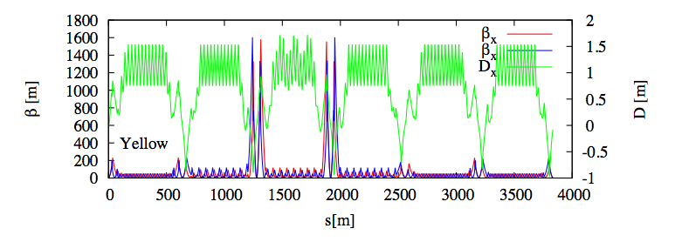
ATS Store Optics
ΔΦ =π
ΔΦ/cell =π/2
Integer tune increased (28,29)→(29,30):
Injection γ_{tr} refit to 23.5 (nominally 23.3)
Injection Β* = 7.5 m (2/3 driving?)

Slide 7
ATS Store Optics
Β = 0.85m
Β = 20 m
Lattice requires modification of Q-trim to make it bipolar

Slide 8
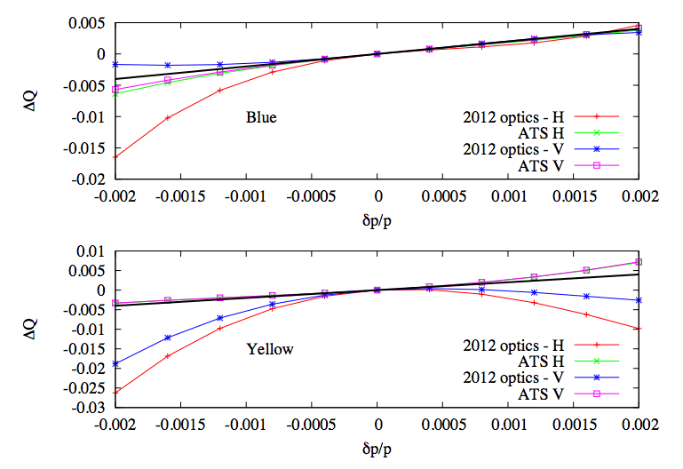
Nonlinear Chroms Improve

Slide 9
E-lens and transverse stability
E-lens presents a substantial impedance to the beam* , “transverse mode coupling instability” (think head-tail instability)
Primary stabilizing force is the solenoidal field at the e-lens (pins the electrons)
Additional stabilizing (against all coherent instabilities, including e-lens) to be provided by the transverse BBB damper.
B_{th} = min solenoid field for stability
r = beam radius (controlled via β*)
ΔQ = |Qx – Qy| (assumed to be 0.01, could be a problem)
*Burov et al, “Transverse beam stability with an ‘electron lens’” Phys. Rev. E, Vol 59, Num 3 (1999)

Slide 10
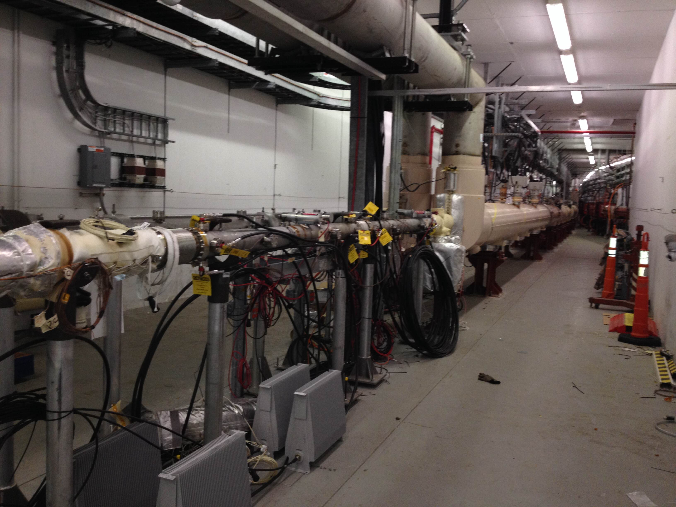
BBB Damper
Hardware (pickups and kickers in the injection area)
Blue BBB kicker
Yel beam
Y-arc
Yellow BBB kicker
PUE can be chosen between Q11 and Q15 (depends on lattice)

Slide 11
So, RHIC will handle higher intensity… can the injectors deliver? (an important measurement from Run 14)
Change source temp to get different input
Adjust scraping to keep AGS extraction intensity constant
Measure emittances
Data cut:
AGS late = 2.0 +/- 0.05 e11
Booster input
AGS Extractions
Intensity
Typical RHIC fills
More scraping = lower emittance ???
AGS Cycle

Slide 12
Absolute emittances
AGS IPM FLATTOP
Emittance (vert, 95% norm, pi-mm-mrad)
AGS IPM injection
MW 006
Booster Input
Increased scraping →

Slide 13
Absolute emittances
Relative emittances
Emittance (vert, 95% norm, pi-mm-mrad)
Booster Input
Increased scraping →
Booster Input
Increased scraping →

Slide 14
Booster emittance dilution
If we cannot get brighter beam from the more intense beam, then we lose (lumi AND polarization)
Possible cures (all aimed at space charge driven problems):
Second harmonic in RF (not two bunches, but flatter bunch)
Altered scraping scheme
Scrape earlier (pre blow-up), even just at injection (do not ever circulate in the Booster what we would scrape later)
Two bunches in the Booster, merge in the AGS (?!)

Slide 15
Booster emittance dilution
If we cannot get brighter beam from the more intense beam, then we lose (to say nothing of polarization)
Possible cures (all aimed at space charge driven problems):
Second harmonic in RF (not two bunches, but flatter bunch)
Altered scraping scheme
Scrape earlier (pre blow-up), even just at injection (do not ever circulate in the Booster what we would scrape later)
Two bunches in the Booster, merge in the AGS (?!)
Fixing this problem is crucial with or without the e-lens

Slide 16
Conclusions
The lattice is in really good shape
…and early
…and well-documented
…but needs to pass the spin test
…but the Devil is always in the ramp implementaion details
E-lens driven improvements in figure of merit will only happen with a real improvement in the injectors (the Booster in particular)
Important things I did not mention
eIPM: emittance understanding/preservation in AGS
56 MHz: Is there are need for MD during pp?

