Slide 1
56 MHz cavity commissioning, plans for shutdown and next run
Qiong Wu
On behalf of the team
August 14, 2014

Slide 2
The Team
Steve Bellavia, Sergey Belomestnykh, Ilan Ben-Zvi, Tony Curcio, Lenny DeSanto, Rich DiFranco, Bill Eisle, Charlie Folz, Darryl Goldberg, Manny Grau, Heather Hartmann, Peggy Harvey, Tom Hayes, Chung Ho, Jerry Huang, Jim Jamilkowski, Prerana Kankiya, Mike Mapes, Kevin Mernick, Gary McIntyre, Gary Miglionico, Geetha Narayan, Paul Orfin, Chien-Ih Pai, Jonathan Reich, Scott Seberg, Freddy Severino, Brian Sheehy, Loralie Smart, Kevin Smith, Tom Tallerico, Roberto Than, Charlie Theisen, Joe Tuozzolo, Dan Weiss, Qiong Wu, Alex Zaltsman, Yi Zhang, and more…
Special Thanks to Mike Blaskiewicz and Mike Brennan

Slide 3
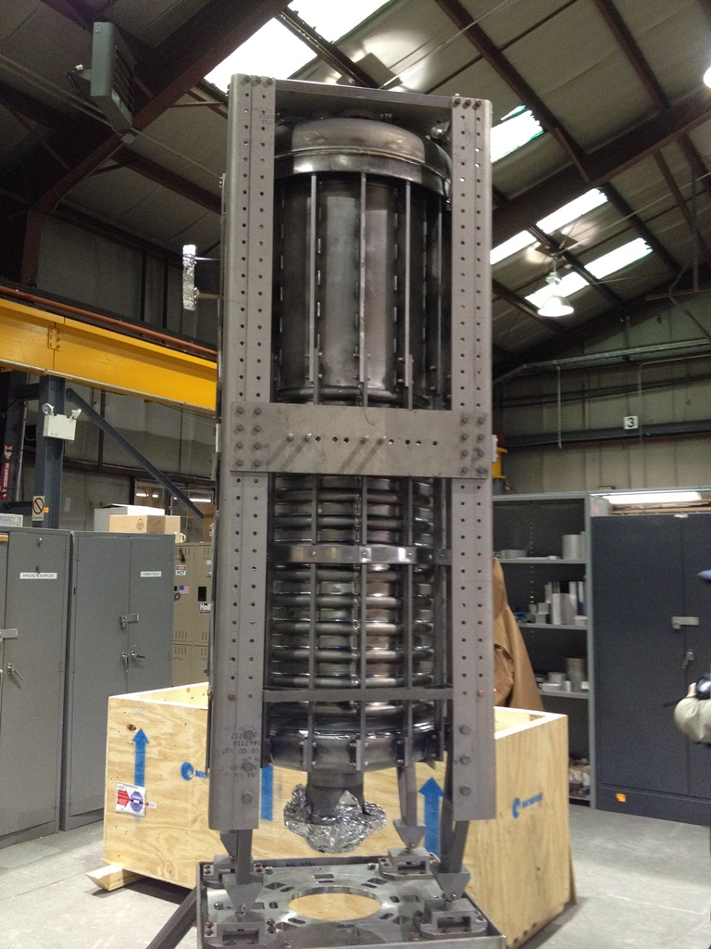
The Cavity
The 56 MHz cavity is a niobium superconducting quarter wave resonator. It is a beam driven cavity.
The 56 MHz cavity will increase the RHIC luminosity by providing very large RF buckets to combat IBS diffusion.
The cavity does not have sufficient tuning range to follow the large frequency change during the energy ramp, so it is turned on only after reaching store.
The cavity fundamental mode is detuned and strongly damped during injection and acceleration.
A 1 kW amplifier is connected to the cavity to : i) achieve required amplitude and phase stability; ii) provide conditioning capability; iii) make up power for intrinsic losses.
At store, the fundamental damper is withdrawn and then the cavity frequency is tuned (approaching from below the beam h=720 line) to achieve an operating voltage of 2.0 MV.
A piezo tuner is employed to minimize wear on the stepper tuner and potentially compensate mocrophonics.

Slide 4
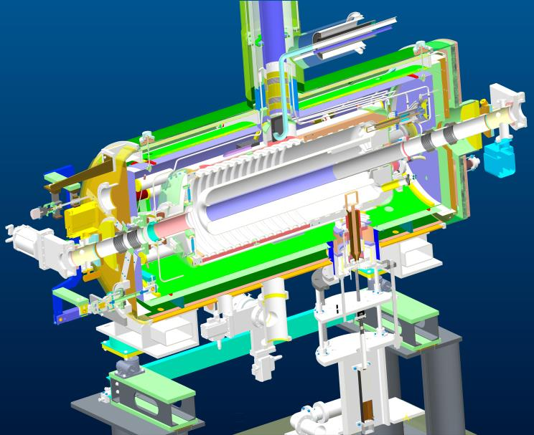
helium supply
HOM coupler
vacuum vessel
helium vessel
tuning
Thermal shield
magnetic shield (x2)
fundamental damper
cavity

Slide 5
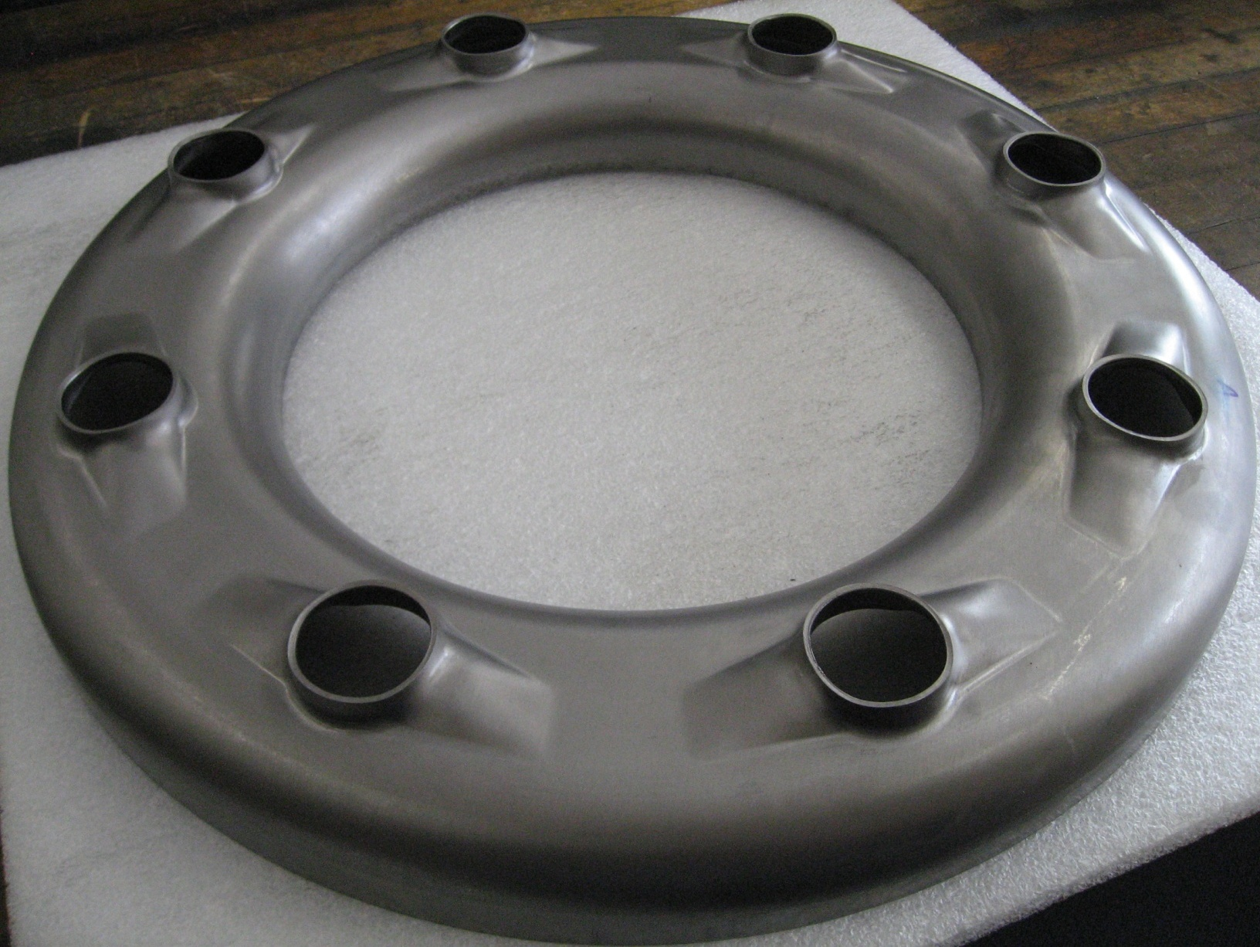
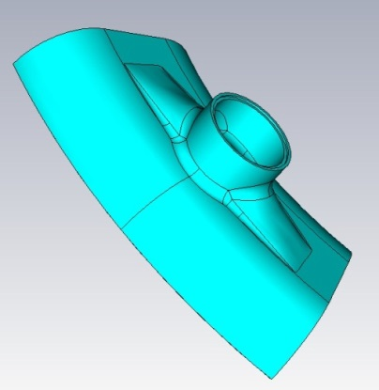
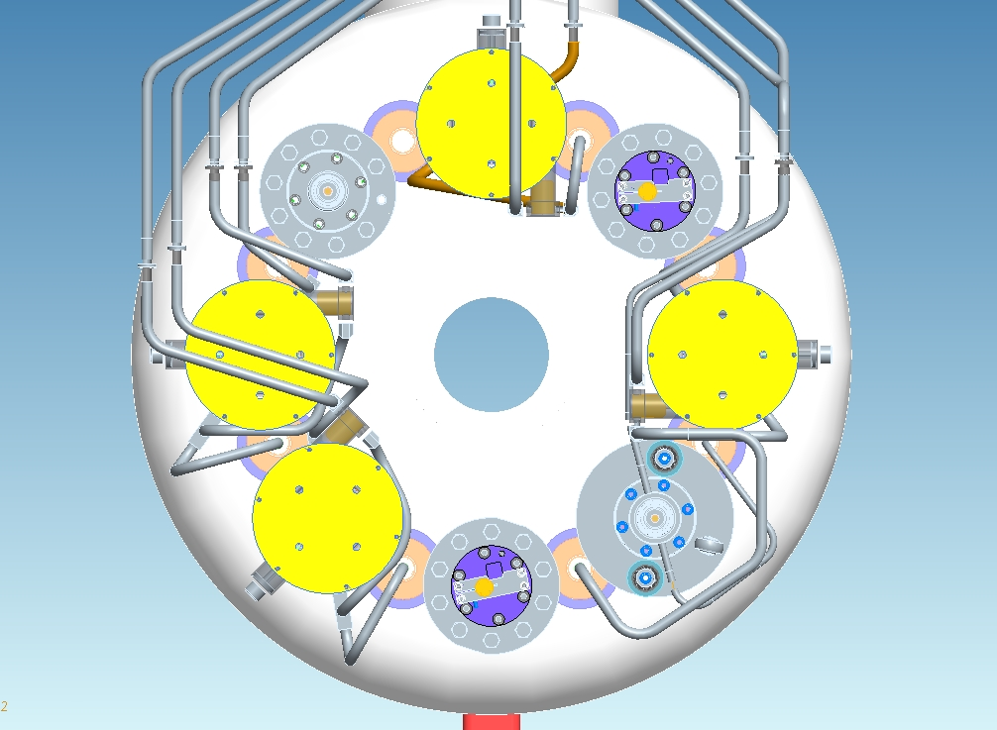
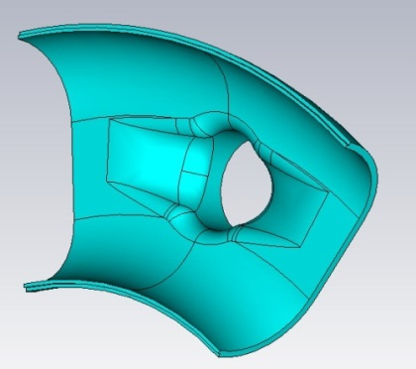
Coupler Ports
The cavity has 8 chemical cleaning ports at the rear end. The ports are occupied by 4 HOM dampers, 1 fundamental power coupler (FPC), 1 pickup probe, and 2 IR quench detectors.
HOM dampers
IR detectors
8 Chemical cleaning ports
PU
FPC

Slide 6
Cavity Parameters @ 2MV
Stored Energy | 139 | Joules
Operating temperature | 4.2 | K
Power dissipation (10nΩ residual surface resistivity) | 42 | W
Q₀ | 1.4E9
Q_{L} | 4E7
R/Q (accelerator notation) | 80.5 | Ω
Maximum surface electric field | 41.6 | MV/m
Maximum surface magnetic field | 89.6 | kA/m
Tuning rate of mechanical tuner | 17 | kHz/mm
Coarse tuning range | 25.5 | kHz
Coarse tuning speed | 3666 | Hz/sec
Tuning sensitivity | 17 | Hz/um
Fine tuning range by piezo drive | 60 | Hz
Fine tuning resolution | 0.06 | Hz/Volt
Lorentz Detuning | 148 | Hz

Slide 7
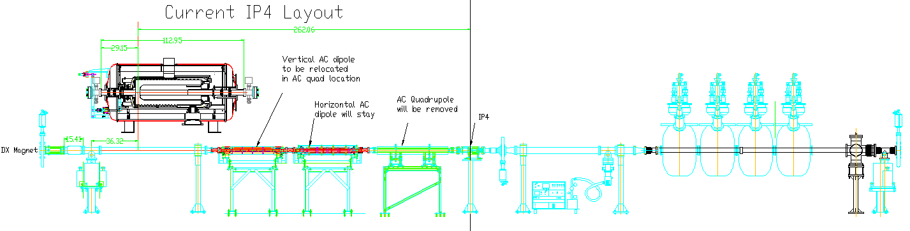
Installation in RHIC
56 MHz cavity is installed in the IP4 area.
Quiet Helium Source
D0
DX
56 MHz Cavity Cryostat

Slide 8
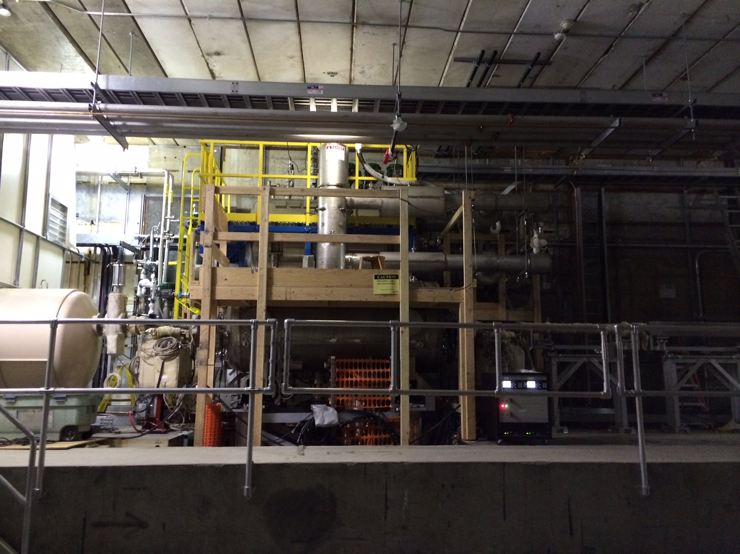
IP4with the 56 MHz cavity installed

Slide 9
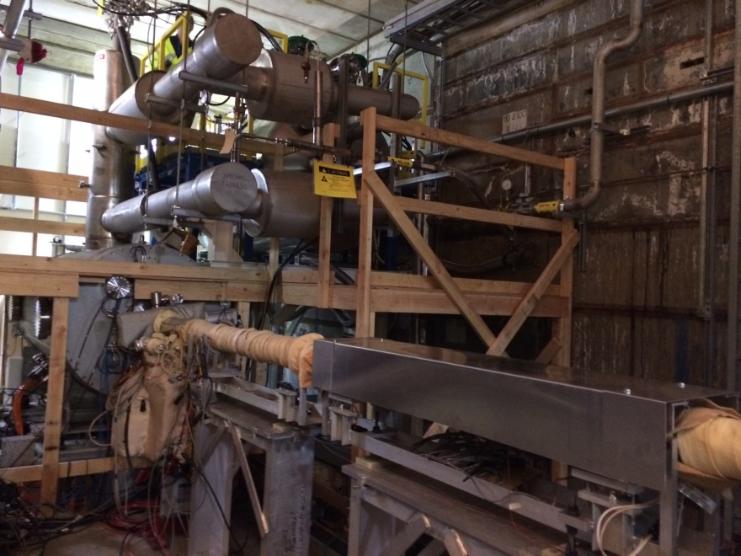
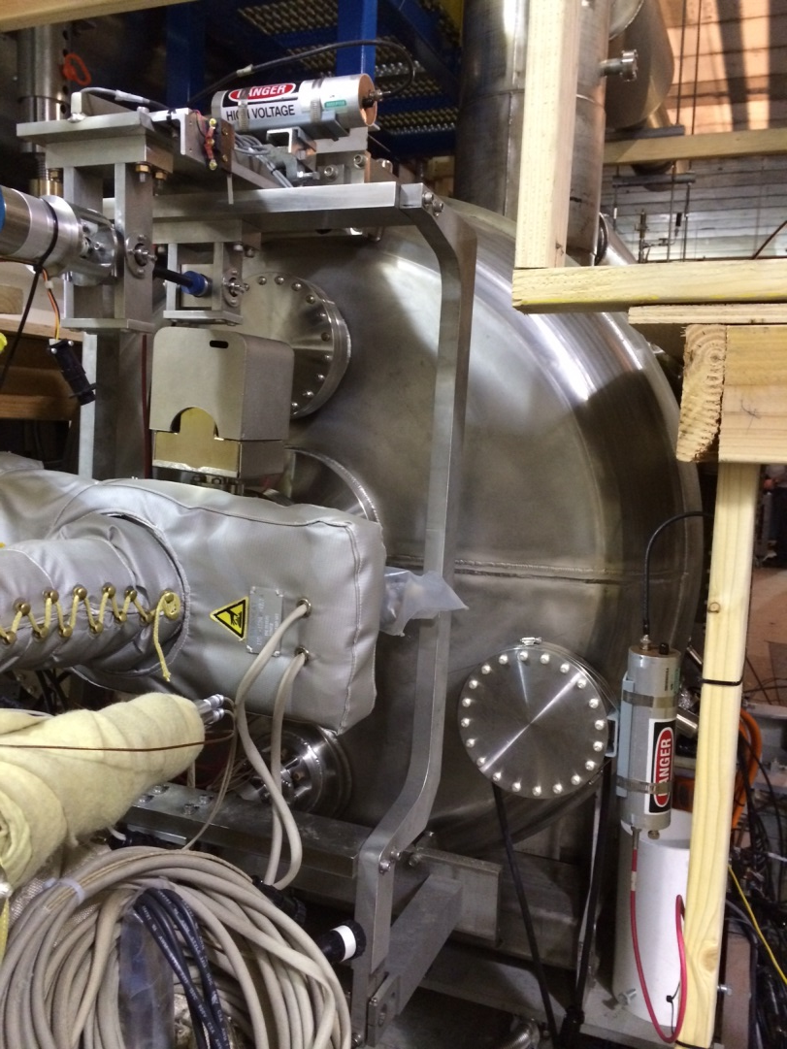
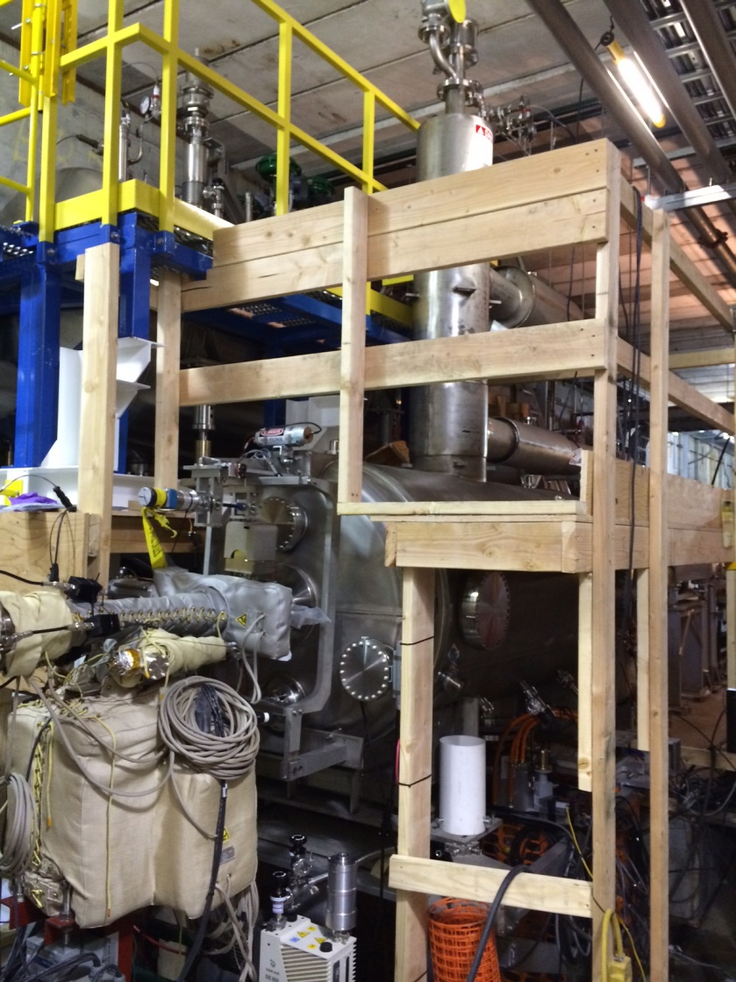
Cavity at IP4

Slide 10
56MHz Statistics for Run 14:
9 dedicated Machine Development time slots for 56 MHz SRF cavity with a total of 52.5 hours:
Date | Start Time | End Time | Duration | What did we do
21-Apr | 10:00:00 AM | 2:20:00 PM | 4:20 | Conditioned cavity with PA up to HOM quench limit.
25-Apr | 10:00:00 AM | 11:46:00 AM | 1:46 | condition not performed due to LLRF issues
28-Apr | 12:00:00 PM | 5:40:00 PM | 5:40 | fully conditioned all multipacting zones. Drove cavity up in pulsed mode.
1-May | 11:00:00 AM | 4:00:00 PM | 5:00 | First beam driven operation
9-May | 1:00:00 PM | 6:00:00 PM | 5:00 | IQ loop, 12 x 12 bunches
15-May | 11:00:00 AM | 7:00:00 PM | 8:00 | close IQ loop with beam, Schottky measurement of cavity voltage
22-May | 11:00:00 AM | 6:30:00 PM | 7:30 | tuner linear pot (freq vs position) for feedback loop, stability threshold studies, 56 x 56 bunches
28-May | 12:30:00 PM | 7:00:00 PM | 6:30 | First time experienced tuner control anomaly, tuner feedback loop study, multipacting conditioning
5-Jun | 12:30:00 PM | 9:15:00 PM | 8:45 | MP conditioning, first 111 x 111 bunches at 7:10 pm, measured HOMs with beam, feedback loop on
7 hours of RF development time on Maintenance Day:
Date | Start Time | End Time | Duration | What did we do
30-Apr | 15:30 | 17:30 | 2:00 | Condition cavity, fixing MPS problems
14-May | 13:00 | 17:00 | 4:00 | Piezo motion, tuner hysterresis solved
28-May | 15:00 | 16:00 | 1:00 | tuner feedback loop study, tuner linear pot (voltage vs position)

Slide 11
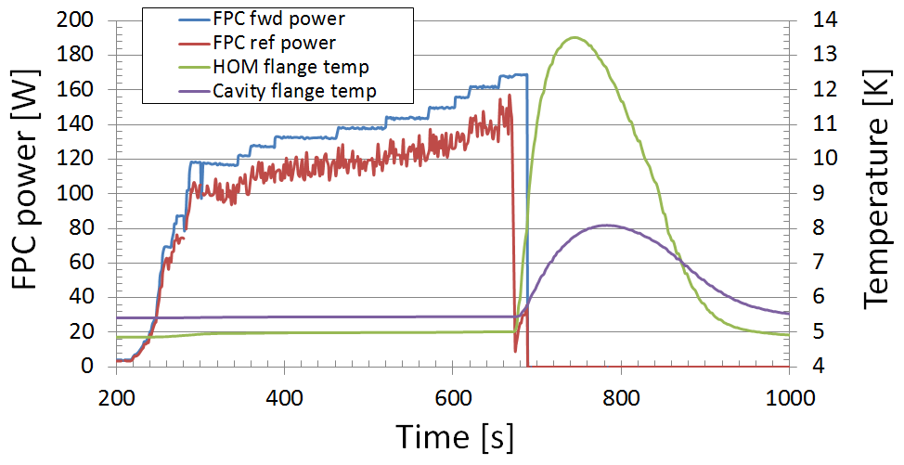
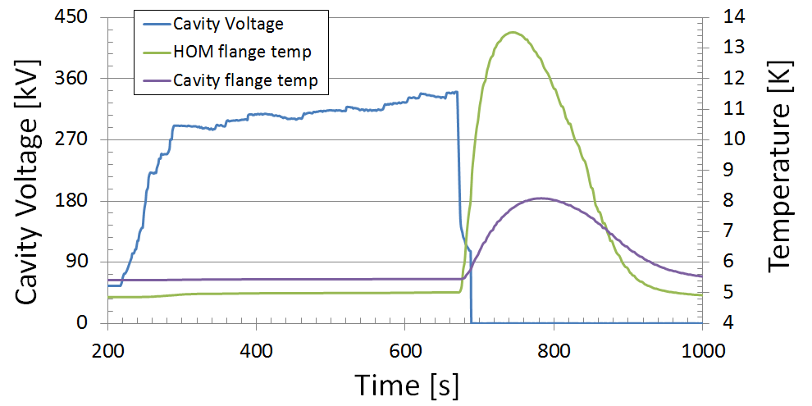
Commissioning Problems (1): HOM Coupler Quench
The cavity voltage was limited by a quench in the HOM coupler assembly.
The maximum reached cavity voltage was:
350 kV DC
550 kV pulsed with amplifier
The LLRF measured voltage is 10% lower than the Schottky calibration.

Slide 12
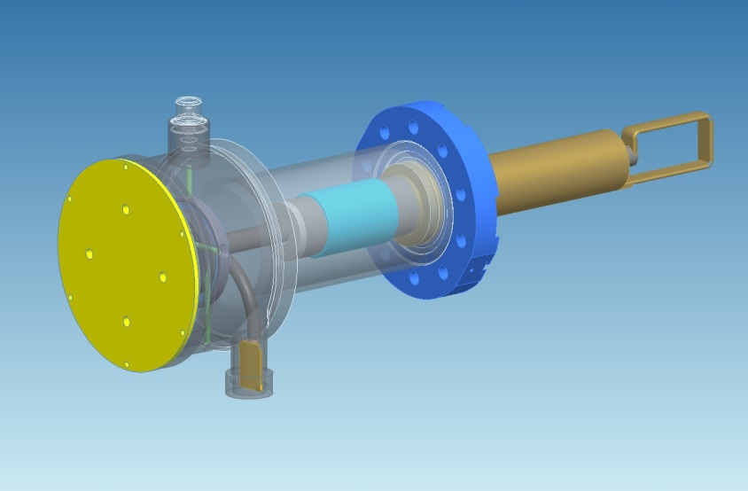
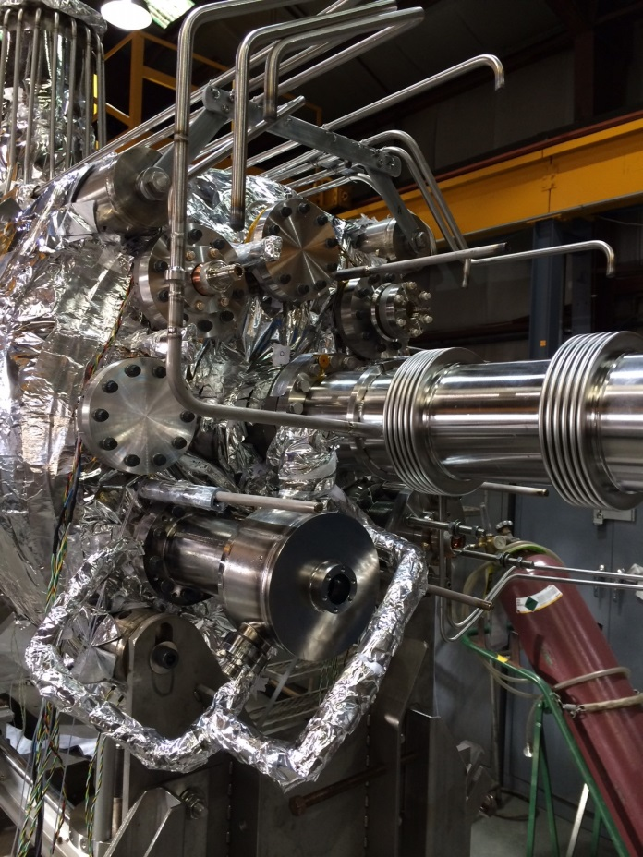
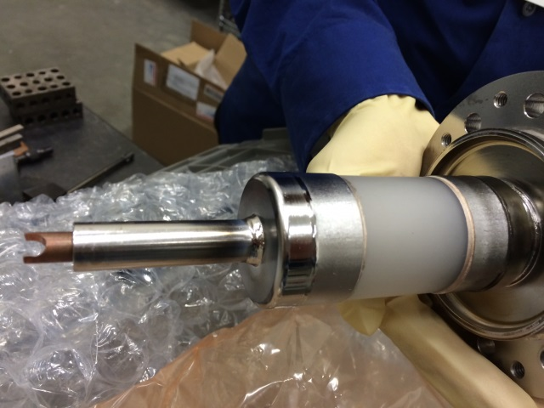
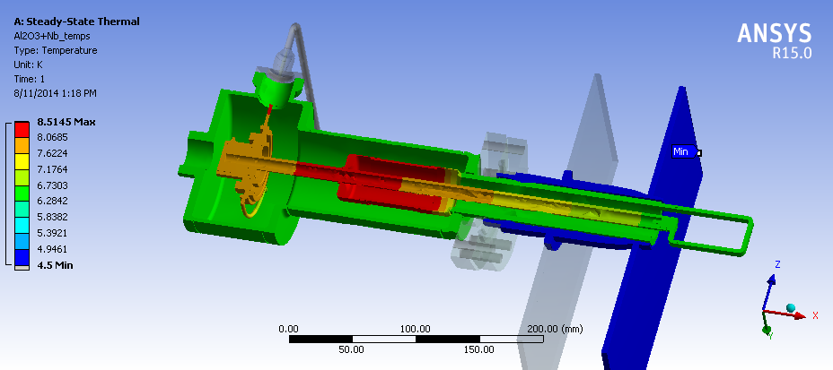
Thermal analysis of the HOM coupler quench
3D model of the HOM coupler assembly (left) and view after installed on the cavity (right).
The HOM coupler has a sapphire RF window that is designed for separating the high-pass filter section from the cavity vacuum.
The braze material at the sapphire – Nb cuff joint is InCuSil, which is normal conducting at 4.5 K.
Thermal analysis (Steve Bellavia) shows that at 1/6th of the design field, the InCuSil material would bring the adjacent Nb (T_{c} = 9.2 K) to 8.5 K. It is currently our best candidate for the quench.
Max: 8.5 K
Min: 4.5 K

Slide 13
Commissioning Problems (2): MPS pulled the permit 4 times:
Date | Time | Reason
1-May | 9:09 | MPS signal messed up
19-May | 0:58 | HOM temperature rose to above threshold due to refilling valve was not open
30-Jun | 14:52 | HOM temperature rose above cryo-interlock limit. Tuner started random motion moving cavity resonance too close to beam h=720 line. HOM temp threshold at MPS was changed to 15.8K in Chung Ho's LabView, but show 8K at PET page. Cavity quenched with beam, burst disc vented Helium. Cavity not operational for remainder of run. Cavity tested on July 1st, no damage to cavity was observed.
5-Jul | 4:17 | HOM temp rose to above cryo-interlock limit. Leak in cryo system causing boil up rate increase, need to open more valves to increase filling rate.

Slide 14
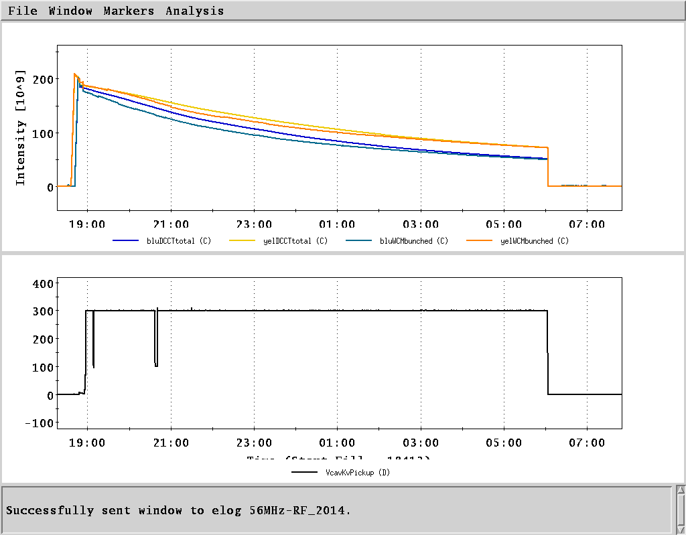
Commissioning Success:
First RHIC operation on June 12, 19:00, fill # 18414.
The cavity was parked at 300kV for the full store.

Slide 15
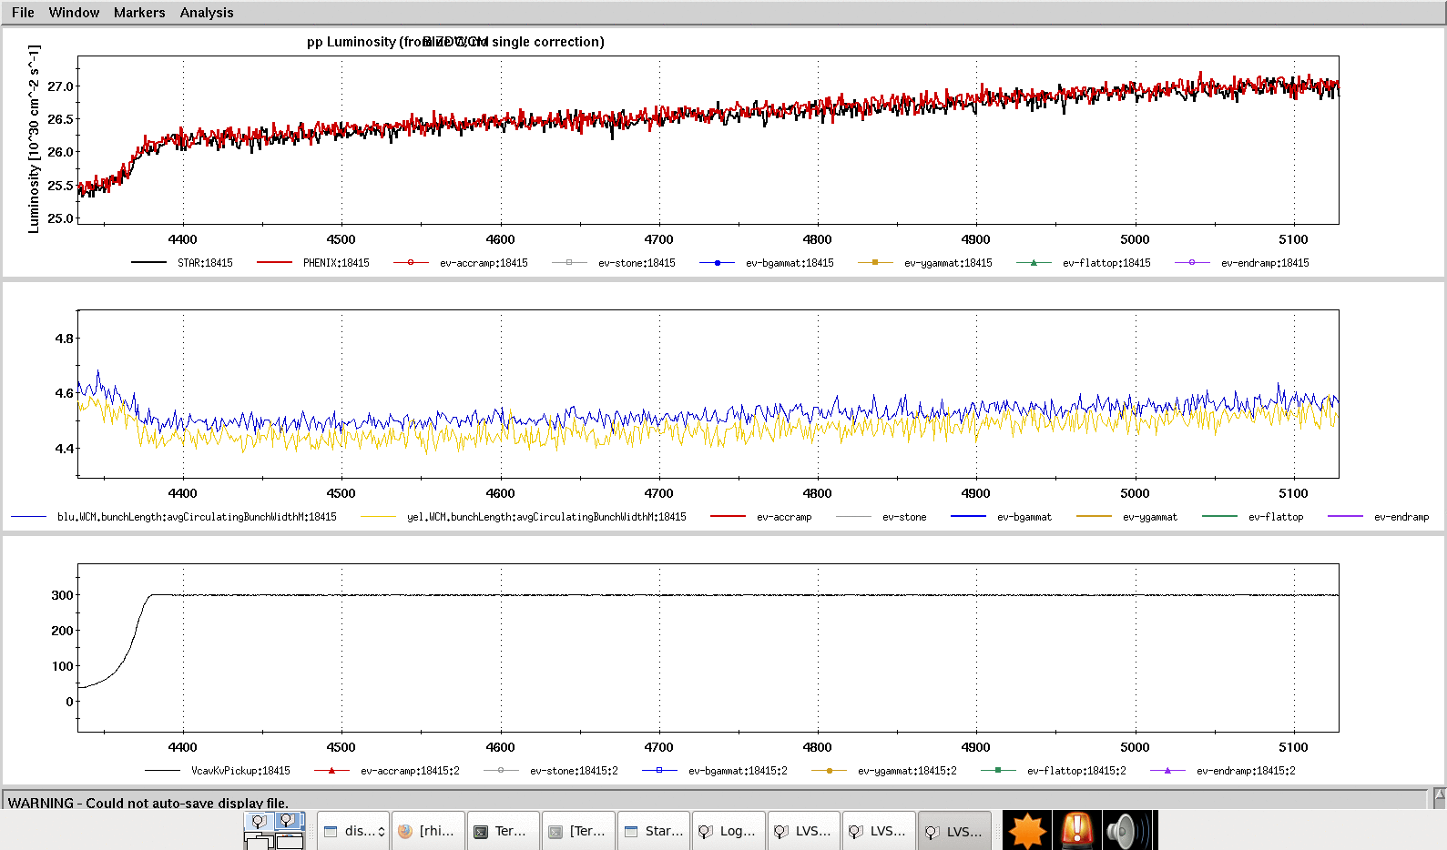
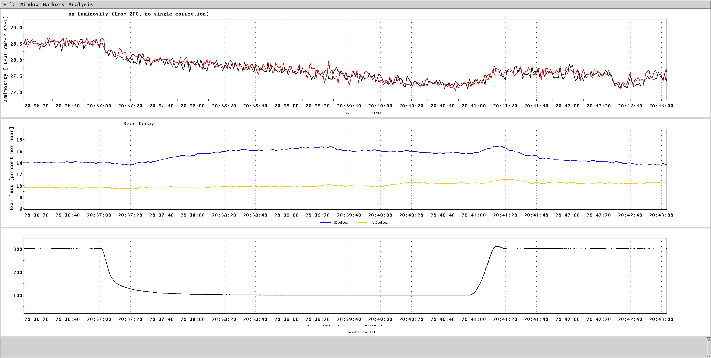
56 MHz Cavity effect on beam:
Luminosity
We observed change in the luminosity (increased by ~3%) as well as bunch length (decreased by ~4.5%) in both rings with the cavity slowly turned on. Fill 18415.
Bunch length
Cavity voltage
300kV
There was a short period of time during fill 18414 where the cavity voltage was brought down to ~100 kV intentionally, and back up to 300 kV after:
The luminosity in the physics experiments had a slight decrease (~3%) at the same time and came back with the cavity voltage.
The beam loss in the blue ring increased from 14% to 17% in the same period of time.
Luminosity
Beam decay
Cavity voltage
300kV
100kV

Slide 16
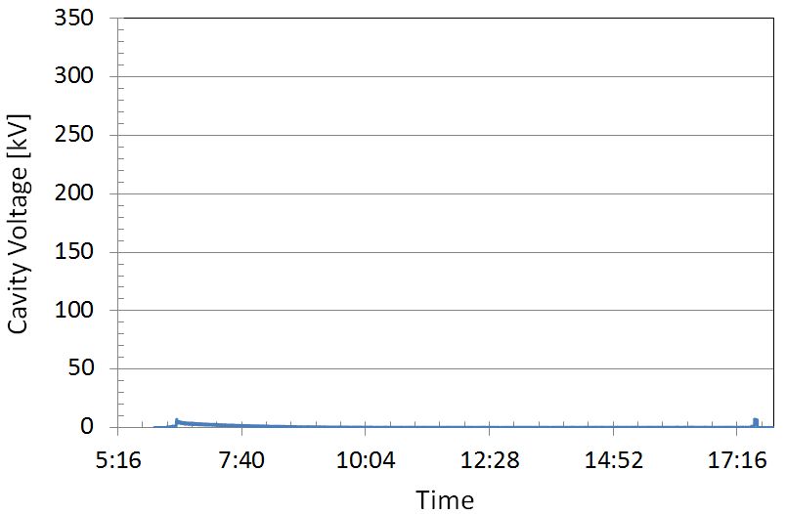
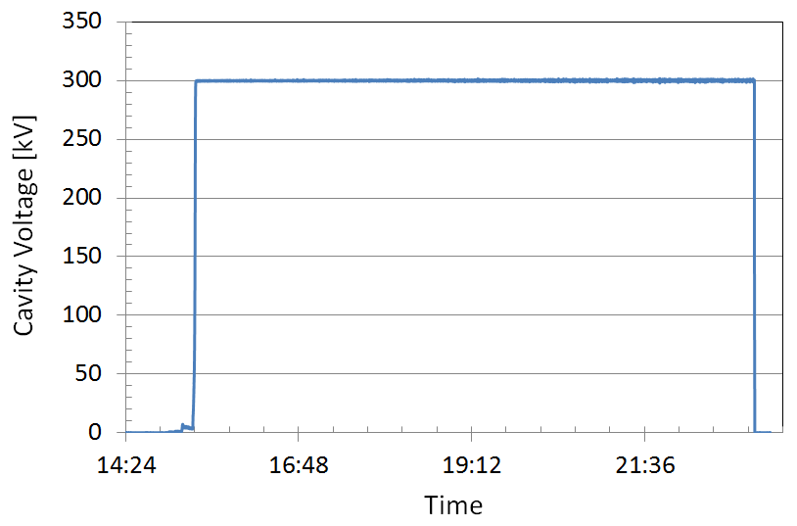
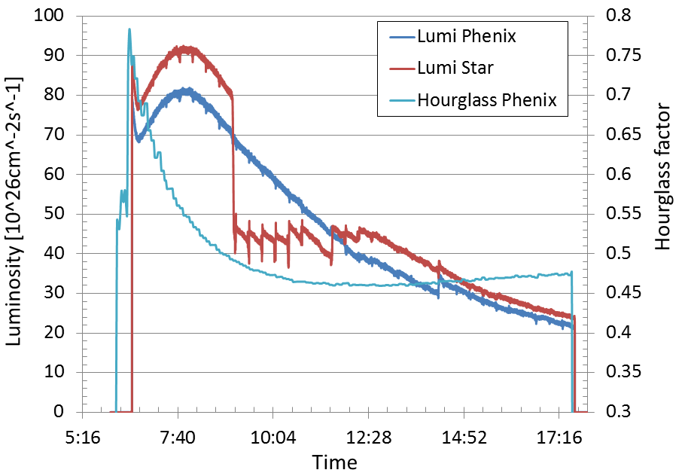
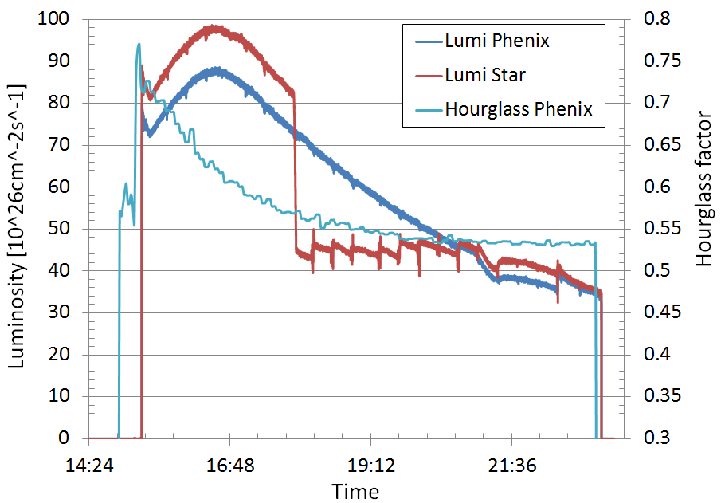
Fill 18411 without 56 MHz Cavity
Fill 18417 with 56 MHz Cavity
The hourglass effect is reduced by the 56 MHz cavity operated at 300 kV.

Slide 17
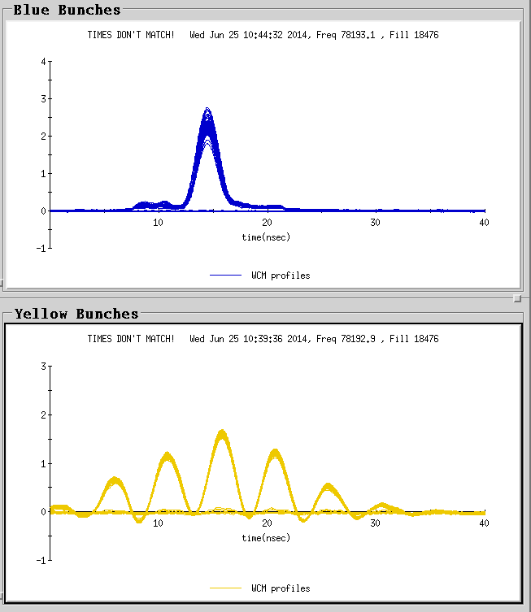
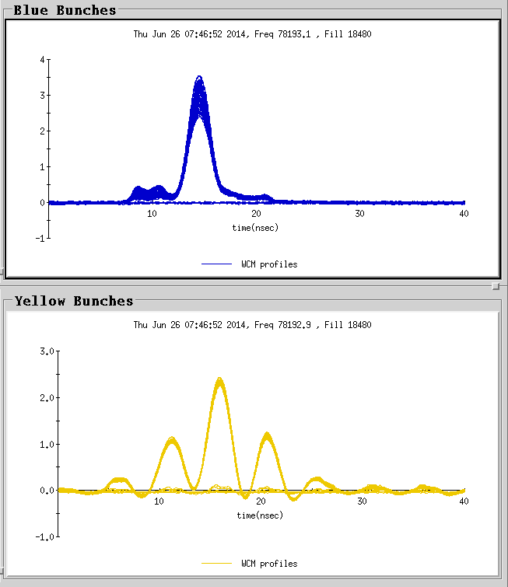
He3 (blue) and Au (yellow):
Left: Fill 18476 without 56 MHz cavity Right: Fill 18480 with 56 MHz cavity
During the asymmetrical collisions, the cavity also operated at 300 kV. The population of Au beam in the satellite buckets is squeezed towards the center.

Slide 18
Plan for Run 15
Plans on cavity and related systems:
Complete commissioning and optimization of LLRF system.
Continue investigation and remediation of beam driven ponderomotive instability.
Complete commissioning of LHe system. Achieve quiet, stable operation.
Commission robust protection of cavity and RHIC.

Slide 19
Plan for Run 15 cont’d
Plans on HOM dampers
No HOM damper installed
Pros:
Cold cavity (4K SC or Gas Cooled NC) is benign to RHIC with FMD inserted.
Damps fundamental and all HOMs.
Guarantees HOM Damper does not limit operating voltage. Potential to:
Achieve 2MV design voltage and investigate operating margin, or identify next limitation
Can be done with and without beam
Characterize HOMs and their impact on beam stability and lifetime.
Cons:
May not have sufficient HOM damping to operate the cavity with beam
Lean nothing about HOM damper
With HOM damper(s) installed
Pros:
Provides design HOM damping
Provides validation of HOM damper mechanical and RF design
Cons:
If the HOM damper still limits the cavity, no progress will be made for Run 16.
Options:
1 HOM coupler but change braze thickness, same penetration
2 HOM couplers with retracted penetration (can also change braze thickness)
‘Our decision (of having HOM dampers or not) needs to maximize the chance of having an operating cavity in Run-16’ -- Wolfram
Need final decision by September 15th

