Slide 1
AGS/Booster pp Study
Haixin Huang
(with inputs from L. Ahrens, Y. Dutheil, C. Gardner, C. Harper, B. Martin, D. Raparia, V. Schoefer, K. Zeno, S.Y. Zhang)
August 14, 2014
RHIC retreat

Slide 2
Goals (and Results) of AGS pp Run
Test the robustness of jump quad timing determination (new application to fit the measurements of energies, frequency, radius, tune and derive the jump quads timing). Done, worked well.
Commissioning AGS vertical eIPM. Get vertical emittance information. Get profiles but need more work to get beta function and measurement automation done.
With more intensity available from upgraded source, scrape more beam away to get brighter beam and higher polarization. Test showed no reduction in emittance. More study is needed.

Slide 3
New This Run
Much easier to reach high input intensity from polarized proton source.
Higher vertical tune near Booster injection to deal with stronger space charge force associated with higher input intensity.
Reduced cold snake solenoid field (current from 152->81A), based on new calculation on the magnetic field. The impact on snake strength is small, even at injection.

Slide 4
General Performance

Slide 5
Emittance and Polarization out of LINAC
Run11 Run12 Run13 Run14
Polarization at 200MeV Polarimeter ~77.5 ~79 ~81 ~84*
Current Booster input 10¹¹ 3.5 4.5 5.0 >6.0
Emittance Out of Tk 9 pi mm-mr H/V 5.3/6.3 4.5/5.0 3.5/3.5 4.75/4.75
* The polarimeter was moified to deal with higher intensity. So it is not the same polarimeter as before.
The error of emittance measurement is 20%. Is the larger emittance this year understood?
The emittance is measured better this year, as more devices are available.
The intensity at Booster input can be larger than 6.0*10¹¹.
The numbers before this year were from RHIC retreat presentation last year.
MW006 unscraped beam emittance of last two runs:
2/27/13 3/11/13 3/19/13 5/7/13 6/3/13 5/13/14 5/16/14
Horiz.( πμrad) 8.98 9.99 9.31 7.09 9.59 16.83 15.37
Vert. (πμrad) 8.74 8.19 8.28 8.35 8.01 10.30 11.04

Slide 6
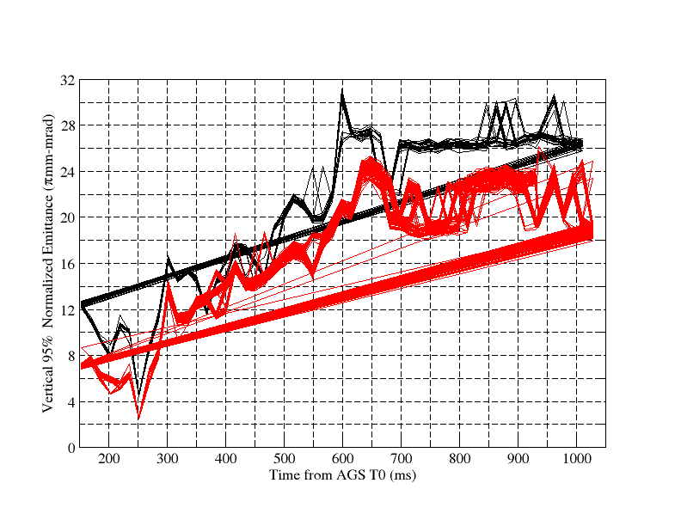
Vertical Emittance in Run 13 and 14(2*10¹¹)
The measured beta functions were used.
Flattop with RF off: 26->20π(run14); 22->17π(run13)

Slide 7
AGS Pol. Profile at Flattop Consistent with Larger Emittance This Year
P₀ is the polarization with zero emittance or source polarization. P^{V}_{max} equivalent to fixed target measurement done with vertical target.
Int P^{V}_{max} R_{H} P^{H}_{max} R_{V} P_{0_mea} Condition
2.0 70.96 0.36 0.092 0.007 67.84 0.41 0.086 0.010 78.85 0.73 Last Year
2.0 64.8 0.5 0.115 0.013 65.8 0.6 0.124 0.015 77.35 1.13 JQ on
2.0 58.9 0.5 0.207 0.016 59.0 0.5 0.213 0.016 78.46 1.20 JQ off
The expected P₀=80.33 for last year (based on 82% source polarization, spin mismatch at injection and vertical component at the polarimeter). One can see the agreement is reasonable.
The emittance is slightly larger this year. This is reflected in the larger R values.
The other underline statement is the polarization at AGS injection (P₀) is not very different from last year, or the polarization loss is imperfection resonance related (not shown in polarization profile).

Slide 8
Booster Scraping Study

Slide 9
No Benefit with Higher Booster Input
The emittance at end of linac does not dependent on intensity in this range. Vertical (blue) and horizontal (red) emittances at MW006. Increasing Booster input beyond 6e11 doesn’t provide a brighter beam.
Normalized 95% Emittance
Booster Input (10¹¹)

Slide 10
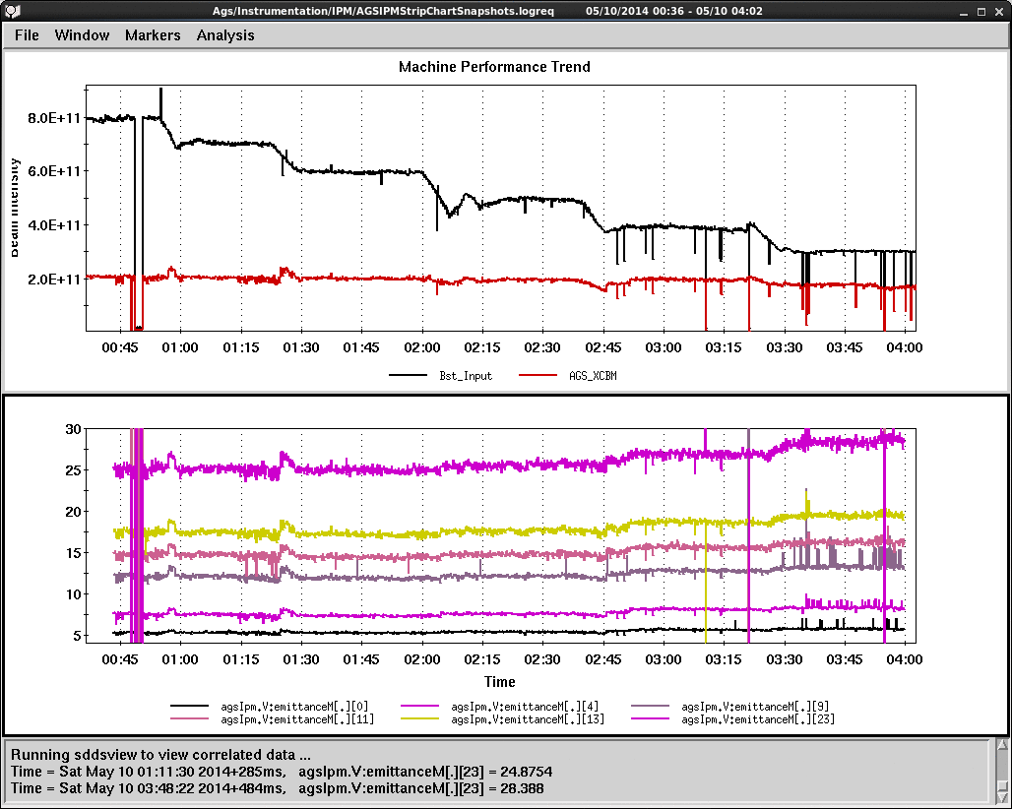
Vertical Emittance and Booster Input Intensity
Vary Booster input from 4 to 8*10¹¹ and maintain the AGS late as 2*10¹¹. Polarization and emittance were measured. There were no difference in the polarization and horizontal emittance, but the vertical emittance is reduced by about 10-15%. Probably source polarization is lower with higher intensity.

Slide 11
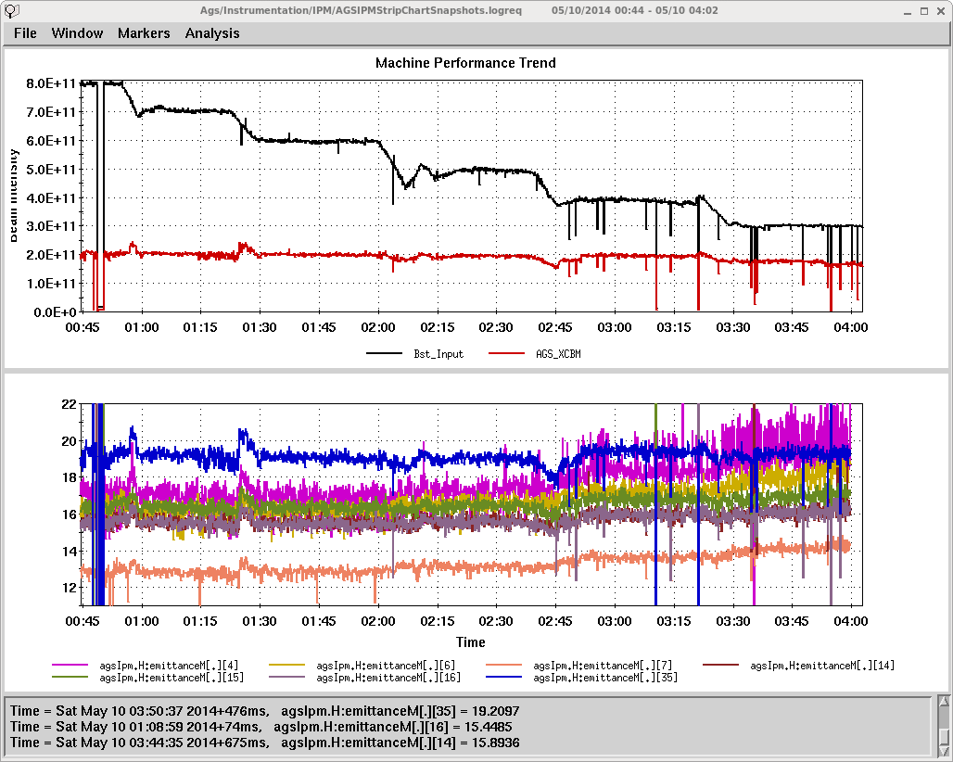
Not Much Change in Horizontal Emit. with 8*10¹¹ Input
Coming in with smaller emit with heavier scraping, but diminished at flattop. Is there a growth scheme associated with brightness? Or/and a limiting aperture?

Slide 12
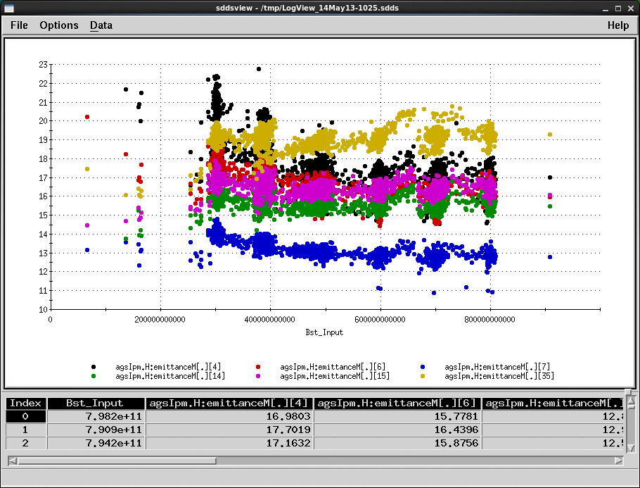
Horizontal Emittance vs. Booster Input Intensity
The larger injected emittance with lower Booster input diminished at flattop (yellow trace).

Slide 13
Vertical eIPM

Slide 14
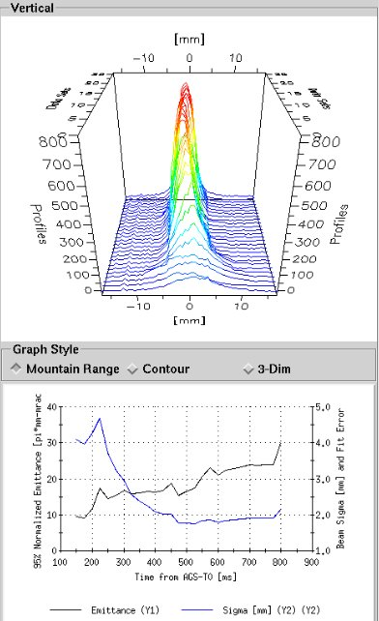
eIPM Multiple Vertical Emittance Measurements in One AGS Cycle
Beam profiles are on the top; beam size and emittance (constant beta function 22m is assumed) are in the bottom.
The beta function have been measured to get the true emittance. But the data (tune, orbit motion) quality is questionable and the analysis is still ongoing.
Done by Roger Connolly, Steve Tepikian, Rob Michnoff, Steve Jao and many others.

Slide 15
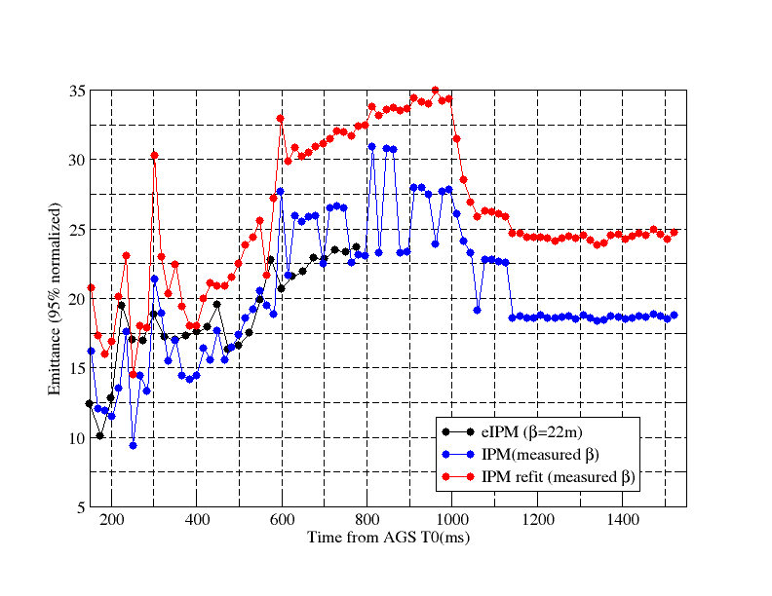
Vertical Emittance on the Ramp
eIPM and IPM in one AGS cycle. Beta function at both devices might be different near injection. RF off at flattop with old IPM gives 18-24pi for 2*10¹¹. Both devices give vertical emittance of ~20π at flattop, which demonstrated larger emittance than MW006 or injection. There is vertical emittance growth in AGS.
(Preliminary)

Slide 16
Comments about eIPM
It is a success with the short commissioning time.
The bias voltage for the MCP can not be adjusted fast enough on the ramp to give good profiles along the ramp: either too low at injection or too high at flattop.
It requires gas leak for good profiles. How to deal with Au beam need more study.
The range does not cover the injection part without a local orbit bump.
Some noise was observed in horizontal eIPM. Adding lead blanket did not eliminate the problem.
Preamp circuit needs to be modified for ramp measurement.

Slide 17
Booster Scraping Schemes
Vertical scraping at 131ms is used.
The effect can be adjusted by changing tunes on the ramp (coupling effect). One can adjust the relative size of vertical and horizontal.
An earlier scraping was also tested in run13 (3/19). Beam is more like a Gaussian. Beam is smaller vertically for later scraping, but is smaller horizontally for earlier scraping. It was a brief test and the results are preliminary.
The need of beam scraping (for polarization and emittance reason) suggests that we have emittance blowup in the Booster. The fact of scraping at different time gave different profiles implies that there are still some emittance blowup/exchange going on at later time.
More study on the timing of the scraping should be done in the coming run.

Slide 18
Plan for the Coming Run
Use double harmonic (h=1 and h=2) RF cavities in the Booster to reduce the peak current. RF group confirmed that the capability is still there after so many changes over these years.
Keith tuned the Booster injection and 20ms nearby. The emittance increase with intensity out of Booster is weaker. We will revisit this with higher input intensity, in hope of brighter beam.
The h=2 in the Booster was tested in run13 but with less Booster input than now. With more intensity coming in, more Booster scraping can be applied. Check emittance and polarization.
With h=2 in the Booster, do bunch merge in the AGS. The bunch merge at AGS flattop takes too long (~1 sec). Test merge at AGS injection to see if it is beneficial(emit/polarization). Items 3 and 4 are exclusive to the first two.
Wider source pulse (400μs vs. 300μs) was tested. No difference after vertical scraping. This was done without adjusting the injection setting. More testing will be in next run.
Simulation and modeling are needed for the Booster and AGS emittance.

Slide 19
Backup Slides

Slide 20
Study List
Beta function measurement at IPM and eIPM locations.
Coupling (dQmin) measurements at various energies on the ramp as fucntion of skew quad current.
ORM measurements at injection, a few points on the ramp.
Booster input intensity scan (check both intensity and emittance).
Turn by turn emittance measurement at AGS injection with eIPM.
Gain calibration for all wires of BtA MW006.
Gain calibration for all wires of AGS IPM.
Using horizontal tune jump system to do vertical tune jump near Gγ=5.
Test the new jump quad timing determination system.
Polarization ramp measurement with real time instead of Gauss Clock Count.
Polarization profile measurements (both horizontal and vertical).

Slide 21
Timeline
April 10: The AGS/Booster pp setup started after RHIC is in physics mode and AGS cold snake is ready.
April 15: Turn on cold snake.
April 29: 60% polarization with 2*10¹¹. Due to Siemens regulator issue, we stayed on slower ramp rate for April.
April 30: AGS vertical eIPM installation done. Commissioning started.
May 2: Switched to regular ramp rate on May 2. Polarization with JQ on is about 62-64% with 2-2.5*10¹¹.
May 10: Booster scraping test.
May 19-23: He3 beam test for one week in the middle of proton operation.
May 25: change focus to eIPM commissioning, beta function measurement. Beta function measurements at IPM and eIPM were done. But we do have issues with these data. This prevented us from assess the vertical emittance at this point.
June 4: The pp run finished.

Slide 22
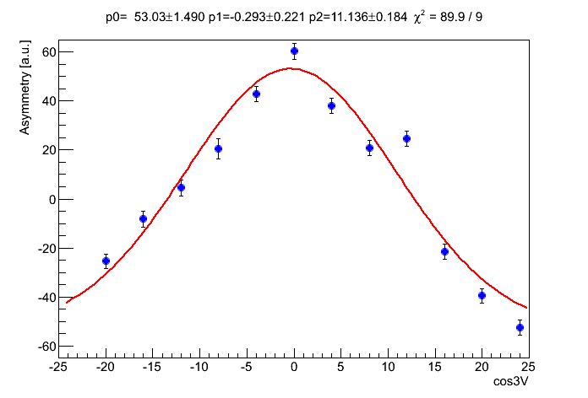
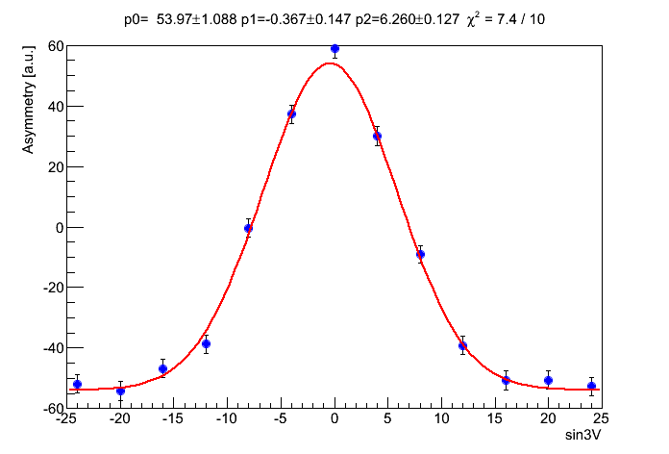
Polarization @ Injection
Last year: asymmetries ranged from 648 to 775 with various targets. But if limit to 45 deg. detectors and good amplitude selection, the range narrows to 735 to 775.
This year: asymmetry at 700.
Possible difference: 1. external clock 2.96MHz vs. 4.44MHz; 2. different 90 deg. detectors; 3. different amplitude range; 4. different target positions.
Because of longer bunch, the carbon banana selection is trickier than at flattop. We are going to analyze data using the core part of the amplitude range for last year and this year.

Slide 23
Booster Input Scan
B_Input AGS late Polarization MW006 hori σ MW 006 vert. σ
8 2. 65.1+-1% 1.924 1.907
7 2. 65.3+-1% 1.898 1.964
6 2 64.7+-1% 1.892 1.955
5 2 66.1+-1% 1.817 2.132
4 2 68.8+-1% 1.729 2.477
3 1.8 66.5+-1% 1.690 3.483
Overall AGS late intensity was around 2, except the case with B_input as 3.
When B_input is equal or less than the nominal value 5, the scraping ratio between H&V changed (not intentionally, but less scraping in vertical resulted more beam to be scraped in horizontal). So it is not a one dimensional (vertical) experiment anymore.
The horizontal fit in MW006 is always poorer than vertical (so NOT due to scraping).
Last 3 rows are with higher polarization and smaller horizontal beam sizes.

Slide 24
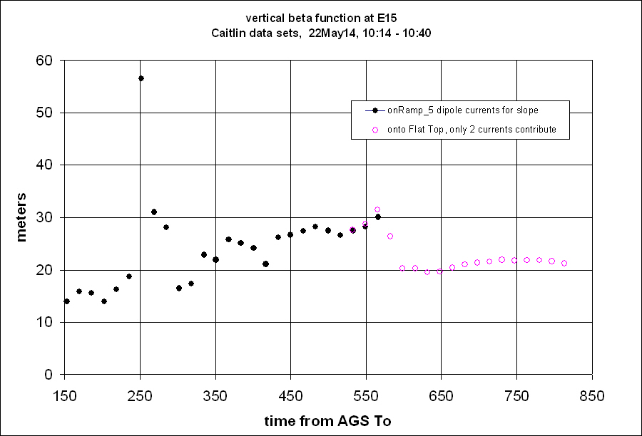
Measured Vertical Beta Function at E15 IPM

Slide 25
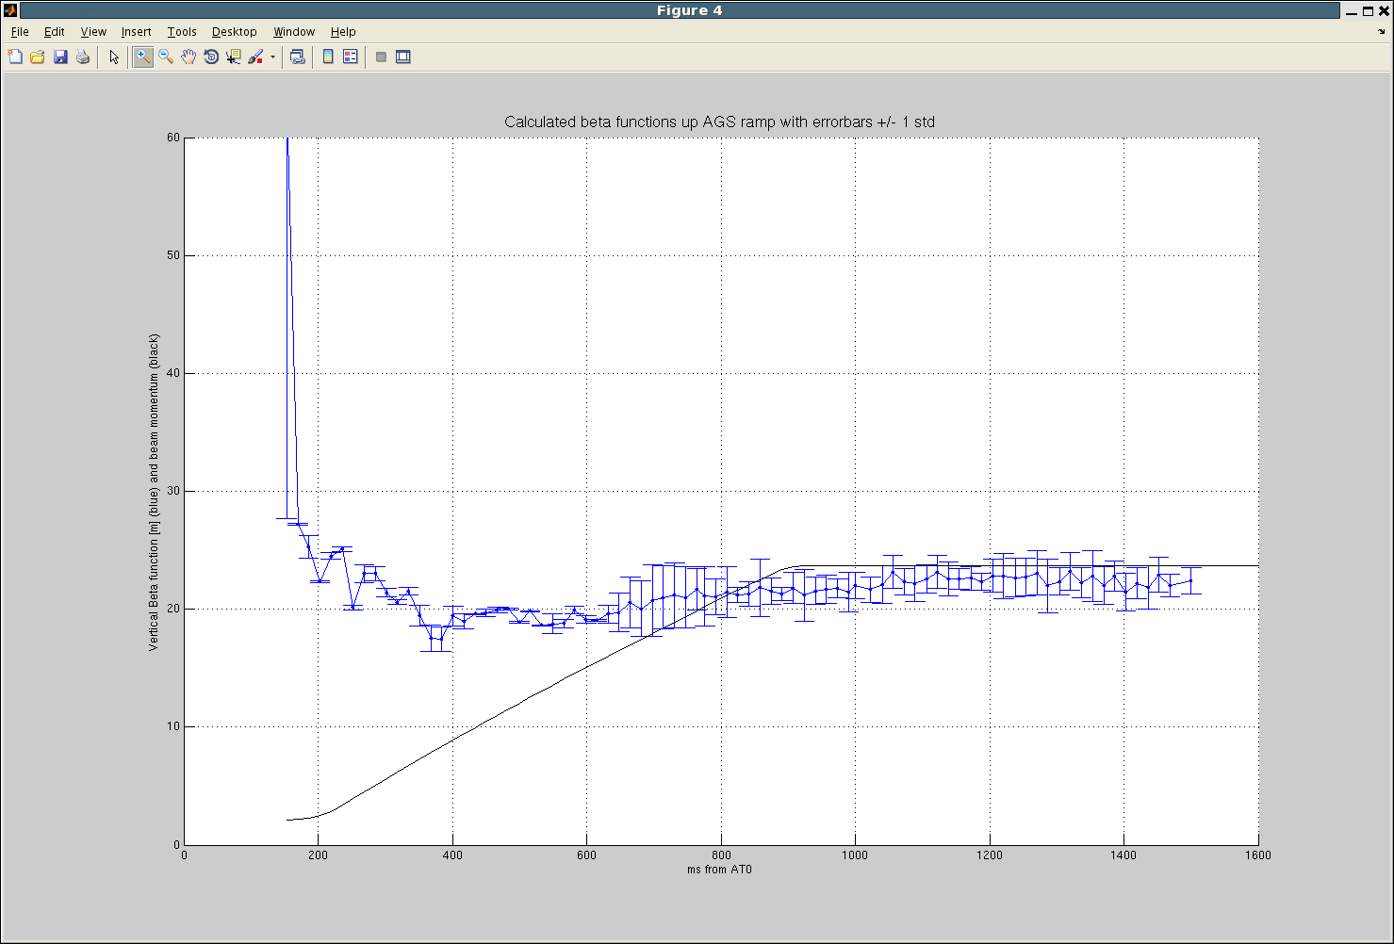
Beta Function Measurement
(Analyzed by Caitlin)
E15 vertical beta function measurement for no snake machine (but unfortunately with large skew quad current, which introduced coupling). At flattop, it is close to 21m (model 22m). This can provide a calibration for kick strength.

