Slide 1
From RHIC to erHIC
Exploring the Quark Sea
and the Gluon Ocean
Berndt Mueller
ALD for NPP
RHIC Retreat
13 August 2014

Slide 2
The Mysterious
Gluon

Slide 3
Standard Model particles
Gluons are gauge bosons like photons (massless and spin 1), but they carry the SU(3) color “charge”.
Gluons carry no electric or weak charge - they cannot directly interact with photons.

Slide 4
Quantum chromodynamics
= Gauge theory of SU(3) color
Quark emits or absorbs a gluon
Gluon emits or absorbs a gluon
Gluon scatters on another gluon
Quark
Quark
Gluon
Gluon
Gluon
Gluon
Gluon
Gluon
Gluon
Gluon
Color Flow
Gluon
Gluon
Quark
Quark
Gluon
Gluon

Slide 5
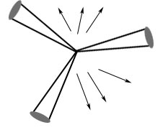
Three-jet events
Originally discovered by TASSO @ DORIS
Later explored in great detail at LEP
quark-antiquark-photon 3-jet
= color flux tube (Lund “string”)
quark-antiquark-gluon 3-jet

Slide 6
Gluons are strange objects
Gluons, like quarks, never occur in isolation.
Quarks are always accompanied by virtual gluons.
States solely made of gluons (“glueballs”) should exist, but have not been unambiguously identified.
Free space without glue fields is unstable against the spontaneous formation of chromo-magnetic fields.
We are constantly immersed in a gluon condensate, just like the Higgs condensate: ⟨G²⟩^{1/4} ≈ 0.6 GeV, with ⟨E²⟩ = - ⟨B²⟩, so that the energy density ⟨E²+B²⟩/2 = 0.
The detailed structure of the gluon condensate and the mechanism by which it creates quark confinement is still unknown - many different models compete.

Slide 7
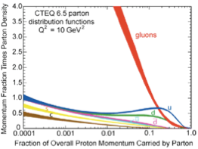
Gluon Ocean and Quark Sea
Gluon “Ocean”
Quark Sea derives from
Gluon Ocean via gluon splitting
into a quark-antiquark pair:
suppressed by factor αs/π.
Clean separation from
valence quarks requires
experiments probing x < 0.01,
or nucleon energies of order
100 GeV.
RHIC provides polarized protons
of up to 255 GeV and nuclei
up to uranium up 100 A GeV.
Quark “Sea”

Slide 8
RHIC:
A universal hadron collider

Slide 9
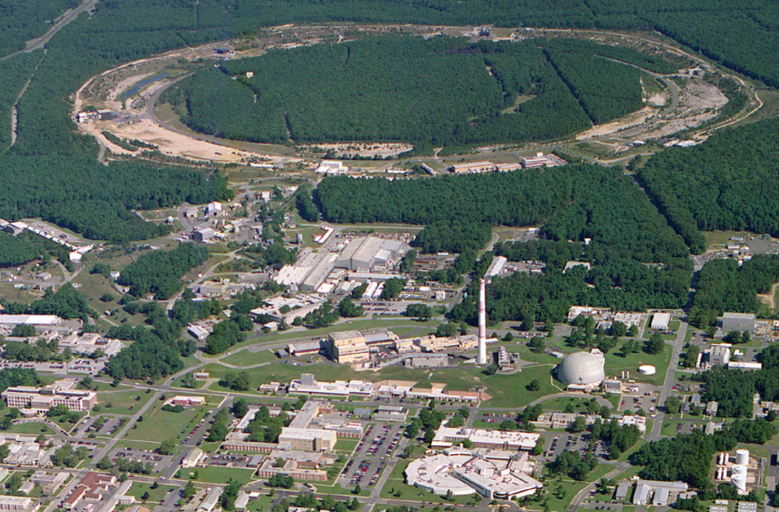
RHIC – a High Luminosity (Polarized) Hadron Collider
Polarized Jet Target
12:00 o’clock
10:00 o’clock
RHIC
(CeC)
2:00 o’clock
PHENIX
8:00 o’clock
RF
4:00 o’clock
STAR
6:00 o’clock
LINAC
NSRL
EBIS
Booster
BLIP
AGS
Operated modes (beam energies):
Au – Au 3.8/4.6/5.8/10/14/32/65/100 GeV/n
U – U 96.4 GeV/n
Cu – Cu 11/31/100 GeV/n
p↑ – p↑ 11/31/100/205/250/255 GeV
d – Au* 100 GeV/n
Cu – Au* 100 GeV/n
³He – Au* 100 GeV/n
Planned or possible future modes:
Au – Au 2.5 GeV/n p↑ – Au* 100 GeV/n
p↑ – ³He↑* 166 GeV/n (*asymmetric rigidity)
Tandems

Slide 10
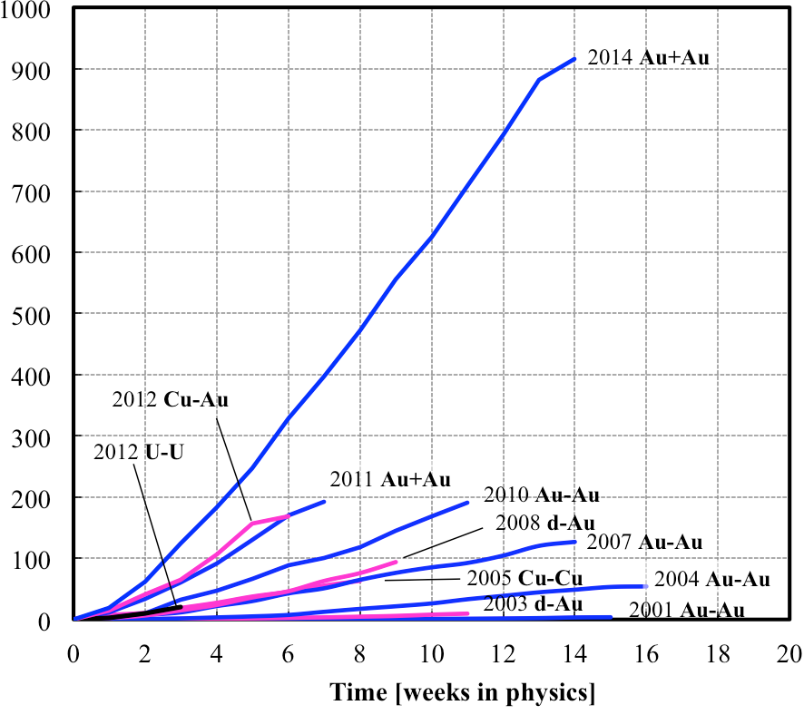
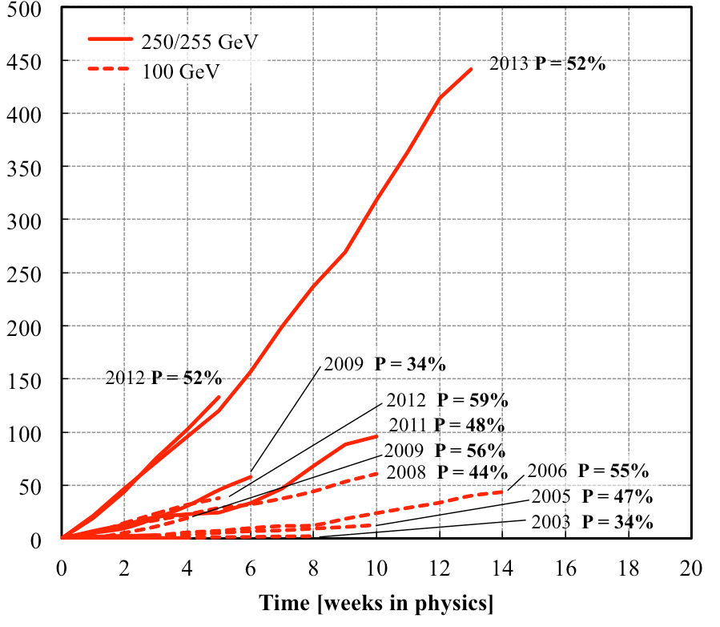
RHIC-II Performance
Heavy ion runs
Polarized proton runs
2014
2013
Integrated luminosity L [pb⁻¹]
Dramatic increase in performance of RHIC as a result of 3-D stochastic cooling, new high intensity
ion source (EBIS), and other improvements (beam-beam compensation, IR compression, etc.).

Slide 11
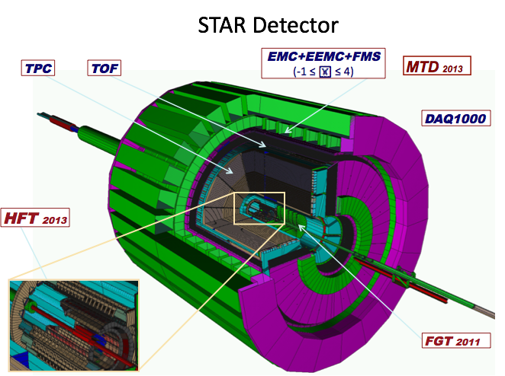
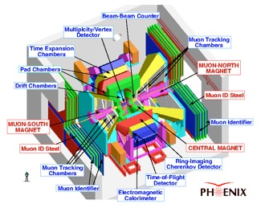
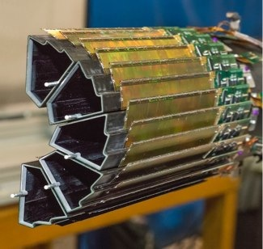
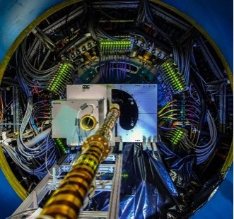
RHIC Detectors
17 subsystems
NEW: Heavy Flavor Tracker

Slide 12
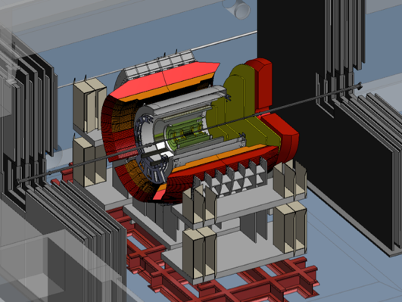
Completing the RHIC Science Mission
Status:
RHIC-II configuration is now complete
Vertex detectors in STAR (HFT) and PHENIX
RHIC Run 14 – Integrated Au+Au luminosity exceeds all previous Au+Au runs combined
Plan: Complete the RHIC Mission in 3 campaigns:
2014/15/16: Heavy flavor probes of the QGP, transverse polarized proton measurements
Install low energy e-cooling in 2017
2018/19: High precision scan of the QCD phase diagram
Install sPHENIX upgrade in 2020
2021/22: Precision measurements of jet quenching and quarkonium suppression, forward p+A physics
RHIC shutdown and transition to eRHIC
STAR with HFT
sPHENIX
RHIC remains a unique discovery facility
Notes:
The suite of upgrades of the RHIC accelerator and its detectors is now complete: The beam intensity of RHIC has been vastly increase thanks to 3-dimensional stochastic cooling, and the STAR and PHENIX detectors have been equipped with silicon vertex detectors that permit the identification of rapidly decaying heavy (charm and bottom) quarks. The integrated luminosity reach in this year’s RHIC run with gold beams exceeded that achieved in all 13 previous RHIC runs combined!
Our plan is now to complete the scientific mission of RHIC in 3 multi-year campaigns: In 2014-16 we will probe the properties of the strongly coupled QGP using heavy quarks, which are especially well suited to explore its interactions. After installing a new type of cooling more effective at low beam energies, using electrons as the cooling medium, in 2017, we will perform a high precision scan of the QCD phase diagram in 2018-19. One objective of this campaign is to find and locate a conjectured critical point in the phase diagram. We will then upgrade the PHENIX detector to a more powerful configuration, named superPHENIX, which will allow RHIC to perform precision measurements in 2021-22 of the interactions of quark jets and atoms of heavy quarks called quarkonia with the quark-gluon plasma. These probes will help us elucidate the internal structure of the quark-gluon plasma. We then plan to shut RHIC down and transition the RHIC complex to an electron-ion collider facility (eRHIC) to begin operations as early as 2025, budgets permitting.
For the next several years, however, RHIC will remain an extraordinarily productive, unique discovery facility producing approximately 30 PhDs per year and garnering more than 3,000 citations of its scientific publications.

Slide 13
Gluon liberation
or
What does hot “empty” space
look like?

Slide 14
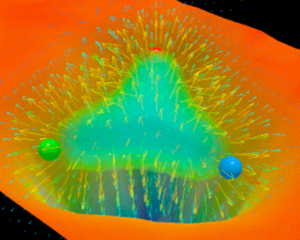
Melting the QCD vacuum
What RHIC does:
RHIC collides many nucleons (as atomic nuclei) and thereby liberates the gluons into a highly excited state (“glasma”) that thermalizes into a quark-gluon plasma.

Slide 15
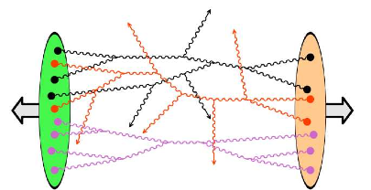
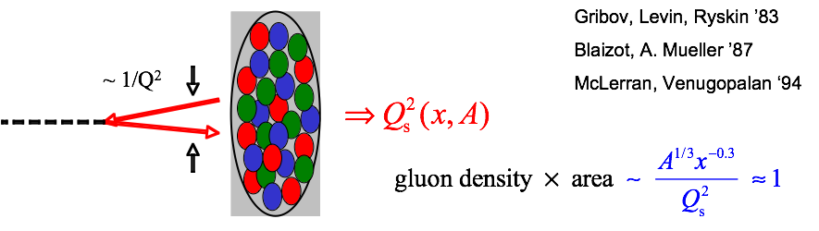
Consensus Model Anno 2014
CGC
“Glasma”
Hydrodynamics
Hadronic gas
Color Glass
Condensate
“Glasma”

Slide 16
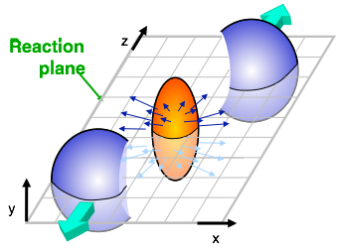
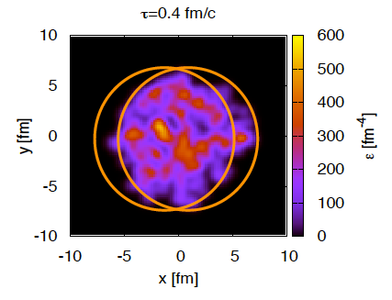
Elliptic flow “measures” η_{QGP}
two nuclei collide rarely head-on, but mostly with an offset:
Density fluctuations in the colliding nuclei are sampled event by event
anisotropic flow coefficients
event plane angle

Slide 17
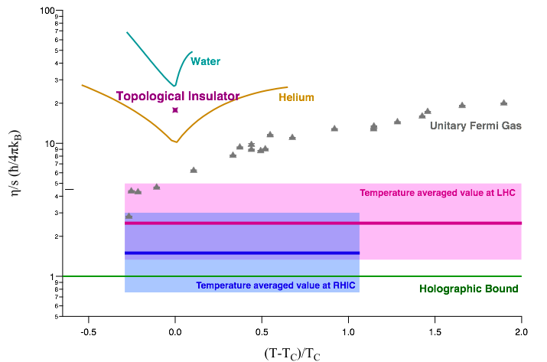
Hot glue is a “perfect” fluid
Hot matter produced in collisions at RHIC/LHC is a liquid quark-gluon plasma (QGP). The plasma is made up of individually flowing gluons and quarks, not quarks bound into baryons and mesons.
The QGP is a strongly coupled nearly “perfect” liquid (η/s near the quantum limit 1/4π). RHIC’s cooler QGP is (on average) closer to perfection than the 40% hotter QGP produced at LHC.

Slide 18
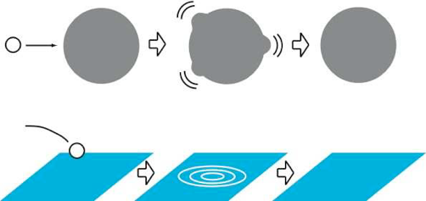
The Black Hole connection
Dynamics of hot QCD matter can be mathematically (holography) mapped onto black hole dynamics in 4+1 dimensions (AdS5 space).
BH swallowing matter
Perfect fluid hydrodynamics
Formation of hot QCD matter at RHIC is analogous to formation of a black hole, tied to information loss. Relies on the notion that ‘t Hooft coupling g²Nc ~ 12 is large enough to apply the classical limit of the dual theory:

Slide 19
Gluon polarization
or
Where is the proton spin?

Slide 20
RHIC Spin program
More 200 GeV
longitudinally
and transversely
polarized p+p
in Run 15;
maybe 510 GeV
transverse p+p
data in Run 16
Transverse
Transverse
Longitudinal Spin Structure
Gluon Spin
Sea Quark Spin
Transverse Spin Structure
Sivers Effect
Collins Effect
Higher Twist
Upgrades in process
Planned for Run 15

Slide 21
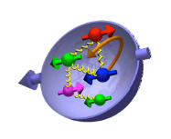
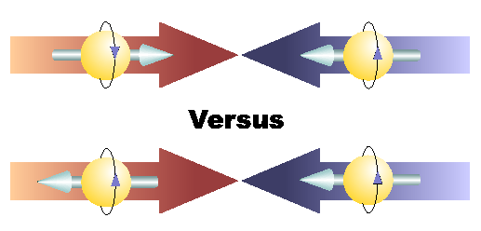
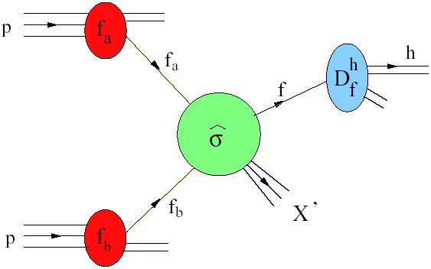
Where is the proton spin?
+
Helicity
+
p
p
-
+
p
p
Polarized DIS tells us that ΔΣ ≈ 0.3
Q² evolution in polarized DIS gives information on gluon polarization but limited kinematic coverage leaves ΔG poorly constrained
A primary goal of RHIC Spin program is to map Δg(x)

Slide 22
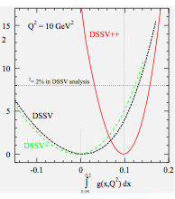
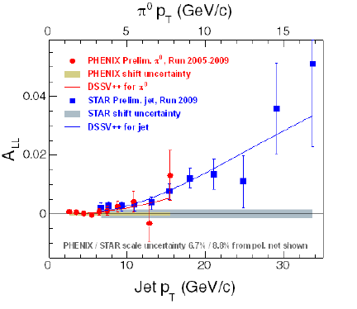
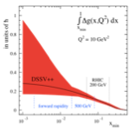
Δg from π⁰ and jets
QCD global fit
PHENIX: π⁰ production
(less sensitive, dominated by quarks)
STAR: jet production
(higher gluon contribution)
~60% of the
proton spin?

Slide 23
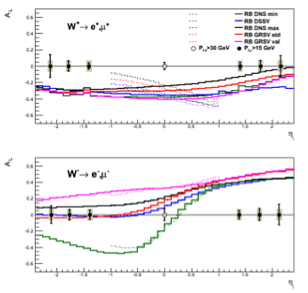
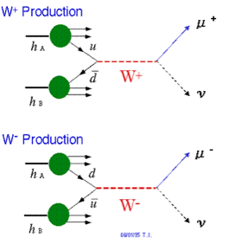
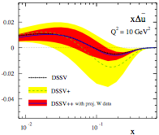
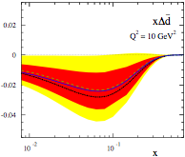
Sea quark polarization
Projected results from Run 13
Self analyzing due to parity violating W-decay
Clean flavor separation possible in different kinematic regions
No fragmentation uncertainty

Slide 24
The Electron-Ion Collider:
A Microscope for Gluons

Slide 25
Where are the gluons?
Lattice simulation with
artificially frozen quarks
D. Leinweber (Adelaide)

Slide 26
EIC: A color dipole microscope
Free color charges (quarks, gluons) do not exist, but color dipoles do! Virtual photons are a good source.
e⁻
Two resolution scales:
momentum k (longitudinal)
virtuality Q (transverse)
⇒ More powerful than an optical microscope!
γ*
HERA was the 1st
generation color
dipole microscope.
Limited intensity
and no polarization.
The EIC will be the
2nd generation color
dipole microscope!
Color dipole
“sees” gluons

Slide 27
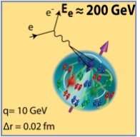
Electron-Ion Collider (EIC)
The 2013 NSAC Subcommittee on Future Facilities identified the physics program for an Electron-Ion Collider as absolutely central to the nuclear science program of the next decade.
Why now?
A powerful formalism has been developed over the past decade that connects measurable observables to rigorously defined properties of the QCD structure of nucleons and nuclei.
A set of measurements has been identified that can answer many of the open questions about the gluon structure of the proton and of nuclei.
Accelerator technology has reached a state where a capable EIC can be constructed at an affordable cost.
The EIC White Paper
(arXiv:1212.1701)

Slide 28
EIC - the ultimate
QCD Laboratory

Slide 29
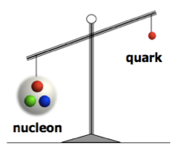
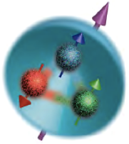
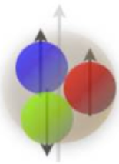
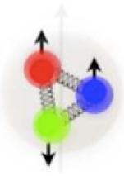
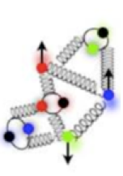
EIC: A QCD laboratory
m_{q} ~ 10 MeV
m_{N} ~ 1000 MeV
Proton mass puzzle:
Quarks carry ~1% of the proton’s mass
How does glue dynamics generate the energy for the nucleon mass?
Proton spin puzzle:
Quarks carry only ~30% of the proton’s spin
How does quark and gluon dynamics generate the rest of the proton’s spin?
3D structure of nucleon:
Color Confinement
Asymptotic freedom
200 MeV (1 fm)
2 GeV (1/10) fm)
Probing
momentum
How does the glue bind quarks and itself into a proton and nuclei?
Can we scan the nucleon to reveal its 3D structure?

Slide 30
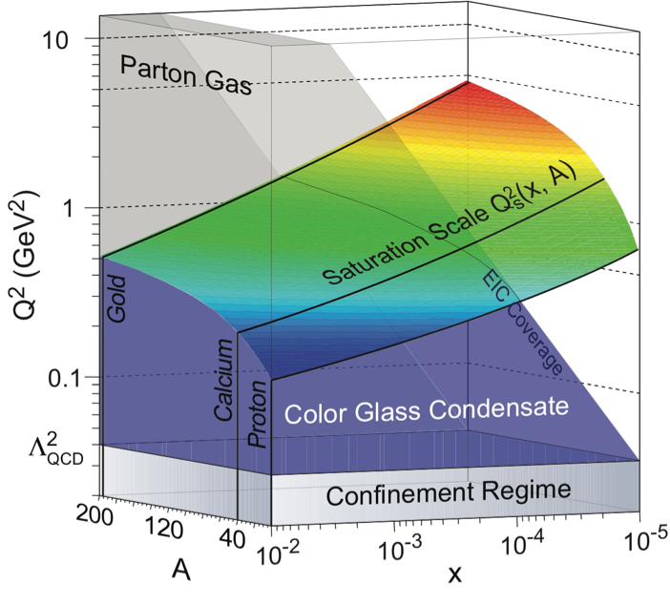
Dense gluon systems
How do gluons saturate in nuclei into a new form of matter?
Color Glass Condensate
Gluons, unlike photons:
Split:
Fuse:
Dynamical scale Q_{s} from the balance
New conceptual framework
Universal properties (CGC)
From the EIC White Paper
Needs a heavy ion beam!

Slide 31
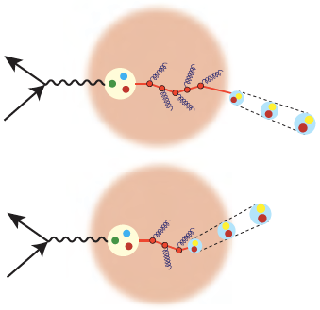
The nucleus is a “femtoprobe”
How do hadrons emerge from a created quark or gluon?
Neutralization of color = hadronization
Femtometer detector/scope:
In vacuum
Nucleus, a laboratory for QCD
Quark/gluon properties:
Initial-condition for hadronization
Inside the
nucleus
Semi-inclusive DIS
From the EIC White Paper
Needs a probe to precisely control the initial condition!
15

Slide 32
eRHIC:
EIC @ BNL

Slide 33
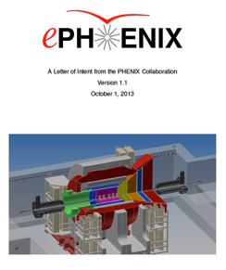
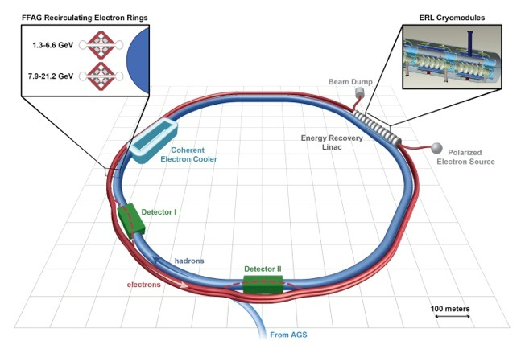
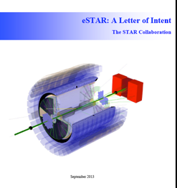
EIC Design
eRHIC ERL + FFAG ring design @ 10³³/cm²s
15.9 GeV e⁻ + 255 GeV p or 100 GeV/u Au.
ePHENIX and eSTAR
Letters of Intent
eRHIC
When completed, eRHIC will be the most advanced and energy efficient accelerator in the world

Slide 34
A revolutionary concept
eRHIC will be a unique, world leading accelerator facility combining several innovative concepts:
World’s first linac-ring collider
99.8% efficient energy recovery linac (ERL)
FFAG arcs each propagating beams with multiple energies
Low cost permanent magnets for the FFAG arcs
Coherent e-cooling (CeC) for record high beam brightness
“Crab” crossings for low background interaction regions
While some of these concepts have been tested at other facilities, their unique combination will create a “green” collider facility of unprecedented energy efficiency at affordable cost.
Estimated target cost for the accelerator: $550M. Bottom-up cost estimate is in progress.

