Slide 1
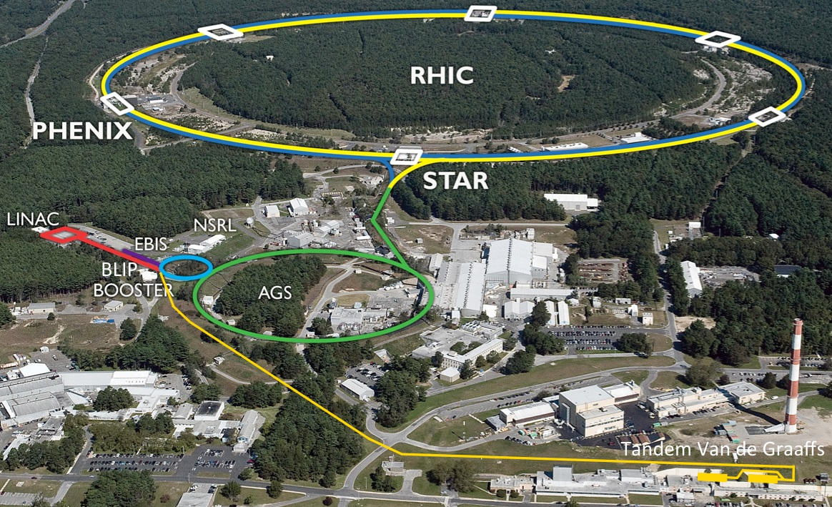
Projections for Run-15 Wolfram Fischer
13 August 2014
RHIC Retreat, BNL
Notes:
13 August 2014, 09:50, 20 min (incl. questions)

Slide 2
Contents
Recent performance, limits
Major upgrades
Species and energies for Run-15
Projections for Run-15

Slide 3
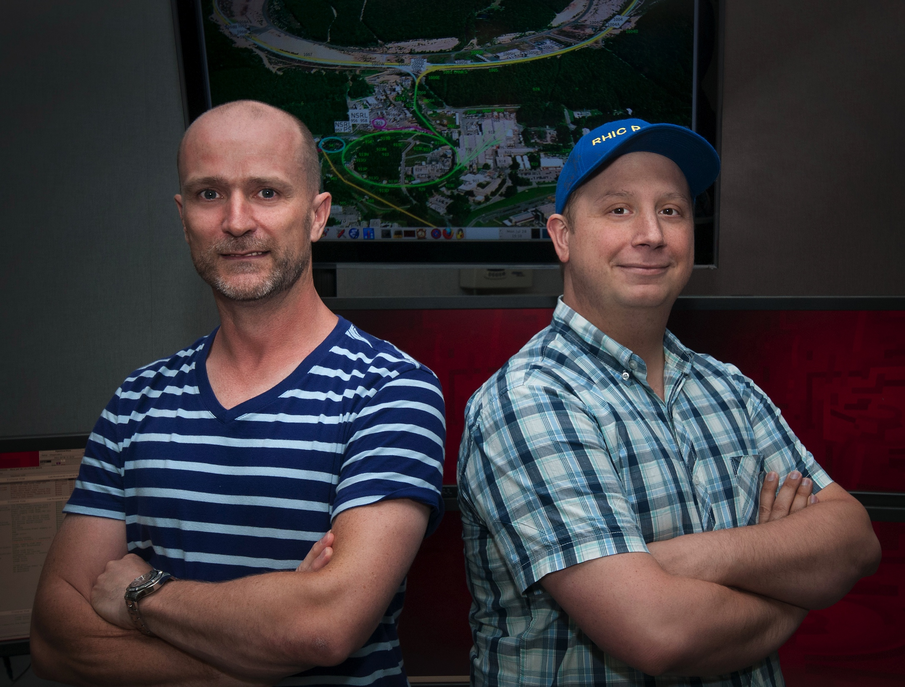
RHIC Run-14
Beam operation
began on 9 February 2014, 11pm ended on 6 July 2014, 7am
3 operating modes
Au+Au at 7.3 GeV/nucleon beam energy (31 days) last energy in the Beam Energy Scan I for search of the critical point in nuclear matter phase diagram
Au+Au at 100 GeV/nucleon (97 days) high-statistics run, integrated luminosity larger than all previous runs combined
h+Au at 100 GeV/nucleon (20 days) first collision of “triangular” helium-3 with Au

Slide 4
DOE Office of Science web site, 12 August 2014

Slide 5
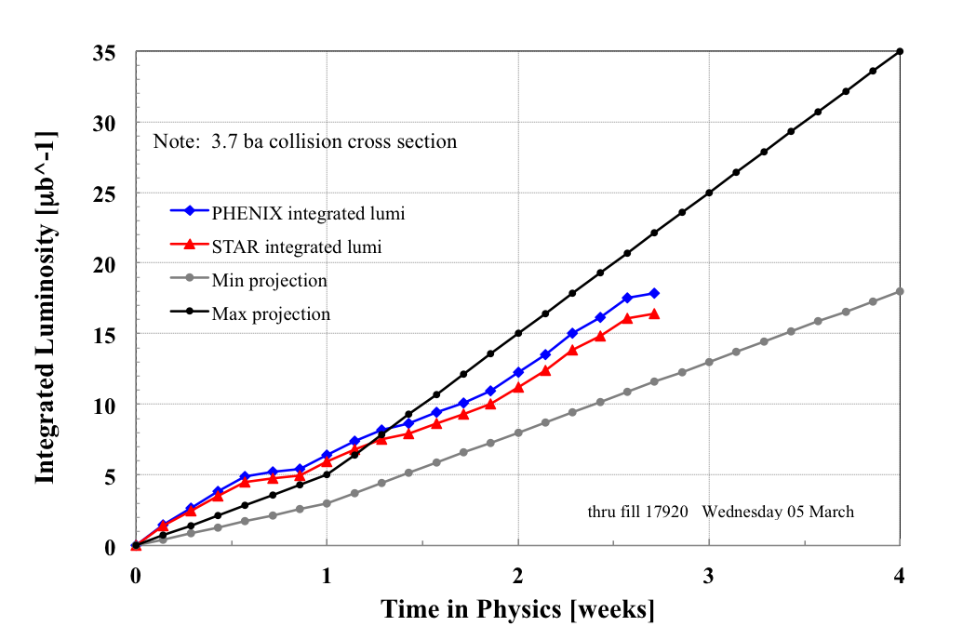
Run-14: Au+Au 7.3 GeV/nucleon RC: C. Montag
AGS extraction below and close to γ_{tr}
used lattice suitable for LEReC B IP2 (β_{x},β_{y})=(23,14)m Y IP2 (β_{x},β_{y})=(13,49)m
raised STAR by 7mm
VODH system
Use of Westinghouse MG set after Siemens failure

Slide 6
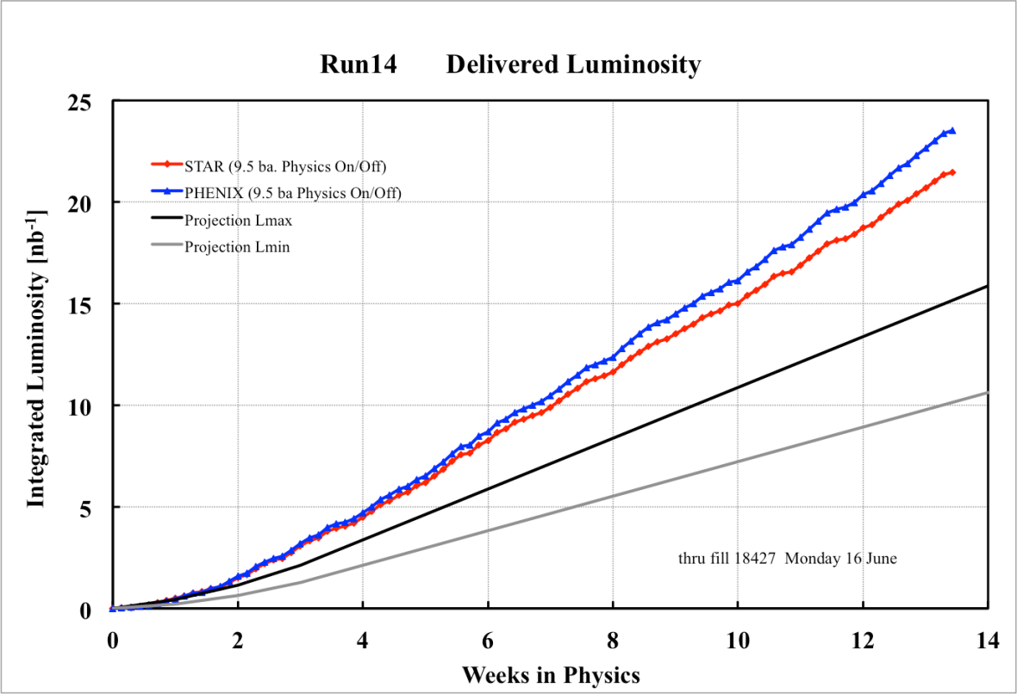
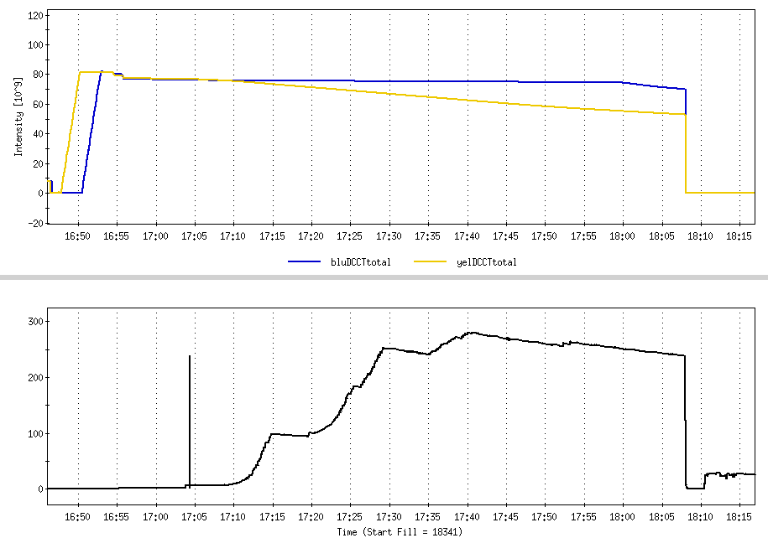
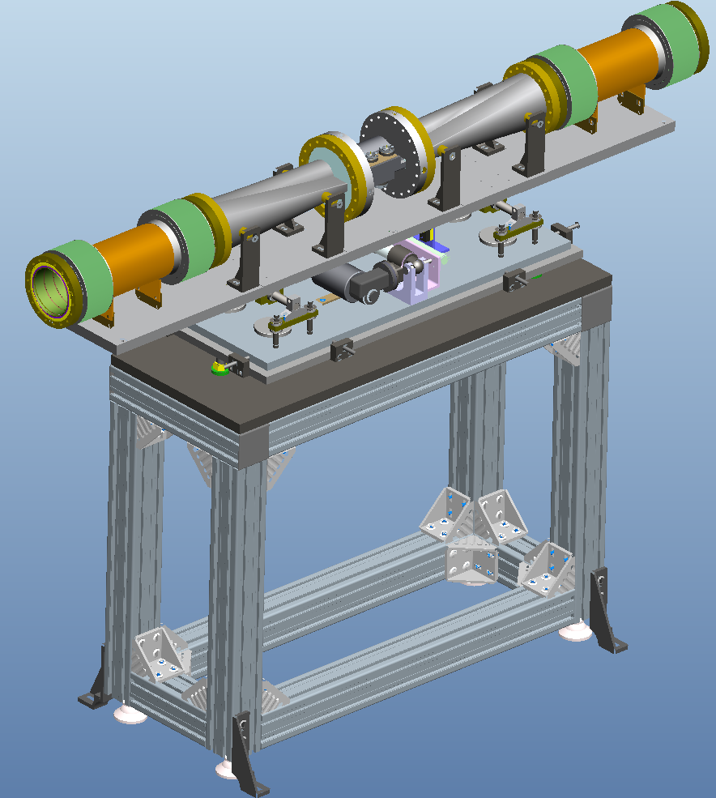
Run-14: Au+Au 100 GeV/nucleon RC: G. Robert-Demolaize
No limit from transition instability like in previous years (due to scrubbing with protons in Run-13)
potential for increase in bunch intensity (LION/EBIS)
protection bumps
1st dynamic β-squeeze
120
Blue and Yellow intensities
Shape transition
Bellows
300
56 MHz cavity voltage, generated by beams

Slide 7
RHIC Run-14 Delivering RHIC-II luminosity
Increase in initial luminosity result of larger bunch intensity
Increase in luminosity lifetime result of 3D cooling, >90% burn-off
2014, End of RHIC-II upgrade
2007, Beginning of RHIC-II upgrade

Slide 8
Run-14: h+Au 100 GeV/nucleon RC: G. Robert-Demolaize
Increase in h bunch intensity:
>4x relative to 2013
(4=>2=>1 merge in AGS)
Horizontal orbit excursions:
Blue : 10 mm in IR6,8 Yellow: 10 mm in IR6,8; 5 mm in IR2,4,10,12

Slide 9
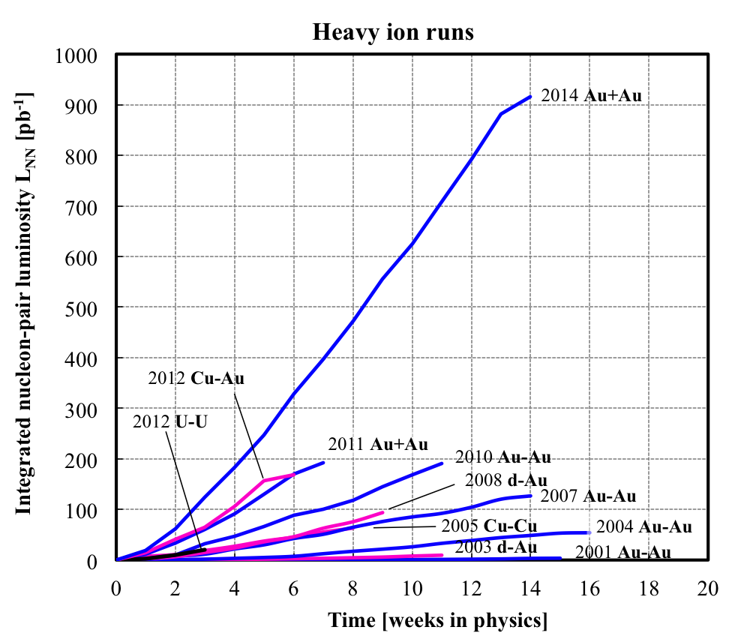
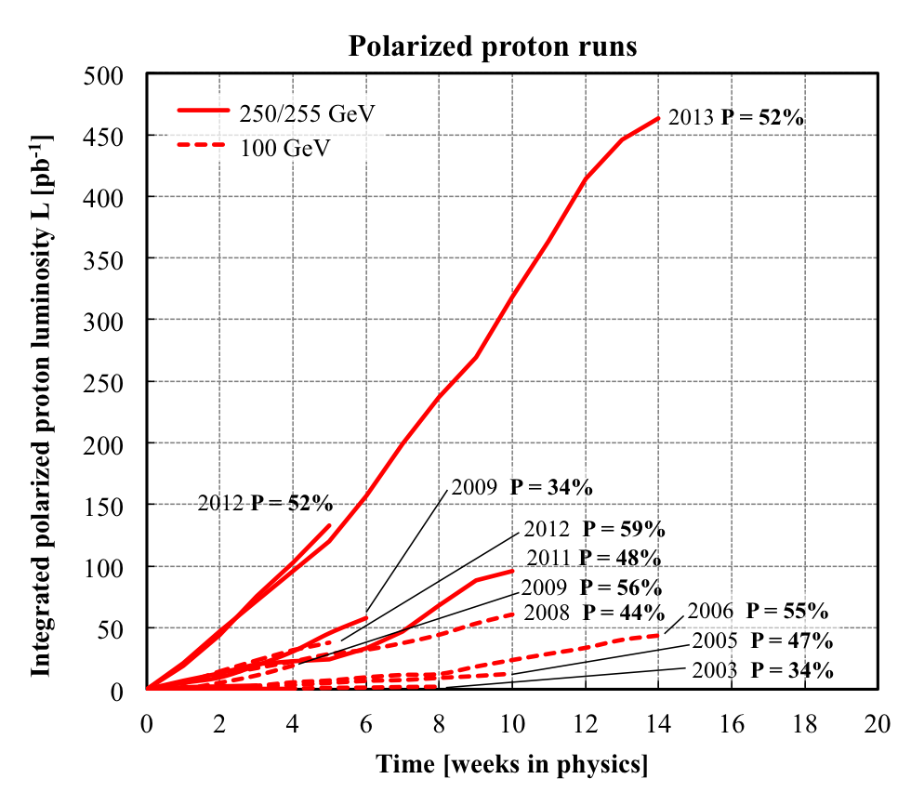
Delivered Integrated Luminosity and Polarization
Au+Au luminosity from Run-14 exceeds all previous Au+Au runs combined
p+p luminosity from Run-13 exceeds all previous p+p runs combined
Nucleon-pair luminosity: luminosity calculated with nucleons of nuclei treated independently; allows comparison of luminosities of different species; appropriate quantity for comparison runs.

Slide 10
Performance measure: setup time
Setup time: - for 1st species in run: from both rings cold to 1st physics store - for following species: from beginning of setup to 1st physics store
Run-14
Run-10
Setup time [d]
Au+Au 100 GeV 24 d
46% reduction
Au+Au 7.3 + 100 GeV 13 d
BLUE: heavy ion runs
RED: polarized proton runs
TRANSPARENT: low energy
INTRANSPARENT: high energy
Notes:
----- Meeting Notes (7/24/13 10:42) -----
go to 40 days on scale

Slide 11
Store-to-store time, time in store
Run-11
Run-14
TRANSPARENT: low energy
BLUE: heavy ion runs
INTRANSPARENT: high energy
RED: polarized proton runs
Time in store = store time / calendar time (denominator includes scheduled maintenance, failure, setup, beam experiments)
Time in store goal: 60%
Notes:
----- Meeting Notes (7/24/13 10:42) -----
Fermi and CERN data

Slide 12
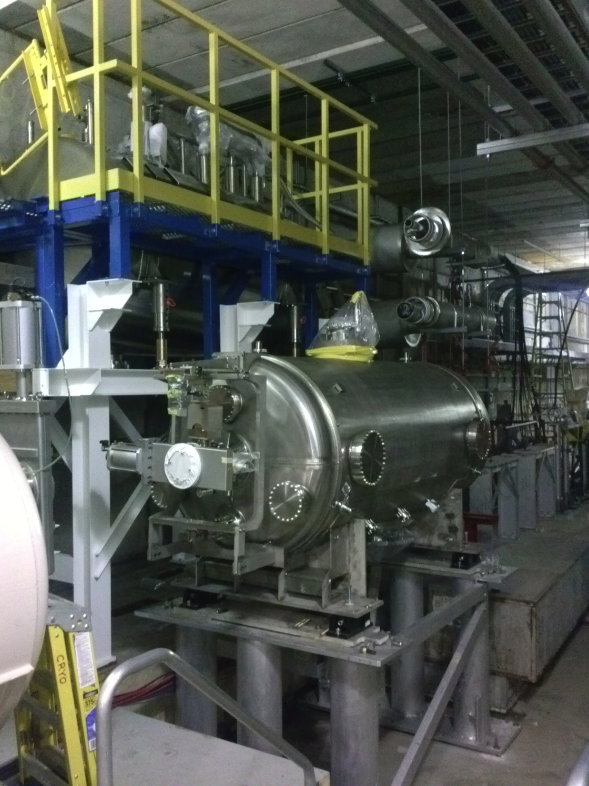
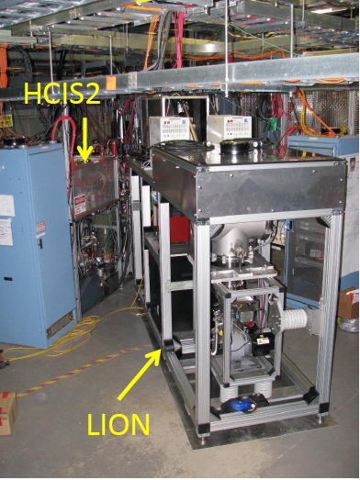
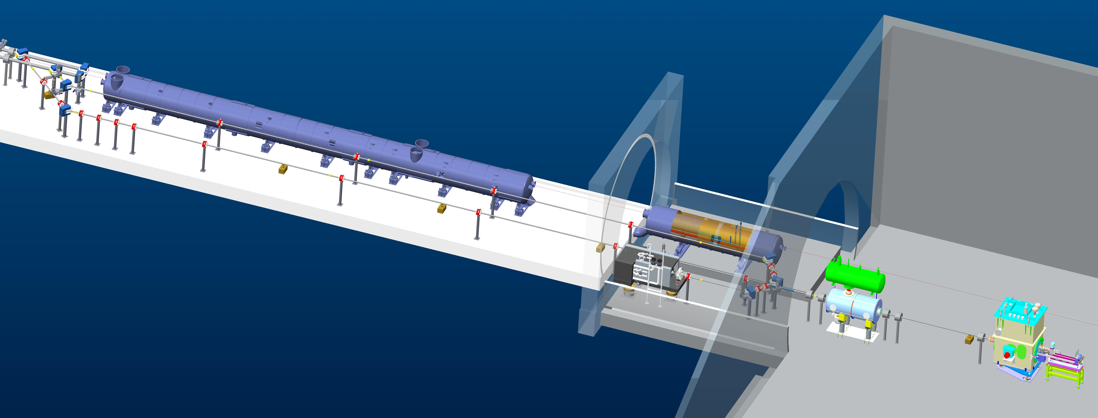
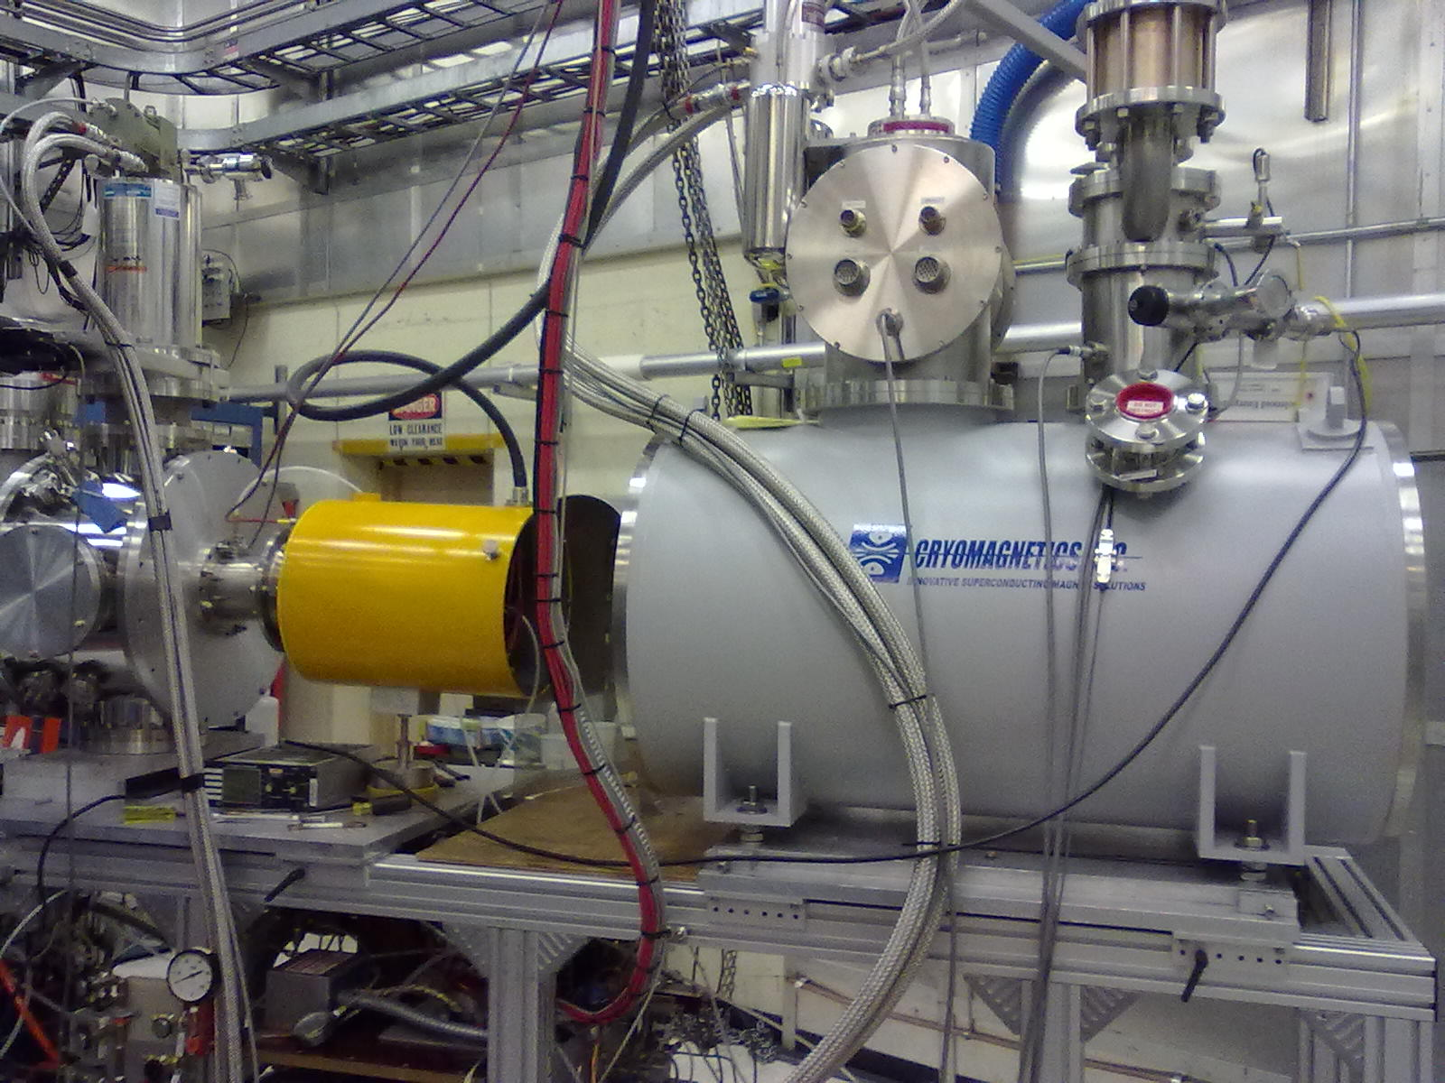
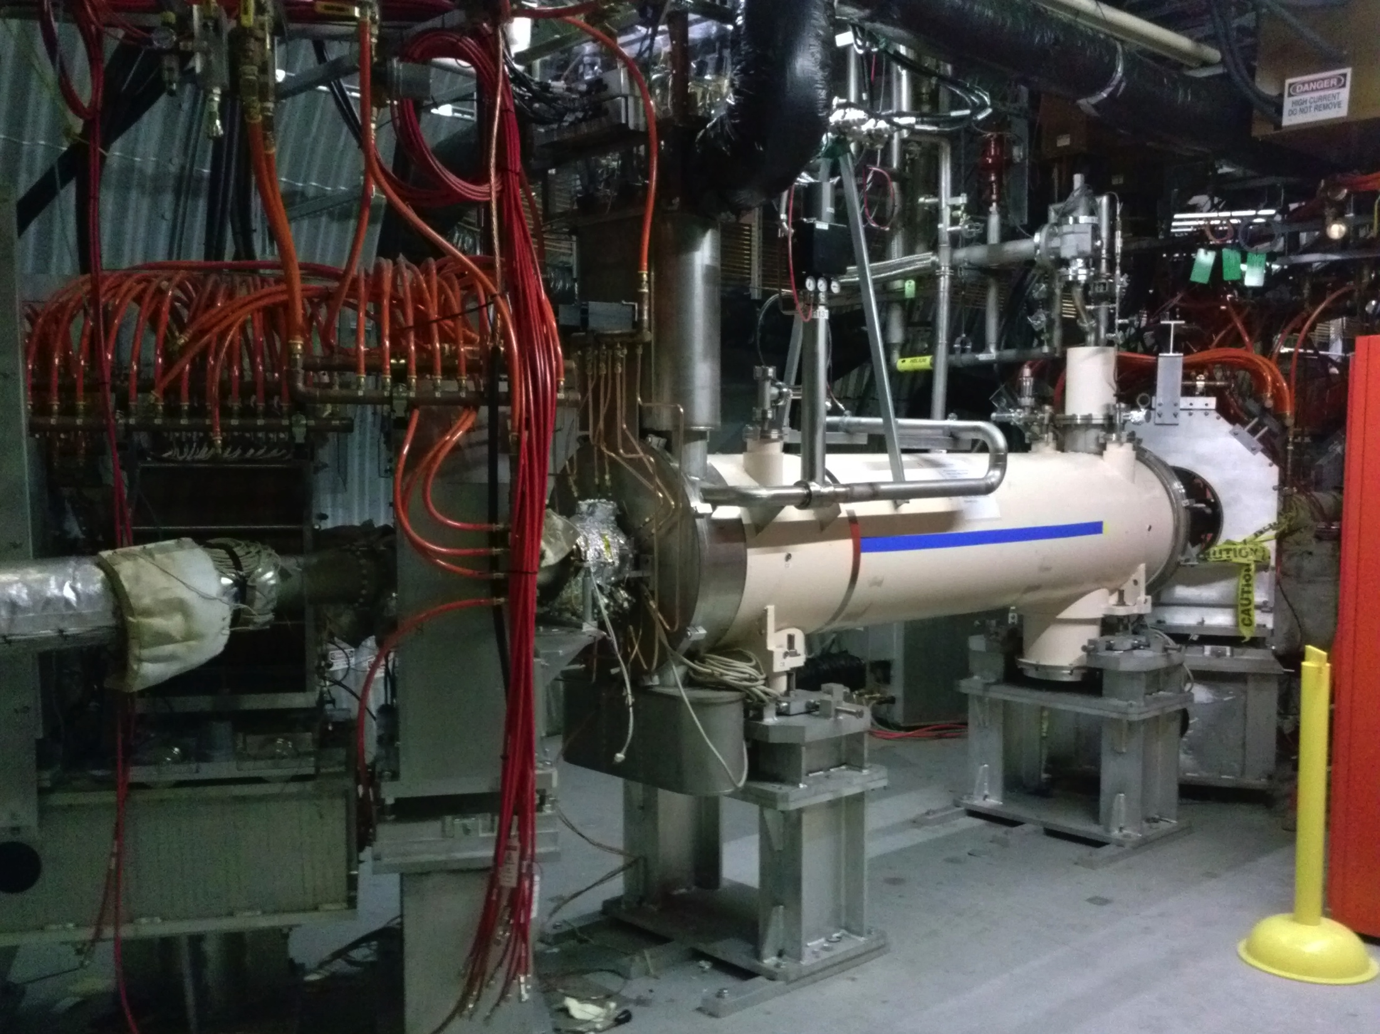
RHIC Upgrades Overview
56 MHz SRF
Heavy ions – high energy
2x L_{avg}, within 2 years
56 MHz SRF fully operational
Laser Ion Source (LION) + EBIS for higher bunch intensity
Heavy ions – low energy
~3-10x L_{avg}, within 4 years
Low-Energy electron cooling (AIP)
Polarized protons
2x L_{avg} 100 and 255 GeV, P+ (small), within 1-2 years
New OPPIS for higher bunch intensity
Electron lenses for head-on beam-beam compensation
Also: polarized ³He acceleration in AGS and possibly RHIC (>2 years)
LEReC
OPPIS
Electron lenses

Slide 13
RHIC luminosity and polarization goals
parameter | unit | achieved |  | goals
Au-Au operation |  | 2014 |  | ≥ 2016 56 MHz SRF + LION/EBIS
energy | GeV/nucleon | 100 |  | 100
no colliding bunches | … | 111 |  | 111
bunch intensity | 10⁹ | 1.6 |  | 2.0
avg. luminosity | 10²⁶ cm⁻²s⁻¹ | 50 |  | 100
p↑-p↑ operation |  | 2013 |  | ≥ 2015 OPPIS + e-lenses
energy | GeV | 100 | 255 | 100 | 255
no colliding bunches | … | 107 | 111 | – 111 –
bunch intensity | 10¹¹ | 1.6 | 1.85 | 2.0 | 2.5
avg. luminosity | 10³⁰ cm⁻²s⁻¹ | 33 | 160 | 60 | 300
avg. polarization* | % | 59 | 52 | 65 | 60
on last years’ slide
(30)
(40)
*Intensity and time-averaged polarization as measured by the H-jet. Luminosity-averaged polarizations, relevant in single-spin colliding beam experiments, are higher. For example, for intensity-averaged P = 48% and R_{x} = R_{y} = 0.2 (250 GeV, 2011), the luminosity-averaged polarization is P = 52%.

Slide 14
RHIC Run-15
Beam operation to begin in January 2015, 22 cryo weeks
2(3) operating modes:
ph+ph at 100 GeV, 9 weeks new lattices (ATS), higher bunch intensities, first operational use of electron lenses
ph+Au at 100 GeV/nucleon, 5 weeks positions of DX, ZDC, Roman pots RHIC ramp between injections
ph+Al at 100 GeV, 2 weeks Al intensity, position of DX, ZDC, Roman pots

Slide 15
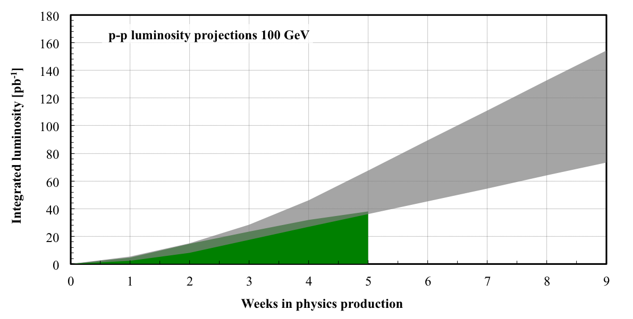
100 GeV ph+ph projection for Run-15
Run-15
Improvements compared to Run-11: OPPIS performance, e-lenses => increase in N_{b} from 1.6 to 2.0x10¹¹
abort kicker, dump, protection masks (replace bumps)

Slide 16
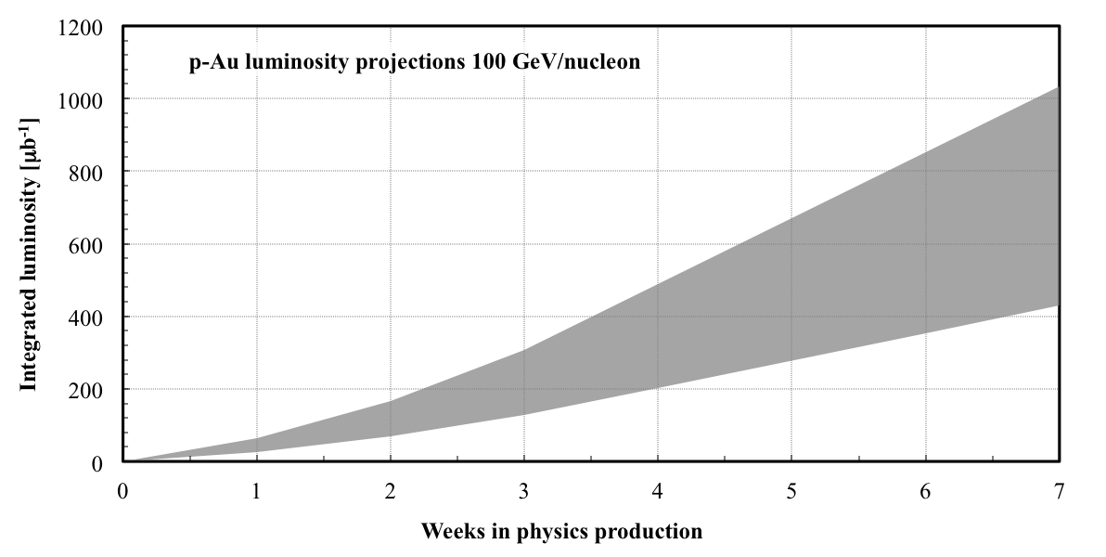
100 GeV/nucleon ph+Au projection for Run-15
Position of DX and ZDC
Min: N_{b} = 1.4x10¹¹ / 1.0x10⁹ Max: N_{b} = 2.0x10¹¹ / 1.4x10⁹

Slide 17
Preparation for Run-15: asymmetric ph-Au operation
maintains same f_{rev} for both beams
Lorentz factor γ
collision ph+Au
107.4
injection ph
store Au (close to γ_{tr})
acceleration ph, Au
injection Au
25.4
10.5
acceleration Au (cross transition)
time
Note: now tolerate ion beam instabilities at transition to obtain higher intensity (can be cooled down again), not possible with ph+Au since have smaller aperture available

Slide 18
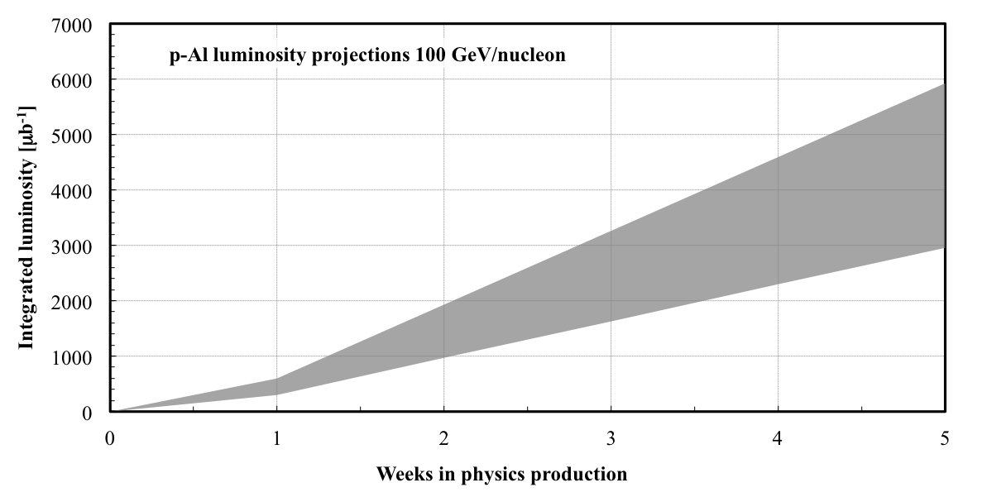
100 GeV/nucleon ph+Al projection for Run-15
~same charge as Cu in Run-12
Position of DX and ZDC
Min: N_{b} = 1.4x10¹¹ / 8x10⁹ Max: N_{b} = 2.0x10¹¹ / 11x10⁹

Slide 19
Summary
Very successful Run-14 (22 cryo week) Au+Au at 7.3 GeV/nucleon (4.4 weeks) last energy in Beam Energy Scan I Au+Au at 100 GeV/nucleon (13.8 weeks) new longitudinal stochastic cooling pick-ups and kickers operation of 56 MHz SRF (with reduced voltage) new records for L_{peak}, L_{avg;} more than doubled entire integrated Au+Au L h+Au at 100 GeV/nucleon (2.9 weeks) first h+Au collisions position, increase of h bunch intensity by >4x
Run-15 (22 cryo weeks) ph+ph at 100 GeV (9 weeks) OPPIS + e-lenses ph+Au at 100 GeV/nucleon (5 weeks) position of DX, ZDC; RHIC ramp between injections ph+Al at 100 GeV (2 weeks) position of DX, ZDC

