Slide 1
C-AD Priorities

Slide 2
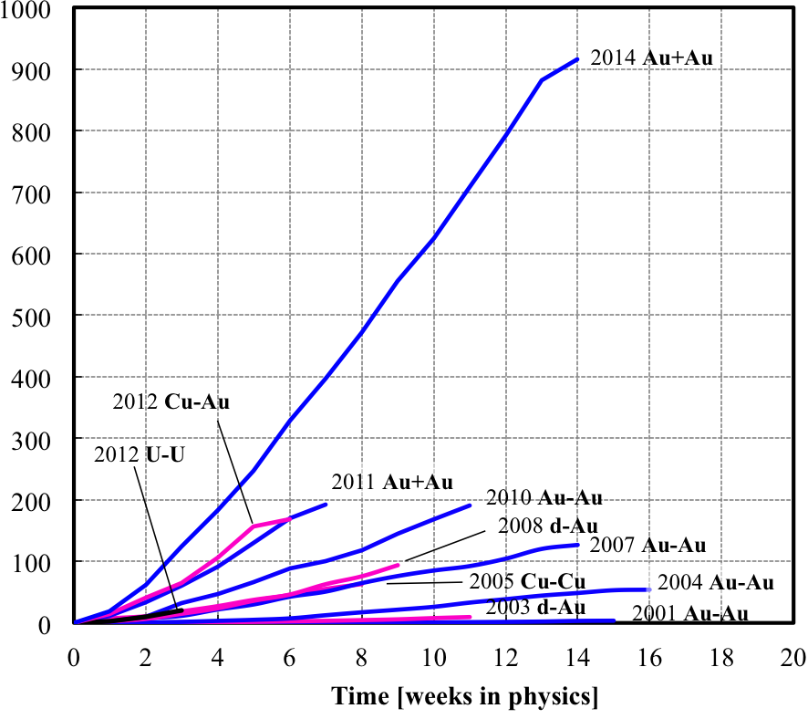
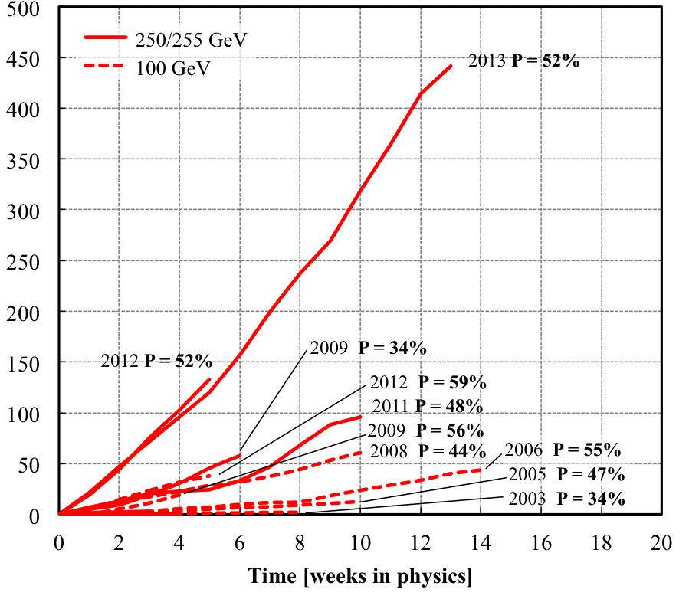
RHIC Integrated Luminosity and Polarization
(RHIC II performance!)
Heavy ion runs
Polarized proton runs
2014
2013
Integrated nucleon-pair luminosity L_{NN} [pb⁻¹]
Integrated luminosity L [pb⁻¹]
Dramatic increase in performance as a result of R&D, capital projects, Accelerator Improvement Projects, and reliability improvements

Slide 3
RHIC operations and transition to eRHIC
2015,16: two more RHIC Runs 15 and 16 and completion of eLens and 56 MHz AIPs
Low Energy RHIC electron Cooling (installation in 2017) and LEReC energy upgrade for RHIC Runs 18 and 19 (Beam Energy Scan II)
sPHENIX construction (final installation in 2020) for final RHIC
Runs 21 and 22 (Jet physics)
eRHIC R&D items:
  Coherent electron Cooling: equipment test during Run 15; cooling test during Run 16
  High intensity ERL test in 2015
  Gatling gun test in 2015
eRHIC: design (CD-0 in 2017?), construction (CD-3 in 2020?), installation (2023 – 2024?) and start of operation (CD-4 in 2025?)

Slide 4
Other projects
In progress:
  BLIP Raster upgrade (completion in 2016)
  Linac intensity upgrade for BLIP (completion in 2015)
  Accelerator Test Facility II in Bldg. 912 (completion in 2017)
  NSRL beam energy upgrade to 1.5 GeV/n (completion in 2016?)
Likely future projects:
  Doubling of Linac intensity
  Ac-225 isotope production after successful R&D
  ATF II beam energy upgrade
  eRHIC prototype (Multi-pass FFAG ERL) at Cornell

Slide 5
Backup slides

Slide 6
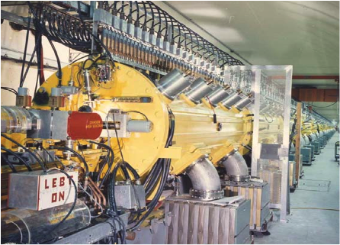
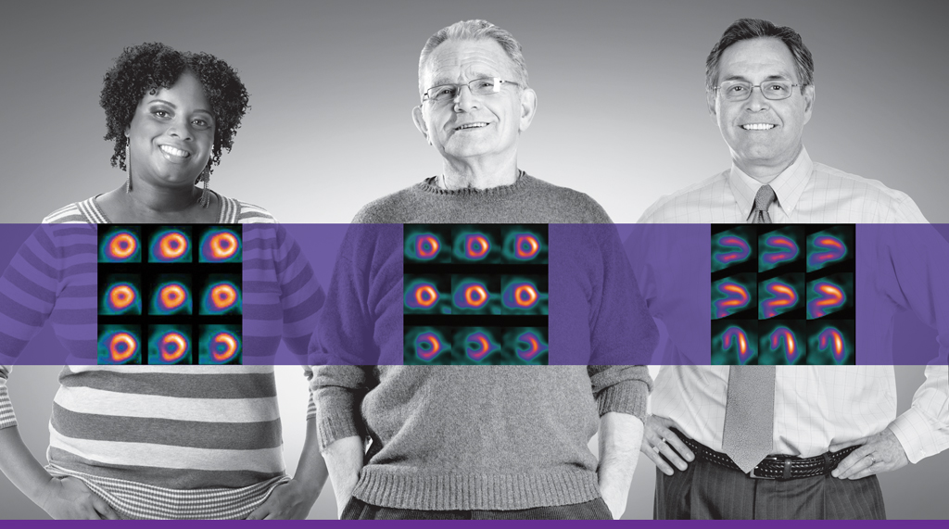
Brookhaven Linac Isotope Producer (BLIP)
Target irradiation with 116 – 200 MeV, 130 μA proton beam
Production of medical radio-isotopes for U.S., mainly ⁸²Sr, mainly shared between LANL and BNL
R&D of new radio-isotopes for diagnosis and therapy (Ac-225, needs ~ 200 MeV protons)
25.5 day 75 sec
⁸²Sr ⁸²Rb ⁸²K(stable)
coronary artery disease diagnosis
used under rest and stress conditions

Slide 7
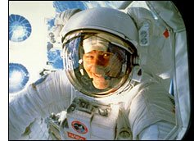
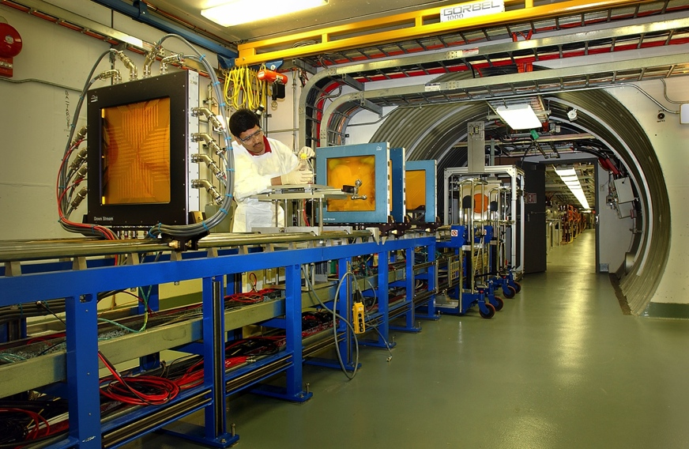
NASA Space Radiation Laboratory (NSRL)
Started in 2003, simulates galactic radiation for human space flight
  Heavy ion beams from AGS Booster
  Electron Beam Ion Source (EBIS)
  provides all necessary ion beams
  New laser ion source for EBIS allows
  for rapid species switching to simulate
  accurately deep space radiation field
Additional uses of NSRL
  Radiation effects studies for National Reconnaissance Office (NRO)
  R&D of ion beam cancer treatment possibly funded by NCI
Notes:
----- Meeting Notes (1/25/13 14:56) -----
NSRL more expensive if stand alone
additional slide with growth opportunities and no RHIC impact

Slide 8
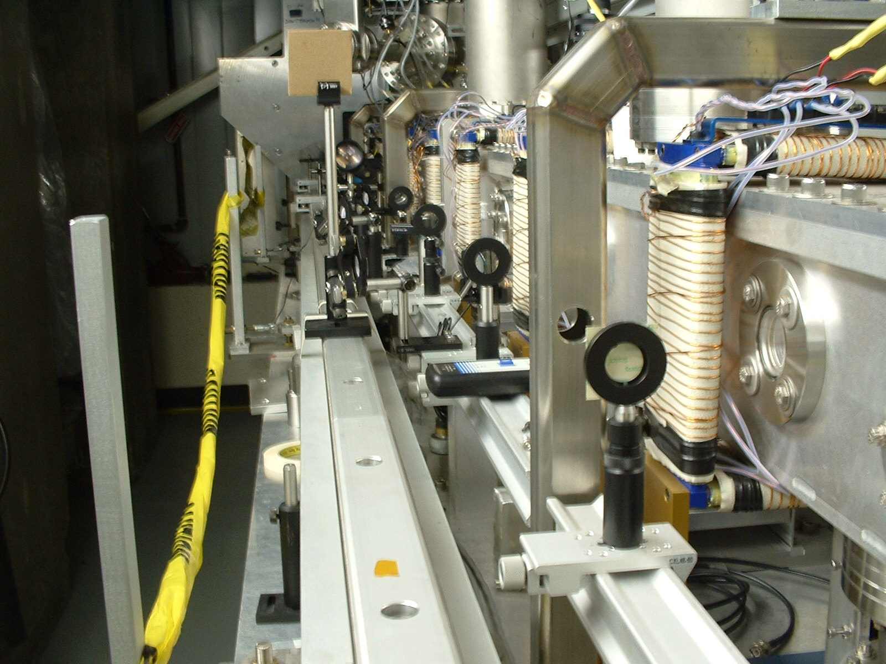
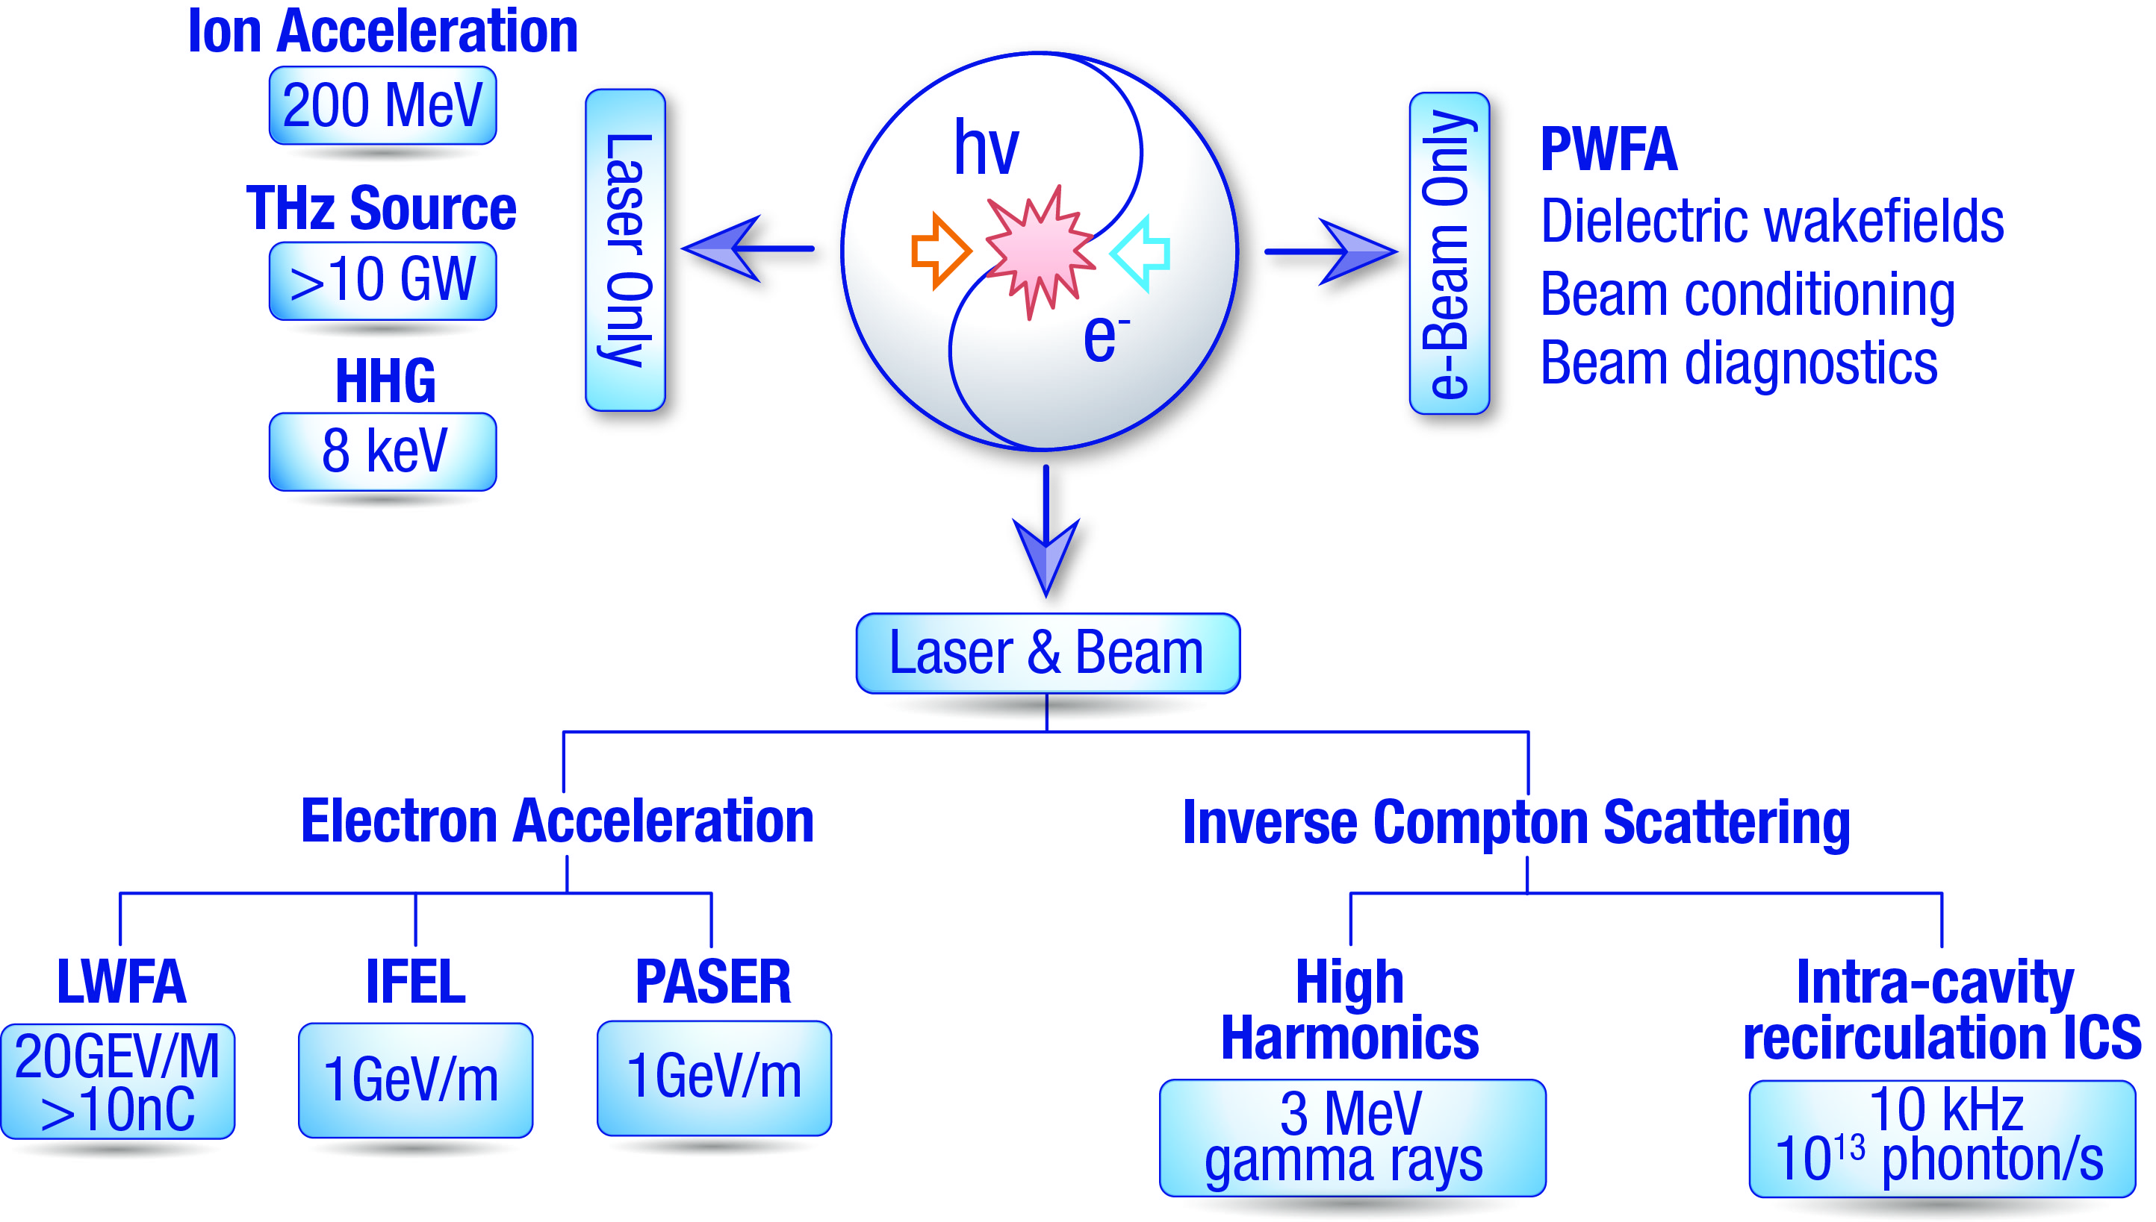
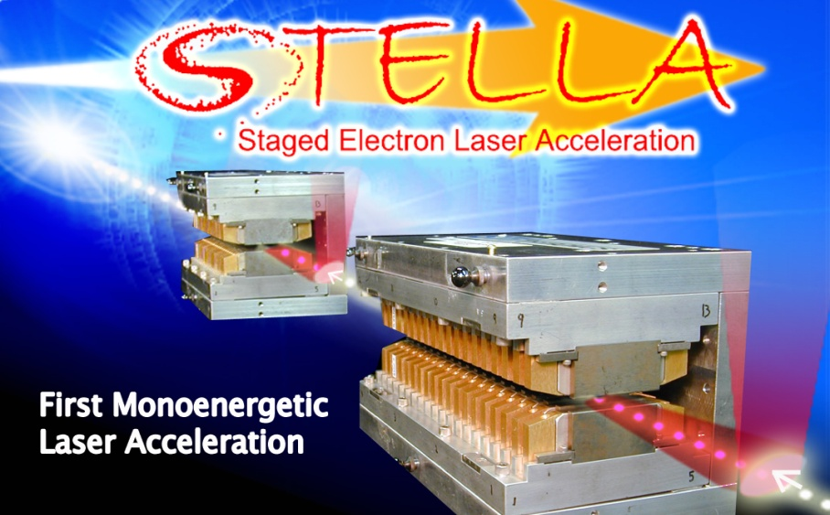
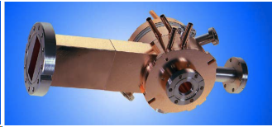
Accelerator Test Facility: unique electron – laser facility
The ATF has been serving accelerator S&T users for the past 25 years.
“Flagship of the [DOE HEP] Accelerator Stewardship Program”
The BNL photocathode RF gun:
BNL original, made the LCLS possible

Slide 9
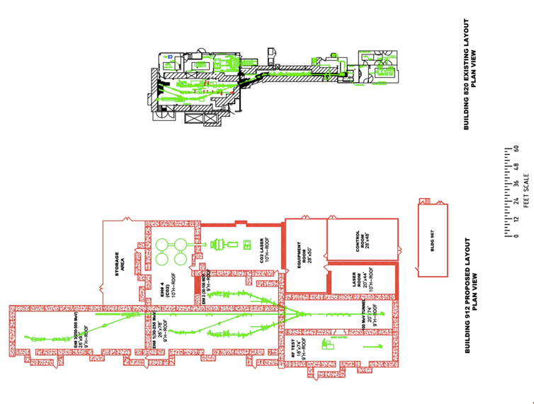
ATF upgrade plan (ATF II)
Present (Bldg. 820)
Approved DOE upgrade (Bldg. 912)
  7 x increased experimental area with three experimental halls
  e-beam energy up to 300 MeV
  Increased productivity
BNL PD funding:
  100 TW CO2 laser

Slide 10
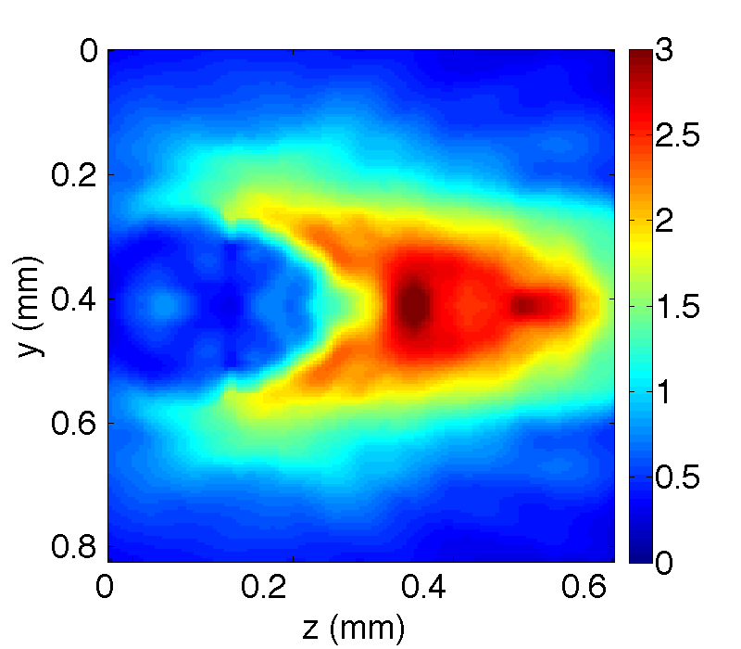
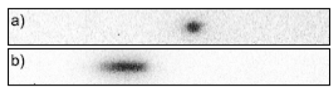
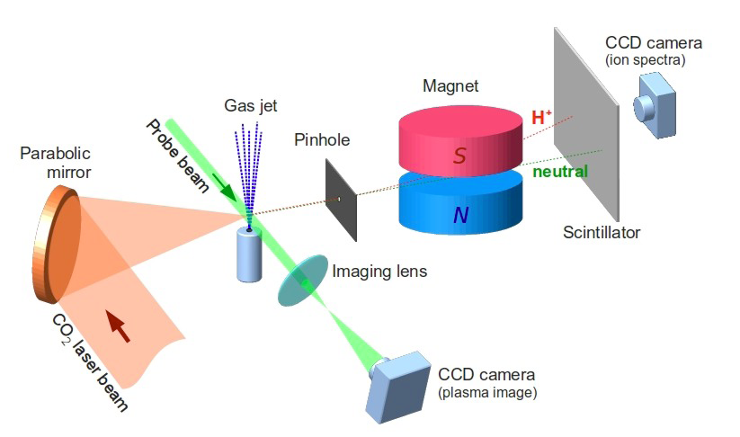
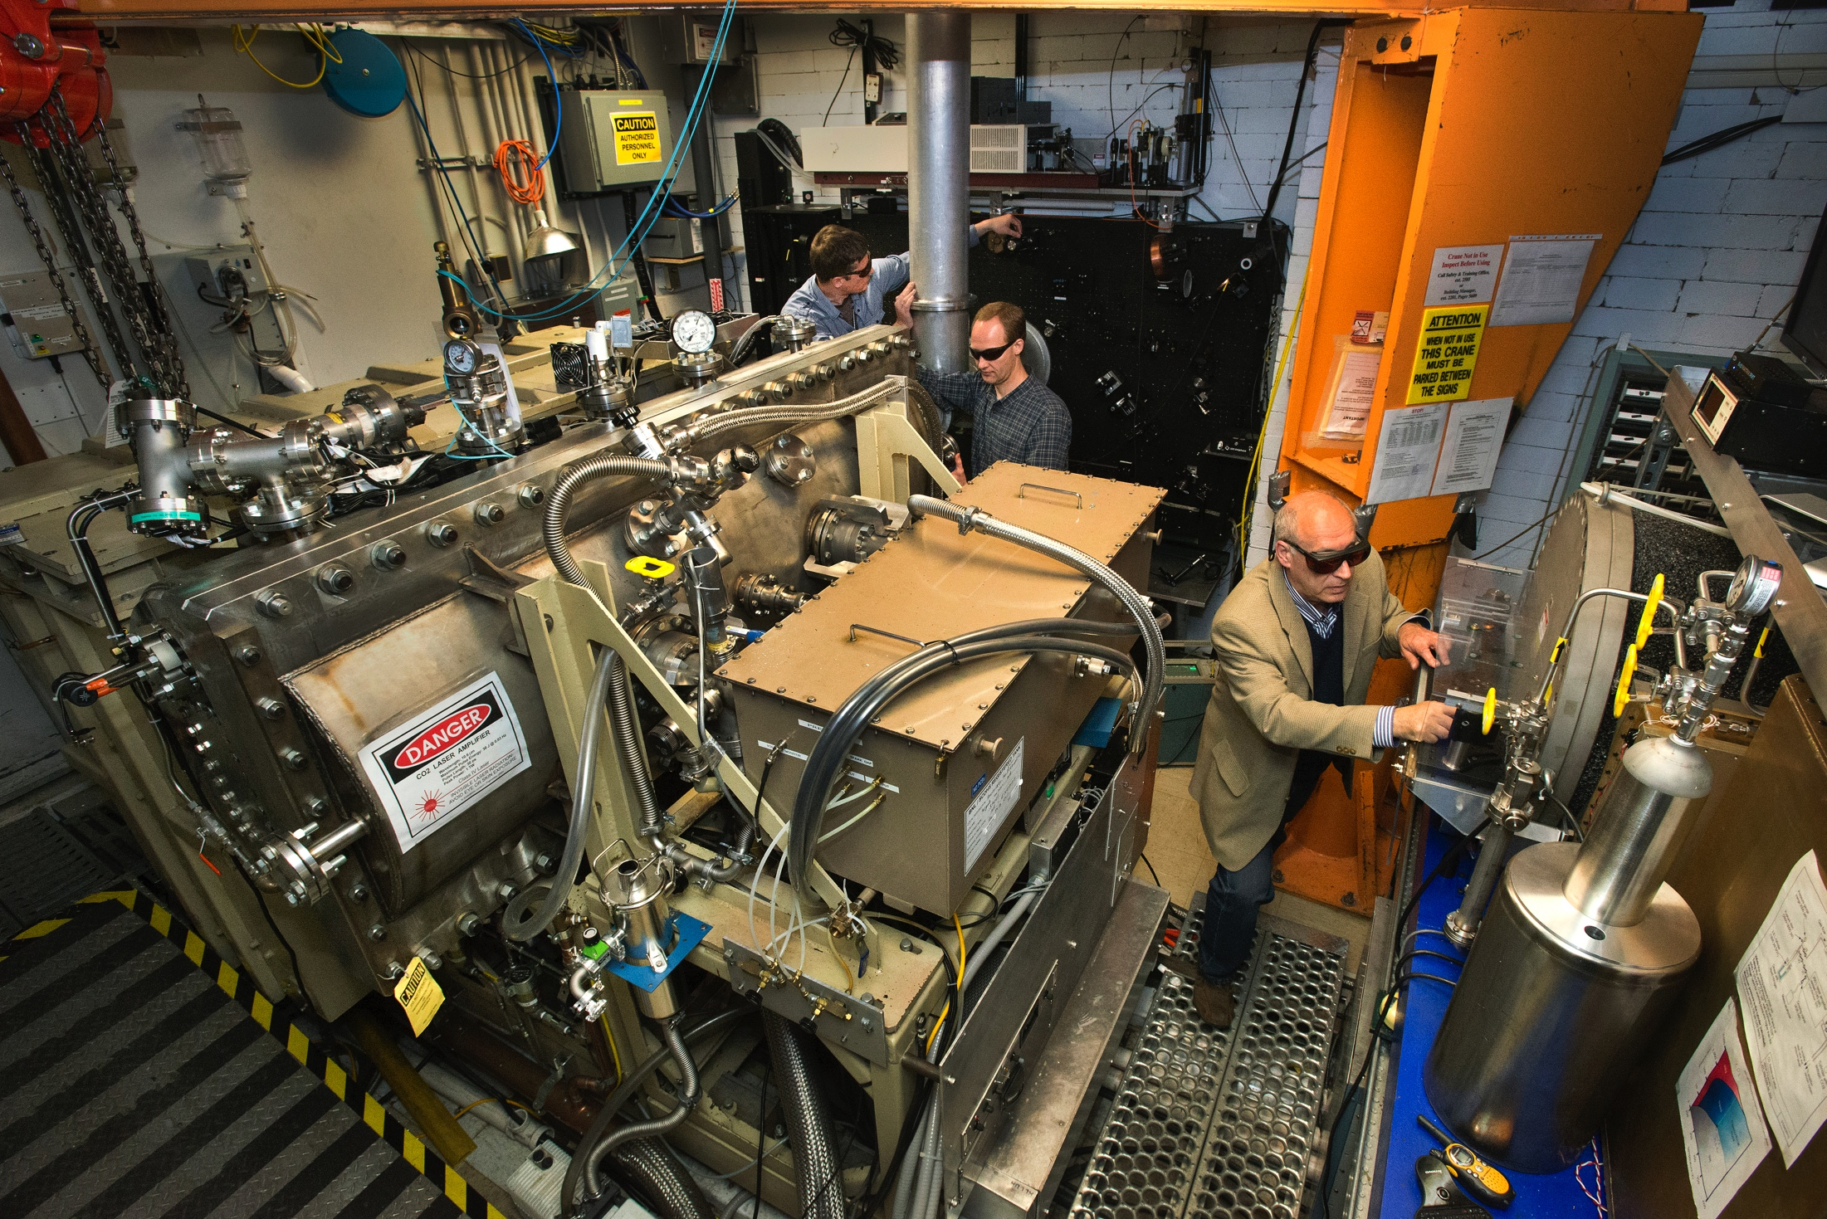
CO₂ laser upgrade to 100TW opens up many new science opportunities
100 TW CO₂ laser will be the world’s most powerful.
Pondermotive potential strength of 10 PW lasers at 1 micron
~ 200 MeV ion beam energy
5% energy spread
5 x 10⁶ protons within 5-mrad
jet
laser
V_{sh}
foil
2V_{sh}
Notes:
Combination of high power MIR laser with high brightness accelerator:
Time synchronized probing or seeding of CO₂ laser-driven plasma waves
Studies of IFEL technology reaching the GeV level
Fundamental studies of Inverse Compton scattering, eg non-linear interactions, pulse recirculation, etc.
High field MIR laser system for advanced accelerator studies:
Ion acceleration – gas targets; H, D, He, Ne, etc.
High bunch-charge electron acceleration
Fundamental science of long wavelength high field scaling:
HHG
Laser-matter interactions at Il² >10²⁰ W/cm² is unexplored territory

Slide 11
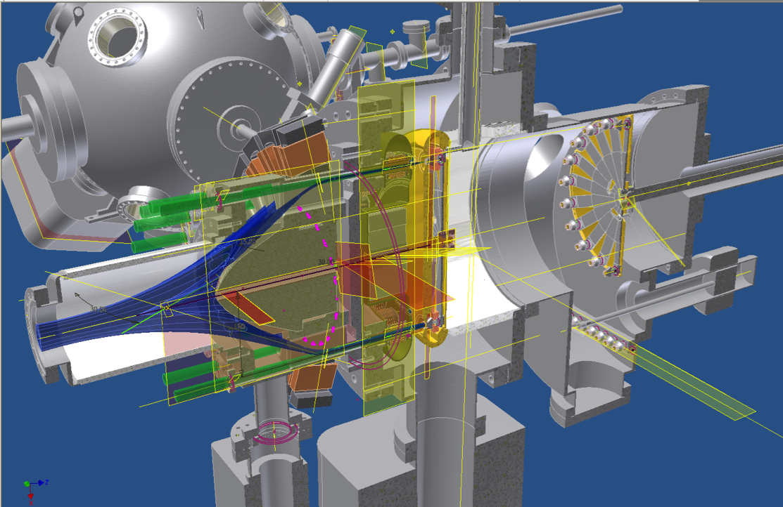
High CW current polarized electron gun
Matt Poelker (JLab) achieved 4 mA polarized e-beam with good lifetime
More current with effectively larger cathode area
Test at MIT with very large cathode area
Gatling gun: multiple cathodes to effectively increase cathode area
Gatling Gun Test: twice the current from two cathodes with same lifetime (by end of 2014)

Slide 12
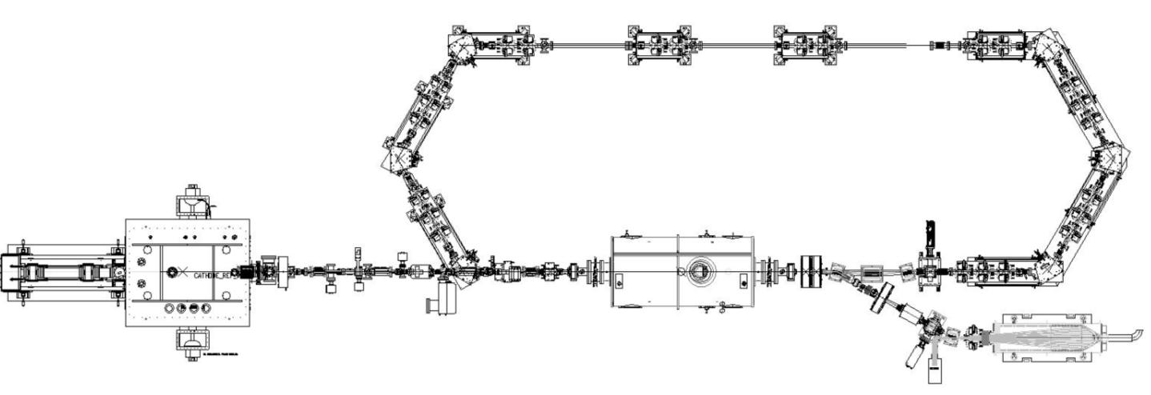
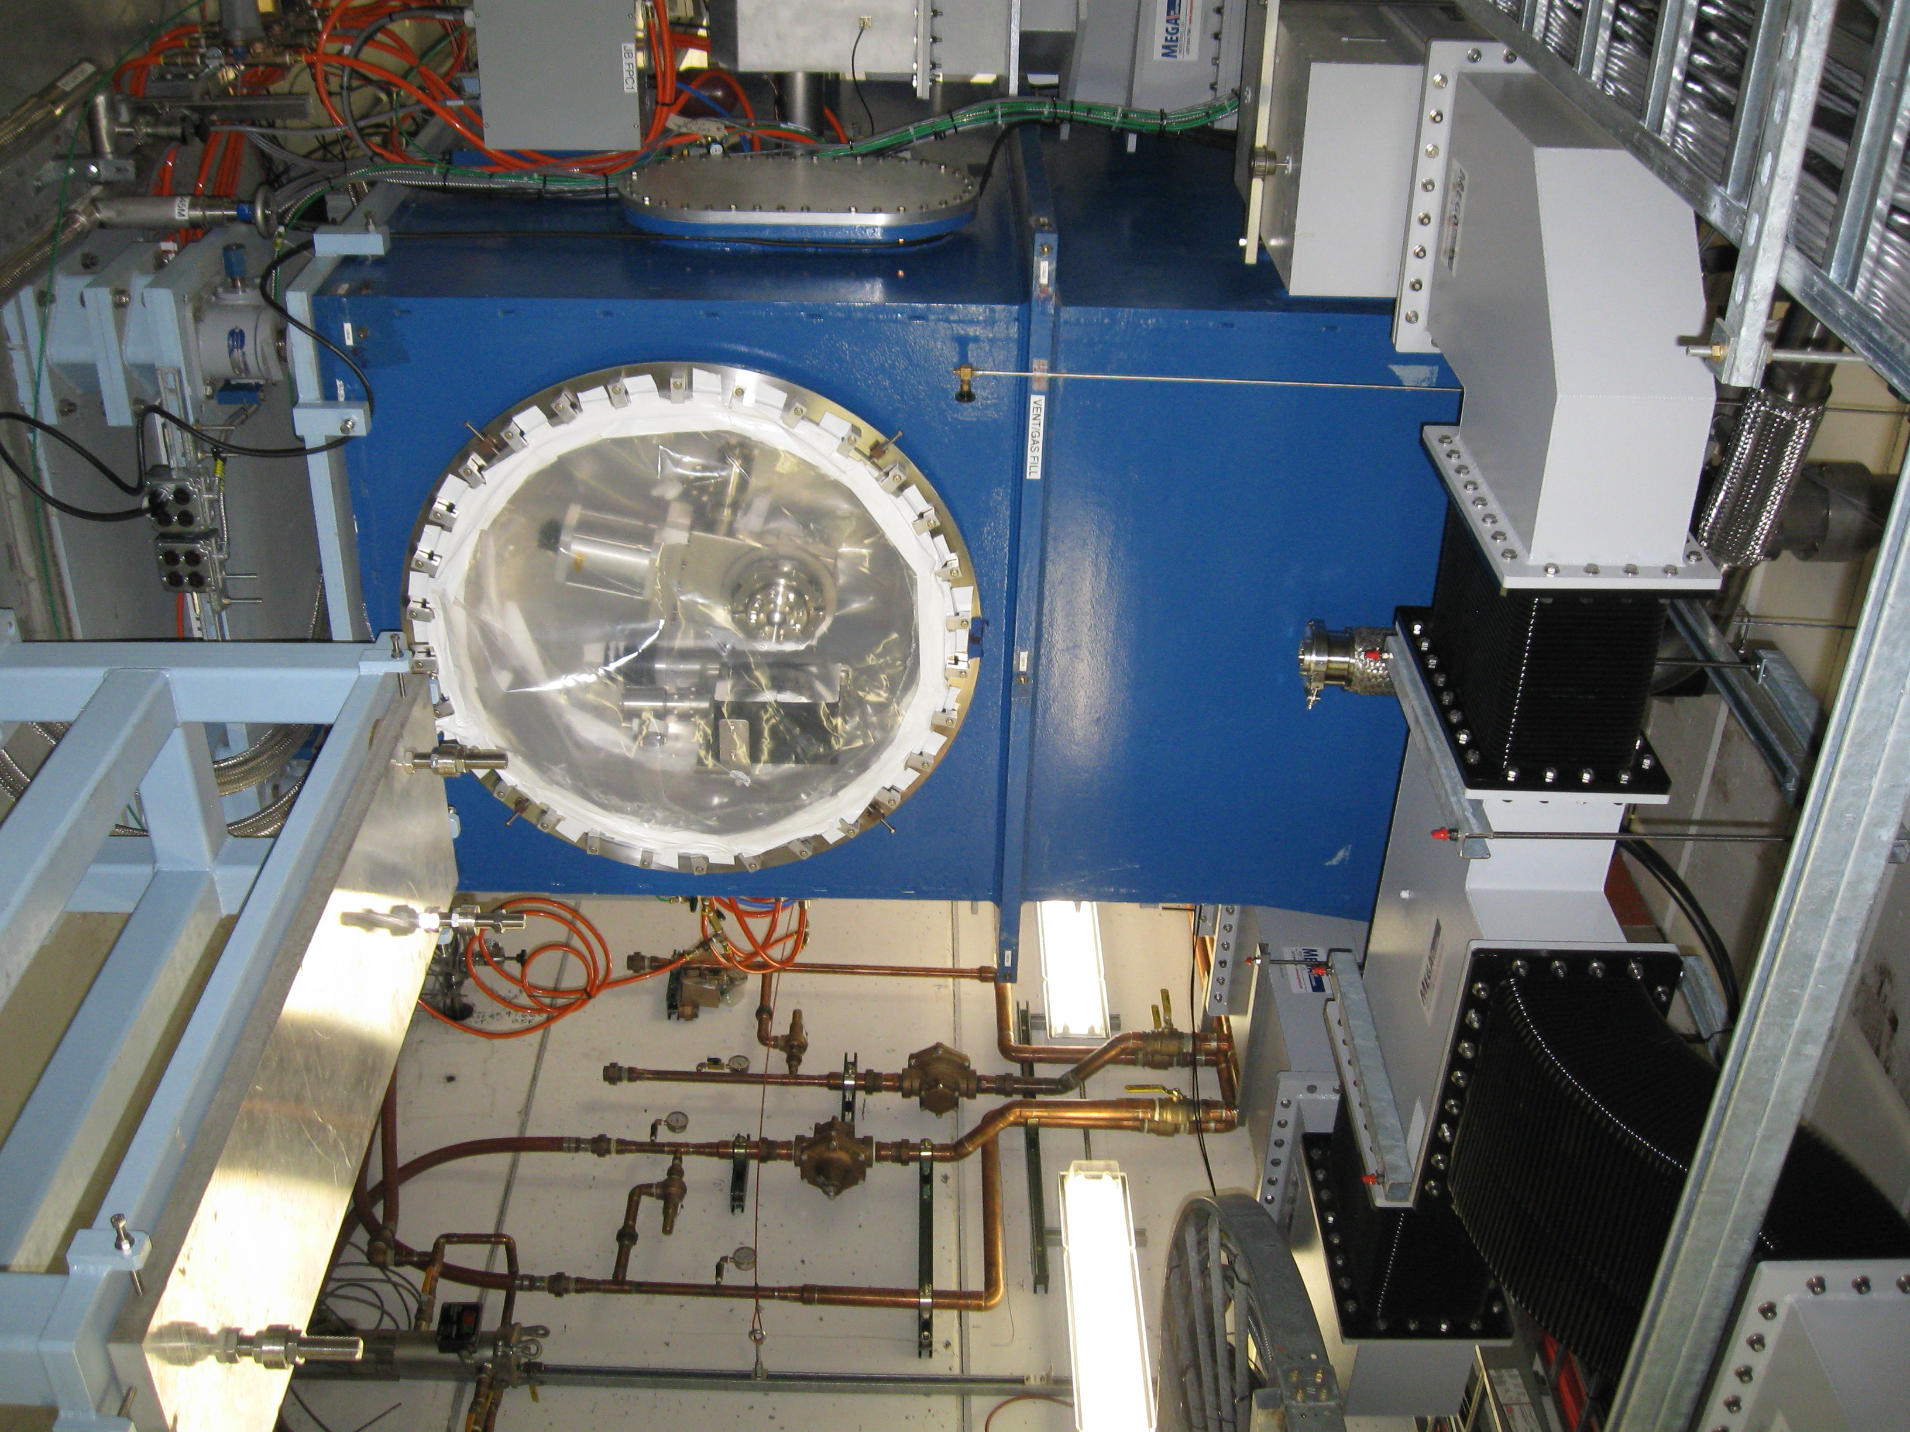
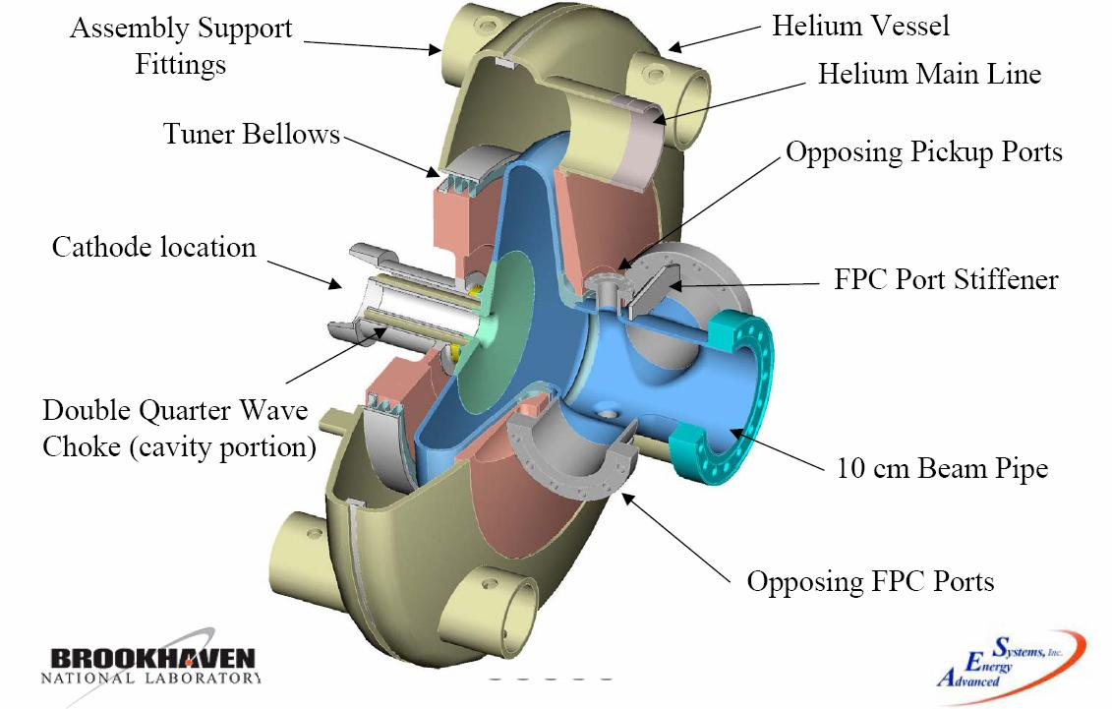
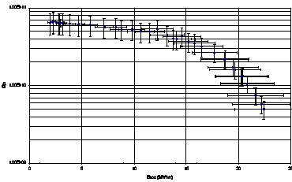
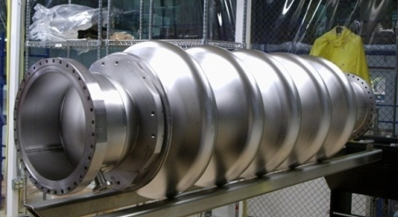
Energy Recovery Linac (ERL) Test Facility
Test of high current (50 mA, 11 passes eRHIC), high brightness ERL operation
Highly flexible return loop lattice to test high current beam stability issues
Gun rf tested at 2 MV; beam from gun: 2014, recirculation: 2015/16
Gun and cavity will be used for ERL of Low Energy RHIC electron Cooling
Return loop
20 MeV
SC RF Gun
20 MeV
20 MeV
1 m
2-3 MeV
2-3 MeV
2-3 MeV
SC 5 Cell cavity
Beam dump
5 Cell SRF “single mode” cavity
Q > 10¹⁰ @20 MV/m CW
10¹¹
Q
10¹⁰
10⁹
20
0
10
Accelerating Voltage [MV/m]

Slide 13
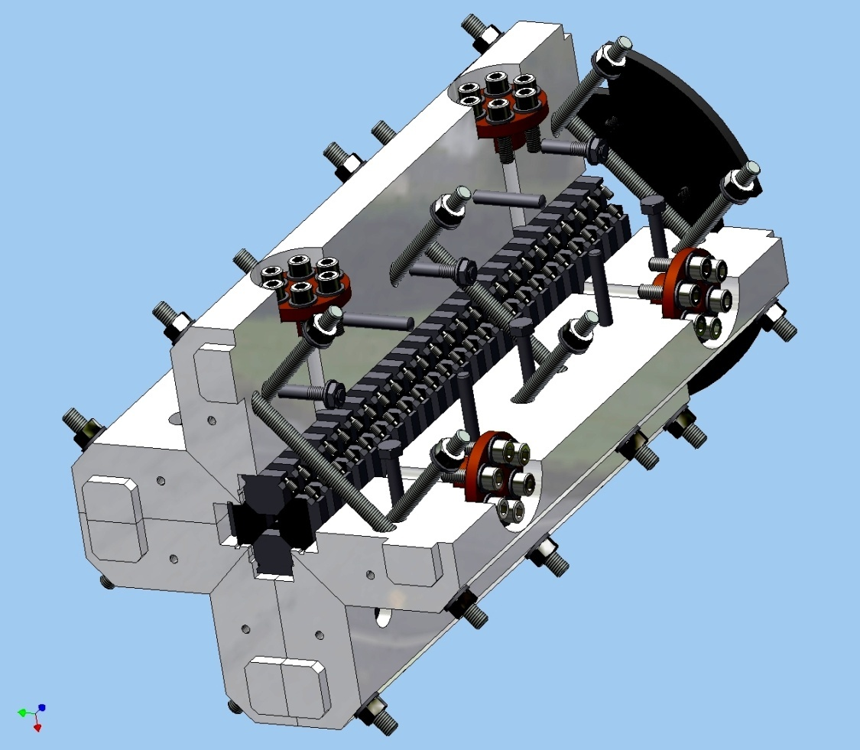
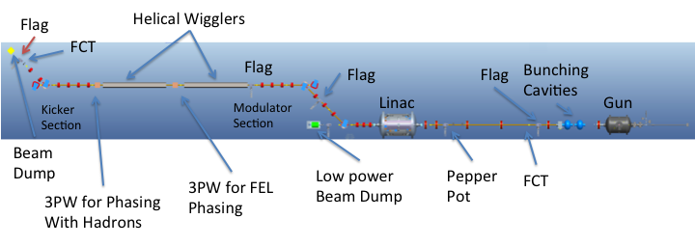
Coherent electron Cooling
Idea proposed by Y. Derbenev in 1980, novel scheme with full evaluation developed by V. Litvinenko
Fast cooling of high energy hadron beams
Made possible by high brightness electron beams and FEL technology
~ 20 minutes cooling time for 250 GeV protons → 10x reduced proton emittance gives high eRHIC luminosity
Proof-of-principle demonstration planned with 40 GeV/n Au beam in RHIC (~ 2016)
Helical wiggler prototype

