Slide 1
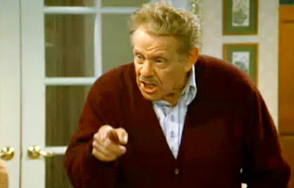
The View from Operations
Festivus

Slide 2
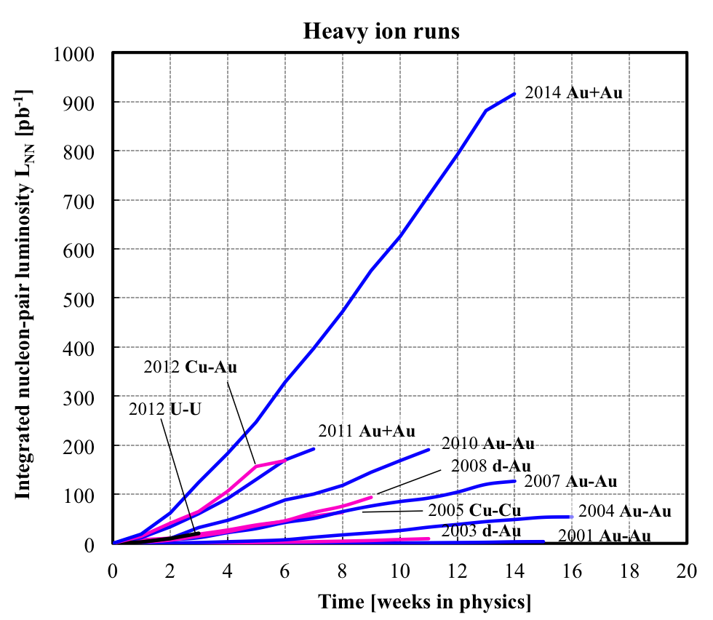
The Celebratory Dinner
A Flawless ‘Run of Firsts’
Booster LLRF, SC, Al, minimal failures, minimal accesses

Slide 3
The Celebratory Dinner
Operations
Half of the operators for this run had ZERO experience in a RHIC run
One shift had a single operator with zero experience, one had two operators with zero experience
‘Real’ turn around times for Ops were very fast

Slide 4
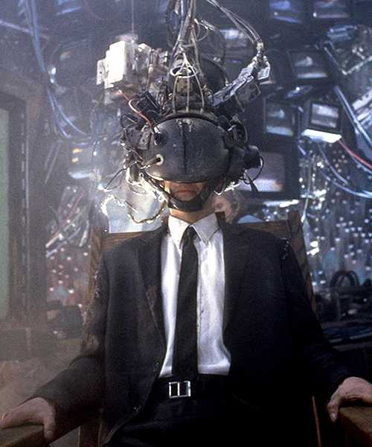
Feats of Strength
Al Marusic
Assistance on virtually every shift of the run at any hour of the day
If Al doesn’t have a closet full of Spotlight Awards there is something wrong
BUT, he wouldn’t need to be jacked into the machine at all hours if he would pass the everyday tasks to Ops (feed forward, bpm timing,etc)

Slide 5
Feats of Strength
Kevin Smith
Low level RF assistance
Troubleshooting work for the RF reflective server
AGS extraction setup
Phase matching across the fill
Kevin Mernick
Very quick establishment of a very simple technique to stop the beam heating when SC misbehaves
General troubleshooting help during all hours
John Morris
AGS field stabilization script saved Ops from going insane and greatly shortened setup times

Slide 6
Feats of Strength
PHENIX
This was the first run I can recall when Ops had a good experience with 1008.
Phone communications were always courteous
The need for Ops to explain backgrounds to new crews every two weeks was gone
Long Stores
Given the inexperience of the Ops crews this paid huge dividends to being able to train people.

Slide 7
The Airing of the Grievances

Slide 8
The Airing of the Grievances
Collimation/Gap Cleaning
Held too close to the vest. Angelika is always extremely helpful but we want the training wheels taken back off.
A few years ago the operation of these systems were entirely within Ops realm after initial setup.
Store collimation should move back to being an Operational part of store setup.

Slide 9
The Airing of the Grievances
Access Controls
The injector security systems are supposed to become ‘RHIC-like’ but they each behave in different ways.
Control interface pages do not have a uniform feel.
The Linac system has a Reset button on almost every page all labeled the same, but the button behaves differently depending on which page you are viewing. ACS techs spent a shift struggling to understand what is going on along with Ops.
The systems are losing trivial abilities and forcing Ops to remember steps unique to each accelerator
The AGS lights used to turn on and off with the access state. Ops can turn the ring lights off with a new button but ACS techs are required to enter a caged area to turn them back on.

Slide 10
The Airing of the Grievances
STAR
Organization consists of thousands, with dozens working on the detector at any given point during the run, but only Bill Christie can decide what is good and bad.
The experimental shift leader should be trained well enough to make decisions for their shift.
http://www.cadops.bnl.gov/cgi-bin/elog/viewMain.pl?elog=rhic-au_2014&shiftlog=Thu_May_1_2014_17:54:36_PM#20140401203132
See J Morris’s FY13 talk (‘They’re a bunch of idiots’)

Slide 11
The Airing of the Grievances
Elens
Disclaimer: we all love the Elens and will joyfully reap the benefits of this astounding system when it provides increased luminosity next run. But…

Slide 12
The Airing of the Grievances
Elens
The only system listed as a complaint on every email I received from Ops members
‘This should have no effect on the beam’
At the very least the use of this phrase should have ceased after 4-5 (starting in FY 13) instances of the opposite being true

Slide 13
The Airing of the Grievances
Elens
Lack of understanding of Conduct of Operations
Changes to magnet parameters during other work in the machine
Changes during Maintenance days without using the Maintenance Day work approval system
Changes made DURING FILLS
This got better by the end of the run

Slide 14
The Airing of the Grievances
Elens
OCs are put in a difficult position when their boss’s boss has multiple hats on
Thursday morning, 5/1/14 – elens supplies changed during setup of 56 MHz development period. Horrible blue lifetime ensued, Ops and most of the AP group spent all day trying to identify the issue. A bad overnight store was put up because the OC backed down instead of using his judgement.

Slide 15
Announcement
A new elog is coming. It is going to be awesome. Not everyone will like it at first because people don’t like change, but it will be better in every way so keep an open mind.

Slide 16
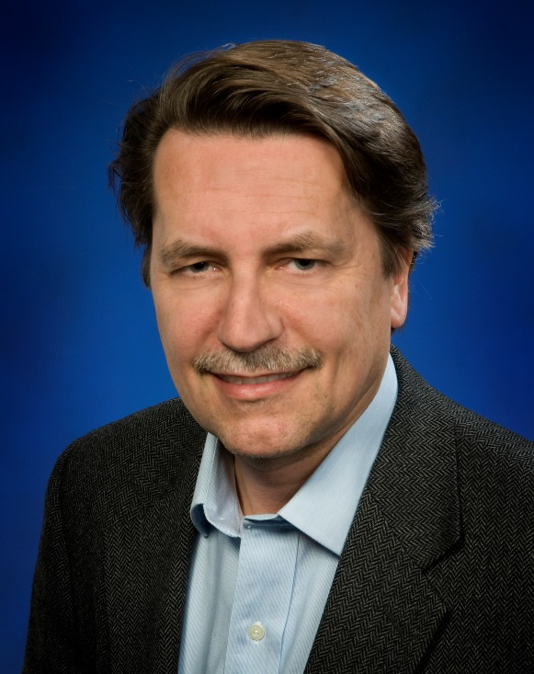
Wrap Up
The Holiday of Festivus is not complete until someone wrestles the head of the household to the ground.
vs ?

