Slide 1
PHENIX
Klaus Dehmelt
For the phenix collaboration
2014 Rhic retreat
August 13, 2014

Slide 2
Run-14 The Parts
2014 – Run-14 subdivided in
Au+Au at $\sqrt{s_{NN}}=15 (14.6) GeV$
Au+Au at $\sqrt{s_{NN}}=200 GeV$
³He+Au at $\sqrt{s_{NN}}=200 GeV$

Slide 3
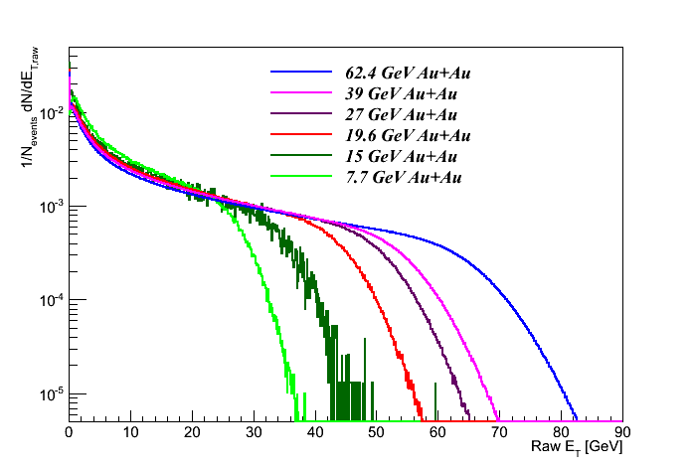
PHENIX and Au+Au @ 15 GeV
Run-14 Low Energy LE @ 15 GeV
Physics declared for PHENIX on February 15
Goal for PHENIX: get detectors fully operational for physics
We have recorded a high quality Au+Au 15 GeV data set and have tested our new detectors in preparation for the 200 GeV run
Estimated number of (real) Au+Au @ 15 GeV events:
~ 15M events in [± 30 cm] (March 10)
ℒ ~ 2.5/μb
~ 6.4M events in [± 10 cm] (March 10)
ℒ ~ 1.1/μb
Very first additional distribution for BES energies from a small fraction of complete dataset

Slide 4
PHENIX and Au+Au @ 200 GeV
The PHENIX collaboration requested
Au + Au @ 200 GeV for 12 weeks
[Physics driven goal is 1.5 nb⁻¹ recorded within |z| < 10 cm]
to collect their definitive Heavy Ion Au + Au data sample
Focus on high precision measurements of Heavy Flavor production
R_{AA} and v₂
for electrons and muons separated charm and bottom decays

Slide 5
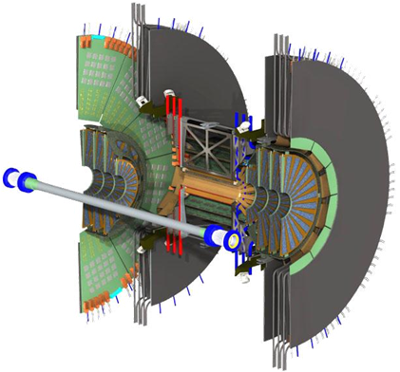
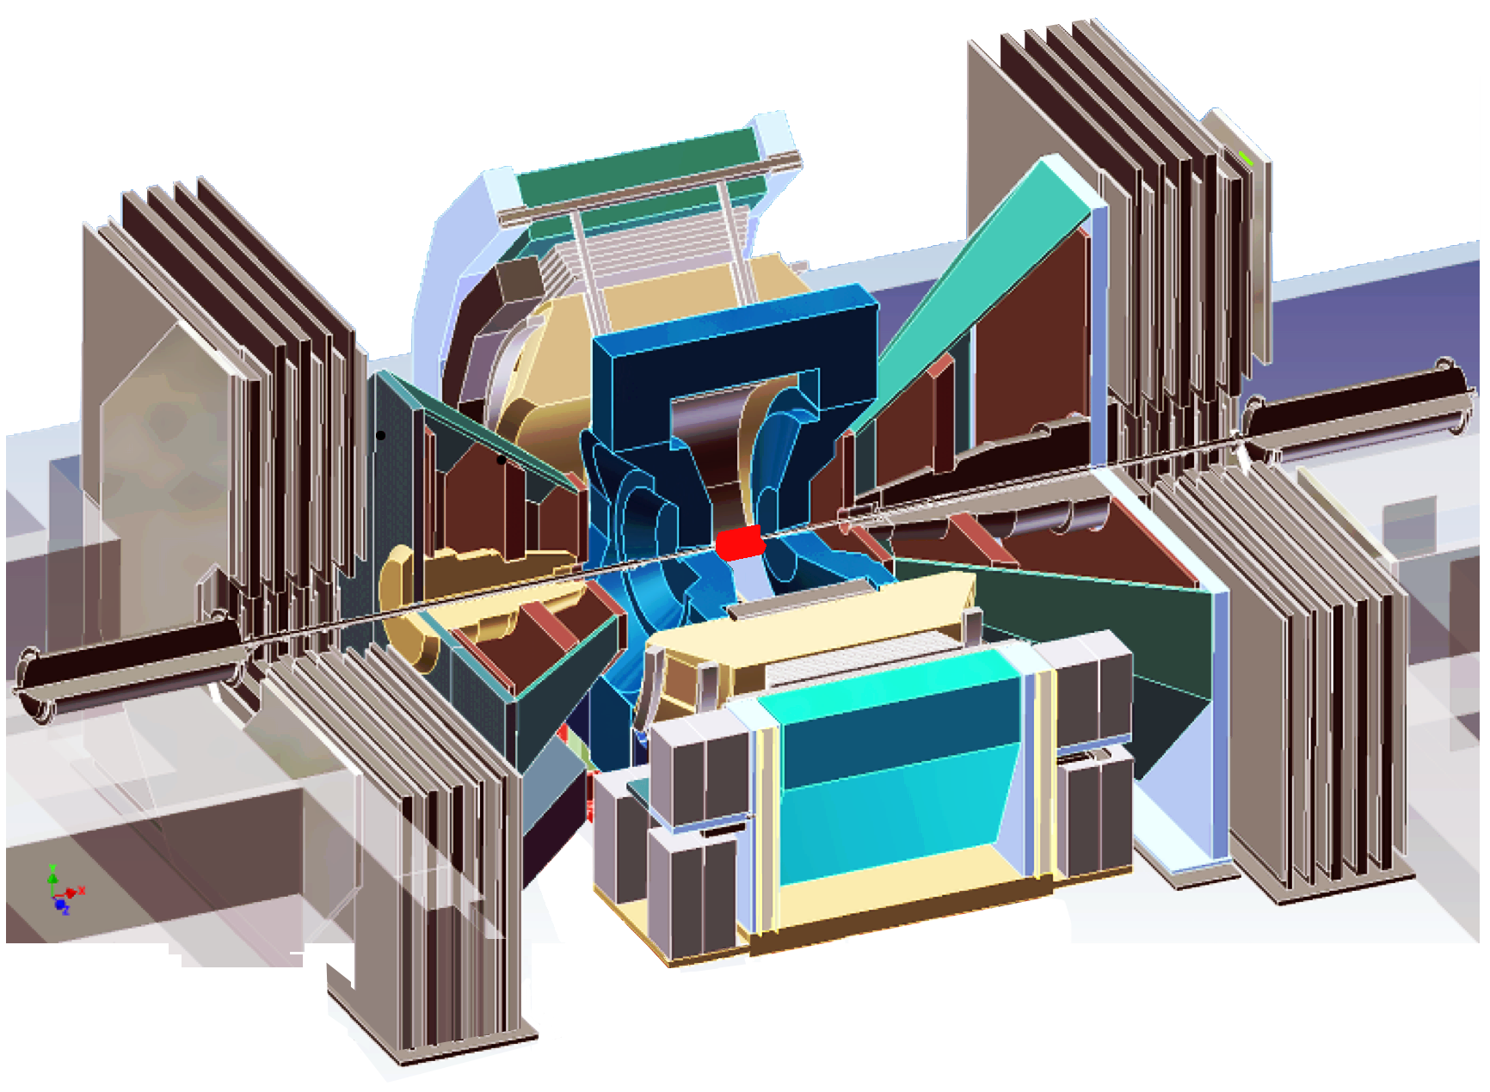
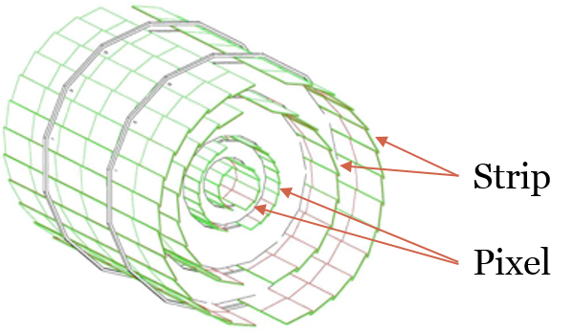
PHENIX and Au+Au @ 200 GeV
PHENIX in Run 14
Barrel region
|η|<1.2, almost 2π in φ
Pixel sensors at inner 2 layers
Strip sensors at outer 2 layers
Forward region
1.2<|η|<2.2, 2π in φ
4 layers of mini strips
(75 x 3400 to 11500μm)

Slide 6
PHENIX and Au+Au @ 200 GeV
First Physics store/run was 18046/405839, March 15
High Energy (HE) run for 93 days $→$ ~13 ½ weeks
Concluded HE run with 193 fills
Our main goal for Au+Au @ 200 GeV was to accumulate ℒ = 1.5 nb⁻¹ in MB for BBC-vertex |z_{vtx}| < 10 cm
Optimal range for VTX coverage
Accumulated ℒ ≈ 2.3 nb⁻¹
More than 50% above our goal

Slide 7
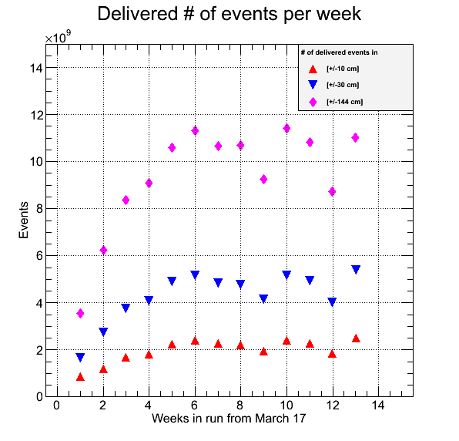
RHIC Performance for Au+Au @ 200 GeV
Excellent RHIC performance

Slide 8
PHENIX and Au+Au @ 200 GeV
Detectors were operating
In general smooth operation
Intermittent problems, resolved in time
Detectors out of DAQ while faulty
Mainly downtime due to failing power supplies
Two major repairs took central arm out for almost one week
Leaks in cooling system caused some downtime

Slide 9
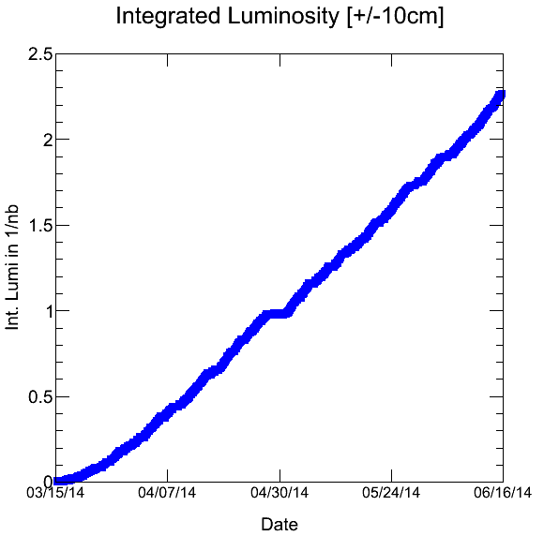
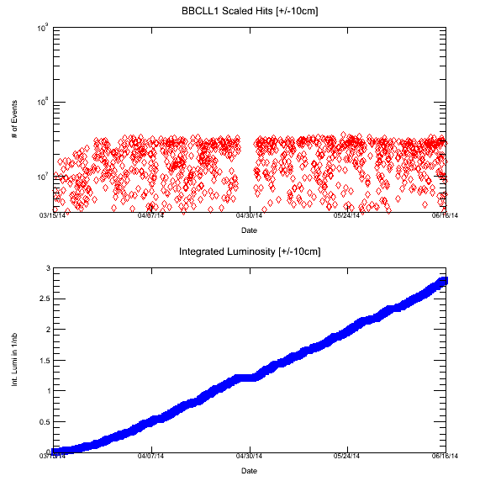
PHENIX and Au+Au @ 200 GeV
Integrated luminosity
with safety factor
ℒ ≈ 2.3 nb⁻¹
Corresponds to
14.2B events
Recorded > 17B events
(~ 2.8/nb)

Slide 10
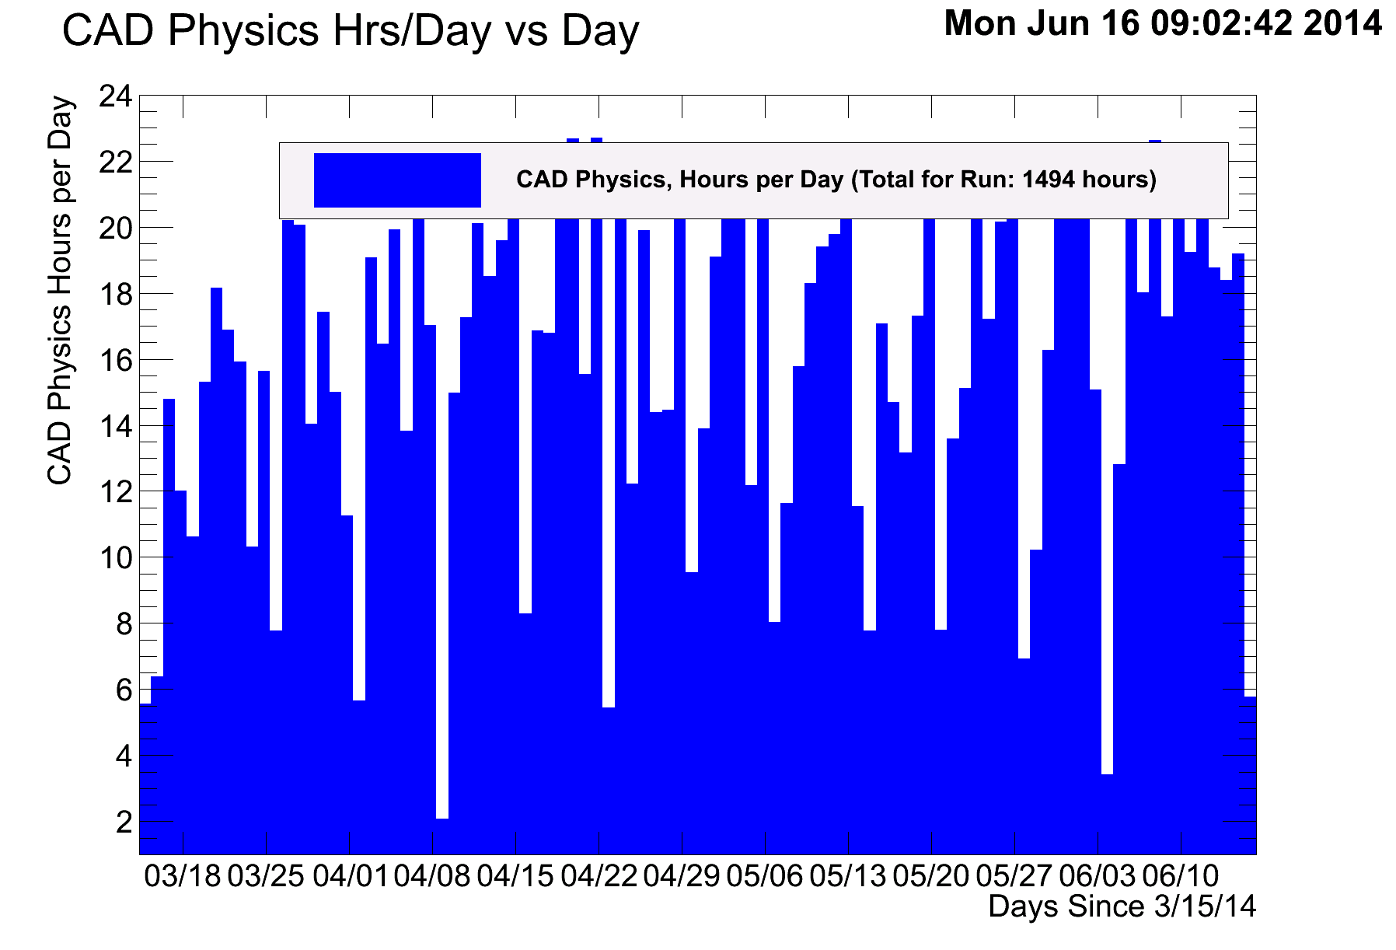
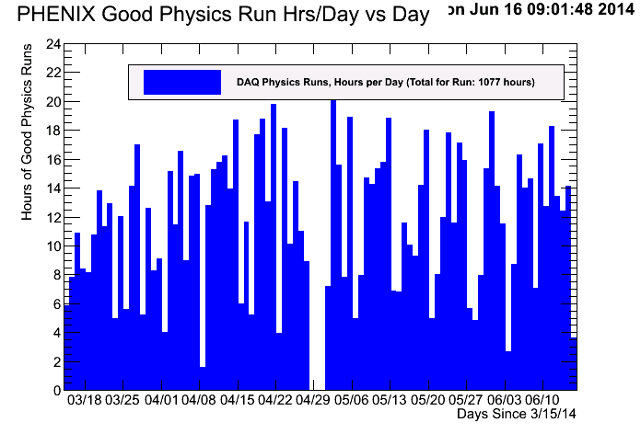
PHENIX and Au+Au @ 200 GeV
~ 1100 hours PHENIX physics runs
~ 1500 hours CAD stores
> 80% efficiency

Slide 11
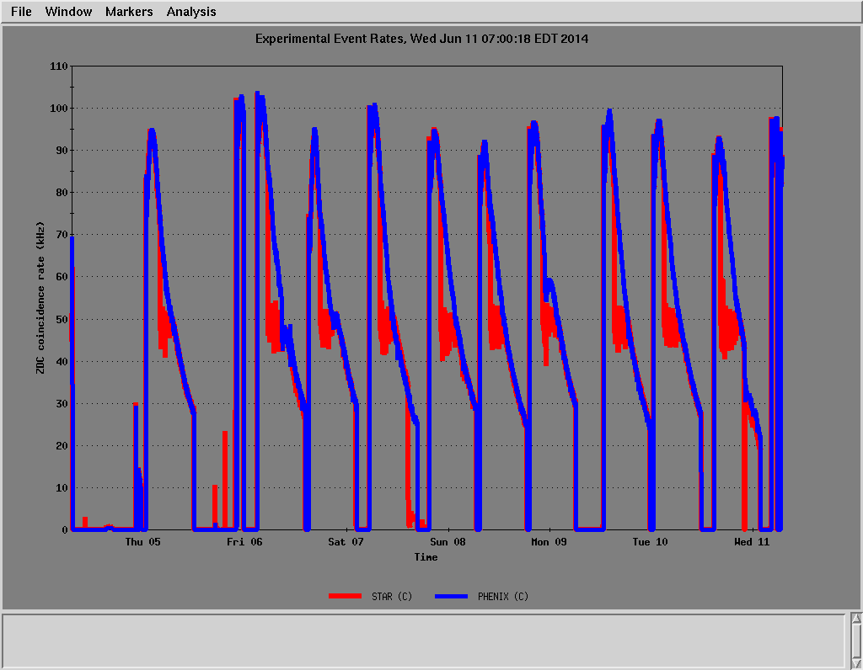
RHIC Performance for Au+Au @ 200 GeV
Default store length:
10 and later 11 hours

Slide 12
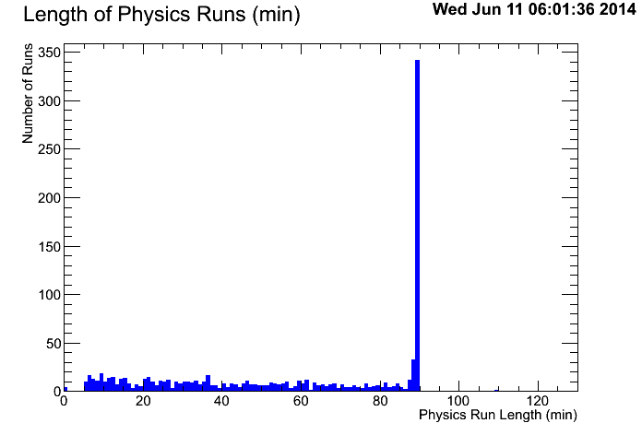
PHENIX and Au+Au @ 200 GeV
Default run length:
90 minutes

Slide 13
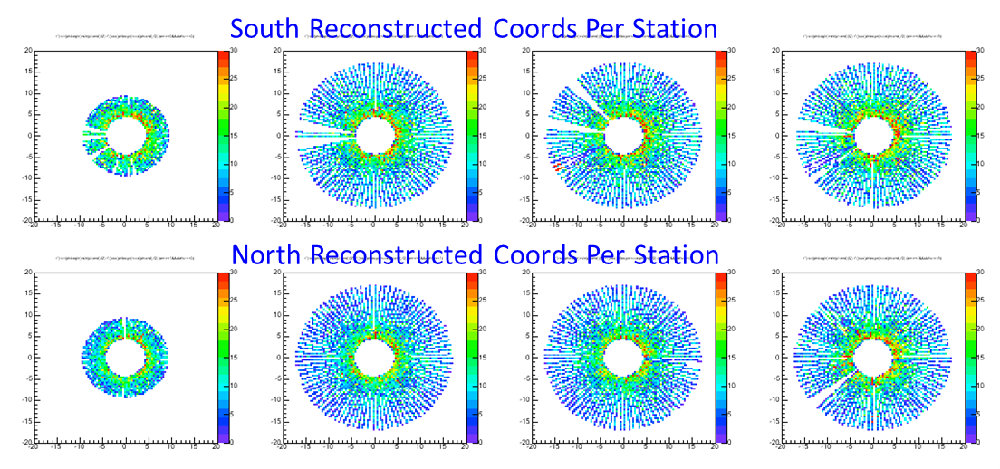
PHENIX and Au+Au @ 200 GeV
F/VTX detectors operating well
Live area > 95%
Internal alignment
Centroid for wedge residual : σ<3μm
Centroid for DCA FVTX track-FVTX vertex within ±50μm limits

Slide 14
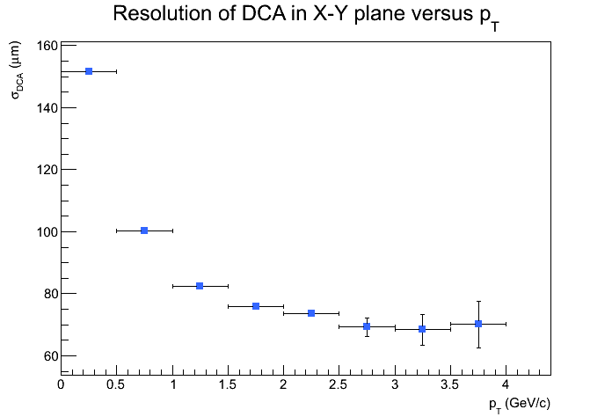
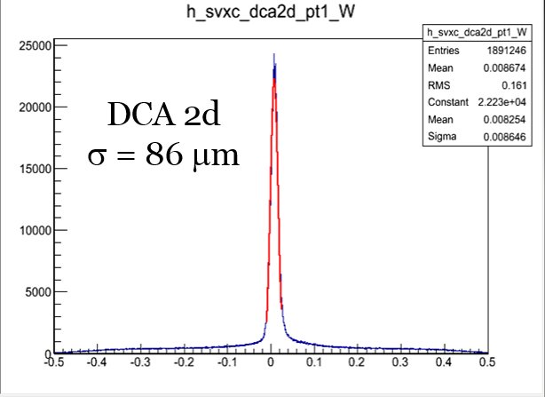
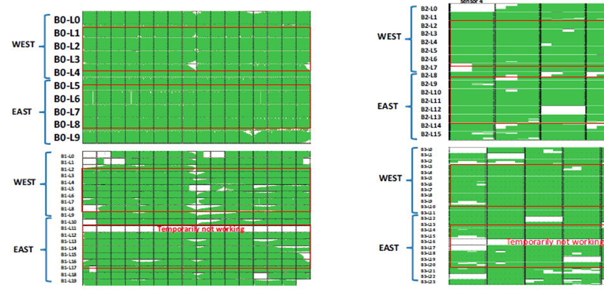
PHENIX and Au+Au @ 200 GeV
F/VTX detectors operating well
Successful repair and operation
Pixel live area > 80 %
Strip pixel live area > 85 %
F/VTX detectors operating well
Preliminary alignment provides better than 100 μm DCA
1.0 GeV/c < p_{t} < 1.5 GeV/c

Slide 15
PHENIX and ³He+Au @ 200 GeV
Our main goal for ³He+Au @ 200 GeV was to accumulate 1.8B events in MB for BBC-vertex |z_{vtx}| < 10 cm
First fill 18463 on Friday, June 20, 12 AM, Physics declared
First fill without central arm
Drift-Chamber repaired and back in big partition after weekend
First run with central arm back on June, 23
Last run on Sunday, July 06

Slide 16
PHENIX and ³He+Au @ 200 GeV
Collision rate
Up to ~ 90 kHz BBCLL1[±10cm]
Stochastic cooling for Au-beam only
Setup for BBCLL1[±10cm] as minimum bias
About 2.2B events recorded
Setup for BBCLL1[±10cm] and ~4% most central events -> centrality trigger
About 0.76B events recorded

Slide 17
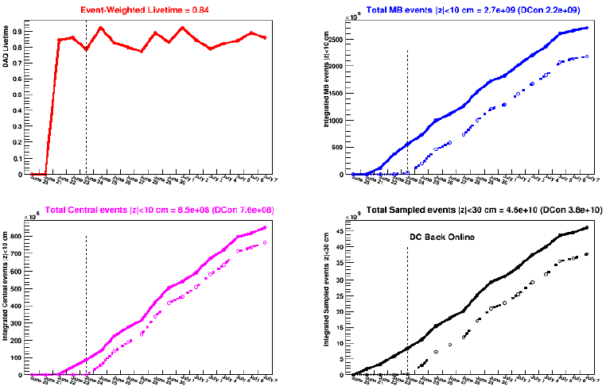
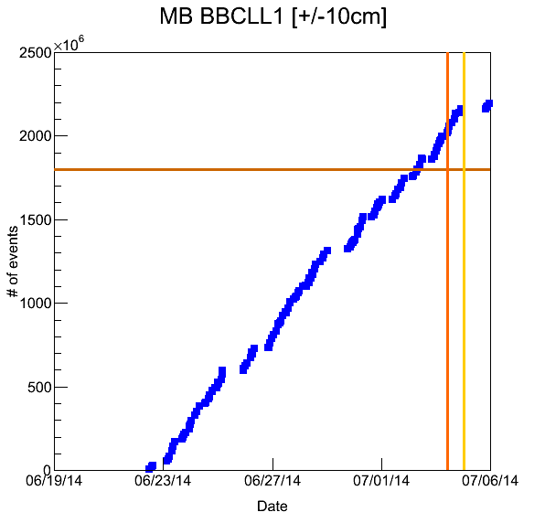
PHENIX and ³He+Au @ 200 GeV
Accumulated 2.2B
events in MB for
BBC-vertex
|z_{vtx}| < 10 cm
-> more than 20%
above our goal
4th of July

Slide 18
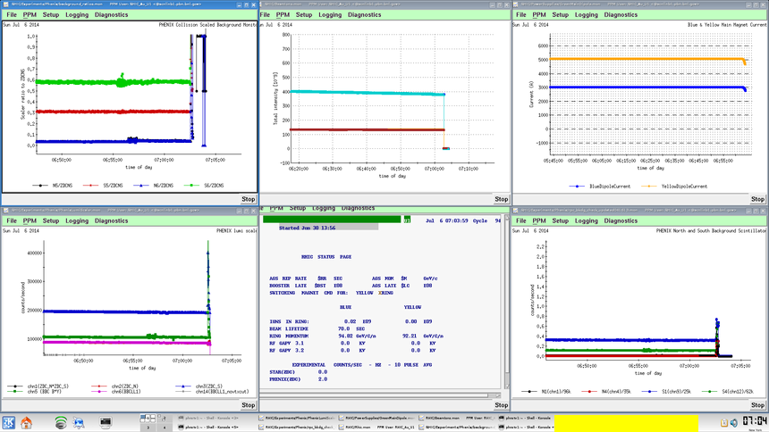
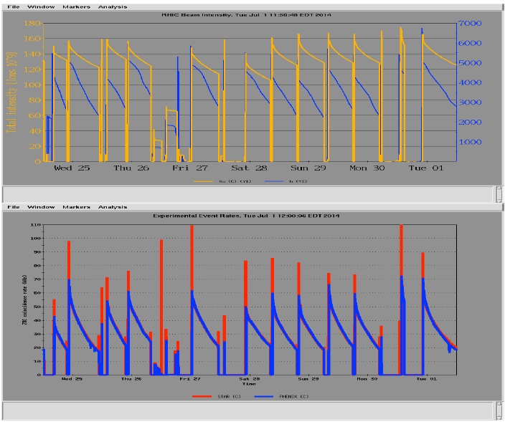
RHIC and ³He+Au @ 200 GeV

Slide 19
Conclusion
Very successful Run-14 and goals well exceeded
Very good communication between C-AD and PHENIX
Thanks to
Fantastic RHIC crews
Fantastic PHENIX crews
Huge data set to be analyzed

Slide 20
More slides

Slide 21
Heavy Quarks with PHENIX
F/VTX detectors
Tracking resolution better than 50 μm
Vertex resolution better than 100 μm
e,μ
X
D
Au
e
Au
D
B
DCA
D
Au
Au
J/ψ
B
K
π
$D^{±}$ ($c\overline{d}/\overline{c}d$) → 312 μm
$B^{±}$ (u$\overline{b}/\overline{u}b$) → 491 μm
$D^{0}$ (c$\overline{u}$) → 123 μm
$B^{0}$ ($\overline{d}b$) → 457 μm
e
X
e

Slide 22
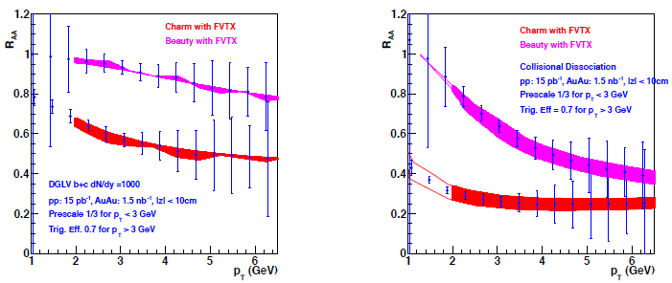
FVTX Data Set
First Au+Au dataset for FVTX
Simulation performance of nuclear modification factor R_{AA}
DGLV
Additional collisional dissociation processes
Notes:
Djordjevic, Gyulassy, Levai, and Vitev DGLV: radiative energy loss (predict c and b quark quenching)
Multiple elastic scattering of fast q-qbar in dense medium, collisional broadening of the meson’s pt, medium induced dissociation

Slide 23
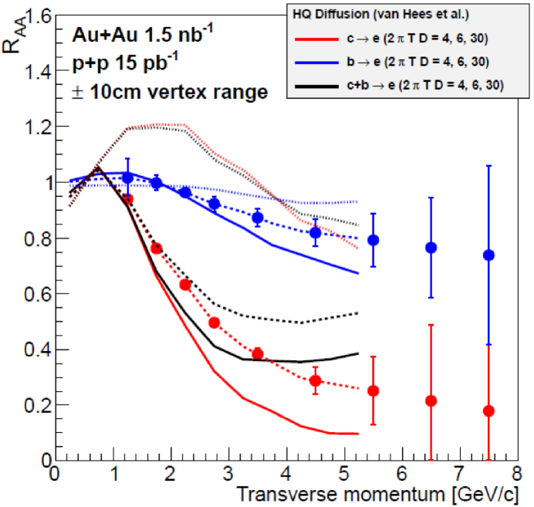
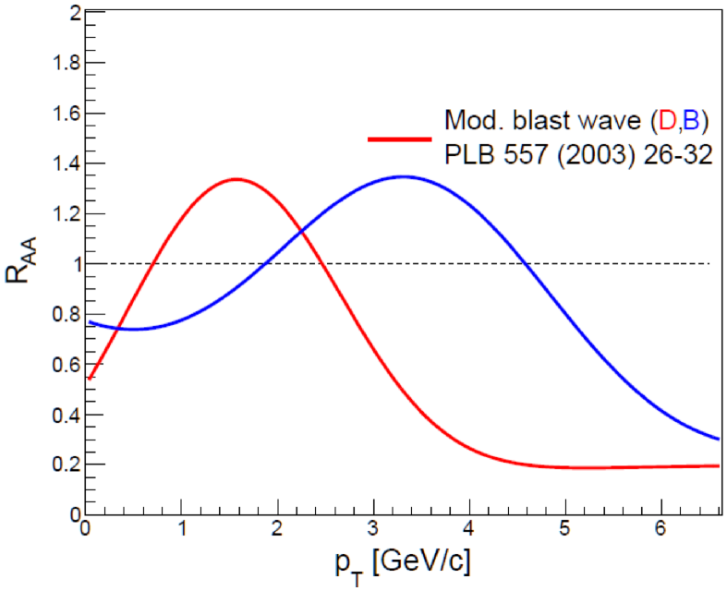
VTX Data Set
Simulation performance of R_{AA} for VTX-system
Very different prediction when
considering extreme scenario of
beauty quarks following flow field
Charm
Beauty
Notes:
Modified blast wave scenario: In extreme scenario of beauty quarks following transvers flow field, very different prediction for b quarks

Slide 24
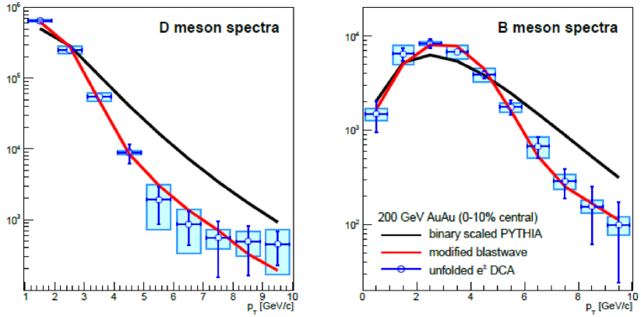
VTX Data Set
Example full unfolding from DCA electrons to parent mesons
Notes:
Using modified blast wave scenario, generated comparable Run-14 statistics for fake data electron DCA distributions as a function
of electron transverse momentum, resulting unfolded distributions are shown as blue points with propagated variance (lines) and bias error from regularized unfolding (boxes).

Slide 25
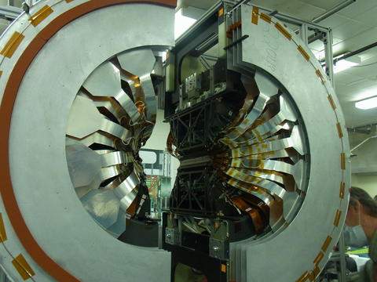
PHENIX Vertex Detector System
Refurbished Barrel VTX system

Slide 26
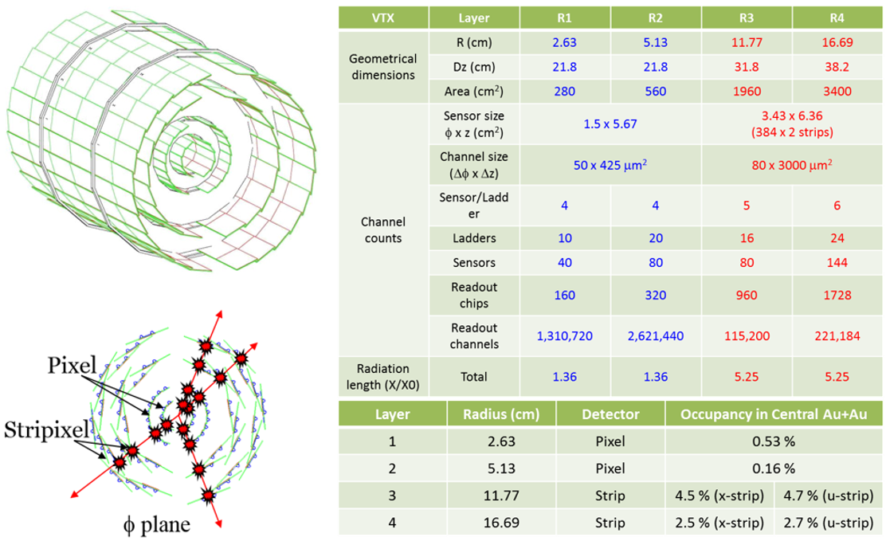
PHENIX Vertex Detector System
Refurbished Barrel VTX system

Slide 27
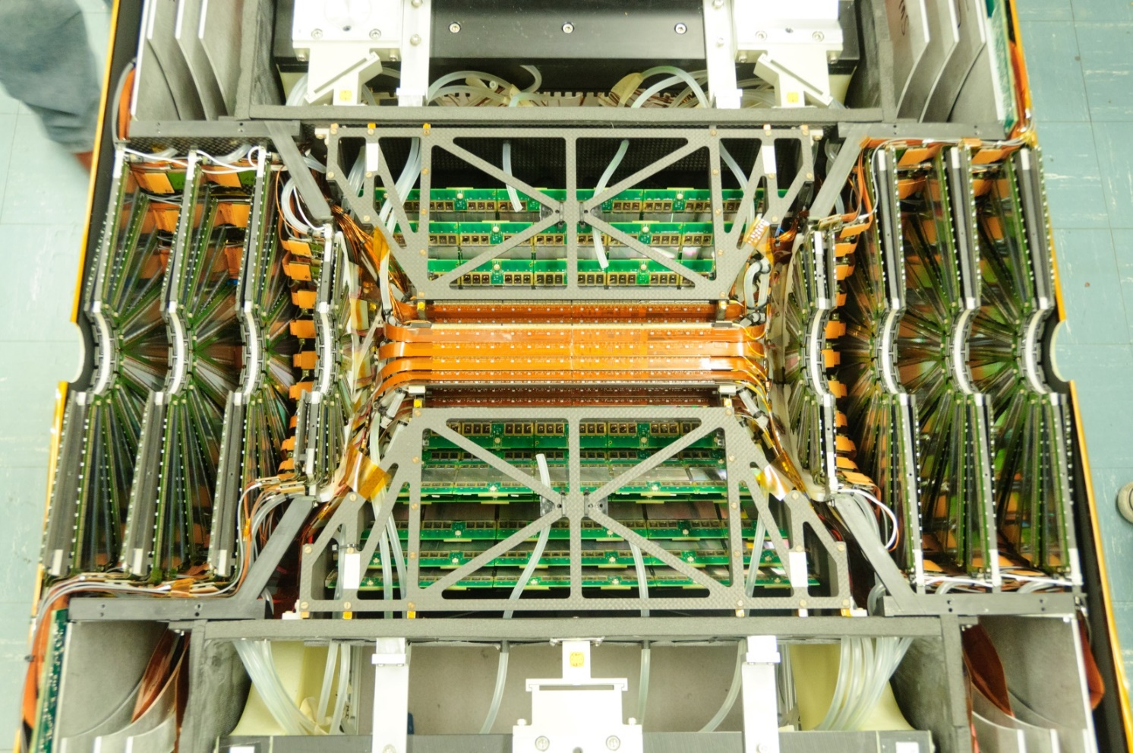
PHENIX Vertex Detector System
Refurbished Barrel VTX system + FVTX

Slide 28
PHENIX Vertex Detector System

Slide 29
Setting Up for ³He + Au
Unique probe of geometry
Make use of large tracking coverage of F/VTX
Measurement if hotspots in deposited energy connect during time evolution $→$ v₂ and v₃?
Notes:
question of whether these two (d+Au) or three (3He+Au) hotspots in deposited energy connect during the time evolution and result in
significant v2 and v3 is what these measurements can definitively answer

