Slide 1
Accelerator Physics EXperiment Highlight of RUN 14
RHIC Retreat 2014
M. Bai, C-A Dept., BNL

Slide 2
Outline
Goal
Improve machine performance
Support developments for RHIC future
Support beam instrumentation development
Inter-lab collaboration
Enrich accelerator physics knowledge
Statistics
Highlights
Summary of RUN 14 APEX

Slide 3
RUN 14 Focus @ APEX workshop
Heavy ion program
New lattice options for further improvement luminocity via
Beta* squeeze below 0.5m to accommodate the emittance reduction from Stochastic cooling
E-lens commissioning
Preparation for pA program
DX aperture scan
Au beam lifetime at proton injection energy
Injector chain
He-3 accelerating
DX shift for preparation of asymmetric collision operation

Slide 4
APEX Statics
RUN | Scheduled/Planned[%] | Beam Availability [%]
RUN-3 | 80 | 65
RUN-4 | 90 | 84
RUN-5 | 84 | 83
RUN-6 | 89 | 86
RUN-7 | 92 | 72 (physics: 49%)
RUN-8 | 97 | 83.4 (physics: 59%)
RUN-9 | 98 | 82.9 (physics: 54%)
RUN-10 | 79 | 82.5 (physics: 83%)
RUN-11:pp | 42 | 92 (physics: 37%)
RUN-11:Au | 63 | 78.5 (physics: 59%)
RUN-12:pp | 134 | 86.8
RUN-12:ion | 61 | 93.7
Run-11 APEX average availability: ~82%(ops certified accounting)
lower ratio of Scheduled/Planned was due to the poor machine availability

Slide 5
APEX Statics
RUN | Scheduled/Planned[%] | Beam Availability [%]
RUN-6 | 89 | 86
RUN-7 | 92 | 72 (physics: 49%)
RUN-8 | 97 | 83.4 (physics: 59%)
RUN-9 | 98 | 82.9 (physics: 54%)
RUN-10 | 79 | 82.5 (physics: 83%)
RUN-11:pp | 42 | 92 (physics: 37%)
RUN-11:Au | 63 | 78.5 (physics: 59%)
RUN-12 | 100 | 83.3
RUN-13 | 78 | 86.6
RUN-14:Au | 100 | 79.9
RUN-14:He3Au | 100 | 88.1
Data collected from Peter Ingrassia

Slide 6
Studies Proposed for RUN14
Study # | title | Studiers | priority | Total time [h]
14.2 | DA measurement w. 2.5GeV working point | Montag | 1B | 4
14.9 14.7 | DX aperture scan & effect of H offset in triplets | Luo, Marusic, Tepikian, Bai | 0A 1A | 11
11-33 | IP coupling matrix measurement | Tepikian | 0A | 7
14.16 | Ramp optics | Liu | 0A | 6
14.10 | Momentum aperture scan | Luo | 0A | 4.5
14.6 | Elens and Ion beam | Gu, Fischer, Luo, White | 1A | 24
N/A | Telescope Beta squeeze | GRD, Marusic, Bai | N/A | 7.5
14.8 | RHIC longitudinal impedance measurement | Blaskiewicz | 1A | 4.5
14.4 | Measurement of total AuAu cross-section | Fischer | 2A | 2
14.3 | S* knob S* correction for He3Au | Bai, Hao, GRD, Duan, Shen | 0A | 7 2

Slide 7
Studies Proposed for RUN14
Study # | title | Studiers | priority | Total time [h]
14.5 | Non-linear driving term | Jing | 0A | 7
14.14 | Polarimeter target light observation | Huang | 0A | 2
14.13 | Beam-beam driven non-linear resonances and amplitude detuning measurement | White | 1B | 5
12-22 | Head-tail chromaticity measurement | Ranjbar | 0A | 2
 | Asymmetric beam beam study | Luo |  | 5
 | Au ramp and store just above transition | Montag |  | 3.5
 | Spin flipper AC dipole bump closure | Oddo |  | 1
 | Injection tuning | Liu |  | 1
14.12 | Off-momentum optics as a function of phase advance between low-beta insertions | White | 1A | 0
14.11 | Near-integer Beam Dynamics Study | Luo, Bai | 2B | 0
14.1 | 2.5GeV Au beam in RHIC | Montag | 1A | 0

Slide 8
Elens Commissioning
Plan to
exercise transverse alignment of e beam w Au beam
Measure the impact of e-Au on beam emittance as well as beam lifetime
The SC cooled Au beam allows for reversal of emittance growth
Observe beam-beam driven instabilities
 | Au+Au 2014 | p+p 2015 (100 GeV)
Beam loss | ~8 %/hour burn-off dominated | ~3 %/hour beam-beam dominated
Emittance growth | negative IBS + stoch. cooling | positive beam-beam
Max beam-beam param. ξ | 0.006 / IP | 0.012 / IP
σ_{e-beam} / σ_{p-beam} | ≈ 2 | ≈ 1
Courtesy of W. Fischer

Slide 9
Elens Commissioning
Effect of e-beam on Au beam’s orbit and tune was measured and used as 1st alignment tool
Tune
Courtesy of W. Fischer
Vertical kick (from orbit)

Slide 10
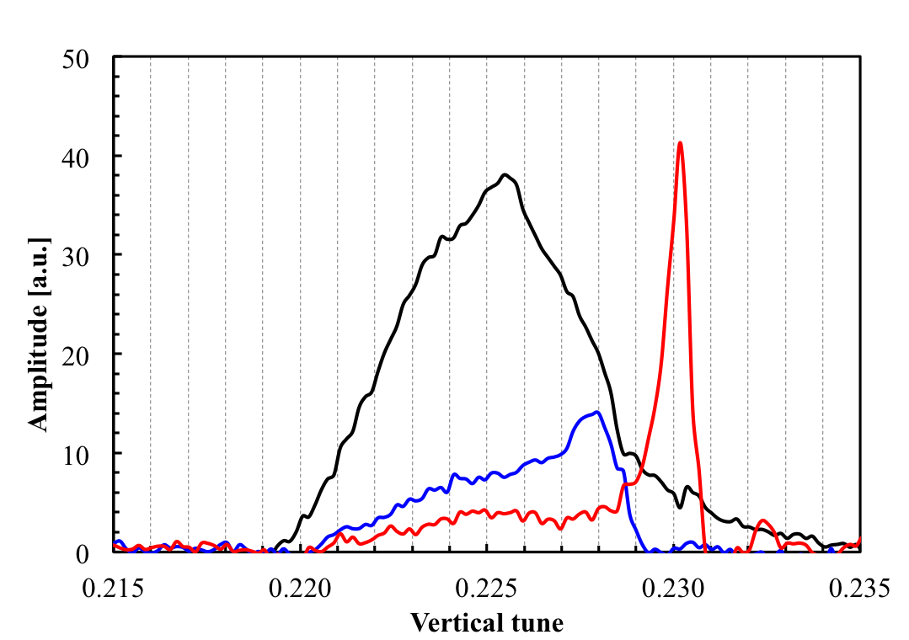
Elens Commissioning
Vertical BTF measurement with e-beam during Physics store shows reduction of the incoherent tune spread and also the emergence of coherent mode at higher e beam current
Coherent mode emerging with increasing electron current
780 mA (last 2 b.)
0 mA (all bunches)
365 mA (last 2 b.)
Courtesy of W. Fischer

Slide 11
Elens Plan for coming pp RUN
Large cathodes
allows for matched beam size w. high solenoid field
Raises instability threshold
Easier alignment
Transverse damper
Bunch by bunch to fight beam-beam driven instabilities if needed
New lattice using ATS optics
Phase advance between IP6/8 and IP10 is k
Minimize the nonlinear chromaticity
Polarization transparent
Courtesy of W. Fischer

Slide 12
DA Measurement with 2.5 GeV working point
Goal is to understand the surprisingly small DA at 5.86 GeV(proton beam), for which working point was set to 0.17/0.13
Measure DA at Au regular injection energy with several different working points
Data is affected by various issues
Blown up beam due to AtR quadrupole problem
Non-gaussian beam profile
Nevertheless, qualitatively the measurement confirmed that DA aperture at tune of 0.17/0.13 is worse than all other choices, especially 0.13/0.12, which had been used at other low energy runs

Slide 13
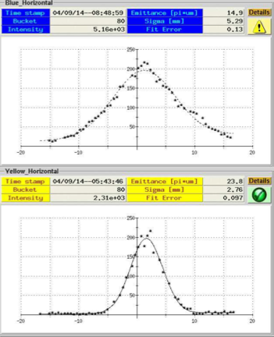
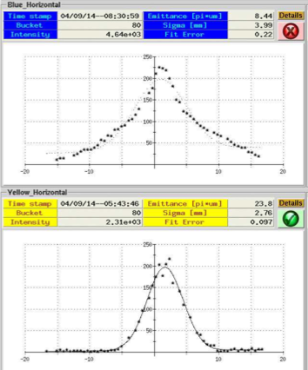
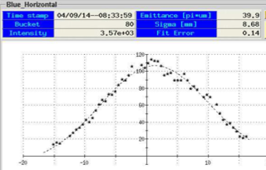
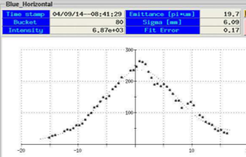
DA Measurement with 2.5 GeV working point
DA scan (only showing Blue data)
14.9
8.44
0.23/0.22
0.17/0.13
39.9
19.7
0.13/0.12
0.09/0.08

Slide 14
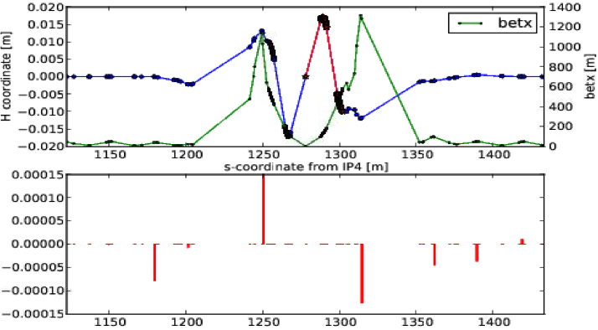
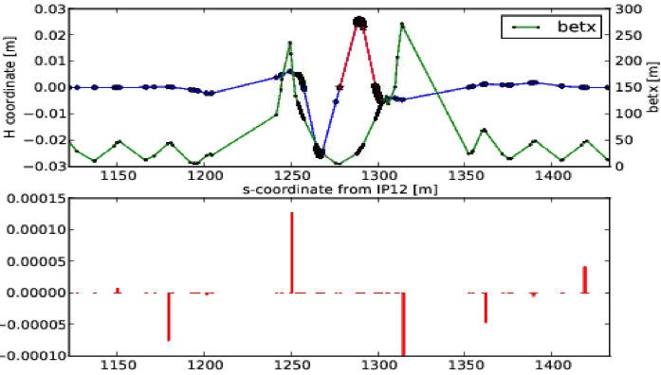
DX Aperture Scan
Confirm the DX aperture scan in RUN13
Exercise the Triplet aperture scan at injection and store
Blue IP8@store
Blue IP4@store

Slide 15
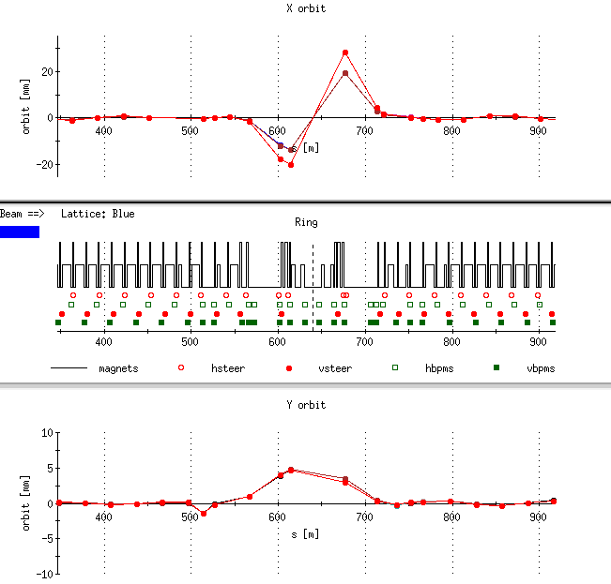
DX Aperture Scan
Confirmed the DX aperture scan in RUN13
Exercised the Triplet aperture scan at injection and store
Critical in developing as well
as debugging the Ramp
Manager and WFG Manager
to accommodate un-equal
species collisions
Confirmed a 15mm offset in
triplet has negligible effect
on beam lifetime for the
He3Au lattice in RUN13

Slide 16
He3Au Orbit@Store
Blue
Yellow

Slide 17
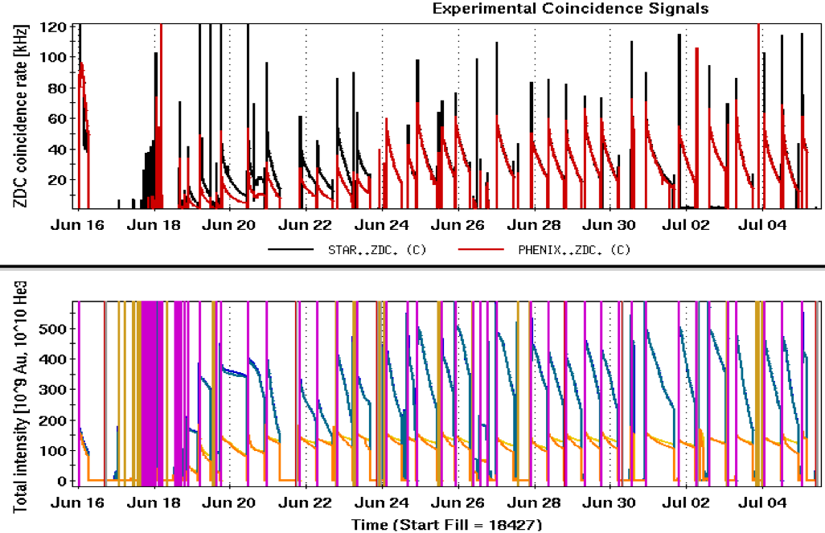
He3Au Run
He3Au
setup
Last AuAu store

Slide 18
Telescope beta squeeze development
SC opens up the possibility of lumi leveraging by further squeeze beta* during a physics store
Launch large beta-beat in the arcs to reach beta* of 0.5 m
This technique was inspired by the Achromatic Telescopic betasqueeze, first invented and tested at LHC by S. Fartoukh
Blue
Yellow

Slide 19
Telescope beta squeeze development
APEX attempt
First APEX attempt: Fill #18126
Established the storage ramp for telescope beta squeezing to 0.6m beta*
1st time 100% online betabeat correction with loptics
first time reaching 50cm in Blue for Fill #18128
first time with 50cm in Yellow for Fill #18239
End of store experiment:
with a 12x12 test ramp (APEX) = Fill #18272
with a full 111x111 = failed (LISA used Au14-s0 to re-optimize), Fill #18261
with a full 111x111 = successful, Fill #18320 (both Blue and Yellow)
THOR declared operational at Fill 18413 (6/12/2014)
From GRD

Slide 20
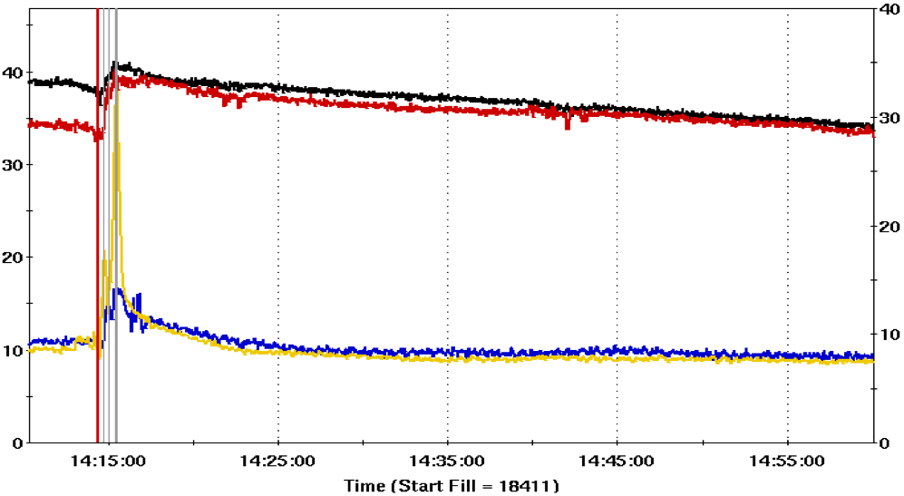
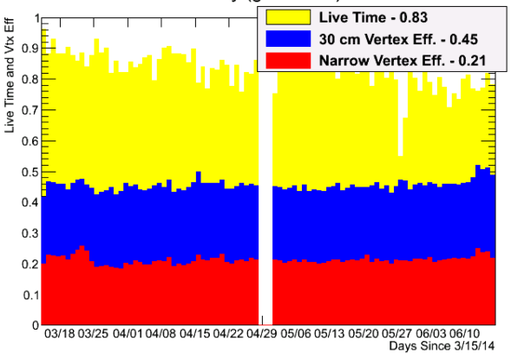
Telescope beta squeeze
Direct benefit of success of THOR lattice
ZDC rate
Beam Decay rate
STAR Live time and Vtx Eff
After THOR was operational and implemented at 7 hour into a physics store

Slide 21
Summary
RUN 14 APEX program has been very fruitful. A handful of beam studies directly benefited the RUN14 performances in luminosity as well as versatility
The past decadal experience of APEX has shown that APEX is one of the crucial investment to ensure the continuous performance improvement of RHIC as well as future projects
CeC PoP, low energy operations, etc
APEX HAS NOT been and WILL NEVER be the Stumbling Block of RHIC!!!

