Slide 1
Electrical Infrastructure needs for the next 10-20 years
Jon Sandberg

Slide 2
Electrical Infrastructure
What Key Changes to the electrical infrastructure need to be made to operate the C-AD facilities for another 20 years?
We must plan to replace equipment, some times very expensive equipment, while it is still operational
The cost and time to repair/replace might be prohibitive but if done in the context of a failure, without proper planning, it could be many times worse
We would like as seamless a transition from the old to the new as possible
The time frame needed to design, procure, install, and commission some large systems can easily be from 3 to 5 years.
The support for some of our older equipment both in industry and at the Laboratory is quickly dwindling
What are the Key Barriers to doing this?
Money
Manpower
Time
Interference with operations (power outages)
Space/Logistics

Slide 3
Electrical Infrastructure
Presently the successful operations of RHIC depends on many key pieces of equipment and systems, some of which have been in operation for almost 5 decades. Upgrades have been done in many cases but some key components remain unchanged.
The cost to replace some of these systems could be in the order of tens of millions of dollars.
In some cases it is not possible to move and replace equipment in one shutdown period. A parallel location may be required.
It is very difficult to make changes to the existing power distribution system because of the consequences of long electrical outages. In part because the system was not designed in a redundant fashion or to comply with present safety requirements.
The basic premise behind all arc flash calculations is that the equipment is properly maintained and in good working order.

Slide 4
Electrical Infrastructure
Some newer equipment is designed with arc flash concerns in mind and is intrinsically safer
When new experimental facilities are proposed the use of existing infrastructure can be a powerful economic advantage
As equipment ages it requires more frequent maintenance implying more resources
Some of the critical expertise and understand of the subtleties of this equipment is being lost, not only at BNL but in industry. We need to build up this expertise in house.
We have become dependent on one or two equipment specialist in some key areas and we need to make a concerted effort to broaden this base. This requires more personnel and a recognition that time must be dedicated to the transfer of information and training.
We need to dedicate some portion of our manpower and money to developing new technologies and R&D

Slide 5
Electric Power Distribution
System Facts:
2–LIPA 69 kV feeders; substation inter-tie; 143 MVa capacity
603 Substation = 80 MVa 631/638 Substation = 80 MVa
Distribution @ 13.8 kV & 2.4 kV
Peak electric demand: 59 MW; 2014 with NSLS-II: rises to 77 MW
Energy Consumed: 250,000 MWh/yr
C-AD uses 56% of the Lab Power
59 unit substations (13.8 kV/480 V)
8000 switches and panel boards
30,000 molded case circuit breakers

Slide 6
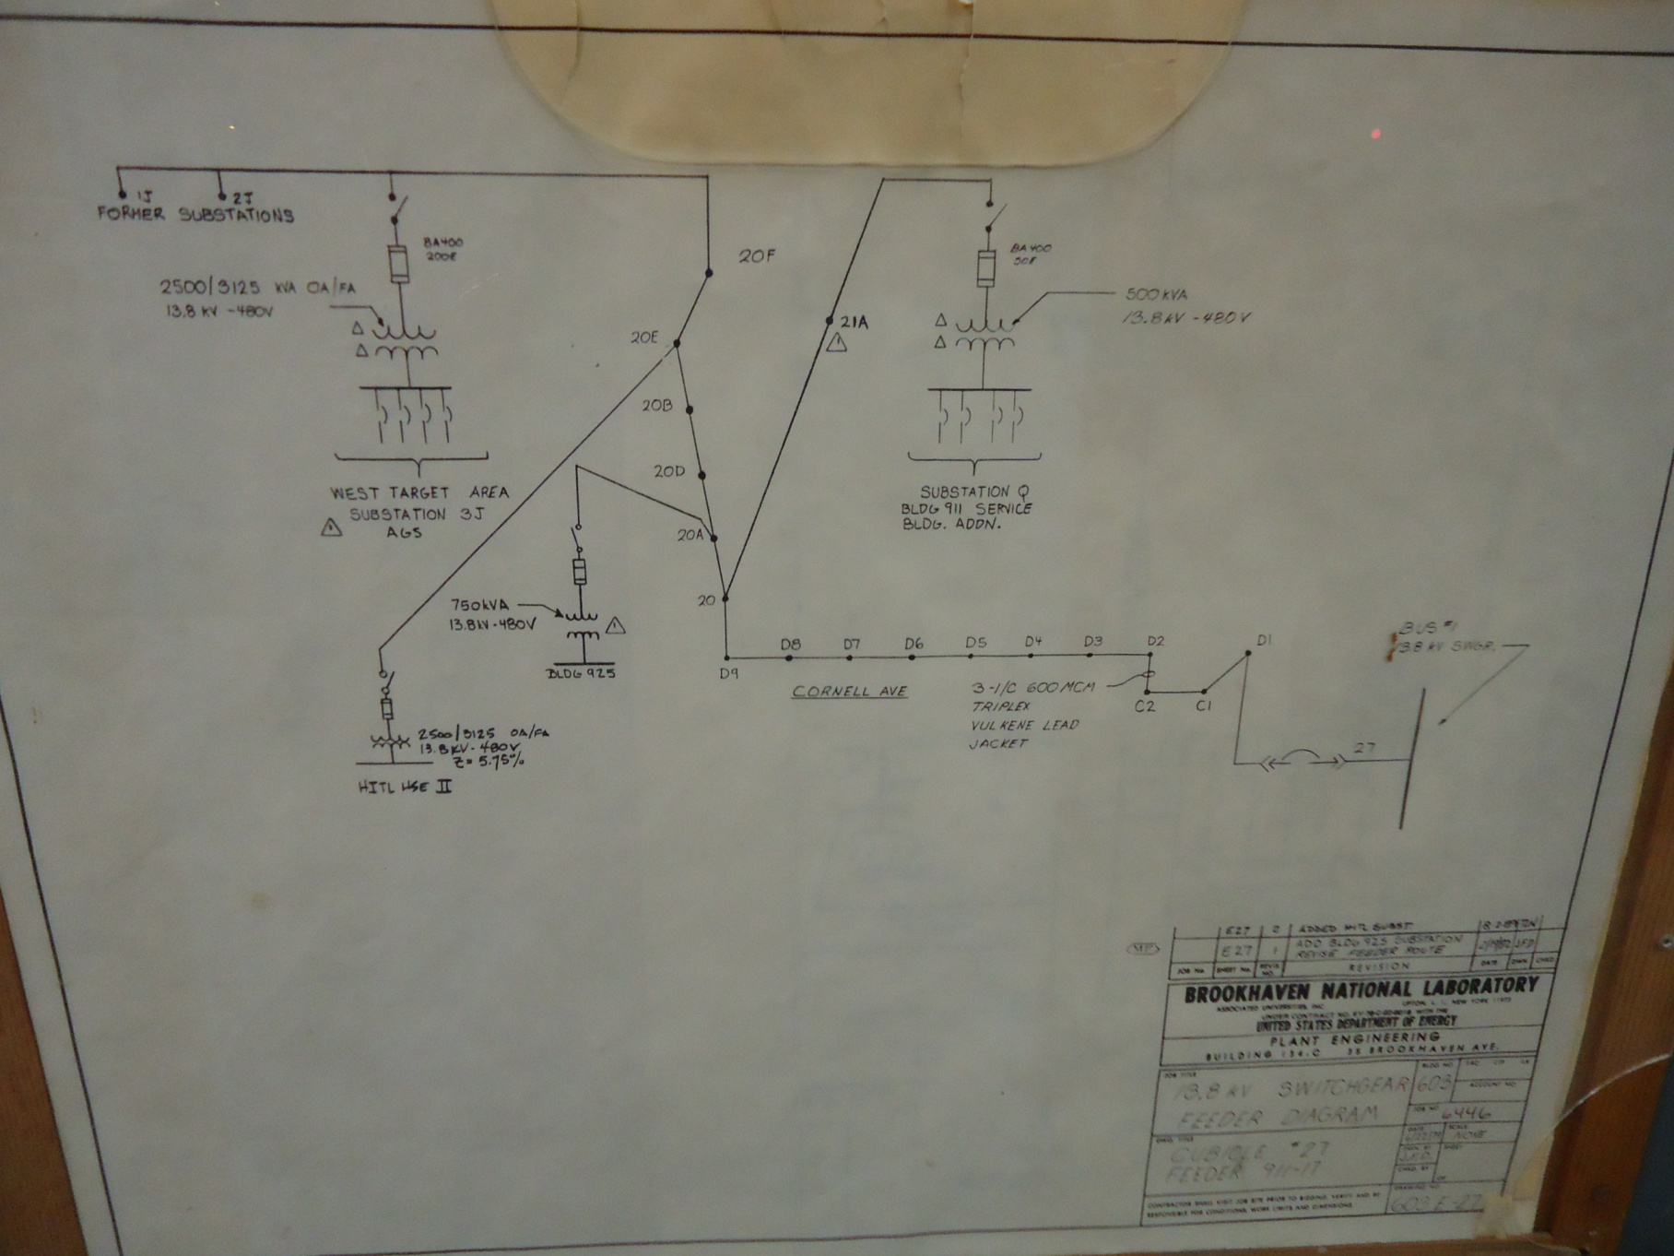
Electrical Systems
2011
2012
Finding the location of a fault can be very difficult and time consuming

Slide 7
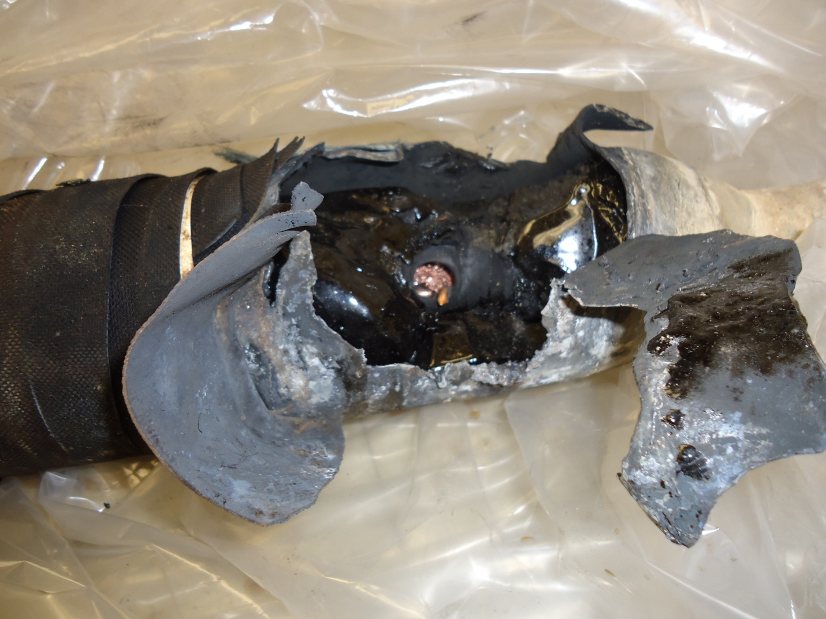
Electrical Systems
Feeder Cable failures occurred in June of 2012 and March of 2011. Exact replacement cable was not available and duct size was to small for modern equivalent.

Slide 8
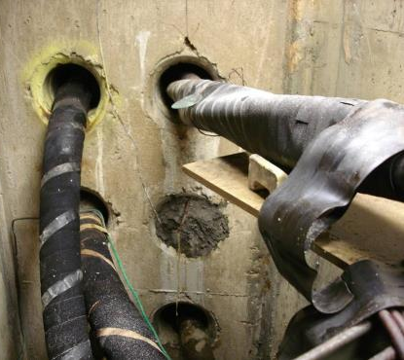
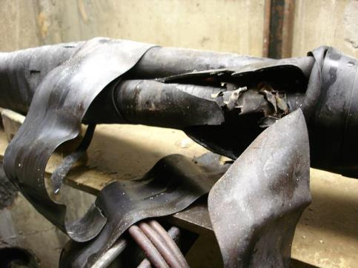
Electrical Systems
F&O is securing funding for major electrical infrastructure projects. By 2017 it is planned to address this issue

Slide 9
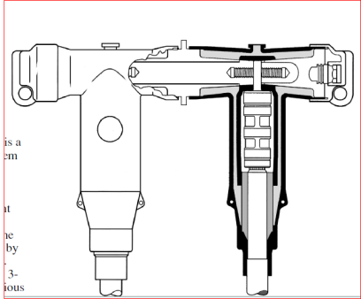
Electrical Systems
Procure a reasonable amount of spare cable
Procure Separable splicing Kits
Explore Cable testing methods
Explore fault location devices

Slide 10
Electrical Systems
C-AD Power Distribution Group
There is an ongoing effort to modernize the electrical distribution system at C-AD. It is limited by manpower restraints and the necessity of taking power outages
Royal Boxes
480 V (Motor Control Centers) MCC’s.
The condition of aging and over-dutied equipment has been brought to forefront and resource are regularly allocated to remediate these conditions
Replacement of High incident energy switchgear and relays. Since 2006:
Over 93 beaker settings have been reviewed and optimized
Soft start circuitry has been added to the STAR main power supply
45 new solid state trip units have been installed
New remotely operated switchgear has been installed at 1005 H
RHIC has 2000 lighting fixtures and 800 lamps and 300 ballasts must be replace annually.

Slide 11
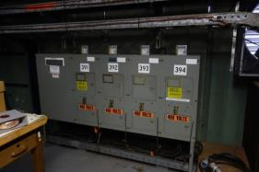
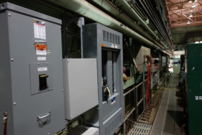
Electrical Systems
ROYAL BOXES are fed directly from substation and are typically arc flash hazard category DANGEROUS.
ROYAL BOX at 911
ROYAL BOX replaced with a main breaker and a breaker panelboard.
There were 122 ROYAL BOXES
46 boxes have been removed
8 have been converted to circuit breaker panels.

Slide 12
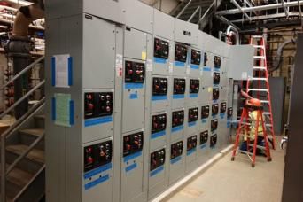
Electrical Systems
New MCC at 928
There were 48 MCC’s at C-AD
5 have been disconnected or taken out of service
14 are for building infrastructure
29 are used for experimental equipment
7 have been replace or refurbished
2 new ones will be installed next year (manpower limitation)
5 more, of the remaining 20, should be replaced

Slide 13
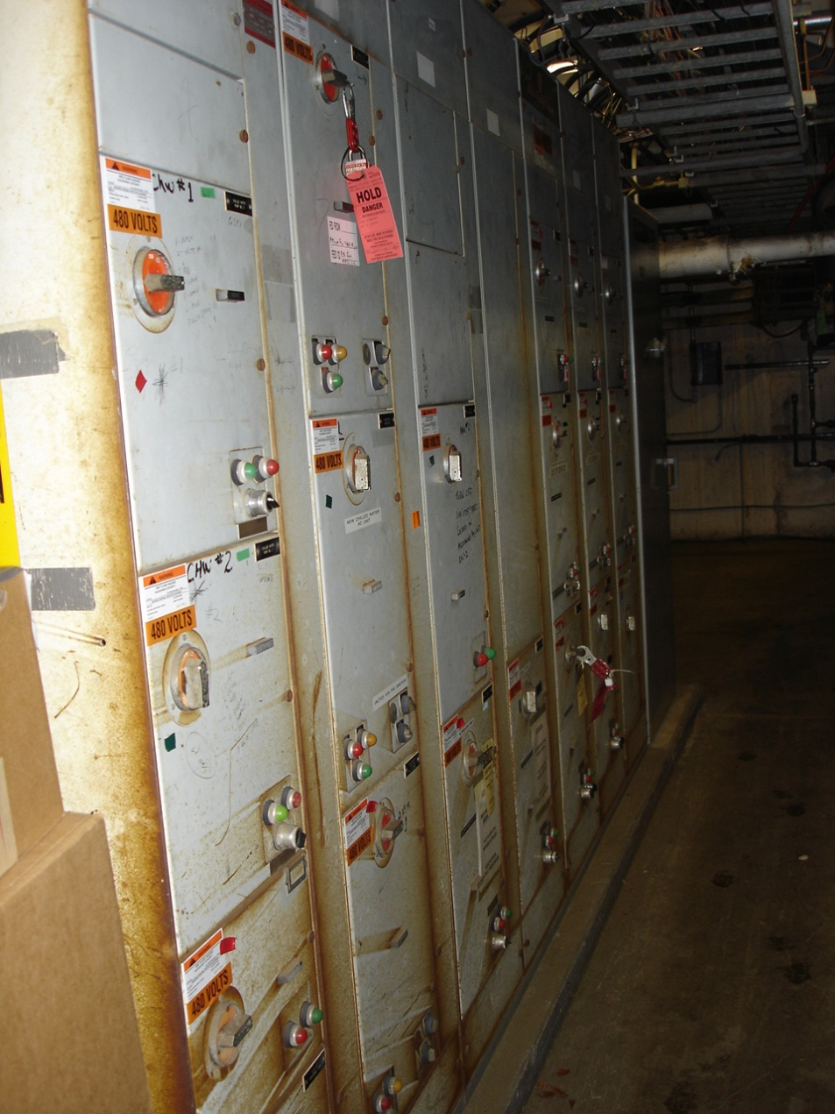
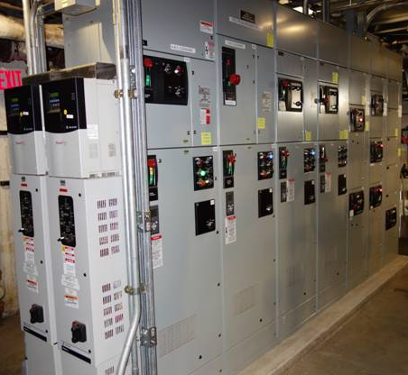
Electrical Systems
Power Distribution Group
Old 929 MCC
New 929 MCC

Slide 14
Electrical Systems
Booster/AGS Ring Power Supply Group (BARPS)
350 power supplies ranging from 1000 Watt correctors to the 95 MVA
Some power supplies date from the 1960’s and were overhauled at BNL in the 1980’s.
Many of the power supplies procured in the 1990’s have obsolete components and were manufactured by companies now closed
The operation and maintenance of two multi MVA motor generator sets.
The Booster main magnet power supply 6,000 V, 6,000 A and associated transformers (30 ea) and switchgear
STAR (1000 V, 5000A) and PHENIX ( 200 V, 3000A) high power PS
Cabling

Slide 15
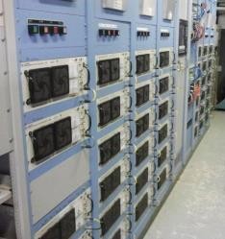
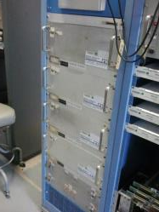
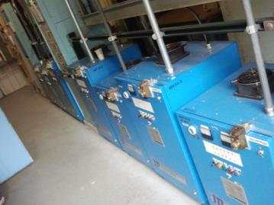
Electrical Systems
Booster/AGS Ring Power Supply Group (BARPS)
Booster Corrector
AGS Correctors
BTA PS

Slide 16
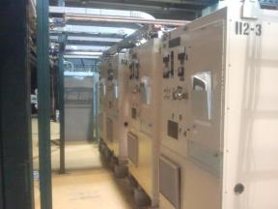
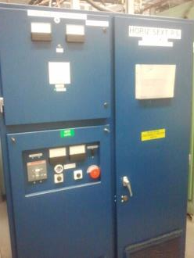
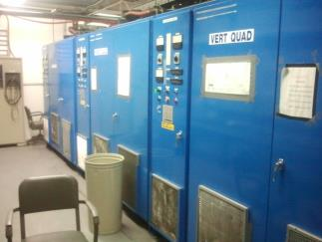
Electrical Systems
Booster/AGS Ring Power Supply Group (BARPS)
BTA PS
Multipole Room PS’s
Sext PS

Slide 17
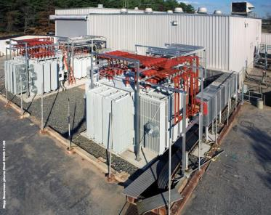
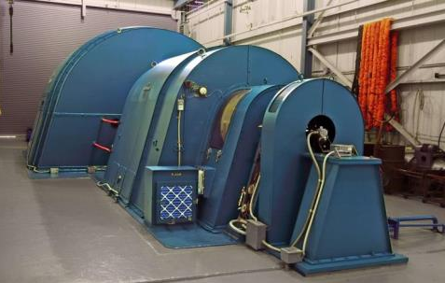
Electrical Systems
Booster/AGS Ring Power Supply Group (BARPS)
AGS MMPS --Transformers, Rectifier Assemblies, and MG Set

Slide 18
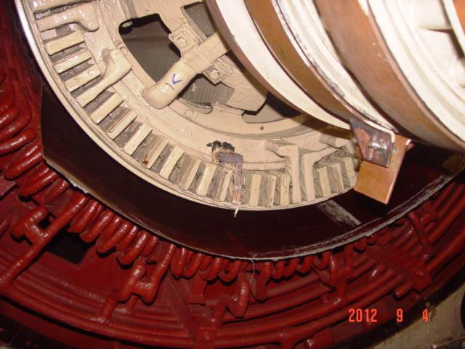
Electrical Systems

Slide 19
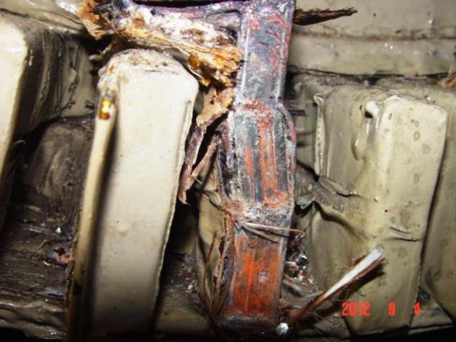
Electrical Systems
This failure cost $400K to repair and kept the machine
out of commission for 7 months in 2012. All key personnel who
worked on this machine for GE came out of retirement

Slide 20
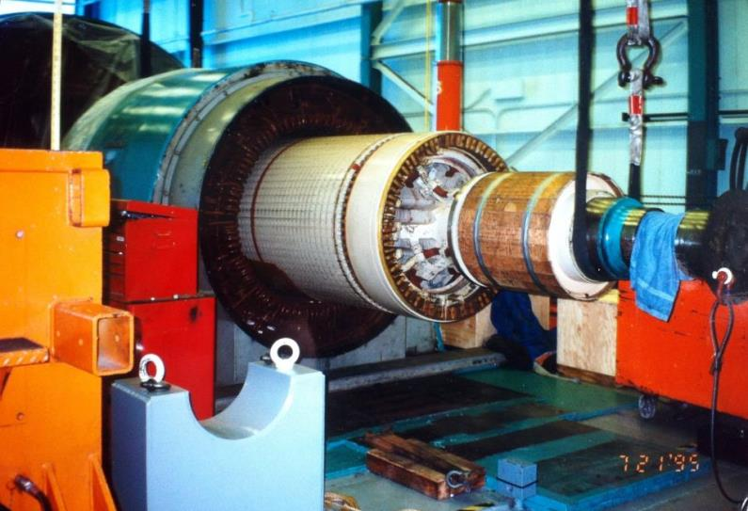
Electrical Systems

Slide 21
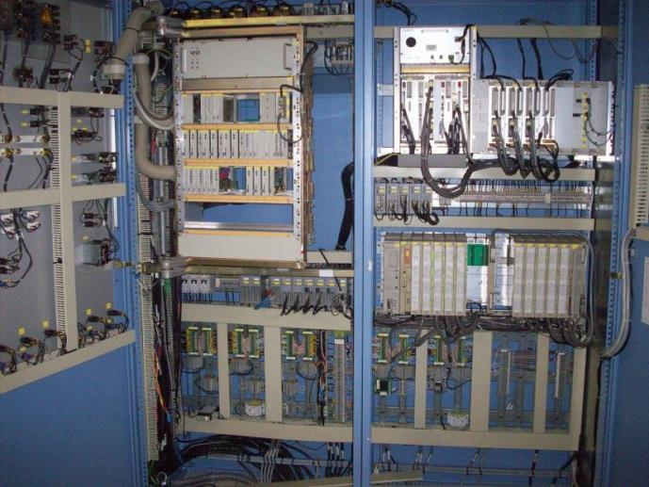
Electrical Systems
Problems with the cyclo-converter regulator kept the Siemens offline from mid February to early April 2014. Outside support was almost nonexistent

Slide 22
Electrical Systems
Replacing the MG set with a capacitive energy storage system as CERN has done would be on the order of $ 12 million
The logistics of installation and transition between systems would be extremely challenging.
There would be a significant in-house engineering effort required
Based on operating modes it could save ~$ 330 K in electricity per year
It could save another $250 K in salaries per year.

Slide 23
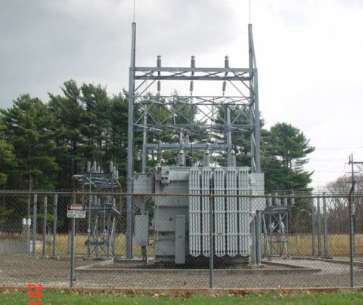
Electrical Systems
Transformer #7 631 Substation
Built with aluminum windings

Slide 24
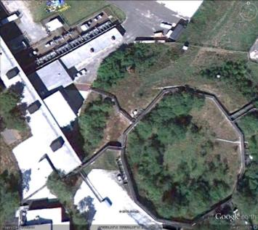
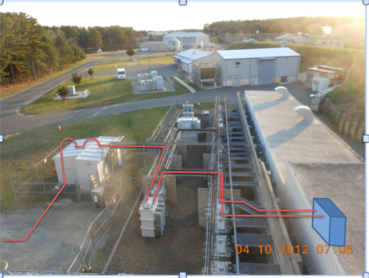
Electrical Systems
Booster/AGS Ring Power Supply Group (BARPS)
Booster MMPS-- Rectifiers, Transformers, and switchgear house

Slide 25
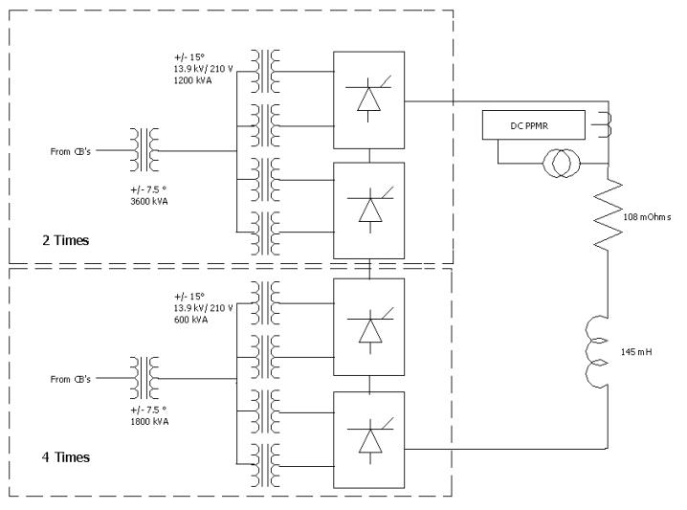
Electrical Systems
Booster
24 Pulse SCR PS

Slide 26
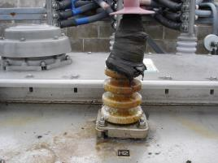
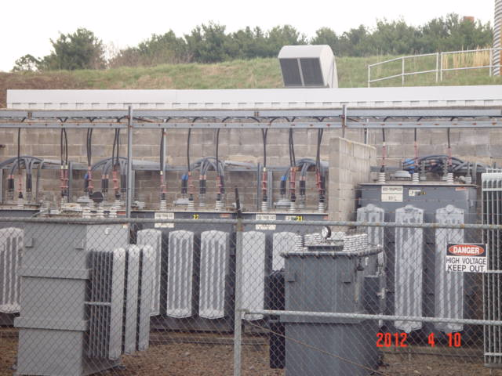
Booster Accelerator
Transformer Yard
7 units have failed since 1993

Slide 27
PPMR (Pulsed Power Monitor Relay)
A GE study done in 1988 showed that there is a natural electromechanical resonance in the vicinity of 1 Hz in the LILCO system. Unacceptable power oscillations might effect plant monitoring at turbine generators near by the Booster if it were operated near this frequency.
Avoid Booster operation at frequencies near 10 Hz the lowest torsional mode of Shoreham. Gas turbines may also have torsional frequencies in the 7 to 20 hz range. If the Booster operates below 8 Hz torsional interaction should not be a problem

Slide 28
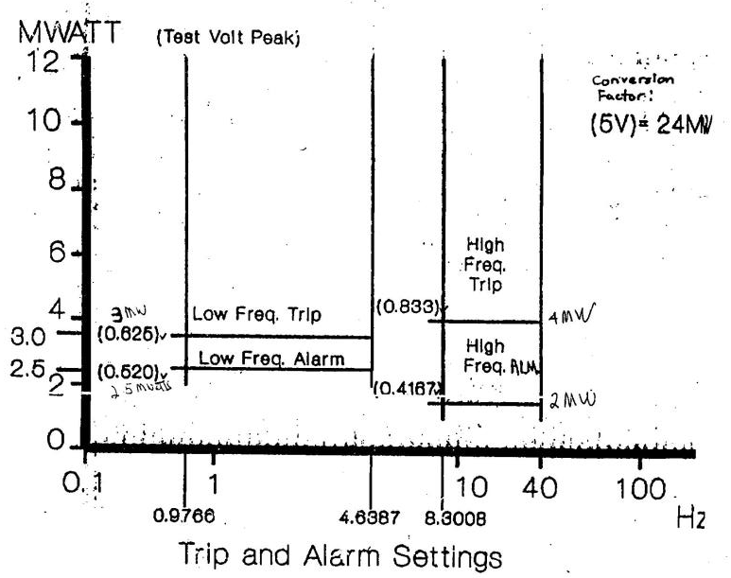
Electrical Systems

Slide 29
Electrical Systems
Replacing the Booster with a capacitive energy storage system would be on the order of $ 8 million
Based on operating modes it could save ~$ 100 K in electricity per year
It should free us from the restraints imposed on us by the PPMR
It should greatly reduce or eliminate the booster electrical noise onsite
The logistics of installation and transition between systems would be extremely challenging.
There would be a significant in-house engineering effort required

Slide 30
Electrical Systems
Pulsed Power Systems Group (PPS)
65 Pulsed power system throughout C-AD
20 systems in the Booster
23 systems in the AGS
20 systems in RHIC
2 in EBIS
Cost and delivery of thyratrons is becoming problematic. Solid state solutions must be found.
The possibility of relocating some of the modulators outside of the radiation areas , although extremely expensive, should be considered.

Slide 31
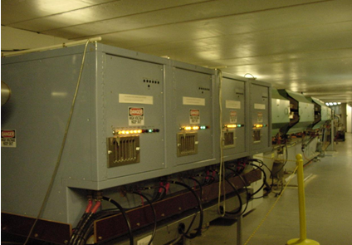
Electrical Systems
Pulsed Power Systems Group (PPS)
H10 PS (early 90’s)
G10 Modulators (early 90’s)

Slide 32
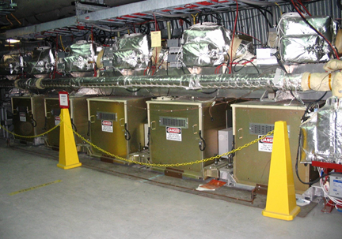
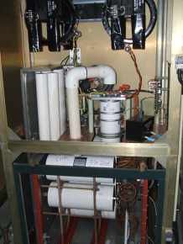
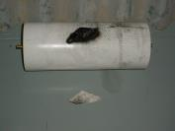
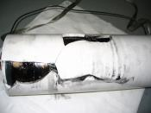
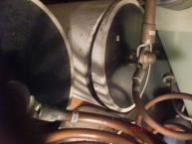
Electrical Systems
Pulsed Power Systems Group (PPS)
RHIC Abort kicker modulators
7/2/2003
9/22/2005
7/9/2014

Slide 33
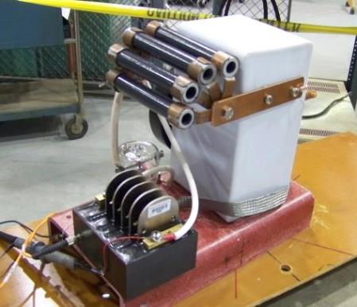
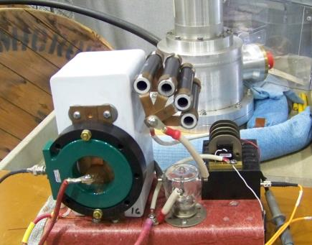
Electrical Systems
Applied Pulsed power systems Ithaca NY
20 kV switch

Slide 34
Electrical Systems
Collider Electrical Power Supply Group (CEPS)
~1045 power supplies ranging from 50 Amp bipolar correction supplies to the RHIC Main Dipole and Quadrupole PS’s (5,500 A, 200 V, & 5,500 A, 90 V))
Presently replacing SCE bipolar 300 ampere power supplies with Kepcos
RHIC correctors power supply bypass and filtering capacitor failures are increasing
Superconducting quench detection and protection systems
36 quench detection systems (Hardware/Software Obsolescence Problem)
309 quench protection assemblies
288 crowbar assemblies
24 DX heater assemblies

Slide 35
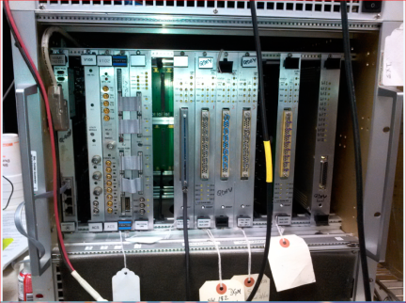
Electrical Systems
Drawings need to be put into Mentor Graphics
The DSP board is obsolete
The ADC on the mux card is obsolete
Quench Detector
Critical software written in Visual Basic 6 has little documentation or comments. An effort should be made to rewrite this and integrate it with the controls group.

