Slide 1
SRF gun Commissioning
BROOKHAVEN SCIENCE ASSOCIATES
Wencan Xu
Brookhaven National Laboratory

Slide 2
Outline
Brief Introduction of the BNL R&D ERL and SRF gun
Summary of SRF gun commissioning with and w/o cathode stalk
First beam commissioning results and short-term plan
Summary
Notes:
This presentation will briefly review the

Slide 3
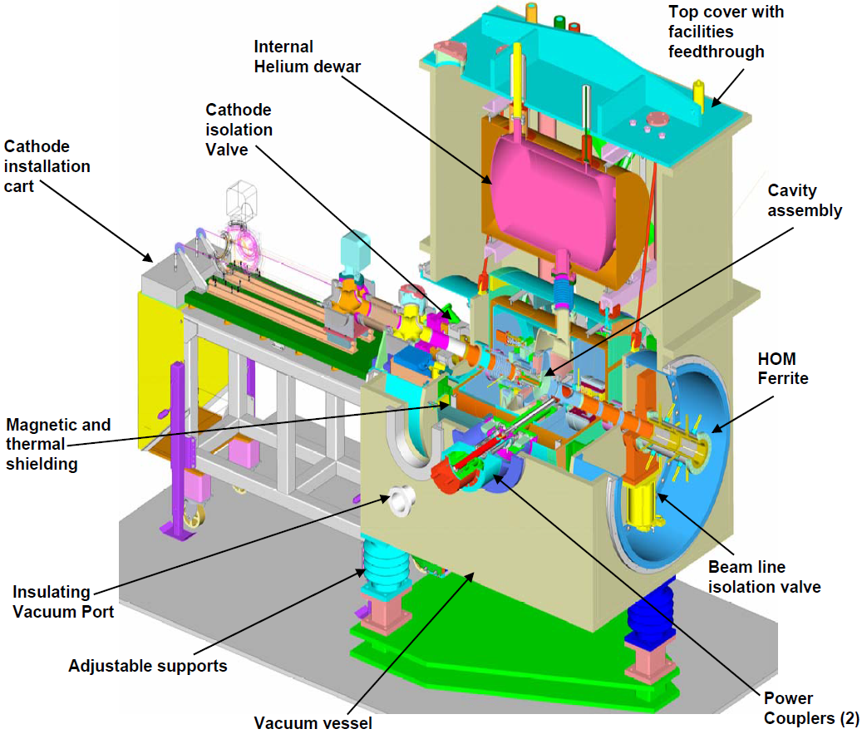
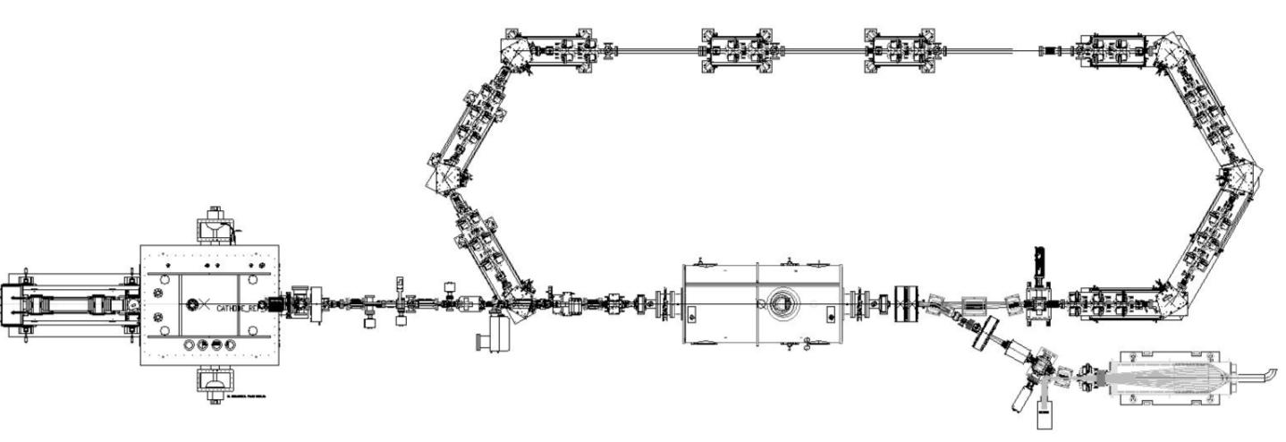
The R&D Energy Recovery Linac at BNL
Straight section is 7m long
20 MeV
SC RF Gun
20 MeV
20 MeV
2-3 MeV
2-3 MeV
2-3 MeV
SC 5 Cell cavity
Beam dump
Most of components (Gun, 5-cell, magnets, diagnostics…) will be used for Low Energy RHIC electron cooler (LEReC).
SRF gun is under commissioning.
Notes:
SRF photo-injector includes SRF cavity, HTS, laser, merger…

Slide 4
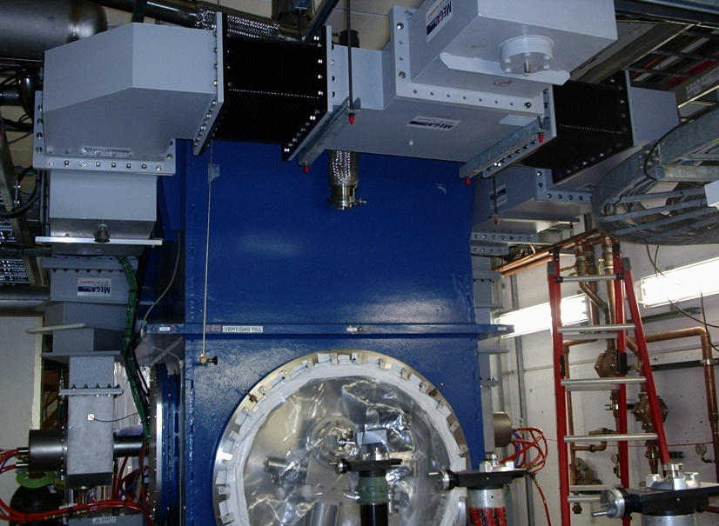
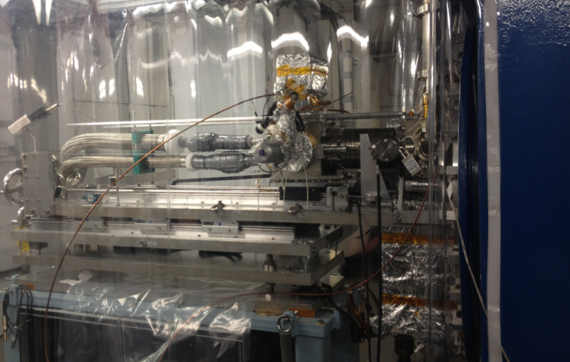
SRF gun commissioning progress
2010 to 2012: Tested and installed the main components of the SRF gun: cavity, FPC, tuner… , and subsystems: cryo, LLRF, vacuum, instrumentation……
The commissioning of the SRF gun is proceeding in stages:
Nov. 2012 to Mar. 2013: Commissioned SRF gun cavity w/o cathode stalk insertion;
Aug. to Oct. 2013: Commissioned SRF gun cavity with copper cathode stalk insertion;
May. 28, 2014 to present: Commissioning SRF gun cavity with Cs₃Sb photocathode and have electron beam to faraday cup.
Cathode insertion

Slide 5
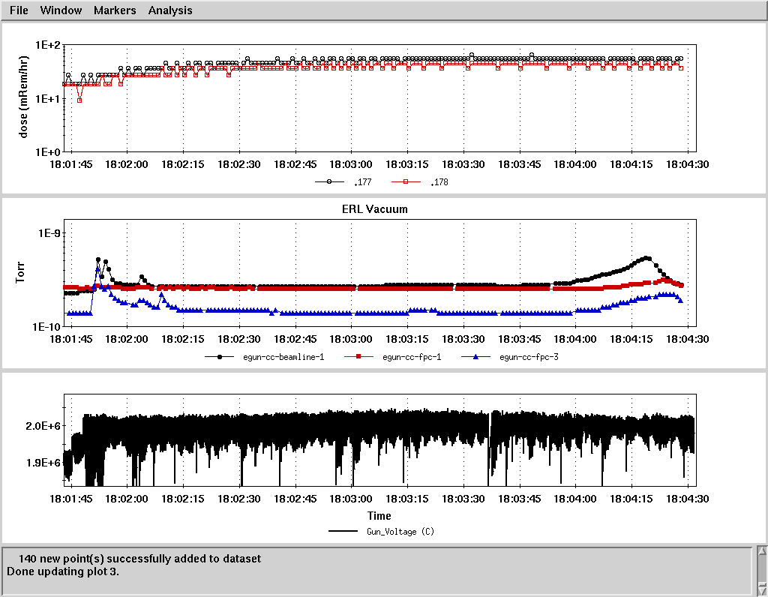
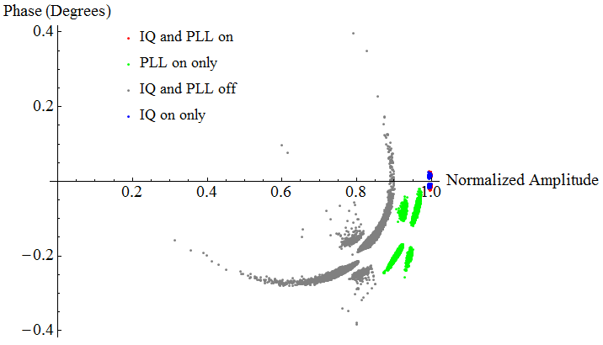
Summary of commissioning w/o cathode stalk
radiation
The SRF gun cavity commissioning without cathode stalk insertion demonstrated to be able to operate at 2.0 MV CW.
Good vacuum
2 MV CW operation open
The amplitude stability is 2.3e-4 (rms) and the phase stability is 0.035 degree (rms), although Lorentz force detuning factor is -11.8 Hz/(MV/m)² and microphonics caused frequency fluctuation is about 700 Hz (peak-to-peak).
I/Q on only for operation

Slide 6
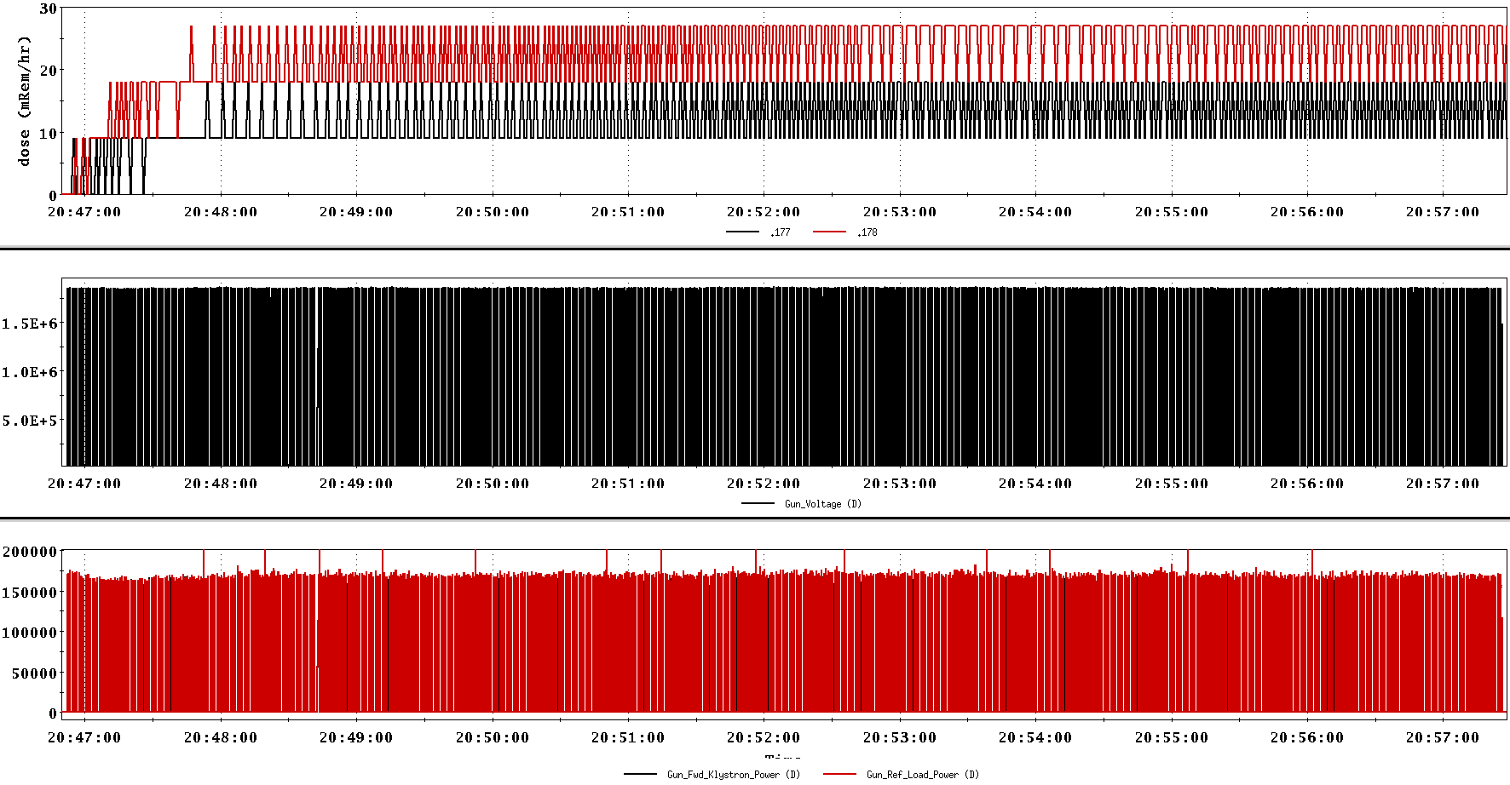
SRF gun commissioning with Cu cathode stalk (1): summary
The SRF gun was carried out commissioning with Cu cathode stalk insertion, and found a missing power at gun voltage of 0.3 - 1.1 MV;
After high power processing/conditioning, with that Cu cathode stalk, operational field would be 1.85 MV, 180 ms, 1 Hz; It quenched in minutes if pulse is longer.
After the cathode stalk was removed, the cavity reached CW 2 MV without any conditioning. This shows that the insertion of a cathode stalk into a superconducting RF cavity does NOT lead to a degradation in the cavity performance.

Slide 7
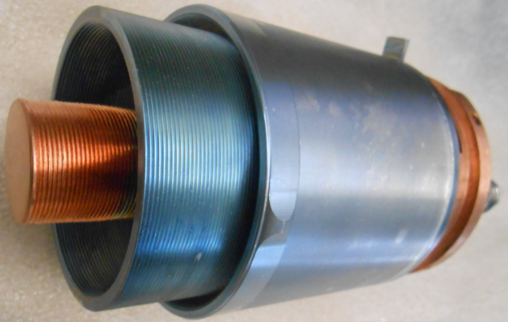
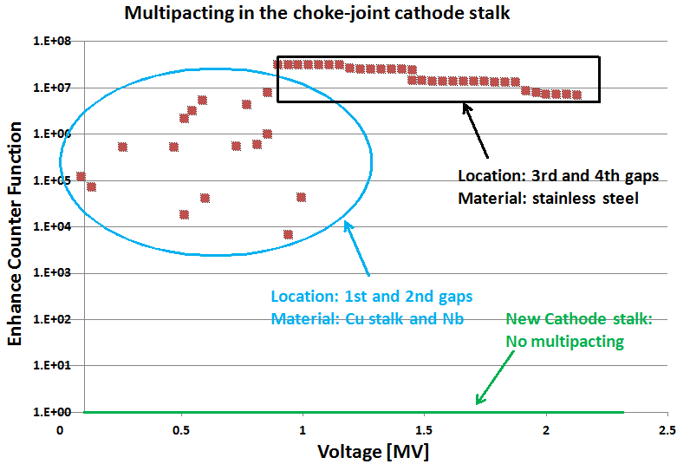
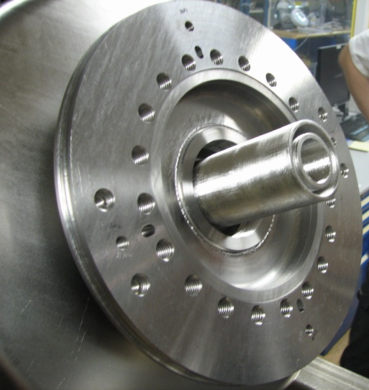
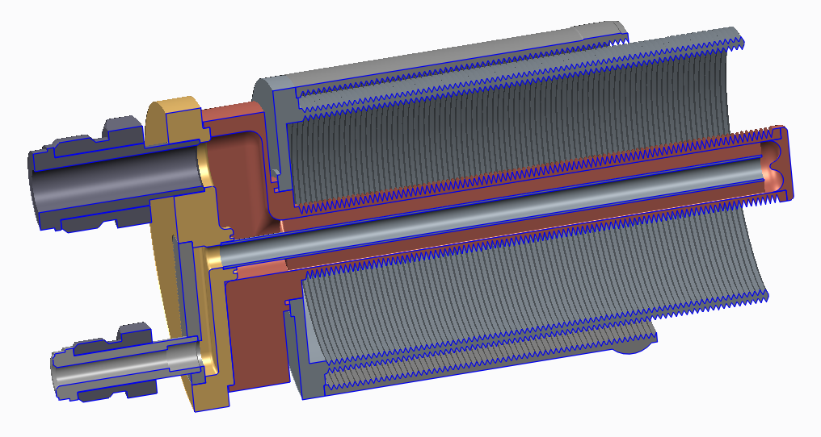
SRF gun commissioning with Cu cathode (2): Multipacting
Current stalk
Cavity
Multipacting-free stalk with Ta tip
Cavity
stalk
4th gap
3rd gap
2nd gap
1st gap
The new cathode stalk with Ta tip will be delivered on Oct. 15, 2014.

Slide 8
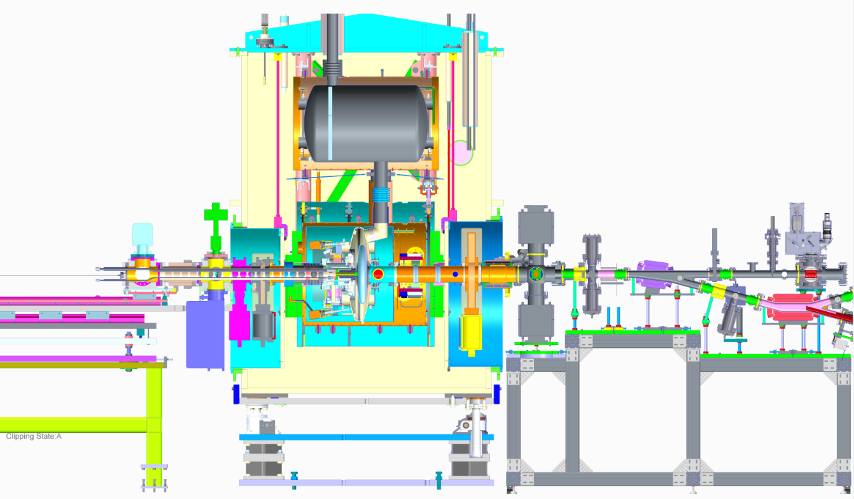
SRF gun beam commissioning
Cathode transport cart
Profile monitor
Cathode
Cavity
HTSS
ICT
Pepper pot
BPM
Beam scraper
Faraday Cup
Gate Valves
Laser cross
Corrector
First beam with Dipole off

Slide 9
SRF gun beam commissioning
Prior to inserting the photocathode, the cavity was tested and reached the design voltage without any conditioning.
After the photocathode was inserted, we only spent about 1 hour on conditioning multipacting up to 1.4 MV, 40 ms pulse. The conditioning time is significantly shorter than the previous test with the cathode stalk, to reach the same field level.
Scan parameters (RF, laser, corrector magnet ) to see electron beams.

Slide 10
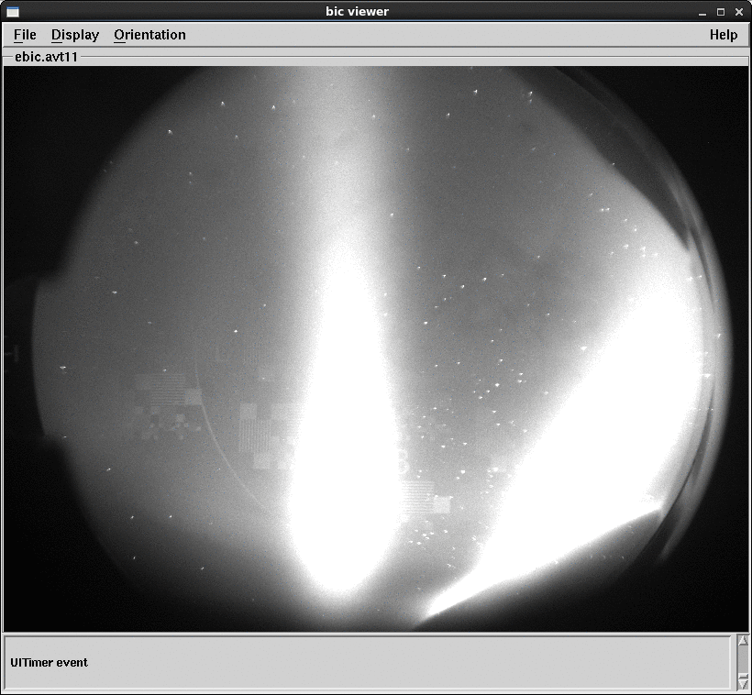
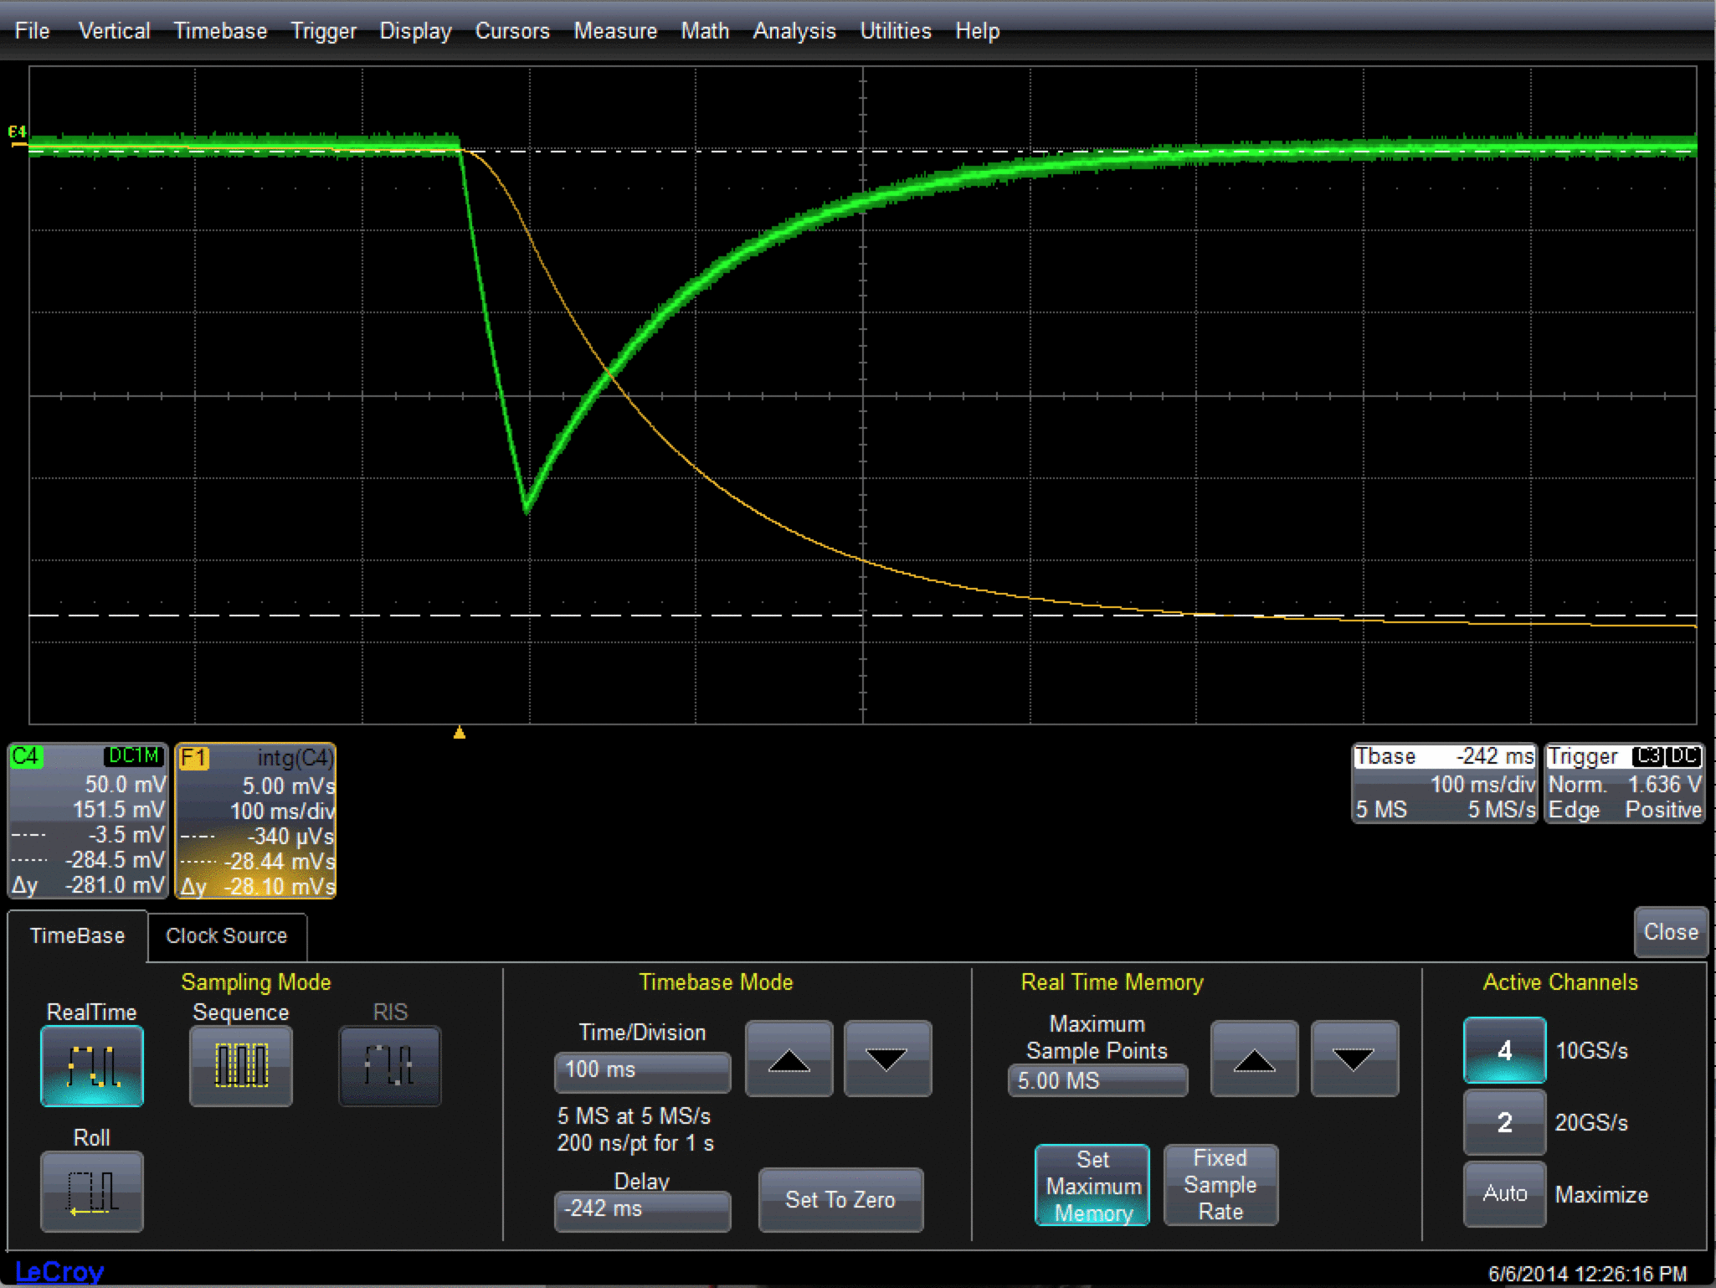
Dark current
Laser reflection
Raw signal
Integrated signal
Dark current on YAG screen
Vgun = 1.4 MV, 40 msec pulses
Typical Faraday Cup Signal

Slide 11
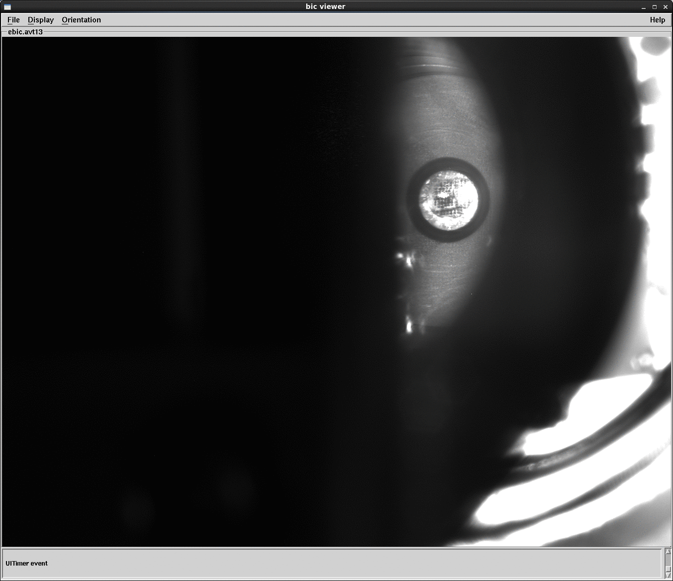
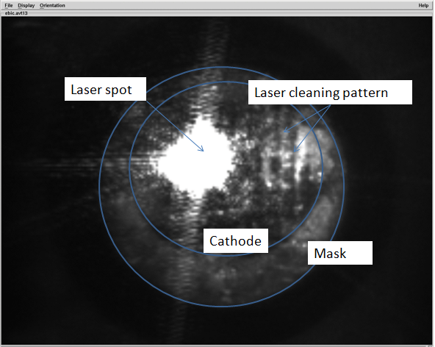
Verify laser shot location
Laser spot was scanned over the whole cathode.
Cathode image
Zoom in

Slide 12
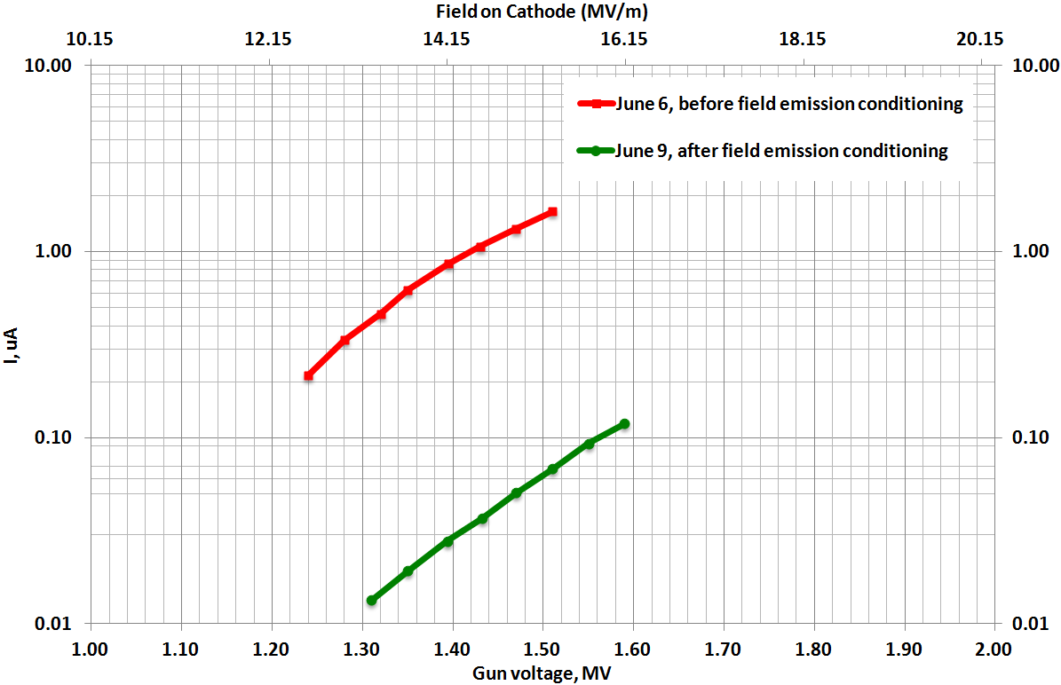
Dark current measurements
The dark current reduced 25 times between two tests with cathode.
The dark current was from the cathode, since there was no measurable dark current with bare cavity.

Slide 13
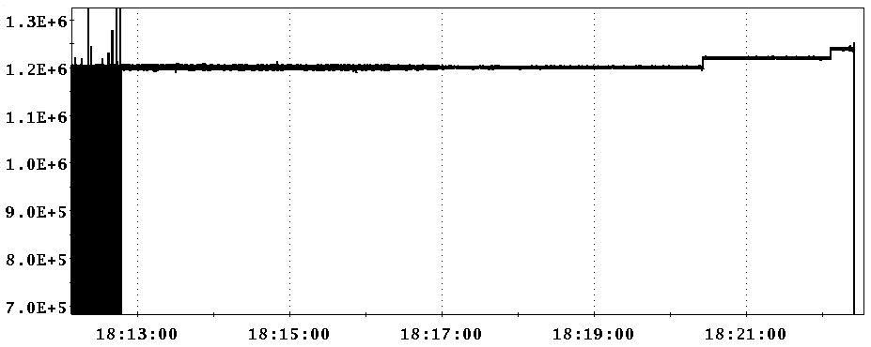
Performance improved after conditioning: CW operating
Gun voltage (Volts)
The gun performance improves after every high power test. The gun is able to operate at CW mode at 1.2 MV after the beam test with cathode stalk and the pulse length for the other field.
After the cathode stalk was again retracted, the bare cavity was tested and reached the same performance without any conditioning. Photocathode insertion does NOT degrade the cavity’s performance at all.

Slide 14
Short-term beam commissioning Schedule
Upgrade the cathode deposition system: by the end of Aug.
Carry out cathode stalk conditioning and (4 to 6 times) beam tests with the existing cathode stalks: present to end of Nov.
New cathode stalk with Ta tip will be delivered on Oct. 15.
Demonstrate CW operation with the new stalk: Dec. 1 to 15.
Beam test with the new stalk: Dec. 26.

Slide 15
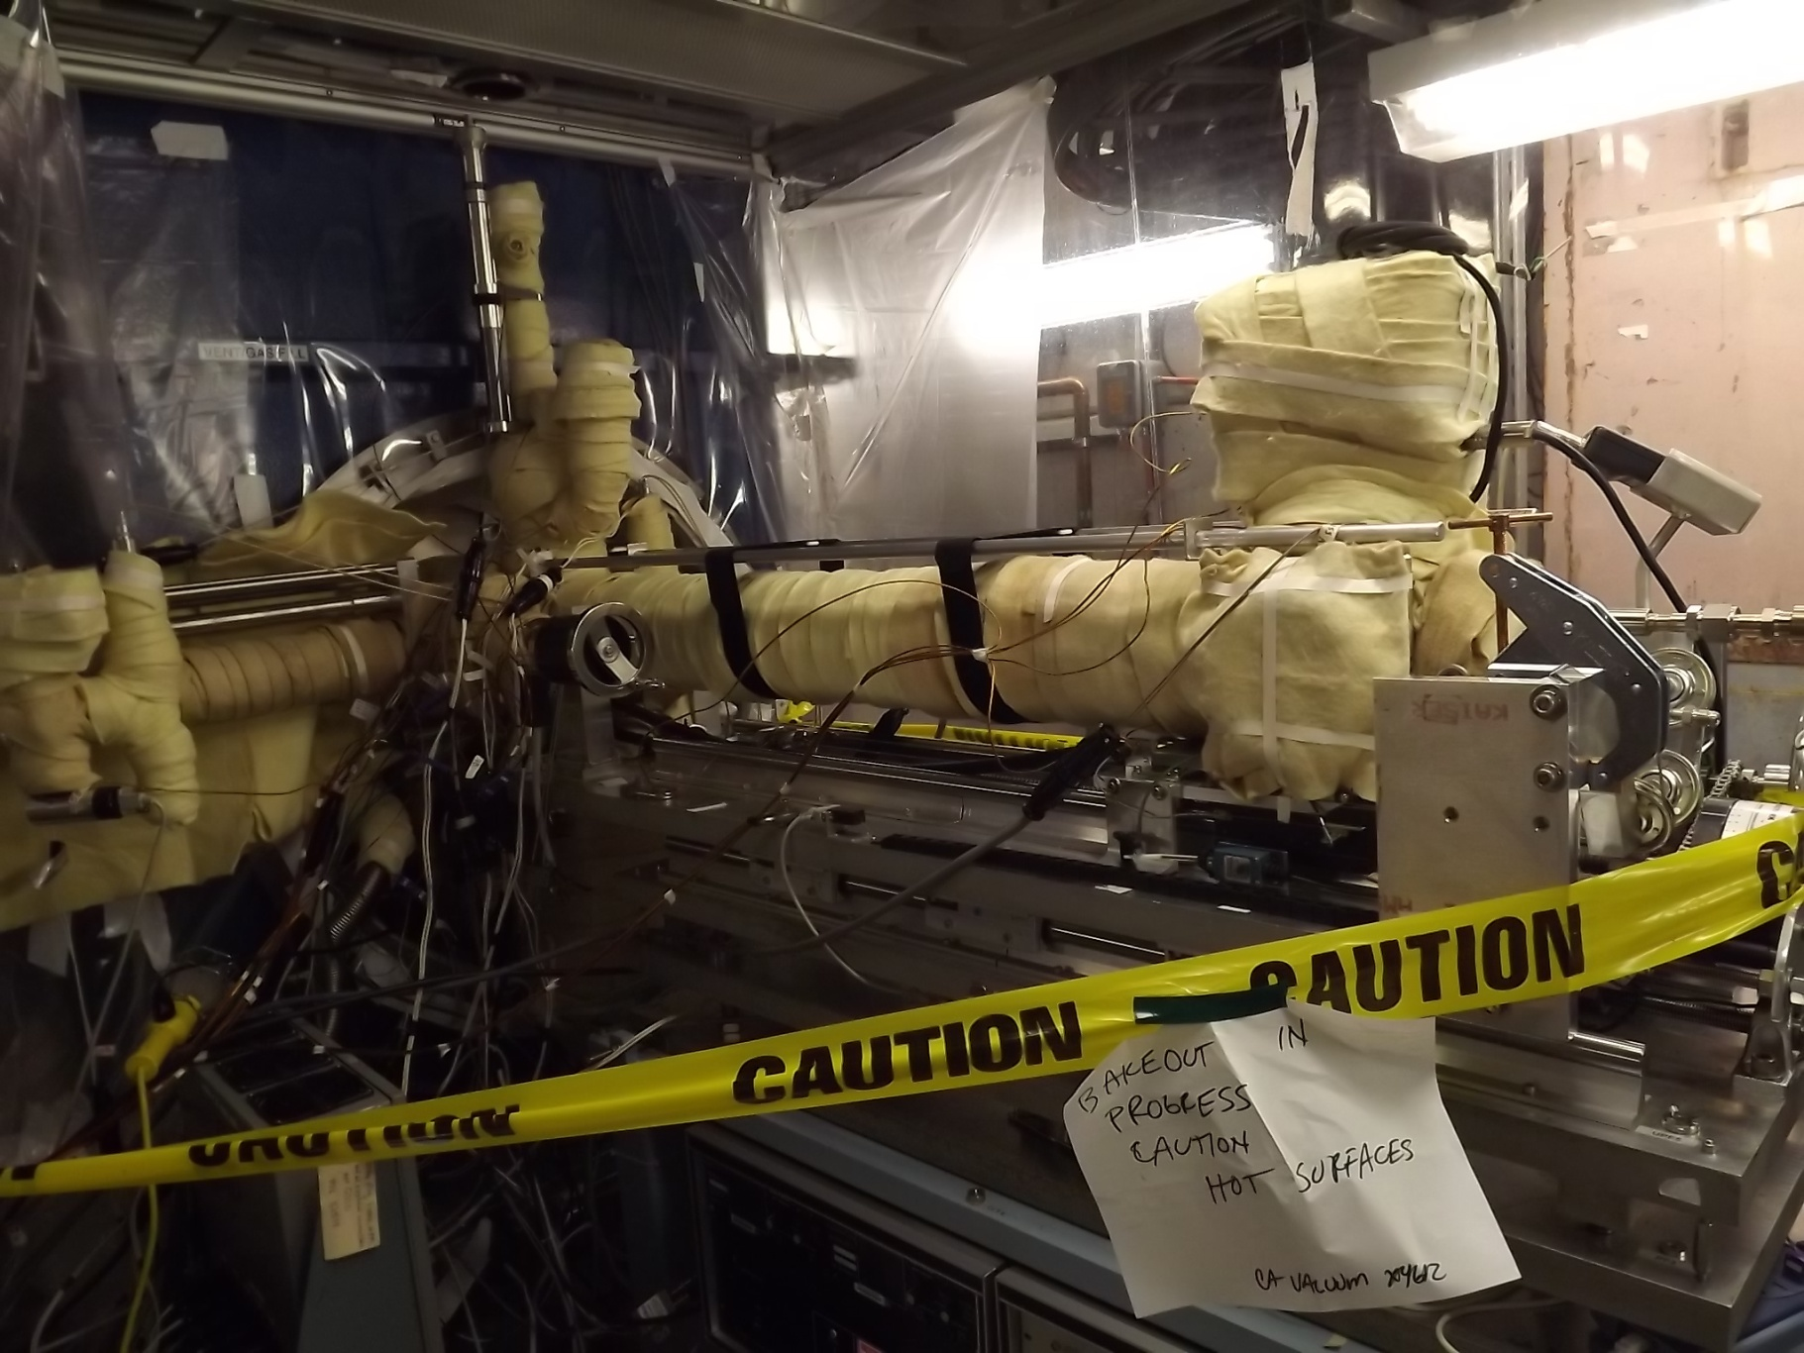
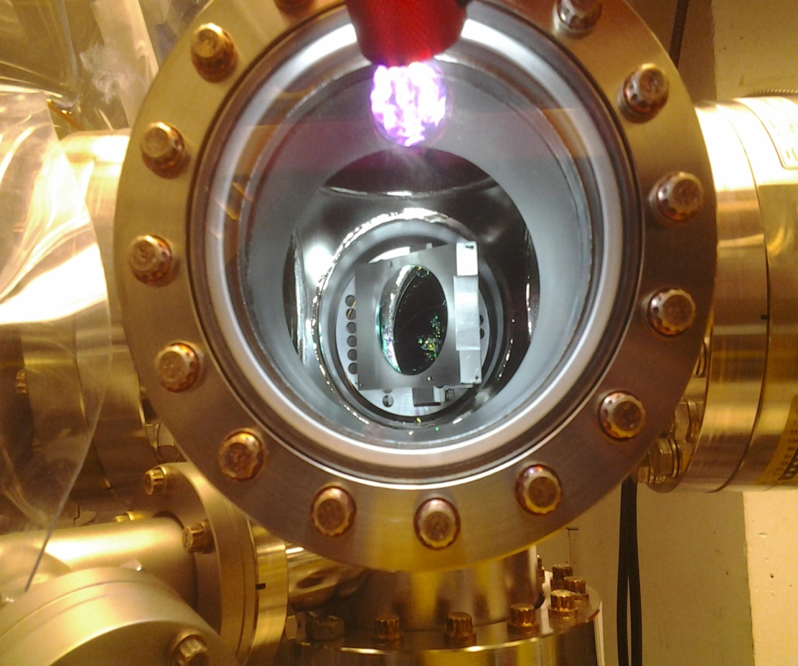
What will be new for the next beam tests
QE measurement on the transport cart
Change Laser cross mirror
Others:
Photocathode insertion procedures to eliminate vacuum fluctuations.
An RGA will be added to the exit of cryomodule.

Slide 16
Summary
SRF gun has made great progress in the past two years, with all the subsystems tested, installed and functioning well.
The SRF gun reached CW 2 MV without cathode stalk insertion.
Mulitpacting problems in the cathode stalk. Copper plated stalk will be tested starting this week.
So far, one photocathode was made and tested. All subsystems function well. This is a milestone, although no photoemission was observed. I believe that we understood the issues and will eliminate them in the future tests.
There is no sign of cavity degradation due to operating with photo-cathode. The cavity performance improves after every test.
A new photocathode stalk will be delivered on Oct. 15 2014, which will ensure the SRF gun operation in CW mode up to 2 MV and high current performance.

Slide 17
Thank you very much to everyone who is involved in this work !

