Slide 1
Linac Reliability and Intensity Upgrade
D. Raparia
2014/08/14
RHIC Retreat

Slide 2
Acknowledgements
J. Alessi, G. Atoian, B. Briscoe, F. Carlino, T. Flanagan, D. Gassner, P. Ingrassia, T. Lehn, V. Lodestro, G. Omar, J. Ritter, W. Shaffer, A. Zelenski

Slide 3
Outlines
Reliability Upgrade
- Historic Data
- Recent Availability
- 5 kW SS amplifier
- Beam Loss Monitor
Intensity Upgrade for BLIP
Recent Performance
Doubling the Current: Phase I
Test stand : Ion Source
Rise Time Measurements
Evaluation of Linac Systems
Summary

Slide 4
Total Failure HRS for HEP/RHIC
P. Ingrassia
Switch to H-
Switch to 5 Hz
Only Polarized P

Slide 5
RF Failure HRS for HEP/RHIC P. Ingrassia
Switch to 5 Hz

Slide 6
BLIP & Linac Availability 2012-2014 P. Ingrassia
Year | Production (HRS) | BLIP Failure (HRS) | Linac Failure (HRS) | Setup (HRS) | Sch. Main. (HRS) | Sch. Shut. (HRS) | UnschShut. (HRS) | BLIP Avail (HRS) | Linac Avail (HRS)
2012 | 4385 | 362 | 172 | 35 | 22 | 12 | 0 | 92.4 | 96.3
2013 | 4842 | 89 | 215 | 36 | 45 | 187 | 1.97 | 98.2 | 95.8
2014 | 4849 | 24 | 210 | 77 | 154 | 83 | 0.25 | 99.5 | 95.9
System | 2012 (%) | 2013(%) | 2014 (%)
RF | 15.13 | 33.99 | 28.11
Source | 48.82 | 18.81 | 22.78
Power dip | 13.07 | 10.97 | 14.55
Vacuum | 0.12 | 2.72 | 11.55
Human Error | 1.53 | 5.52 | 5.12
Cool. water | 0.47 | 7.52 | 3.69
Access Ctr | 7.32 | 5.62 | 3.66
Quad | 9.70 | 9.01 | 3.14

Slide 7
Linac System Failure P. Ingrassia

Slide 8
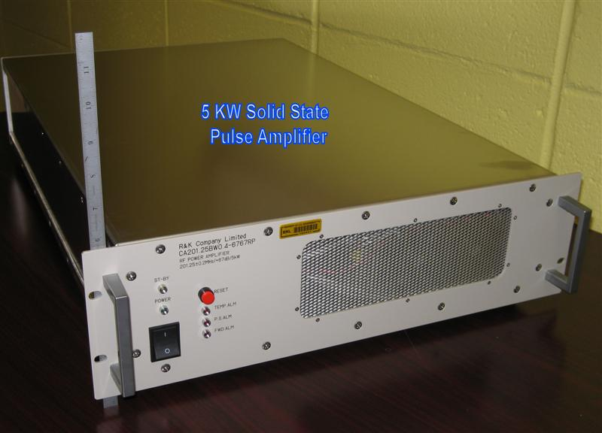
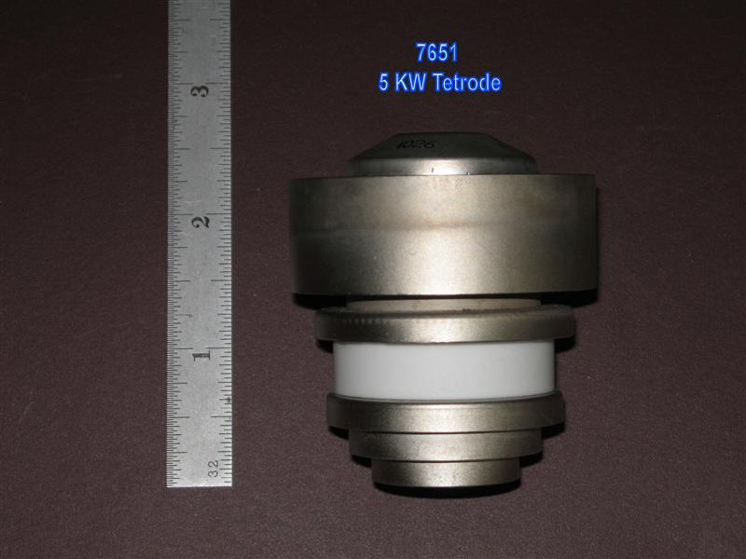
Upgrade: 5 kW Amplifiers
Solid state amplifiers replace 1 of 6 tube types
Complete delivery in September
AC electric work started
Changes in PLC finish and tested (mod 10)
All 10 system will be complete this summer
Lodestro
1 amplifier currently being used in linac buncher
5kW tetrode 7651
Notes:
6 tube amplifiers in operation:
7651: 1 per tank, 5 kW pulsed power, need about 15/year (total $35k/year w/o overhead)
4616: 1 per tank, 200 kW pulsed power, need about 4/year (total $135k/year w/o overhead)
7835: 1 Per tank, 2.5 MW pulsed power, need about 4/year (total $520k/year w/o overhead)
8616: 1 Per tank, ?? kW pulsed power, need about 9/year (total $80k/year w/o overhead)

Slide 9
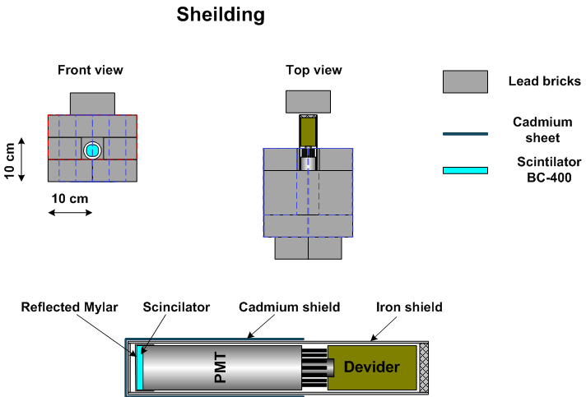
Beam Loss Monitor
Grigor

Slide 10
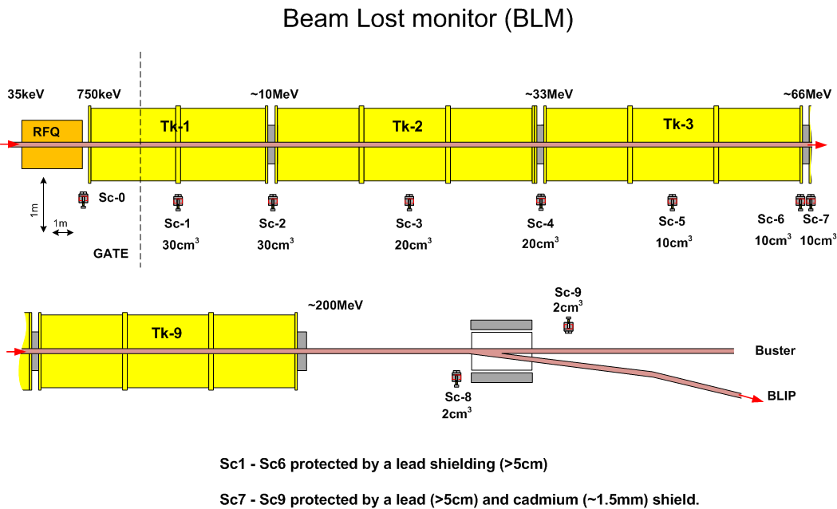
Grigor

Slide 11
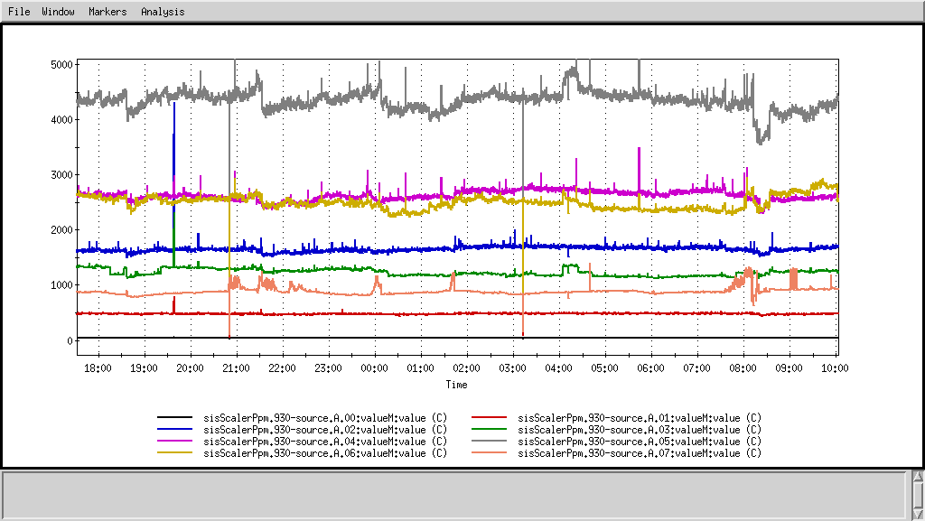
BLM Test
Grigor, Gould, Zelenski
Beam Current 120 uA
Sc 6
Sc 7
Sc 5
Sc 4
Sc 3
Sc 8
Sc2
Sc1

Slide 12
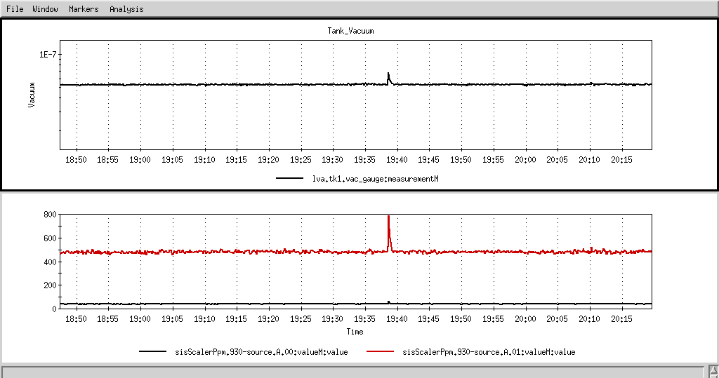
Gas Stripping Losses are Detectable
~7.2e-8
~5.3e-8

Slide 13
Sensitivity
Device | Count/nA
Tk1-1 | 30
TK1-2 | 180
Tk2-1 | 1850
Tk2-2 | 950
Tk3-1 | 1280
Tk3-2 | 1280
Tk3-2Cd | 60

Slide 14
Reliability Upgrade Items
New inter-tank beam current transformers
New retractable multi-wire probe for HEBT tuning
New secondary emission monitors

Slide 15
Summary: Reliability Upgrade
All 5 kW amplifiers will be install this summer
Install and test BLM for all 9 tanks in this summer
Next we replace all current monitors

Slide 16
H⁻ Intensity Upgrade

Slide 17
This year performance
μAhrs
μAhrs
 | 2013 | 2014 | Ratio
Webplot | 430556 | 613745 | 1.425
Tank9sum* | 327004 | 426658 | 1.305
Blip | 454913 | 515816 | 1.134
* Arbitrary unit ,Tank9sum is the most stable

Slide 18
Doubling in the Current ( after 2016 )
Doubling the average current to 240 μA by doubling the pulse length to 900 μs
Design Present Upgrade
Beam current 100mA 45 mA 45mA
Beam PL 200μs 450 μs 900 μs
RF PL 400 μs 650 μs 1100 μs
Rap. Rate 10 Hz 6.67 Hz 6.67 Hz

Slide 19
Doubling in the Current Phase I To be completed 2016
Phase I has two parts
- Increase current by 15 %
( 5% ion source,LEBT; 10 % RF rise time)
- Evaluate linac systems for doubling the pulse length (RF, Quad, cooling, etc)

Slide 20
Status
Test stand ion source is now operational after 10 years, gas valves PS being tested
RF rise time has been measured for all 9 systems
To reduce the rise time coax length need to be optimize, a phase shifter has been build.
This summer rise time optimization for four systems will be finish.

Slide 21
Ion-Source Test Stand
Lehn, Zelenski

Slide 22
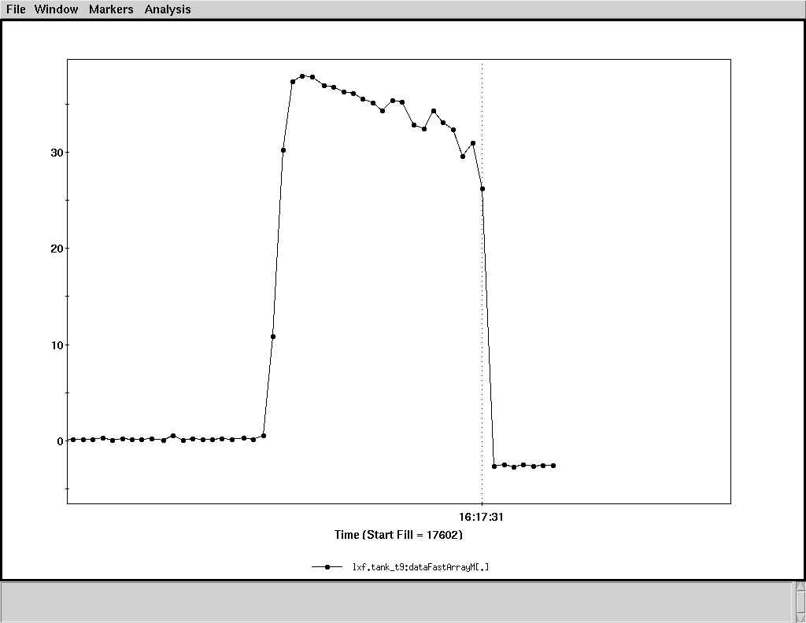
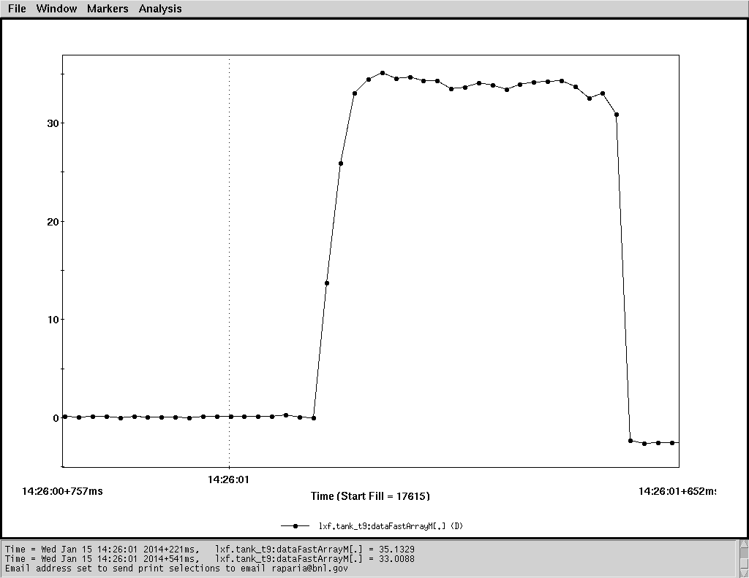
Pulse Shape and Width
2013
Width (FWHM) 415 us
2014
Width (FWHM) 445 us
Optimization source
LEBT solenoids
Xenon gas pressure in LEBT

Slide 23
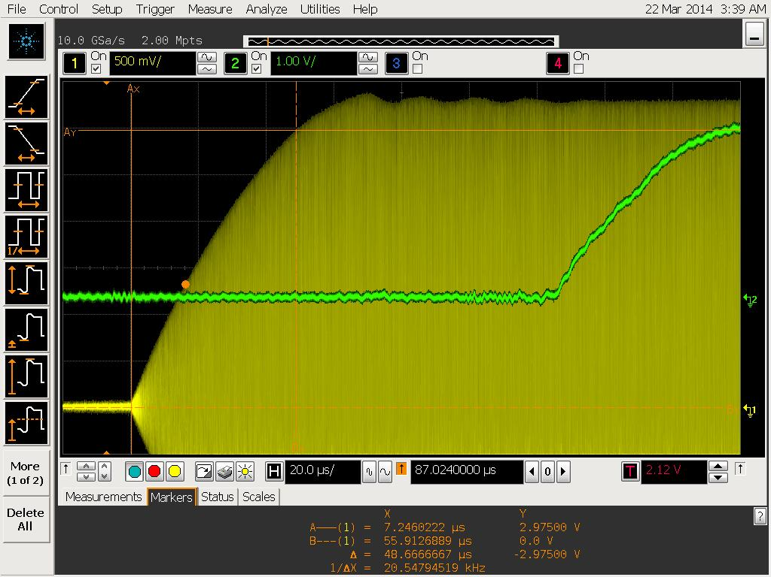
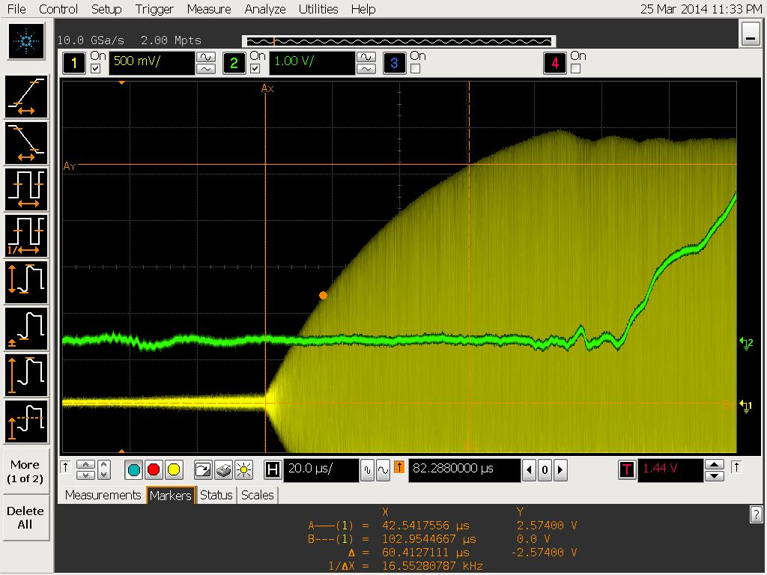
RF Rise Time Measurements
LoDestro, Briscoe
Tank3: Rise time (90%) 48.7 us
Beam delay 125.1 us
Tank8: Rise time (90%) 60.4 us
Beam delay 106.22 us

Slide 24
RF Rise Time Measurements
LoDestro, Briscoe
Tank # | Rise time (90%, us) | Beam delay (us)
1 | 53.1 | 127.33
2 | 48.88 | 127.10
3 | 48.6 | 125.10
4 | 50.0 | 126.88
5 | 51.7 | 127.77
6 | 52.0 | 127.70
7 | 54.89 | 130.00
8 | 60.0 | 106.22
9 | 61.0 | 127.10

Slide 25
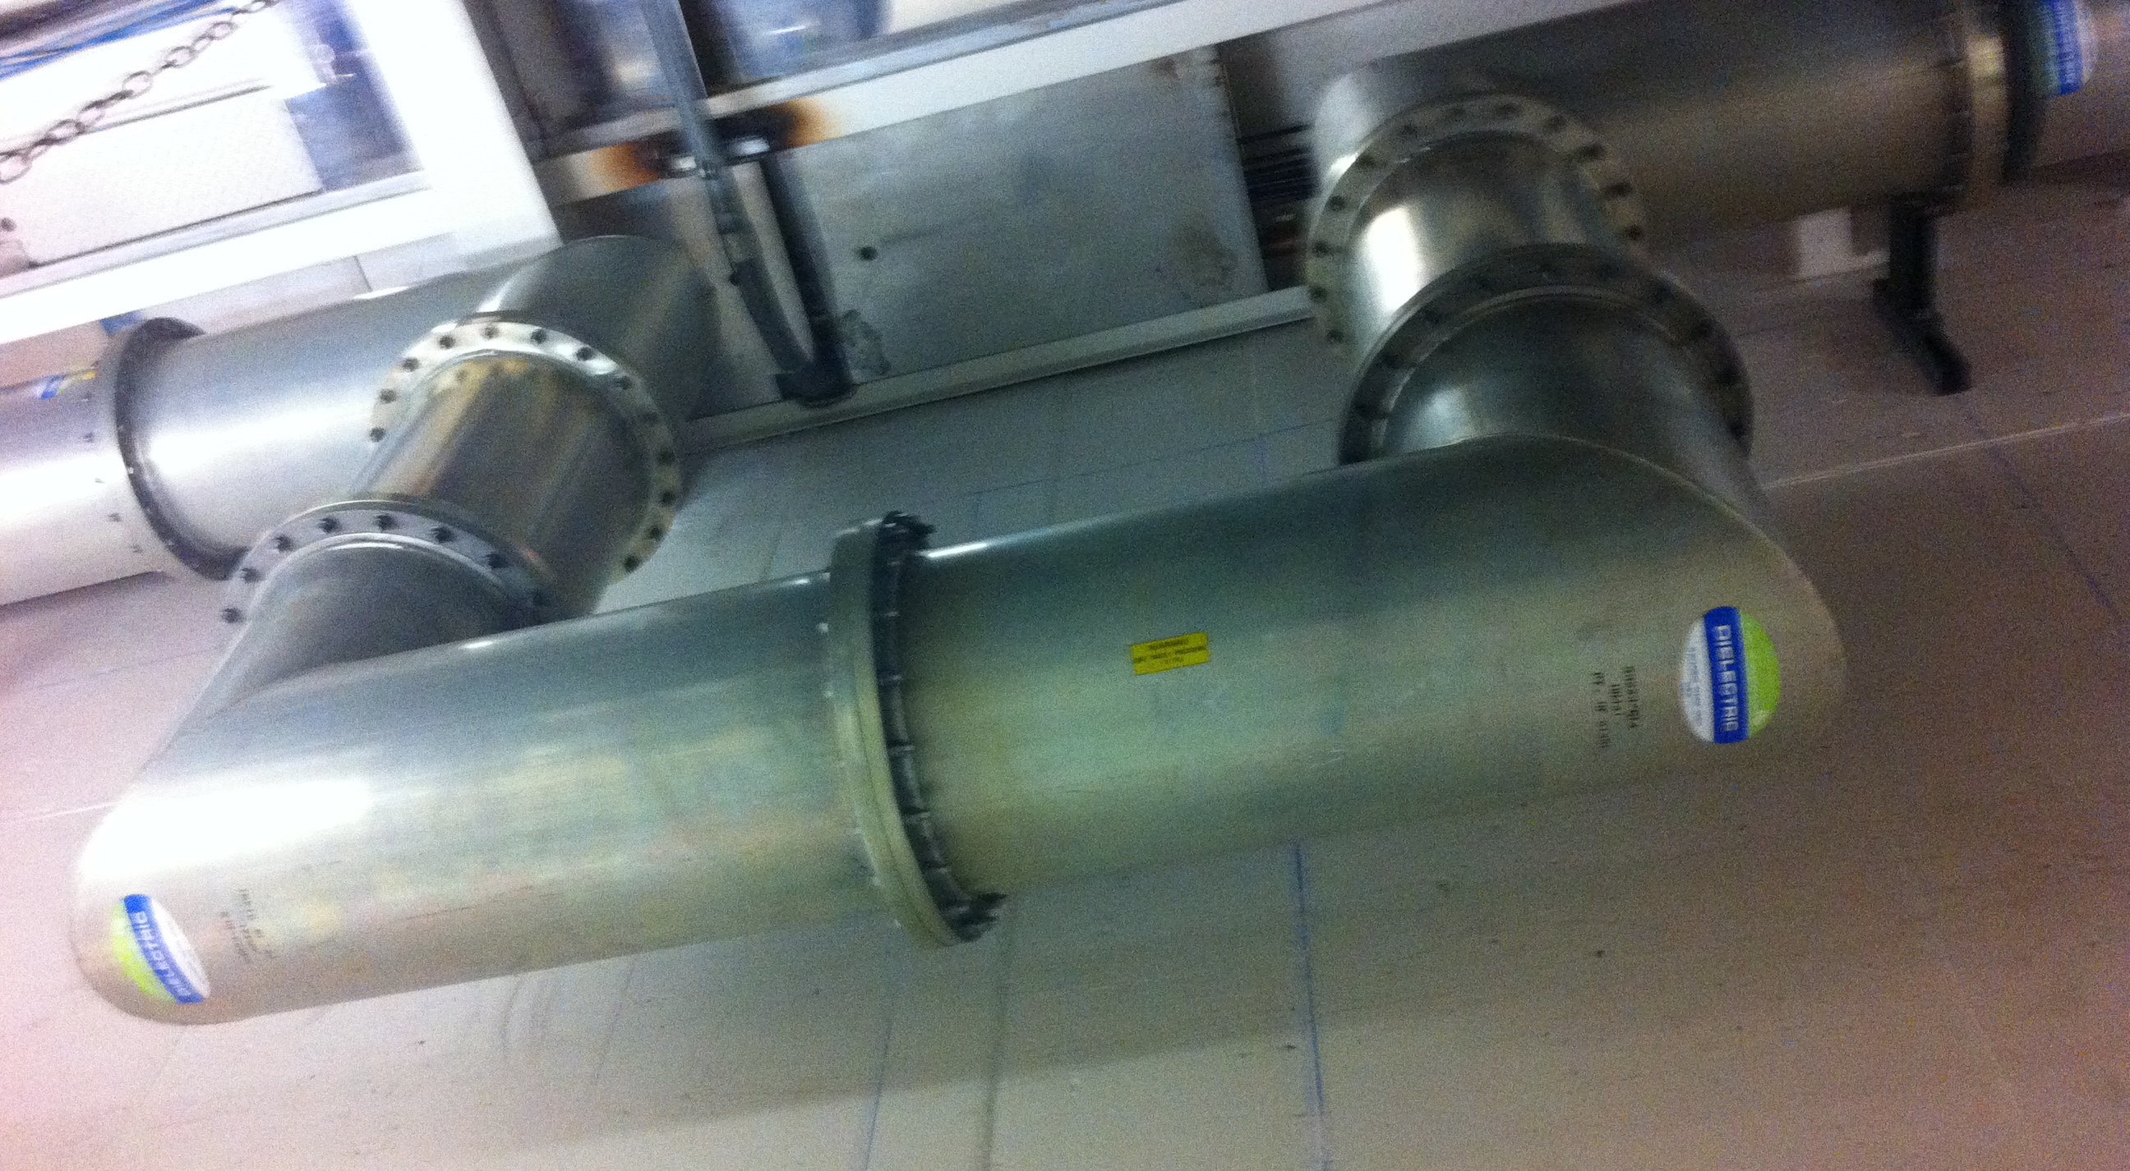
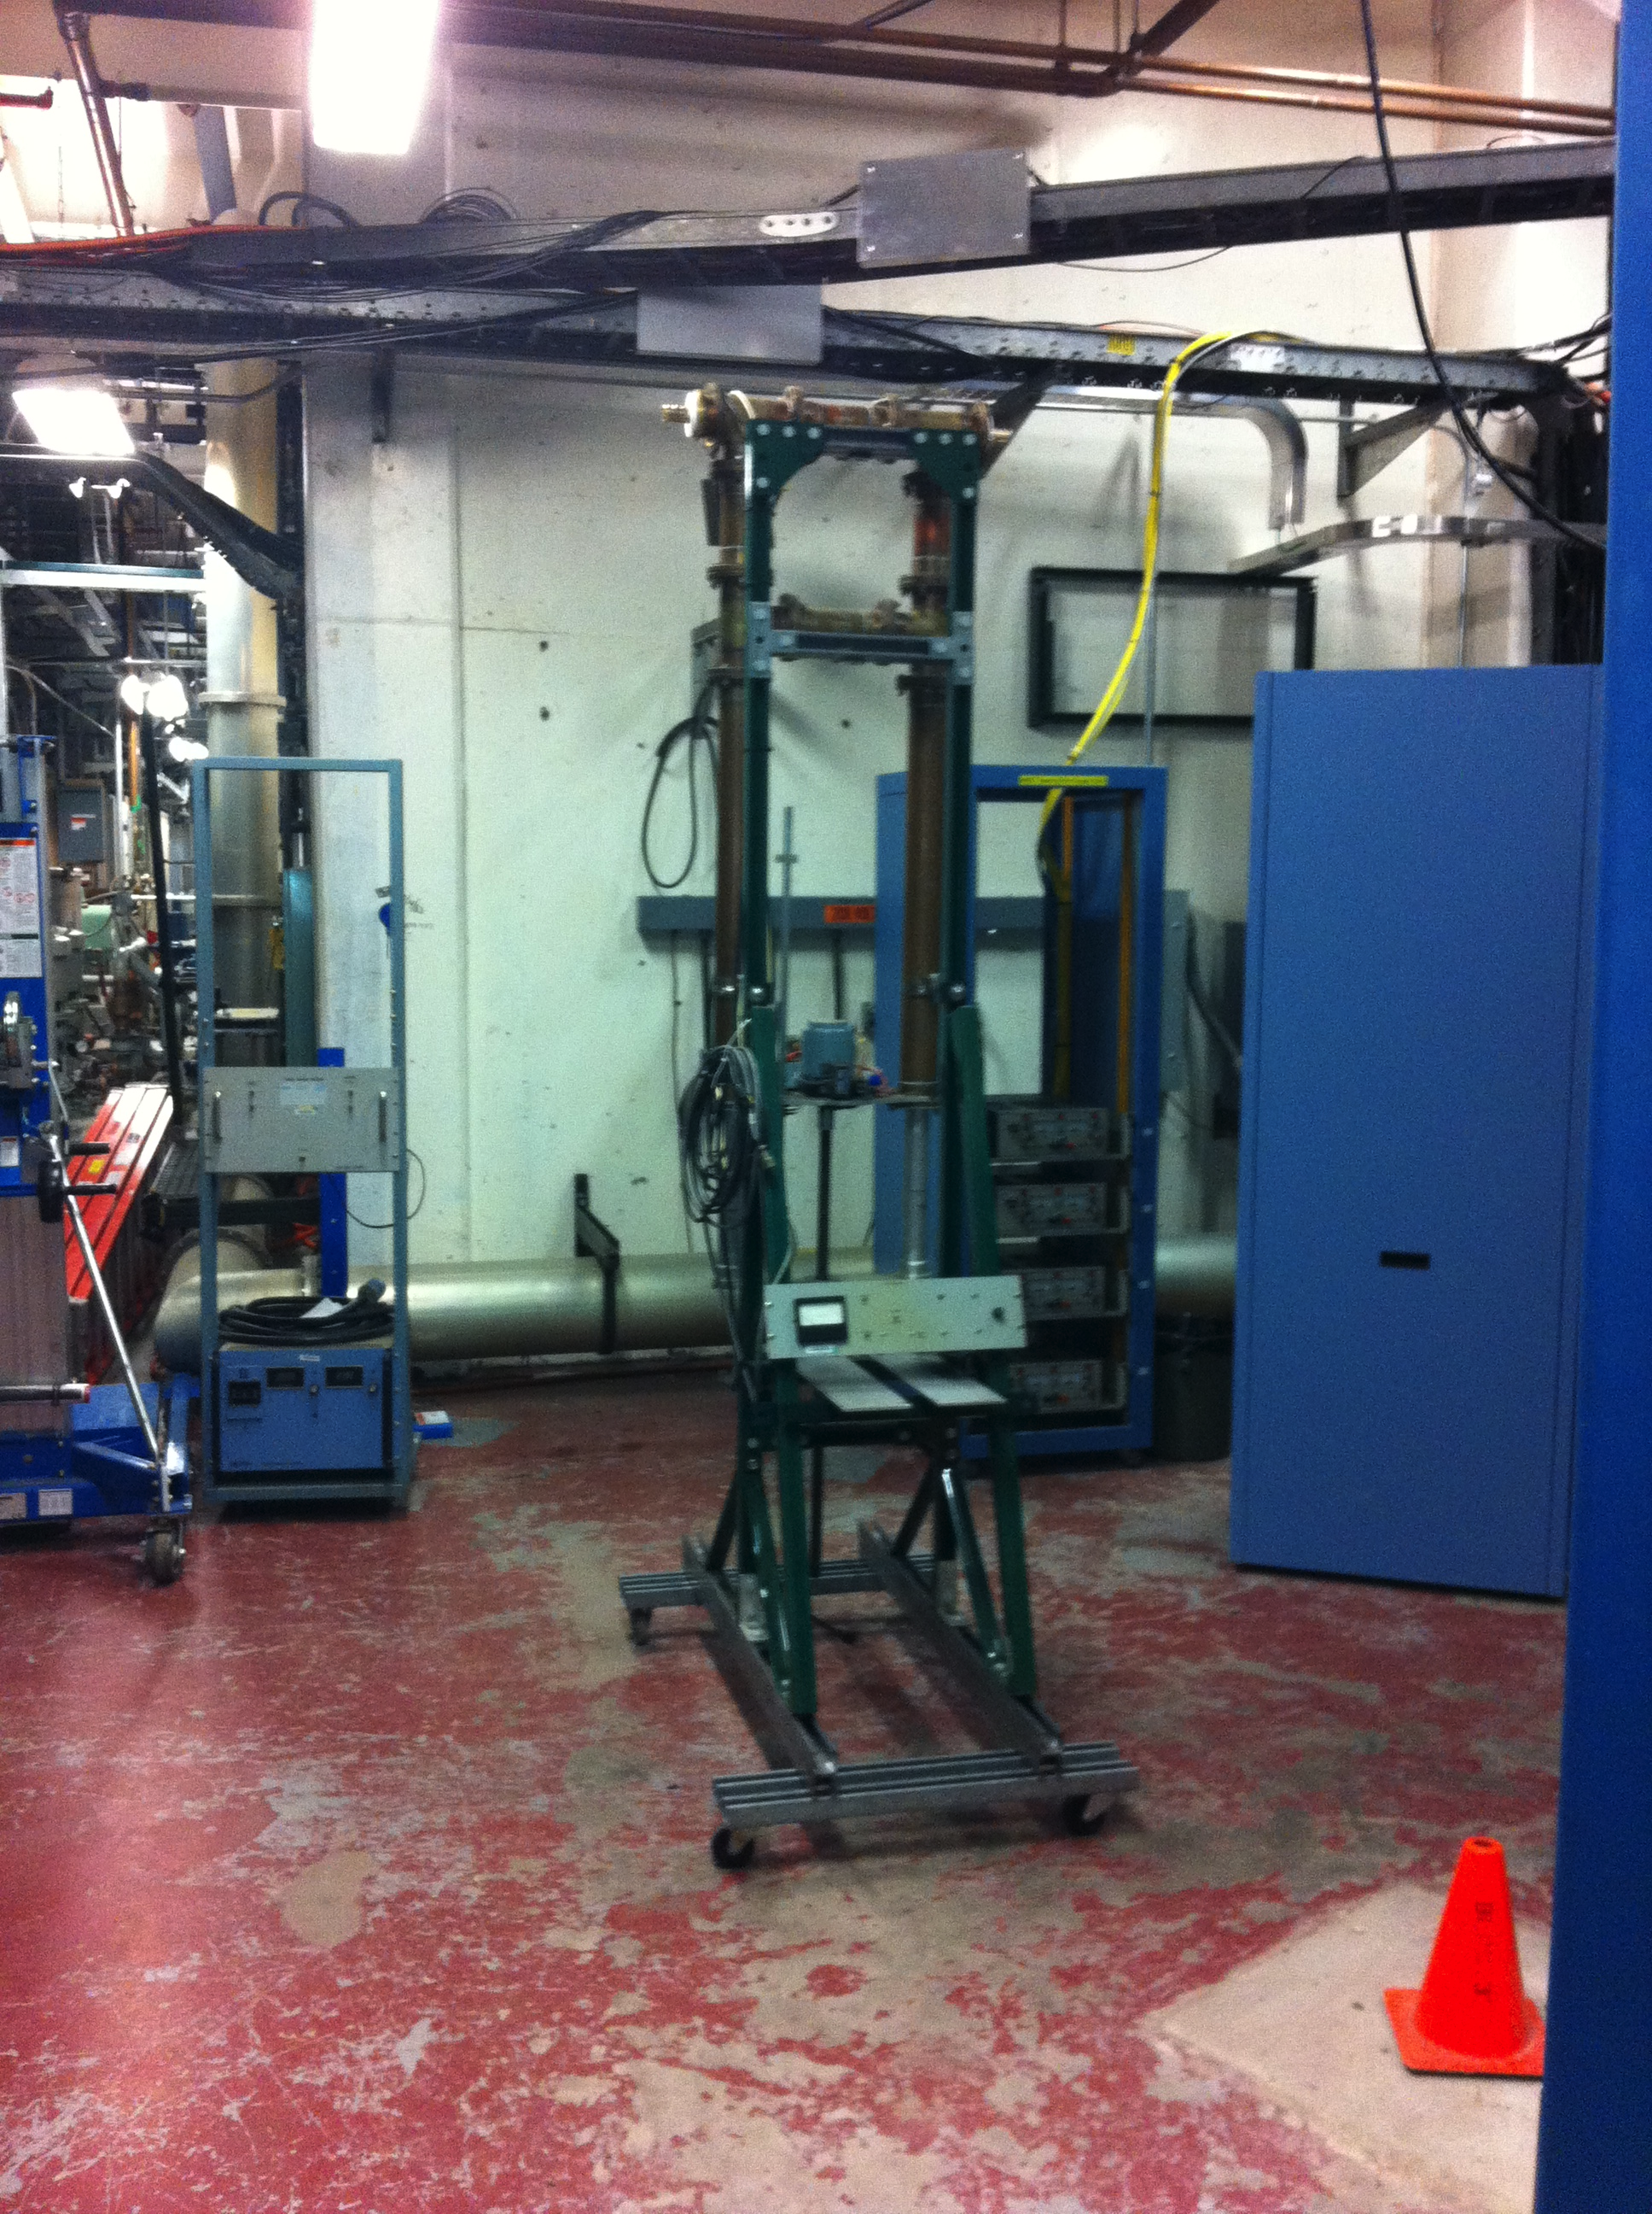
Coax and Phase Shifter
LoDestro, Briscoe,Shaffer
Coax Line
Phase Shifter

Slide 26
Evaluation of Systems
Present quad pulse length cannot be extended to 1 ms without about 1 of ripple
New PS will fit into racks
Water channel in the tank quad will be examined for blockage or erosion
1.1 ms long rf pulse will be tested in mod 10

Slide 27
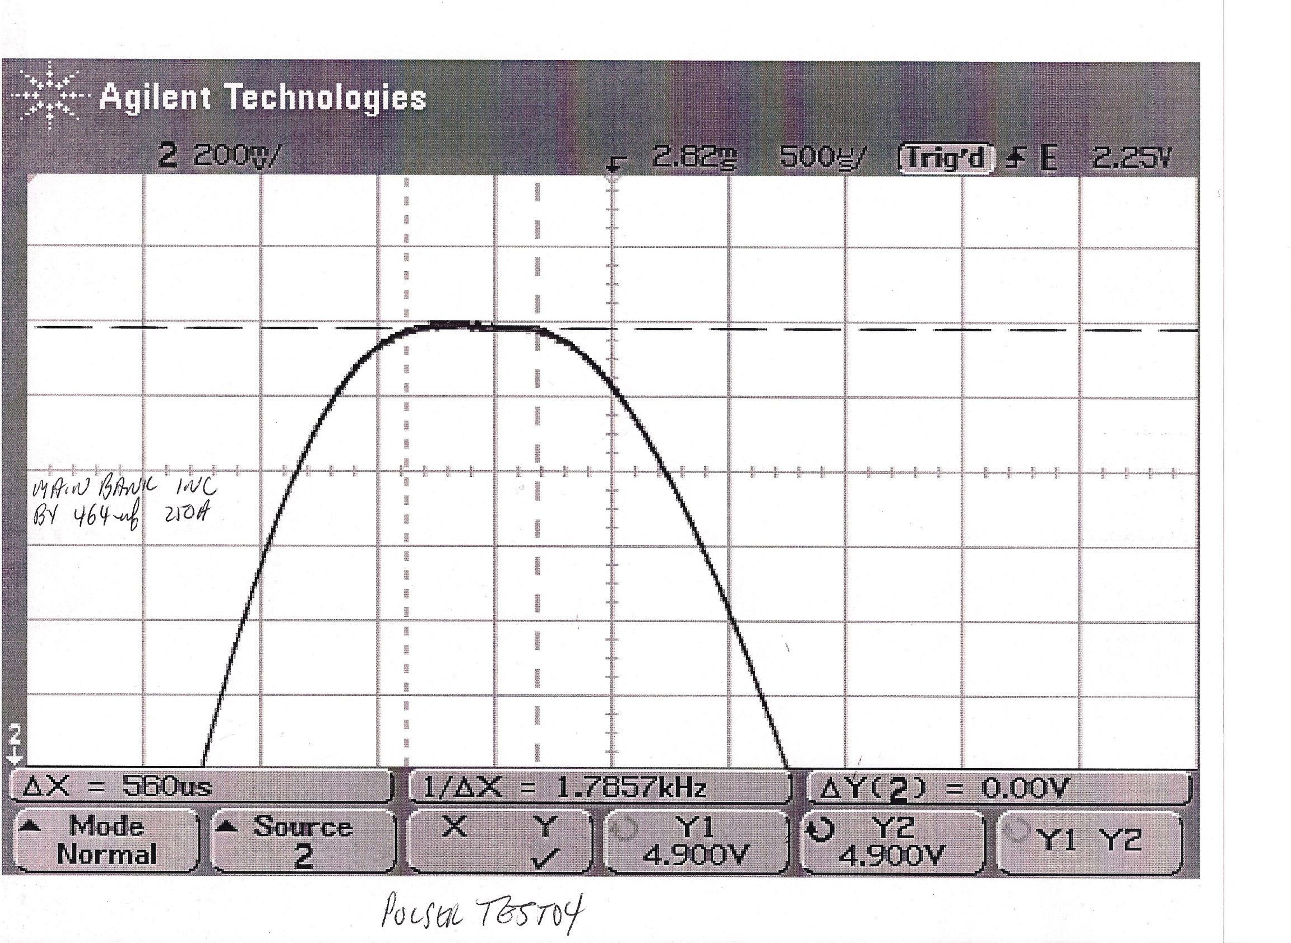
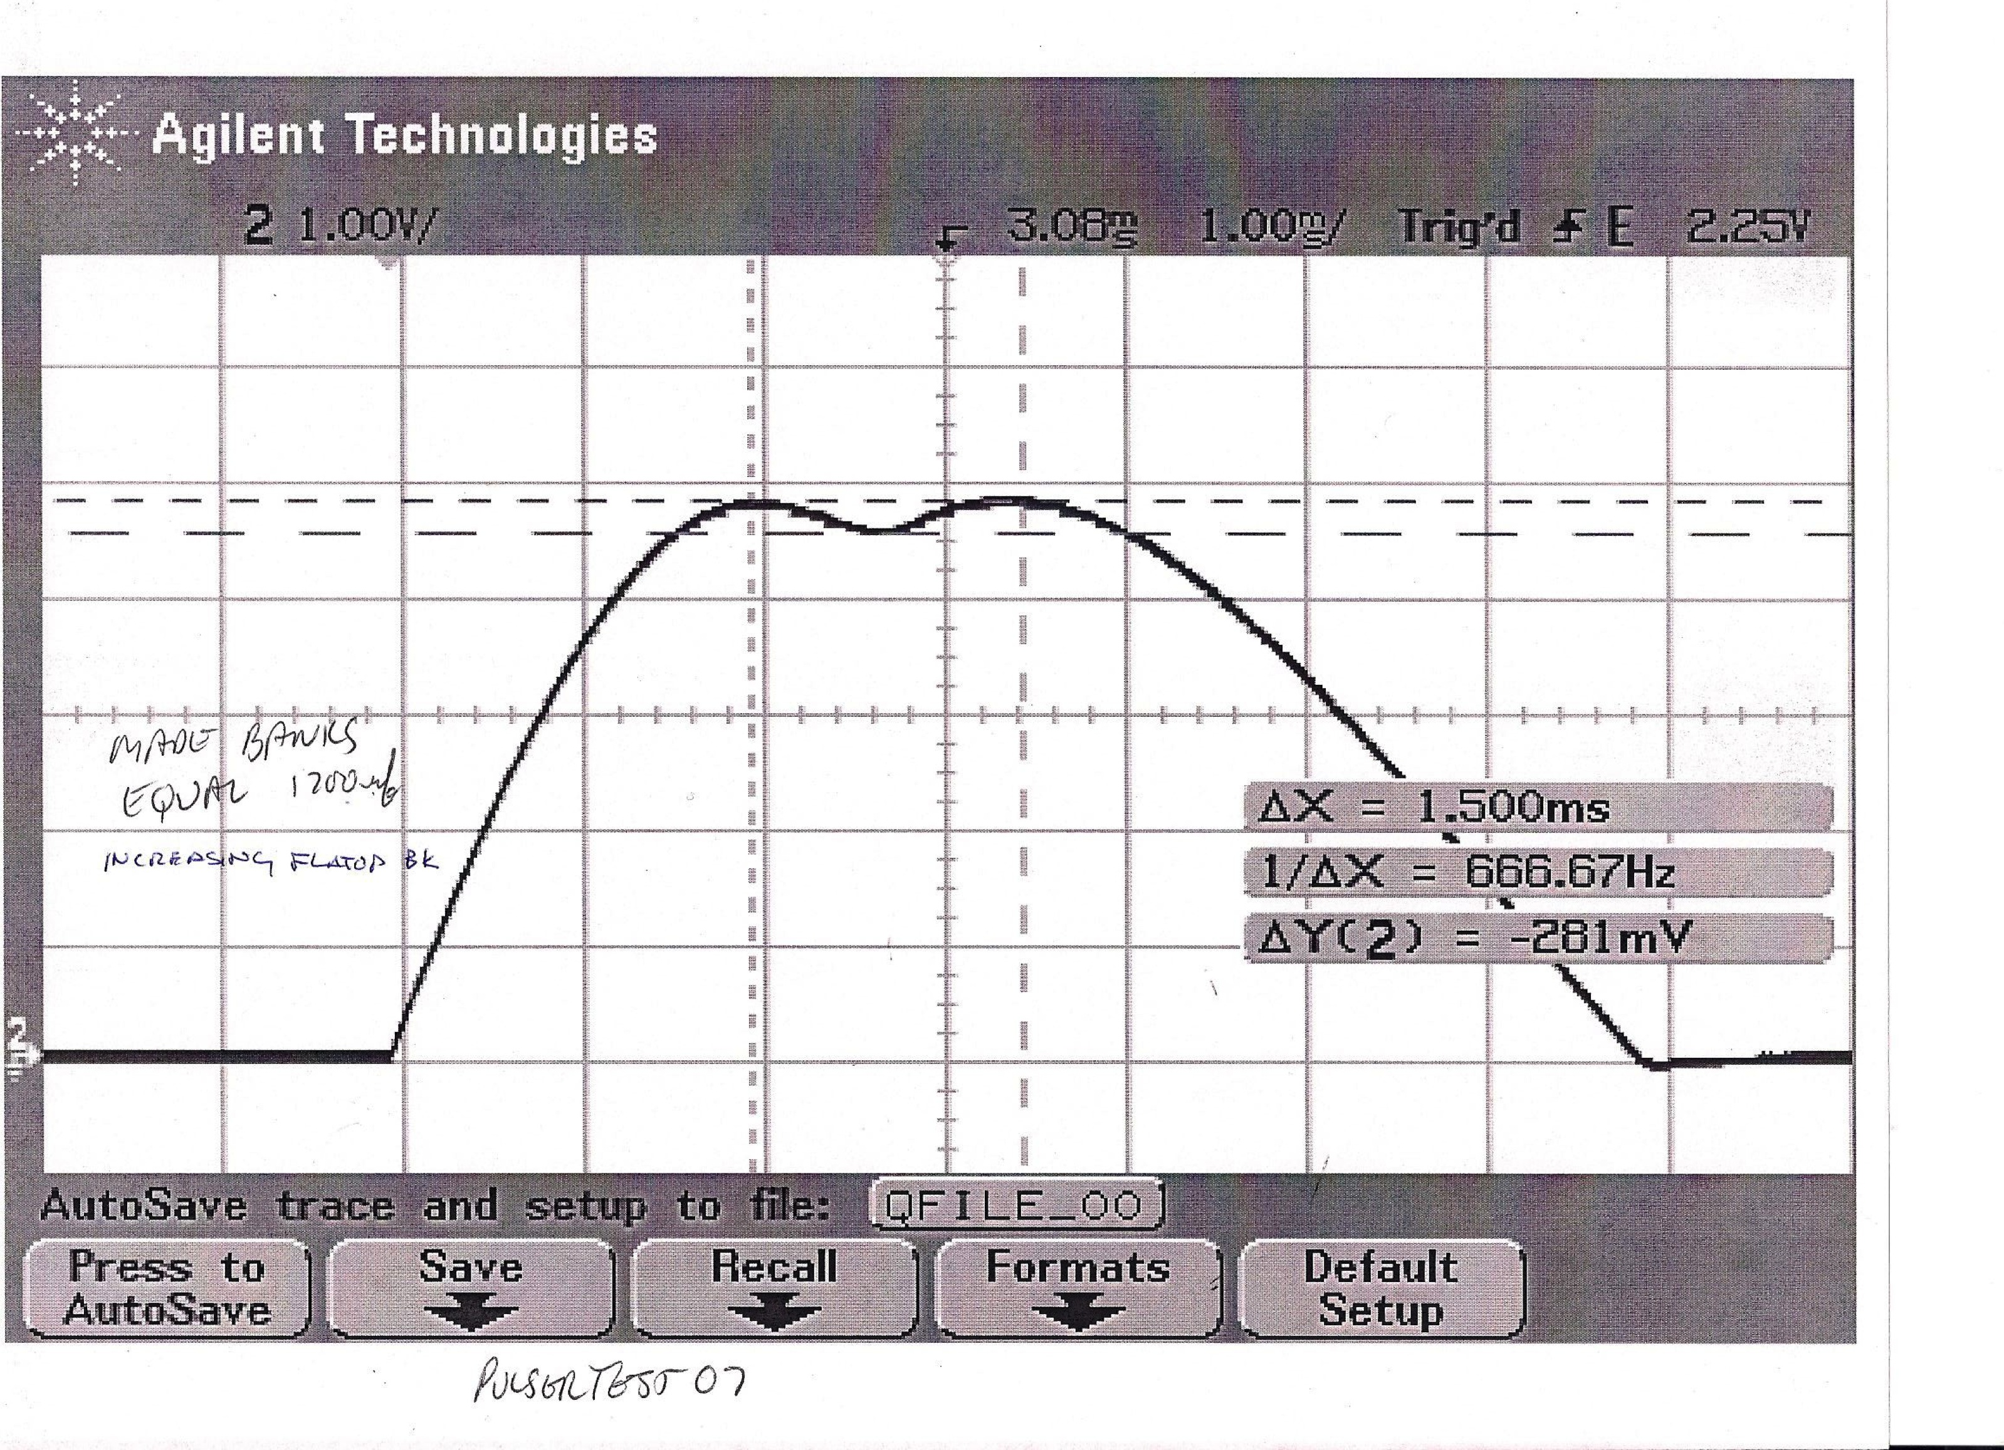
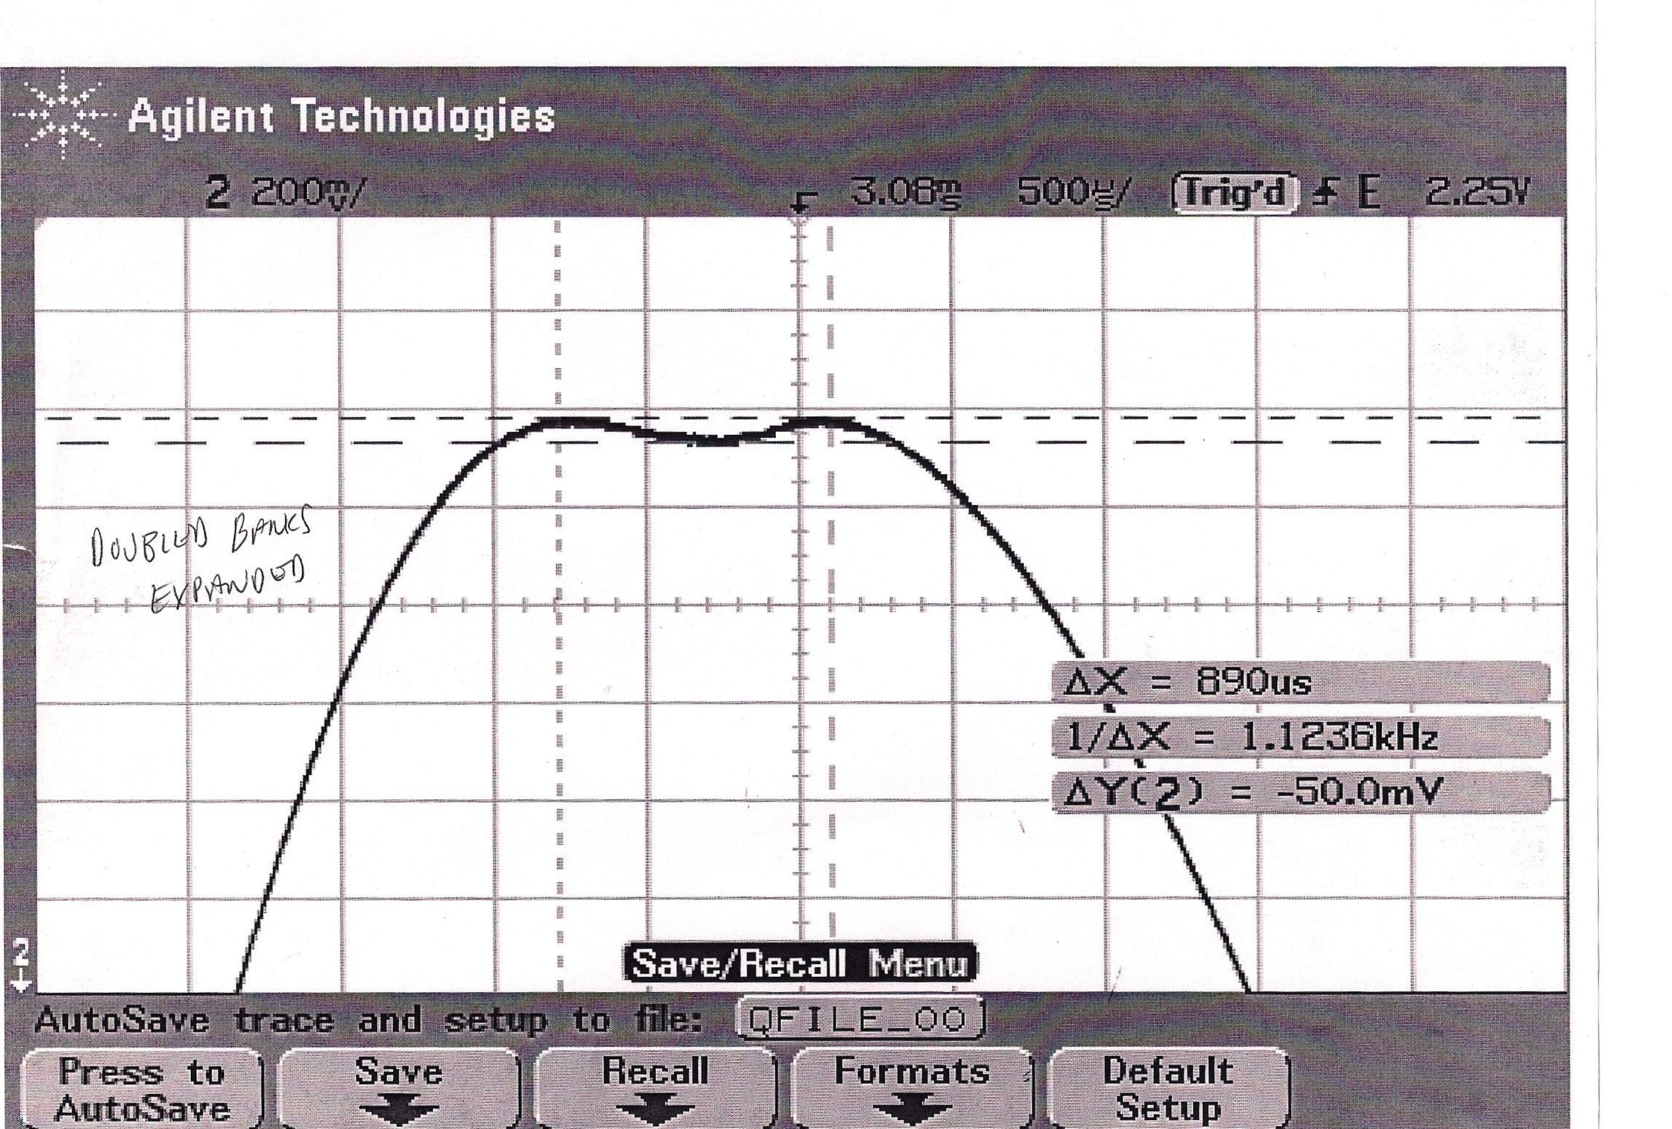
Quad PS test for doubling the Pulse Length
LoDestro, Brescoe
Normal, FT 650 μs, ΔI 0.6 A
Main Cap double, FT 560 μs, ΔI 0.0 A
Main and FT Cap equal, FT 1500 μs, ΔI 3.0 A
Main and FT Cap double, FT 890 μs, ΔI 0.5 A

Slide 28
Summary: Intensity Upgrade
Test ion source is operating, gas valve PS are testing started
RF rise time for all 9 system has been measured
Ready to optimize coax length to minimize rise time
Present quadrupole PS will not support 900 us pulse length, we have quote for new PS

