Slide 1
Particle-IDentification (PID) & Tracking
PID Deliverables to Pavia:
Requirements on “external” systems
Pro/Con matrix (e-Arm, Barrel, h-Arm)
Physics requirements.
Physics
Community
PID
:
Detectors
Machine
Tracking
mRICH
TOF
RICH
DIRC
Today’s Focus:
Assistance required/assumed from tracking to PID devices

Slide 2
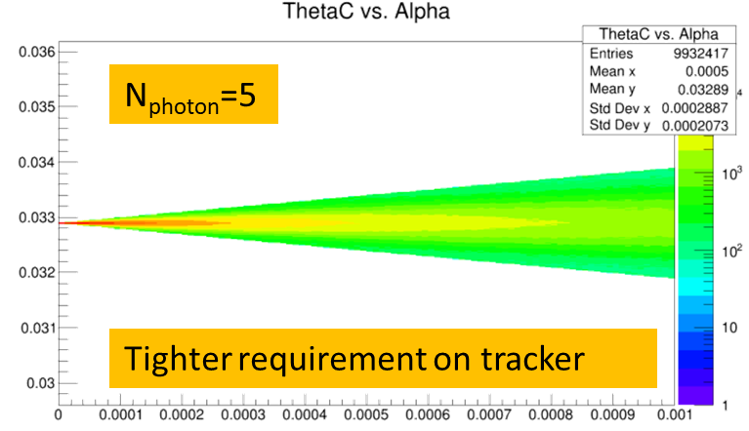
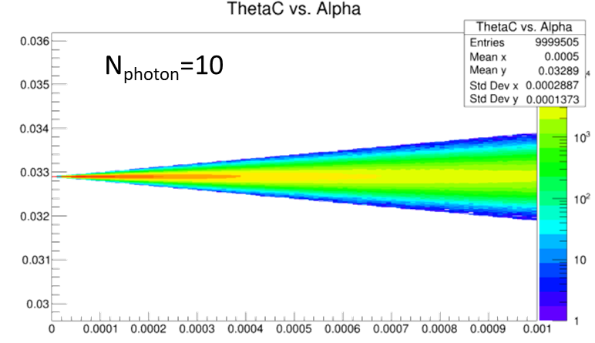
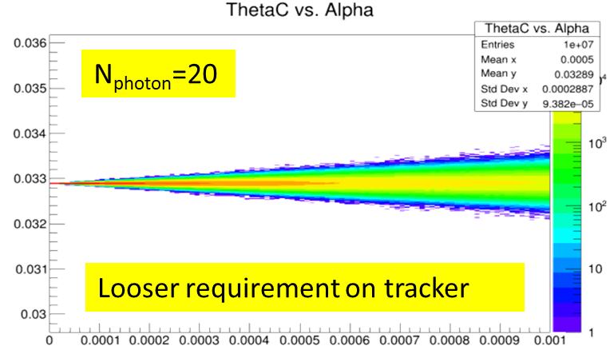
Ring Imaging Cherenkov (RICH) vs. Track Direction
Trivial (just math) Calculation:
Assume photon measured perfectly.
Tracker makes fixed error α.
δθ_{C} depends on both $\frac{\left\langle N_{pe}\right\rangle }{ring}$ and α!
Requirements depend upon performance
Parameterizations:
Wide range of assumptions possible.
Full Monte Carlo
Robust and Reliable results.
We present both parameterizations and full Monte Carlo calculations

Slide 3
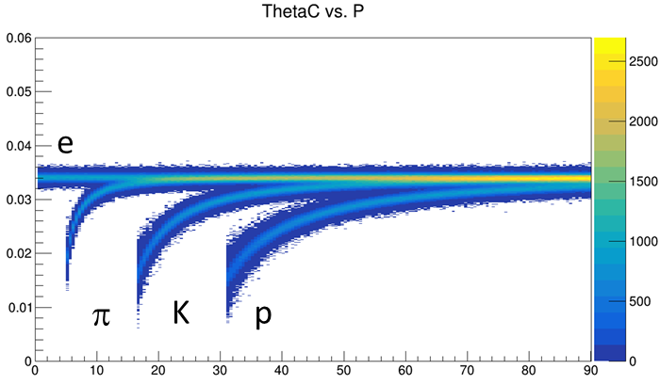
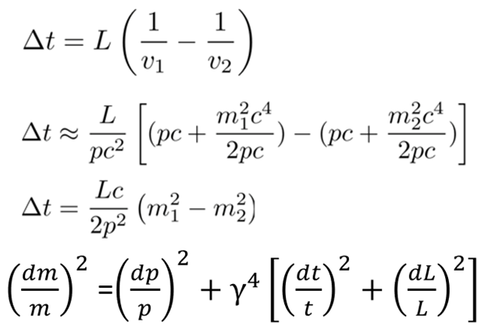
Basic Coupling of Tracking to PID
$${\left(\frac{dm}{m}\right)}^{2}={\left(γ^{2}\frac{dβ}{β}\right)}^{2}+{\left(\frac{dp}{p}\right)}^{2}$$
Dominant Term
Cherenkov Angle (θ_{C}):
Centroid from n
δθ_{c} from:
N_{photo-electrons}
chromaticity (aka dispersion; n(λ))
pixel size
optical aberration (aka “emission”)
magnetic field
Track Pointing
δp from tracking
Time Of Flight (TOF):
Calculates m² using p, β.
δm from:
δ_{t}
δ_{p}
δ_{L}
$c∙5ps=1.5 mm$
Dominant
If δ_{t} is tiny, δ_{L} is significant
NOTE: Where PID is excellent, it can contribute to momentum resolution.

Slide 4
Were we are: Summary Table
 |  | Contr. ϑ_{c} | Param. | Pro/Con | Ext. Const | MONTECARLO Sim.
psec TOF LGAD TOF | M. Chiu W. Li | NO | ~YES | YES | ~ YES | NO
dual RICH (dRICH) | E. Cisbani, M. Contalbrigo R. Preghenella | YES Chrom Emission Pixel Field Tracking | YES | YES | YES Simulated constant w/ momentum | YES GEMC/Geant4 AI-driven Optimization
GEM RICH (Gas Electron Multipliers) | SBU/BNL |  | YES |  | YES | YES (Simplified)
modular RICH (mRICH) | X. He M. Sarsour M. Contalbrigo Z. Zhao | YES Chrom Emission Pixel Tracking | YES | YES | YES (tracking) | ~YES GEMC/Geant4 work in progress
DIRC (Detection of Internally Reflected Cherenkov) | G. Kalicy J. Schwiening | YES Tracking Mult. Scat No B field Chrom Emission Pixel | YES | NO | YES | YES GEMC/Geant4 without B field

Slide 5
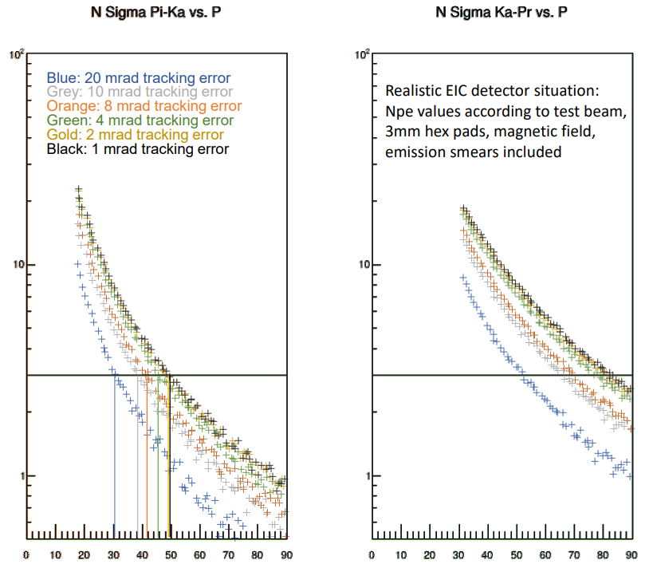
High Momentum GEM RICH
1m of CF₄ radiator at 1.003 bar (slightly overpressure)
CsI Photocathode on top GEM
Mirror in deep UV -> MgF₂ coating
Single Photon Capability ->quintuple GEM stack with APV25-SRS
Particles ~perpendicularly incident on spherical mirror, focused onto a GEM stack directly
According to the parameterization, tracking is leading error contribution if worse than ~7 mrad, becomes negligible resolution factor around 2 mrad. Between 2 and 7mrad , more detailed investigation is required.
Plot shows viscerally the effect.
More detailed simulation required.
hmm
OK
:

Slide 6
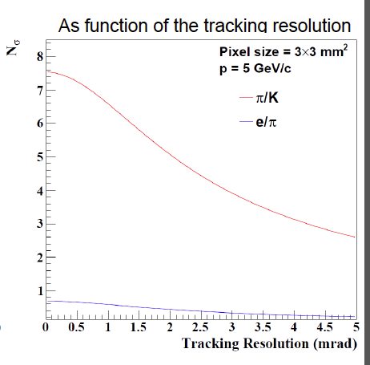
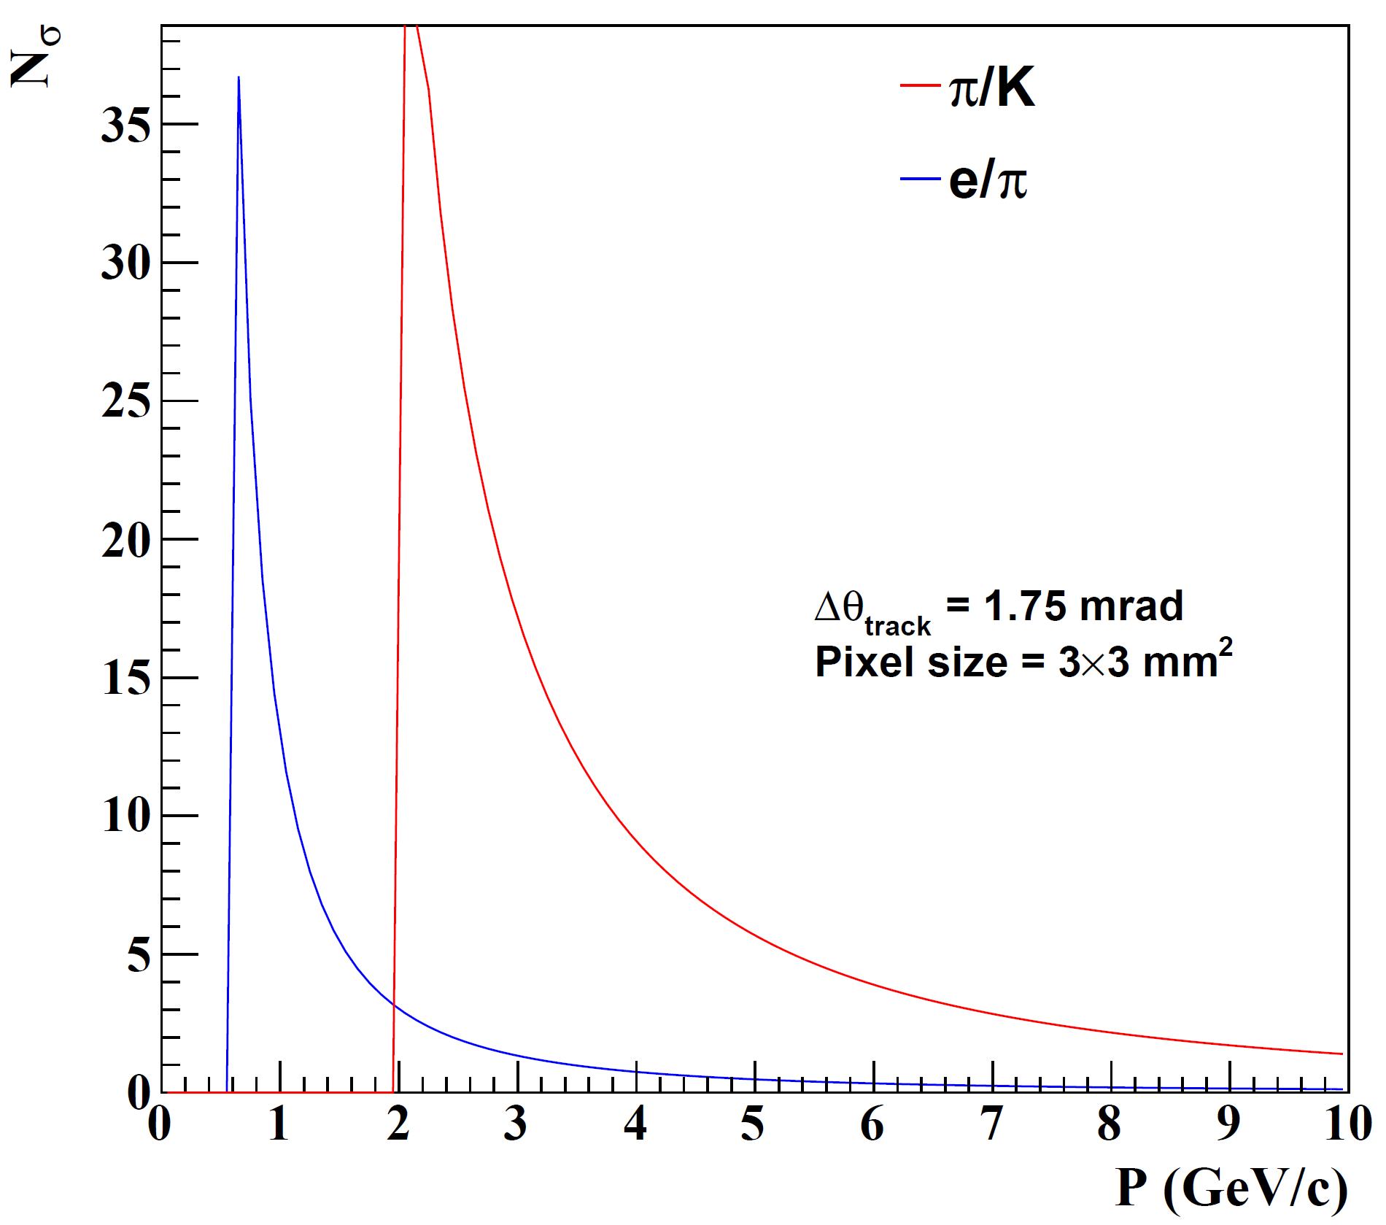
mRICH
Cherenkov radiator
(Aerogel) refractive index, n = 1.03
length of the radiator, L = 3cm
lens with focal length, 𝑓= 6”
Photon Detector
3 mm pixel size
:
Tracking influence minor
Tracking influence major

Slide 7
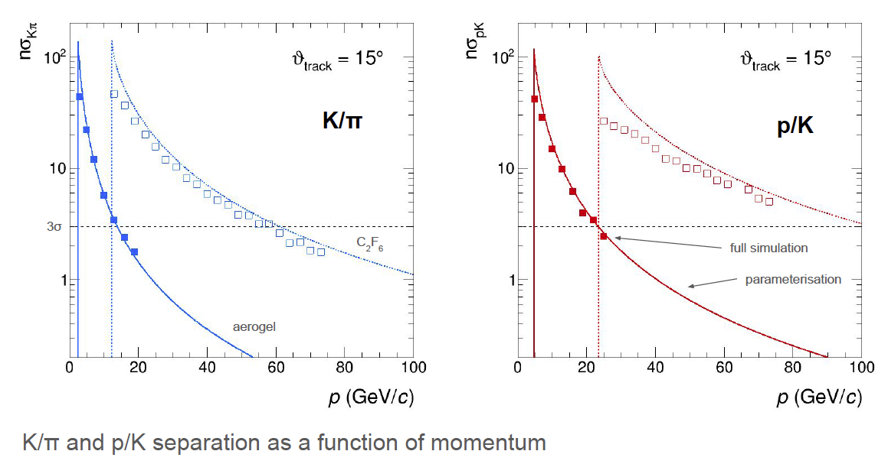
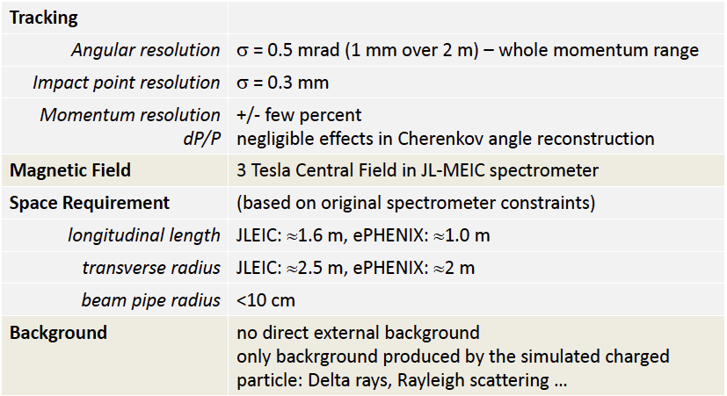
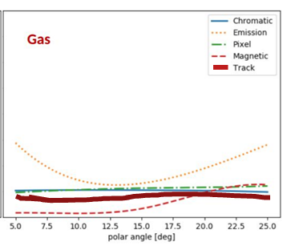
dRICH
Cherenkov radiator
○ Refractive Index
n = 1.02 (aerogel) 1.0008 (C₂F₆)
○ length of the radiator
L = 4 cm (aerogel) , 160 cm (C₂F₆)
Mirrors
Photon Detector
3 mm pixel size; 200-500 nm MAPMT
Particle Generation
Originate from the vertex
Exquisite detail in simulation.
AI-based optimization.
Uses constant external angular resolution assumption.
Similar external constraint assumed as deduced for separate gas & aerogel RICHes
:
Tracking maybe tolerates ~2X sim (0.5 – 1.0 mrad)

Slide 8
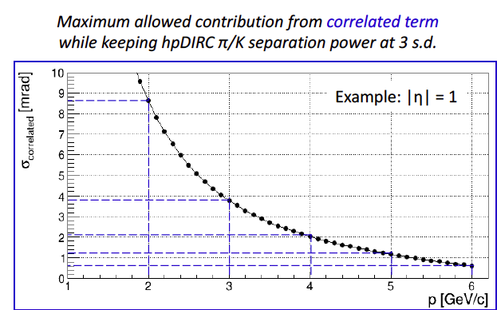
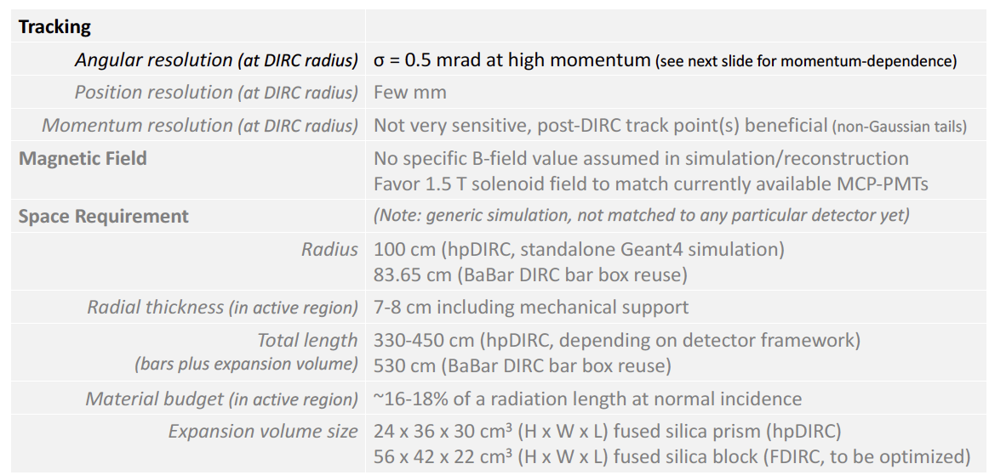
DIRC
Generic reference design: 1m barrel radius, 16 sectors
176 bars: synthetic fused silica,17mm (T) ´ 32mm (W) ´ 4200mm (L)
Photo sensors: MCP-PMTs -3x3mm2 pixels
:
Ext. Requirements
In the absence of multiple scattering σ_{correlated} = σ_{track}.
Secondary tracker (behind DIRC) may be beneficial both at low momentum and at high momentum (possible impact not studied yet).
All non-tracking factors sum to ~0.8 mrad, tracking must not exceed this.

Slide 9
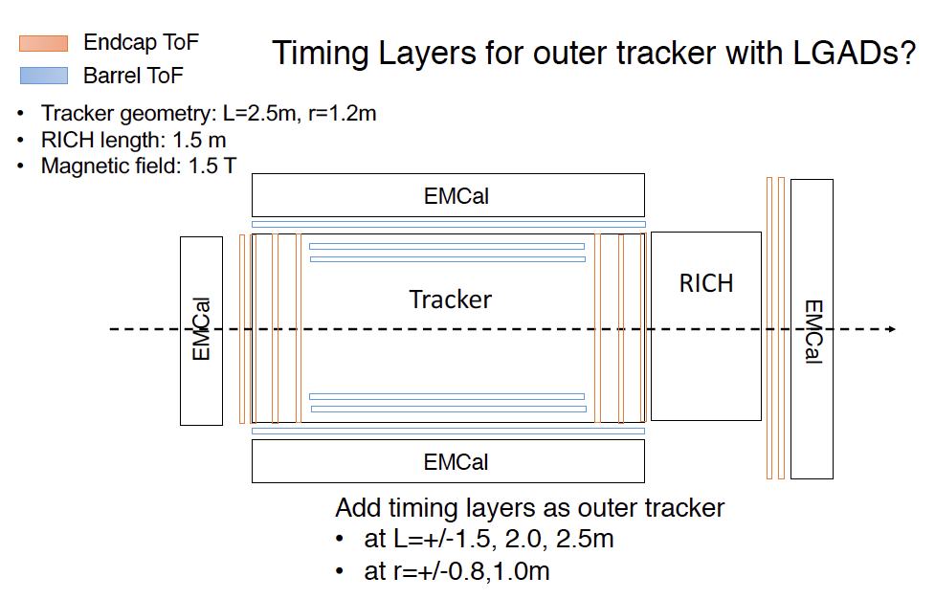
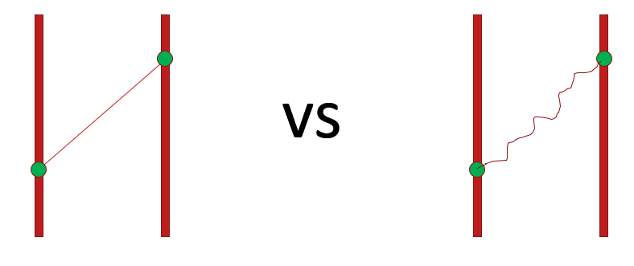
psTOF
Several technologies reviewed, no one chosen yet
AC-LGADs could provide a very good tracking layer (~100 um) + timing (20 ps)
External start time provided by forward detectors could be helpful
Study of Self-timing (Internal) using tracks
:
TOF needs a measurement of p and L
As δt➝5 ps, requires precision path length L ( c*δt~1.5 mm…tracking must exceed this.)
Multiple scattering might be the biggest worry, need to ensure low material budget and/or enough tracking layers to catch scattering.
Depends partly upon the material that does not provide position measurement:

Slide 10
Summary
Cherenkov:
Parameterizations of gas Cherenkov indicate pointing required at 0.5-1.0 mrad level while inside the radiator.
Calculations of aerogel devices indicate 0.5 -1.0 mrad level.
Calculations of DIRC indicate 0.5 mrad level or better.
Hemmick’s guess for why so similar:
All the technologies are focused.
The limiting momentum of each device comes basically from an angular resolution of the rings that are merging.
Result: wildly different internal details are reaching constraints.
TOF:
Path length can influence PID resolution at the best δt.
Non-trivial influence of “material budget distribution”.
Need deeper understanding of this issue.
All roads likely point to tracking sandwich around all PID devices.

