Slide 1
Integration meeting PID & Tracking discussion
D. Elia, K. Gnanvo, L. Greiner
for the Tracking WG

Slide 2
Status and ongoing activities
EicRoot-based simulations
working out main deliverables for Pavia:
evaluate all-silicon vs silicon & gaseous trackers
compare realistic alternatives for gaseous detectors (barrel and forward)
ongoing studies:
central region Si-vertex + TPC/MPGD
endcap region GEM trackers
all-silicon (barrel) tracker + forward/backword silicon disks
comparisons all-silicon vs BeAST (Si-vertex + TPC) concepts
available results:
relative momentum and pointing resolution vs p
preliminary angular resolutions for PID (more next week, also based on today)
eRD6
eRD16, eRD18

Slide 3
Status and ongoing activities
EicRoot-based simulations
working out main deliverables for Pavia:
evaluate all-silicon vs silicon & gaseous trackers
compare realistic alternatives for gaseous detectors (barrel and forward)
Ongoing efforts with Fun4All/ESCalate:
working on realistic parameters and material for TPC in Fun4All
implementation of all-silicon tracker in Fun4All
implementation of all-silicon tracker in G4E + comparisons with EicRoot

Slide 4
Preliminary results
M. Posik, Tracking-WG meeting 23.4.2020

Slide 5
Preliminary results

Slide 6
Preliminary results

Slide 7
Preliminary results

Slide 8
Preliminary results

Slide 9
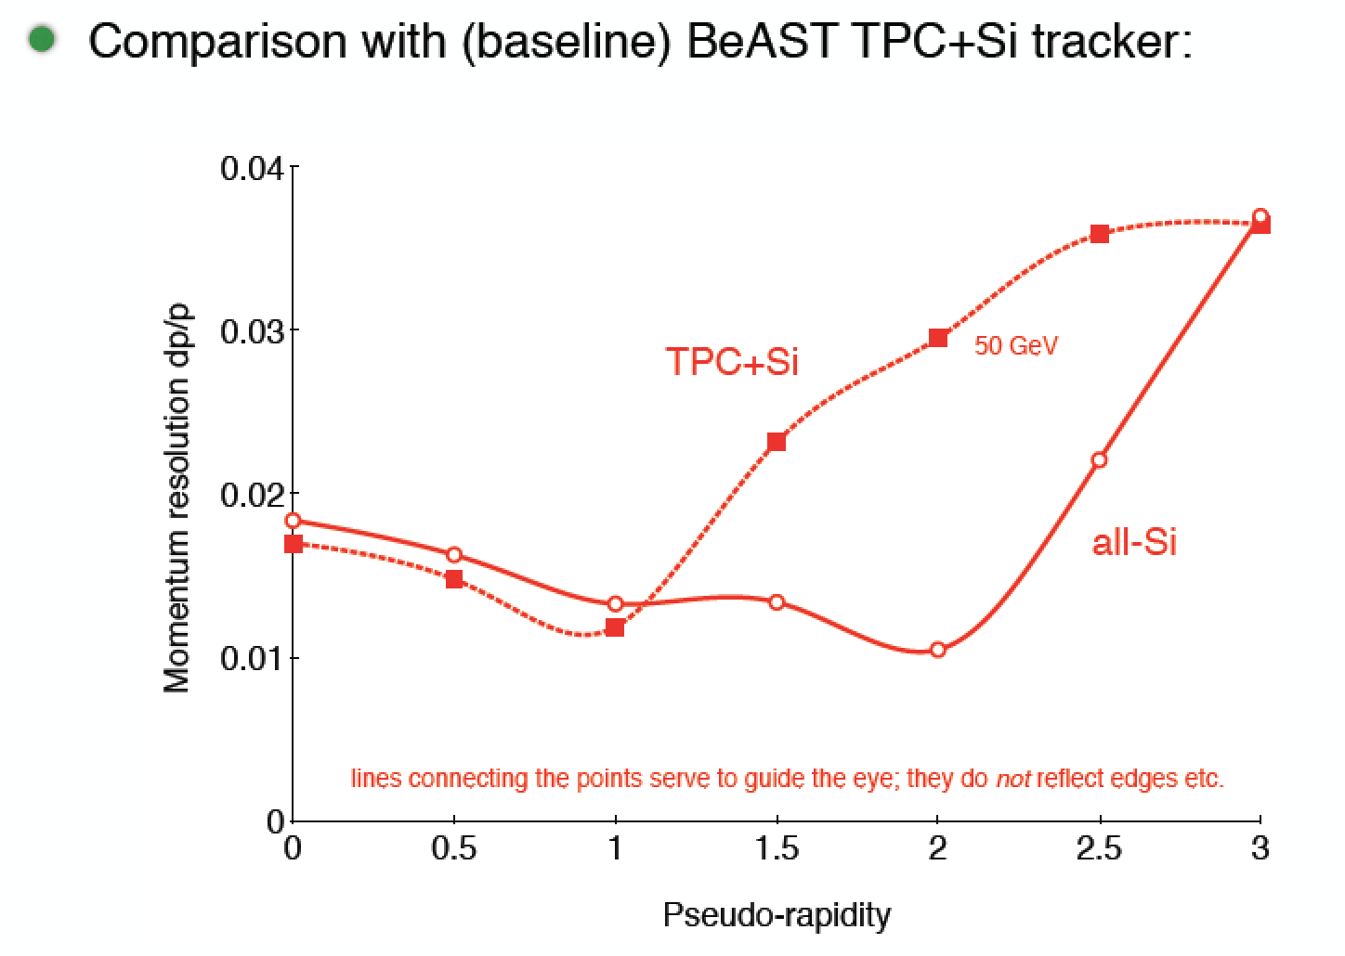
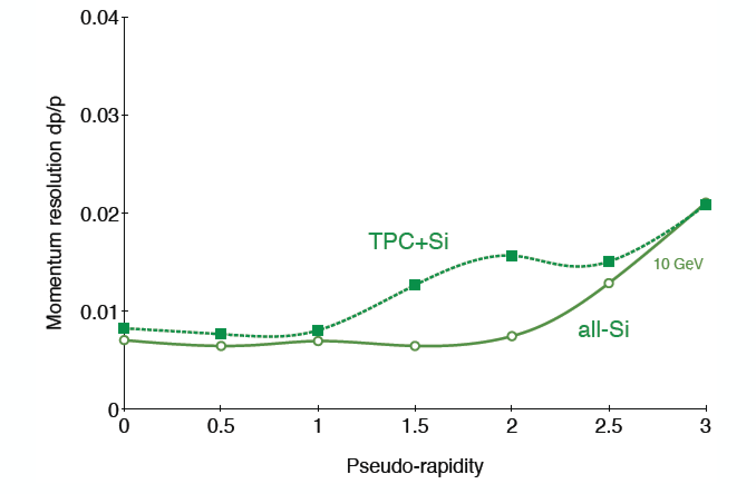
Preliminary results
E. Sichtermann, Tracking-WG meeting 30.4.2020

Slide 10
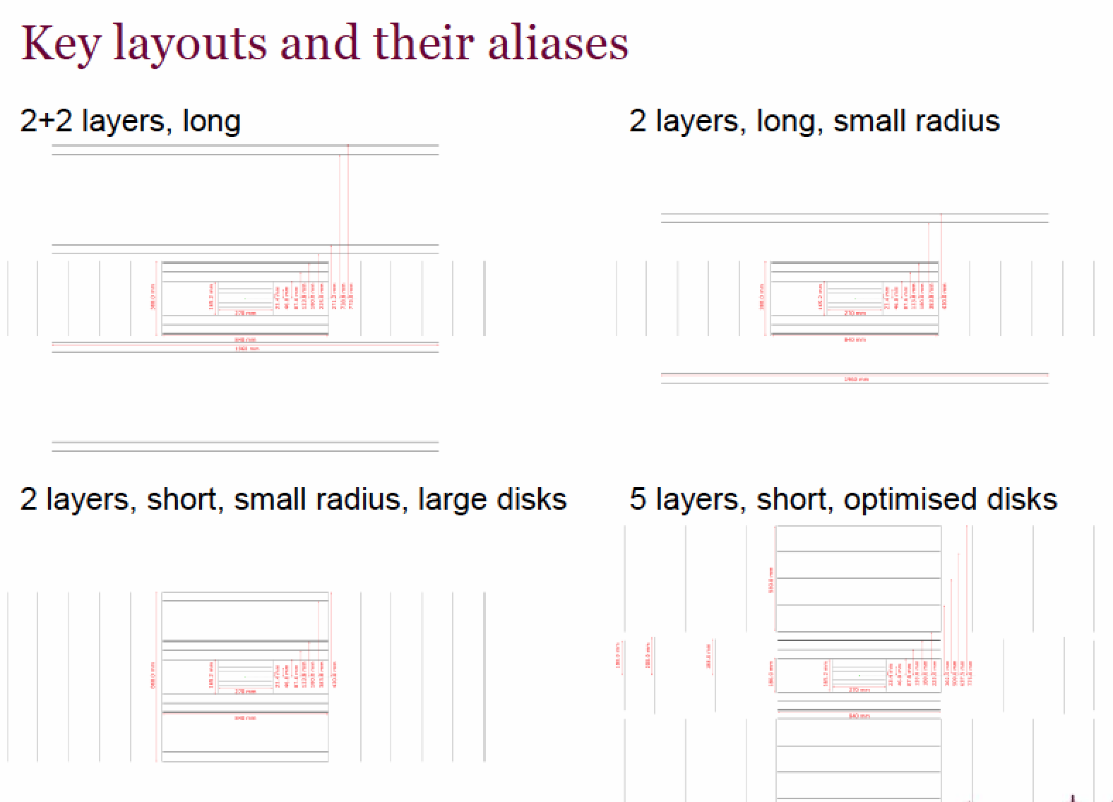
Preliminary results
H. Wennlof, Tracking-WG meeting 30.4.2020

Slide 11
Short term plan
Deliverables for Pavia:
finalize ongoing EicRoot-based studies (basic performance and comparisons)
report progress on Fun4All/ESCalate simulations (maybe preliminary checks)
Connected to PID:
work out space point and angular resolutions at PID positions
based on the feedback collected today

