Slide 1
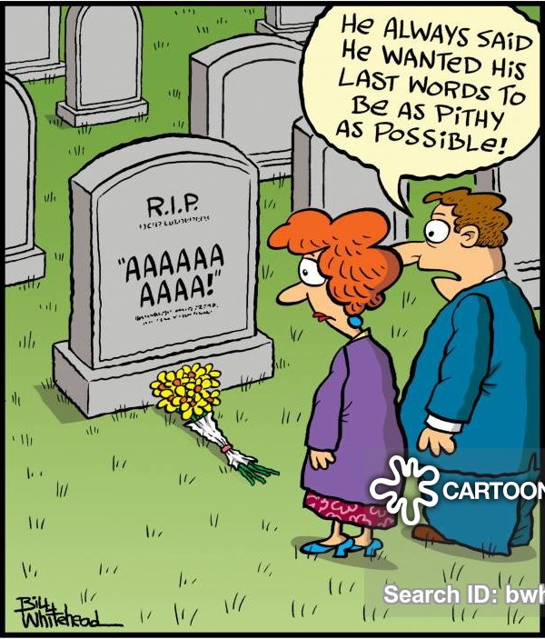
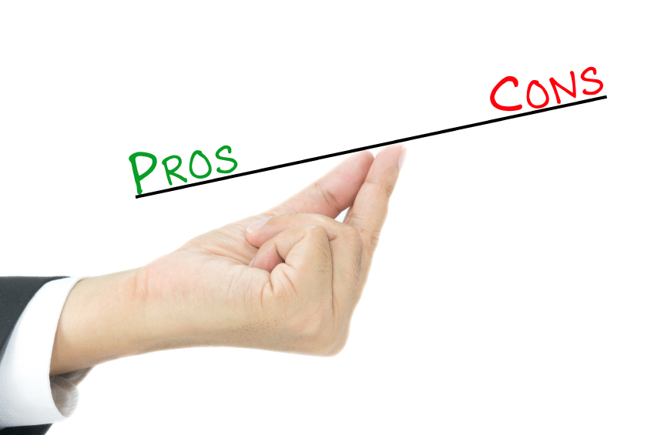
Last words before Pavia
Bringing together the Pros & Cons Matrix
P Rossi & TK Hemmick

Slide 2
Were we are: Summary Table
 | P Range | Contr. ϑ_{c} | Param. | Pro/Con | Ext. Const | MONTECARLO Sim.
psec TOF LGAD TOF | Up to 10 Depending on the σ_{T} and L | NO | ~YES | YES | ~ YES | NO
dual RICH (aerogel, gas) | 2-60 @ 1.6 m | YES Chroma Emission Pixel Field Tracking | YES | YES | YES Simulated constant w/ momentum | YES GEMC/Geant4 AI-driven Optimization
GEM RICH (Gas Electron Multipliers) | 20-50 @1m | Chroma (Emission) Pixel Tracking | YES | YES | YES | YES (Simplified)
modular RICH (mRICH) | 2-10 @ 3 cm | YES Chroma Emission Pixel Tracking | YES | YES | YES (tracking) | ~YES GEMC/Geant4 work in progress
DIRC | 2-6 @ 1.7 cm | YES Tracking Mult. Scat Chrom, Emis, pix | YES | YES | YES | YES GEMC/Geant4 without B field

Slide 3
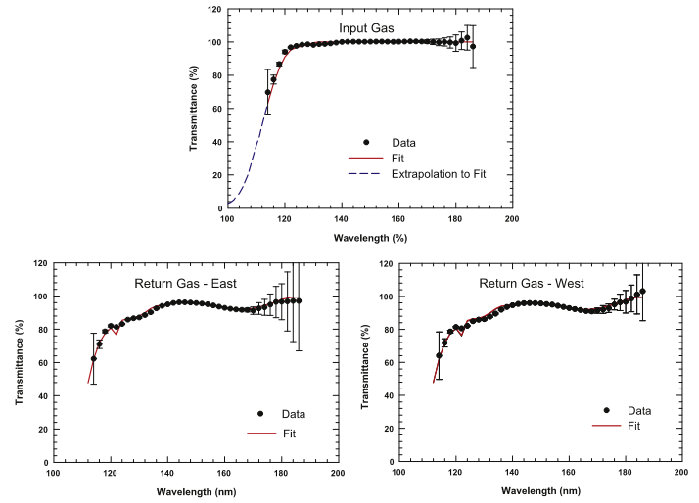
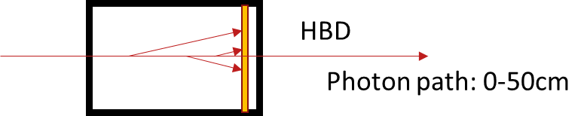
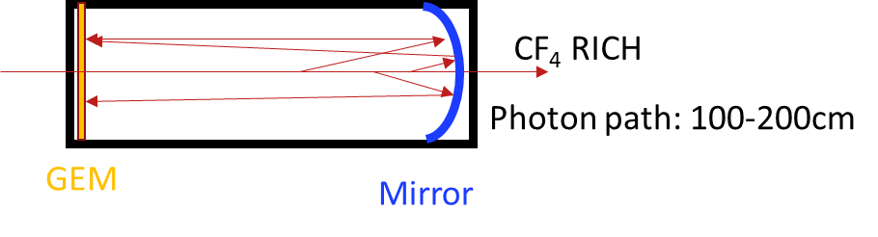

High Momentum GEM RICH
Pro
  Sensor insensitive to B-field
  Short (12pe/m windowsless)
  Thin photo-cathode leads to more ideal optics.
Con
  Unknown how to bridge the gap in π-K
    High pressure??
    Different gas??
  Loses light with contaminants @ few ppm level (tougher than PHENIX HBD...)
    Requires superb gas system (OK)
    Requires better detector materials
  Photo-cathode in high radiation zone.
$$e^{−\frac{3L}{\left\langle L\right\rangle }}={\left(e^{−\frac{L}{\left\langle L\right\rangle }}\right)}^{3}$$
Supply
Return
Triple length => Transmission³
NOTE: PHENIX Contamination was the detector, not the gas system

Slide 4
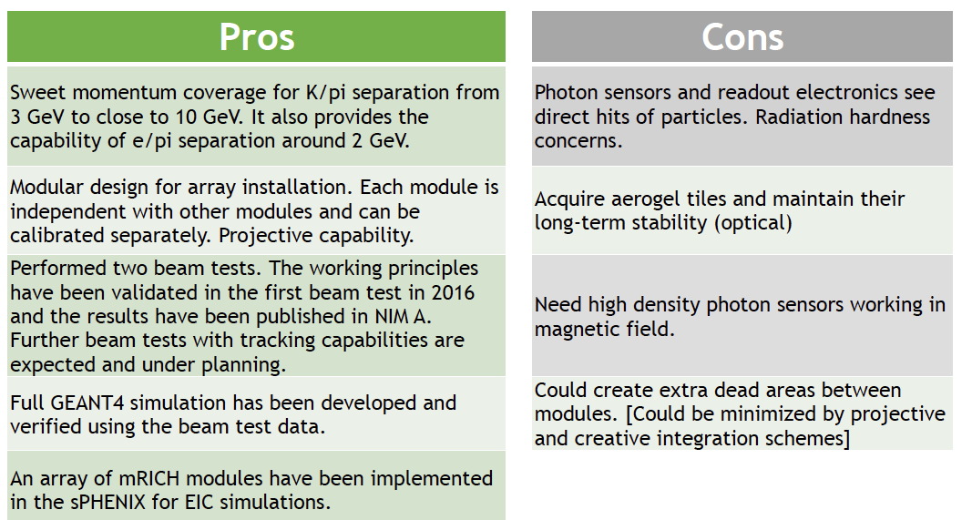
mRICH
Cherenkov radiator
(Aerogel) refractive index, n = 1.03
Length of the radiator, L = 3cm
lens with focal length, 𝑓= 6”
Photon Detector
3 mm pixel size
:
Provide a time meas. with proper sensor?

Slide 5
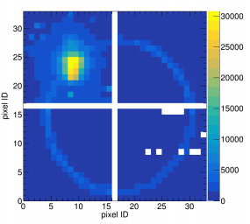
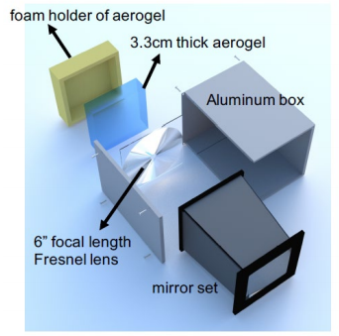
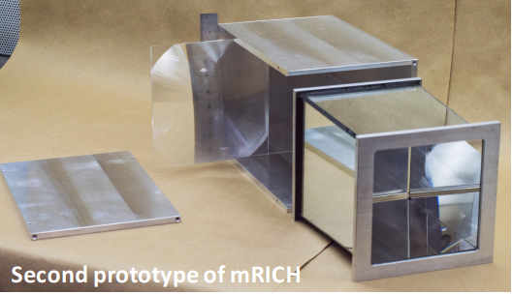
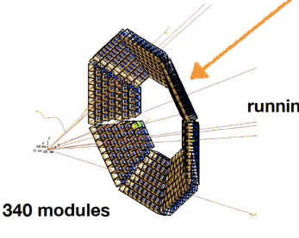
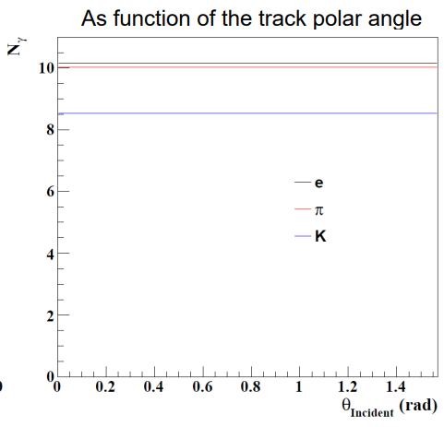
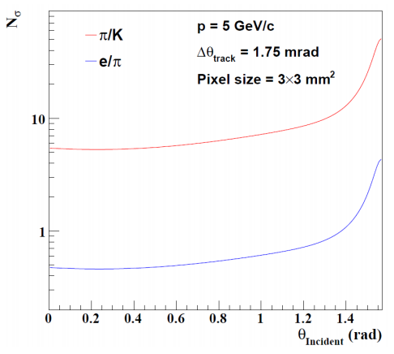
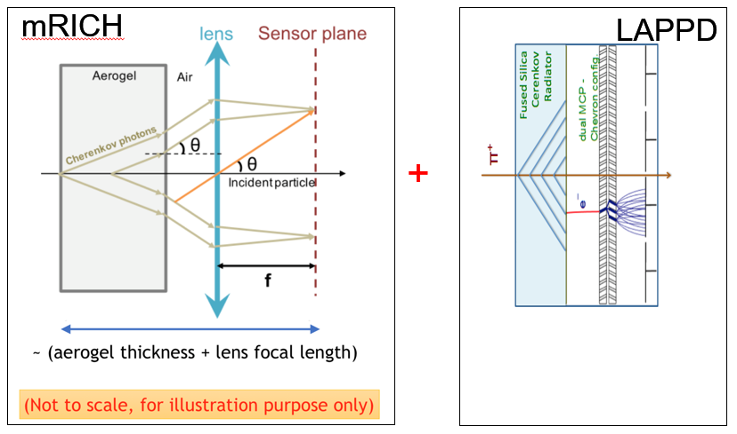
mRICH: A few comments/questions
More quantitative estimate of dead area:
Aerogel size from foam holder/box.
What about corners of Fresnel lens?
  Even without lens = proximity focus.
  Blocking the corners:
    Less light.
    Only focused photons?
  Eliminate the corners?
    2nd prototype moves that way.
Integration improvement dramatic if the array is flat.
Utility of the device is expanded if it provides psec TOF & Cherenkov
Why curve the array?
Simulations w/ huge incident angle!
N_{γ} flat to 90º ??
N_{σ} best @ 90º ?

Slide 6
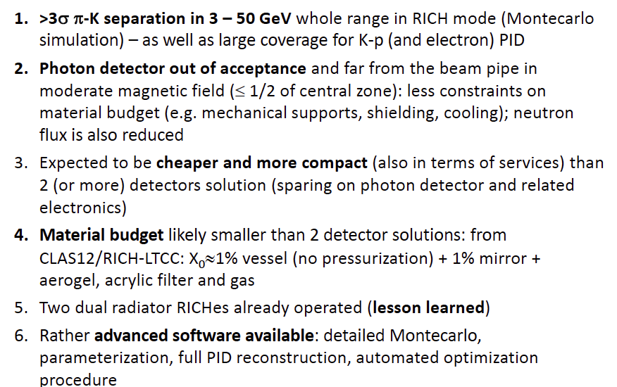
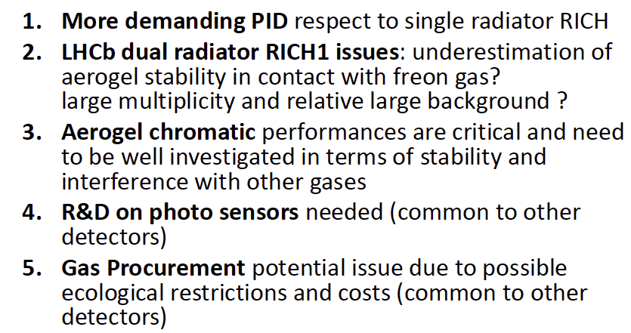
dRICH
Cherenkov radiator
○ Refractive Index
n = 1.02 (aerogel) 1.0008 (C₂F₆)
○ length of the radiator
L = 4 cm (aerogel) , 160 cm (C₂F₆)
Mirrors
Photon Detector
3 mm pixel size; 200-500 nm MAPMT
Particle Generation
Originate from the vertex
PROS
:
CONS

Slide 7
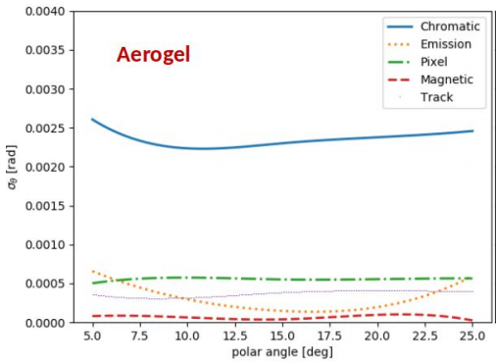
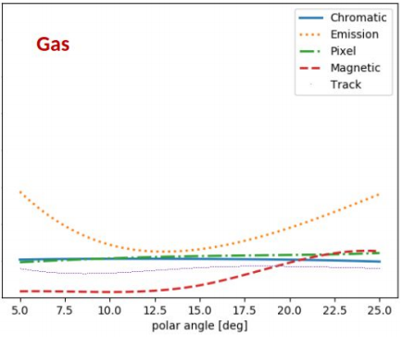
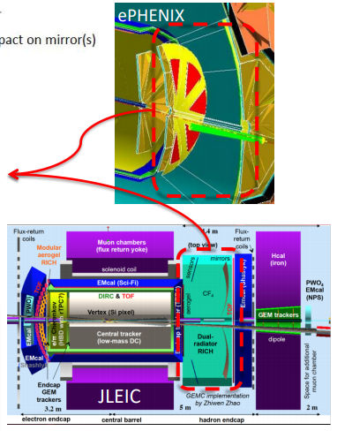
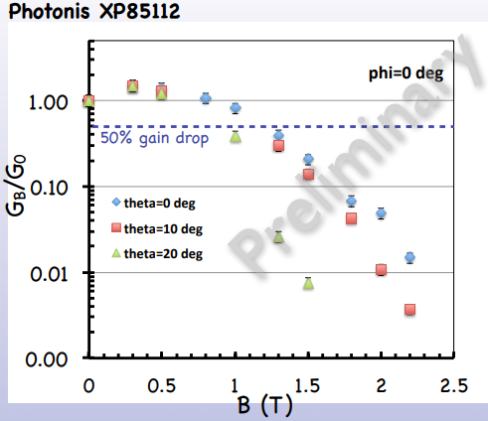
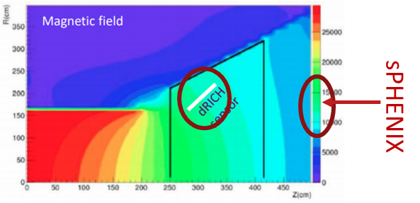
dRICH: A few comments/questions
Sensors out of acceptance
Lower material budget
Lower radiation
Lower field
Limited by emission
Sensors in acceptance
Decrease emission term.
Curved at exit?
Fewer pe (1.1/1.6)?
Limited by emission pt.
“Too good” for aerogel
Index seems good (pure C₂F₆), can be tuned by gas mixing.
What are material budget limits?
  Question to others…
“Implemented”
sPHENIX/JLEIC fields
comparable/feasible
“Optimized”

Slide 8
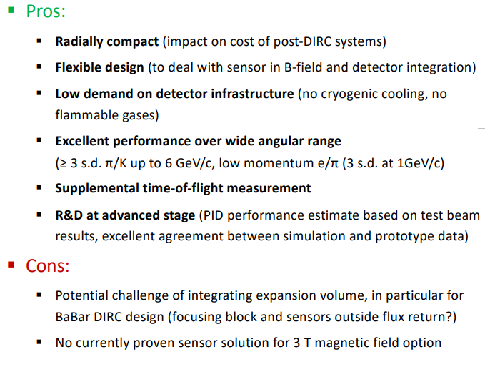
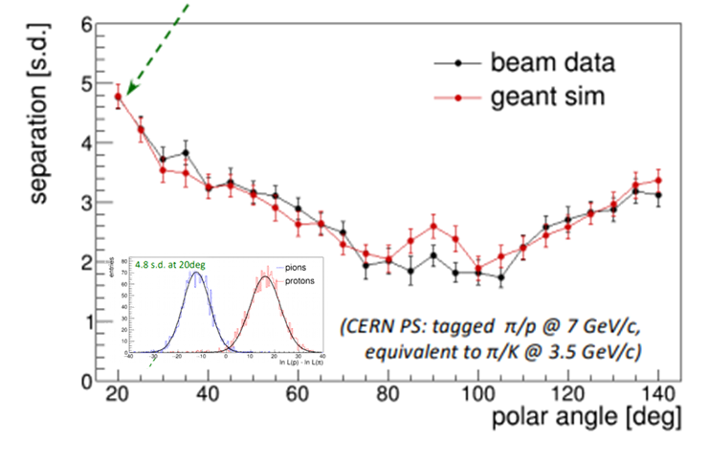
DIRC
Generic reference design: 1m barrel radius, 16 sectors
176 bars: synthetic fused silica,17mm (T) ´ 32mm (W) ´ 4200mm (L)
Photo sensors: MCP-PMTs -3x3mm2 pixels
Simulation & Test Match
:

Slide 9
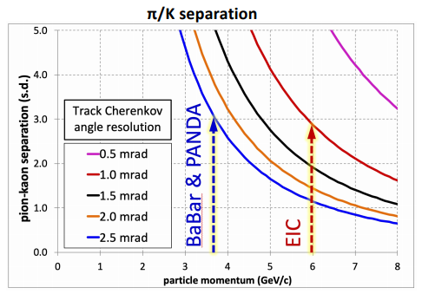
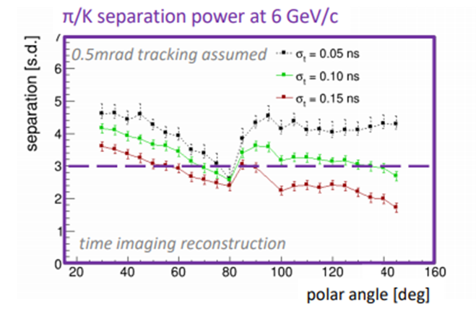
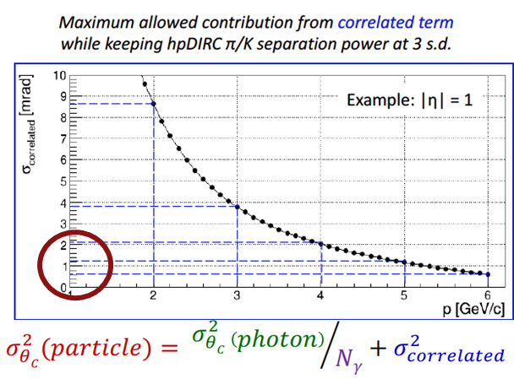
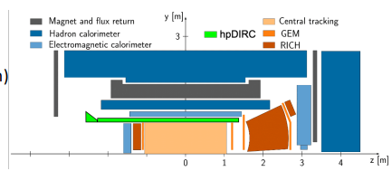
DIRC
Generic reference design: 1m barrel radius, 16 sectors
176 bars: synthetic fused silica,17mm (T) ´ 32mm (W) ´ 4200mm (L)
Photo sensors: MCP-PMTs -3x3mm2 pixels
What is the sensor time resolution assumed in the simulations?
Which types of sensors are compatible with the strength/direction of B-field at the focal plane.
Should we SUPPLY a specification (max & preferred direction)?
Can I have that one please?
Tricky field here

Slide 10
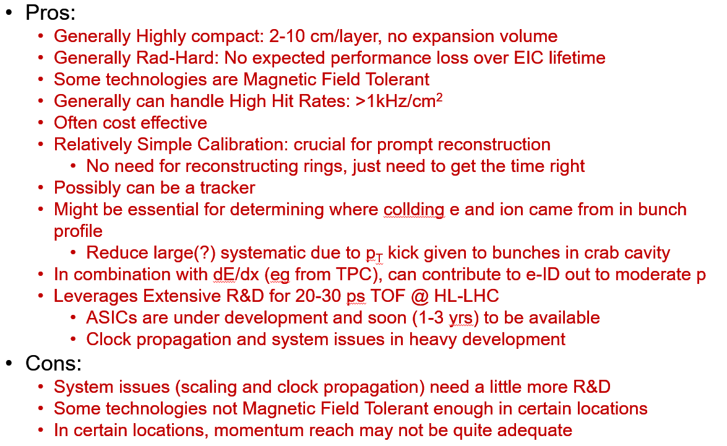
TOF

Slide 11
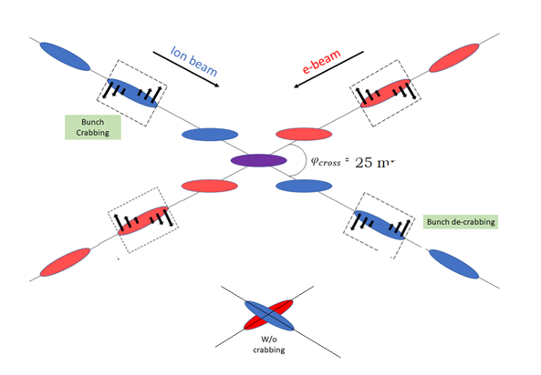
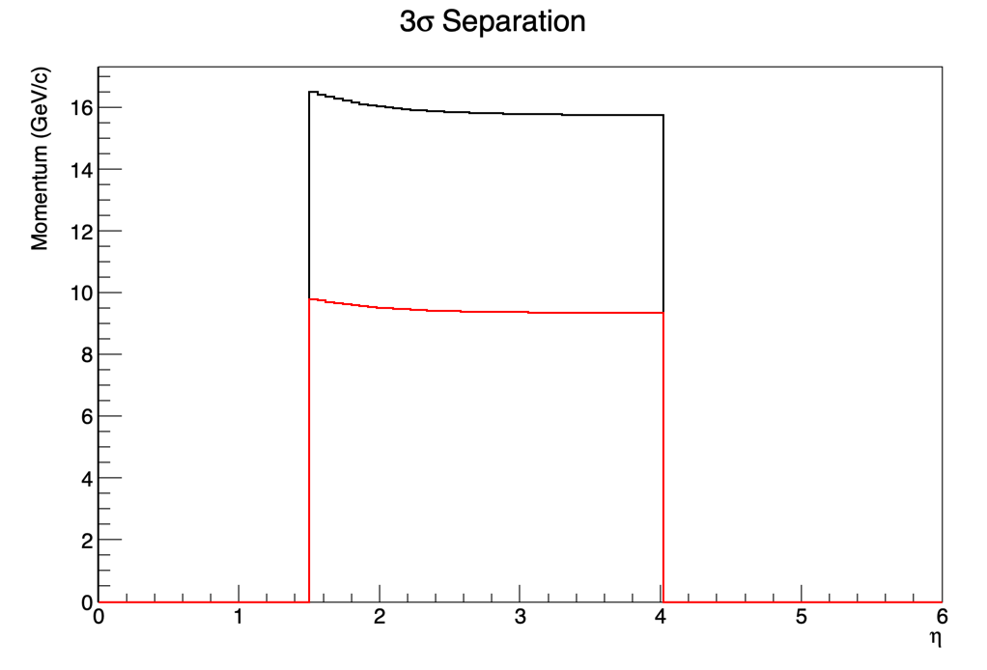
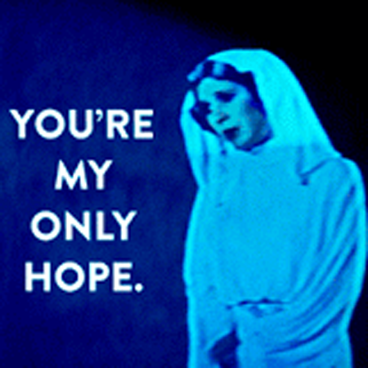
TOF
K/p
LGAD
20 psec
𝜋/K
LAPPD
5 psec
Not TOF, but really “t₀”
Collision p_{T}
  Is our only hope having both vertex + time measured independently?
  Spec on p_{T} resolution required?
  Performance of δp_{T} vs δt?
  How do we fill in these blanks?
~0.5m for EMCAL/HCAL…tight?
Move collision vertex?
What if the result of psec TOF readout of mRICH?
Ultimate resolutions/PID.
Is it like improving by sqrt(2)?

Slide 12
Hadron Arm Cartoons
Either
LAPPD
mRICH
Gas’
Gas’
mRICH/TOF
Fresnel
MPGD
PMT
dRICH
dRICH

Slide 13
Hadron Arm Cartoons
Either
LAPPD
mRICH
Gas’
Fresnel
MPGD
PMT

Slide 14
Hadron Arm Cartoons
LAPPD
Gas’
mRICH/TOF
Fresnel
MPGD
PMT

Slide 15
Hadron Arm Cartoons
LAPPD
Fresnel
MPGD
PMT
dRICH

Slide 16
Hadron Arm Cartoons
LAPPD
Fresnel
MPGD
PMT
dRICH

Slide 17
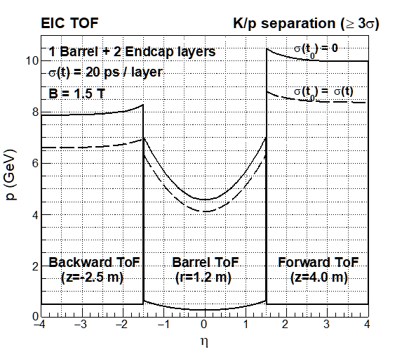
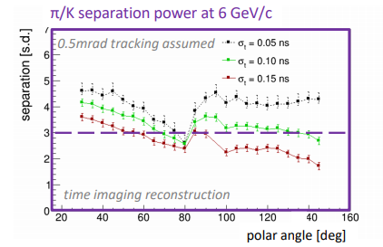
Barrel Cartoon
DIRC
Length of equal performance ~1.2 meters
LGAD TOF
Not presently addressed by us:
  Proximity focus liquid RICH(?) ala ALICE HMPID
  dE/dx from TPC
  TORCH

Slide 18
Electron Arm
Need further consideration following Pavia…

