Slide 1
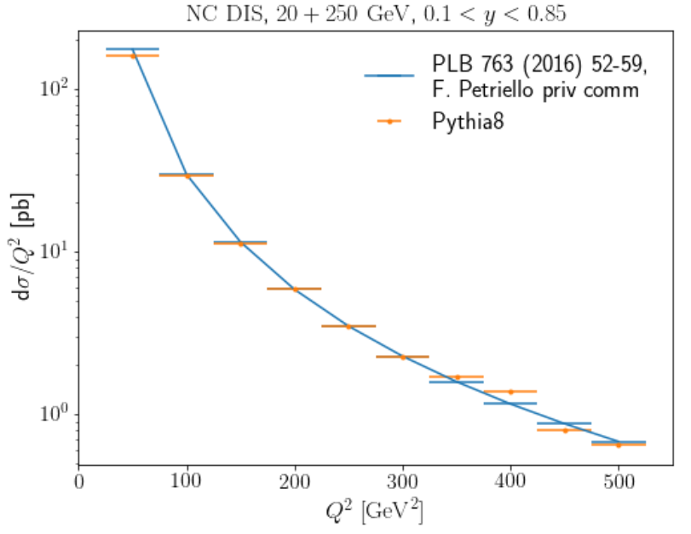
Partonic channel, (NNLO calculation by F. Petriello)
20 x 200 GeV
(anti-kt, R=1.0), Q^2>25 GeV^2, 0.1<y<0.85, |etajet|<4

Slide 2
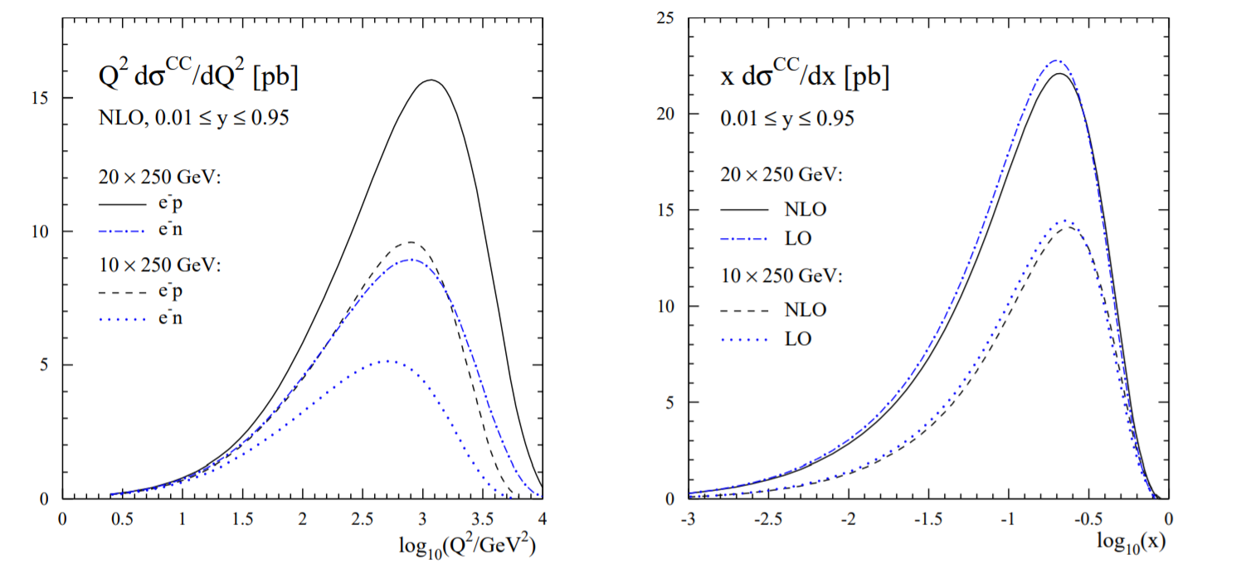
- Pythia (LO) very similar to calculations - NLO effects are pretty small. - Inclusive cross-section for Q2>100 GeV2 is 14.4 pb, or 1.4 M events in 100 fb-1.
Aschenauer et al. Phys. Rev. D 88, 114025 (2013)

